Slide 1




Students at the gates of the university:
A multifactorial and differentiated approach of students’ adjustment process
Mikaël De Clercq
mikael.declercq@uclouvain.be

Slide 2


What’s on the agenda today?
Introduction
    1.1. Where do I come from?
    1.2. Expertises
    1.3. Topic of investigation
4. Other projects
    4.1. Doctoral completion
    4.2. Learning strategies
    4.3. Teacher coping
2. Diversity in HE
    2.1. Rationales
    2.2 Environments
    2.3. Student’s profiles
3. Assessment and
promotion of AA
    3.1. Support for success
    3.2. Critical requirements

Slide 3
Introduction
    1.1. Where do I come from?
    1.2. Expertises
    1.3. Topic of investigation

Slide 4




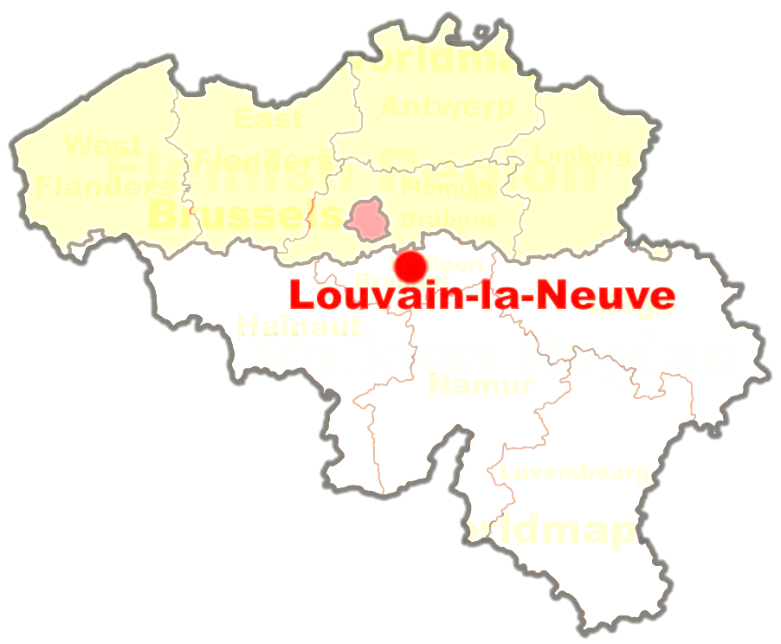

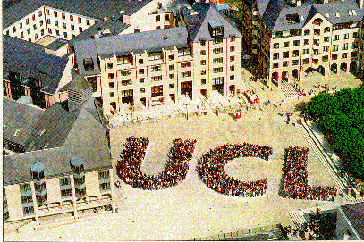
1.1. Where do I come from?
« This is not the uni that you’re looking for »

Slide 5


One Faculty, two research institutes
I am a psychologist from the
Faculty of psychology
I am a researcher attached to the
Psychological Sciences
Research Institute
  266 members
I am working on educational questions as a member of the Interdisciplinary research group for education and training
  80 members
  Sociology, psychology, anthropology, philosophy…

Slide 6

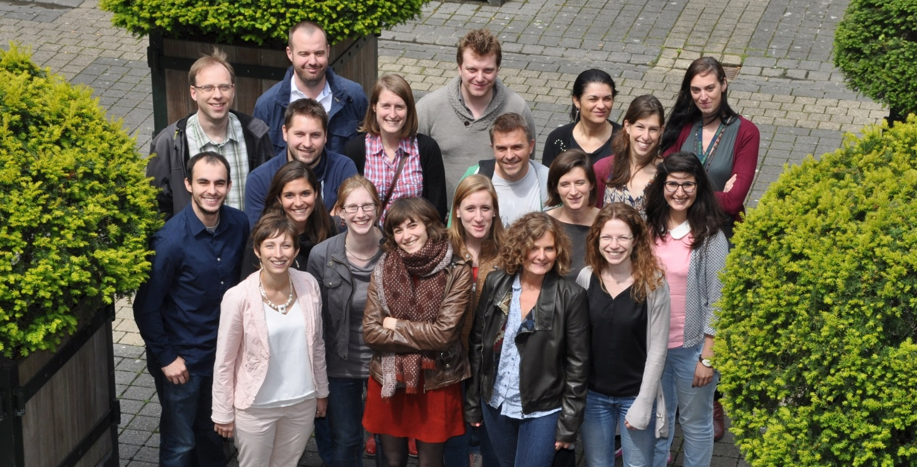
But actually, my research team is…
The LIMe Lab
Research lab for Learning, Instruction and Motivation in education
  43 members (9 professors, 34 phd students and post-doctoral researchers)
  Mainly educational psychologists
Topics:
Teaching practices
Educational transition
Lifelong learning
Assessment and evaluation
Bullying
ICTE (Information and Communication Technologies in Education)

Slide 7
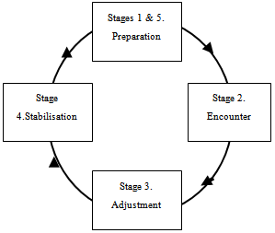
1.2. My Expertises
Theoretically grounded in:
Self-determination theory (Deci & Ryan, 2000)
Expectancy-value theory (Eccles & Wigfield, 2002)
Self-System Model of Motivational Development (Appleton, Christenson & Furlong, 2008)
Model of transition cycles (Nicholson, 1990)
Methodological expertise in:
Person-centered approach (Cluster analysis, LPA)
Structural equation modeling (CFA, cross-lag model, multigroup analysis)
Multi-level analysis
But also in qualitative analyses (thematic analysis, sequential analysis, IPA & focus group)

Slide 8


1.3. My topic of investigation
« Understand the adjustment process in the first year at the university and the levers of action to promote student’s achievement »
  Focus on the transition from secondary to Higher Education
  Psychological investigation of the individual experience (micro-level)
  Multifactorial analysis of achievement’s determinants

Slide 9
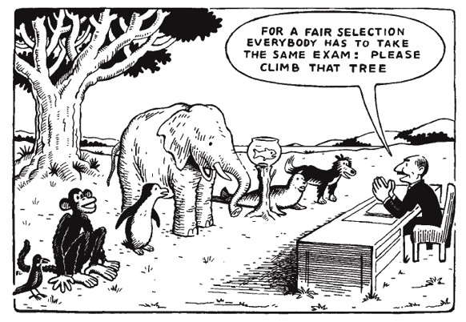
Introduction
    1.1. Where do I come from?
    1.2. Expertises
    1.3. Topic of investigation
2. Diversity in HE
    2.1. Rationales
    2.2 Environments
    2.3. Student’s profiles

Slide 10

2.1. Rationales
Belgium: an open access educational system
  Stable failure rate for 30 years
    60% of failure
      35% fails but stay in HE
      25% of dropout
  Psychological negative consequences
  pour l’étudiant
  «It’s sad because… I’ve really got the feeling of ‘losing’ two years of my life…,especially when I heard my friends who say: ‘yeah! next year we will be master students’. I think I had some sort of breakdown » (Carolina)

Slide 11
2.1. Rationales
  Extensive investigation of adjustment process in HE
High school grade
(Dadeppo, 2009)
Socioeconomic status
(Sirin, 2005)
Study choice process
(Biémar et al., 2003)
Self-efficacy beliefs
(Elias & MacDonald, 2007)
Academic achievement
Task value
(Eccles & Wigfield, 2002)
Self regulation
(Minnaert & Janssen, 1999)
Peer support
(Fass & Tubman, 2002)
Study time
(Vandamme et al., 2005)
But an important limitation…

Slide 12
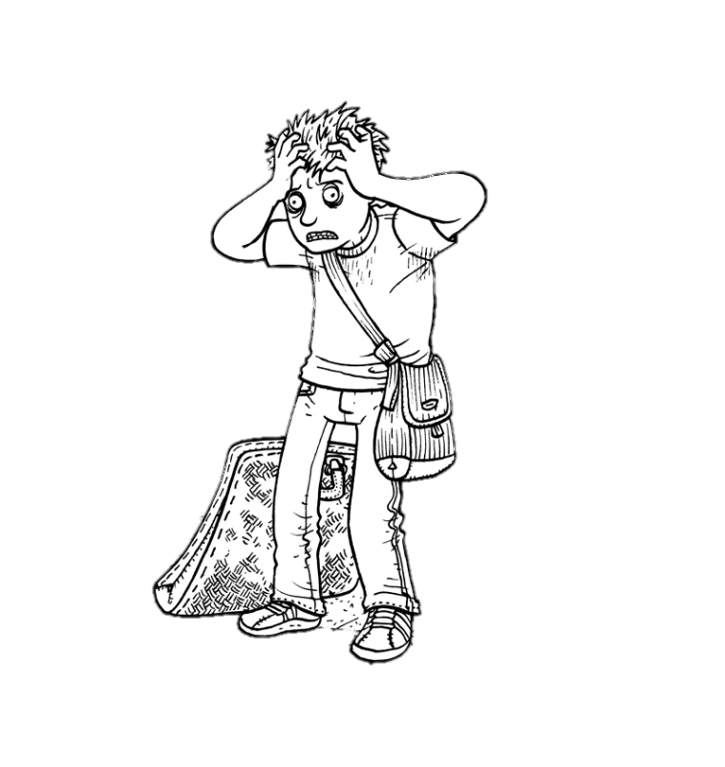
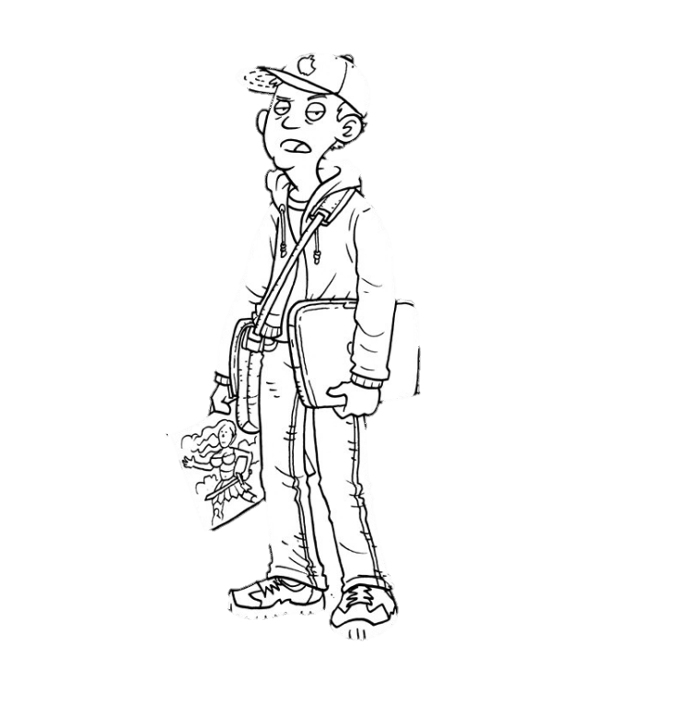




2.1. Rationales
Limitation : undifferentiated approach of academic adjustment
    But, evidence for students’ heterogeneity and diversity of curriculum organisation (Bosse, 2015)
I am not a number!

Slide 13

2.2. Context-specificity of adjustment
  Context-specificity mainly disregarded
  Yet,
    Academic context vary in admission procedures, student body, requirement, assessment… (Kuh, Kinzie, Schuh & Whitt, 2011)
    Curriculum characteristics impact on academic success (Jansen 2004, Van der Hulst & Jansen, 2002)
    Achievement predictors differ from one study program to another (Lizzio, Wilson and Simons, 2002; Millet, 2003; De Clercq, Galand, Dupont & Frenay, 2012)
How achievement rate varies from one study program to another?
Which variables explain achievement variations?
Are predictors of achievement equal accross study programs?

Slide 14
2.2. Context-specificity of adjustment (sample)
1173 first year students
  53% of female
  +/- 30% of first year students of our university
21 study programs (psychology, law, economics, phylosophy, medicine, physical education, biology, chemistry, computer science, engineering…)
  Characteristics of the study program (class size, gender ratio, mean age, opportunity for practice)
2 self-completion questionnaires
September: background variables (Age, gender, past performance,SES, choice)
November: ψsocial and teaching factors (SEB, value, social integration, study time, teaching practices…)

Slide 15
2.2. Context-specificity of adjustment (method)
Multilevel analysis (MLM) allow for
  Two levels of analysis
    student level→ as regular linear regression
    study programs level → variable aggegated by programs
  Distinguish achievement variation among students (within variance) and among programs (between variance)
6 steps analytical procedure
  M0→ Empty model M3→ M2 + psychosocial variables
  M1→ Characteristics of program M4→ M3+ teaching practices
  M2→ M1+ background variables M5→ M4 + slopes variations
De Clercq, M.,Frenay, M., & Galand, B. (2017, September).The role of study programs on freshmen’s academic adjustment: context-specificity under investigation. Paper presented at the EARLI, Tampere,Finland.

Slide 16
2.2. Context-specificity of adjustment (M0+M1)
Parameters | Coefficients
Intercept | 60.34 (1.12)
ICC | 0.15
A. Level 2 Curriculum characteristics
Gender ratio | -5.18
2. Mean age | 2.13
Lecture/tutorial ratio | 21.85**
Class size | -0.02*
Deviance | 9230
*p<.05;**p<.01;***p<.001
ICC→ 15% of achievement variance occured accross study programs
    Extensive variation of failure rate (from 30 to 70%)
Both opportunity for practice and class size impacted on achievement
    Explain 9,3% of between variance

Slide 17
2.2. Context-specificity of adjustment (M2)
Parameters | Coefficients
Intercept | 60.34 (1.12)
A. Level 2 Curriculum characteristics | …
B. Level 1 Background variables
Gender | -2.17
2. Age | -0.73
High school grade | 7.42***
Socioeconomic status | 0.99**
5. Informed choice | 0.40**
Deviance | 9208
*p<.05;**p<.01;***p<.001
Past performance, SES and Informed choice explain
16,3% of achievement variation accross students
24,7% of achievement variation accross programs (composition effect)

Slide 18
2.2. Context-specificity of adjustment (M3)
Parameters | Coefficients
Intercept | 60.46 (1.16)
A. Level 2 Curriculum characteristics | …
B. Level 1 Background variables | …
C. Level 1 Psychosocial variables
Self-efficacy beliefs | 2.17**
Value | 1.64*
Peer support | -0.93
Intention to persist | 0.21
Study time | 1.41***
Attendance | 0.31
7. Paid job | -3.72*
Deviance | 9169
*p<.05;**p<.01;***p<.001
SEB, course value, study time and paid job are significant predictors of student’s achievement
Provide 9,1 additional percent of within variance explanation

Slide 19
2.2. Context-specificity of adjustment (M4)
Parameters | Coefficients
Intercept | 61,05 (0.81)
A. Level 2 Curriculum characteristics | …
B. Level 1 Background variables | …
C. Level 1 Psychosocial variables | …
d. Level 2 Perceptions of the learning context
Teachers relationships | 12.46*
Mastery goal structure | 25.75**
Performance goal structure | -7.04
Deviance | 9140
*p<.05;**p<.01;***p<.001
Both teachers relationships and mastery goal structure are related to student’s achievement
Explain 15.6% additional percent of variance between the programs

Slide 20
2.2. Context-specificity of adjustment (M4)
Parameters | Coefficients
Intercept | 60.86 (0.87)
A. Level 2 Curriculum characteristics | …
B. Level 1 Background variables | …
C. Level 1 Psychosocial variables | …
D. Level 2 Teaching perceptions | …
E. Slopes variations
 | Chi²
1. Paid job | 27,81*
2. Attendance | 34,46*
3. Peer support | 29,78*
Deviance | 9062
*p<.05;**p<.01;***p<.001
Social integration: + effect in enonomics but no effect in engineering
Attendance: + effect in science but no effect in law
Paid job: no effect in psychology but – effect in medecine
Explain 4.6% additional percent of within variance
Final model:
30% of within variance expl.
49.9% of between variance exp.

Slide 21
2.1. Student’s profiles (study 1)
Several studies emphasized on the necessity to consider student heterogeneity in HE (Fenollar et al., 2007; Heikkilä, Niemivirta, Nieminen & Lonka, 2011)
    Study 1: What is the impact of student heterogeneity on adjustment?
      2129 freshmen
      4 background variables:
        Past performance
        Study choice process
        Socio-economic status
        Self-efficacy beliefs
      K-mean clustering (confirmed by latent profile analysis)
De Clercq, M., Galand, B., & Frenay, M. (2017). Transition from high school to university: a person-centered approach to academic achievement. European Journal of Psychology of Education, 32, 39–59.

Slide 22
2.1. Student’s profiles (study 1- results)
  R² for the 4 indicators ranged from 45 to 60 %
  6 cluster solution was the best fitting classification (compared to 1 to 8 cluster solution)
    Optimal division in 6 clusters
 | High Risky | Poor performer | Thoughtless | Humble background | Apprehensive | Low Risk
n | 280 (13%) | 429(20%) | 276(13%) | 291(14%) | 418(20%) | 435(20%)
SocioEconomic Status | -,93 | ,48 | ,14 | -1,33 | ,38 | ,61
HighSchool Grade | -,66 | -1,04 | -,23 | -,06 | ,71 | ,87
Informed Choice | -,34 | ,50 | -1,71 | ,02 | ,45 | ,38
Self-Efficacy Beliefs | -1,26 | ,08 | ,20 | ,54 | -,69 | ,91

Slide 23
2.1. Student’s profiles (study 1- results)
Anova: F=34.949 (p<.001), R²=0.118
post-hoc comparison highlighted 3 achievement groups (Tukey, p<.05)

Slide 24
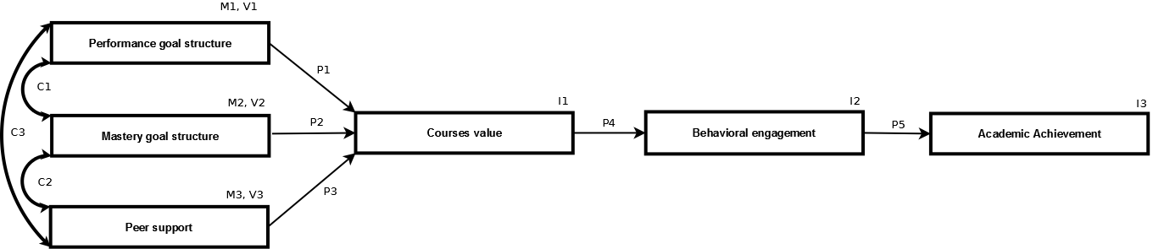
2.2. Student’s adjustment process (Study 2)
Study 2: To what extent achievement process varies from one student profile to another?
  1335 freshmen
  Simplified adjustment model (based on SSMMD: Appleton, Christenson & Furlong, 2008; Reschly & Christenson, 2012; Skinner & Pitzer, 2012)
  Multi-group analyses:
5 steps procedure
Progressive released of model constrains

Slide 25
2.2. Student’s adjustment process (Study 2- results)
Perform.Struct.
-.03→-.39
Mastery
Struct.
-.08→.17
Value
.18→.37
Study time
Acad
Achiev.
.15***
Peer support
.04→.38
Model | χ² | df | RMSEA | CFI | PCFI | SRMR | AIC
Final model fit | 118.2 | 78 | .021 | .93 | .74 | .044 | 286,2

Slide 26
2.2. Student’s adjustment process (Study 2- results)
  paths’ weight pairwise comparisons across the profiles
  Conclusion:
    Different subgroups of students enter at the university
    Entrance characteristics will entail specific adaptation to the academic context
Critical ratio of differences test | Perf.S.→ Value | Mast.S.→ Value | Peer supp.→ Value | Value→ Study time
1. High Risk | -.166*(a) | ns | ns | .373***(b)
2. Poor performer | ns | ns | .239***(b) | .177**(a)
3. Thoughtless | -.387***(b) | ns | ns | .273***(a,b)
4.Humble background | ns | ns | .383***(c) | .152*(a)
5.Apprehensive | ns | .143*(a) | .144*(a) | .176**(a)
6.Low Risk | ns | .174**(a) | .294***(b) | .223***(a)
Note: a, b & c= group categorization with pairwise comparisons

Slide 27
2. Diversity in HE
    2.1. Rationales
    2.2 Environments
    2.3. Student’s profiles
3. Assessment and
promotion of AA
    3.1. Support for success
    3.2. Critical requirements

Slide 28
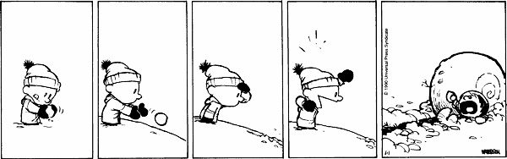
3.1. Promoting support for success
Specific focus on the very first week at the university
      Theoretical importance of this stage (Nicholson, 1990)
  A well-timed,well-targeted ψ intervention taps into recursive processes and changes the trajectory of students’ experiences (Cohen et al., 2009)
      Change of mindset → stable beliefs →attitudes and behaviors (Walton and Cohen, 2011)
« There is huge potential in this stage for the University to find out what would make a substantial difference» (Purnell, 2002; p.6)

Slide 29
3.1. Promoting support for success
Social-belonging intervention in laboratory (Walton & Cohen, 2011)
  Reading of testimonies about social integration at the university
    Reduce social adversity = shared and short-lived
    Message internalization
  Effects of the manipulation :
    Increase academic retention, performance, well-being and health (! minority students)
Adaptation of this study in a real context
  375 freshmen in Psychology (all psychology freshmen)
  Random assignment to two conditions:
    Control intervention
    Social-belonging intervention
  Each intervention was administrated in subgroups of 25 students

Slide 30
3.1. Promoting support for success
Brief intervention:
  Intervention included in « Introduction workshop » of two hours
    Content: Discovery of the academic world (faculty, virtual platform, academic workforce…)
  Control condition = usual content
  Social belonging condition = usual content + 30 min. of:
    Reading of testimonies of master students on social integration
    Reflection and sharing of the way the testimonies echoed to their experiences and beliefs
Hypotheses:
  H1: Short-term effect on social expectations
  H2: Mid-term effects on social integration, well-being and intention to persist
  H3: Mid-term effects on social studying and performance in a study task

Slide 31
3.1. Promoting support for success (results)
H1: Short-term effect on social expectations
  Confirmed: (F=11,748; p<.001)
    Mean difference of.51 (p<.001) with Control Condition (CC)
H2: Mid-term effects on social integration, well-being and intention to persist
  Social integration → Confirmed:(F=3,508; p<.05)→ Mean difference of .32(p<.05) with CC
  Well-being→ Refuted: (F=0.253; p=.776)
  Intention to persit→ Confirmed:(F=4,322; p<.05)→ Mean difference of .23(p<.05) with CC
H3: Mid-term effects on social studying and test performance
  Social studying→ Confirmed: (F=3,815; p<.05) → Mean difference of .43 (p<.05) with CC
  Performance → Refuted: test (F=0,311; p=.733)

Slide 32

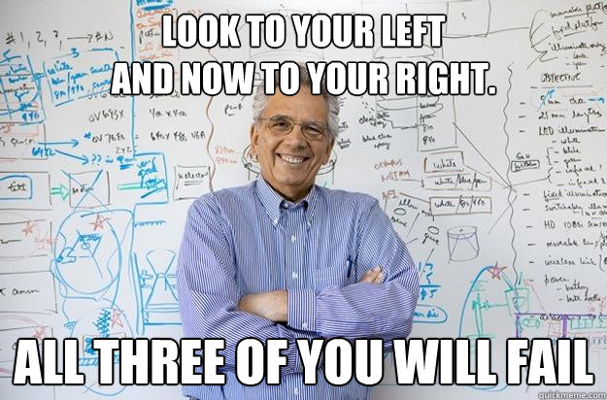
3.1. Promoting support for success
30 minutes of social-belonging manipulation induced significant effects 2 months later:
  Impacts on social integration, intention to persist and social studying
  First weeks seems to be a pivotal phase of adjustment (snowball effects, recursive processes)
    Interesting moment of action
    Beware of negative messages
    which could enhanced
    perceived adversity

Slide 33
3.2. Critical requirements a new assessment of student adjustment (in progress)
Academic adjustment mainly studied by GPA as indicator
  But,
    Aggregation of distinct evaluations which do not draw on the same learning process
    Limited view of adjustment complexity
      What are the concrete challenges of the first year experience?
Identification of critical requirements (Trautwein & Bosse, 2017)
  Large scale project (6 faculties + 2000 freshmen)
  Mixed approach (qualitative & quantitative)
  Longitudinal approach: 4 years follow-up
  Based on student’s testimonies

Slide 34
3.2. Critical requirements a new assessment of student adjustment (in progress)
Four-pronged taxonomy:
    Content-related → Scientific approach, personal expectations
    Personal → Study activities, pressure management, daily living
    Organizational → Relational climate, social relationship, choice justification
    Social → Formal rules, administrative study management
French Validation of the CR questionnaire
  2 times: 1308 freshmen
  EFA, CFA → confirmed theoretical structure
  Relationship with adjustment determinant in progress…
  Impact on GPA in progress…

Slide 35
4. Other projects
    4.1. Doctoral completion
    4.2. Learning strategies
    4.3. Teacher coping
3. Assessment and
promotion of AA
    3.1. Support for success
    3.2. Critical requirements

Slide 36
More domains of investigation
  4.1. Doctoral completion
    5 motivation profiles of phd students (Deci & Ryan, 2000)
      Different impacts of supervisor’s support
  4.2. Learning strategies and self-regulation
    Relationship between motivation and cognition
    Development of student’s metacognition
  De Clercq, M., Galand, B., & Frenay, M. (2013). Chicken or the egg: Longitudinal analysis of the causal dilemma between goal orientation, self-regulation and cognitive processing strategies in higher education. Studies in Educational Evaluation, 39(1), 4-13.
  De Clercq, M., Galand, B., & Frenay, M. (2013). Learning processes in higher education: Providing new insights into the effects of motivation and cognition on specific and global measures of achievement. In Learning Patterns in Higher Education (pp. 157-178). Routledge.

Slide 37


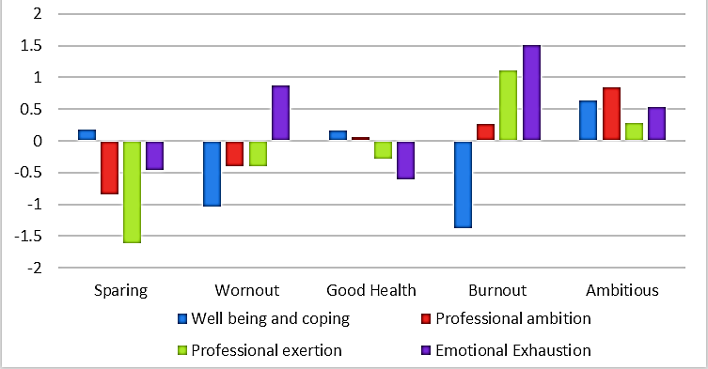
More domains of investigation
  4.3. FIT-choice: teachers’coping profiles
    5 profiles of teachers

Slide 38
Thank you for your attention!
mikael.declercq@uclouvain.be
If you want to see more or to keep informed:
researchgate.net/profile/Mikael_Clercq

