Slide 1


Facing climate and societal change:
Concepts for designing, sharing, and using educational resources in traditional and new subjects in compulsory and higher education
Educational resources supporting advanced water resources agency
29–31 May 2024, Paris
M. Vanclooster, UCLouvain – Earth and Life Institute
Chair, Climate Knowledge Hub
Notes:
I’ll addres the issue of water quality in agricultural systems in my presentation.

Slide 2
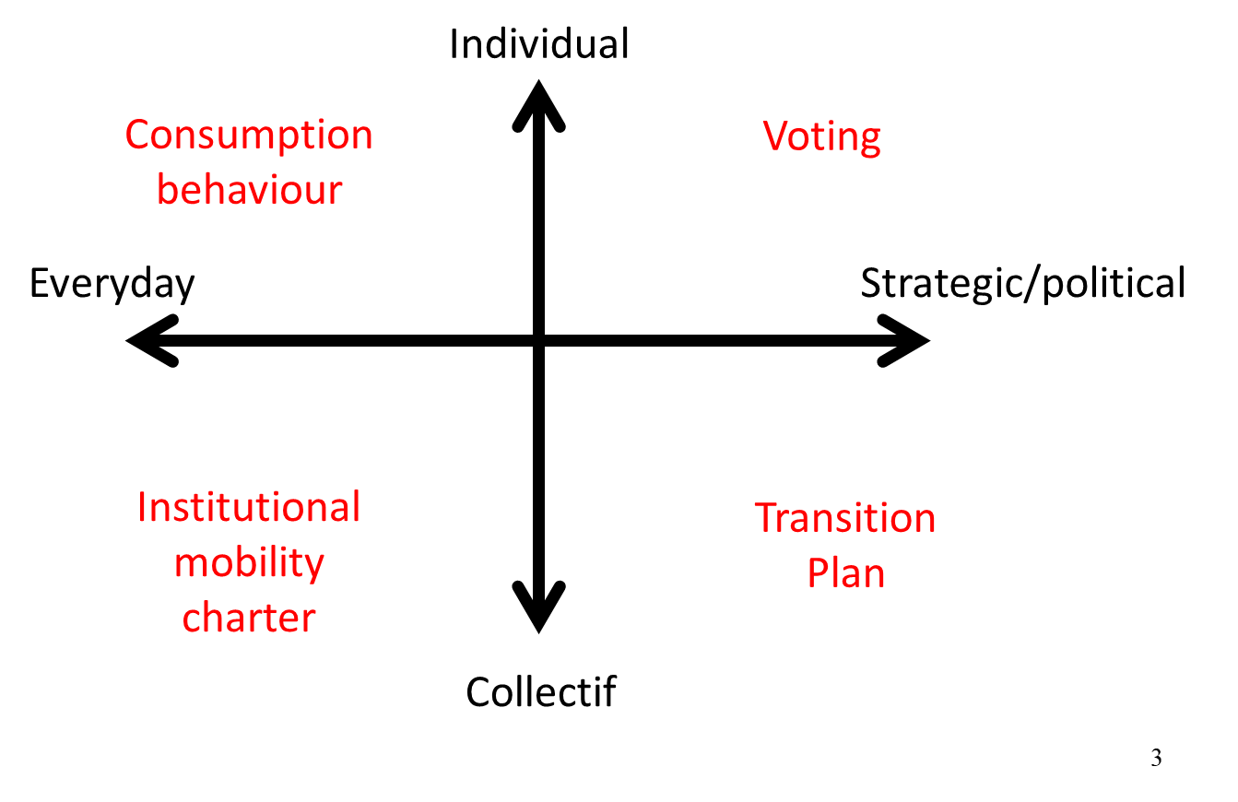
How humans can build a climate resilient world
Capacity building
Training - education
Research
Innovation

Slide 3
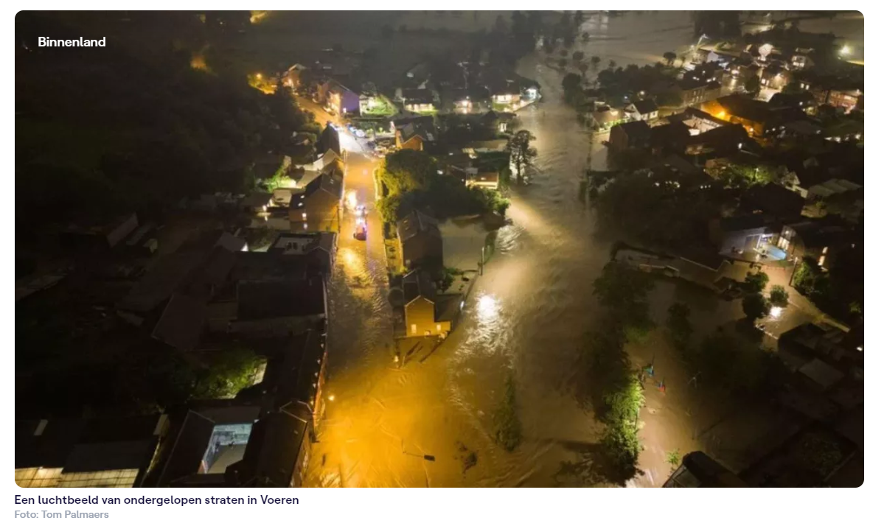
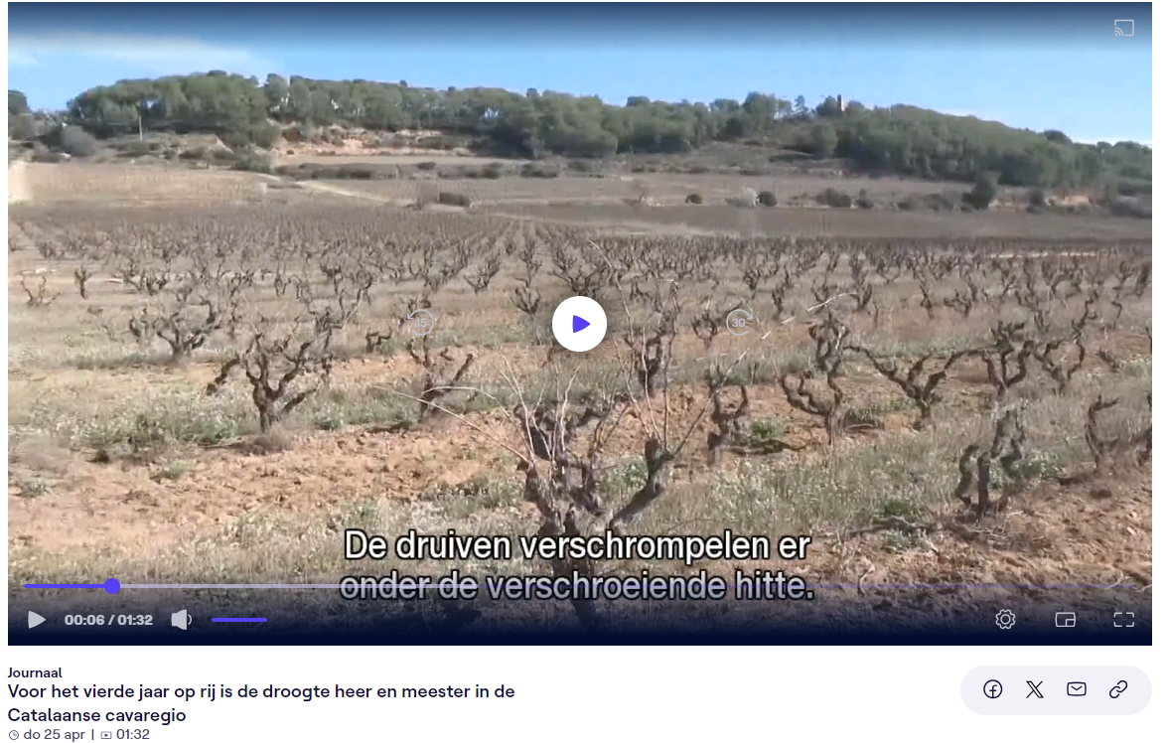
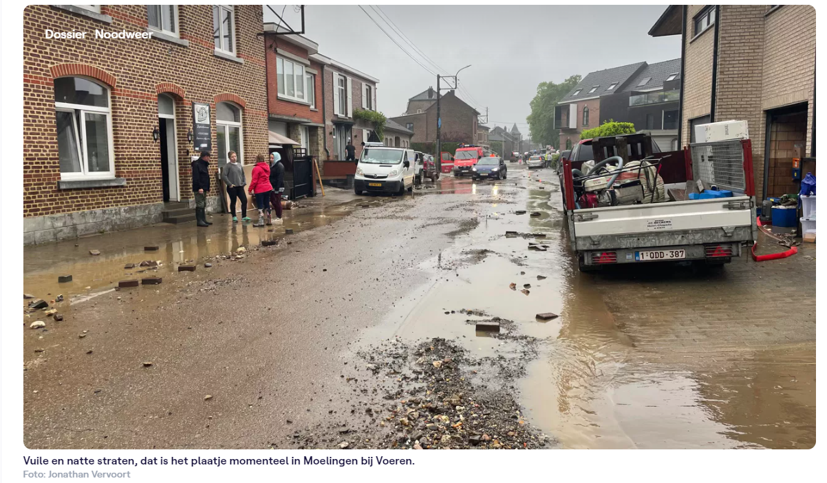
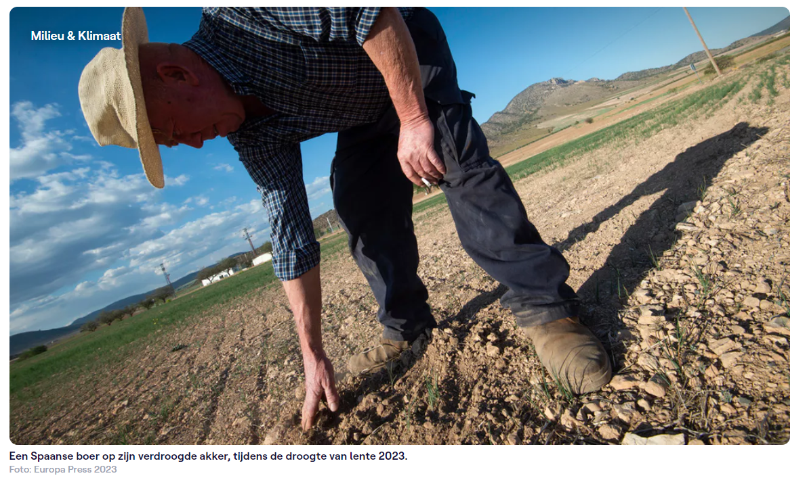
Climate change: It’s all about water
Source: VRT News

Slide 4
Yes, there is scope for a technical narrative
Wisdom
Information
Data
Knowledge

Slide 5
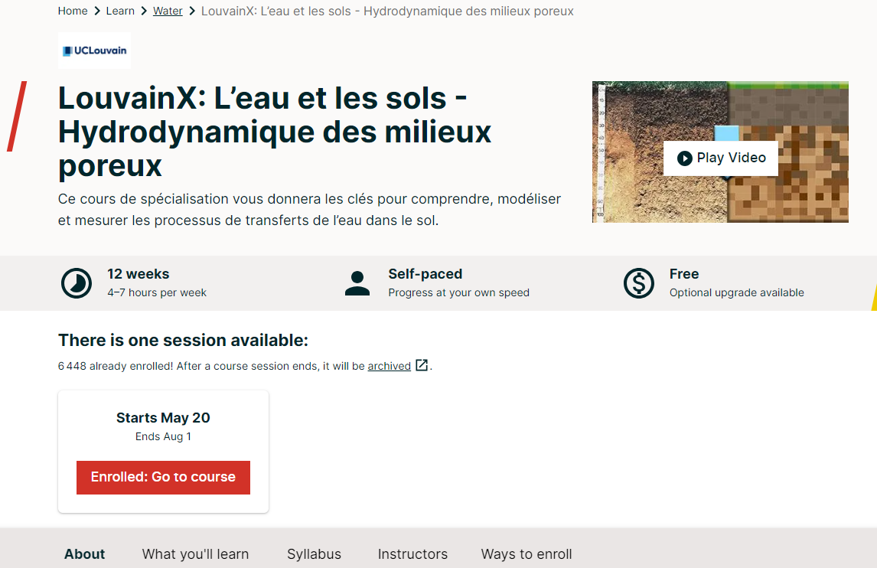
Rescif MOOC resources https://www.rescif.net/en/projects/moocs/

Slide 6
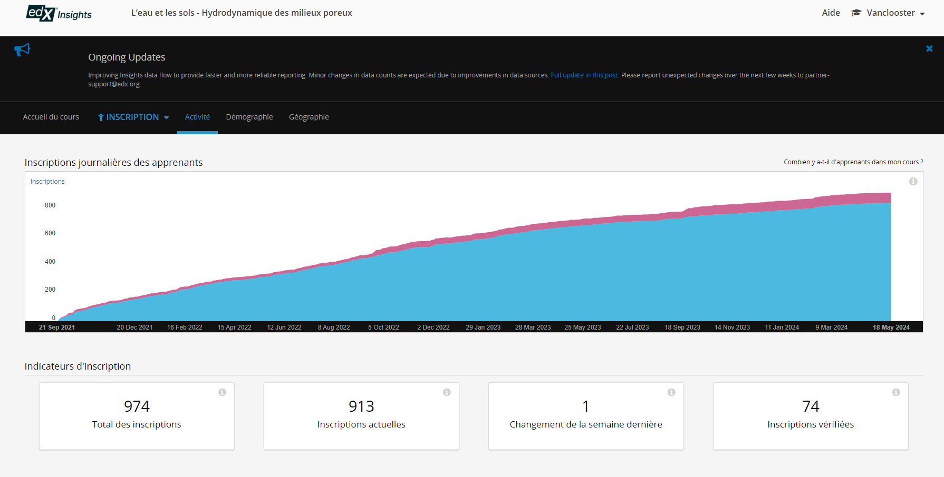
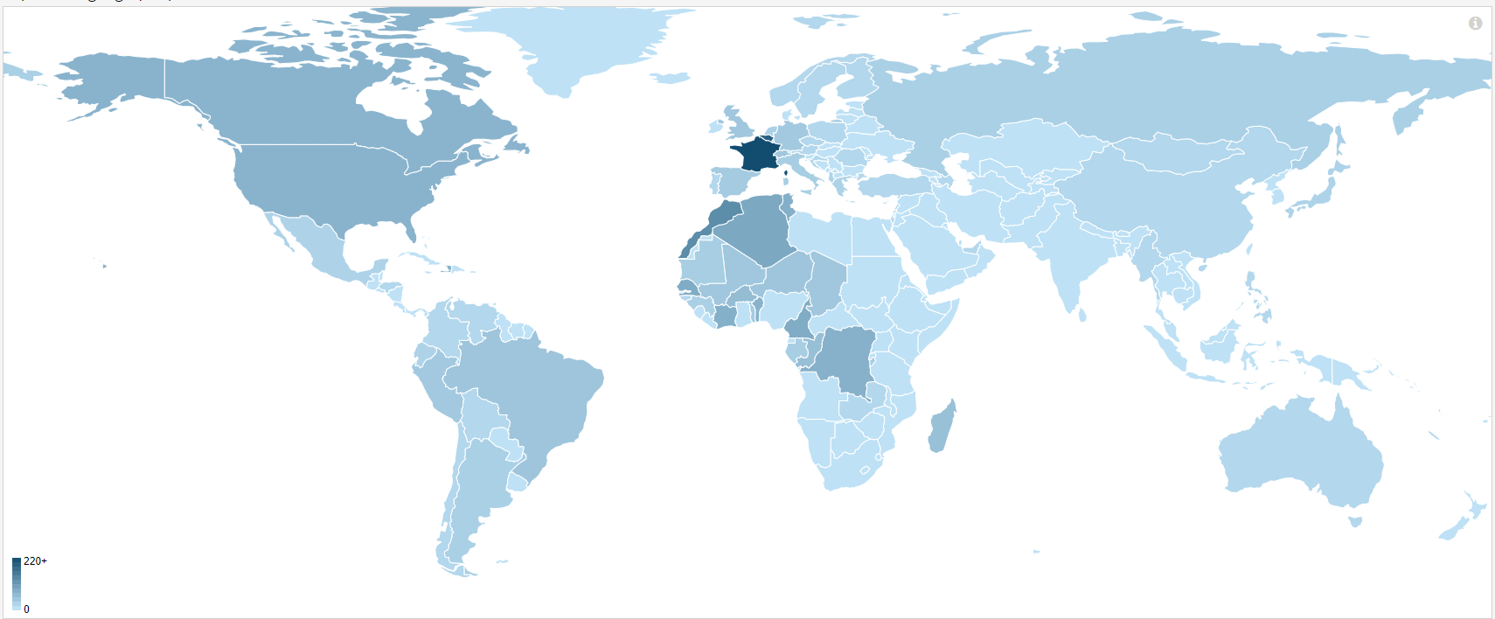
Rescif MOOC resources https://www.rescif.net/en/projects/moocs/

Slide 7
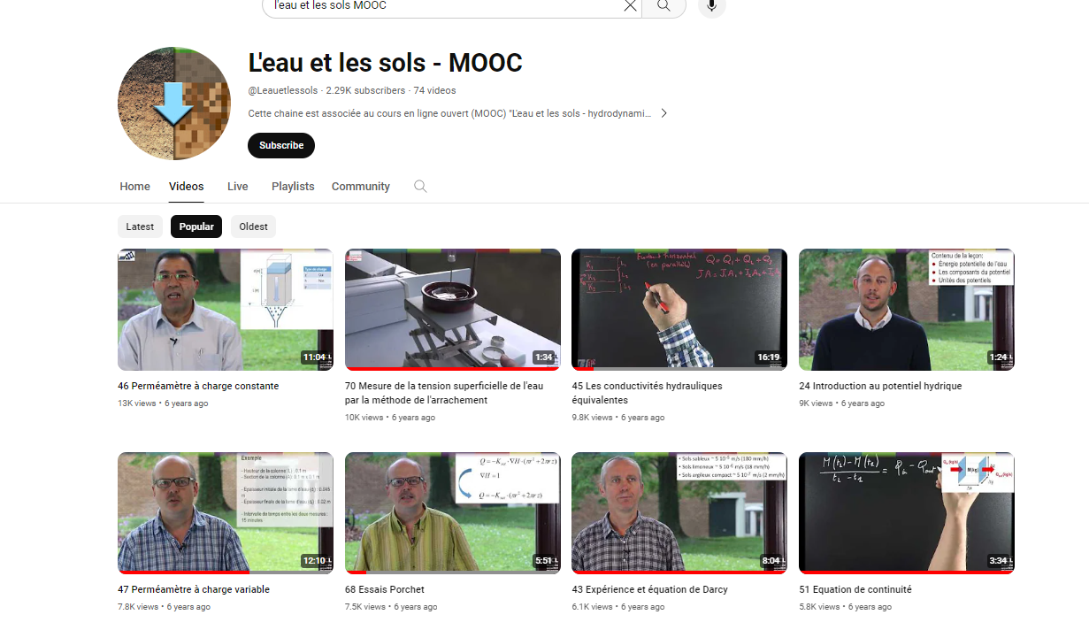
Rescif MOOC resources https://www.rescif.net/en/projects/moocs/

