Slide 1





The Memory of WORLD WAR II a driver of war attitudes and collective defence readiness 80 years on?
Fierens, L., the collaborators of the PEACE project, Bouchat, P.
loic.fierens@uclouvain.be

Slide 2
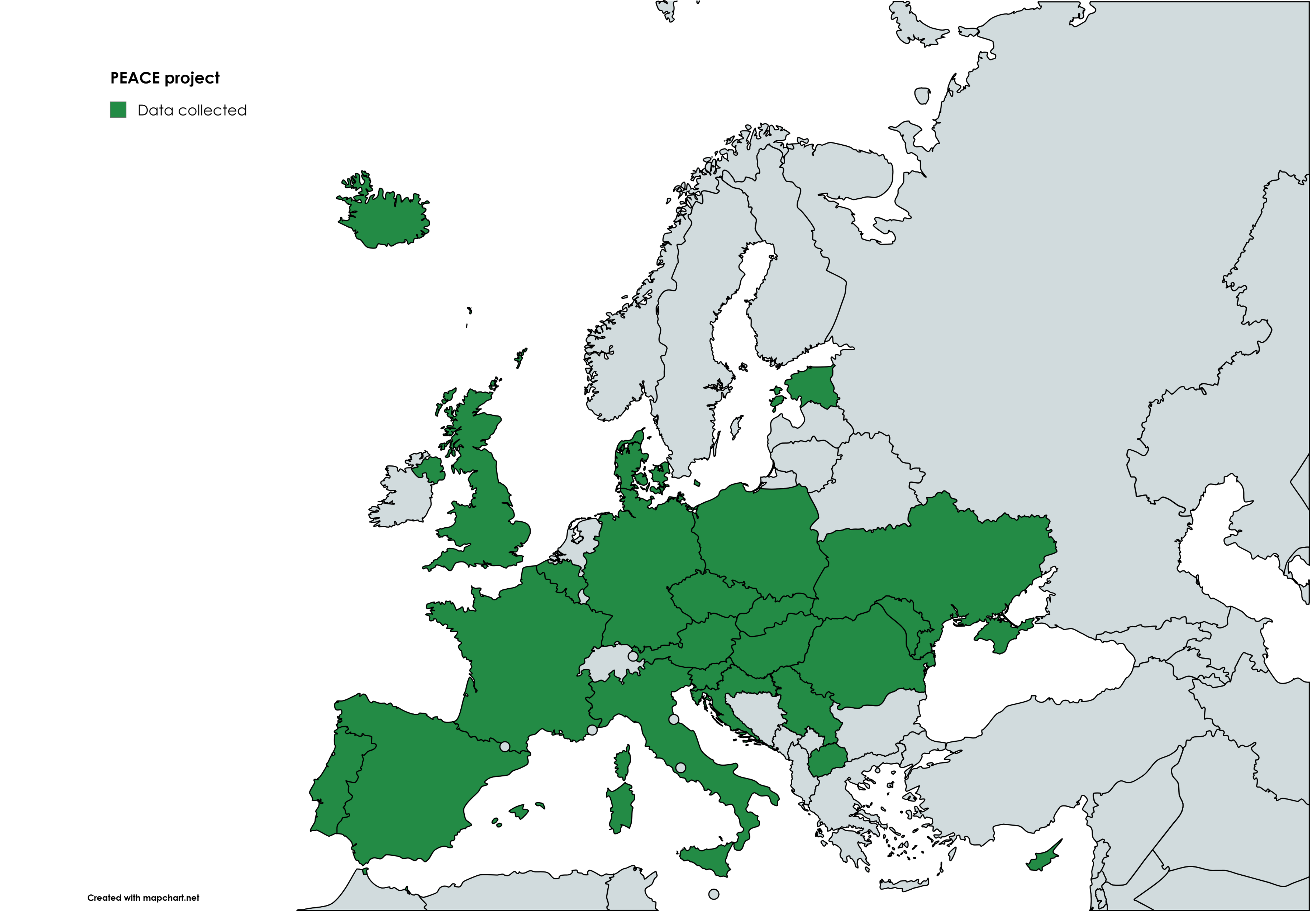
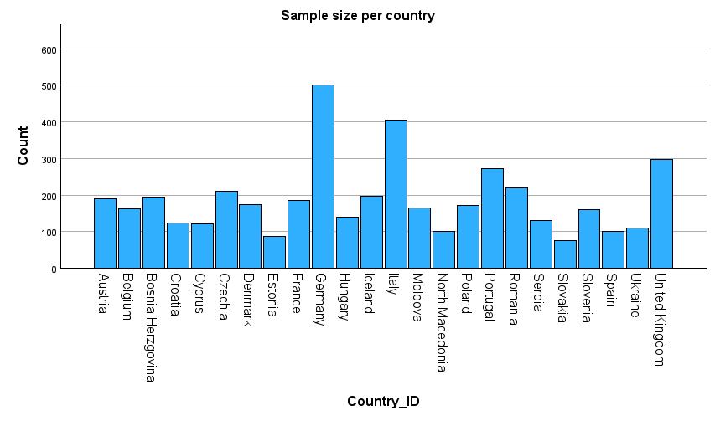
PEACE project

Slide 3
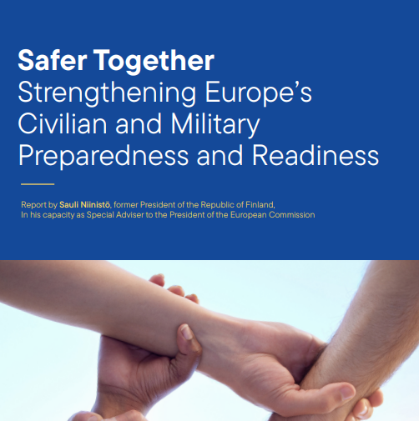
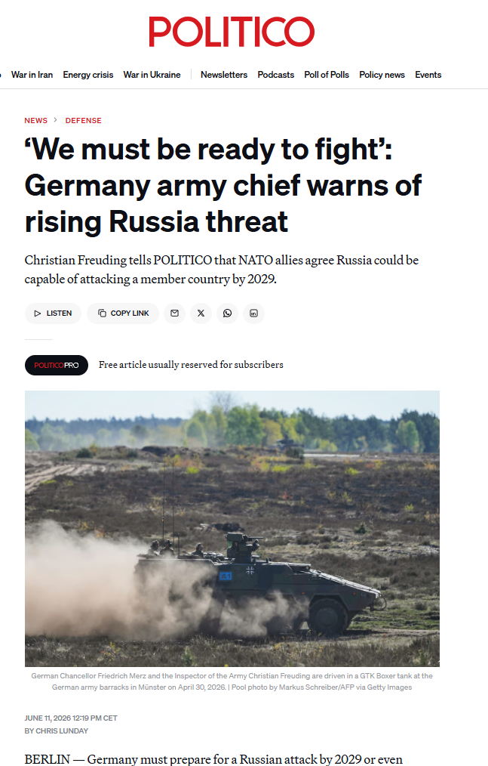
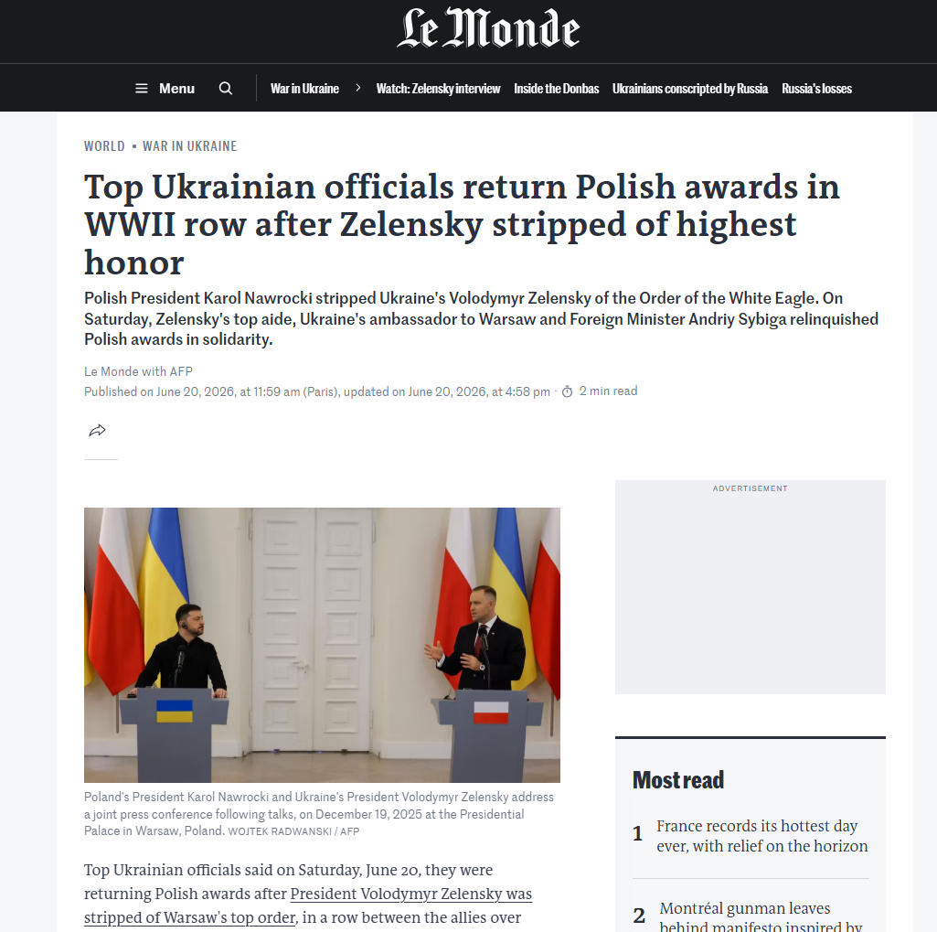
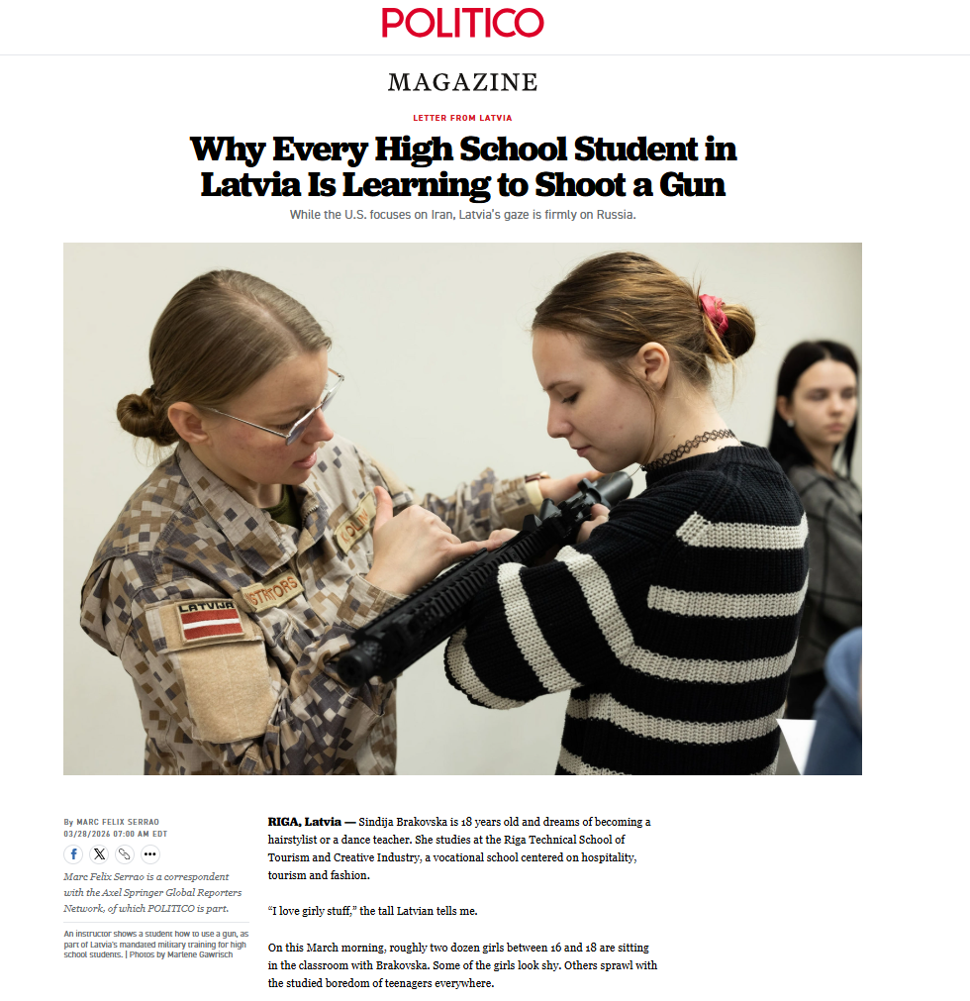

Slide 4
Research question
What is the role of WWII memory in shaping war attitudes and collective defence readiness at the individual level?
Collected memory as representations of the group’s past held at the individual level
Collective defence readiness: readiness at the individual level to commit to the defence of the group in case of war
War attitudes: general attitudes towards war
Notes:
SRH:
managing potential conflict by keeping track of the social group’s friends and enemies
building social identity, for instance, by varying access to or altering the interpretation of past actions that might elicit collective guilt,
avoiding future mistakes by supplying ‘lessons from history’
→ can be elaborated in
! But collective memories can be fragmented

Slide 5
This study
Where does it fit ?
WWII memory
General war attitudes
Subjective norms regarding defence and war
Collective defence readiness
Behaviours
Perceived obstacles and levers
Adapted from planned behaviour theory (Azjen, 1988)
Notes:
Norms: do you think people should defend your country in case of war

Slide 6
State of the art
Where does it fit ?
WWII memory
Rejection of war by former villains (collective charter)
Victorious justification of war
Collective defence readiness
Behaviours
Perpetual ingroup victimhood orientation
Perceived obstacles and levers
Adapted from planned behaviour theory (Azjen, 1988)
Notes:
Collective charter (Hilton & Liu, 2017)
Effect on defence readiness?
WWII moral roles differ between countries (Giner-Sorolla et al., 2021)
Differences inside countries?
Victorious justification at the aggregate level (Bobowik et al., 2014)
Same effect at the individual level?
Perpetual ingroup victimhood orientation (Bilali & Vollhardt, 2019)
Pushing defence readiness higher?
Heroization of past perpetrators inside families (Welzer, 2010)
Showing in surveys?

Slide 7
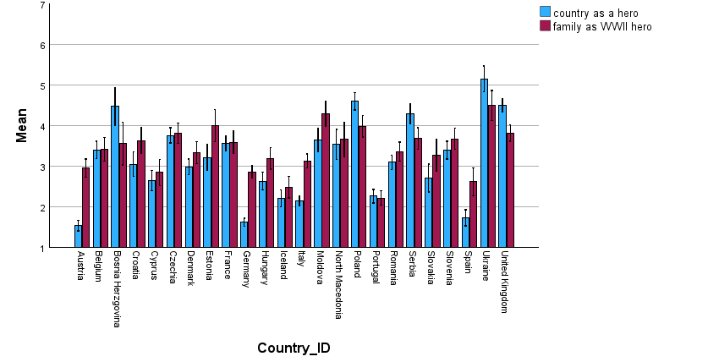
Hero
How well does each of the following role fit with your family/country for the period of WWII?

Slide 8
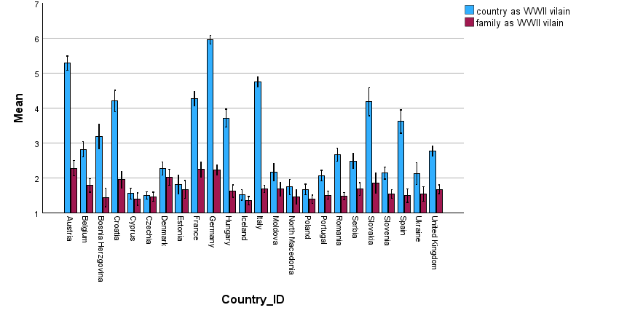
Villain
How well does each of the following role fit with your family/country for the period of WWII?
Notes:
Welzer, H. (2010). Re-narrations: How pasts change in conversational remembering. Memory Studies, 3(1), 5–17. https://doi.org/10.1177/1750698009348279

Slide 9
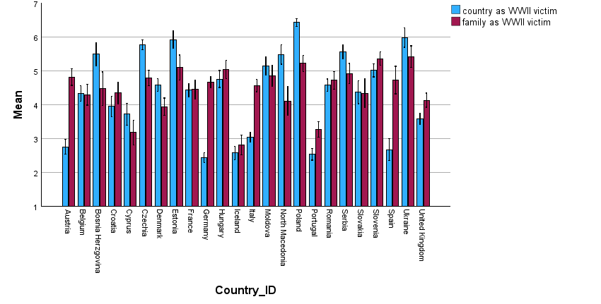
Victim
How well does each of the following role fit with your family/country for the period of WWII?

Slide 10
Pathway #1
Shape war attitudes?
WWII memory
General war attitudes
Subjective norms regarding defence and war
Collective defence readiness
Behaviours
Perceived obstacles and levers
Notes:
Norms: do you think people should defend your country in case of war

Slide 11
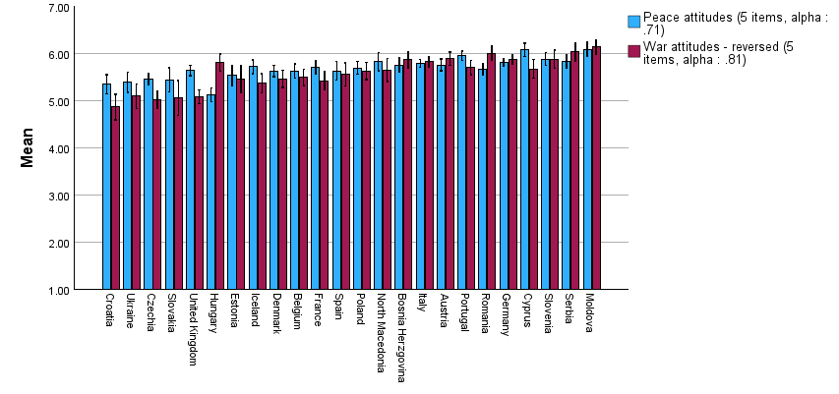
Peace and War attitudes
APWS (Bizumic et al., 2013; Van der Linden et al., 2017): bidimensional scale
General peace attitudes
  Our country's first priority should be world peace
  We must devote all our energy to securing peace throughout the world
  I believe that peace is extremely important
  Peace brings out the best qualities in a society
  In general, I am not too concerned about peace in the world
General war attitudes
  There is no conceivable justification for war
  War is sometimes the best way to solve a conflict
  War is a futile struggle resulting in self-destruction
  Under some conditions, war is necessary to maintain justice.
  Although war is terrible, it has some value.

Slide 12
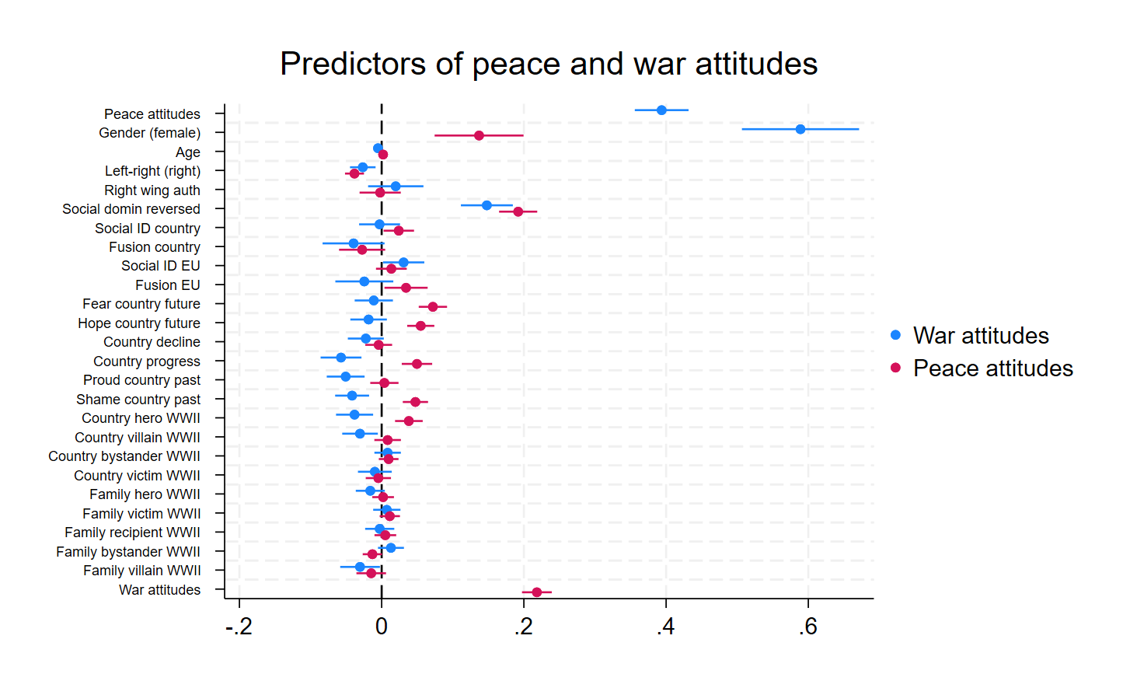
Anti-peace
Pro-war
Pro-peace
Anti-war
Notes:
!! All centred around the group-mean
Seeing more one’s country as a hero: pro-peace and anti-war
Seeing more one’s country as a villain: anti-war
Social roles of WWII
Hero (country) + villain (country and family) = higher pro-war attitudes
Modest contribution
Potential double effect
Heroic justification (war can be justified to bring about peace)
Villain identity management (war can be justified as such)
Level 2 effect: mean of country-villain and country-hero drives up the anti-militarism
1) Victorious justification (Bobowik et al., 2014)
BUT also, villain justification through identity management → if we were villain/ashamed then war is sometimes necessary
Works both at the collective and familial level
Peace attitudes are more future oriented
EU fusion prompts higher peace-attitudes
Paradox? Progress, shame, and hero are predicting opposite direction (pro-war and pro-peace)
Peace attitudes are predicted by a sense of progress
Progress in future
Shame of the past
Heroization of country in wwii
Both by fear and hope
Fusion at the EU level
Left and equalitarian between social groups
Non-anti-war attitudes
- Sense of collective progress
Heroization of the past
Shame & proud of the past
Family as villain

Slide 13
Relative strength of predictors (15-17%)
Notes:
Ideology trumps memory
BUT memory is associated with ideologies when memory is contrasted / debated in a country

Slide 14
Pathway #2
Shape intentions?
Social representations of WWII
General war attitudes
Subjective norms regarding defence and war
Collective defence readiness
Behaviours
Perceived obstacles and levers
Notes:
Norms: do you think people should defend your country in case of war

Slide 15
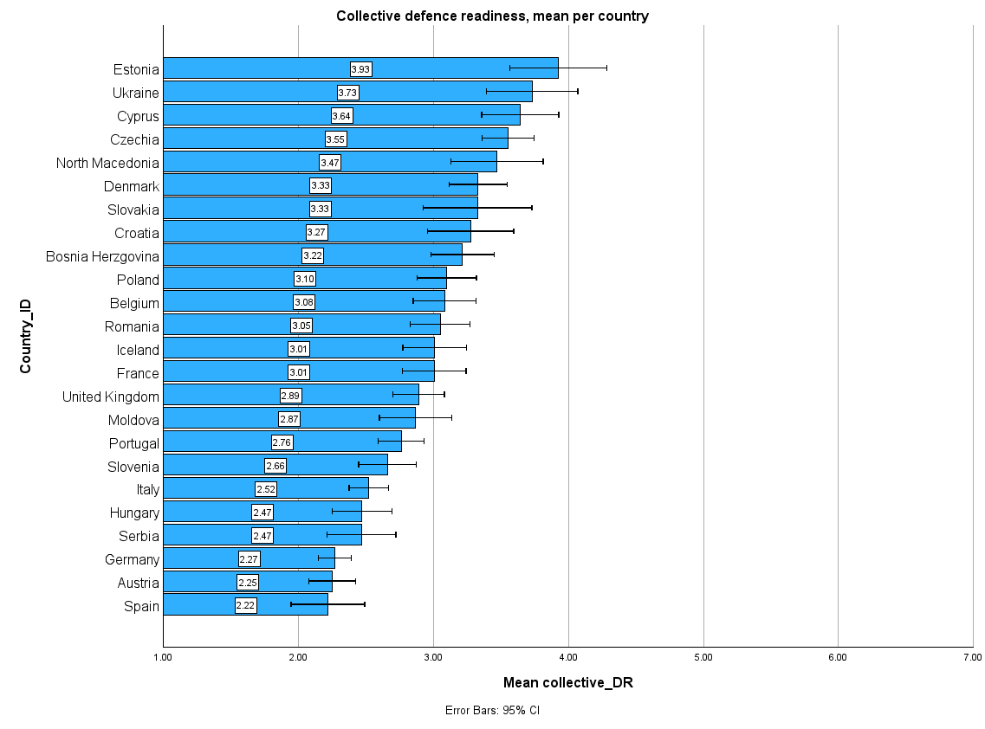
Collective defence readiness
Imagine that a war broke out between NATO/EU and Russia, and that your country is taking part in it. How ready do you feel to pursue the following actions?
Fight for your country
Enlist in the military to learn a fighting function
Enlist in the military to learn a support function
Contribute to the war effort with your time and skills

Slide 16
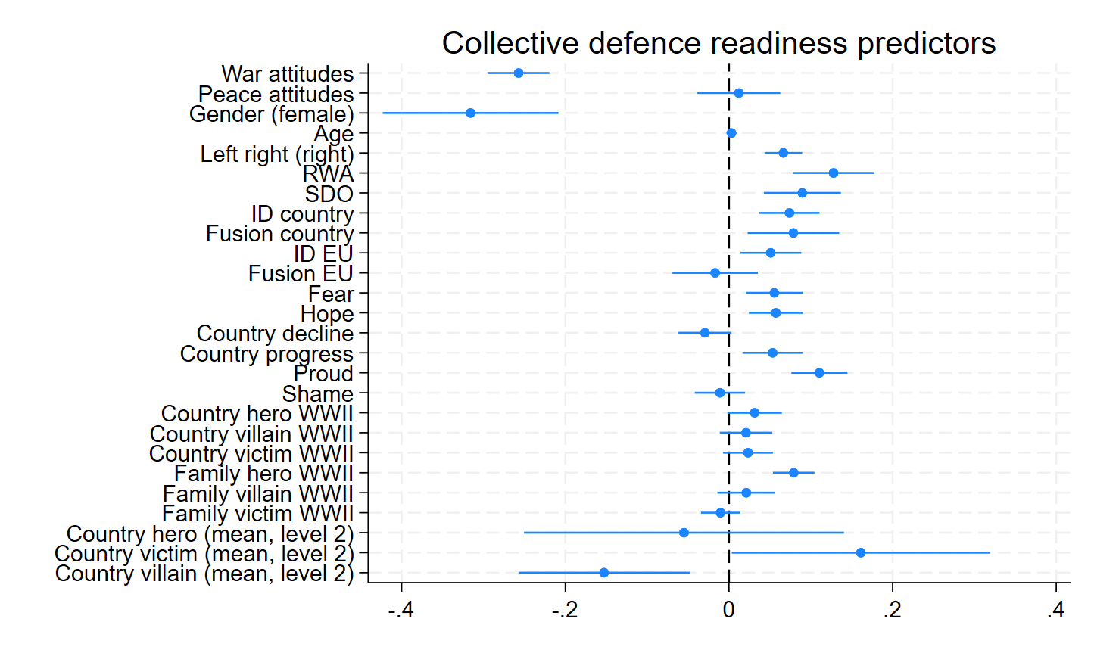
Collective charters and CDR
Notes:
Collective victimhood
// avec victim justifie l’usage de la force (never again)
Collective charters
// avec villain crée une norme de non-emploi de la force
Familial transmission; vicariant learning (vygostky?) that explains the victorious justification?
Not the collective heroization rather than the familial one

Slide 17
Relative strength of predictors (24,7% variance)

Slide 18
Any question, remarks, suggestion ?
WWII memories
RWA / SDO
General war attitudes
Collective charter
Villain
Victims
Subjective norms on defence and war
Collective defence readiness
Behaviours
Vicariant learning – family hero of WWII
Perceived obstacles and levers to act
Contact: loic.fierens@uclouvain.be
Notes:
Norms: do you think people should defend your country in case of war
Around Europe anti-war and pro-peace attitudes are the norm
Between countries differences are subtle for attitudes, but more pronounced for behavioural intentions
Memory of WWII are significantly associated, 82 years later with:
general war attitudes (small effect)
norms of collective defence (moderate effect)
perceived control on defence behaviours (small)
Way forward: attitudes regarding specific conflict

Slide 19
The end

Slide 20
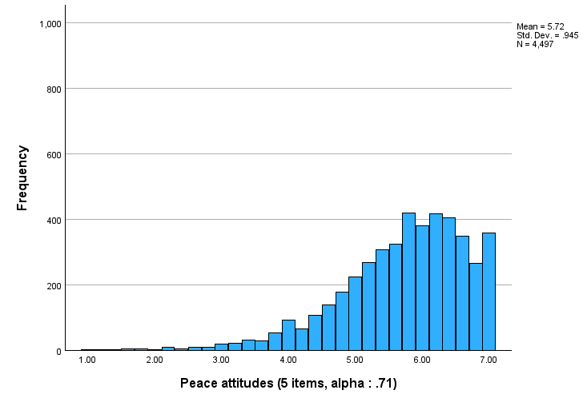
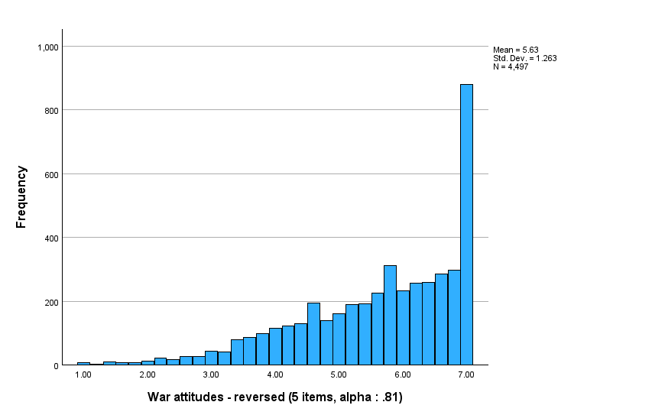
Global trend towards peace / anti-war

Slide 21
Peace and War attitudes
General peace attitudes
  Our country's first priority should be world peace
  We must devote all our energy to securing peace throughout the world
  I believe that peace is extremely important
  Peace brings out the best qualities in a society
  In general, I am not too concerned about peace in the world
General anti-war attitudes
  There is no conceivable justification for war
  War is sometimes the best way to solve a conflict
  War is a futile struggle resulting in self-destruction
  Under some conditions, war is necessary to maintain justice.
  Although war is terrible, it has some value.
APWS (Bizumic et al., 2013; Van der Linden et al., 2017): bidimensional scale

Slide 22
Alpha
APW_peace: alpha per country
APW_war: alpha per country
Country | Cronbach's Alpha
Austria | .734
Belgium | .774
Bosnia Herzgovina | .806
Croatia | .773
Cyprus | .673
Czechia | .671
Denmark | .678
Estonia | .745
France | .749
Germany | .708
Hungary | .597
Iceland | .749
Italy | .729
Moldova | .659
North Macedonia | .661
Poland | .737
Portugal | .712
Romania | .721
Serbia | .646
Slovakia | .767
Slovenia | .711
Spain | .765
Ukraine | .700
United Kingdom | .756
Country | Cronbach's Alpha
Austria | .709
Belgium | .727
Bosnia Herzgovina | .830
Croatia | .840
Cyprus | .738
Czechia | .820
Denmark | .841
Estonia | .833
France | .831
Germany | .788
Hungary | .771
Iceland | .846
Italy | .791
Moldova | .565
North Macedonia | .792
Poland | .812
Portugal | .847
Romania | .803
Serbia | .853
Slovakia | .872
Slovenia | .878
Spain | .806
Ukraine | .725
United Kingdom | .825

Slide 23
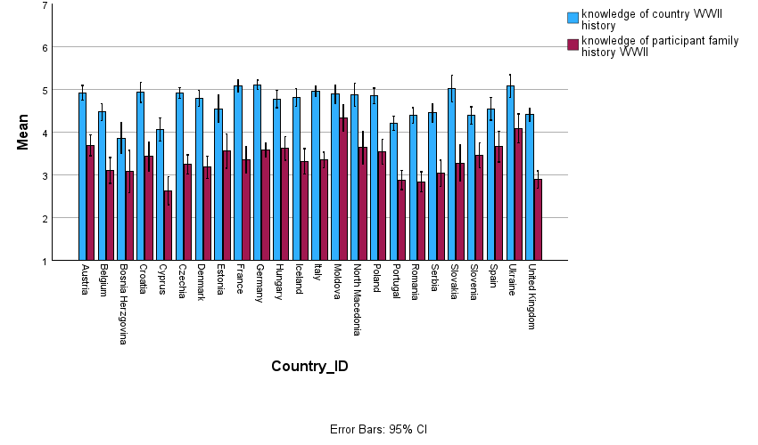
Knowledge of family/country history

Slide 24
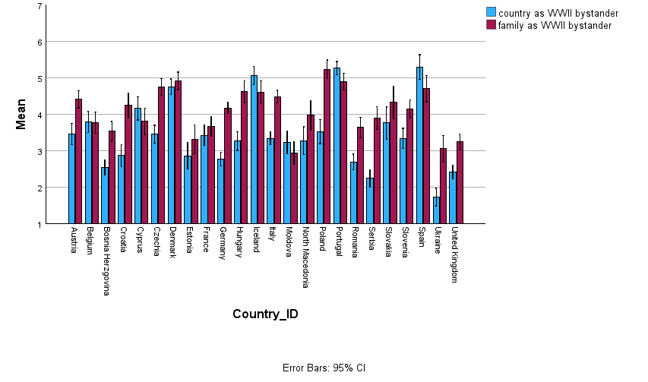
Bystander

Slide 25
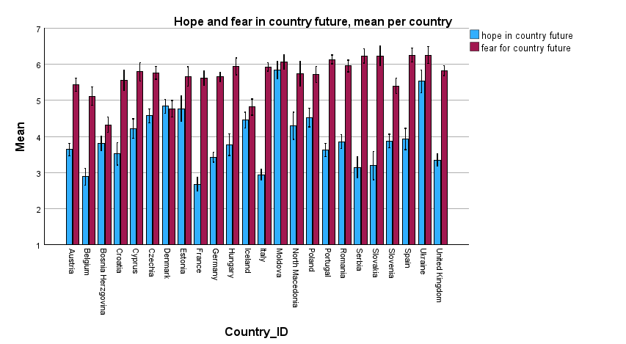
A fearful (and sometimes hopeful) future
Notes:
EU integration as driving higher hope (Moldova + Ukraine)

Slide 26
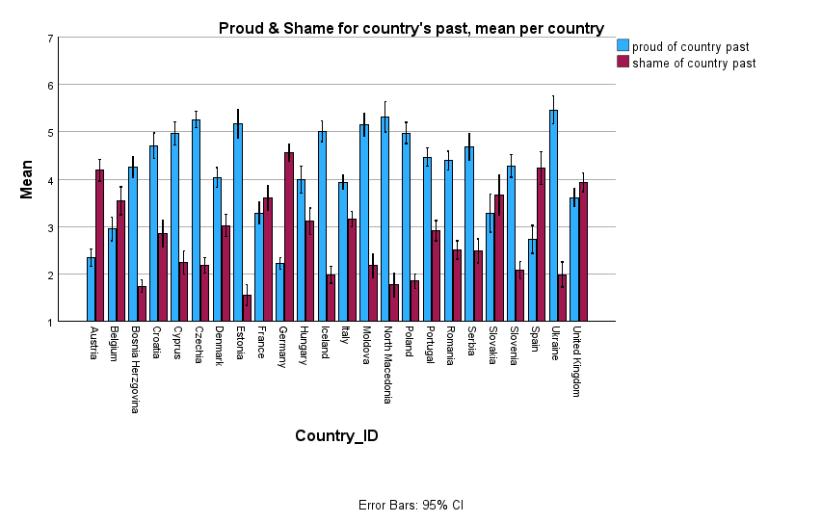
A contrasted past

Slide 27
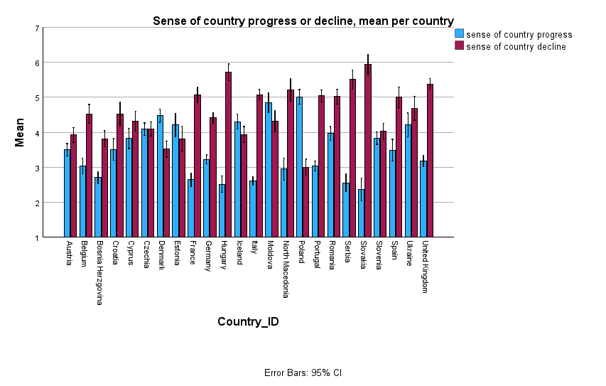
Intertemporal collective trajectory

Slide 28
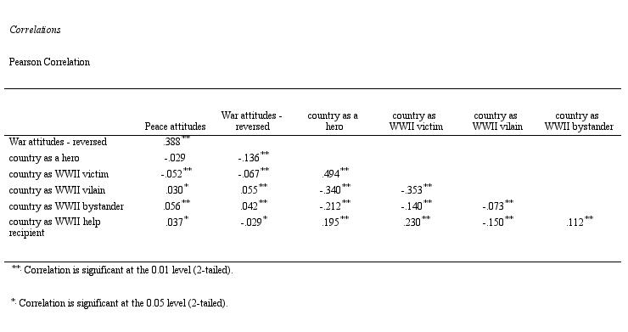
General sample correlations: country

Slide 29
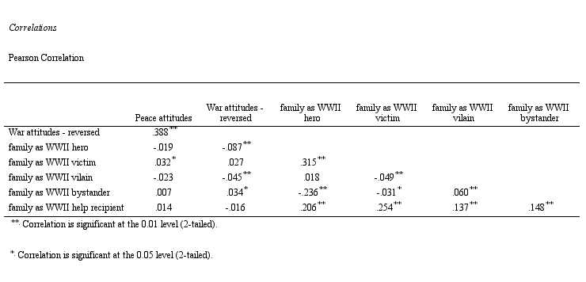
General sample correlations: family

