Slide 1
Shaping research and innovation in the Circle U
Climate Knowledge Hub
Pr. M. Vanclooster,
UCLouvain, Earth & Life Institute

Slide 2
Context
Climate change (CC) is one of the most important challenges for humanity.
The scientific evidence of CC, and current and expected future impacts of CC are well documented.
Adaptation and mitigation is urgently needed, but pathways to make the transition to climate resilient societies are still subjected to large uncertainty.
Innovation in technology & infrastructure, but also in human agency is needed to successfully reach sustainable societies.

Slide 3
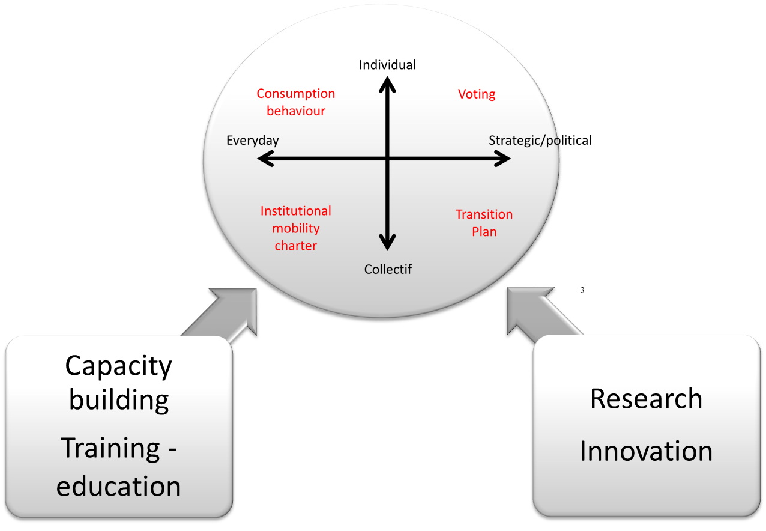
How humans build a climate resilient world

Slide 4
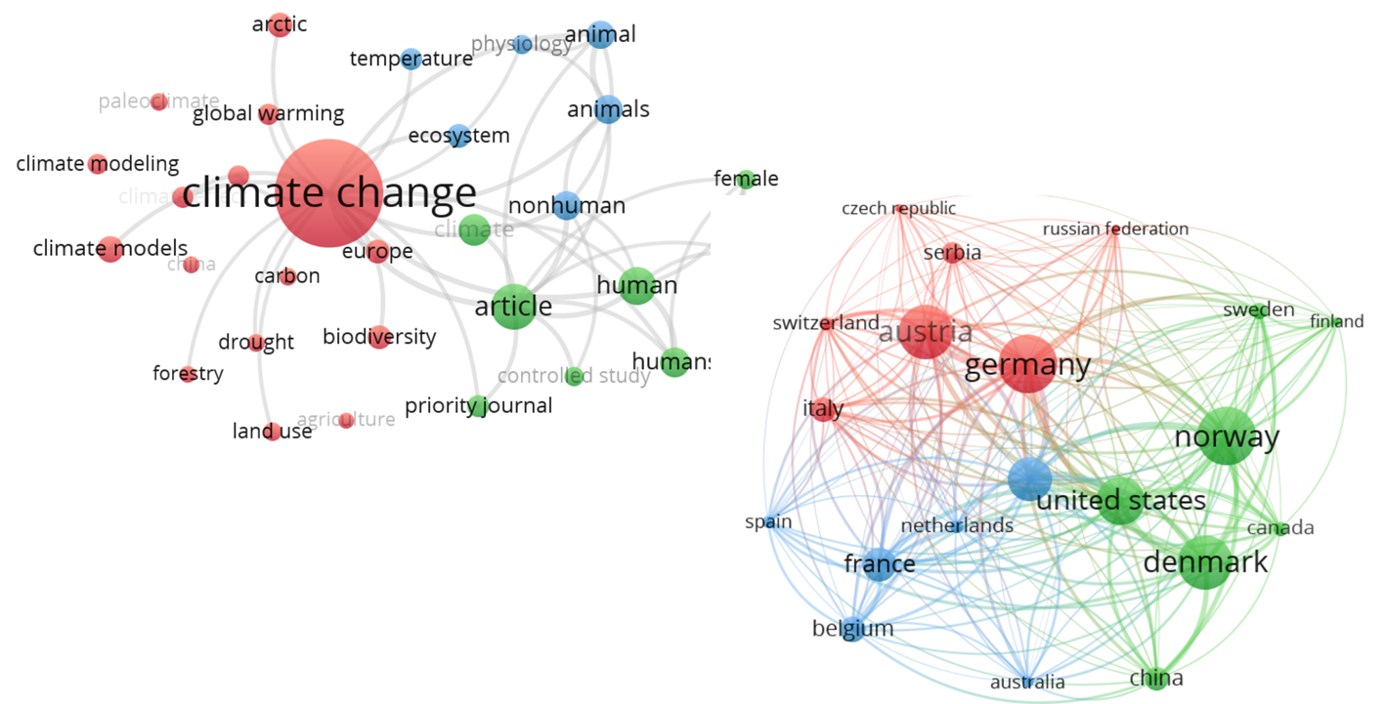
expertise on CLIMATE iSSUES in Circle U

Slide 5
Shaping innovation
Joint organisation of summer schools for undergraduate & graduate students
Joint organisation of specific thematic seminars
Joint interdisciplinar and transdisciplinar training for profesionnals
Joint new research project initiatives

Slide 6
AN Exemple: The berlin summer school
Videoclip

Slide 7
Challenges
The potential of university alliances is large, but the ecosystem is complex:
How can alliance identity (e.g. Circle U) be increased for local staff & students?
How can co-constructed activities be implemented efficiently?
How can activities be scaled-up?

Slide 9
Prof. Marnik Vanclooster
Université catholique de Louvain
Earth & Life Institute
Email: marnik.vanclooster@uclouvain.be

