Slide 1






Imaging the electrocaloric effect at the nanoscale
Valentin Fonck
Jean Spièce
Charalambos Evangeli
Pascal Gehring

Slide 2


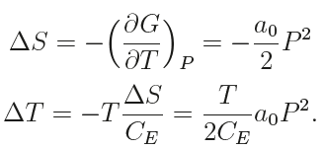
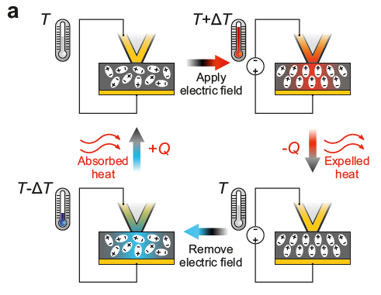
The electrocaloric effect
…
Thermodynamics
Pandya, S. et al. Phys. Rev. Appl. 7, 034025 (2017).
Iguchi, R. et al. Applied Physics Letters 122, 082903 (2023).

Slide 3
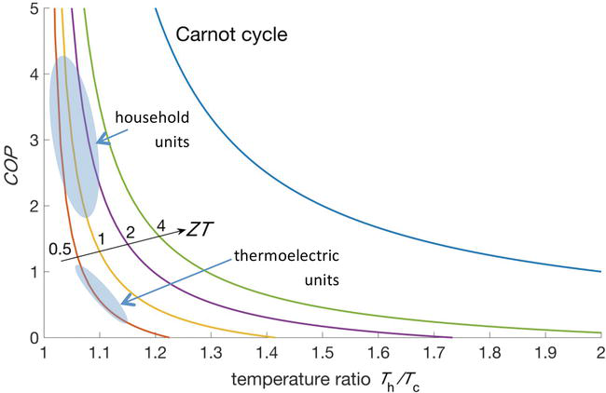
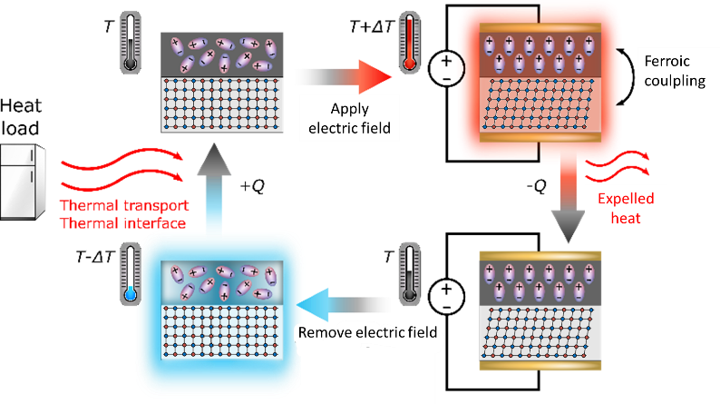
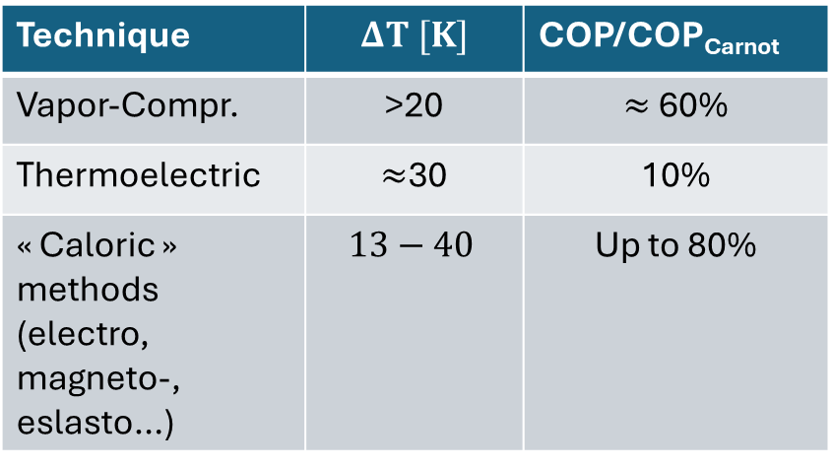
Motivations
Technique | $$ΔT [K]$$ | COP/COP_{Carnot}
Vapor-Compr. | >20 | $≈$ 60%
Thermoelectric | $≈$30 | 10%
« Caloric » methods (electro, magneto-, eslasto…) | $$13−40$$ | Up to 80%
Can we build an electrocaloric nanoscale fridge ?
On-chip spot-cooling
Sensor cooling
Individual cell manipulation
Moya, X., Defay, E., Mathur, N. D. & Hirose, S. MRS Bulletin 43, 291–294 (2018).

Slide 4
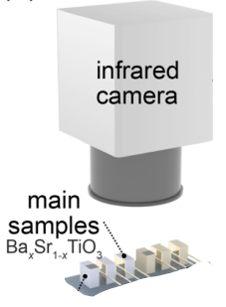
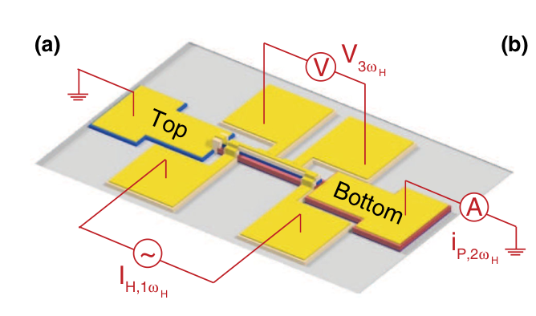
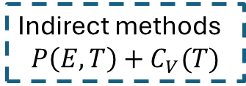
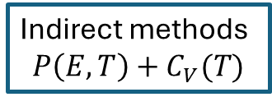
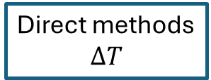
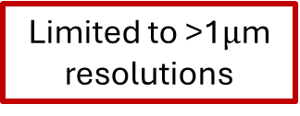
The electrocaloric effect
Direct methods
$$ΔT$$
Indirect methods
$$P\left(E,T\right)+C_{V}(T)$$
Indirect methods
$$P\left(E,T\right)+C_{V}(T)$$
Local methods
Spatially averaged
Limited to >1$μ$m resolutions
Requires sample fabrication
Pandya, S. et al. Phys. Rev. Appl. 7, 034025 (2017).
Iguchi, R. et al. Applied Physics Letters 122, 082903 (2023).

Slide 5
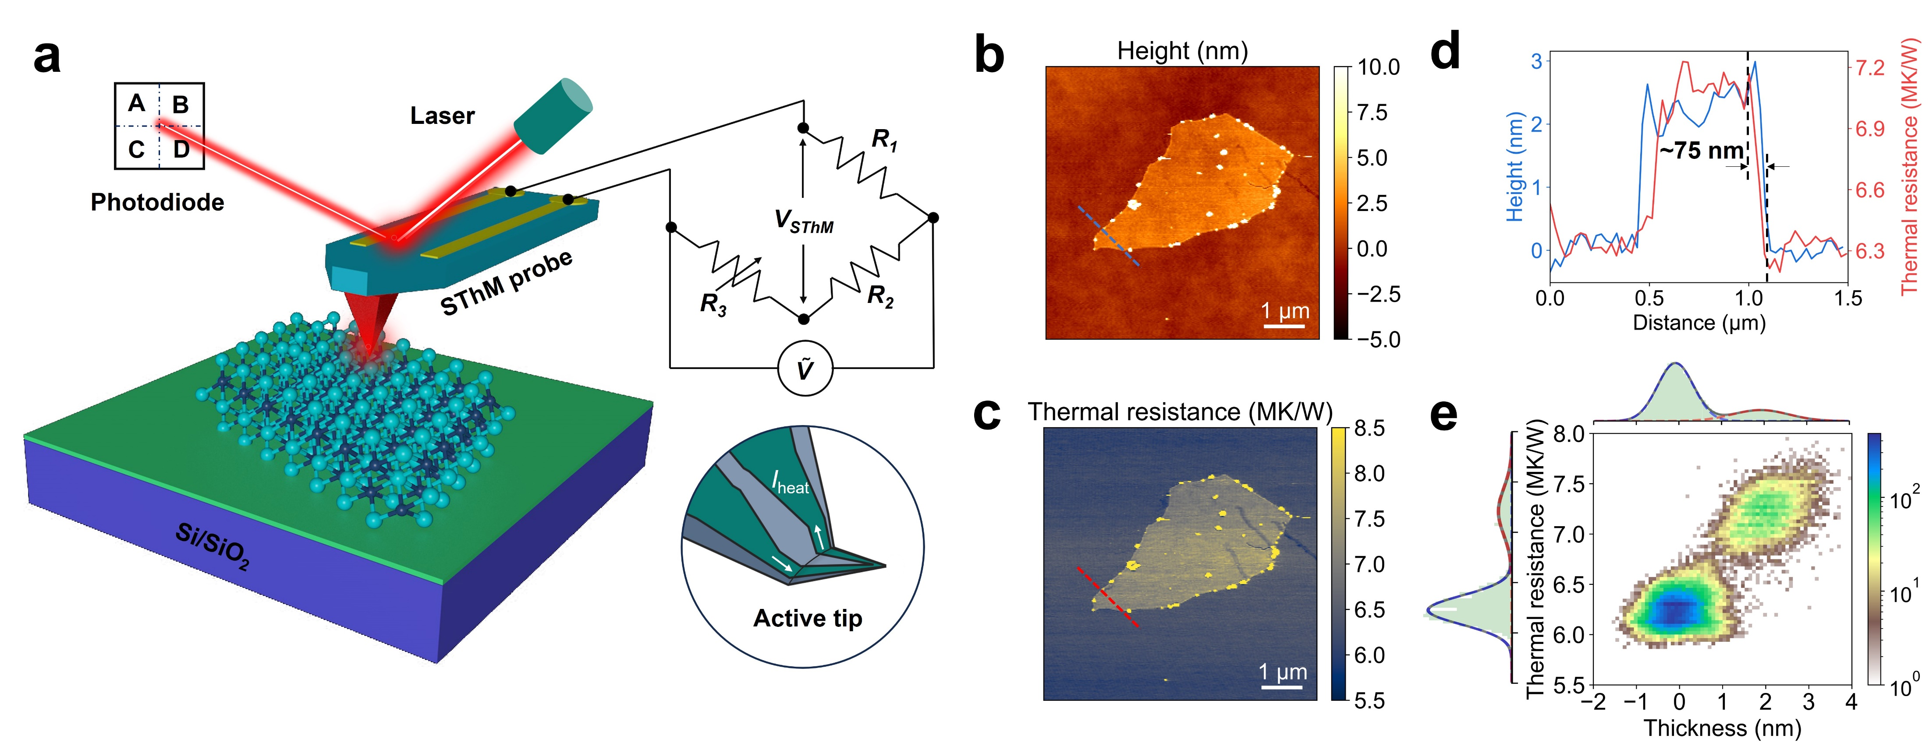

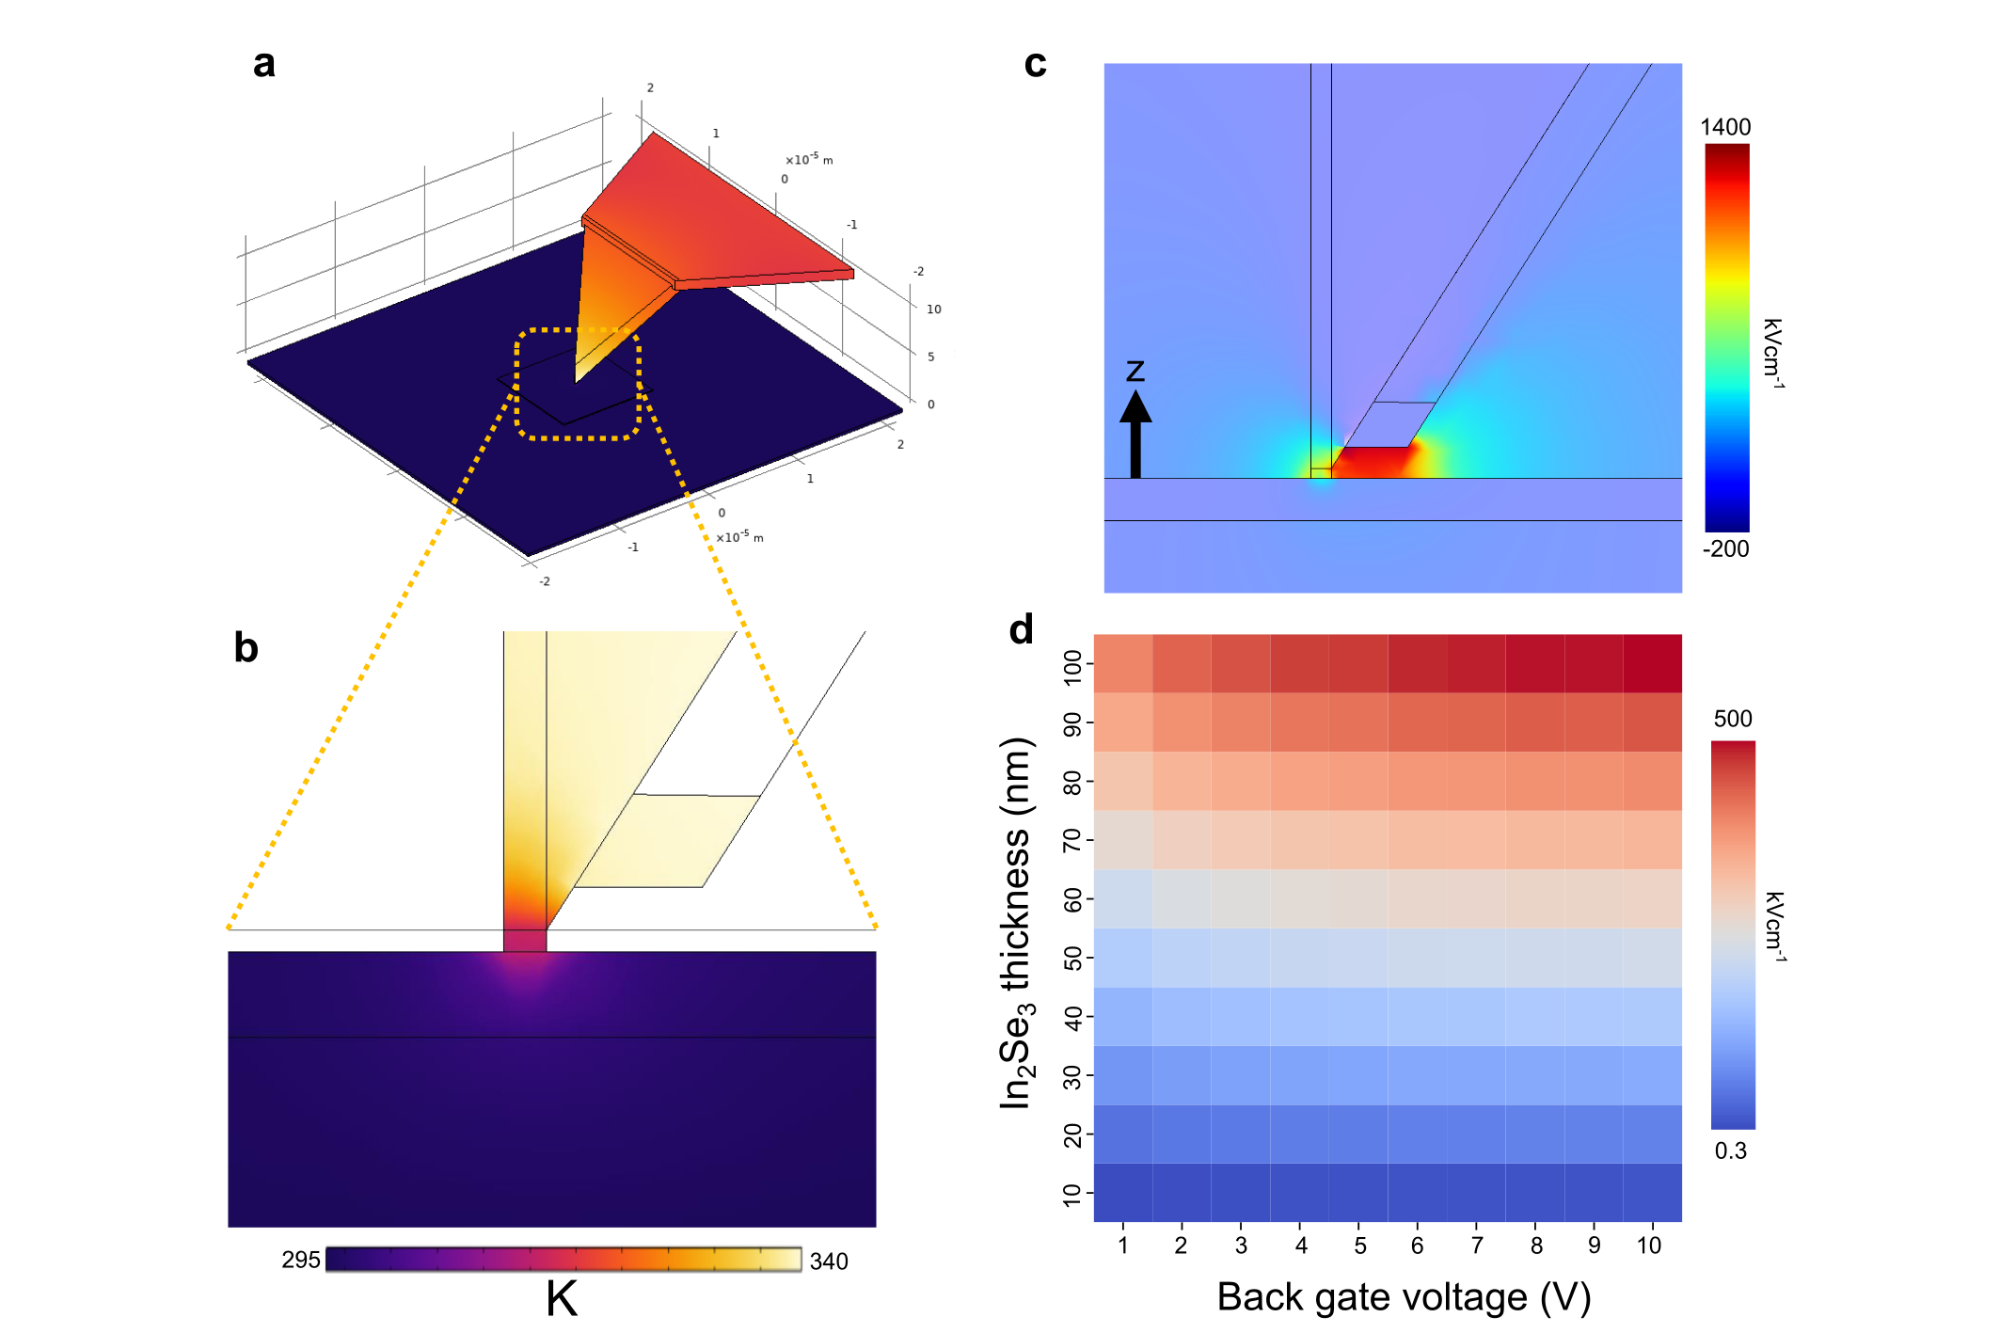
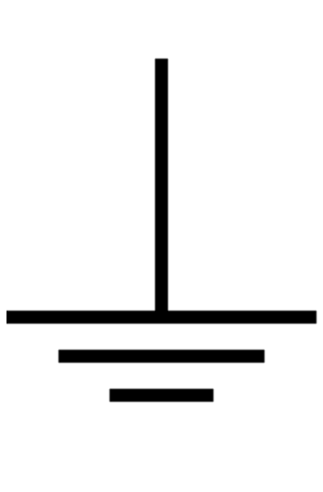
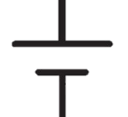


Scanning Electrocaloric Thermometry
Can we apply a local electric field ?
air
$$α−In_{2}Se_{3}$$
Si
Nanoscale thermometry
Local electric field
Scanning electrocaloric thermometry (SeCT)

Slide 6
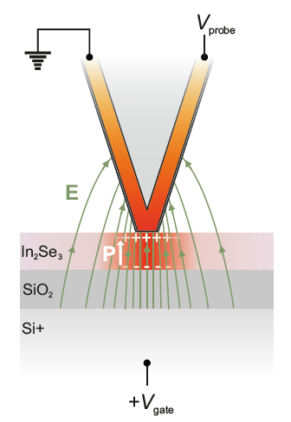
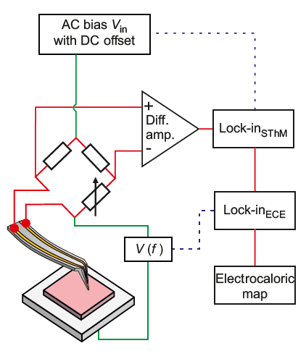
Local imaging

Slide 7
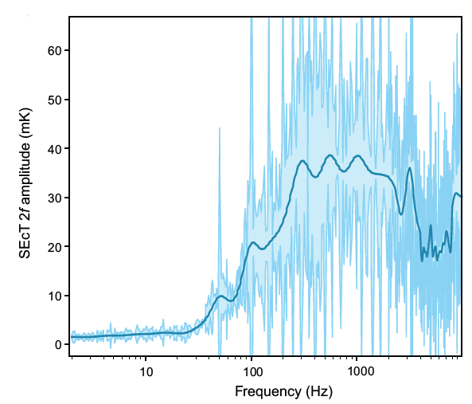
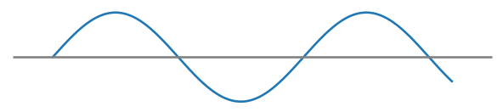
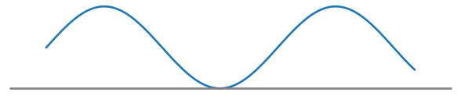

Local imaging
$$|\vec{E}|$$
4um
Excitation matters
Frequency matters

Slide 8
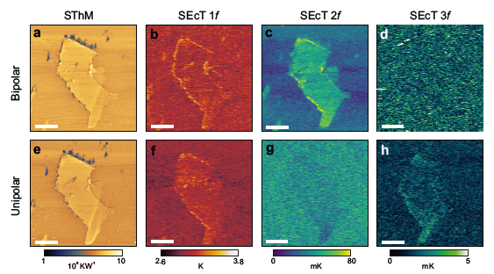
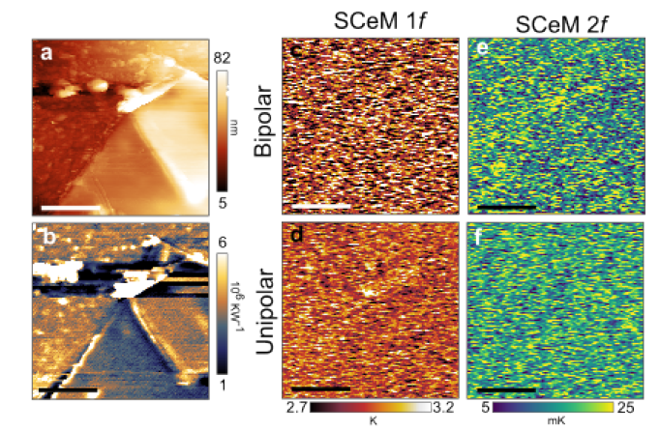
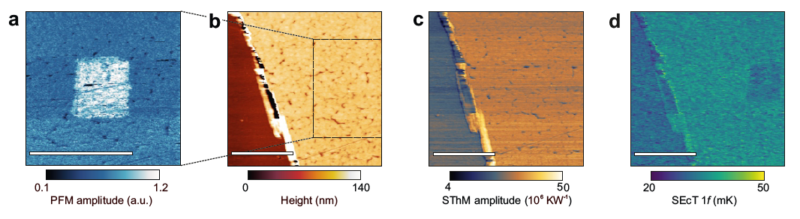


Scanning Electrocaloric Thermometry
$$α−In_{2}Se_{3}$$
hBN
PVDF-TrFE
Control experiment
No response ➔ Not a contact artifact
Polarisable 2D material
Unipolar vs bipolar excitation
Ferroelectric thin film
Writing and writing polarisation
Polarisation dependent ECE response

Slide 9

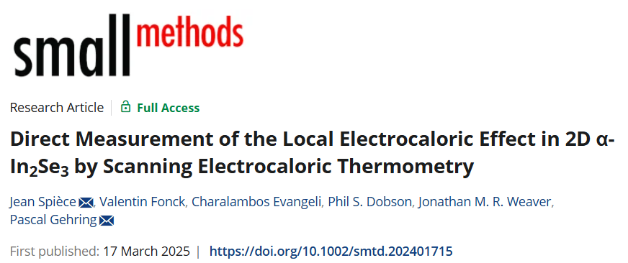
Takeaway message
With this technique you can simultaneously :
Image the ECE at the nanometer scale
Separate the Joule response from the ECE
Perform PFM measurement
Write FE domains and image them
It can be performed on any polarisable material
(ferro-, para- or dielectric)

Slide 10



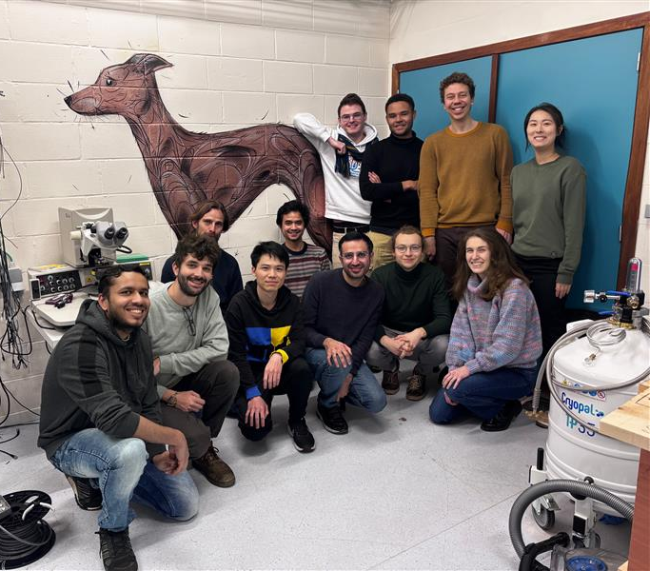

Are you looking for a postdoc ? pascal.gehring@uclouvain.be

Slide 11
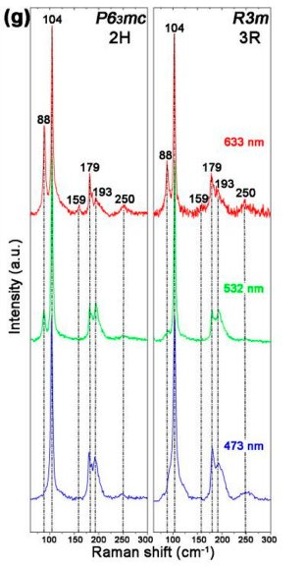
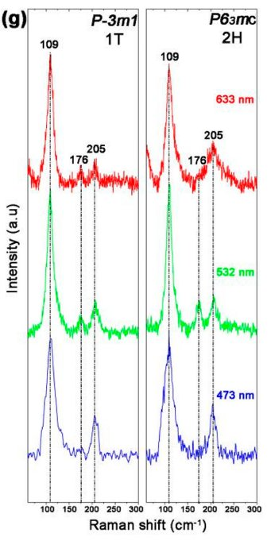
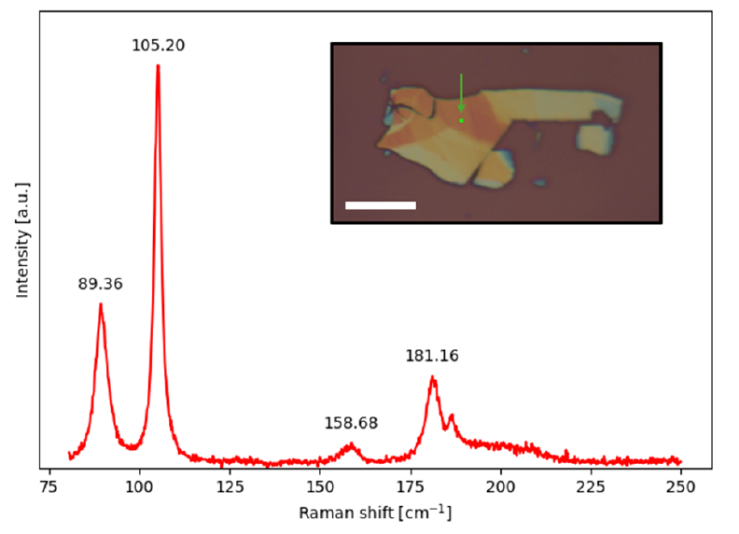


Raman spectroscopy
$$α−In_{2}Se_{3}$$
$$β−In_{2}Se_{3}$$
Liu, L. et al. Atomically Resolving Polymorphs and Crystal Structures of In2Se3. Chem. Mater. 31, 10143–10149 (2019).

Slide 12
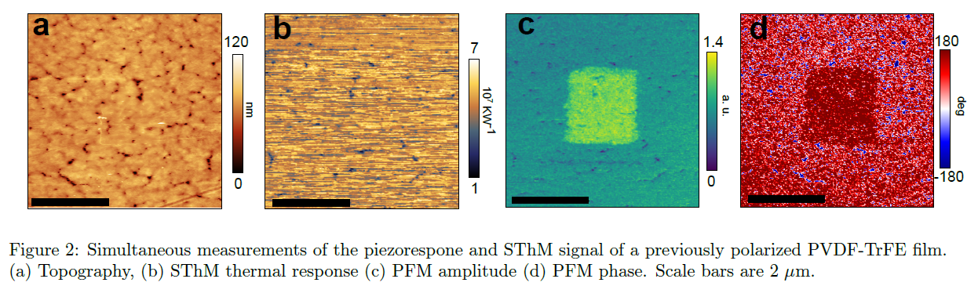
PVDF PFM response

Slide 13
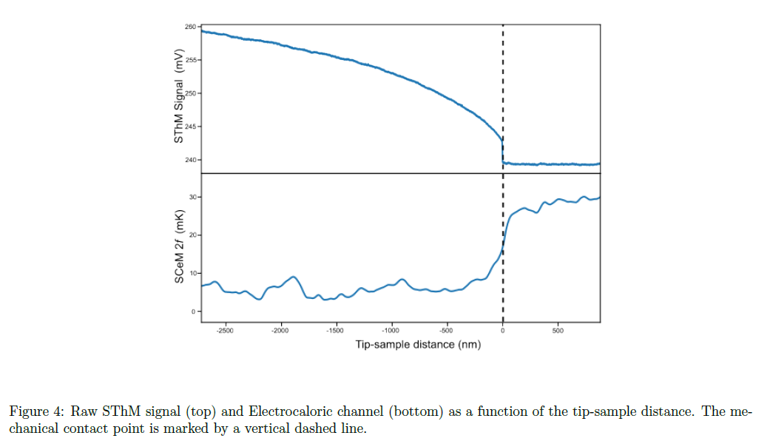
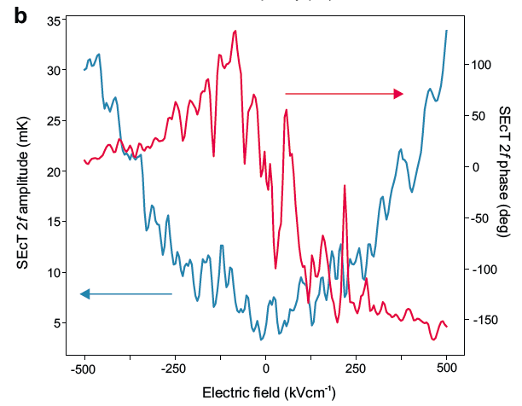
Approach curve

