Slide 1
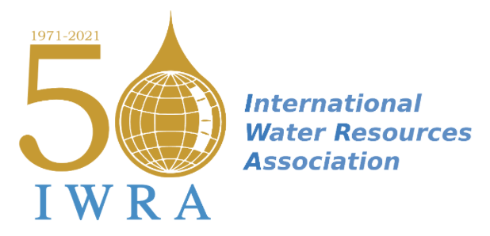


Transboundary Groundwater, Peace and Security: Opportunities and challenges in Central America
IRWA 2021 – World Water Congress
29 November - 3 December 2021
EXCO, Daegu, Republic of Korea
Maureen Walschot, Université catholique de Louvain
maureen.walschot@uclouvain.be
Wagner Costa Ribeiro, Universidade de São Paulo
wribeiro@usp.br
Notes:
This applicable to Flash presentation too.
Just change the background color to more darker or lighter to distingish between both.

Slide 2
Background
IRWA 2021 – World Water Congress
29 November - 3 December 2021
EXCO, Daegu, Republic of Korea
Water - threat multiplier/enhancing cooperation
Opportunities and challenges regarding peace, water security and transboundary water management
Joint management of transboundary aquifers: difficult balance of different interests and uses
RQ: What is the state of water cooperation in Central America?

Slide 3
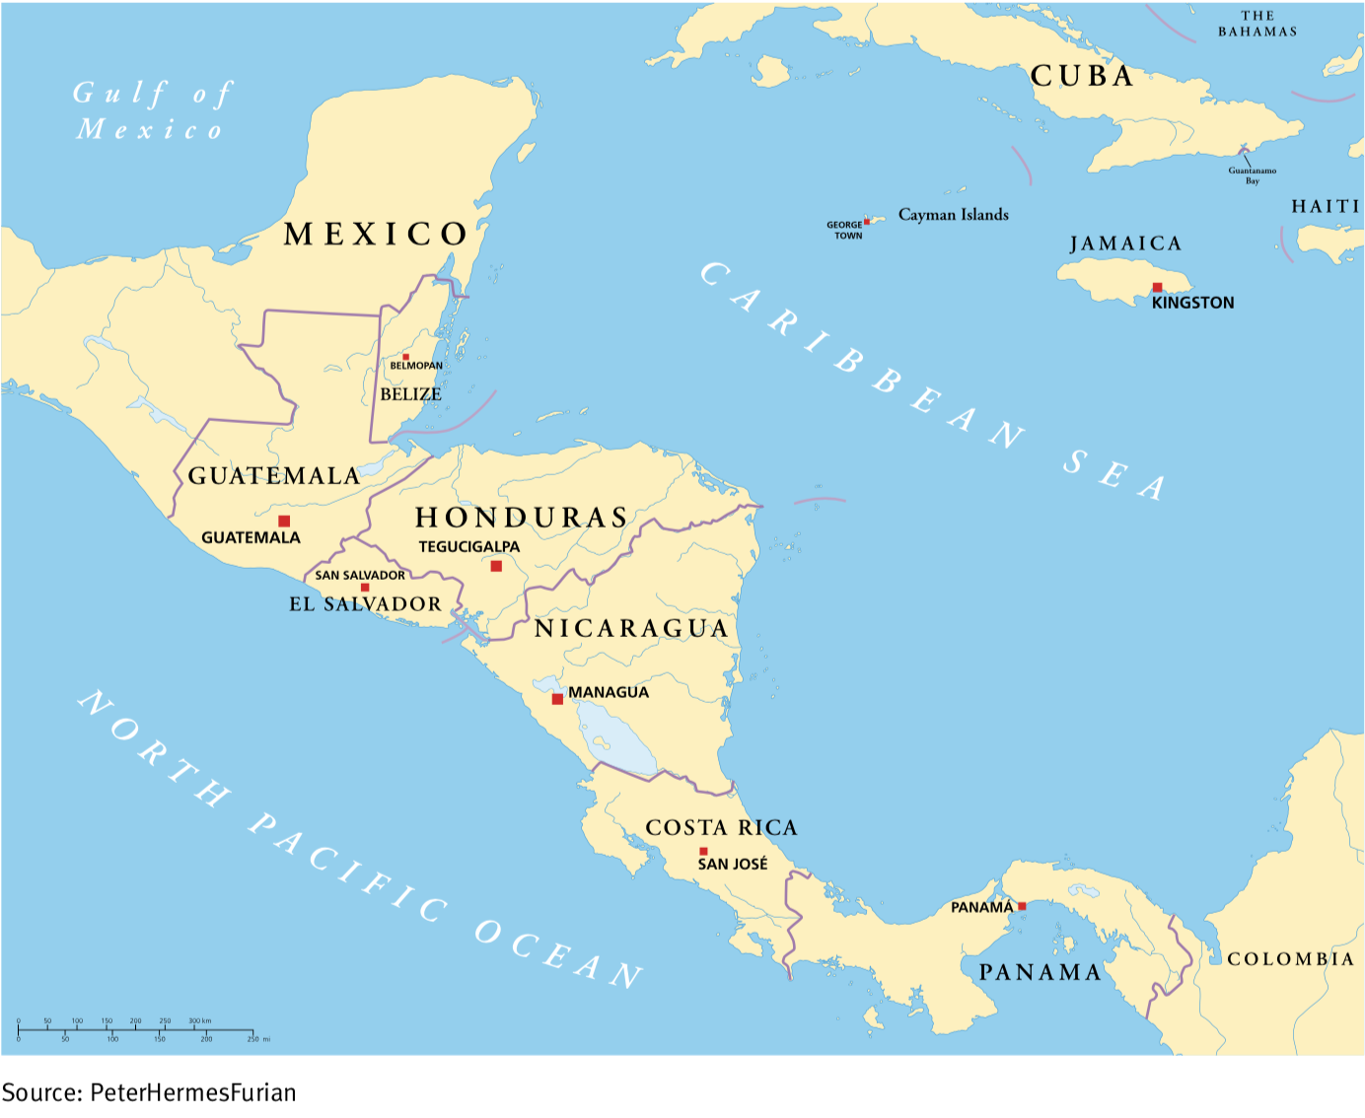
Transboundary Groundwater, Peace and Security in Central America
IRWA 2021 – World Water Congress
29 November - 3 December 2021
EXCO, Daegu, Republic of Korea
CA endowed with water resources BUT water scarcity = concern: lack of mechanisms and actions for managing, allocating, and developing water resources
Vulnerability to climate change critical
7 States interconnected through 23 international watercourses and 18 transboundary aquifers.
Despite several joint management projects, cooperation still nascent

Slide 4
Methodology
IRWA 2021 – World Water Congress
29 November - 3 December 2021
EXCO, Daegu, Republic of Korea
1. Applying enabling factors in transboundary aquifer cooperation (Conti, 2014) to CA to analyze the strengths and the flaws
The higher the number of enabling factors, the stronger the possibilities of enabling cooperation over transboundary groundwater
2. Use the TWINS model (Mirumachi & Allan, 2007) to analyze how transboundary water management implies both cooperation and conflict among the different stakeholders
Challenges: local transboundary water politics = reflection of local power (a)symmetries

Slide 5
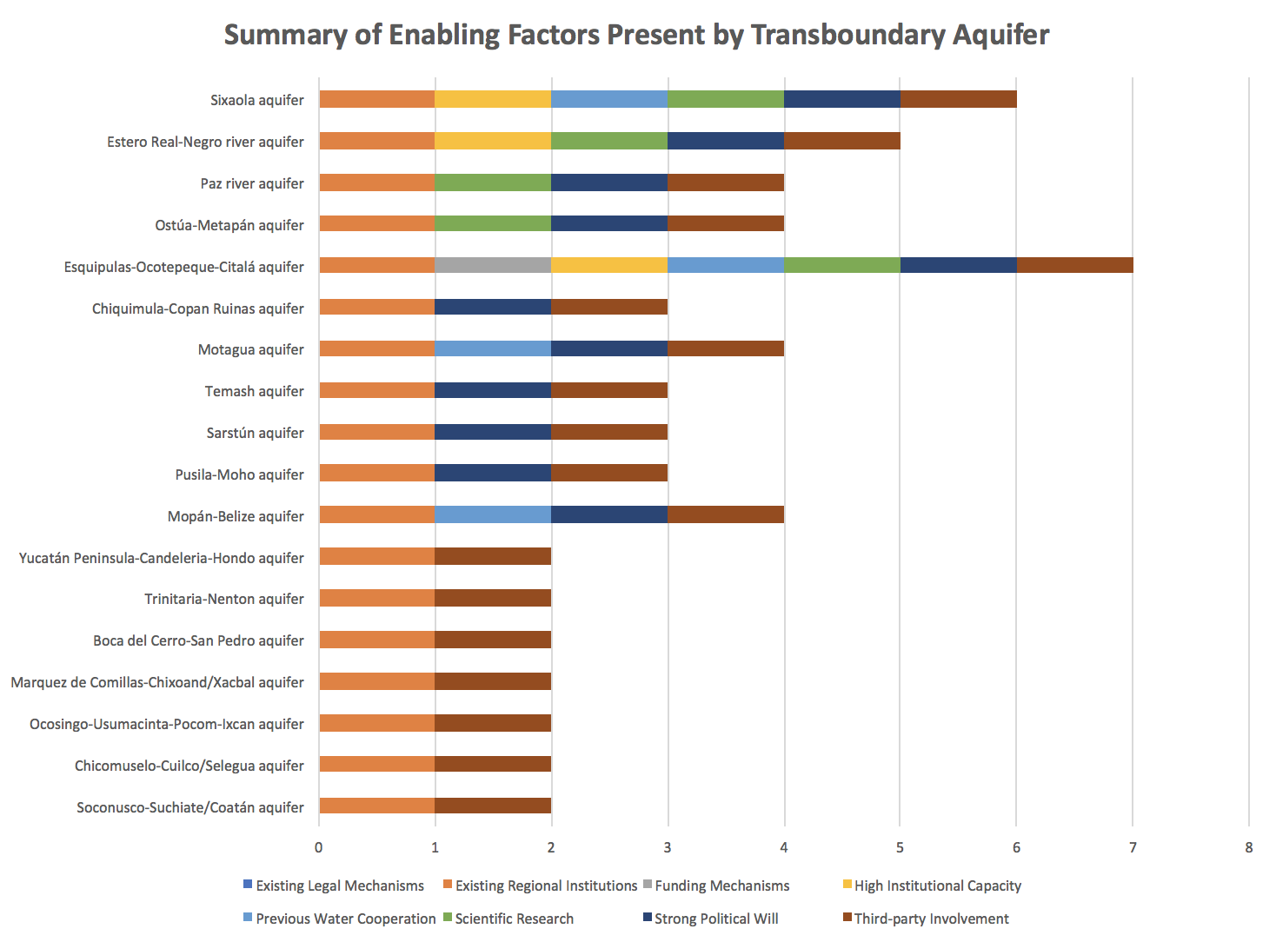
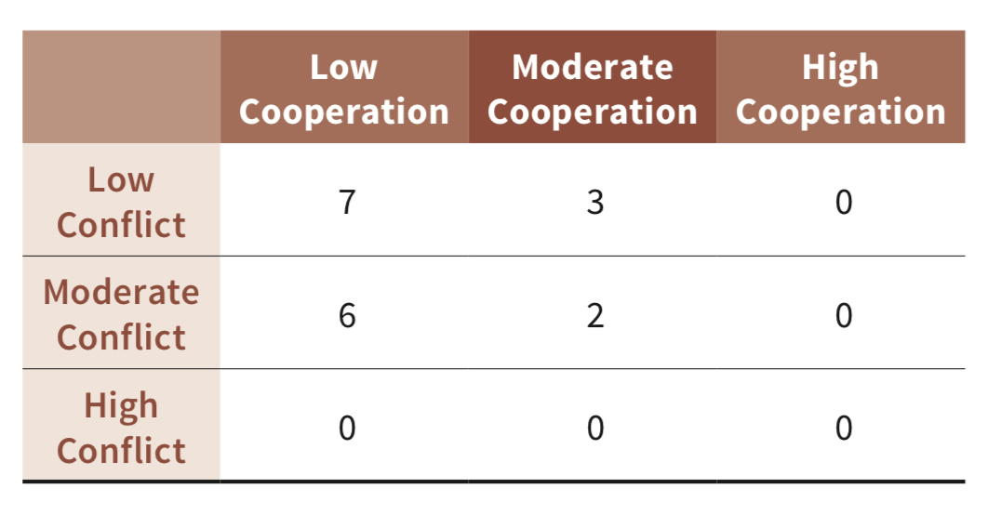
Case study
IRWA 2021 – World Water Congress
29 November - 3 December 2021
EXCO, Daegu, Republic of Korea
Summary of Transboundary Aquifer Interactions

Slide 6
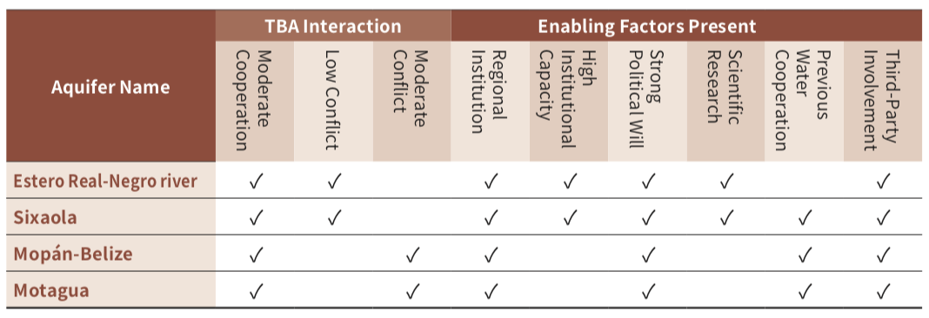
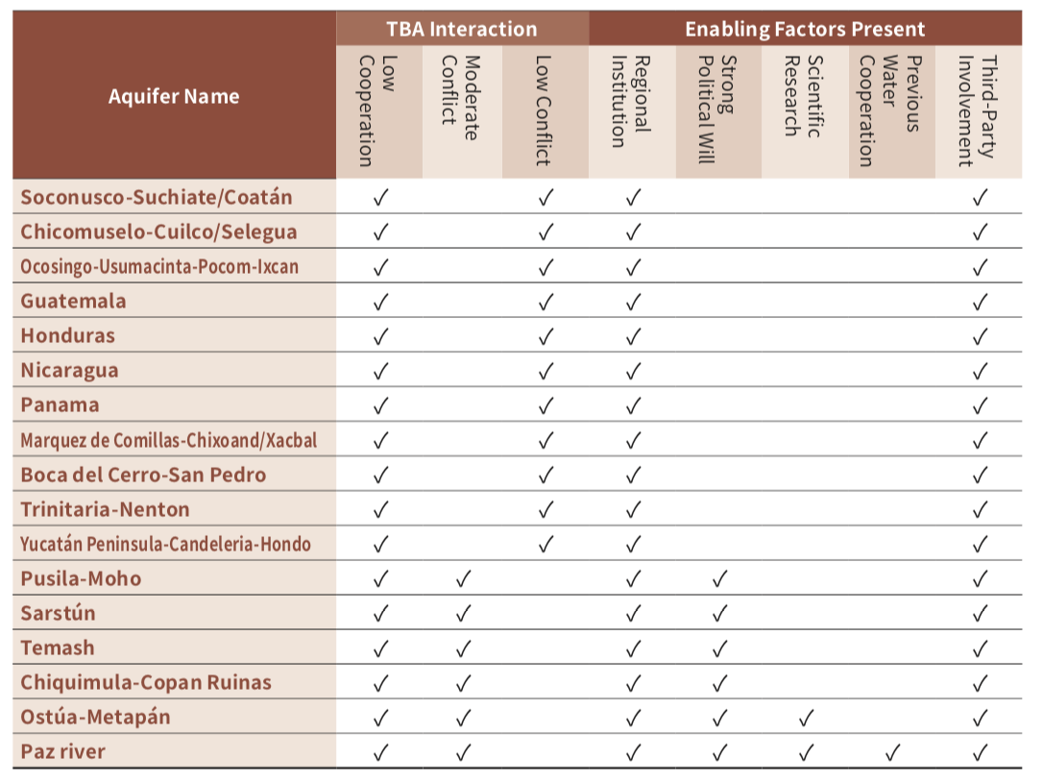
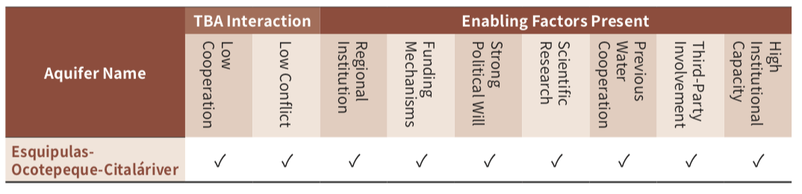
Discussion
IRWA 2021 – World Water Congress
29 November - 3 December 2021
EXCO, Daegu, Republic of Korea
Summary of Moderate Engagement Cases
Summary of Low Engagement Cases
Summary of High Engagement Cases

Slide 7
Policy Recommendations and Conclusions
IRWA 2021 – World Water Congress
29 November - 3 December 2021
EXCO, Daegu, Republic of Korea
Set of recommendations for governance mechanisms to enhance transboundary groundwater security (Albrecht et al., 2017)
Adapting these to the specific context of CA as a regional hydro-security complex
Water can be a tool for peace if the right enabling factors, mechanisms and policies are put in place
+ essential to incorporate all actors as early as possible in the cooperation/negotiation process

Slide 8
Thank you for your attention.
ISARM 2021 - International Conference on Transboundary Aquifers "Challenges and The way forward“
December 6-9 , 2021

