Slide 1

Application of depth-averaged bedload finite-volume models to a progressive embankment dam-failure
Masoumeh Ebrahimi, Robin Meurice, and Sandra Soares-Frazão
Notes:
Hello everyone, I appreciate this opportunity to share with you some numerical modelling contribution and the most interesting outcomes regarding a dike-breach modelling to simulate numerically a recent laboratory benchmark test.
Two depth-averaged finite volume models were applied to model the breaching of a homogenous dike exposed to overtopping.

Slide 2
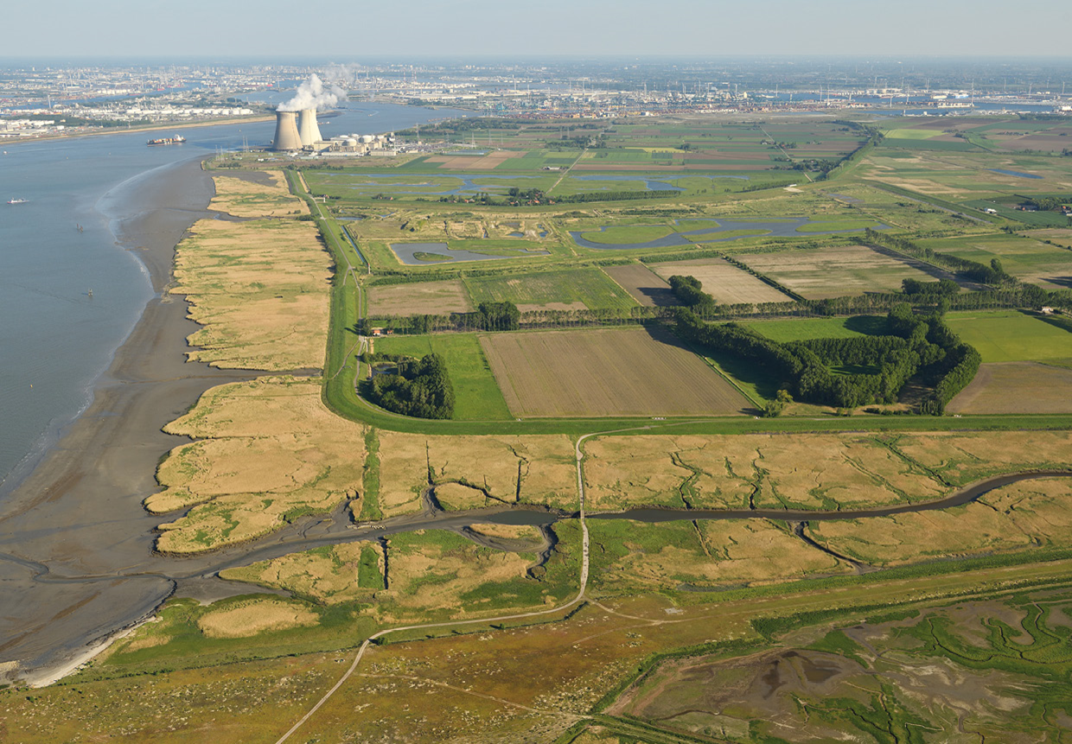

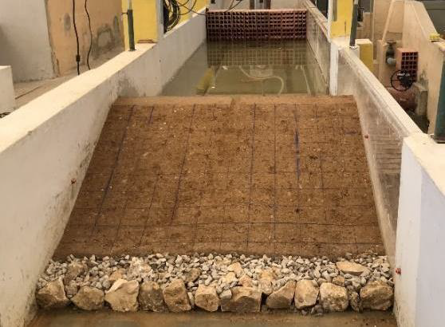
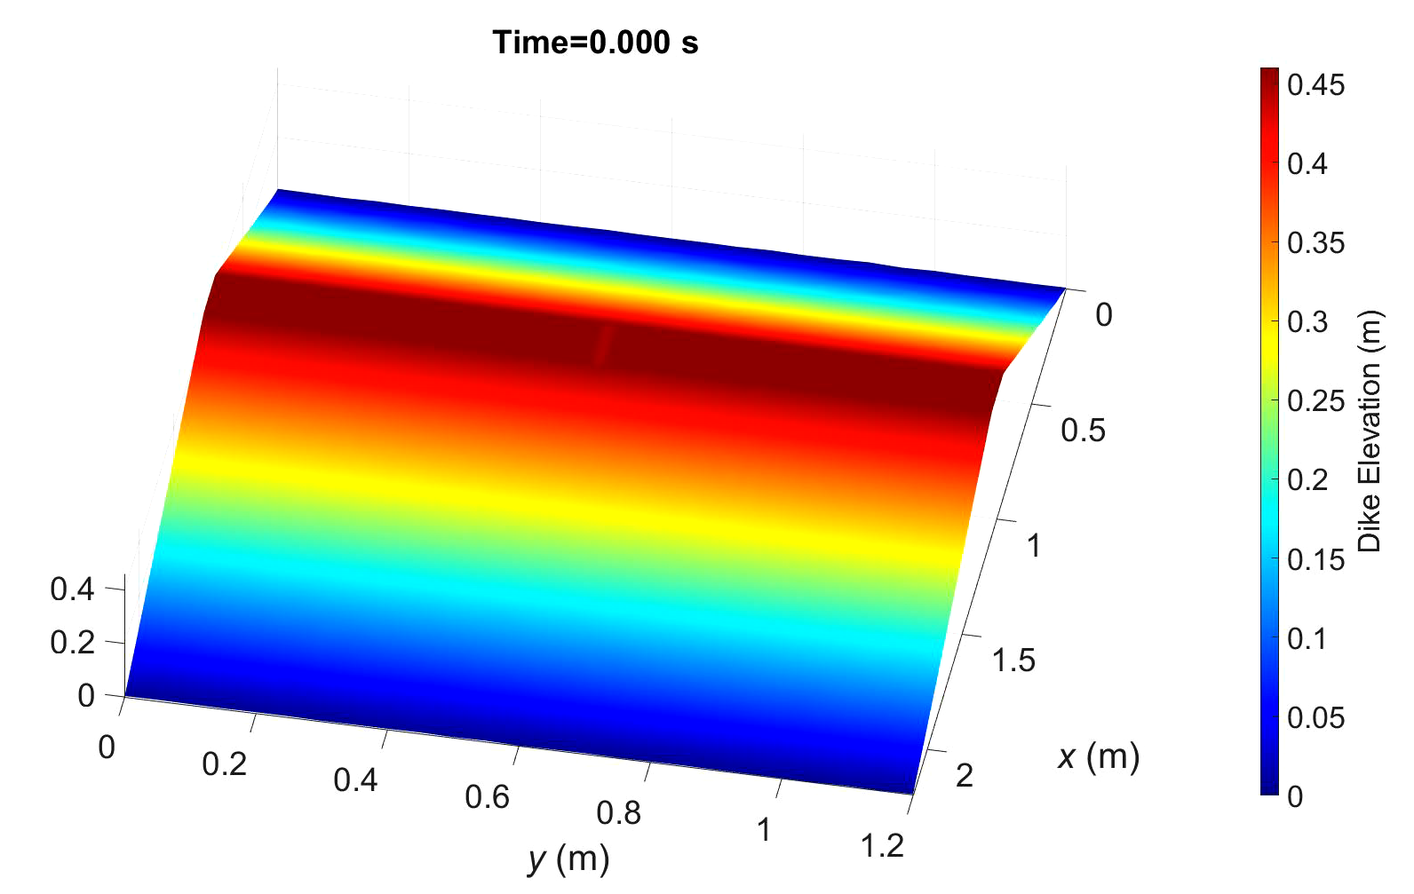
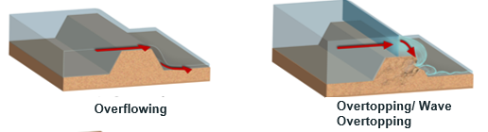
Earthen dikes role in a flood contol system Dike breach benchmark test (Alvarez et al. IAHR Congress 2022)
Main failure modes To fulfill the goal:
Photo: Vilda-Yves Adams
Notes:
Earthen dikes also known as embankments and levees are constructed along rivers and coastlines primarily to prevent flooding of adjacent land and to guarantee an integrated fluvial system in watersheds. For example, in Netherlands, systems of levees protect the country against flooding at different scales: with an approximate length of 12,000 km that are responsible to keep 60% of the country from flooding.
These defense structures are highly prone to breaching under river overflowing/overtopping and wave overtopping (in more than 50% cases these are failure cause).
The flood water flowing over the embankment, dike or levee’s crest is usually called overflowing with constant discharge or overtopping with varying discharge, and in some cases wave overtopping depending on the origin and form of hydraulic loading forms.
In the frame of the 6th workshop on River and Sedimentation Hydrodynamics and Morphodynamics, a blind benchmark test concerning progressive dam failure due to overtopping was offered to modelers in order to evaluate and calibrate their models in a blind phase (since they only provided limited data at this stage). We applied two depth-averaged finite-volume models based on the shallow-water Exner equations to this benchmark test to simulate the whole failure process.

Slide 3
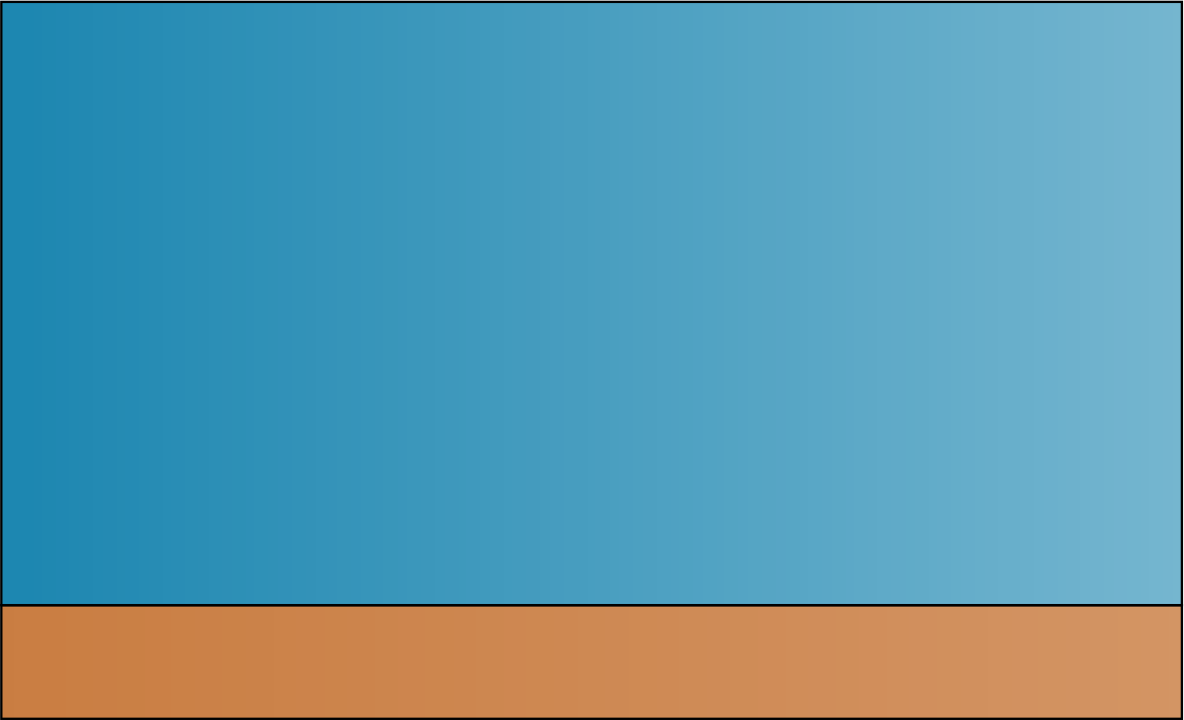

Governing Equations: Shallow-Water-Exner equations
Continuity equation
$\frac{∂h}{∂t}+∇⋅q=0$
Momentum equation (2D)
$\frac{∂q}{∂t}+∇⋅\left(σ+μ_{xy}\right)= gh\left(S_{0}−S_{f}\right)$
Exner equation
$\frac{∂z_{b}}{∂t}+\frac{1}{\left(1−ε_{0}\right)}∇⋅q_{s}=0$
$$h$$
$$q_{x}=uh$$
$$h_{s}$$
$$q_{s,x}$$
Notes:
Two main governing equations include Saint-Venant’s equations known as shallow-water equation and the Exner eq., While the Shallow-Water equations describes mass and momentum conservation for water in partial differential form the Exner equation accounts for the mass conservation of sediments and predicting the morphological evolution of the mobile bed.
Where 𝜎 is the vector of normal momentum fluxes in two direction and 𝜇_𝑥𝑦 the transverse momentum flux. The source terms S0 and Sf stand for bed slope and bottom friction.
Here qs refers to bedload transport rate or the sediment discharge through the mobile bed, and describes the bed level evolution due to erosion or deposition.

Slide 4
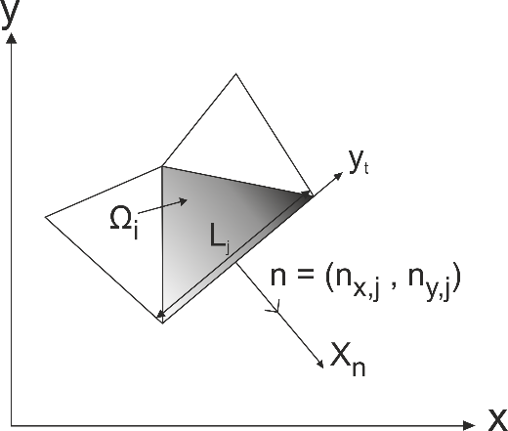
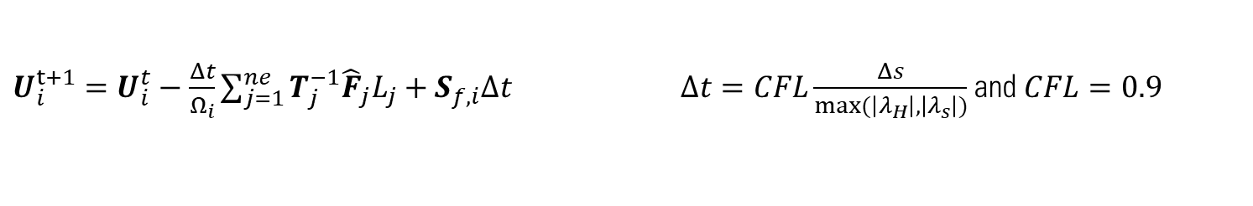
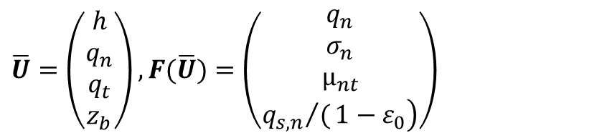
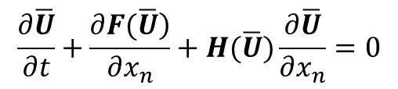
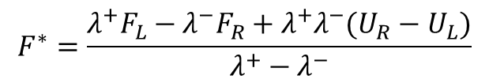
Numerical discretization
Coupled Model (CM) and Weakly Coupled Model (WCM):
$$\frac{∂\overline{U}}{∂t}+\frac{\left.∂F(\overline{U}\right)}{∂x_{n}}+H(\overline{U})\frac{∂\overline{U}}{∂x_{n}}=0$$
$$\overline{U}=\left(\begin{matrix}h \\ q_{n} \\ q_{t} \\ z_{b}\end{matrix}\right), F(\overline{U})=\left(\begin{matrix}q_{n} \\ σ_{n} \\ µ_{nt} \\ \left.{q_{s,n}}/(1−ε_{0}\right)\end{matrix}\right)$$
First-order finite-volume scheme
$U_{i}^{t+1}=U_{i}^{t}−\frac{Δt}{Ω_{i}}\sum_{j=1}^{ne}{T_{j}^{−1}{\hat{F}}_{j}L_{j}+S_{f,i}Δt}$ $Δt=CFL\frac{Δs}{max⁡(\left|λ_{H}\right|,\left|λ_{s}\right|)}$ and $CFL=0.9$
Hydraulic variables – Lateralized HLLC scheme
$$F^{∗}=\frac{λ^{+}F_{L}−λ^{−}F_{R}+λ^{+}λ^{−}(U_{R}−U_{L})}{λ^{+}−λ^{−}}$$
Notes:
These equations are commonly written together in vector form and are solved for a triangular cell. This is the principal equation for two finite volume models and depending on whether the hydraulic and sediment parameters are solved together simultaneously or separately it called as CM whereas if only weak links are considered between hydraulic and sediments parameter is know as WCM.
The abovementioned differential equations are solved then using a First order finite volume scheme. The stability is dictated by the (CFL) condition on the time step delta t.
Hydraulic variables are then calculated by applying a Lateralized HLLC solver to calculate the fluxes at the interfaces.

Slide 5
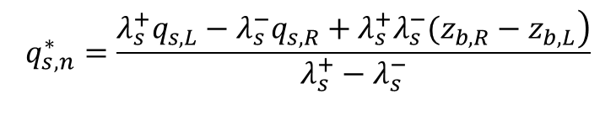
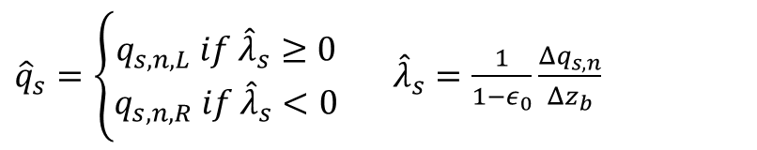
Coupled vs. Weakly Coupled : sediments variables
Coupled Model (CM):
Weakly Coupled Model (WCM):
${\hat{q}}_{s}=\left\{\begin{aligned}q_{s,n,L} if {\hat{λ}}_{s}≥0 \\ q_{s,n,R} if {\hat{λ}}_{s}<0\end{aligned}\right.$ ${\hat{λ}}_{s}=\frac{1}{1−ε_{0}}\frac{Δq_{s,n}}{Δz_{b}}$
$$q_{s,n}^{∗}=\frac{\left.λ_{s}^{+}q_{s,L}−λ_{s}^{−}q_{s,R}+λ_{s}^{+}λ_{s}^{−}(z_{b,R}−z_{b,L}\right)}{λ_{s}^{+}−λ_{s}^{−}}$$
Numerical simulations resume
Notes:
So what is exactly the difference between these two models? The main difference between two model is the way that sediment parameters are resolved: within the Coupled model the HLLC is applied also to the sediments parameters and sediments fluxes are always influenced by the left and right cells due to the presence of lambda + and – (which means information come from both neighboring cells.
However in WCM, information comes either from the left cell or the right cell depending on the sign of the new characteristic lambda s given the definition here.
This table summarizes all parameters that can influence the erosion and consequently breach progression which are examined in simulations. For example several closure equations are considered: MPM Van Rijn and Wong and Parker. Another key feature of the model is the Bank failure operator which accounts for the failure of the local steep slopes based on the simple geotechnical considerations.

Slide 6
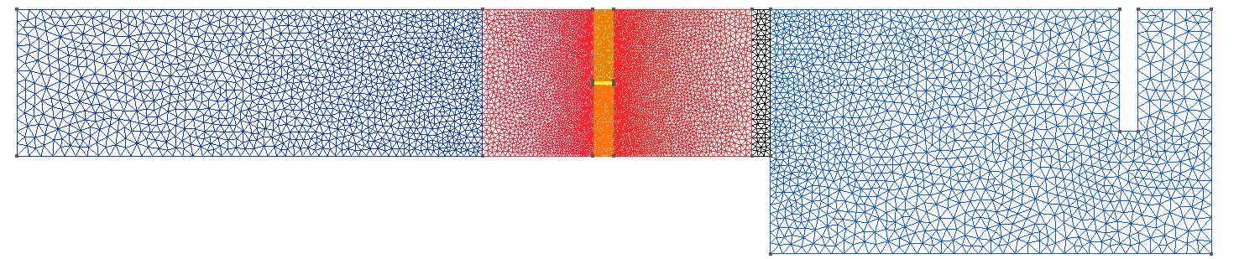
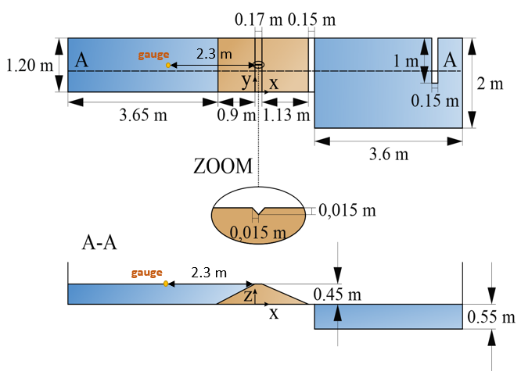



Boundaries
$$(b)$$
Open boundary conditions
5 cm
1.5 cm
$$(a)$$
10 cm
$(a)$ Inflow hydrograph
Notes:
These two models are applied to this benchmark test: the dike with a height of 45 cm is built over the entire width of channel.
The boundary condition at the upstream of the dam is a combination of 45 cm water depth and the injection of an increasing discharge at the inlet located far from the dam to avoid any perturbation.
A Gague located in the upstream reservoir record continously the water level evolution during test. This water level evolution was the only evidence offered to modelers to evaluate their models in the blind phase.

Slide 7

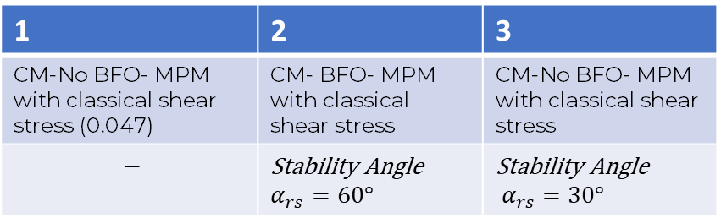

Coupled Model: Influence of BFO
1-NoBFO
2-BFO
3-BFO
$α_{rs}=60°$
$α_{rs}=30°$
1 | 2 | 3
CM-No BFO- MPM with classical shear stress (0.047) | CM- BFO- MPM with classical shear stress | CM-No BFO- MPM with classical shear stress
$$−$$ | Stability Angle $α_{rs}=60°$ | Stability Angle $α_{rs}=30°$
Notes:
How does the BFO influence the process ? Small paranteses: Better results by 1-cm increasing crest level in CM. Then to study the influence of Bank Failure Operator, simulations were repeated without and with BFO with the same closure equations. The stability angel for local bank failures are incresed from No.2 to No.3 as well which allows for more widening of the breach.
The water level falls highly from left to right and even without BFO a decrease of 10 cm is seen during the first 500 s Due to the fast erosion rate.

Slide 8


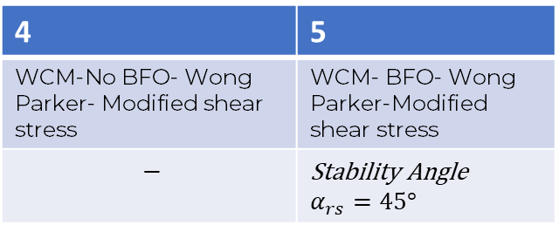
Weakly Coupled Model: Influence of BFO
4-NoBFO
5-BFO
$α_{rs}=45°$
4 | 5
WCM-No BFO- Wong Parker- Modified shear stress | WCM- BFO- Wong Parker-Modified shear stress
$$−$$ | Stability Angle $α_{rs}=45°$
$τ_{∗c}$=0.26
time(s)
Notes:
The same sensitivity analysis were done on the WCM. The model is able to reproduce the water level evolution to a high extent specially without the BFO to even reach the experimental values at the end of the test. With the BFO the breach widening is more important hence the important fall in the water level.

Slide 9
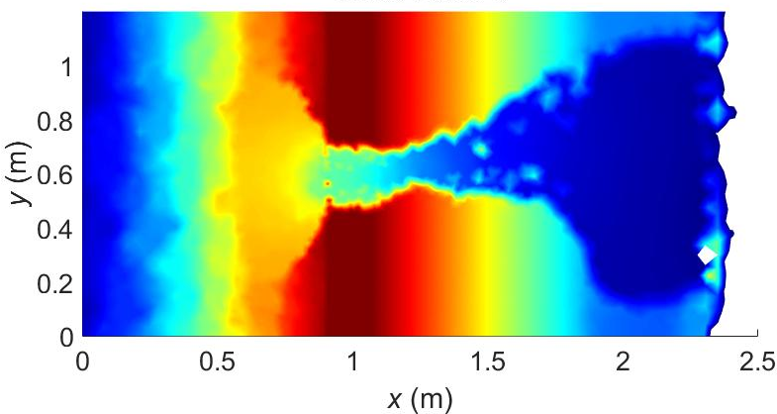
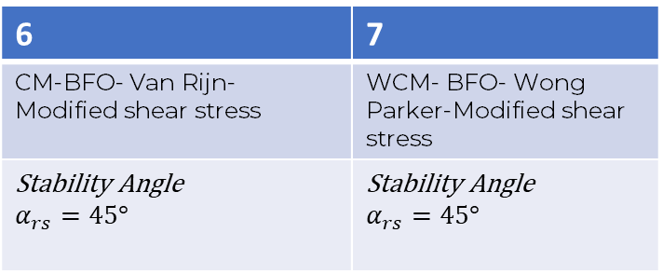
CM and WCM comparison
6-CM-BFO
7-WCM-BFO
6 | 7
CM-BFO- Van Rijn- Modified shear stress | WCM- BFO- Wong Parker-Modified shear stress
Stability Angle $α_{rs}=45°$ | Stability Angle $α_{rs}=45°$
Notes:
To compare the two models, the CM results with Van Rijn Formula and WCM with Wong Parker formula are compared in presence of BFO.

Slide 10
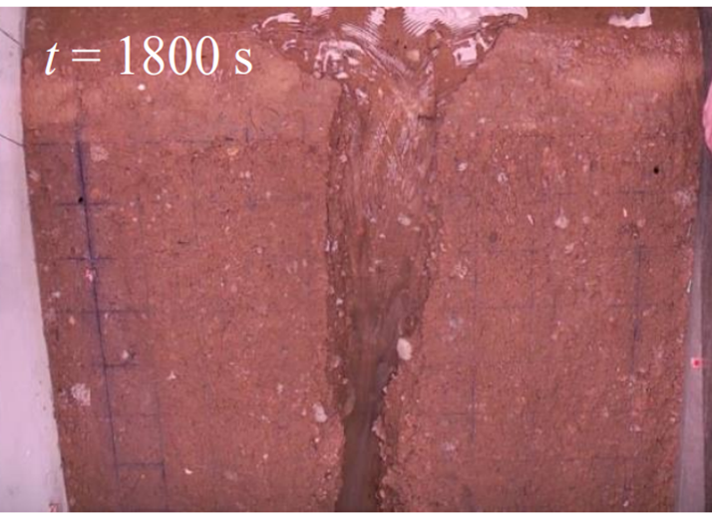
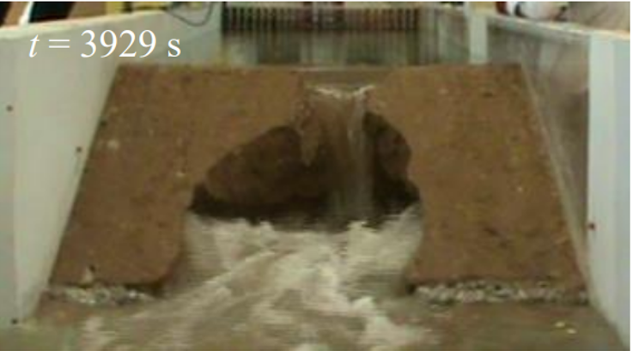
Summary & Conclusion
2D Shallow-water equations coupled and decoupled from Exner equation
Finite-volume model
  HLLC solver for hydraulics
  HLLC solver for sediment in CM vs. upwind strategy in WCM model
Results
  Without BFO – final water level is relatively close but unphysical sandy heaps
  With BFO – increase of the breach width, decrease of the water level,
  but reduction of the heaps’ slopes
Sensibility of simulations to: (i) sediment transport formulas
(ii) Stability Angle
(iii) Critical shear stress
Failure time and erosion progression speed
Dam Compaction
Erosive behaviour of sediments
Notes:
*WCM could reproduce the reservoir's water level evolution well and could better predict the breach discharge and potentially width growth while the CM produces a more realistic breach widening, however too fast.
*CM led to faster dam erosion and a more a rapid decrease in the reservoir's water level.

Slide 11



Thank you for your attention !
Contact: Masoumeh.ebrahimi@uclouvain.be

Slide 12
Resume of studied scenarios
Notes:
I will explain a series of scenarios implemented in order to gain the most out of numerical simulations the results

