Slide 1
Identifying the Drivers of Citizens’ Defence Readiness Across Europe
The Respective Role of Identities, Attitudes, Threat Perception and Geopolitical Narratives

Slide 2
Collective defence readiness: why it matters
Decaying international liberal order
Small and middle power need to learn to defend themselves, especially when bordered with imperialistic great powers
War are fought between entire systems not just armies
In democracy, citizens support to defend their political system is the precondition to continued resistance to an armed aggression
→Research Question: what are the drivers of citizen’s defence readiness across Europe ?

Slide 3
Collective defence readiness
The perceived level of readiness to personally commit to the collective defence in a direct (e.g., fight in the military) or supportive way (e.g., take part in the military logistic).
Psychological readiness rather than “factual readiness”
Bidimensional, 4 items, 7-point Likert scale, contextualized to a given conflict, and a given group
  item 1: fight for your country
  item 2: enlist in the military to receive training and join a combat unit
  item 3: contribute to the war effort to the best of your abilities
  item 4: enlist in the military to receive training and join a non-combat unit (support, logistics, office work)

Slide 4

Theoretical outlook
Jim Orford’s On the Warpath
  Theoretical work on the support for war, proxi for defence readiness
  Not empirically tested as a model
  Psychology has neglected the study of war support
  Normative side: psychology should see how to prevent war by acting on its drivers at the individual level (limit of that argument: under what political system can we act towards it?)
Identified drivers
  Identity: in-group identification, patriotism, nationalism, out-group dehumanization
  Threat: existential threat perceived, world seen as a dangerous place
  Attitudes: war seen as legitimate under certain condition
  Simplified thinking: demonization of the enemy, black or white, no compromises, zero-sum game thinking, group thinking

Slide 5
War: « a collectively organized violence between organizations which have political purposes. » (Orford, 2023, p. 14)
« We may have our own individual thoughts and emotions concerning war, but it is how we collectively support war which counts in the end » (Orford, 2023, p. 14)

Slide 6
Hypotheses
Collective defence readiness is best predicted by
  Identification with the in-group
  Sense of threat to which someone feels ready to defend its group
  More positive attitudes towards war

Slide 7
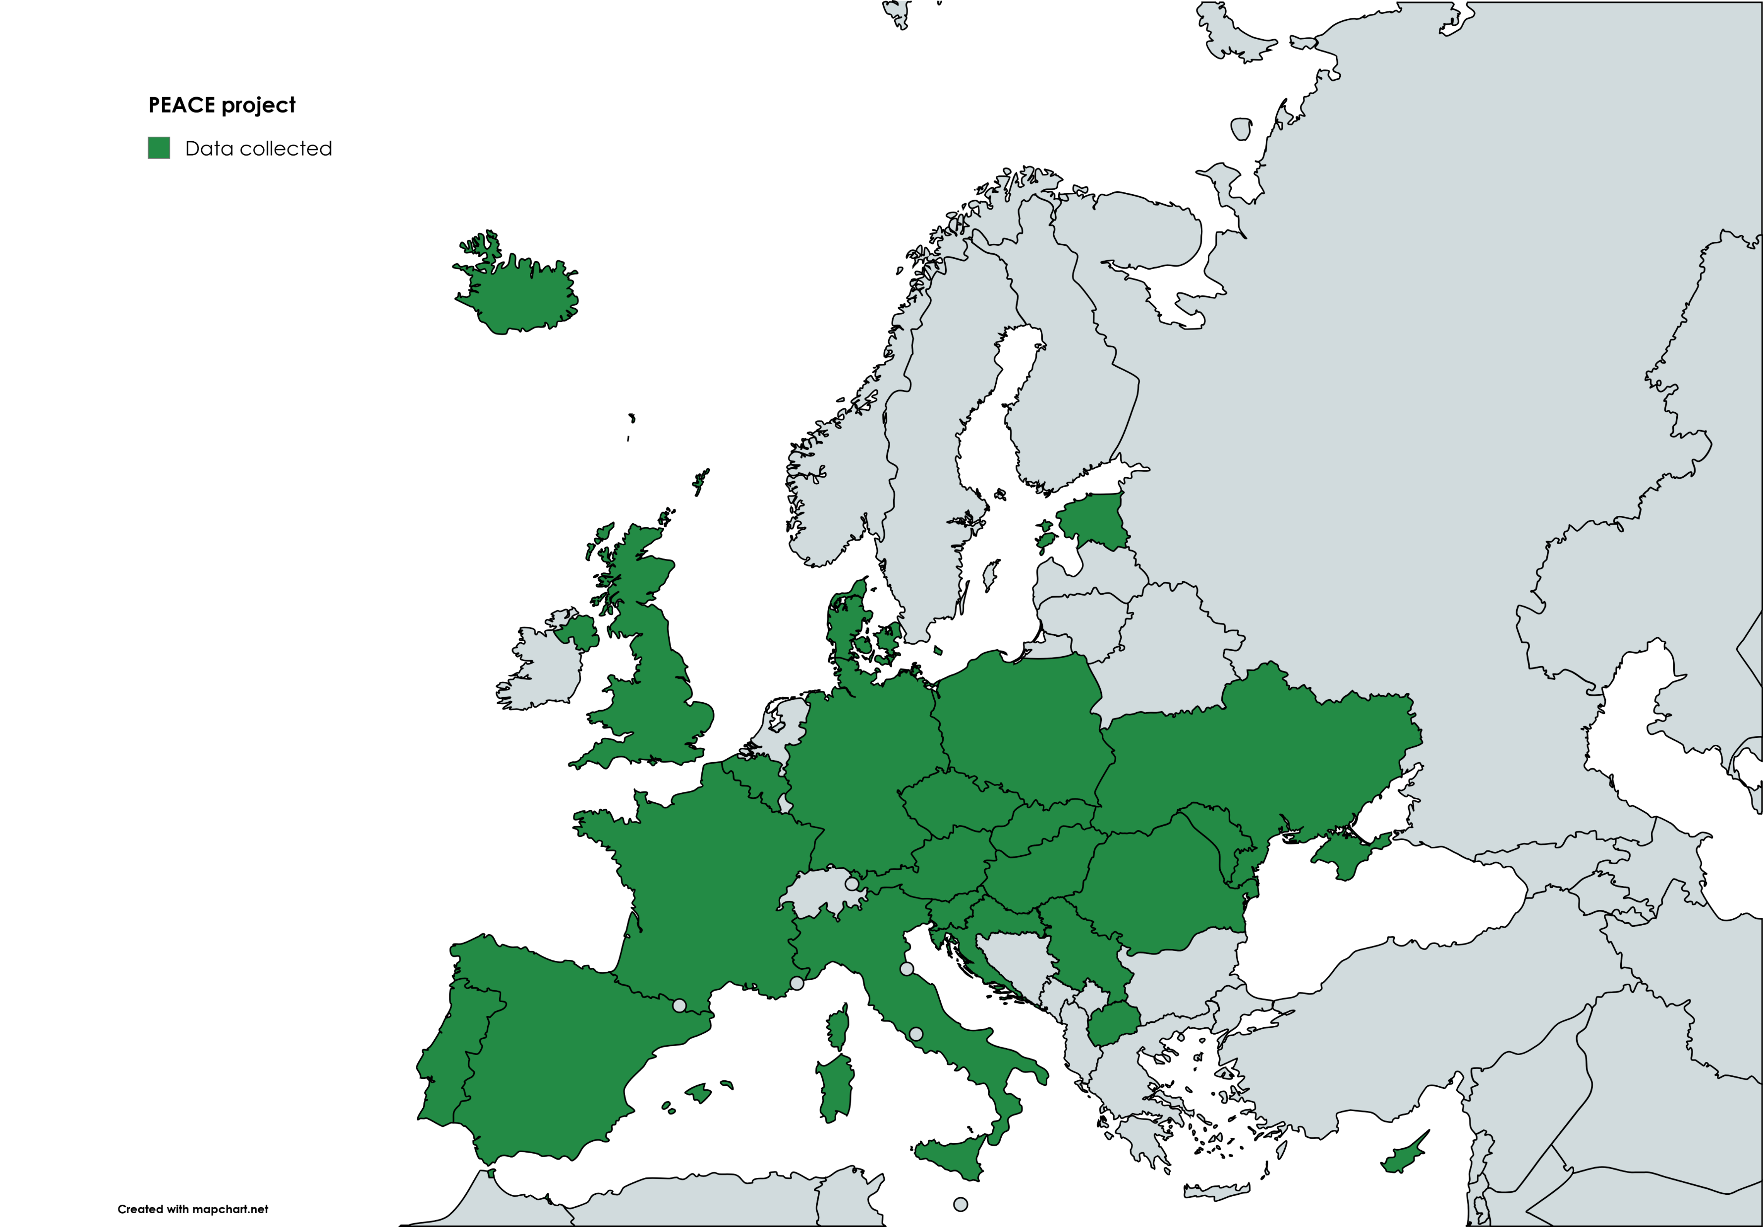
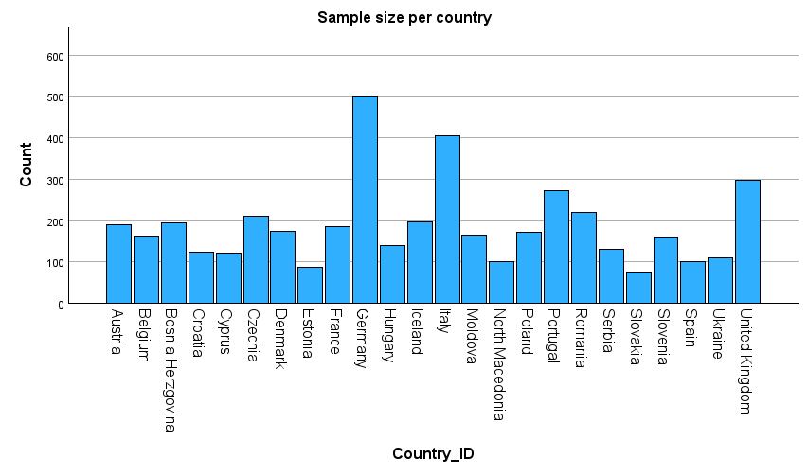
Sample
Students
24 countries
N > 4400

Slide 8
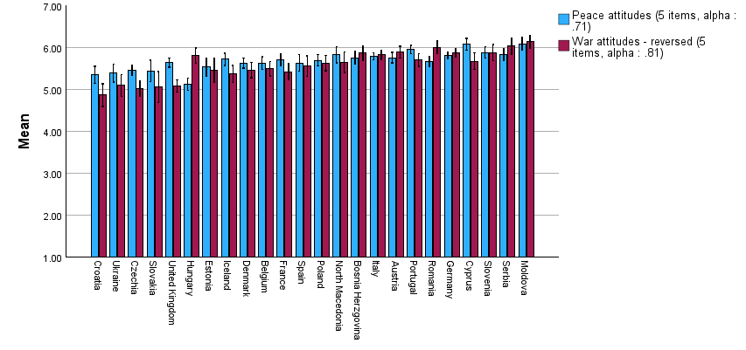
Peace and War attitudes
APWS (Bizumic et al., 2013; Van der Linden et al., 2017): bidimensional scale
General peace attitudes
  Our country's first priority should be world peace
  We must devote all our energy to securing peace throughout the world
  I believe that peace is extremely important
  Peace brings out the best qualities in a society
  In general, I am not too concerned about peace in the world
General war attitudes
  There is no conceivable justification for war
  War is sometimes the best way to solve a conflict
  War is a futile struggle resulting in self-destruction
  Under some conditions, war is necessary to maintain justice.
  Although war is terrible, it has some value.
Notes:
Hungary: interesting case: anti-war but no so convinced about peace (Orban effect? But low alpha for peace!

Slide 9
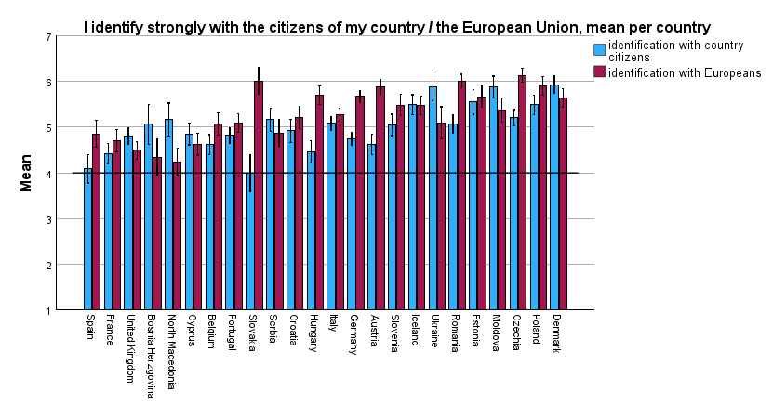
Identity

Slide 10
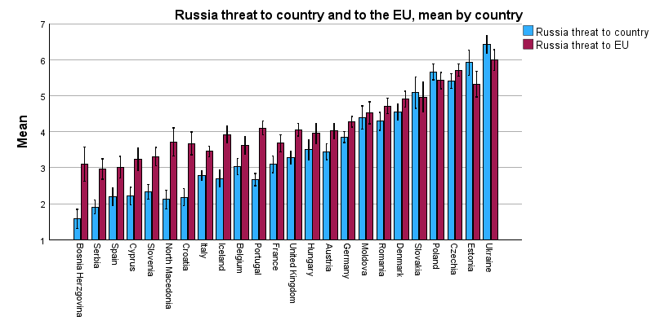
Threat level of Russia

Slide 11
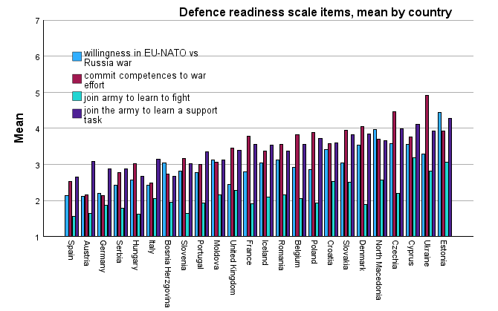
Collective defence readiness (1)

Slide 12
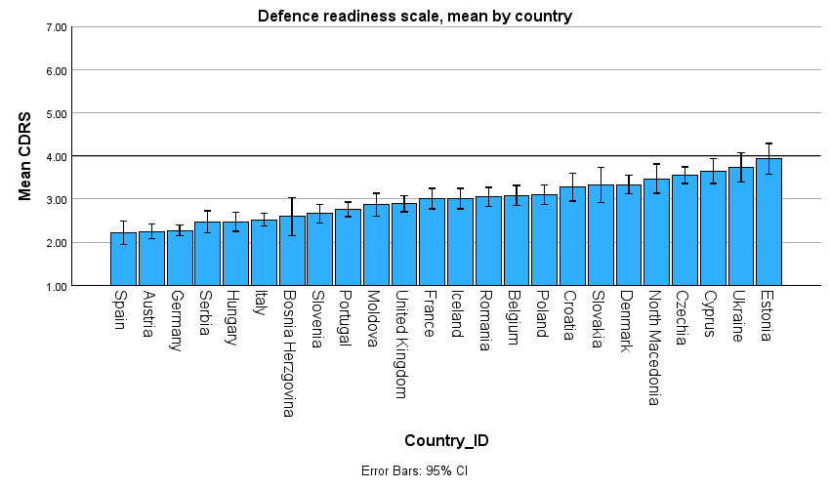
Collective defence readiness (2)

Slide 13
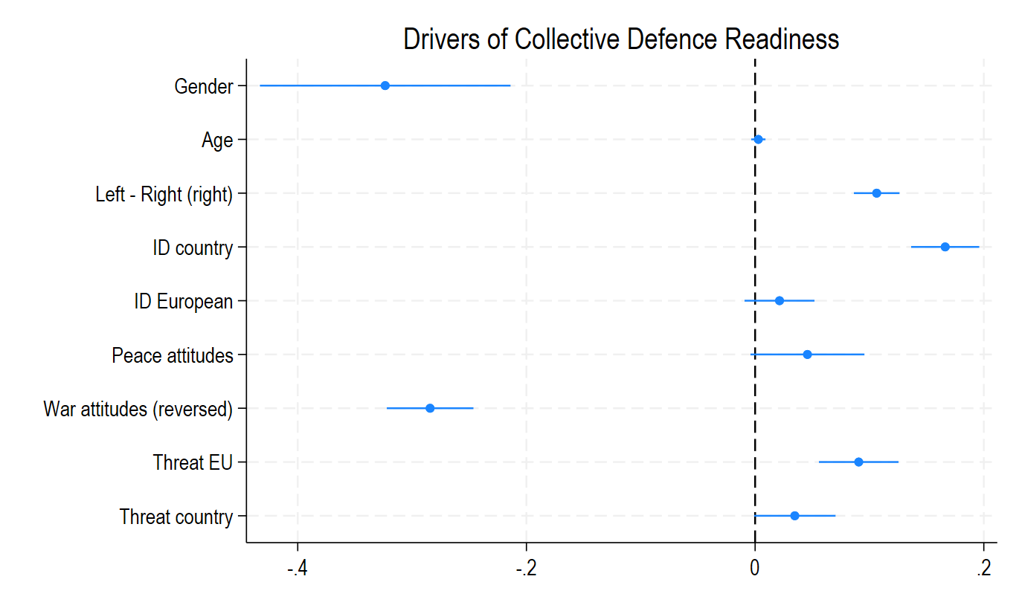
Analysis: multilevel regression

Slide 14
Effect size: what explains most defence readiness (to do)

Slide 15
Discussion
Hypotheses: corroborated
Effect size: medium to small
Cumulative and co-construction of the different elements (threat can only exist because social ID exists)
Securitization theory but human grounded, rather than speech grounded: two sides of the same coin
Importance: threat against the EU is associated with defence readiness in a war between NATO and Russia
Correlational results: reversed causality, other underlining variable ; but strong theoretical background + empirical results

Slide 16
Further down the road
Memorialization of past conflict (e.g., WWII)
  Significative and sizable effects (exploratory analyses)
  Reproduce in time social identities (enemies/friends), the legitimacy of armed action, the role of citizens towards their political system (sacrifice, disobedience)
  To be further studied: respective effect of familial and official memories
  « When I started on this project, like many of my compatriots I had in mind the Second World War, the war in which my father served. When, in Britain, we talk of the war or use expressions like post-war, it is that war we understand is being referred to. » (Orford, 2023, p. 15-16 »
Distinction between identity fusion and social identity
  Useful as mechanism
  OR as a predictor
  OR as a measure
Shape of identity: open vs closed, important?

Slide 17
Question: the role of academics
Further the readiness of citizens to face an armed aggression ; but potentially precipitate a war?
Question threat assumptions?
Bring complexity in “oversimplified discourses”?
Study the “mechanisms” without reflecting on their application?
Avoid both the pitfall of naïve pacifism, and naïve realism

