Slide 1


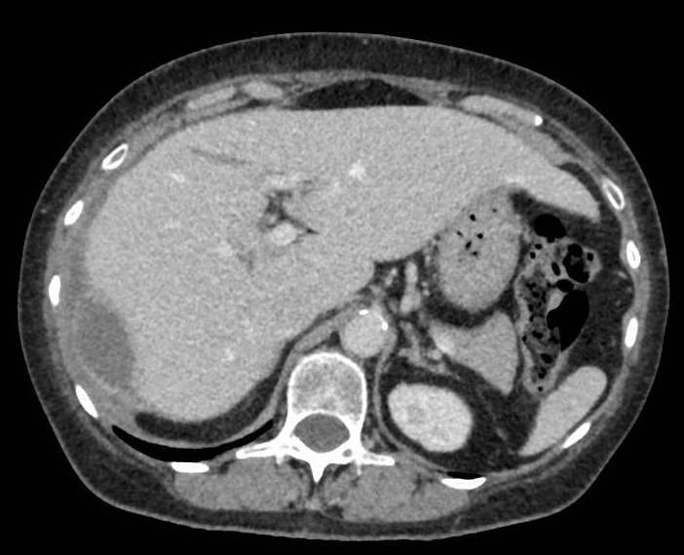
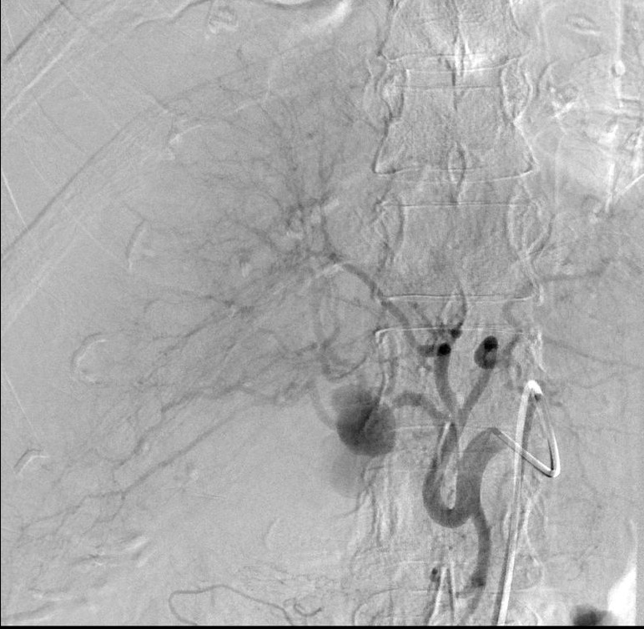
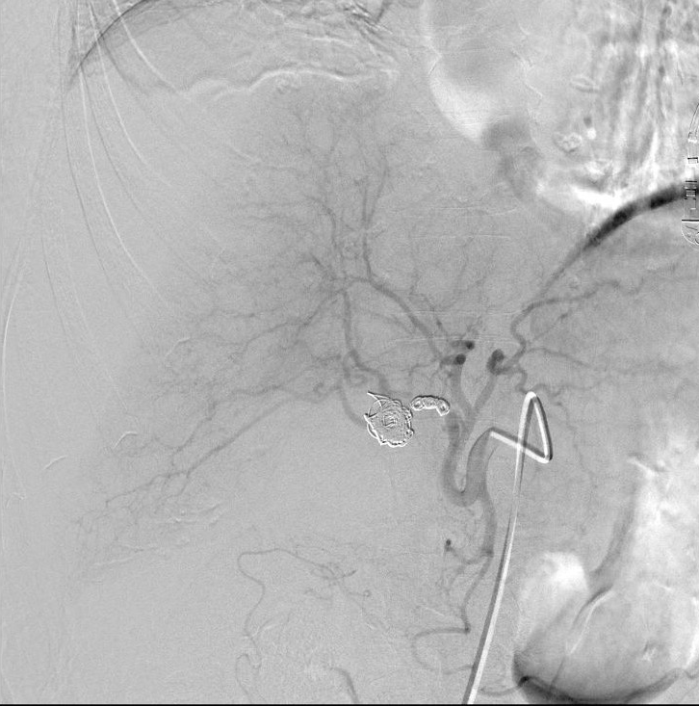
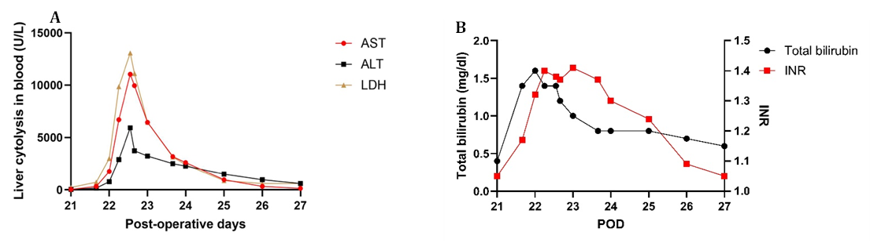
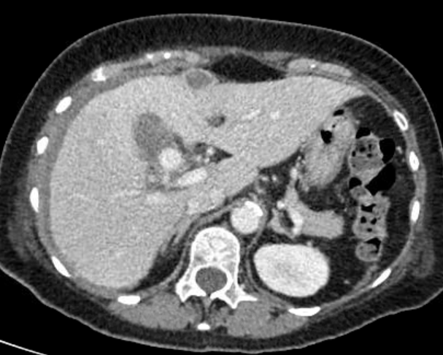
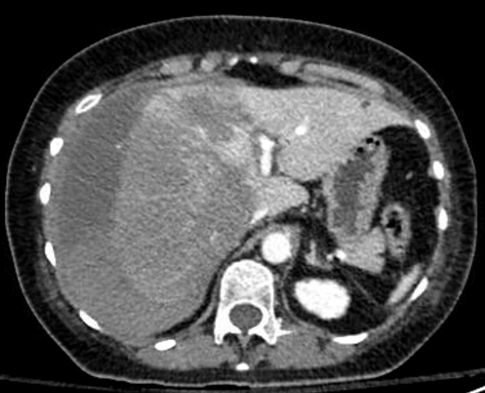

Conservative Management of Acute Hepatic Compartment Syndrome Following Rupture of a Hepatic Artery Pseudoaneurysm
Sheena Castiaux, Maxime Foguenne, Lancelot Marique
Liver and Pancreas Unit, Service de Chirurgie Abdominale et Transplantation, Cliniques Universitaires Saint-Luc, Brussels, Belgium.
Introduction
Angiography revealed a modal arterial anatomy with a pseudoaneurysm originating from main trunk of right branch of hepatic artery (Figure 3A). Selective embolization was achieved (pseudoaneurysm and right branch of hepatic artery). Completion angiography confirmed preservation of residual right hepatic parenchymal perfusion through vicariance from left side (Figure 3B).
Despite effective hemostasis, liver cytolysis continued to rise up to 365N (AST =11057 IU/L and ALT =3926 IU/L) (Figure 2A).
On POD22, liver function pursued its degradation: increase in the international normalized ratio =1.4 (ref: 0.90 – 1.15), total bilirubin =1.6 mg/dL (ref: 0.2 à 1.2 mg/dL), compared with 0.4 mg/dL 24 hours earlier and factor V = 49% (compared with 92% earlier the same day)
(Figure 4 A,B).
At this stage, the diagnosis was established : Acute Hepatic Compartment Syndrome
A follow-up CT scan performed two months later showed near-complete resolution of the subcapsular hematoma and restored hepatic perfusion (Figure 5). Follow-up was subsequently discontinued.
Hepatic compartment syndrome (HCS) is a rare but life-threatening condition caused by increased intrahepatic pressure, leading to vascular compromise and acute liver failure1.
It has been described in various contexts, including trauma, liver transplantation, interventional procedures, and spontaneous or iatrogenic subcapsular hematomas.
Surgical decompression is widely considered the standard treatment, especially in cases of rapid clinical deterioration1,2.
Objective :
To report a case of acute HCS successfully managed nonoperatively after rupture of a hepatic artery pseudoaneurysm.
A
B
Case report
A 75-year-old woman with a medical history of arterial hypertension, sigmoid diverticulitis, acute pyelonephritis, and prior appendectomy.
Admitted for acute cholecystitis; treated by cholecystostomy.
Two months later : elective laparoscopic cholecystectomy with intraoperative cholangiography (normal) and discharged on postoperative day (POD) 1.
POD11, the patient was readmitted for an infected surgical site collection → interventional ultrasound–guided drainage.
Despite broad-spectrum antibiotic therapy, the patient developed persistent fever, tachycardia, and de novo anemia.
Abdominal computed tomography (CT) performed on POD16 revealed a subcapsular hepatic hematoma, without evidence of active bleeding.
On POD21, the patient developed refractory arterial hypertension (BPs >160–200 mmHg and BPd >100–120 mmHg).
This was associated with liver cytolysis, (AST = 330 IU/L (ref: <40 IU/L) and ALT = 164 IU/L (ref: <49 IU/L)).
Contrast-CT demonstrated a pseudoaneurysm located on the right branch of the hepatic artery, with significant enlargement of the subcapsular hematoma, suggesting ongoing low-grade bleeding (Figure 1). Transarterial embolization was planned on POD22.
During the night between POD21 and POD22, the patient acutely deteriorated and developed an acute abdomen.
Emergency repeat CT demonstrated pseudoaneurysm rupture associated with an extensive hepatic hypoperfusion involving the right and part of the left lobe, massive expansion of the subcapsular hematoma, and multiple secondary hemorrhagic foci (Figure 2). Liver cytolysis majored rapidly (AST =1756 IU/L and ALT =776 IU/L). Urgent embolization was therefore performed overnight.
Figure 3 A: Pseudoaneurysm of the right branch of the hepatic artery (arrow). B: Post-embolization cholangiography showing preservation of residual right hepatic parenchymal perfusion through vicariance from left side
Figure 5: Two month later Ct-scanner showed nearly complete resolution of the subcapsular hematoma and restored hepatic perfusion.
Discussion
Hepatic compartment syndrome is a rare but life-threatening condition.
Recent reports emphasize the importance of early recognition and urgent surgical intervention.
However, this case suggest that conservative management may be feasible in highly selected patients, provided that :
Effective control of bleeding is achieved
Residual vascularization is preserved
Close multidisciplinary monitoring (hemodynamic, biochemical, and Doppler monitoring) is ensured under intensive care
This highlights the potential role of careful risk stratification in acute hepatic compartment syndrome. And may identify a highly selected subset of patients in whom nonoperative management can be considered.
Doppler ultrasonography appears particularly useful for assessing hepatic perfusion dynamics and guiding close surveillance in this context3.
Conclusion
Although surgical decompression remains the recommended first-line treatment for hepatic compartment syndrome, this observation suggests that conservative management may be feasible in exceptionally selected cases after effective hemostasis and under strict multidisciplinary monitoring. This isolated experience does not challenge current recommendations but supports further research aimed at defining predictive factors for safe nonoperative management.
References
Figure 4 : graph representing liver cytolysis (A) and liver function markers (B) according to postoperative days.
1. Nassar A, Braquet T, Aussilhou B, Ronot M, Weiss E, Dondéro F, Lesurtel M, Dokmak S. Hepatic compartment syndrome, a rare complication after any liver insult or liver transplantation: Three case reports and literature review. Ann Hepatobiliary Pancreat Surg. 2024 Aug 31;28(3):283-290. doi: 10.14701/ahbps.24-040. Epub 2024 Jun 13. PMID: 38867651; PMCID: PMC11341880.
2. Nissen NN, Geller SA, Klein A, Colquhoun S, Yamini D, Tran TT, Weinberg B, Winn J, Poordad F. Percutaneous liver biopsy after living donor liver transplantation resulting in fulminant hepatic failure: the first reported case of hepatic compartment syndrome. J Transplant. 2010;2010:273578. doi: 10.1155/2010/273578. Epub 2010 Apr 8. PMID: 20396383; PMCID: PMC2852596.
3. Ando Y, Ishigami M, Ishizu Y, Kuzuya T, Honda T, Hayashi K, Ishikawa T, Goto H, Hirooka Y. Utility of Doppler ultrasonography for diagnosing and assessing treatment effects in liver compartment syndrome. Clin J Gastroenterol. 2017 Jun;10(3):265-269. doi: 10.1007/s12328-017-0741-4. Epub 2017 Apr 26. PMID: 28447328.
A
B
Figure 1 : Pseudoaneurysm of the right branch of the hepatic artery (arrow). Associated hematoma with subcapsular extension (asterisk).
Intervention
Despite the severity of the biochemical injury, a conservative management strategy was adopted:
Close monitoring in the intensive care unit.
Laboratory monitoring,
Transfusional support,
Short-term antifibrinolytic therapy guided by thromboelastometry.
Serial Doppler-ultrasonography was performed and demonstrated a patent portal vein with alternating hepatopetal and hepatofugal flow patterns, consistent with hepatic compartment syndrome.
Acknowledgements
Acknowledgements might go here.
Contact Information
Sheena CASTIAUX
Address | Tel: 02 764 1479 Email: sheena.Castiaux@gmail.com
Results
From POD 23 onward, liver function tests progressively improved without any need for surgical decompression.
A spontaneous improvement was subsequently observed, with a decrease in the international normalized ratio to 1.24 and factor V levels reaching 70%. These improvements continued over the following days (Figure 4 A,B).
Patient was discharged on POD 27 after normalization of laboratory tests and significant clinical improvement (Figure 4 A,B).
Figure 2 : Rupture of the right hepatic artery branch aneurysm, complicated by a hypoperfusion of the hepatic parenchyma (arrows) and massive expansion of the subcapsular hematoma, (asterisks).

