Slide 1



How to optimize dam-flushes to limit their downstream impacts?
Robin Meurice
Supervisor : Sandra Soares-Frazão
e-mail : robin.meurice@uclouvain.be
Notes:
Hello everyone, I’m Robin Meurice from UCLouvain in Belgium and my talk today will concern dam-flushes and a temptative numerical model to optimize them.

Slide 2
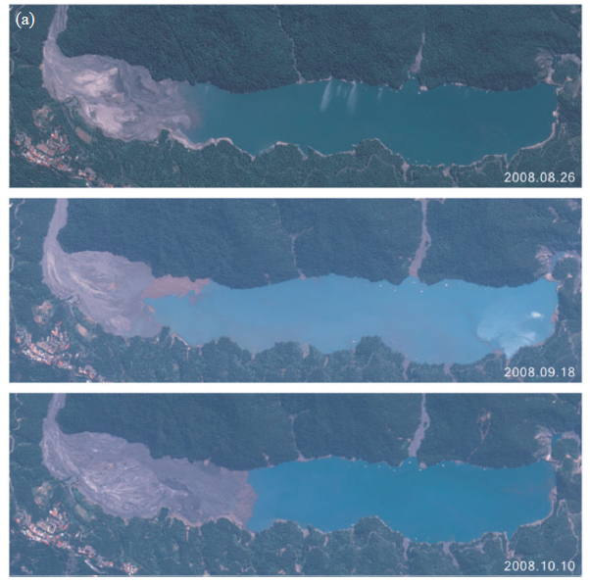
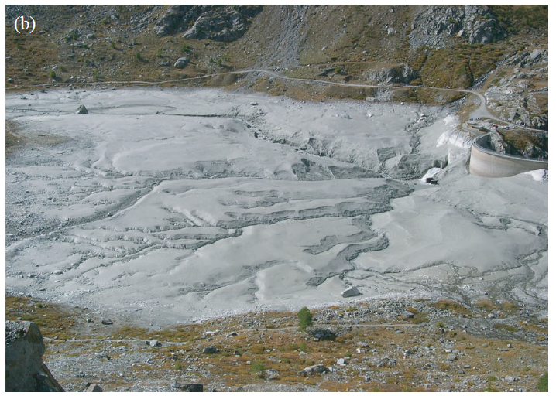
Introduction
Sedimentation
Turtmann reservoir, Switzerland
Wushe reservoir, Taiwan
Schleiss et al. (2016)
Notes:
Let’s insist on every meaningful word here. First of all: what is a dam-flush? Flushes are a solution to reservoir sedimentation which corresponds to the continuous accumulation and deposition of sediment transported from the watershed into the reservoir. If nothing is done, the capacity of the dam can eventually reduce to nothing and the dam can become completely useless.
You can see here two examples of dams that suffered greatly from sedimentation and whose capacity severely reduced.
Currently, 0.5% to 1% of the global reservoir capacity is lost each year and 5% to 10% is already occupied by sediment. It is hence far from negligible and as usually, it is far from being equally distributed spatially.
And moreover, besides sedimentation upstream of the dam, the blockage of the sediment can lead to important morphological and ecological consequences on the downstream river such as bed granulometric changes, delta sinking or biogeochemical alterations.
A solution must hence be found to cope with these issues and flushing is one technique among others.

Slide 3
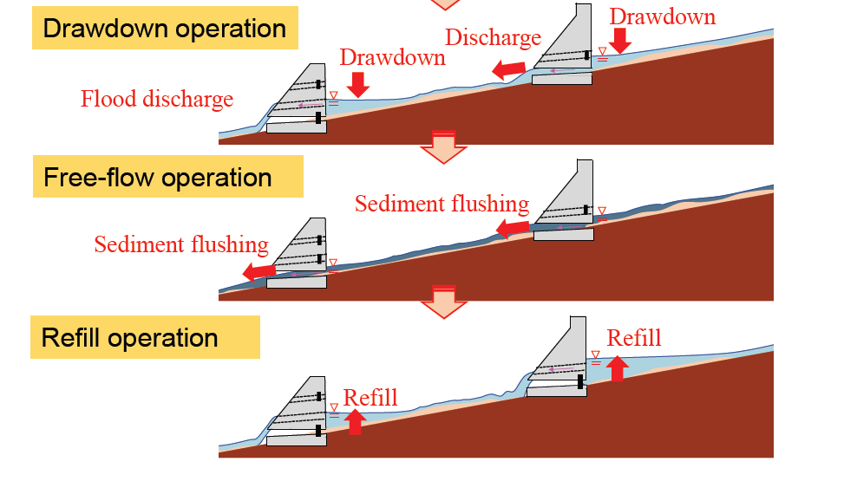
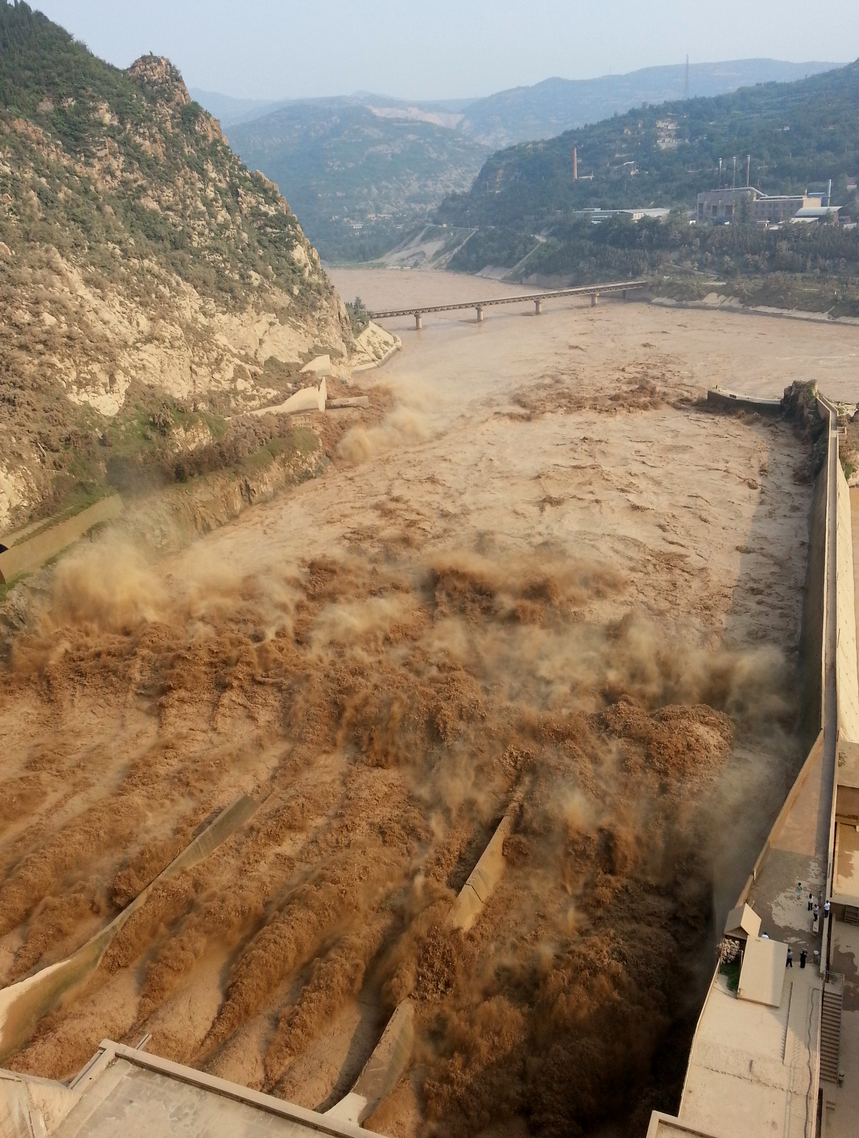
Introduction
Flushing
Flushing procedure
Fukuoka & Suzuki (2020)
Sanmenxia dam, Yellow River, China
ICOLD (2009)
Notes:
Now, what does actually a flush consist in? Different types of flush exist but what we are concerned with here is a drawdown flush, which consists in the decrease of the water level in the reservoir followed by a free-flow operation at high velocity and shallow depth with maximum transport capacity to remobilize as much sediment as possible. Because of these conditions, the concentration of suspended matter can increase dramatically as you can see on the right panel. And as a consequence, there might be problems downstream.

Slide 4
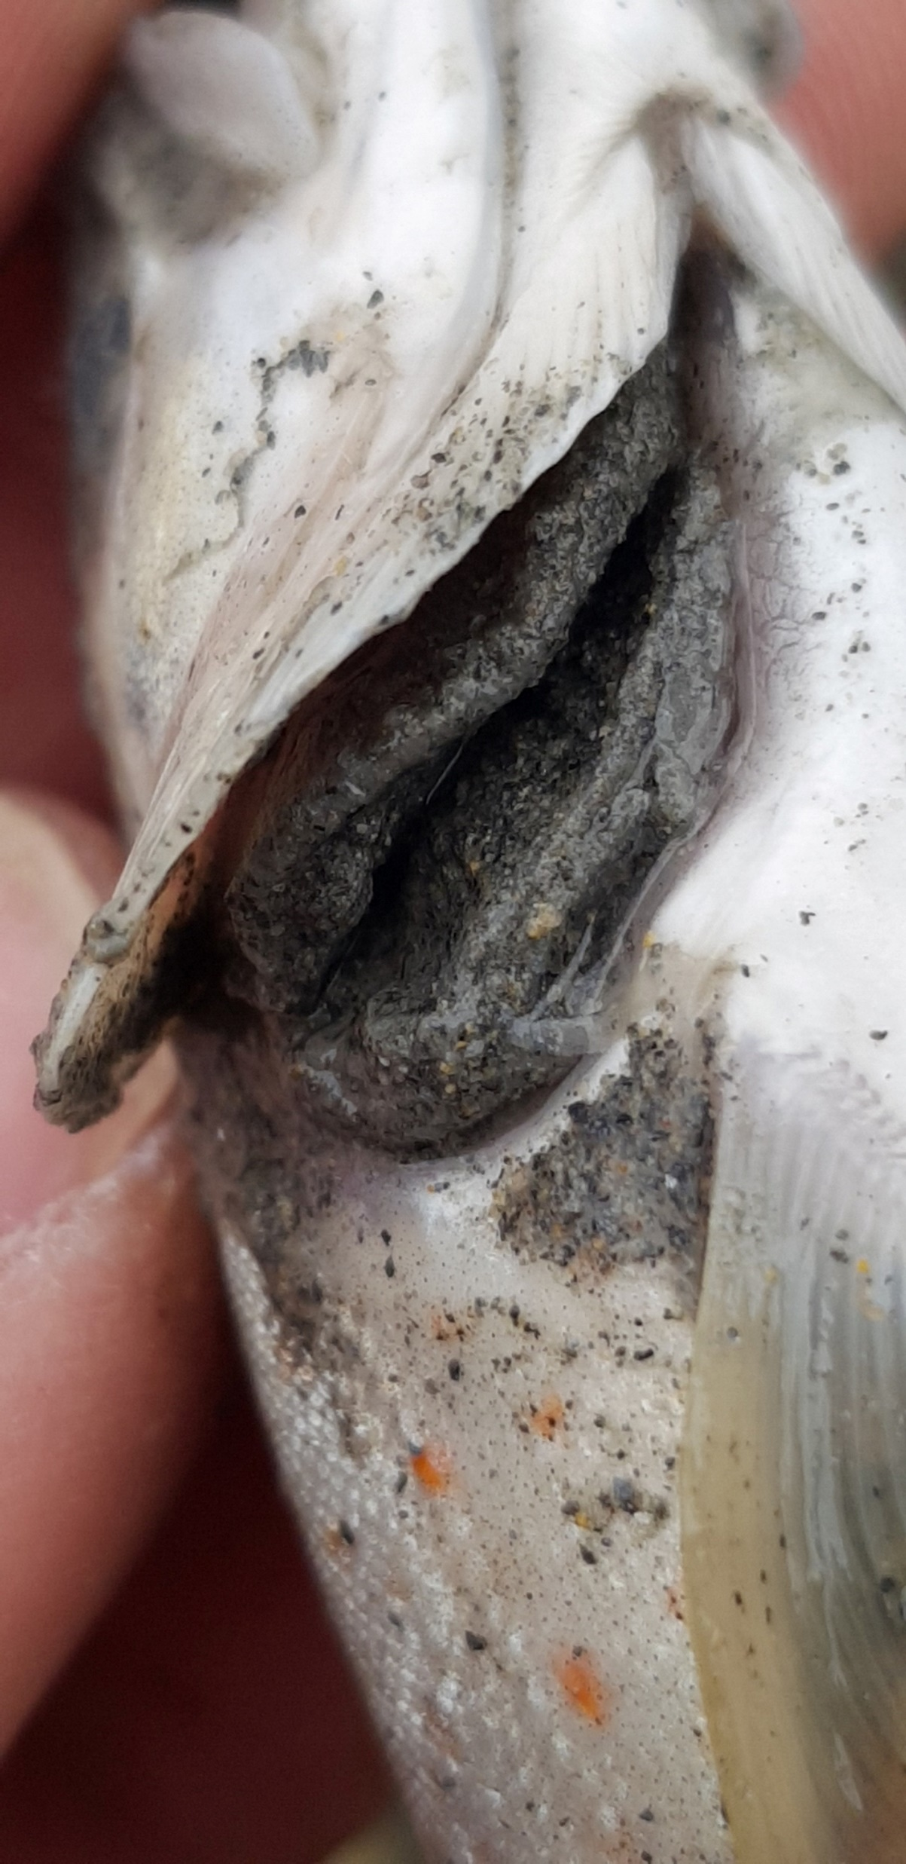
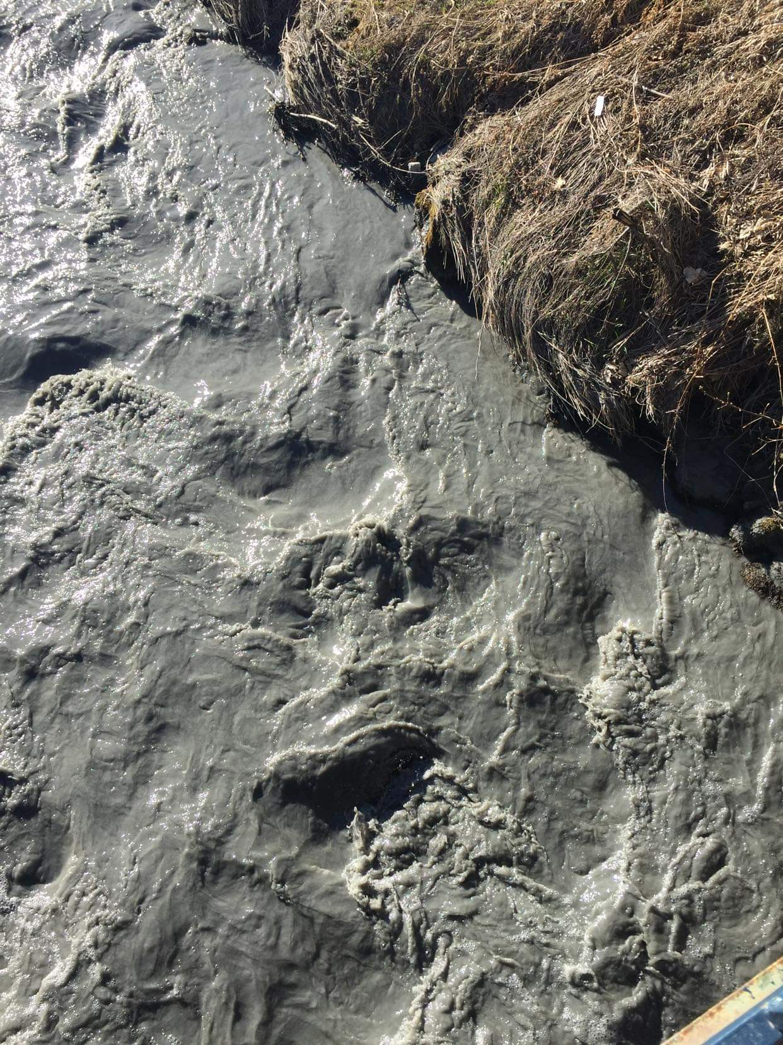
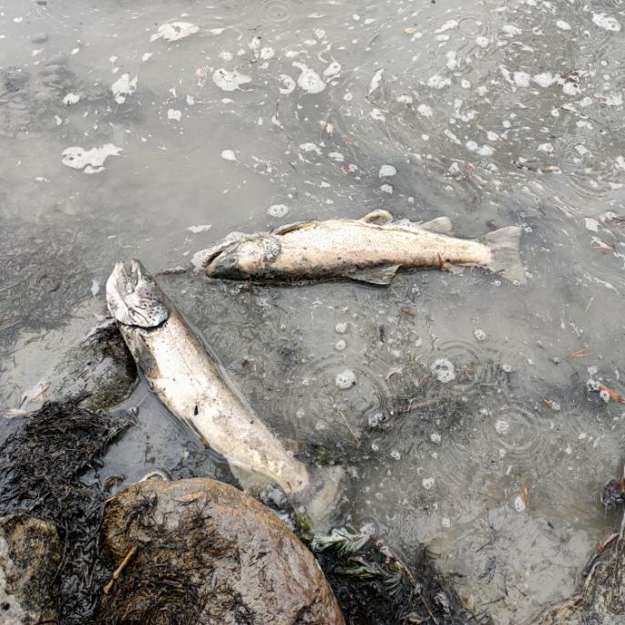
Introduction
Durance, April 2022
Fédération de Pêche des Hautes-Alpes, 2022
Notes:
Here you can see a few pictures that were captured on the Durance river after a flush on one of its tributaries in April 2022. While the concentration of suspended matter was meant to be limited around 10 g/l approximately, peaks around 200 g/l were measured every day of the flush, with a maximum at 616 g/l. Of course, the fish that were not saved from this mud did not survive as the increase in suspended matter comes with a depletion of the oxygen rate in the water and as the gills of the fish were blocked by the sediment, as you can see on the first picture.
So in these conditions, what does it mean to optimize dam-flushes? In my perspective, it means that we want the flush to be effective, that it removes a large amount of sediment from the reservoir with as little water as possible, while keeping the downstream impacts limited.
The goal of my thesis is hence to develop a numerical model that is able to reproduce dam-flushes and eventually that can be used as an accurate predictive and optimisation tool.

Slide 5





Outline
Methods
  Description of the model and its parameters
  Closing formulation from the literature
  Description of the closing procedure
Results
  Comparison between the prediction and the correction
Perspectives
  Experimental dam-flush
  Application to a real dam-flush
General procedure
Application of the procedure to the model
Notes:
So, after this introduction, I will briefly present you the model that I have been developing so far and I will insist on the model parameters that still need to be calibrated. As no closure formulation looks to be existing in the literature, I will propose you a procedure that can be used to close any last model parameter of any similar morphodynamical model. By the way, everytime you will find a puzzle piece on the slide, it will mean that the contents of this slide can be applied to any model while a hammer will mean that I only speak for my model.
After the description of that closing procedure, I will briefly show you some results.
And finally, I will have a few words about future work that still needs to be adressed.

Slide 6
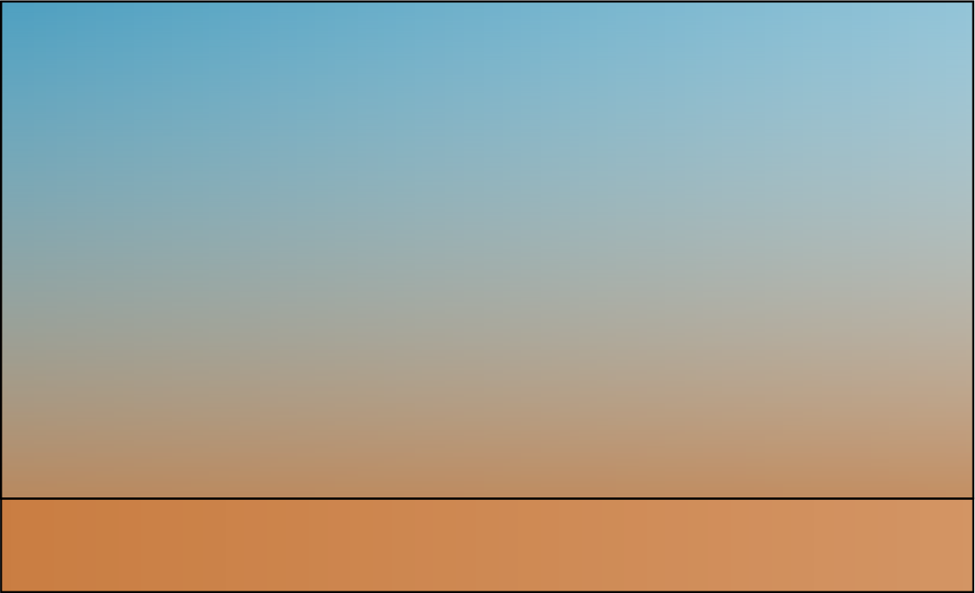
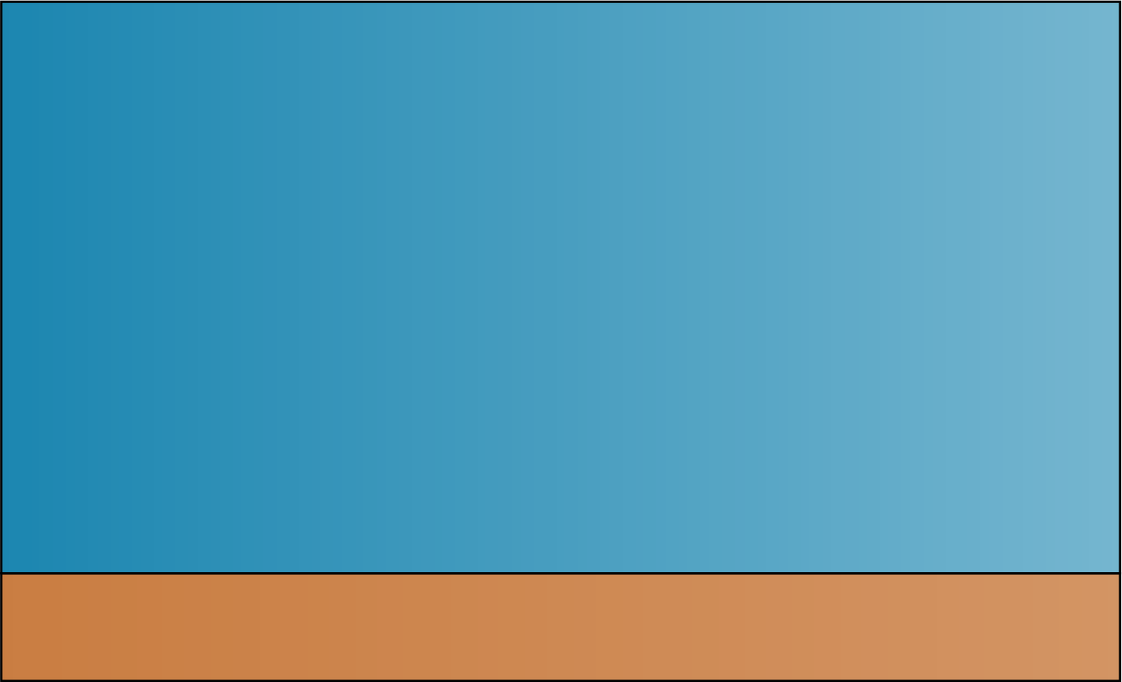
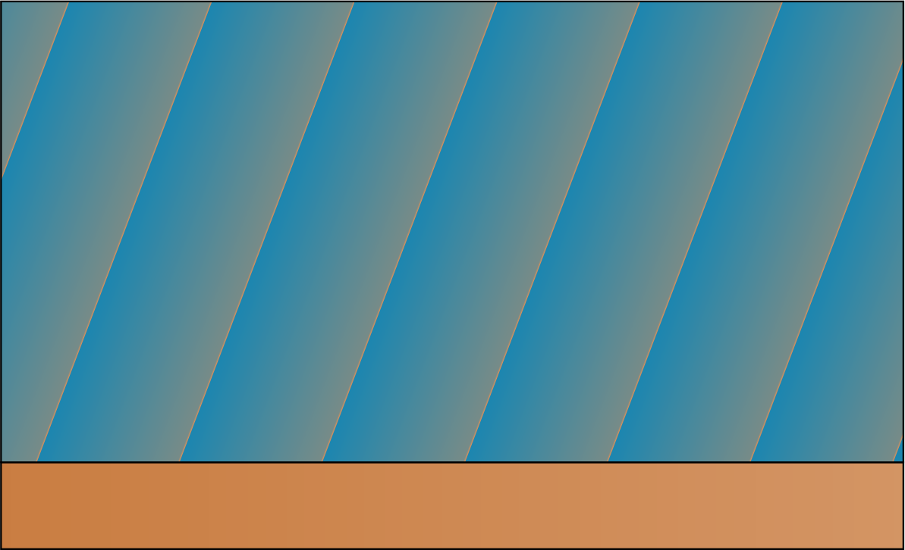
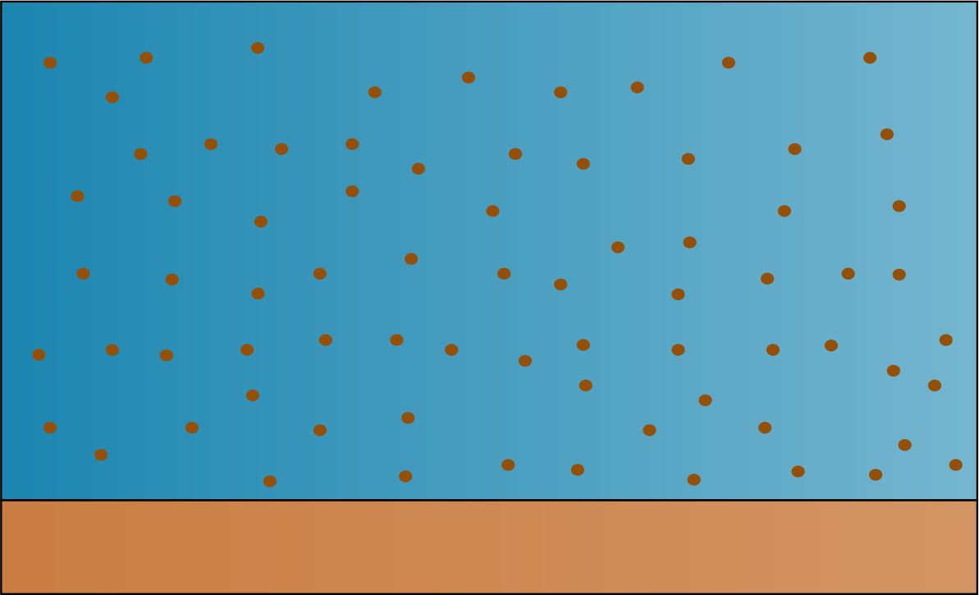
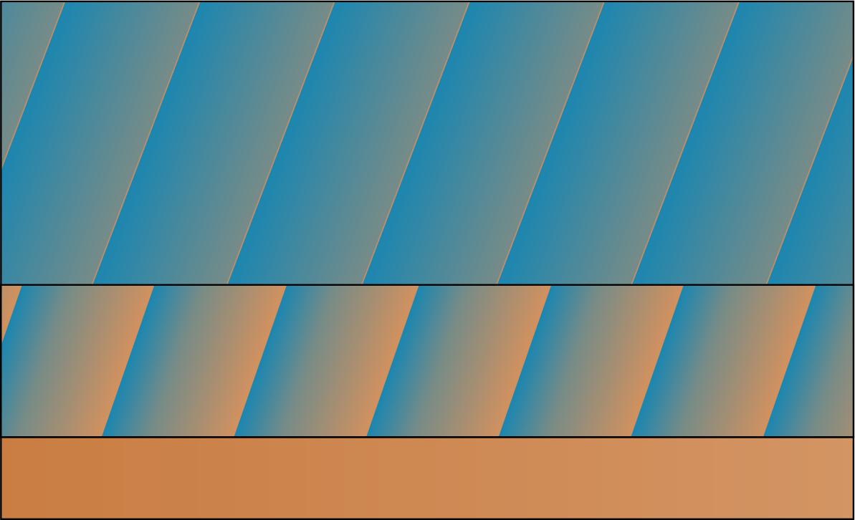
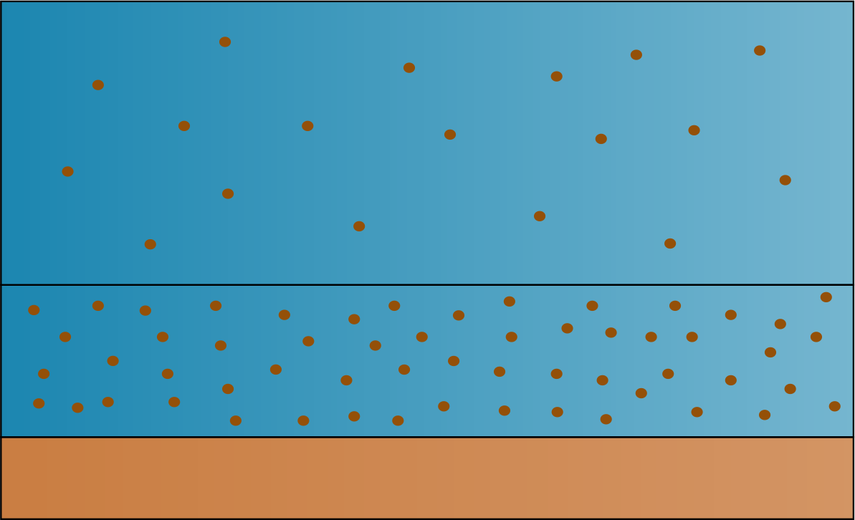
2D modelisation
Considered models
z
C
Real situation
Bedload
Mixture
2P2L
Two-phase
Two-layer
Two-phase/two-layer
Notes:
To properly simulate transient flows highly-laden with sediment, the very common shallow-water models coupled with the Exner equation or bedload models will very likely show their limitations.
In the case of a flush, the concentration can be so important that a pure column of water becomes an overly simplifying assumption. We can hence either consider a homogeneous mixture or a two-phase flow made of water and sediment, each phase having its own density and inertia. Momentum exchanges between the two phases are hence made through drag.
Moreover, the bedload models only consider transport along the water bed while the real concentration profile admits non-negligible concentrations at some distance from the bed, before decreasing significantly. To cope with this concentration curve while remaining in 2D, we can divide the column in two layers following this approximate line.
If we combine both approaches, we end up with a two-phase/two-layer model such as the one I have been developing and that I will hereinafter refer to as the 2P2L model.

Slide 7
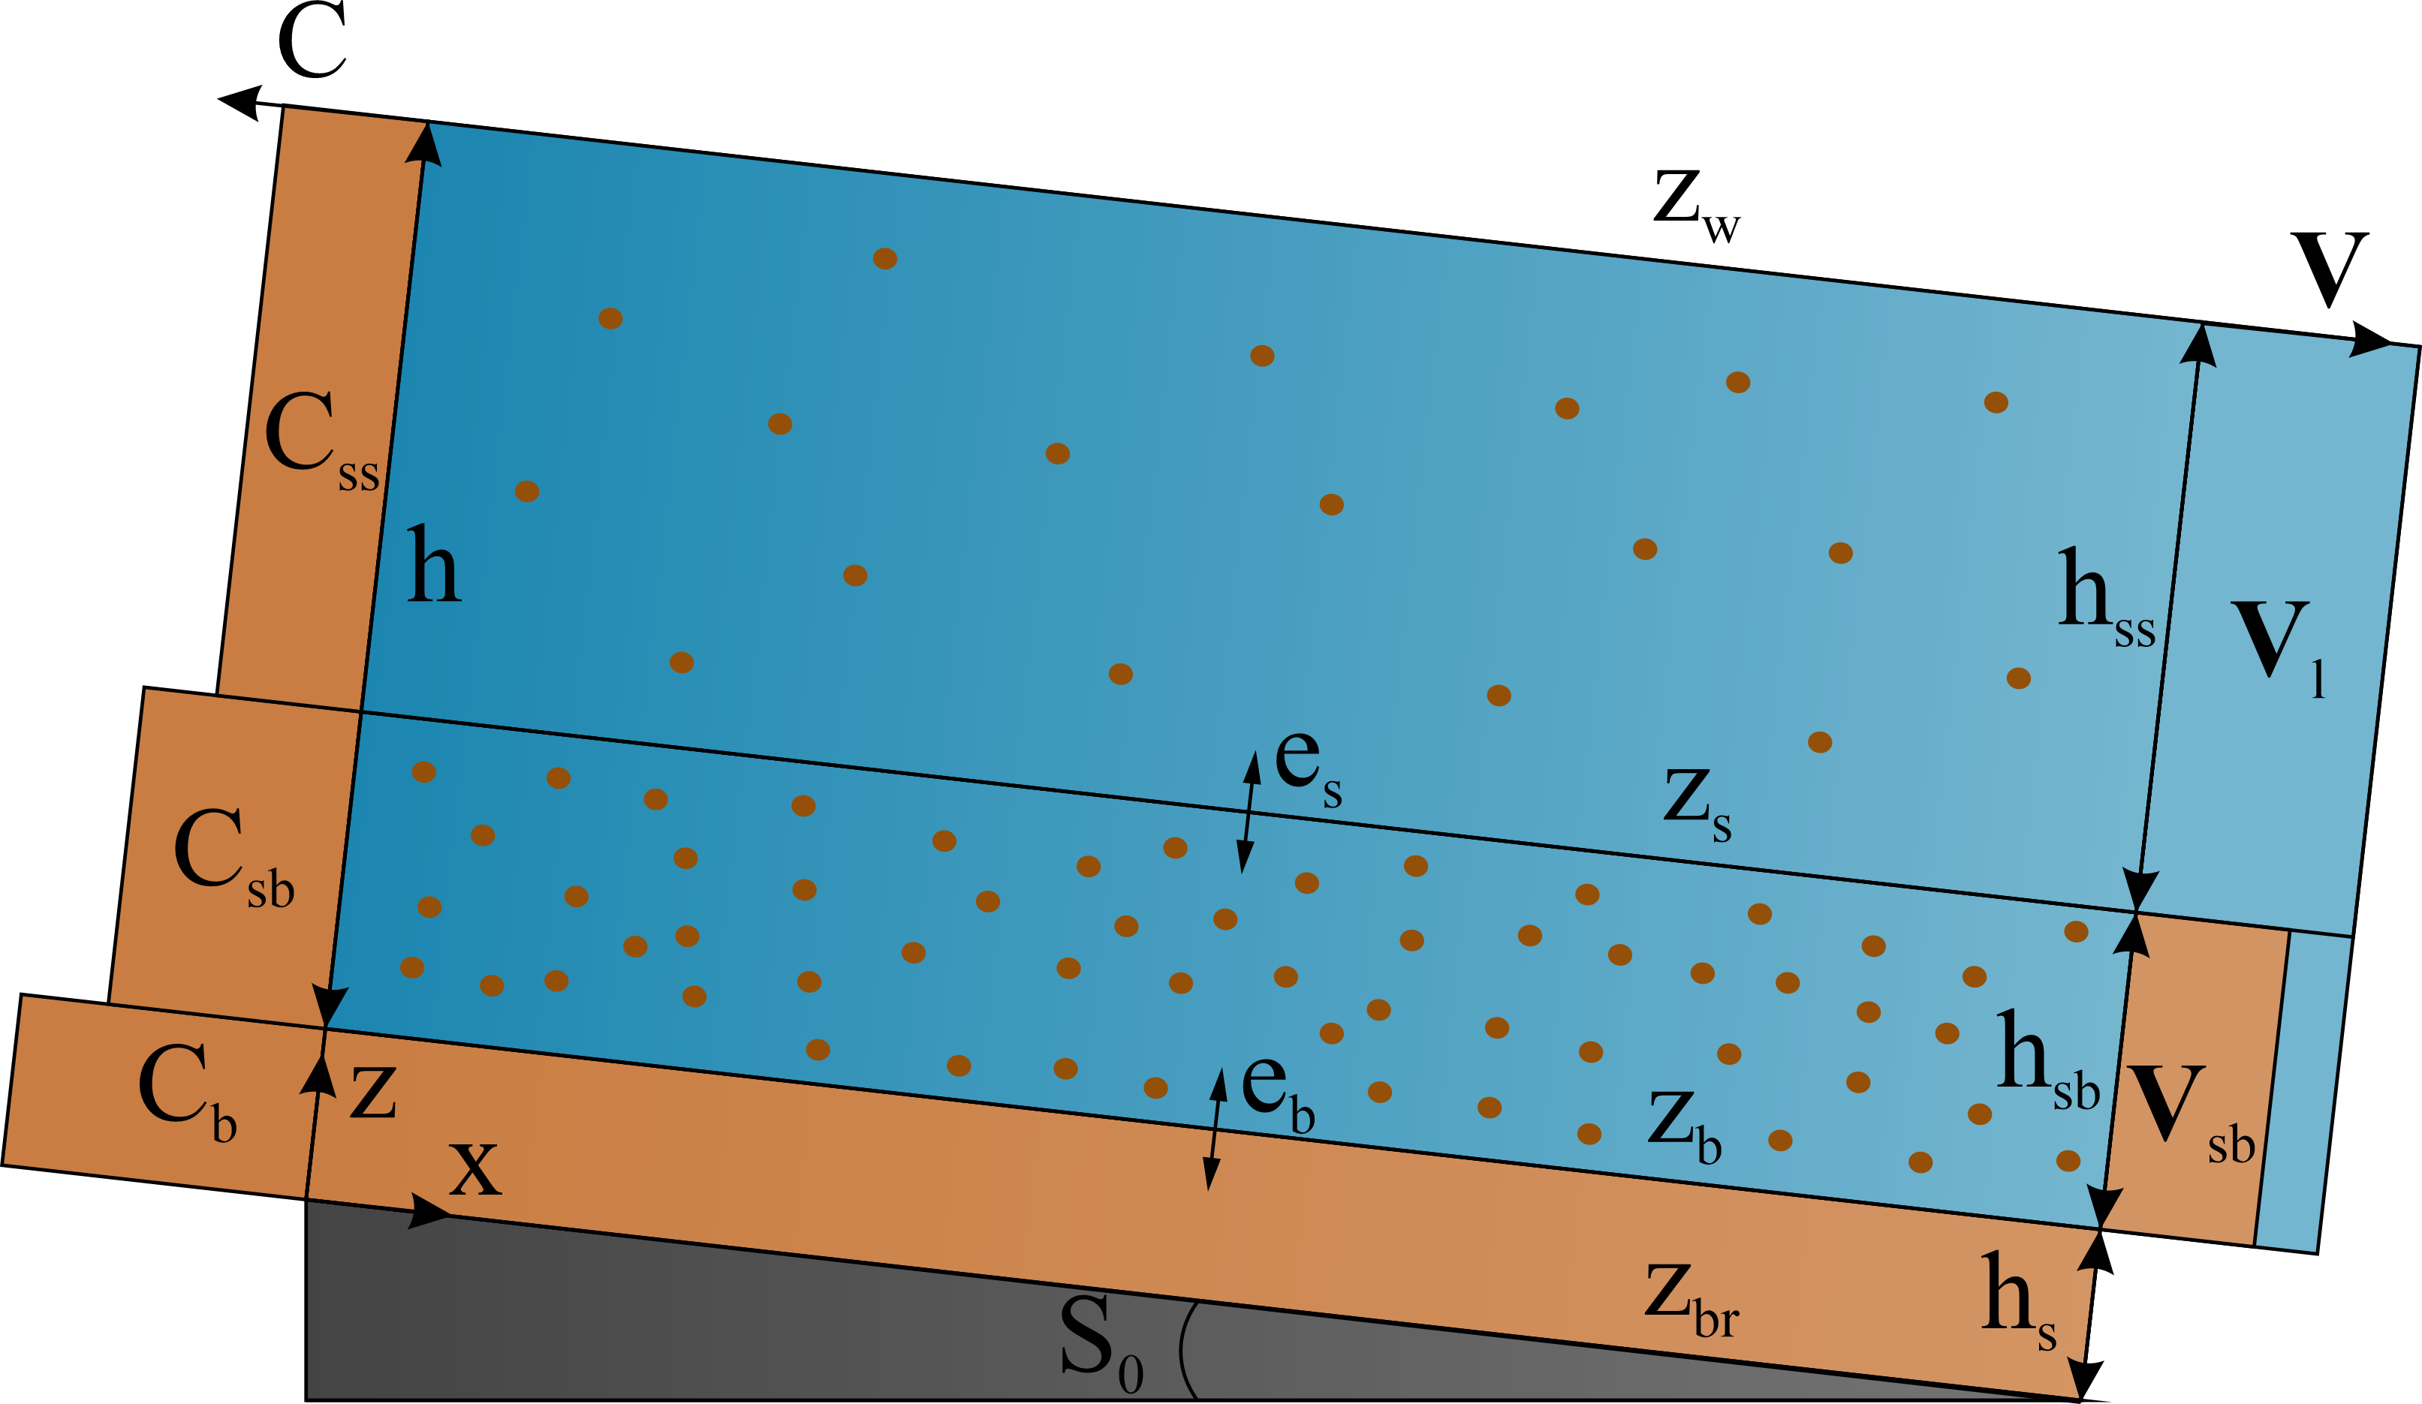
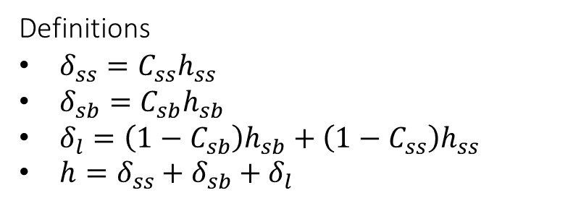
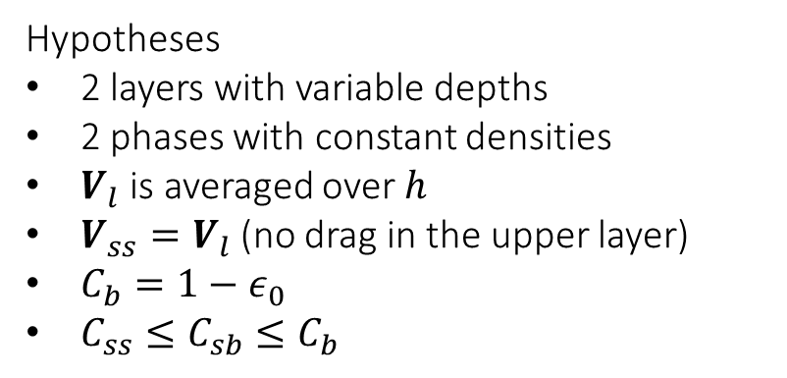
2P2L
Description of the model
Definitions
$δ_{ss}=C_{ss}h_{ss}$
$δ_{sb}=C_{sb}h_{sb}$
$δ_{l}=\left(1−C_{sb}\right)h_{sb}+\left(1−C_{ss}\right)h_{ss}$
$h=δ_{ss}+δ_{sb}+δ_{l}$
Hypotheses
2 layers with variable depths
2 phases with constant densities
$V_{l}$ is averaged over $h$
$V_{ss}=V_{l}$ (no drag in the upper layer)
$C_{b}=1−ε_{0}$
$C_{ss}≤C_{sb}≤C_{b}$
Notes:
The 2P2L model is a 2D finite-volume model whose velocity is averaged over the water depth. Above a non-erodible bed layer lies a finite and erodible layer of sediment of constant concentration. Above that layer lies the water column, split in two layers of variable concentrations. While the velocity of the sediment in the lower layer is different from that of the water, there is no drag assumed between the sediment in the upper layer and the water. Furthermore, the velocity of the water is averaged over the whole water column rather than over each layer, to reduce computational efforts.
The volumic fraction of the depth associated with each component (two for the sediment in the upper and lower layer and one for the water) is represented by the greek letter delta. The sum of these three volumic fractions corresponds to the water depth of the whole water column h.

Slide 8
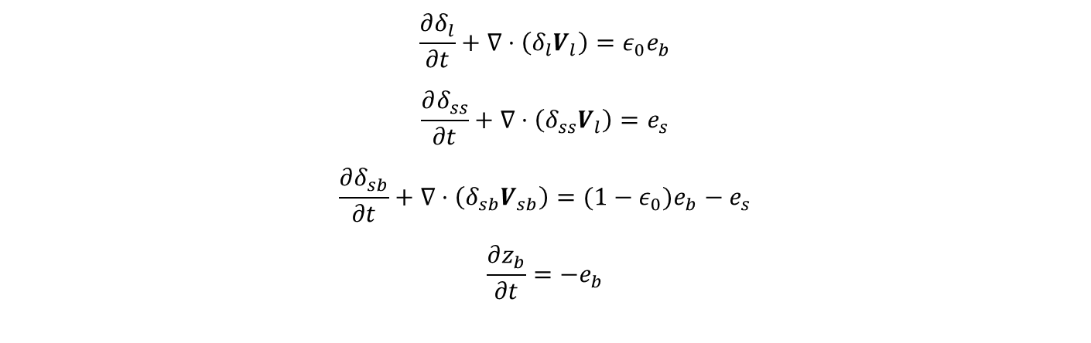
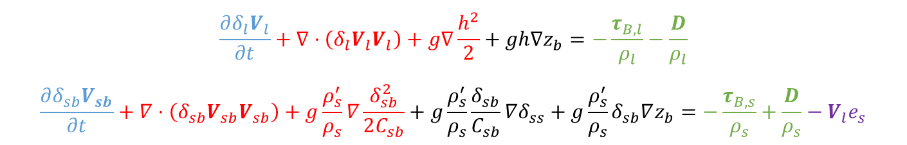
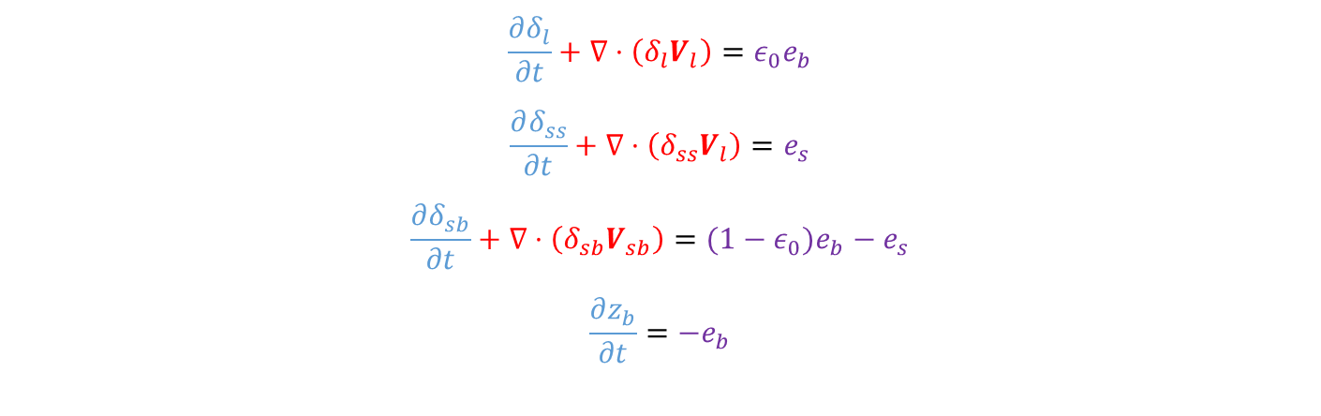
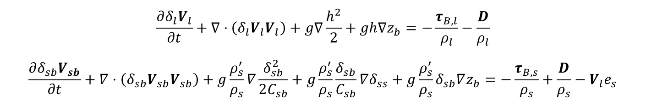
2P2L
Equations
Mass conservation equations
$$\frac{∂δ_{l}}{∂t}+∇⋅\left(δ_{l}V_{l}\right)=ε_{0}e_{b}$$
$$\frac{∂δ_{ss}}{∂t}+∇⋅\left(δ_{ss}V_{l}\right)=e_{s}$$
$$\frac{∂δ_{sb}}{∂t}+∇⋅\left(δ_{sb}V_{sb}\right)={(1−ε}_{0})e_{b}−e_{s}$$ $$\frac{∂z_{b}}{∂t}=−e_{b}$$
$$\frac{∂δ_{l}}{∂t}+∇⋅\left(δ_{l}V_{l}\right)=ε_{0}e_{b}$$
$$\frac{∂δ_{ss}}{∂t}+∇⋅\left(δ_{ss}V_{l}\right)=e_{s}$$
$$\frac{∂δ_{sb}}{∂t}+∇⋅\left(δ_{sb}V_{sb}\right)={(1−ε}_{0})e_{b}−e_{s}$$ $$\frac{∂z_{b}}{∂t}=−e_{b}$$
Momentum conservation equations
$$\frac{∂δ_{l}V_{l}}{∂t}+∇⋅\left(δ_{l}V_{l}V_{l}\right)+g∇\frac{h^{2}}{2}+gh∇z_{b}=−\frac{τ_{B,l}}{ρ_{l}}−\frac{D}{ρ_{l}}$$
$$\frac{∂δ_{sb}V_{sb}}{∂t}+∇⋅\left(δ_{sb}V_{sb}V_{sb}\right)+g\frac{ρ_{s}^{′}}{ρ_{s}}∇\frac{δ_{sb}^{2}}{2C_{sb}}+g\frac{ρ_{s}^{′}}{ρ_{s}}\frac{δ_{sb}}{C_{sb}}∇δ_{ss}+g\frac{ρ_{s}^{′}}{ρ_{s}}δ_{sb}∇z_{b}=−\frac{τ_{B,s}}{ρ_{s}}+\frac{D}{ρ_{s}}−V_{l}e_{s}$$
$$\frac{∂δ_{l}V_{l}}{∂t}+∇⋅\left(δ_{l}V_{l}V_{l}\right)+g∇\frac{h^{2}}{2}+gh∇z_{b}=−\frac{τ_{B,l}}{ρ_{l}}−\frac{D}{ρ_{l}}$$
$$\frac{∂δ_{sb}V_{sb}}{∂t}+∇⋅\left(δ_{sb}V_{sb}V_{sb}\right)+g\frac{ρ_{s}^{′}}{ρ_{s}}∇\frac{δ_{sb}^{2}}{2C_{sb}}+g\frac{ρ_{s}^{′}}{ρ_{s}}\frac{δ_{sb}}{C_{sb}}∇δ_{ss}+g\frac{ρ_{s}^{′}}{ρ_{s}}δ_{sb}∇z_{b}=−\frac{τ_{B,s}}{ρ_{s}}+\frac{D}{ρ_{s}}−V_{l}e_{s}$$
Notes:
Altogether, the model counts 8 governing equations. 4 equations of mass and 4 equations of momentum conservation, as it is a 2D model.
Besides the blue temporal evolution terms, we find red advection terms, black slope terms, green friction and drag terms and finally purple mass exchange source terms.

Slide 9
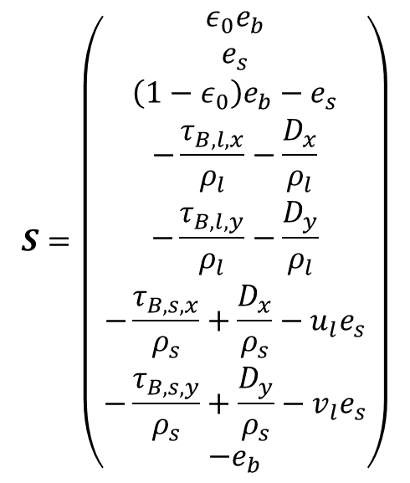




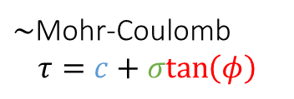
2P2L
Friction source terms
$$S=\left(\begin{matrix}ε_{0}e_{b} \\ e_{s} \\ \left(1−ε_{0}\right)e_{b}−e_{s} \\ −\frac{τ_{B,l,x}}{ρ_{l}}−\frac{D_{x}}{ρ_{l}} \\ −\frac{τ_{B,l,y}}{ρ_{l}}−\frac{D_{y}}{ρ_{l}} \\ −\frac{τ_{B,s,x}}{ρ_{s}}+\frac{D_{x}}{ρ_{s}}−u_{l}e_{s} \\ −\frac{τ_{B,s,y}}{ρ_{s}}+\frac{D_{y}}{ρ_{s}}−v_{l}e_{s} \\ −e_{b}\end{matrix}\right)$$
$$τ_{B,l}=\frac{ρ_{l}n^{2}V_{l}\left|V_{l}\right|}{h^{1/3}}$$
Shear exerted by the water
Shear exerted by the solid phase
$$τ_{B,s}={βρ}_{s}V_{sb}\left|V_{sb}\right|+g\left(ρ_{s}−ρ_{l}\right){(δ}_{sb}+δ_{ss})\frac{V_{sb}}{|V_{sb}|}μ_{d}$$
Bed resistance
$τ_{B}$ = $τ_{c}+g\left(ρ_{s}−ρ_{l}\right){(δ}_{sb}+δ_{ss})μ_{s}$
$\sim$Mohr-Coulomb
$$τ=c+σtan\left(φ\right)$$
Friction coefficients
$$μ_{d}=\tan\left(φ_{d}\right)<\tan\left(φ_{s}\right)=μ_{s}$$
Notes:
For the rest of this presentation, we will mainly focus on the friction source terms. These friction terms need to be closed by any experimental or theoretical formulation.
The friction exerted by the water on the bed is often and efficiently closed by the Manning formulation, which by the way emphasizes the conditions for an efficient flush with high velocities and low water depths.
Following Di Cristo (2016), I closed the shear exerted by the solid phase on the bed with an expression combining a Manning-like term accounting for the interactions between particles and a Morh-Coulomb-like term depending on the weight of the sediment lying on the bed and a dynamic friction coefficient mud.
The bed resistance to these shears follows the same Mohr-Coulomb approach but uses a static friction coefficient mus.
The whole problem concerns these two friction coefficients as no value or closure formulation looks to exist in the literature. Consequently, a trial-and-error calibration on past measures needs to be accomplished before any study of a river. A blind prediction of the consequences of any flush on a river is hence not possible as these coefficients need to be calibrated for every river.
Here, following what is done in geotechnics, I propose to relate these friction coefficients to sediment stability angles phi_static and phi_dynamic. Of course, the dynamic coefficient should always be inferior to the static one.

Slide 10
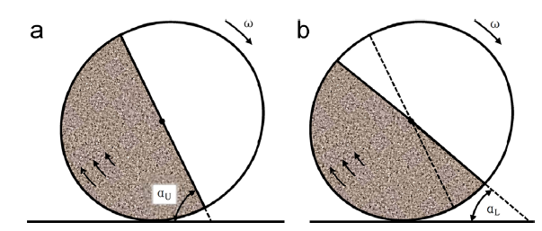
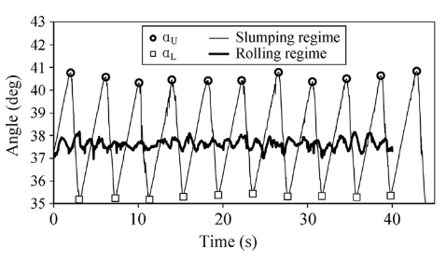
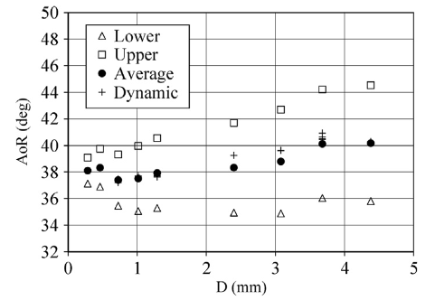



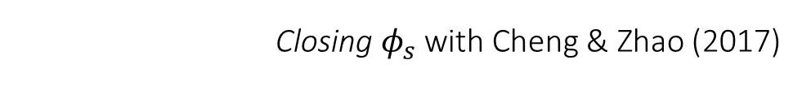
Closing parameters
Closing $φ_{s}$ with Cheng & Zhao (2017)
$$φ_{su}$$
$$φ_{sl}$$
$φ_{su}=φ_{s}=\left(1+0.06\sqrt{d_{50}}\right)φ_{d}$
Notes:
We hence have two parameters that need to be closed if we want to use our model as a predictive tool.
As a first estimation, I closed the static angle thanks to the works of Cheng & Zhao who determined the upper, lower and dynamic stability angles of granular materials in rotating drums.
When the rotating speed kept limited, the material was oscillating between upper and lower stability angles that can be seen as critical and residual angles during the collapse of the soil. When the speed was increased on the other hand, the stability angle of the soil oscillated around a constant value that they refer to as the dynamic angle.
Thanks to their analytical efforts, it is possible to derive a relation between the dynamic angle phid and the upper angle of stability whose definition is very close to the static angle of my model.
Thanks to this closure of phis based on phid, I only had to close one last parameter. But to that, I had no formulation at all.

Slide 11
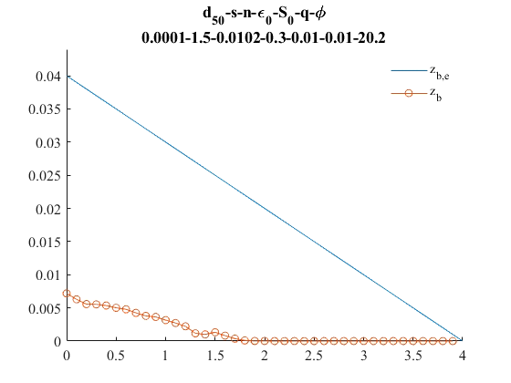
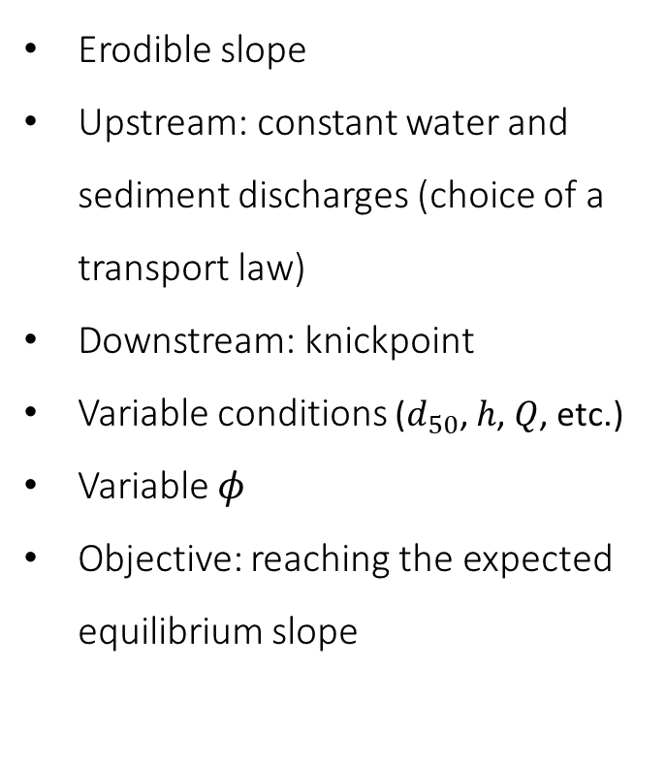
Closing parameters
Closing with a numerical experiment
Erodible slope
Upstream: constant water and sediment discharges (choice of a transport law)
Downstream: knickpoint
Variable conditions ($d_{50}$, $h$, $Q$, etc.)
Variable $φ$
Objective: reaching the expected equilibrium slope
Notes:
To close this last parameter, I hence made a numerical experiment which consisted in feeding from upstream an erodible slope with constant water and sediment discharges, based on any transport law from the literature. Downstream, a non-erodible knickpoint ensures the complete transmission of water and sediment beyond a weir.
To make sure that the final closure equation could be applied to a wide range of flows, I generated 64 situations with different grain and flow properties such as the median diameter or the water discharge and I incremented the value of my lasting parameter, phid until the equilibrium slope of my model reached the slope expected by the transport law that was chosen.

Slide 12
Closing parameters
Optimisation procedure for any transport law
Generating the situations
Extraction of the best $φ_{d}$ for each situation and generation of the possible $φ_{s}$
Extraction of the best 𝜙_𝑑 for each situation and generation of the possible 𝜙_𝑠
Sim 2: Optimisation of $φ_{s}$ with constant $φ_{d}$ for each situation
Sim 2: Optimisation of 𝜙_𝑠 with constant 𝜙_𝑑 for each situation
Closure for $φ_{s}$
Closure for 𝜙_𝑠
Sim 1: Optimisation of $φ_{d}$ with $φ_{s}$ based on Cheng & Zhao (2017) - prediction
Sim 1: Optimisation of 𝜙_𝑑 with 𝜙_𝑠 based on Cheng & Zhao (2017) - prediction
Sim 3: Optimisation of $φ_{d}$ with $φ_{s}$ based on the new relation - correction
Sim 3: Optimisation of 𝜙_𝑑 with 𝜙_𝑠 based on the new relation - correction
Closures for $φ_{d}$
Closures for 𝜙_𝑑
Application to test cases and validation
2P2L
Notes:
In this case, I actually ran the simulations three times.
After generating the situations, I first determined the phid values that led to the closest slopes to the expected one, based on the relation of Cheng & Zhao. I call this, the prediction step. From that step, we can already develop a closure for phid.
Secondly, I used these optimal values of phid to find the value of phis that delivered a better result than what was obtained with the relation of Cheng & Zhao. I hence was able to determine a new closure formulation for phis that can be compared with that of Cheng & Zhao.
The third step consists in re-running all the simulations with the new relation linking phis and phid to derive a closure formulation of phid.
Finally, we can apply these two closure formulations and simply run any test case.

Slide 13




Closing parameters
Closing $φ_{s}$ - comparison between Cheng & Zhao (2017) and new relations
$φ_{s,CZ}=\left(1+0.06\sqrt{d_{50}}\right)φ_{d}$
$$φ_{s,MPM}(°)$$
$$φ_{s,MPM}=\operatorname{atan}\left(−0.05+6.097d_{50}+1.18μ_{d}\right)$$
$$RMSE=1.21°$$
$$φ_{s,CZ}(°)$$
Notes:
So like I told you, I derived closure formulations for the parameter phis that can be compared with that of Cheng & Zhao. Of course, every closure is dependent on the transport law chosen at the beginning of the experiment. Here, I represented the results for the law of Meyer-Peter & Müller. You can see that the expressions for phis take a different form but both only involve the median grain diameter and the dynamic angle of the sediment and that they give very close results with an RMSE of only 1.21°. This very low difference suggests that the derived closure formulation will give us static angles that comply very much with what happens in reality if we choose this transport law.

Slide 14
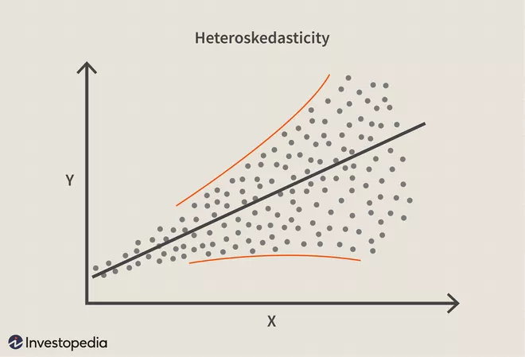
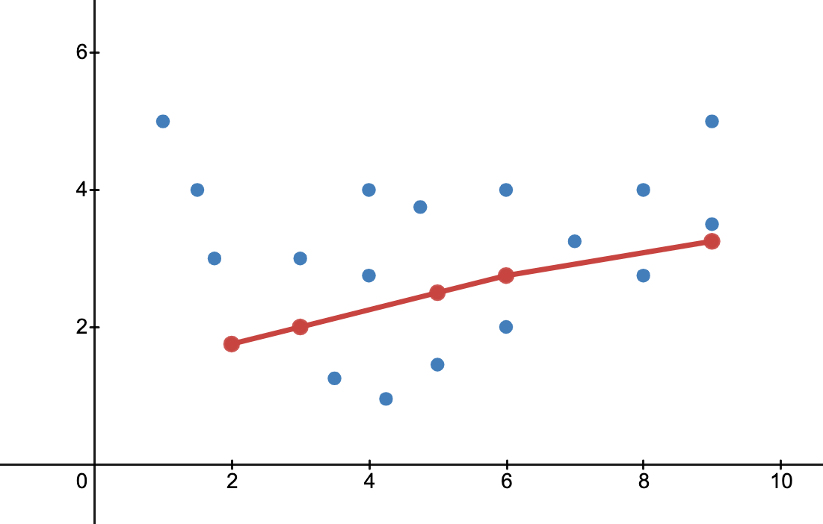
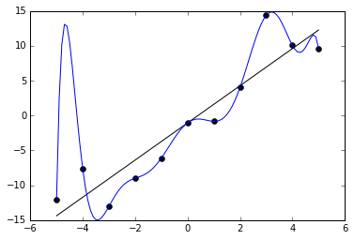
Closing parameters
Construction of a predictive model
Two problems to consider
Normal distribution and constant variance ➔ Box-Cox Transformation
Balance between underfitting and overfitting ➔ k-fold cross validation
Underfitting
Overfitting
Notes:
Ok, so now, we have a closure formulation for phis, but we still need to find a closure for phid. And it is more complicated for two reasons.
First, the optimal values of phid show heteroskedasticity, which means that they do not follow a normal distribution and have no constant variance. However, to construct a linear regression model, the variables should ideally have these properties. To solve that issue, we can use a Box-Cox transformation as I will explained afterwards.
Secondly, we must make sure that we capture the behaviour of the data accurately enough, that there is no underfitting, and that we do not capture noise, that we avoid overfitting. To address this problem, we can use machine learning and especially, a k-fold cross validation algorithm.

Slide 15
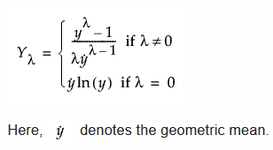
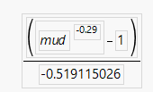
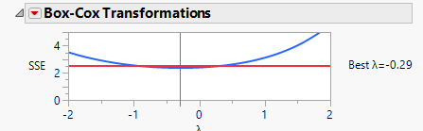



Closing parameters
Box-Cox transformation
Distribution of $μ_{d}$
Distribution of $μ_{d,BC}$
$$μ_{d,BC}=$$
Notes:
The Box-Cox transformation aims to transform the variables to make them follow a normal distribution.
You can see on the left panel that our mud variables do not really follow a normal distribution.
In the center of the slide, you can find an example of a Box-Cox transformation expression that highlights the parameter lambda that will be used to give the distribution that is the closest to a normal one.
And on the right, you can see that, after applying such a transformation, the variables are almost normally distributed.
Now, we can use these variables to derive a linear regression model.

Slide 16
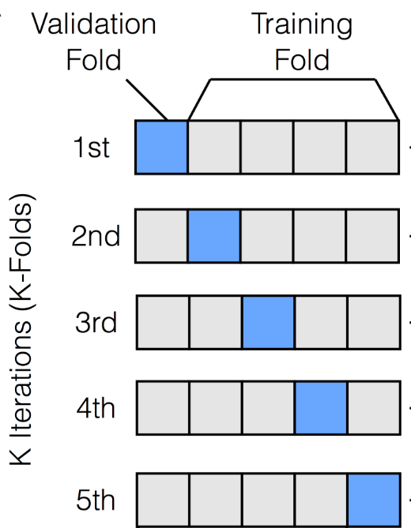
Closing parameters
Closing with machine learning
Random division between a training (75%) and a test set (25%)
K-fold cross validation on the training set
  Random division of the training set in k folds
  Select one fold as the validation set
  Train on the k-1 other folds
  Retain the R² for that iteration
  Perform again steps 2-4 with different folds as validation sets
  Select the model with the best R² on the validation set
Apply the model to the test set and ensure a sufficient R²
Notes:
As mentionned earlier, the regression model will be constructed thanks to a k-fold cross validation algorithm.
This algorithm consists in randomly dividing the dataset in a training and a test set.
The training set is then subdivided in k folds or dataset chunks.
A fold will then be used as a validation set while the other k-1 folds will be used to train a regression model. The model that gives the best R² value for that validation set will be retained.
Then, each fold is alternatively used as the validation set while the others are used to train k-1 other models.
When all folds were used as validation sets, the models that gave the best R² values on the different validations sets are applied to the remaining test set. The model that gives the best R² value on that set will be selected as the final regression model and hence the closure formulation for phid.

Slide 17

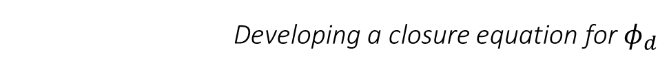

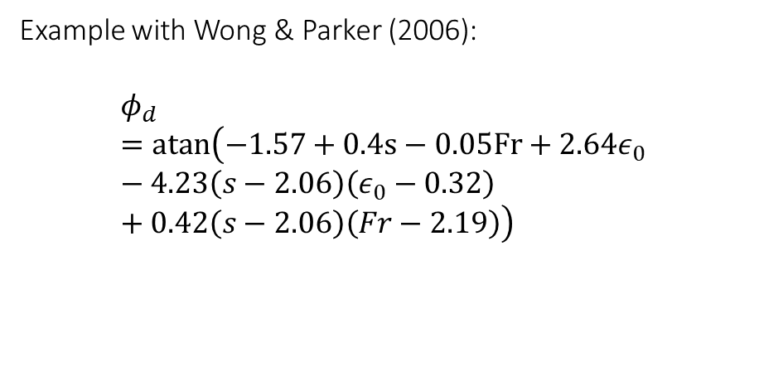
Closing parameters
Developing a closure equation for $φ_{d}$
Objective: maximise $R_{test}^{2}$ with $φ_{d}=f\left(s,ε_{0},S_{0},\frac{h}{d_{50}},Fr\right)$
Example with Wong & Parker (2006):
$$φ_{d}=atan\left(−1.57+0.4s−0.05Fr+2.64ε_{0}−4.23\left(s−2.06\right)\left(ε_{0}−0.32\right)+0.42\left(s−2.06\right)\left(Fr−2.19\right)\right)$$
$$μ_{d,BC,obs}$$
Source | R² | RMSE
Training Set | 0.8 | 0.09
Test Set | 0.29 | 0.32
$$μ_{d,BC,pred}$$
Notes:
So after simulating all the results, we want to maximise the R² value in function of several grain and flow parameters.
Here, I gave an example for the transport law of Wong & Parker. As you can see, these closure formulations can become a bit nasty, but they keep very easy to be implemented in a numerical model.
You can see that the R² square value on the training set was only of 0.29. On the right panel, you can see that indeed, a significant part of the actual optimal values could not be explained by the model. Nevertheless, the overal tendency is ok.

Slide 18
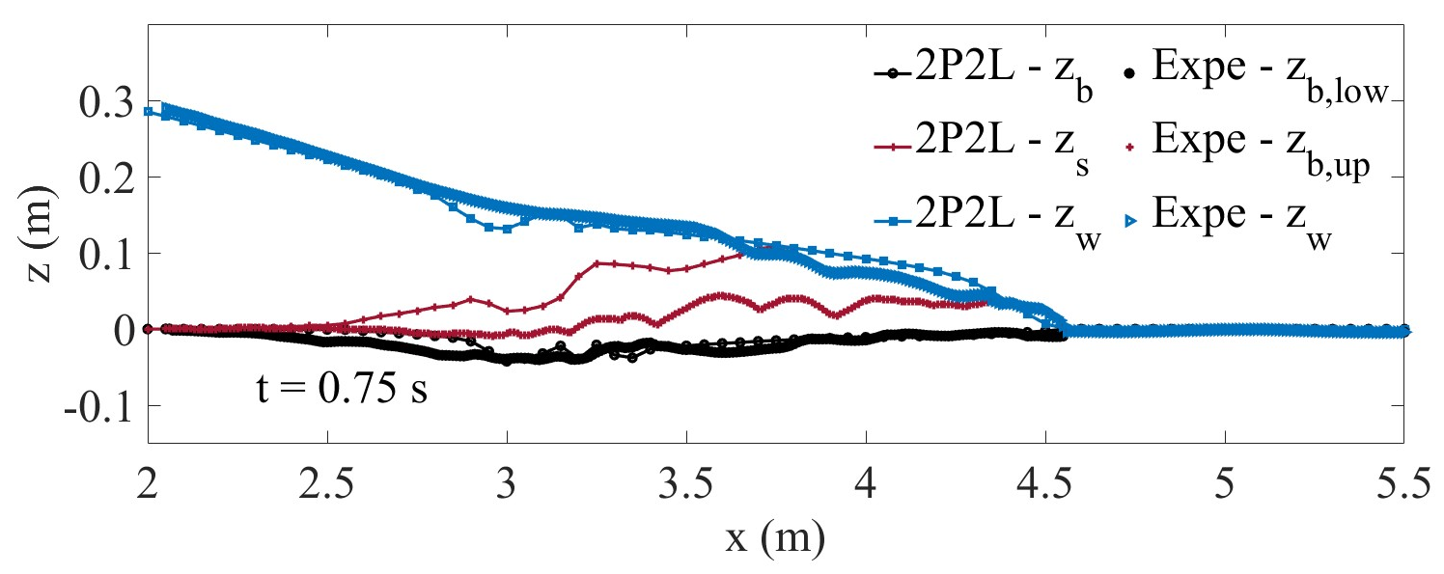
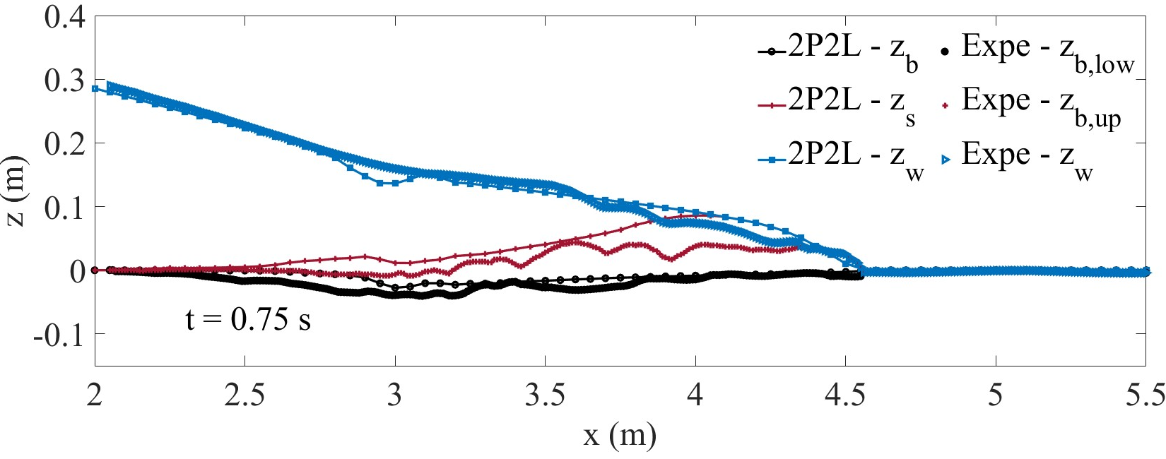
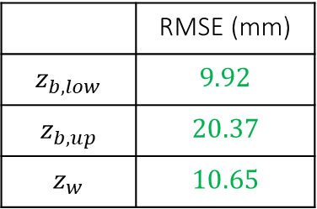
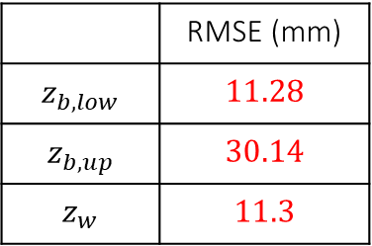
Application to Spinewine & Zech (2007) – PVC
Meyer-Peter & Müller (1948)
Prediction
 | RMSE (mm)
$$z_{b,low}$$ | $$11.28$$
$$z_{b,up}$$ | $$30.14$$
$$z_{w}$$ | $$11.3$$
Correction
 | RMSE (mm)
$$z_{b,low}$$ | $$9.92$$
$$z_{b,up}$$ | $$20.37$$
$$z_{w}$$ | $$10.65$$
Notes:
Now, it is finally time to apply the models with their brand new closure formulations. Here, I will show you the results I obtained with the transport law of MPM for a 1D dam-break on an erodible bed made of PVC pellets. Ideally, all the curves with the same color should be superposed.
In the upper panel, you can see the results from the prediction model, where phis was closed thanks to the expression of Cheng & Zhao.
In the lower panel, you can see the results from the correction step, which admit a new relation for phis.
While the prediction results are far from being completely wrong, it appears that the correction results simply better perform with respect to every curve. In general, the same conclusion can be drawn for every transport law and for every test case.

Slide 19
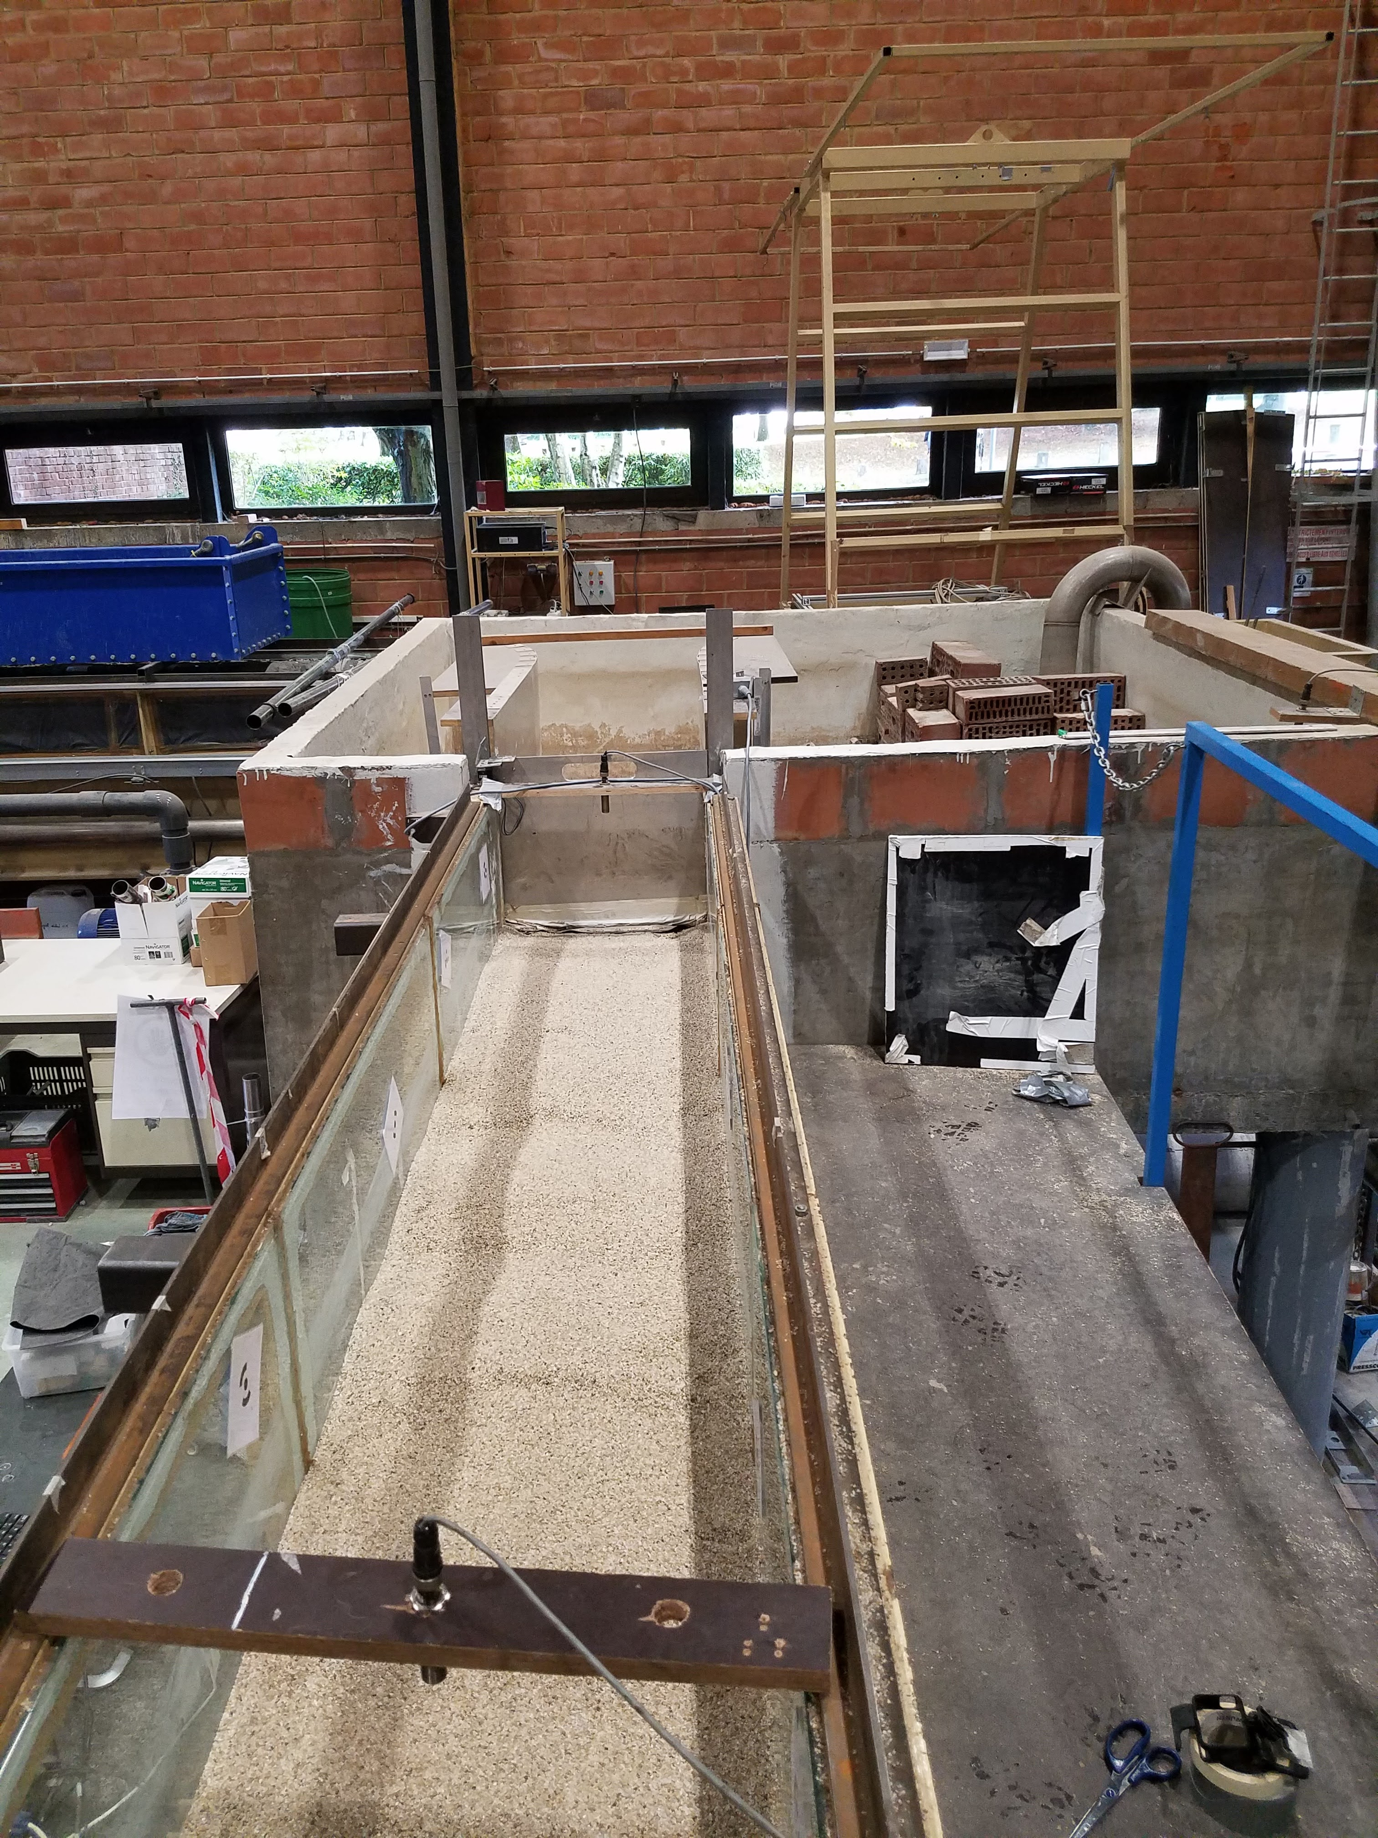
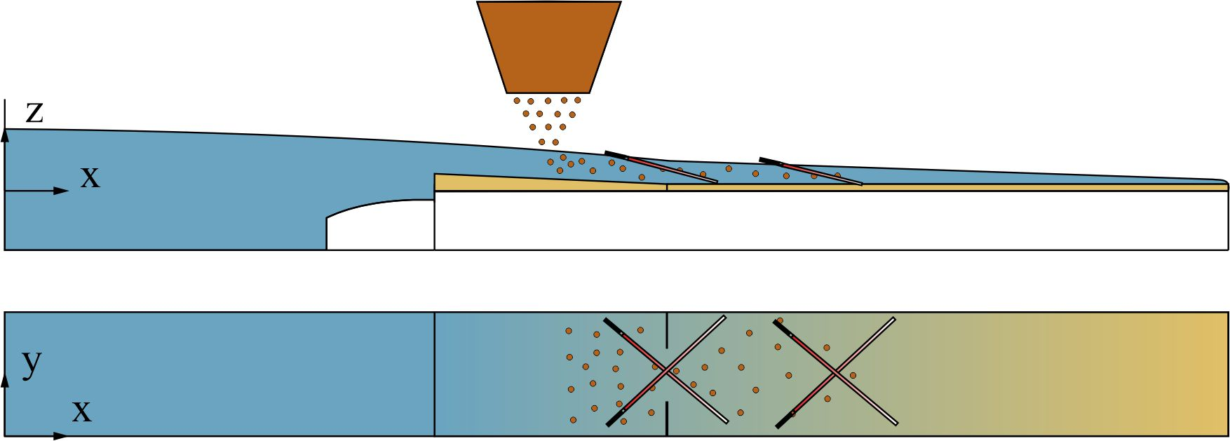
Perspectives
Performance with intense suspension
Idealised flushing experiment
Stepwise hydrograph and sedimentograph
Velocity and concentration measurement with UVP gauges
Morphological changes measured with Laser Profilometry
Objective: evaluate the performance of the model with intense suspension
Notes:
These results are encouraging but the model’s behaviour in the case of high suspension was not really assessed for the moment. And in the case of dam-flushes the suspended matter represents a very important part of the total transport as previously discussed.
Unfortunately, laboratory and extensive data lack for this type of transport. Laboratory experiments made at UCLouvain in the flume that you can see on this slide during the next semester with two Master students should try to reproduce a dam-flush and to measure not only the morphological changes during, and after the flush, but also to measure the solid transport and concentrations with Ultrasonic Velocity Profiling gauges. You can also see a temptative design for the setup of the experiment, but this still needs to be done by the students. And if you have any recommendation regarding this topic, please do not hesitate.

Slide 20
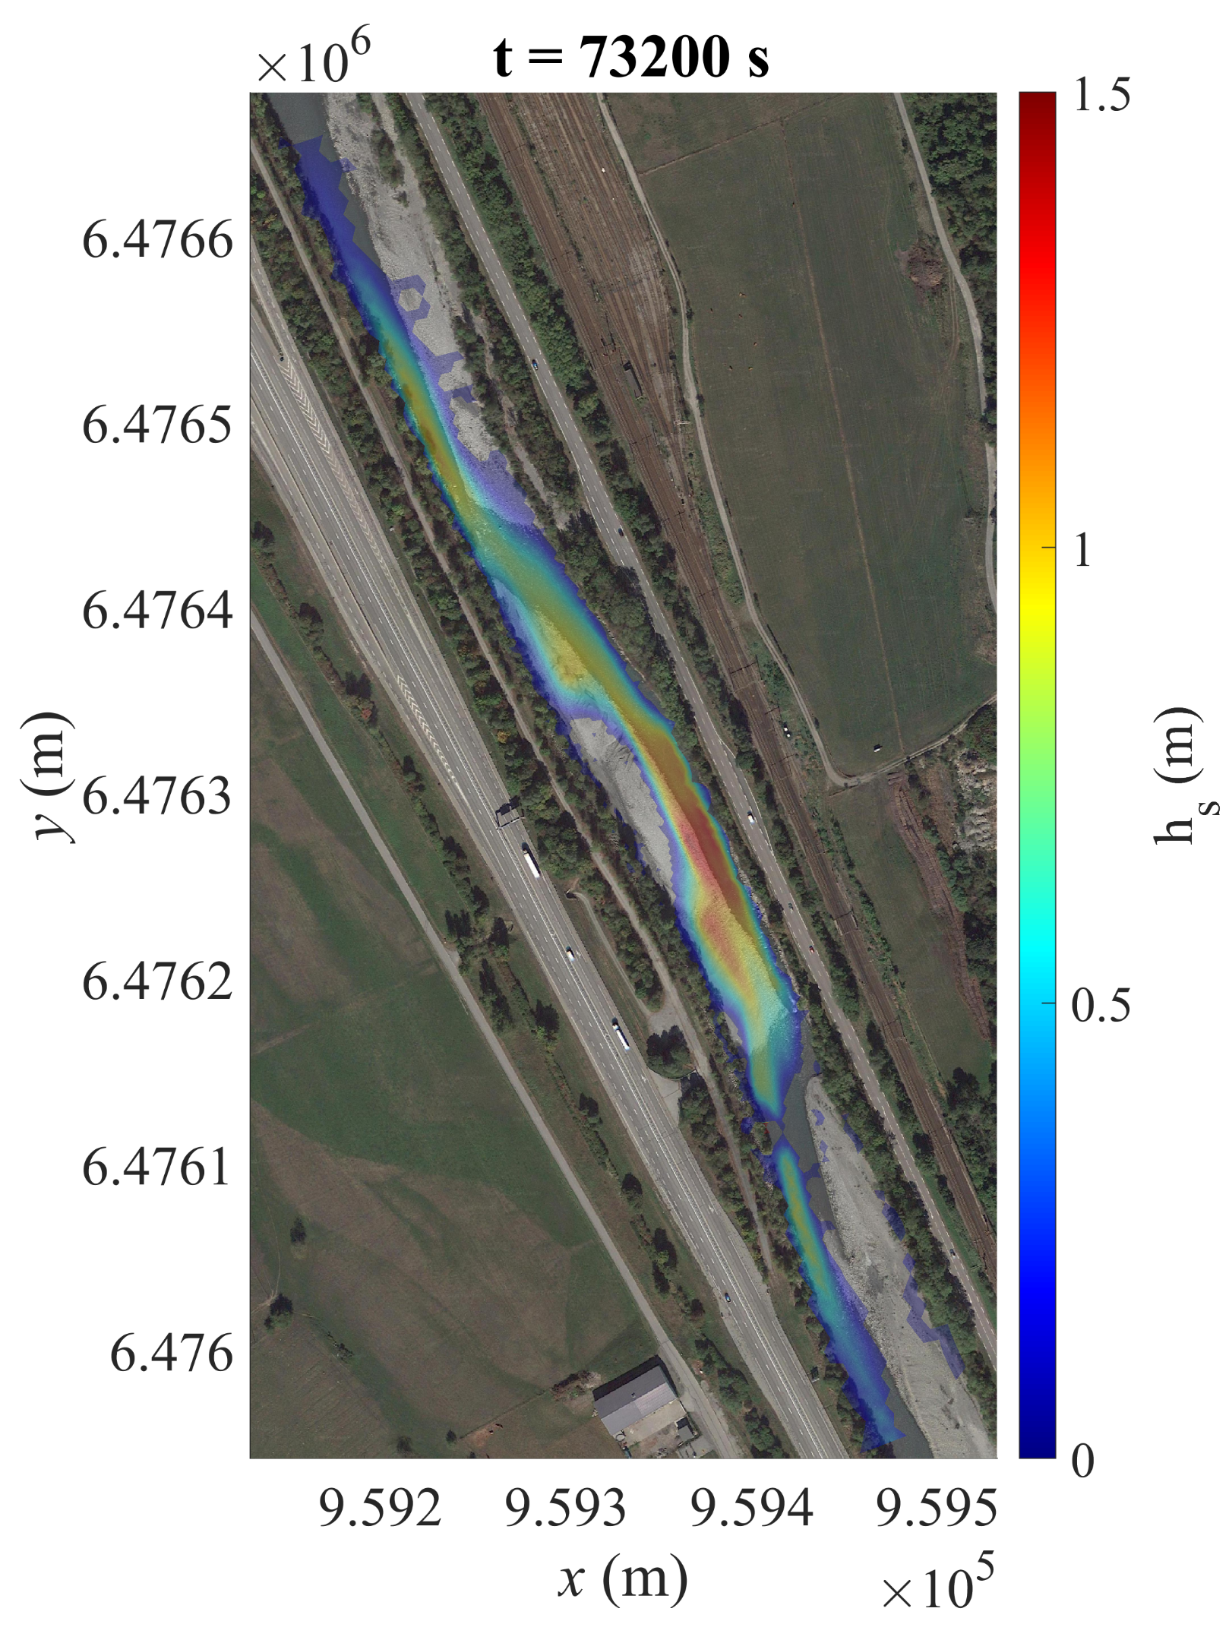
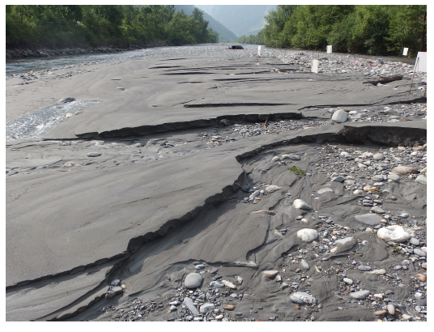
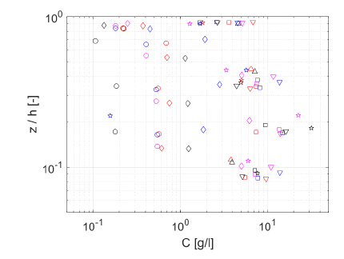
Perspectives
Performance on a real case flush – Arc, France
Deposition zone
Deposits in the Arc
Camenen et al., 2016
Secondary channel
Concentration in the secondary channel
Camenen et al., 2018
Notes:
Finally, the model should also be tested on a real case.
To do this, I received data from the team of Benoit Camenen in Lyon who monitored the deposition on a bar of the Arc river before and after a flush as well as the concentration in the secondary arm created by that bar.
As you can see on the left, the very first results that were made before the implementation of the closure procedure gave unrealistic deposition depths, and supplementary simulations still need to be done.

Slide 21
Conclusion
Tool
Constraints
Solution
Problem
Downstream impacts of dam-flushes
A 2D numerical model to optimize dam-flushes
Being able to be used as a predictive tool
Closing the last unknown parameter with a numerical experiment and machine learning
Uncertainties
Performance of the model with high suspension
Avoiding a trial-and-error calibration
Notes:
To resume this presentation, we started from a problem which concerns the negative consequences of dam-flushes on the downstream side of the dam.
To address this problem, we proposed to develop a two-phase/two-layer finite volume model that is supposed to be able to optimize the flushes.
The problem is that such a model with unclosed parameters cannot be properly used as a blind predictive tool since it needs ad-hoc calibrations made by trial-and-error and which are based on previously obtained data.
To solve that problem, we proposed a procedure involving a numerical experiment and machine learning to close the last parameter of the model. I want to stress that this procedure could be applied to any morphodynamical model for which one single parameter still needs to be closed.
Finally, the model gave satisfactory results with large particles that mostly travel along the bed but still needs to be assessed in the case of high suspension. In that perspective, laboratory experiments and real case simulations still need to be performed.

Slide 22
Thank you for your attention!
Robin Meurice
Supervisor : Sandra Soares-Frazão
e-mail : robin.meurice@uclouvain.be
Notes:
Thank you very much for your attention and please do not hesitate to ask questions and suggest new ideas !

Slide 24
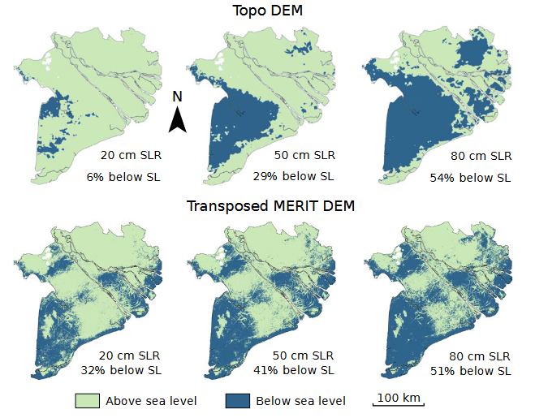
Introduction
Downstream impacts of dams
Biogeochemical alterations
Bed mixture modifications
Habitat quality decrease
Deprivation of the bed
Delta sinking
Mekong’s delta submersion by 2100
Minderhoud et al. (2019)

Slide 25
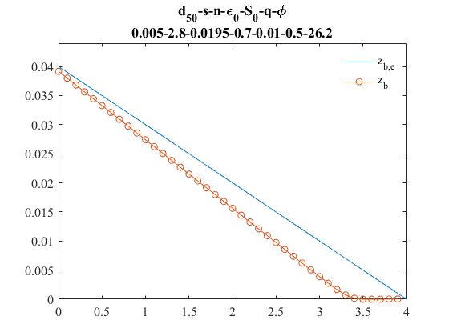
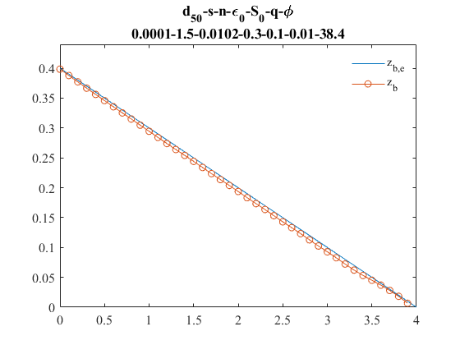
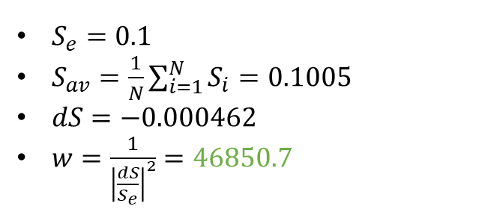





Closing parameters
Definition of the weights
$$S_{e}$$
$$S_{e}$$
$$S_{i}$$
$$S_{i}$$
$S_{e}=0.01$
$S_{av}=\frac{1}{N}\sum_{i=1}^{N}{S_{i}}=0.0375$
$dS=−0.0275$
$w=\frac{1}{{\left|\frac{dS}{S_{e}}\right|}^{2}}=0.13$
$S_{e}=0.1$
$S_{av}=\frac{1}{N}\sum_{i=1}^{N}{S_{i}}=0.1005$
$dS=−0.000462$
$w=\frac{1}{{\left|\frac{dS}{S_{e}}\right|}^{2}}=46850.7$

