Slide 1





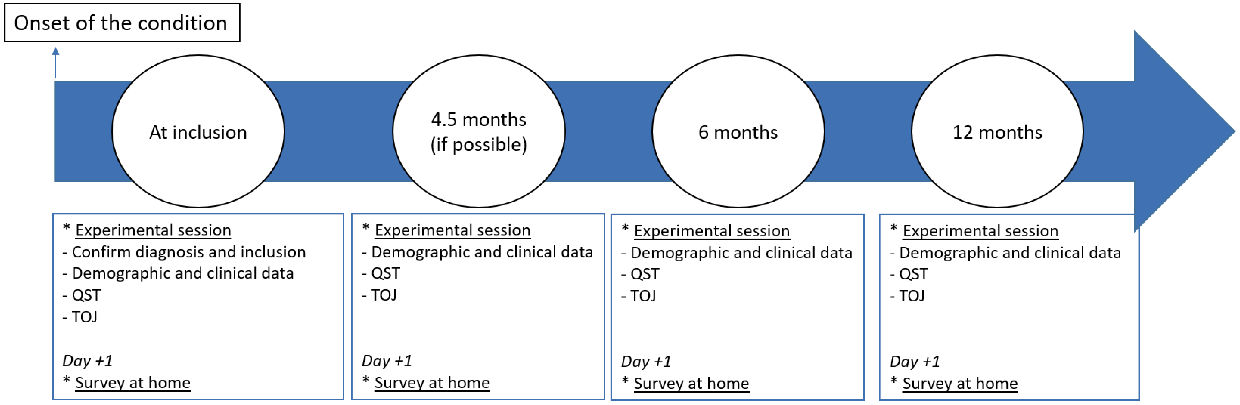
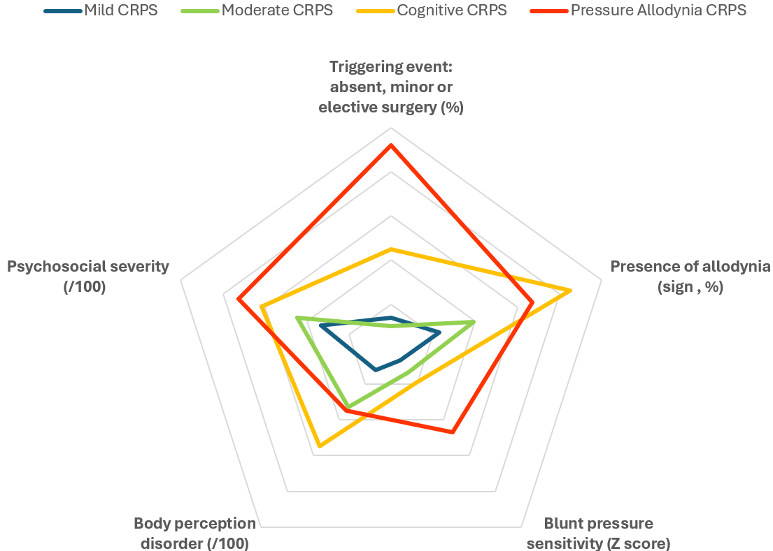
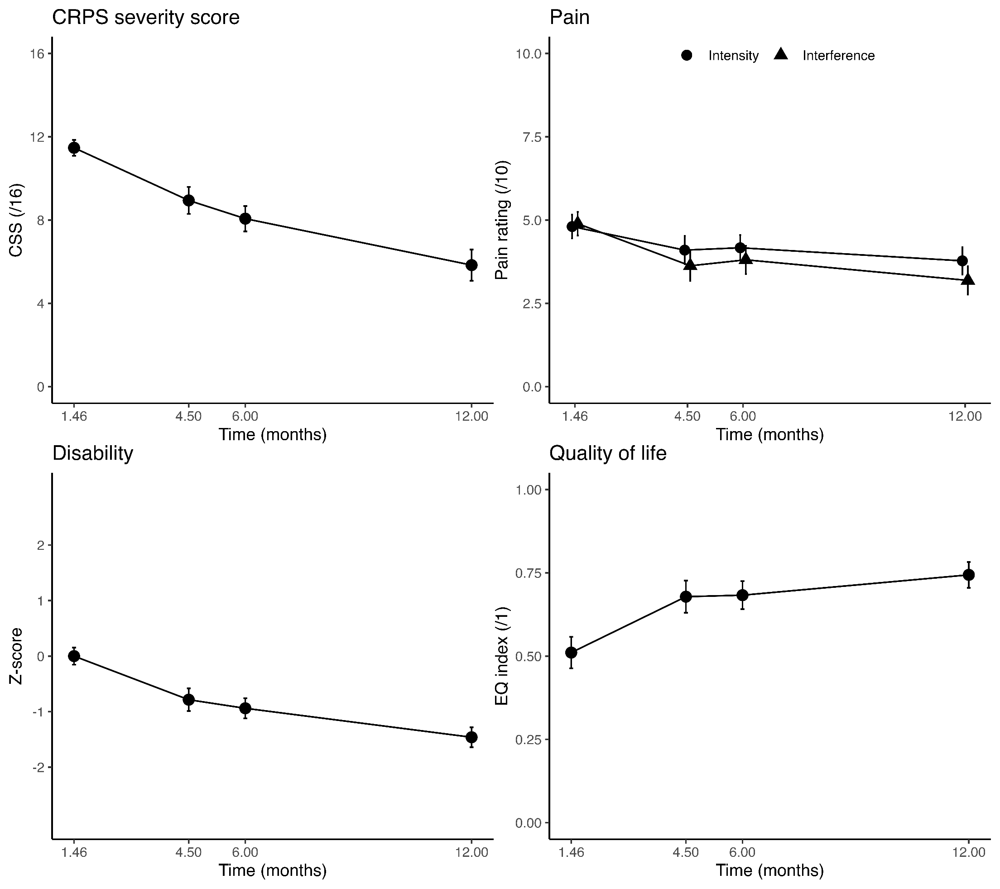
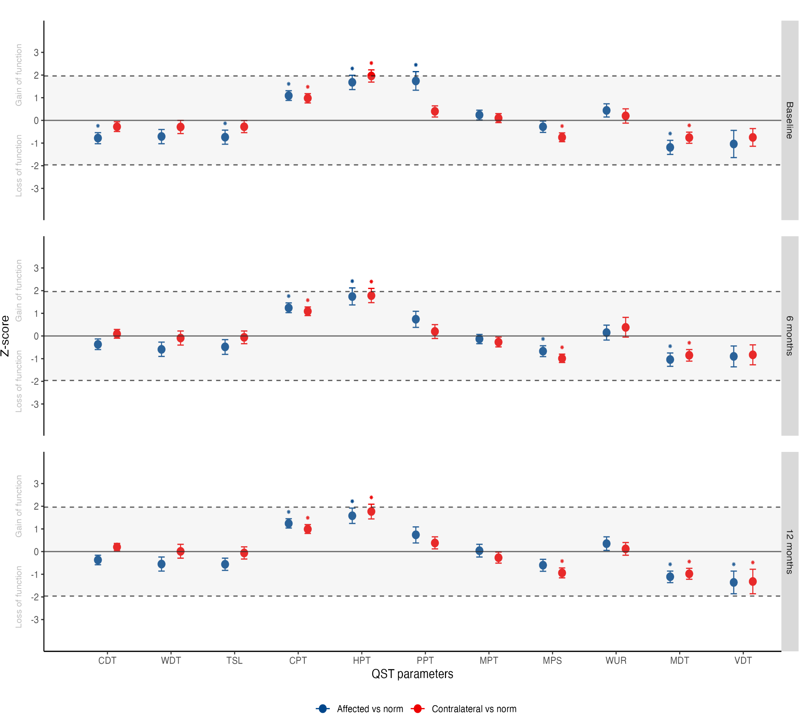
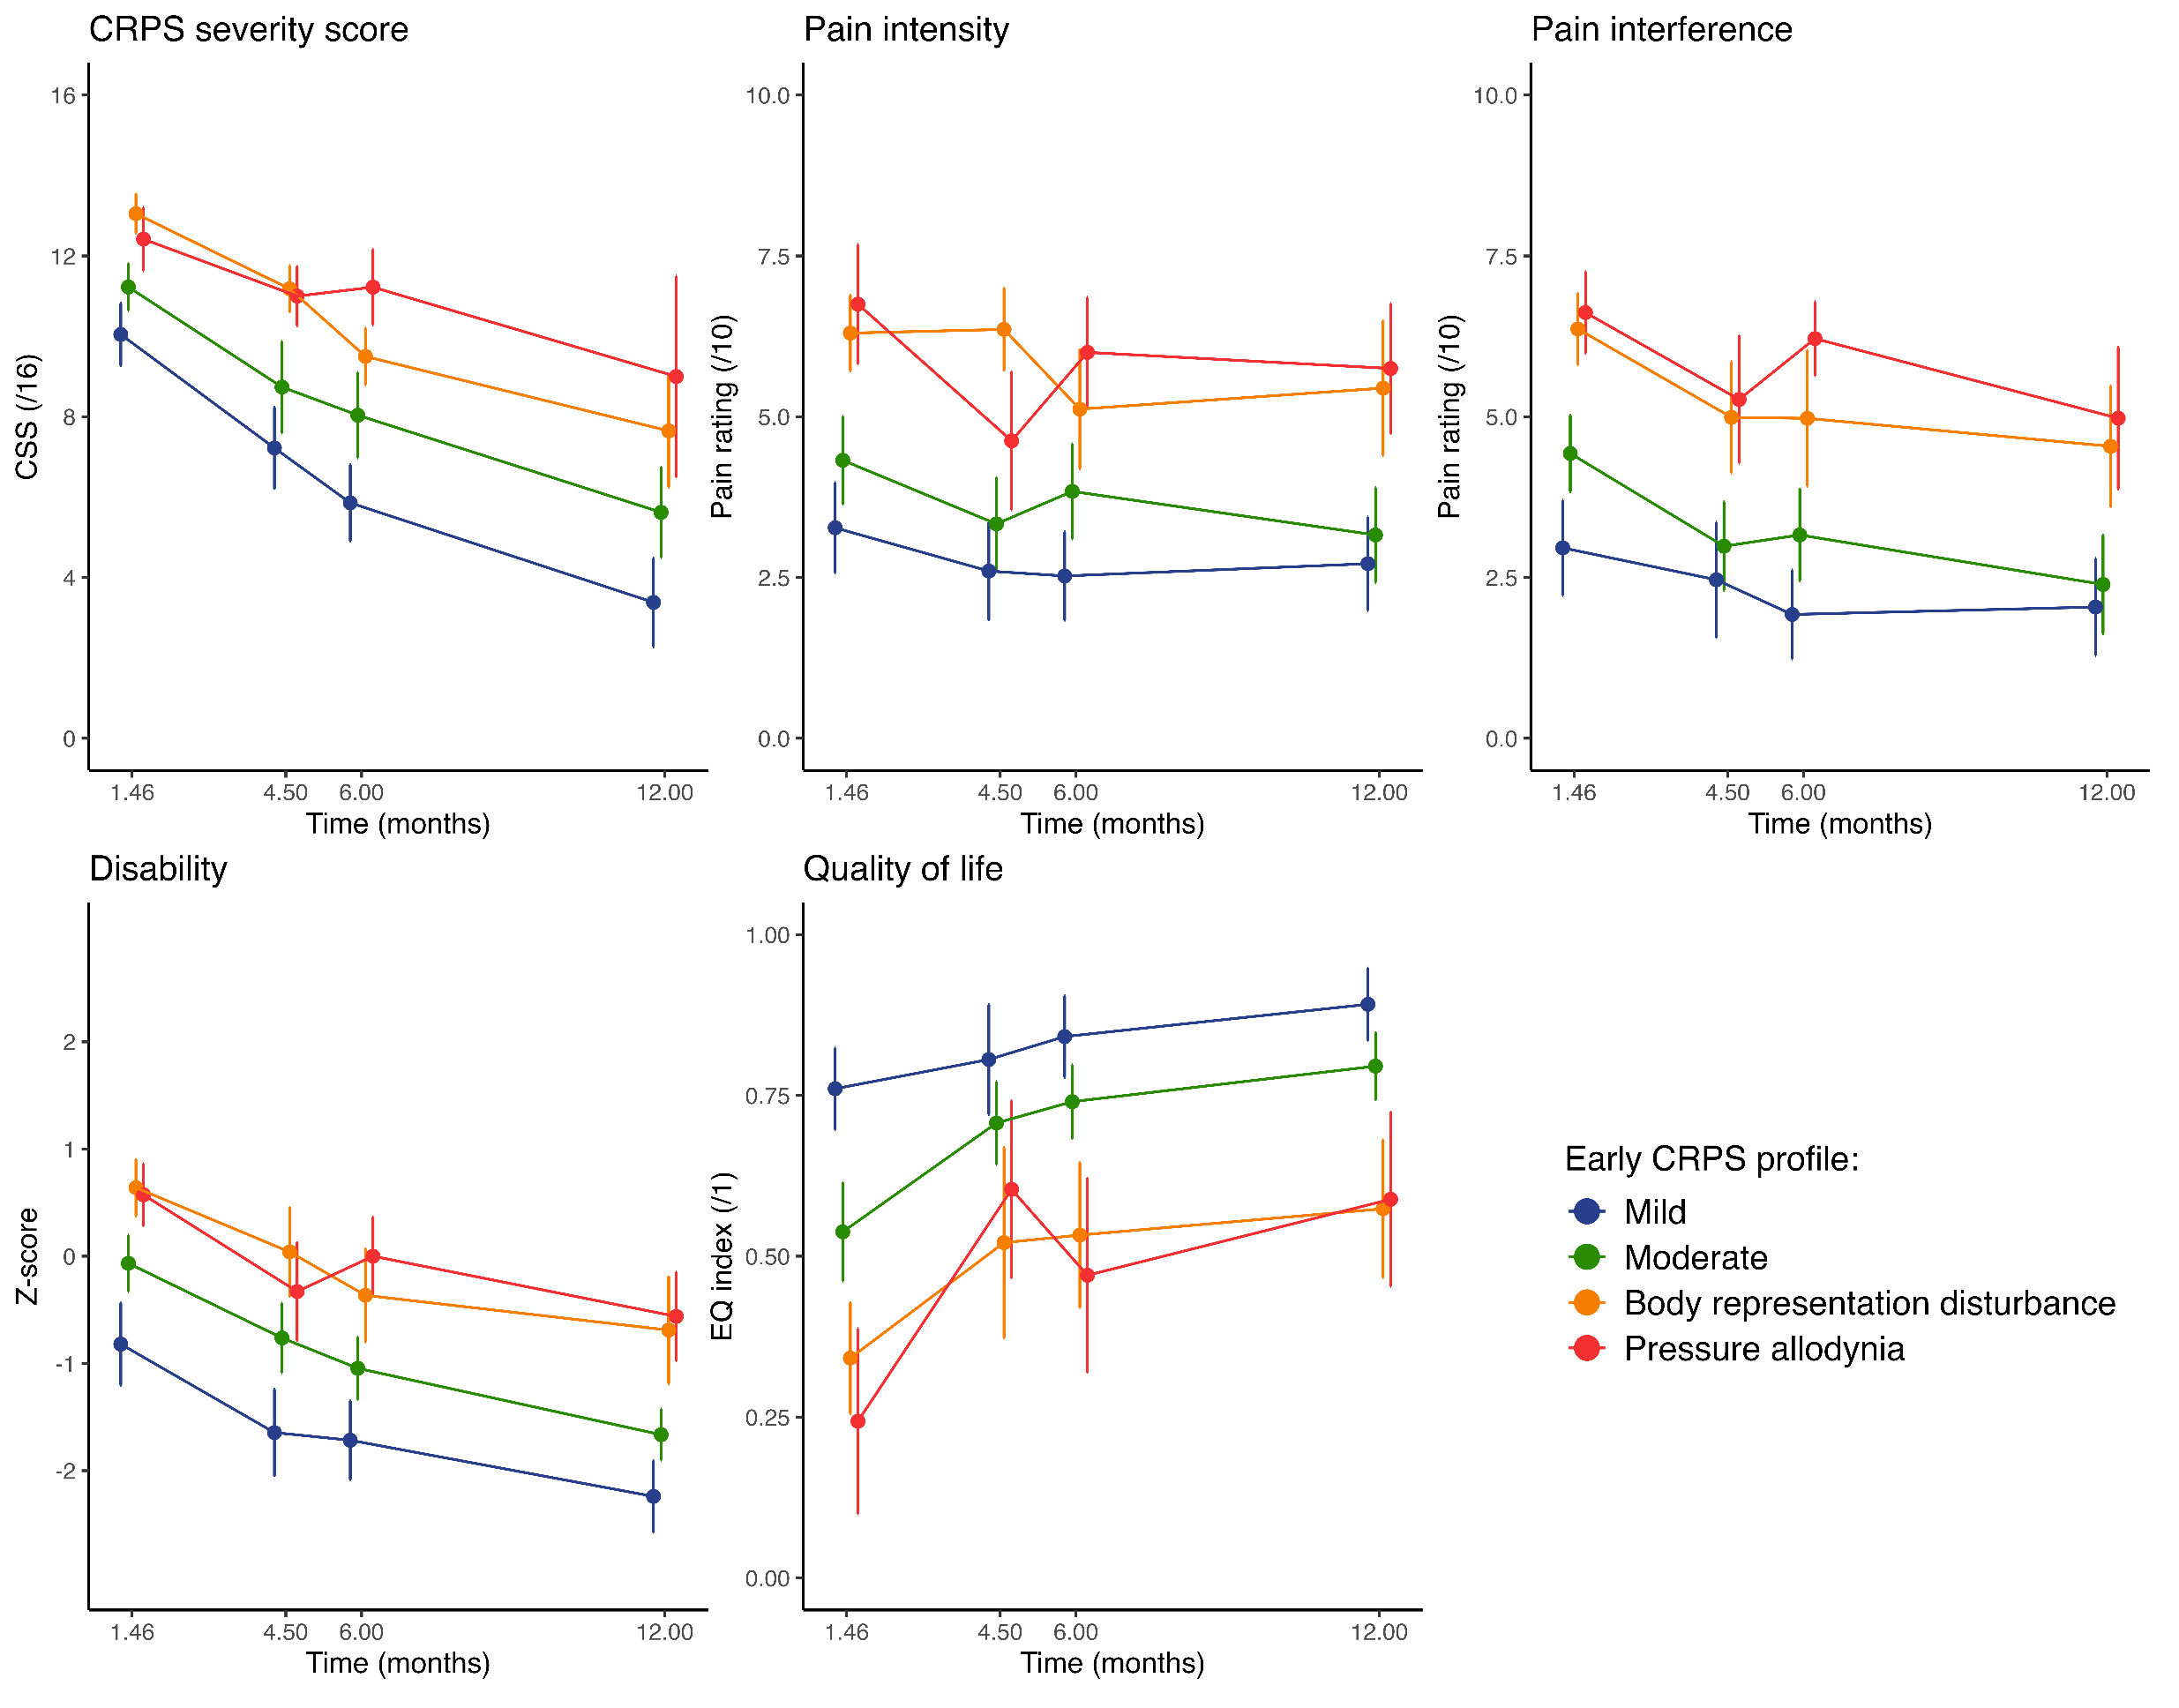
Early prognostic factors in CRPS:
a 1-year prospective longitudinal study
LOUIS Marc-Henri^{1,2}, LEGRAIN Valéry¹, ARON Vladimir¹, FILBRICH Lieve^{1,3}, HENRARD Séverine¹, MOURAUX André¹, BERQUIN Anne^{1,2}
1 Université catholique de Louvain, Institute of Neuroscience, Brussels, Belgium
2 Saint-Luc University Hospital, Physical medicine and rehabilitation department, Brussels, Belgium
3 Katholieke Universiteit Leuven, Leuven, Belgium.
II-B2.W.08
BACKGROUND
Complex regional pain syndrome (CRPS) is a challenging condition with an unpredictable trajectory¹. Recent studies report poor outcomes at 1 year: 51-89% still present some features of CRPS, 14 to 27% meet Budapest criteria, while only 60-70% have returned to work^{2,3}. Some risk factors have been associated with the incidence of CRPS⁴ but little is known about its (early) prognostic factors and how they influence long-term outcomes⁵. Whereas historical research linked biological factors with poorer outcomes^{6,7}, recent findings highlight the importance of psychological factors^{8,9}. Identifying these (modifiable) variables could transform patient management.
METHODS
OBJECTIVE
Examine the role of biopsychosocial factors in the development of persistent CRPS
Design: prospective longitudinal observational study (NCT0533750), four time-points.
Inclusion criteria: early CRPS (< 6 months since the onset).
Data collection: demographic variables, work-related factors, CRPS history and clinical manifestations, body perception disturbances (questionnaire), quantitative sensory testing (QST), and a visuospatial attentional task (TOJ).
Statistical method: multiple imputation and mixed effect models using baseline value of the potential predictors.
RESULTS & DISCUSSION
113 included participants, 107 assessed at final follow-up (drop-out: 5%). Four early profiles identified (Fig. 1)¹⁰.
Clinical evolution and prognosis
No difference (characteristics and outcomes) based on condition duration at inclusion.
→ No minimal duration before diagnosis?
Poor prognosis (Fig. 2):
  At 1 year: most of participants have persistent impairments, 35% meet Budapest criteria, 66% returned to work.
Body perception disturbances: stable over time.
→ Present at onset and not worsening in persistent cases?
Sensory profile: stabilize in early months, independently of condition evolution (Fig. 3).
Early prognostic factors
Most important: psychosocial severity (Örebro Musculoskeletal Pain Screening Questionnaire [ÖMSPQ]).
Other relevant factors: allodynia, BMI, coping strategies, social support.
Early profiles (Fig. 4) : different outcomes, strong independent predictors of the evolution.
Previous latent class analysis of the inclusion characteristics suggests four different profiles, associated with different pathophysiologies¹⁰.
Fig.1 Early CRPS profiles, based on five early characteristics (n=85).
Fig. 2 Clinical evolution (n=107). Mean ± CI95
Fig. 3 Sensory profiles over time (n=74). Mean ± CI95. *: significant after Bonferroni correction; CDT, cold detection threshold; WDT, warm detection threshold; TSL, temperature sensory limens; CPT, cold detection threshold; HPT, heat pain threshold; PPT, pressure pain threshold; MPT, mechanical pain threshold; MPS, mechanical pain sensitivity; WUR, wind-up ratio; MDT, mechanical detection threshold; VDT, vibration detection threshold.
Fig.3 Clinical trajectories according to early profiles (n=83). Mean ± CI95.
CONCLUSION
Both early CRPS profiles and ÖMPSQ score (expressing psychosocial severity) are strong predictors of CRPS evolution.
The implication of these findings to understand persistent CRPS and suggest a personalized therapeutic approach remains to be studied.
REFERENCES
Funding: MHL is supported by Fonds national de recherche scientifique (FNRS) and Fondation Saint-Luc. No other specific funding.
References: [1] Goebel Pain 2021; [2] Bean, EJP 2016; [3] Johnson, EJP 2022: [4] Pons, Anes Res Pract 2015; [5] Louis, EJP 2022; [6] Brunner J Rehab Med 2011; [7] Wertli J Rehab Med 2013; [8] Bean, Pain 2015; [9] Cave, J Pain 2023; [10] Louis, EJP 2025.
QR code to a quick app allowing the assessment of early CRPS profiles:
Contact: Marc-Henri Louis
marc-henri.louis@uclouvain.be

