Slide 2
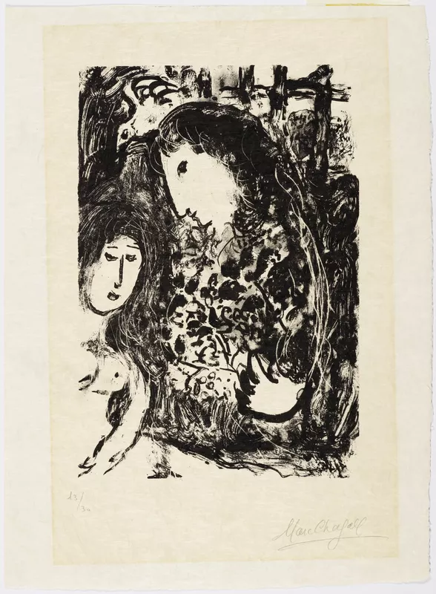
A Way In Between?
Avrom Sutzkever Between Historical and Transhistorical Perspective
Ellen De Doncker UCLouvain 24 November 2022

Slide 3
Overview
Vilna Gaon: Teshuva as Silence
Transhistorical and Historical Answer
  Transhistorical: toledot
  Historical: 614th commandment
Avrom Sutzkever as a Way in Between?
Conclusion

Slide 4
Vilna Gaon

Slide 5
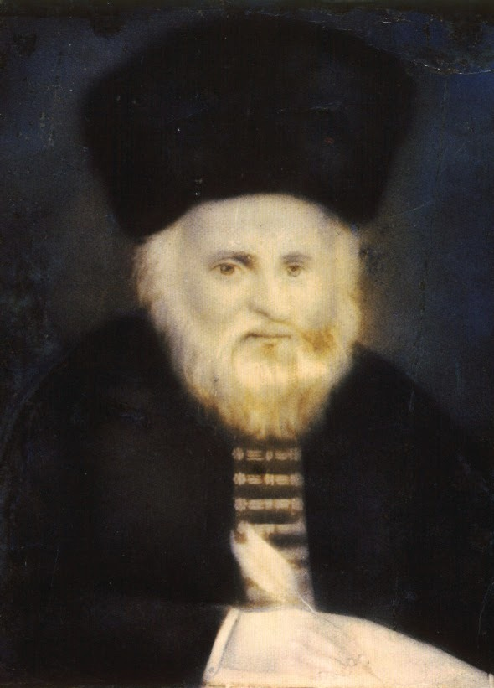
Vilna Gaon: Teshuva as Silence
Vilna Gaon (1720 – 1797).
Iggeret HaGra, a Mus(s)ar letter: Vilna Gaon’s discussion of teshuva
“Man must deprive himself until he dies, not by fasting or asceticism, but by controlling his mouth and desires. This is teshuvah. […] But the main way to merit Olam Haba (the World-to-Come) is by guarding one’s tongue. That is worth more than all the Torah and good deeds […] “What should be a man's occupation in this world? He should become as a mute person” (Chullin 89a). One must seal his lips as tight as two millstones.”
context of Mussar: the liberation of the self by discipline and freedom from worldly deviations is the focal point cf. tikkun hamidot
double dynamics of teshuva: away from sin and towards righteousness
Feasable? Desirable?
Post-Holocaust silence: problem? Cf. Paul Celan Todtnauberg!
Messianic aporia: should one wait (silently), or should one act by “Messianische Aktivismus” here and now?

Slide 6
Transhistorical and Historical Answer

Slide 7
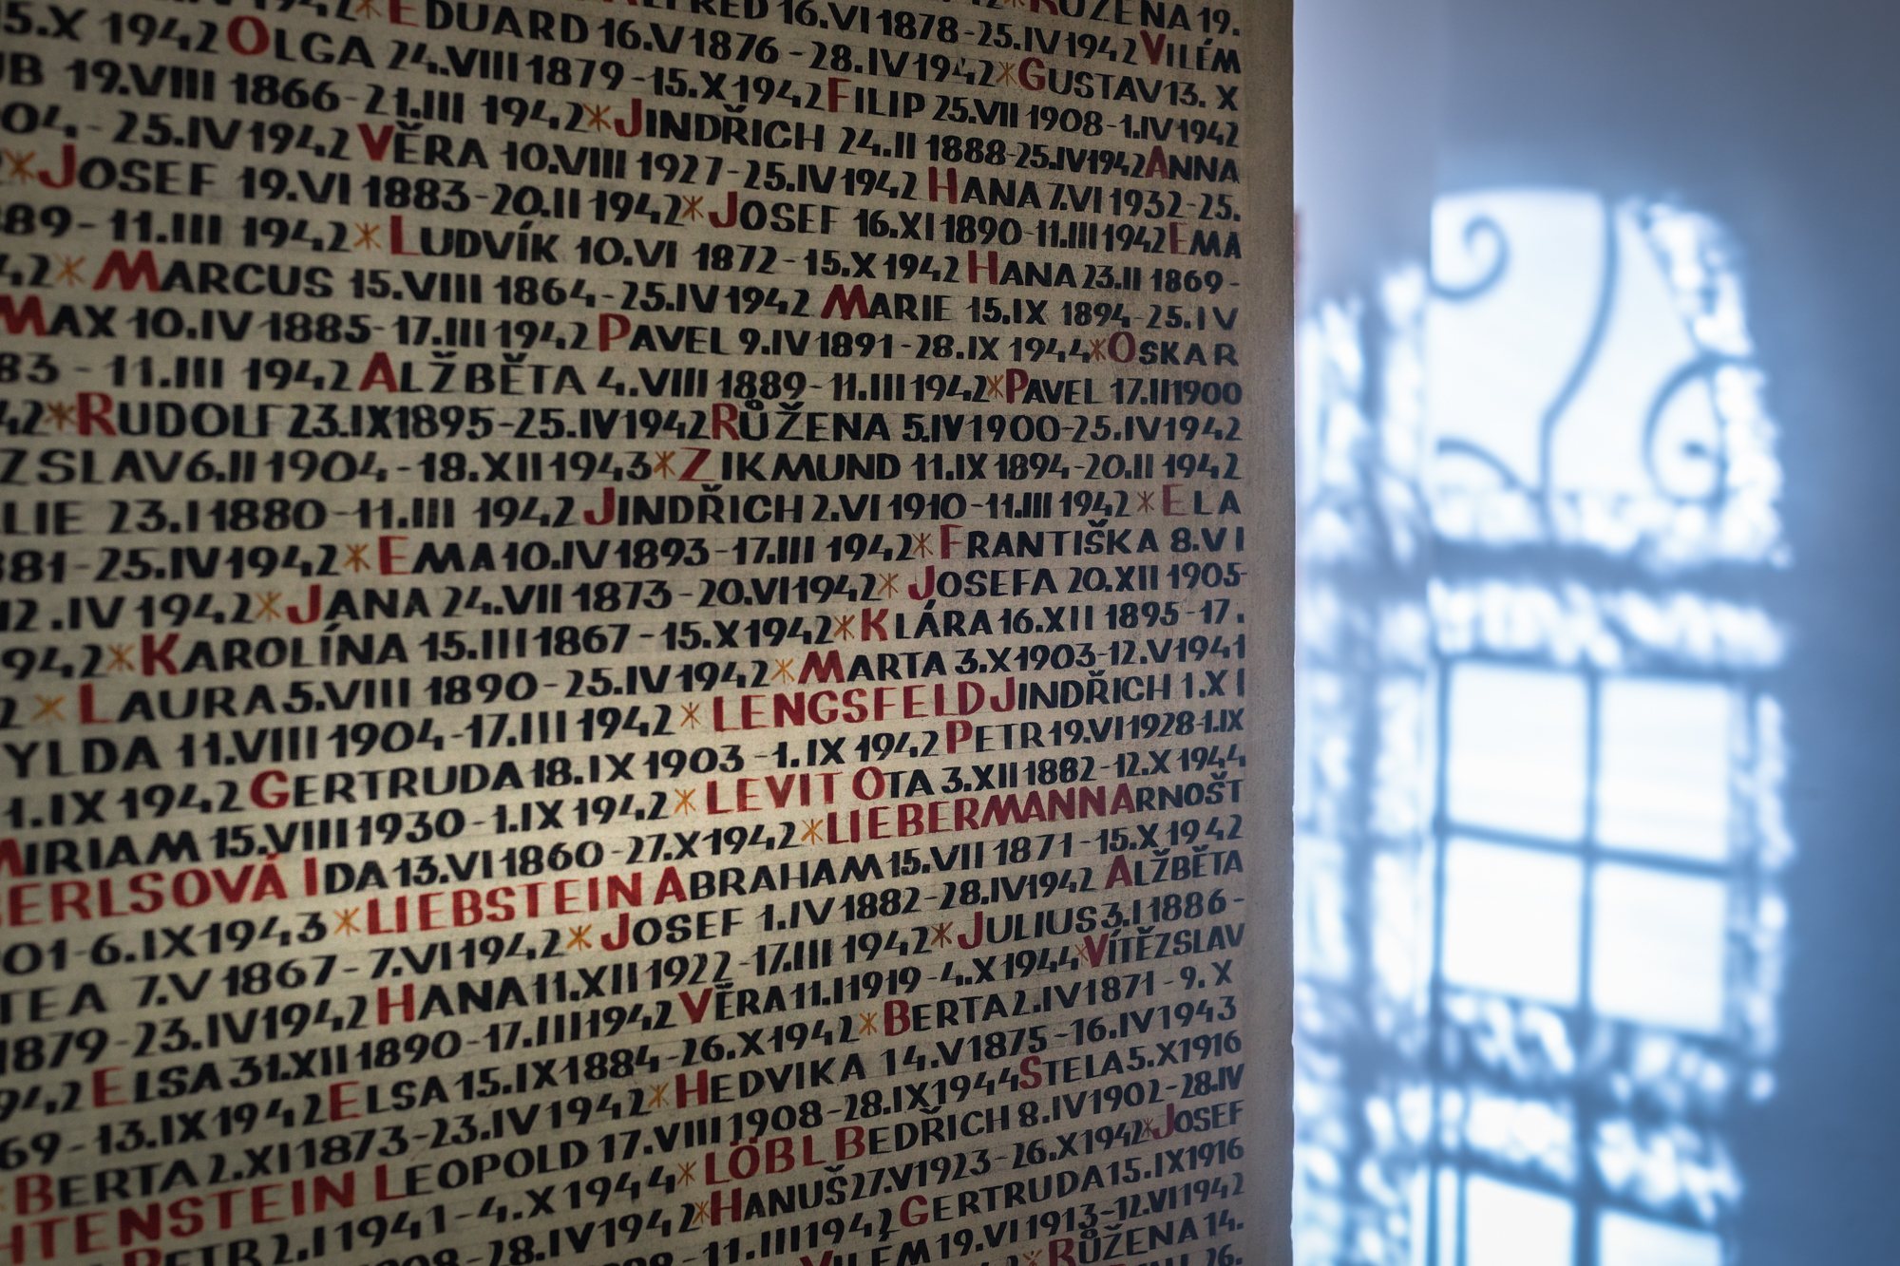
Transhistorical and Historical Answer
Transhistorical: Toledot
F. Rosenzweig & C. Chalier
Rosenzweig: triple absence of Jewish people in history -> holiness
Teshuva as triple criticism to historicism:
  Linguistic
  No fatalism
  Heteronomy
Chalier: teshuva –> messianic time: teshuva as response to election of Jewish people
Jewish people outside of history: proper, transcendent history: toledot!
  « La longue patience nécessaire à l’énumération de noms qui engendrent d’autres noms possède en elle-même une excellence, celle qui donne sens au temps par la grâce des noms propres. La langue hébraïque, en parlant de toledot [...] enseigne que l’histoire comprise comme quête d’un sens à donner au devenir humain n’est pas liée à la lutte du pouvoir recherchant à s’imposer, à la violence des Etats avides de puissance et de reconnaissance, mais bel et bien à la possibilité d’énoncer des noms propres sources d’autres noms propres”
Continuation of toledot as ultime protest against annihilation of Shoah

Slide 8
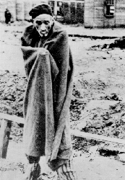
Transhistorical and Historical Answer
2. Historical: 614th commandment
E. Fackenheim
Criticism to transhistorical perspective
  Questioning possibility of teshuva after Shoah
  Necessity of teshuva: tikkun of the irreparable!
  Possibility of teshuva because tikkun within Holocaust
Commanding voice of Holocaust
the ‘614th commandment’ [is] forbidding Jews to five Hitler posthumous victories

Slide 9
Avrom Sutzkever as a Way in Between?

Slide 10
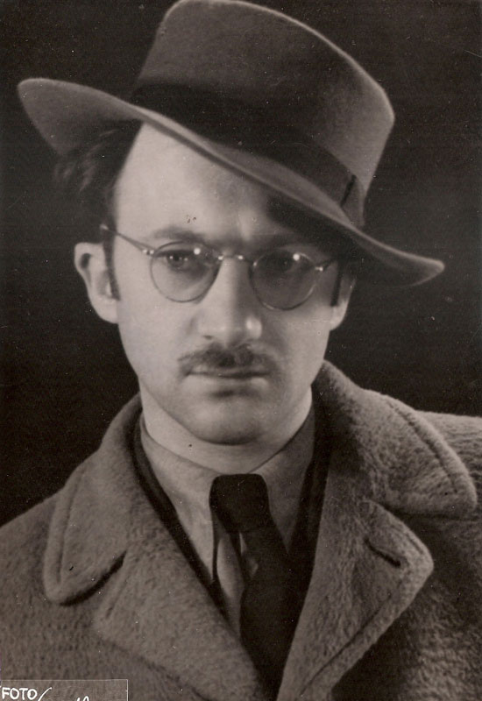
Avrom Sutzkever
Avrom Sutzkever (1913-2010): important voice within the Yiddish (post)-Holocaust poetry
Poetry as act of resistance
Adorno “Nach Auschwitz ein Gedicht zu schreiben, ist barbarisch”
  Sutzkever: response! “écrire pour briser la vitre du temps “
  Symbiosis past – present through the word
  Poetry as redemptive act!:
To conquer domains of time with the word,
anointing your spotless pure syllables with them;
to bind all your muscles in tefillin of music,
and clothe your earthly skin in silence,
to split open a rhyme like a pomegranate, drink it,
and let all your limbs melt away into poems
until all your poems become limbs once again –
It was for this, lad, that you were created
  Poetry contains eternity cf. transhistorical perspective
Not some sweet-and-sour hybrid with strange taste.
Whether I rise on the rungs of my ribs, or fall –
That word is mine. In the black pupil of death – a little flame
Now matter how great my generation might be – still greater yet is its smallness.
Still eternal is the word in all of its ugliness and splendor.

Slide 11
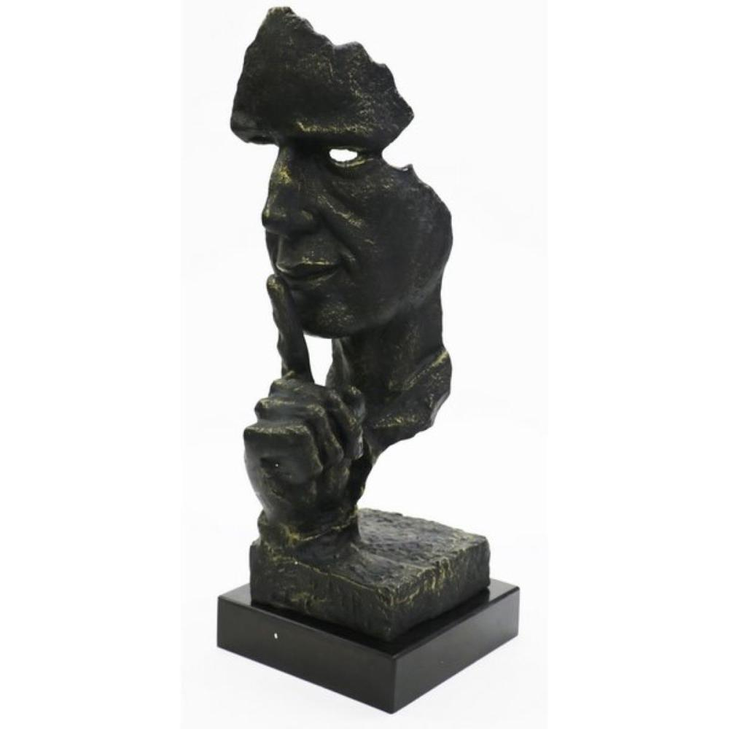
Avrom Sutzkever
Poetry as act of resistance
  Active! Cf. historical perspective!
  Eternity within the word! Cf. transhistorical perspective
Sutzkever and silence
  Positive perspective!
  Goal of poetry = silence!
  Three terms for silence as leading themes throughout Sutzkever’s poetry: שטומקייט (shtumkayt, muteness), שטילקייט (shtilkayt, stillness or silence), and שווַײגן (shvaygn, silence)

Slide 12
Avrom Sutzkever
Avrom Sutzkever and silence: the third silence
Two pans hang before me on these scales:
on one the silence of the sea. And on the other
the desert’s silence. Someone must weigh them.
Their ancient weeping is my true companion.
The pointers wavers to and fro. It’s not yet clear
which silence is the heavier.
Don’t flee, my heart. Just wait a little while.
A third silence exists. O, listen carefully:
It gave birth to life. It is immortal.
There is no grain of sand without its seed.
The fragment hunters kiss its fragments,
and though men call it death, it has a different name.
At night, the scale pans gleam with silvery light,
glowing blue with sea and desert silence,
the pointer falls asleep, without a voice or sound –
and that third silence speaks out from its slumber

Slide 13
Avrom Sutzkever
Avrom Sutzkever and silence:
  Eternity in silence evoked through poetic word
  Here lies bridge with the past and present: communication with dead
  Also theme in Sutzkever’s life: Nuremberg trial

Slide 14
Conclusion

Slide 15
Conclusion
Gaon: silence -> olam ha ba
Transhistorical: teshuva as messianic anticipation
Historical perspective: 614th commandment
Avrom Sutzkever: a way in between?

Slide 16
Thank you!

Slide 21



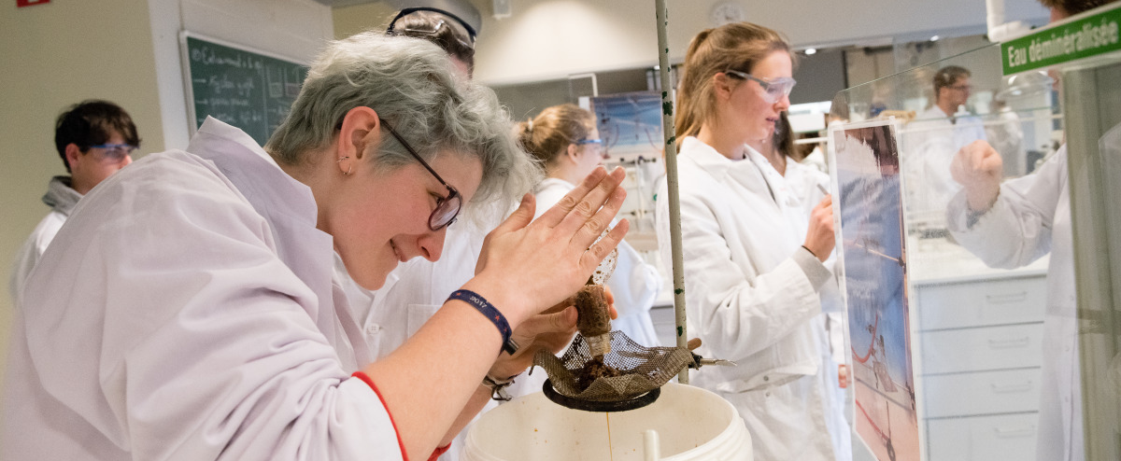

Slide 22



Slide 23
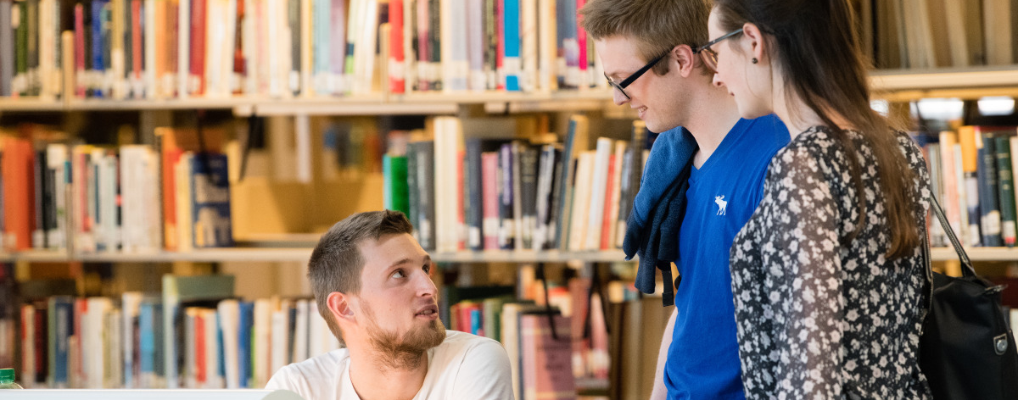

Slide 24


Slide 25



