Slide 1







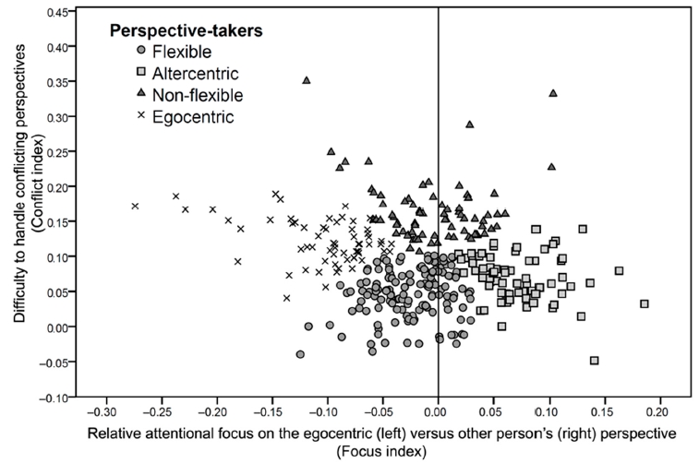
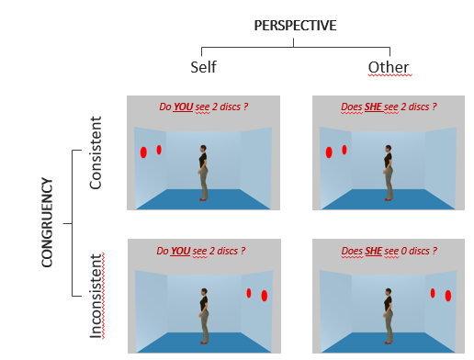
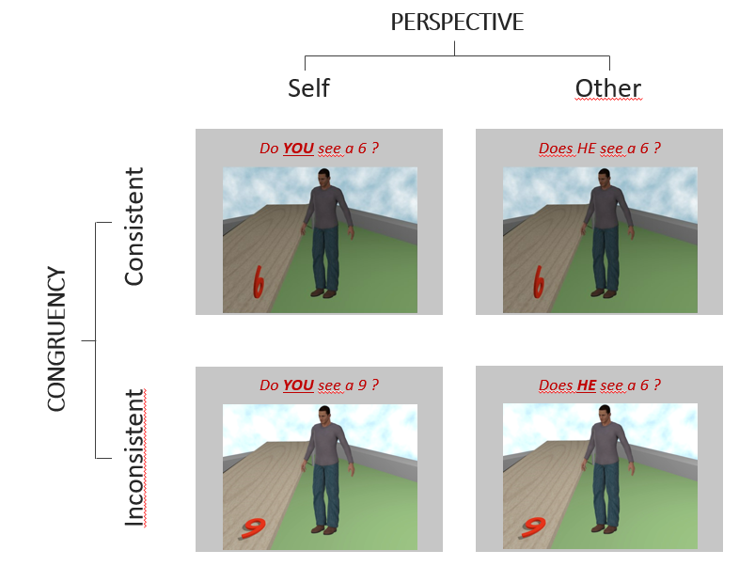
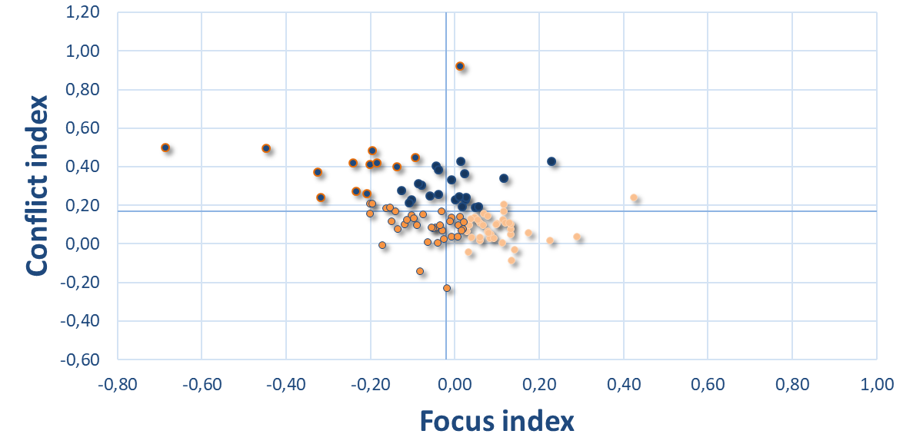
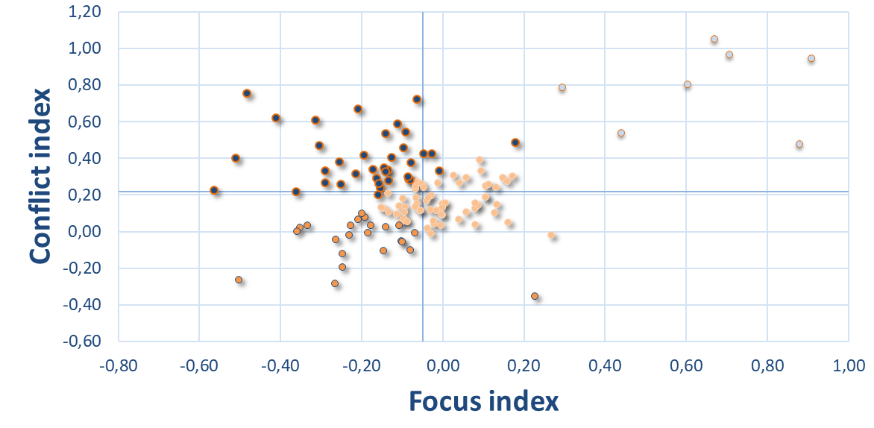

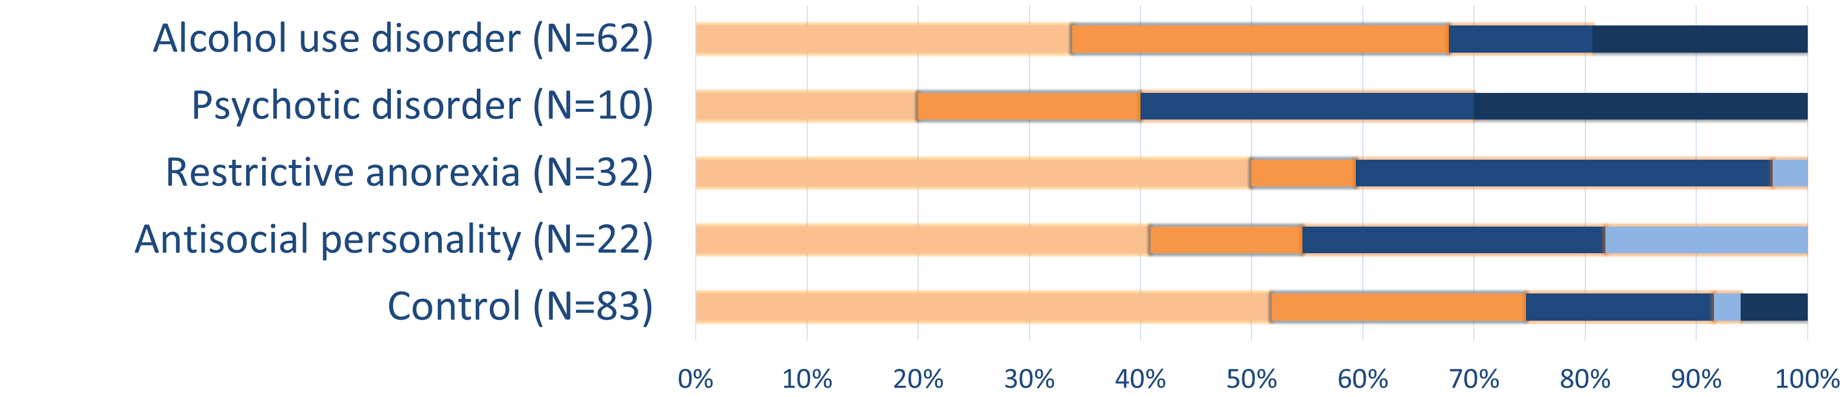
Bigot, A.*, De Timary, P., Amadieu, C., Leclercq, S., Pham, T., Saloppé, X., Tiberi, L., Nandrino, JL., Peeters, JC., Bukowski, H. (2022)
Identifying transdiagnostic socio-cognitive profiles
across 4 clinical populations
*alix.bigot@uclouvain.be
Introduction
Distinct profiles of perspective-takers found in healthy participants^{1,2}.
Socio-cognitive impairments and interpersonal difficulties are frequently observed in various mental disorders⁴⁻⁵.
But inconsistent findings: possibly due to overreliance on single-score and self-report measures, and unaccounted heterogeneity
within populations sharing the same diagnosis Multidimensional and transdiagnostic assessment of social cognition^{1,6} .
We examined socio-cognitive performance across two dimensions⁶ posited to underpin mentalizing skills across all populations
      Self-Other Priority: the tendency to focus more (or attentionally prioritize) on one perspective compared to the other.
      Self-Other Distinction: the ability to handle conflicting perspectives and inhibit the interference.
4 social-cognitive profiles in healthy adults¹
VPT1
Method
7
VPT2
8
Other
Previous studies⁹⁻¹¹ had 1 condition vs. 4 conditions
96 trials : Response time / accuracy rate IES (inverse efficiency score)
Other
Do YOU see 2 discs ?
Does SHE see 2 discs ?
Self-Other priority:
(IES Other-persp. - IES Self-persp.) / (IES Other-persp. + IES Self-persp.)
Do YOU see a 6 ?
Does HE see a 6 ?
Self-Other distinction:
(IES Incongruent-persp. - IES Congruent-persp.) / (IES Incongruent-persp. + IES Congruent-persp.)
Inconsistent
Do YOU see 2 discs ?
Does SHE see 2 discs ?
WHETHER (s)he can see
→ Evidence of construct and convergent validity with more ecological measures^{1,10-13}
WHAT (s)he can see
Inconsistent
Do YOU see a 9 ?
Does HE see a 6 ?
Analyses and results
High conflict
Two-steps clustering analyses (AIC) conducted on VPT1 and VPT2 samples
Self-Other Distinction
High conflict
Self-Other Distinction
VPT1
N=105
VPT2
N=129
Self-Other Priority
Self-Other Priority
Flexible
Egocentric
Altercentric
Flexible
Egocentric
Altercentric
Transdiagnostic socio-cognitive profiles:
VPT1
3 main results:
High individual differences along both dimensions
3 similar clusters across VPT1 and VPT2
Heterogeneity of profiles within same-diagnosis populations
VPT2
VPT1 & 2
Discussion
Distinct transdiagnostic socio-cognitive profiles identified via 2-dimensional assessment : Self-Other Priority and Self-Other Distinction.
Replicates and extends previous studies conducted on healthy students in cognitive and affective PT^{1,2}.
Heterogeneity of profiles despite same diagnosis across 4 clinical populations (alcohol use disorder, psychotic disorder, restrictive anorexia, antisocial personality).
Three socio-cognitive profiles irrespective of PT task (flexible and altercentric, flexible and egocentric, conflicted and egocentric)
→ common basic processes/profiles underlying individual differences.
(5) Subtypes of ‘mentalizing deficit’ (instead of present/absent) : Excessively egocentric, excessively altercentric, conflicted, or a combination of deficits…
Perspectives and limitations
References
Rehabilitation / personalized training programs adapted to specific socio-cognitive profile.
Foundation for transdiagnostic collaboration.
Extension to other populations (collaborations welcomed ☺ )
New PT tool with 8 sub-dimensions in development.
PRELIMINARY DATA → small sample sizes
→ unrepresentative samples (for now).
(2) Unmatched controls, no covariates currently included (demographics, questionnaires, …).
(3) Assessment via distinct tasks for distinct populations.
(4) Cluster partitions variation (parameters and indexes), as reported in previous study^{1,5}.
Bukowski, H., & Samson, D. (2017). New Insights into the Inter-Individual Variability in Perspective Taking. Vision, 1(1), 8. https://doi.org/10.3390/vision1010008
Bukowski, H., Silani, G., Riva, F., Tomova, L. & Lamm, C. Measuring self-other sharing and self-other distinction as distinct dimensions of empathy. Poster presentations at Social Cognition Workshop (2015) at University of Bangor and Normal and pathological personality colloquium (2018) at University of Mons.
Bora, E., & Köse, S. (2016). Meta-analysis of theory of mind in anorexia nervosa and bulimia nervosa: A specific İmpairment of cognitive perspective taking in anorexia nervosa?: ToM IN ED. International Journal of Eating Disorders, 49(8), 739–740. https://doi.org/10.1002/eat.22572
Bora, E., & Zorlu, N. (2017). Social cognition in alcohol use disorder: A meta-analysis: Social cognition in AUD. Addiction, 112(1), 40–48. https://doi.org/10.1111/add.13486
Bora, E. (2020). Theory of mind and schizotypy: A meta-analysis. Schizophrenia Research, 222, 97–103. https://doi.org/10.1016/j.schres.2020.04.024
Bukowski, H. (2014). What influences perspective taking ? A dynamic and multidimensional approach [Thesis, UCLouvain]. Dial. http://hdl.handle.net/2078.1/151995
Samson, D., Apperly, I. A., Braithwaite, J. J., Andrews, B. J., & Scott, S. E. B. (2010). Seeing It Their Way: Evidence for Rapid and Involuntary Computation of What Other People See. 12.
Surtees, A., Samson, D., & Apperly, I. (2016). Unintentional perspective-taking calculates whether something is seen, but not how it is seen. Cognition, 148, 97–105. https://doi.org/10.1016/j.cognition.2015.12.010
Epley, N., Keysar, B., Van Boven, L., & Gilovich, T. (2004). Perspective Taking as Egocentric Anchoring and Adjustment. Journal of Personality and Social Psychology, 87(3), 327–339. https://doi.org/10.1037/0022-3514.87.3.327
Lin, S., Keysar, B., & Epley, N. (2010). Reflexively mindblind: Using theory of mind to interpret behavior requires effortful attention. Journal of Experimental Social Psychology, 46(3), 551–556. https://doi.org/10.1016/j.jesp.2009.12.019
Galinsky, A. D., & Moskowitz, G. B. (2000). Perspective-taking: Decreasing stereotype expression, stereotype accessibility, and in-group favoritism. Journal of Personality and Social Psychology, 78(4), 708–724. https://doi.org/10.1037/0022-3514.78.4.708
Bukowski, H., & Samson, D. (2016). Can emotions influence level-1 visual perspective taking? Cognitive Neuroscience, 7(1–4), 182–191. https://doi.org/10.1080/17588928.2015.1043879
Mattan, B. D., Rotshtein, P., & Quinn, K. A. (2016). Empathy and visual perspective-taking performance. Cognitive Neuroscience, 7(1–4), 170–181. https://doi.org/10.1080/17588928.2015.1085372
Nielsen, M. K., Slade, L., Levy, J. P., & Holmes, A. (2015). Inclined to see it your way: Do altercentric intrusion effects in visual perspective taking reflect an intrinsically social process? Quarterly Journal of Experimental Psychology, 68(10), 1931–1951. https://doi.org/10.1080/17470218.2015.1023206
Bukowski, H., Ahmad Kamal, N. F., Bennett, D., Rizzo, G., & O’Tuathaigh, C. (2021). Association between dispositional empathy and self-other distinction in Irish and Belgian medical students: A cross-sectional analysis. BMJ Open, 11(9), e048597. https://doi.org/10.1136/bmjopen-2020-048597
Notes:
Ne pas oublier de cacher le trait rouge de other image et vpt 2 aussi instructions
IPSY… IONS, crds, Umons, Lille, Charleroi

