Slide 1





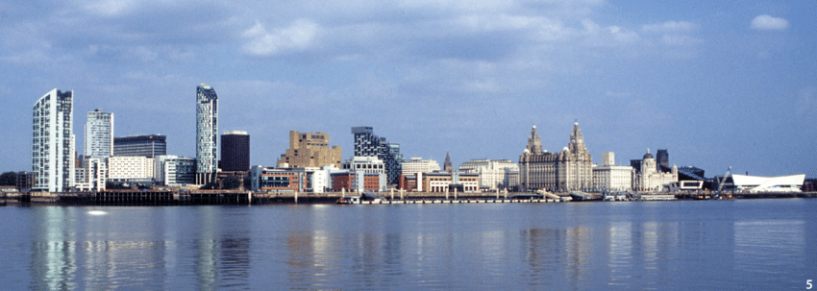



12TH INTERNATIONAL CONFERENCE ON FLUVIAL HYDRAULICS
Climate change and adaptation
Flood interpretation in case of measurement failure.
The Wamme river in 2021.
Y. Zech, R. Meurice, N. Delpierre,
P.-Y. Gousenbourger & S. Soares-Frazão
IMMC, UCLouvain, Belgium.
LIVERPOOL, 2ND – 6TH SEPTEMBER

Slide 2
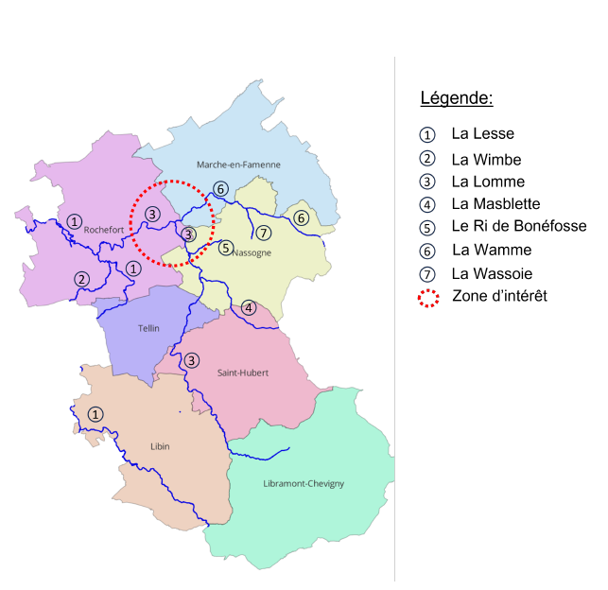
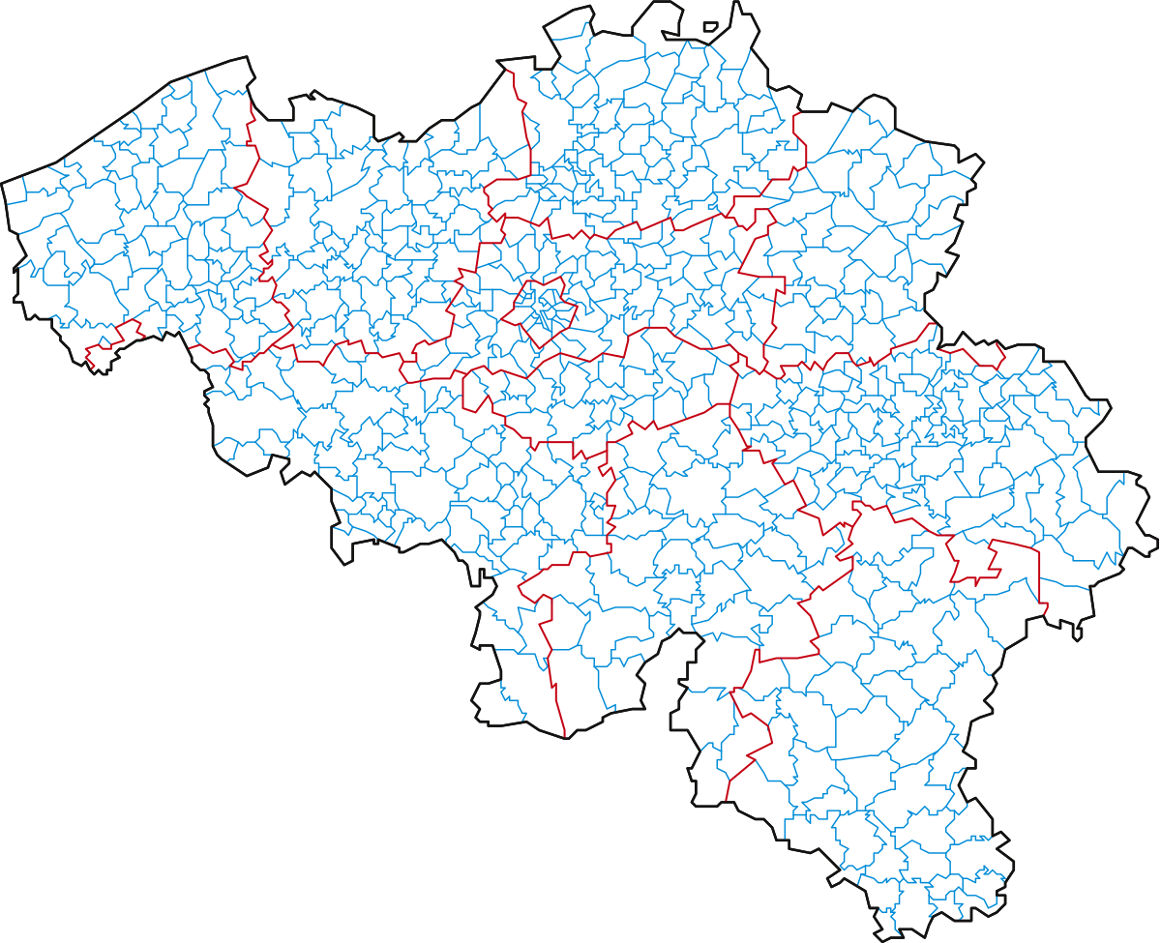

12TH INTERNATIONAL CONFERENCE ON FLUVIAL HYDRAULICS
Geographical context
LIVERPOOL, 2ND – 6TH SEPTEMBER

Slide 3
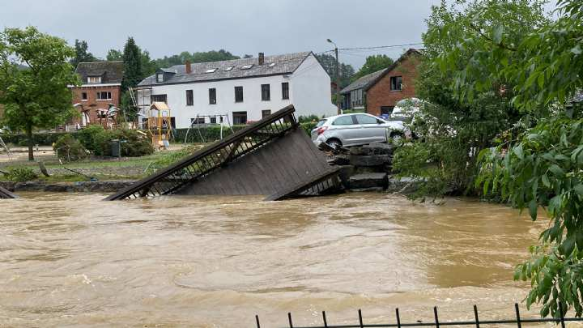
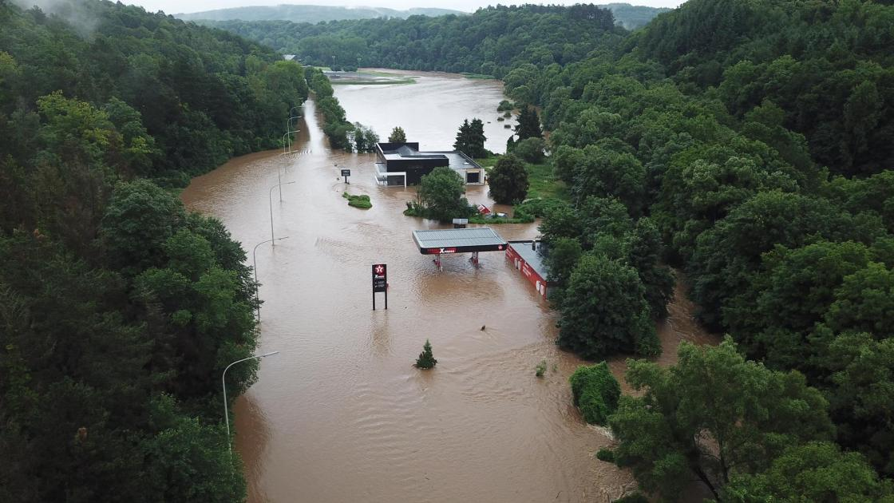
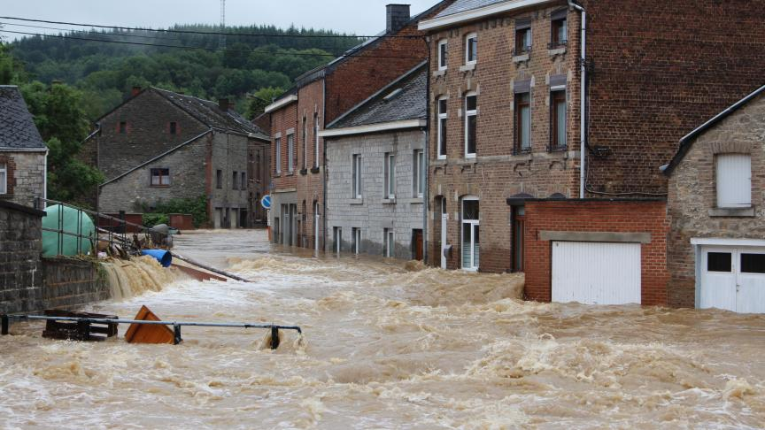
12TH INTERNATIONAL CONFERENCE ON FLUVIAL HYDRAULICS
2021 event in Rochefort
1444 houses were flooded (1 in 4 inhabitants)
2 bridges and 3 footbridges were destroyed
31 814 993 m³ of water flowing between the 13th and the 16th of july
LIVERPOOL, 2ND – 6TH SEPTEMBER

Slide 4
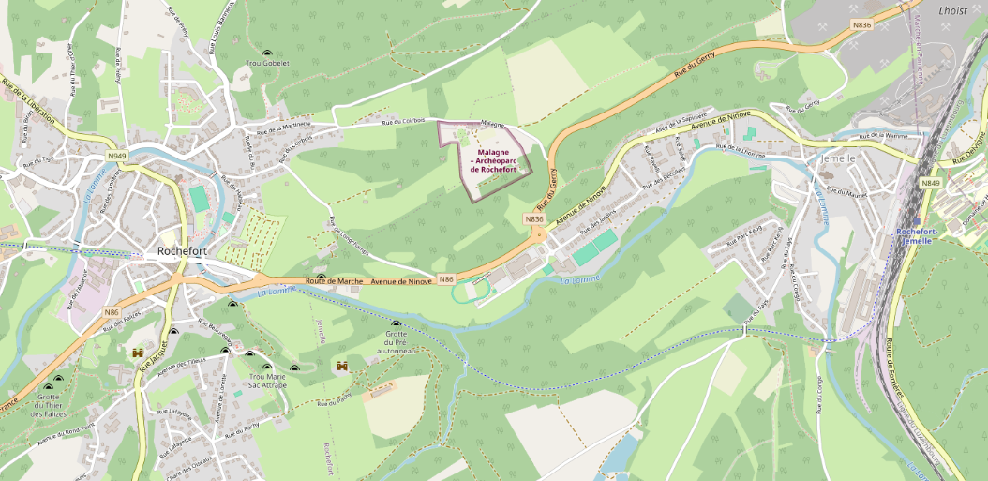
12TH INTERNATIONAL CONFERENCE ON FLUVIAL HYDRAULICS
Focus on the floods in Jemelle
LIVERPOOL, 2ND – 6TH SEPTEMBER

Slide 5
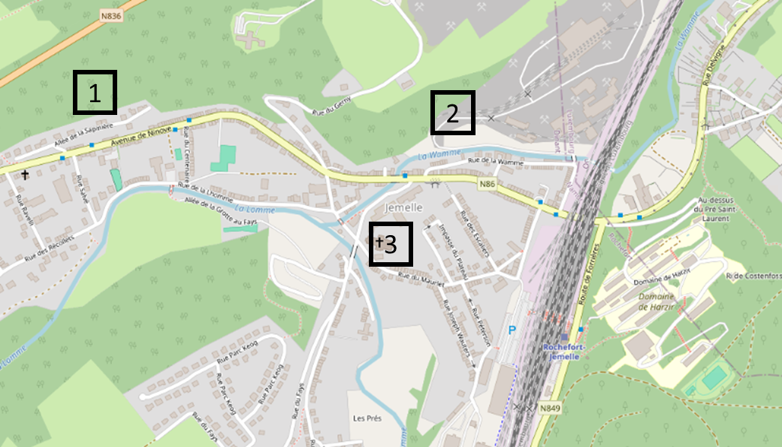
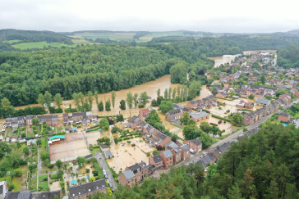
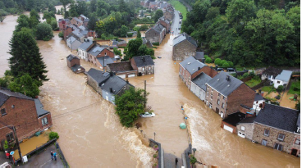
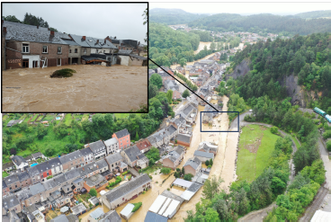
12TH INTERNATIONAL CONFERENCE ON FLUVIAL HYDRAULICS
1
3
2
LIVERPOOL, 2ND – 6TH SEPTEMBER

Slide 6

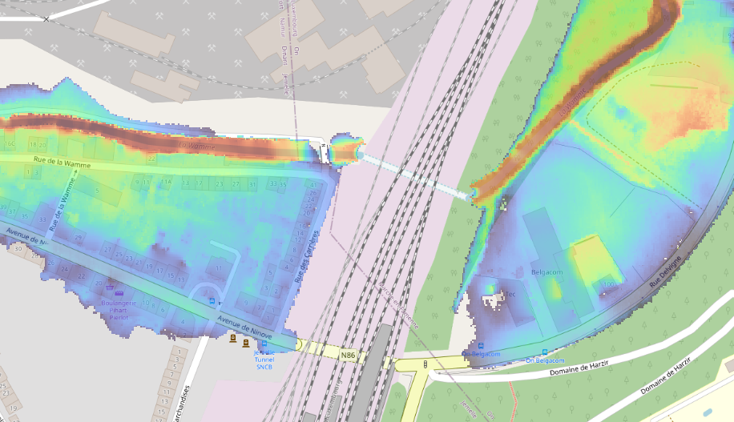
12TH INTERNATIONAL CONFERENCE ON FLUVIAL HYDRAULICS
Focus on the floods in Jemelle
2 options were foreseen by the municipality to avoid new floodings:
Walloon region data: 2021 flood extent
LIVERPOOL, 2ND – 6TH SEPTEMBER

Slide 7
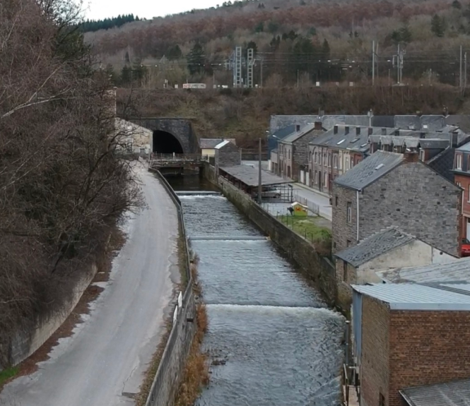
12TH INTERNATIONAL CONFERENCE ON FLUVIAL HYDRAULICS
Focus on the floods in Jemelle
2 options were foreseen by the municipality to avoid new floodings:
Building a wall along rue de la Wamme
Walloon region data: 2021 flood extent
Walloon region data: 2021 flood extent
LIVERPOOL, 2ND – 6TH SEPTEMBER

Slide 8
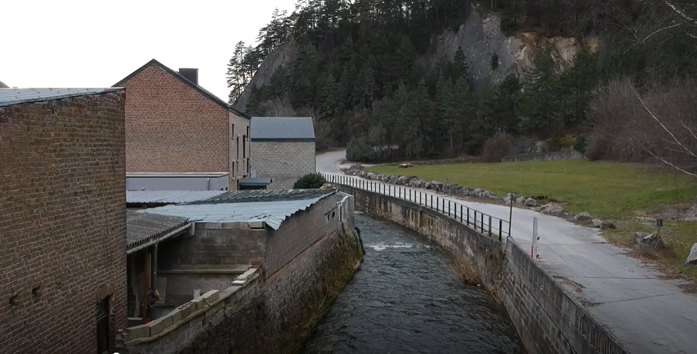
12TH INTERNATIONAL CONFERENCE ON FLUVIAL HYDRAULICS
Focus on the floods in Jemelle
2 options were foreseen by the municipality to avoid new floodings:
Building a wall along rue de la Wamme
Enlarge the river
Walloon region data: 2021 flood extent
LIVERPOOL, 2ND – 6TH SEPTEMBER

Slide 9
12TH INTERNATIONAL CONFERENCE ON FLUVIAL HYDRAULICS
Focus on the floods in Jemelle
2 options were foreseen by the municipality to avoid new floodings:
Building a wall along rue de la Wamme
Enlarge the river
These solutions are not valid for events comparable to 2021 as the flooding also came by the road tunnel.
Walloon region data: 2021 flood extent
LIVERPOOL, 2ND – 6TH SEPTEMBER

Slide 10
12TH INTERNATIONAL CONFERENCE ON FLUVIAL HYDRAULICS
Focus on the floods in Jemelle
2 options were foreseen by the municipality to avoid new floodings:
Building a wall along rue de la Wamme
Enlarge the river
These solutions are not valid for events comparable to 2021 as the flooding also came by the road tunnel.
What is the return time for which these solutions are valid ?
= Find the maximum discharge with no flow in the road tunnel
LIVERPOOL, 2ND – 6TH SEPTEMBER

Slide 11
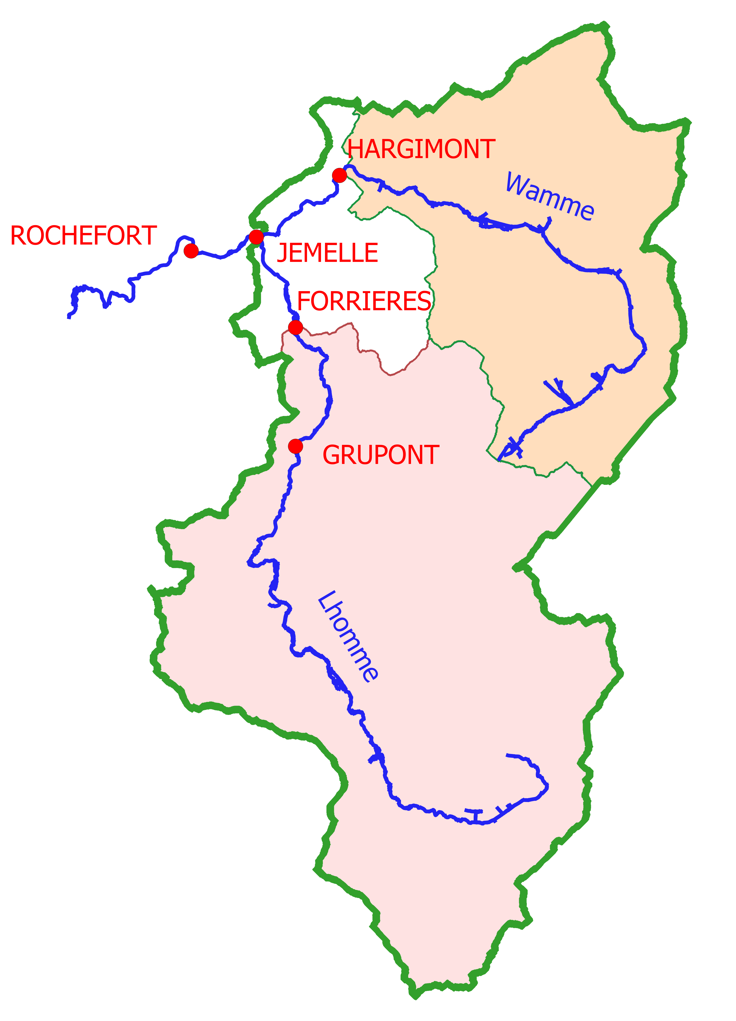
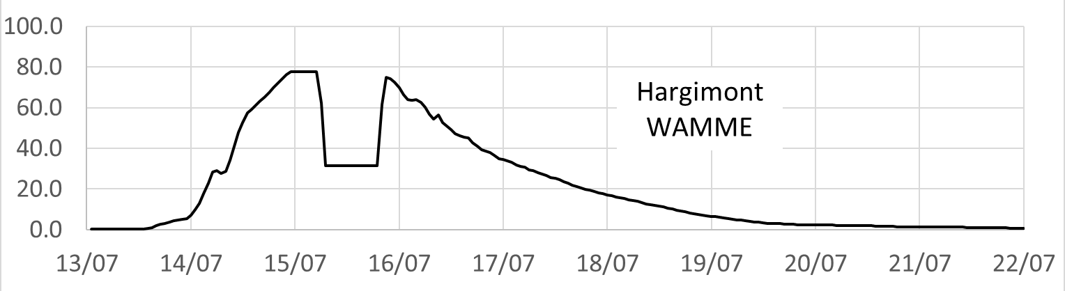
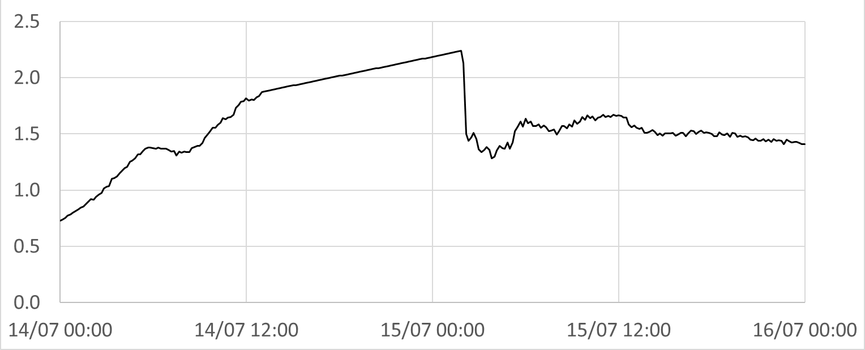
12TH INTERNATIONAL CONFERENCE ON FLUVIAL HYDRAULICS
First, let’s calibrate our model
Which discharge should we consider ?
Three limnimetric stations are availables
Hargimont station is the interesting one
Recorded water discharge
Linear rise
Sudden 80 cm drop
And … The data is weird 😬
Recorded water level
LIVERPOOL, 2ND – 6TH SEPTEMBER

Slide 12
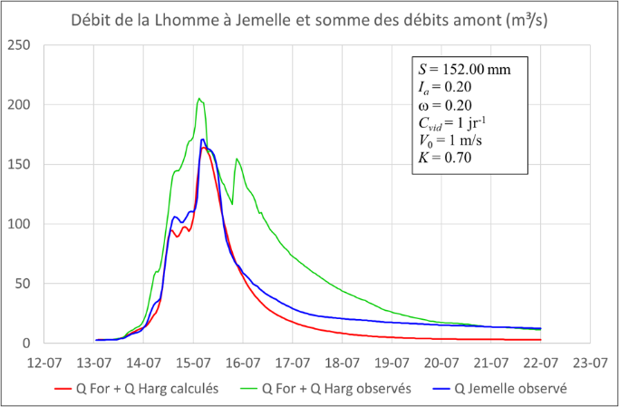
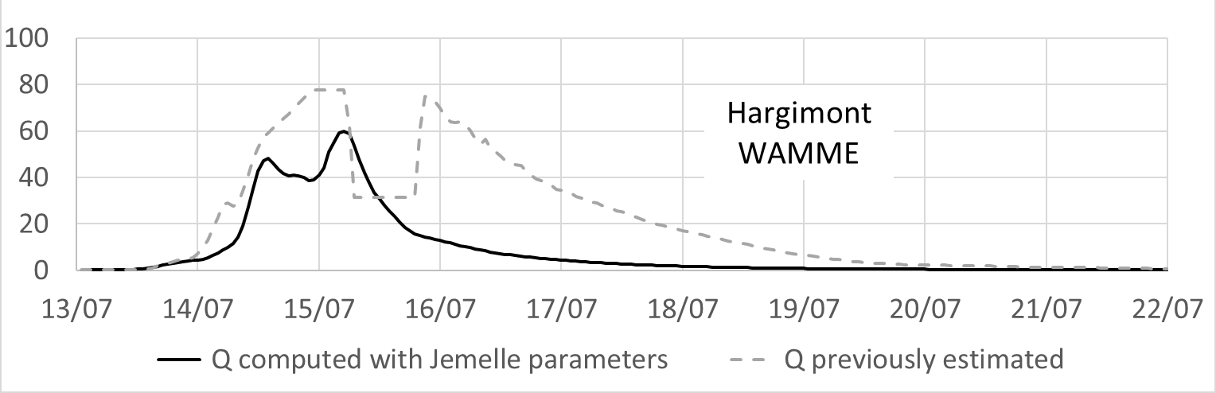
12TH INTERNATIONAL CONFERENCE ON FLUVIAL HYDRAULICS
First, let’s calibrate our model
Which discharge should we consider ?
Three limnimetric stations are available
Hargimont station is the interesting one
Reconstruction of the water discharge by calibrating a hydrologic model using Forrieres and Jemelle stations
A maximum 60 m³/s discharge will be considered
LIVERPOOL, 2ND – 6TH SEPTEMBER

Slide 13
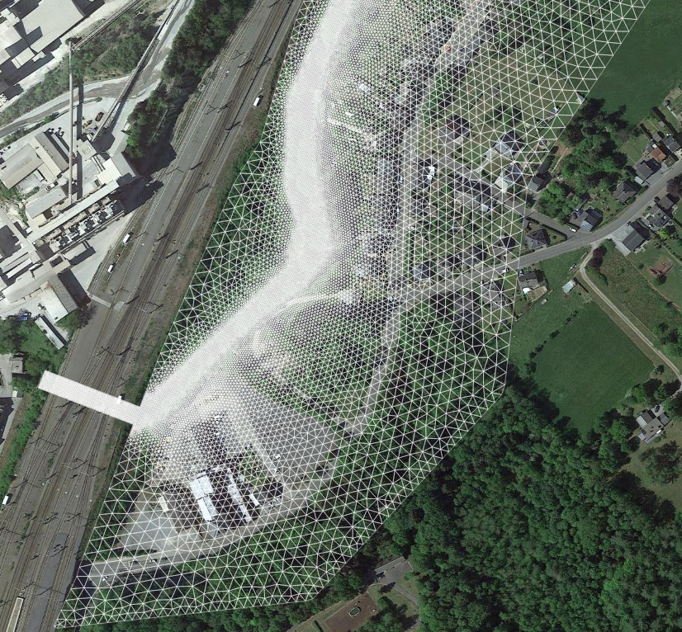
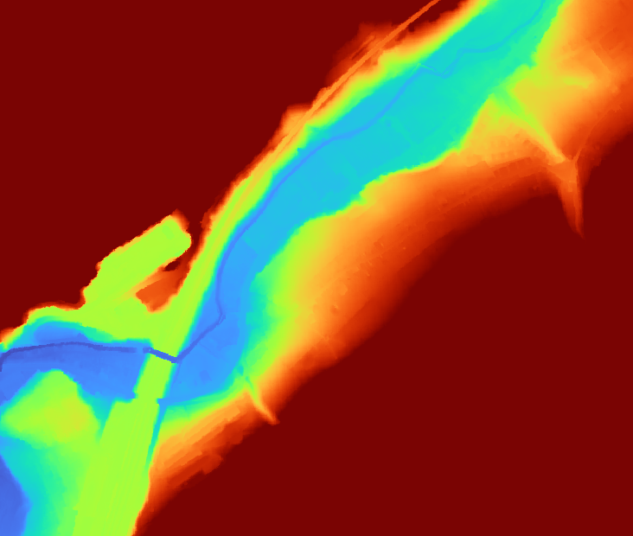
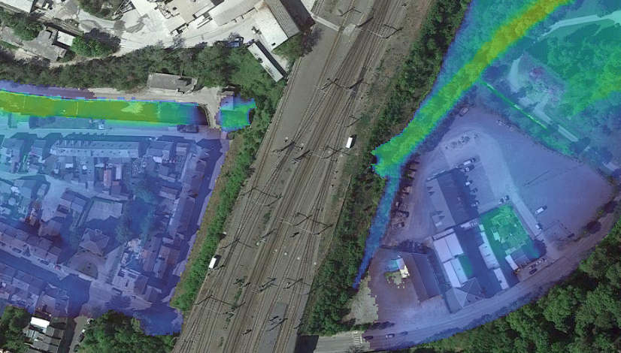

12TH INTERNATIONAL CONFERENCE ON FLUVIAL HYDRAULICS
Modelling of the flood: which ingredients for our recipe ?
A Mesh (built using GMSH)
Digital elevation model
Initial and boundary conditions
WATLAB
Results to be analysed
LIVERPOOL, 2ND – 6TH SEPTEMBER

Slide 14
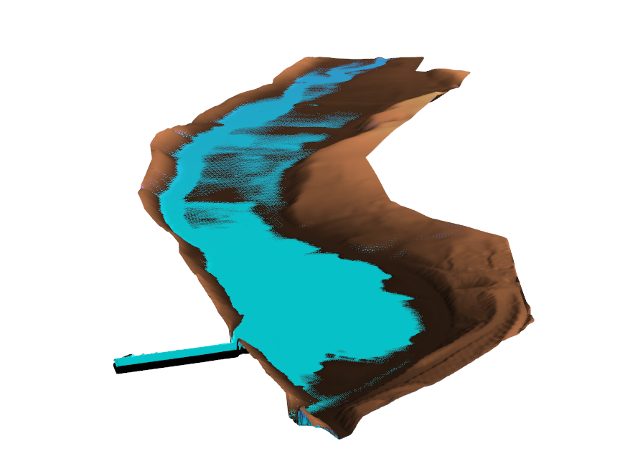
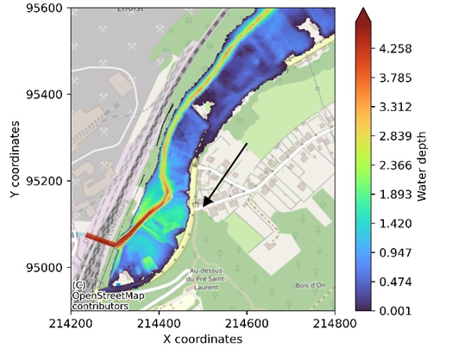
12TH INTERNATIONAL CONFERENCE ON FLUVIAL HYDRAULICS
Modelling of the floods: reference simulation
The road tunnel is flooded for the reference discharge confirming the 2021 observations
3D vizualisation of the area
LIVERPOOL, 2ND – 6TH SEPTEMBER

Slide 15
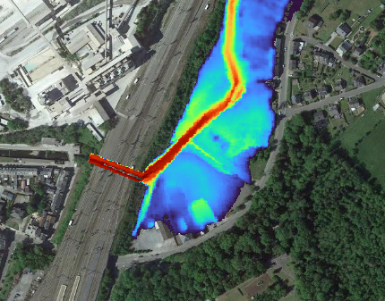
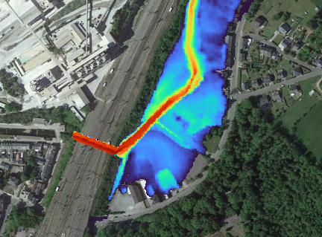
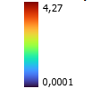
12TH INTERNATIONAL CONFERENCE ON FLUVIAL HYDRAULICS
Modelling of the floods: Lower discharge
No flooding of the road tunnel is observed
Input discharge: 55 m³/s
Input discharge: 50 m³/s
The two solutions can be studied for discharges lower than 55 m³/s
LIVERPOOL, 2ND – 6TH SEPTEMBER

Slide 16


12TH INTERNATIONAL CONFERENCE ON FLUVIAL HYDRAULICS
Further work should examine the mitigation measures along rue de la Wamme
A flood wall or the river enlargement may
lead to a diminution of the flood risk
Most of the past floods happened with
lower than 60 m³/s discharges
→ The range of application could be
interesting
Uncertainties subsist concerning the exact river topography, and the riverbank positions
A flood wall acts as a barrier, preventing water from escaping after the flood
Flood walls are not esthetic above a given height
LIVERPOOL, 2ND – 6TH SEPTEMBER

Slide 17
12TH INTERNATIONAL CONFERENCE ON FLUVIAL HYDRAULICS
Climate change and adaptation
Thank you for listening!
Watlab software :
Conference paper:
Flood interpretation in case of measurement failure.
The Wamme river in 2021.
Y. Zech, R. Meurice, N. Delpierre, P.-Y. Gousenbourger & S. Soares-Frazão
LIVERPOOL, 2ND – 6TH SEPTEMBER

