Slide 1
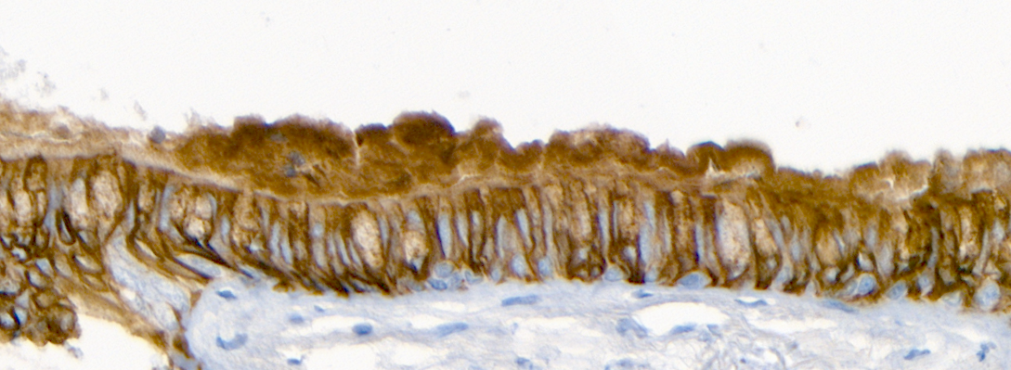

Altered pIgR/S-IgA mucosal immunity in BOS
Dr François Carlier
CHU UCL Namur, UCLouvain
BTS CONGRESS 2022
Brussels, 16 September

Slide 2
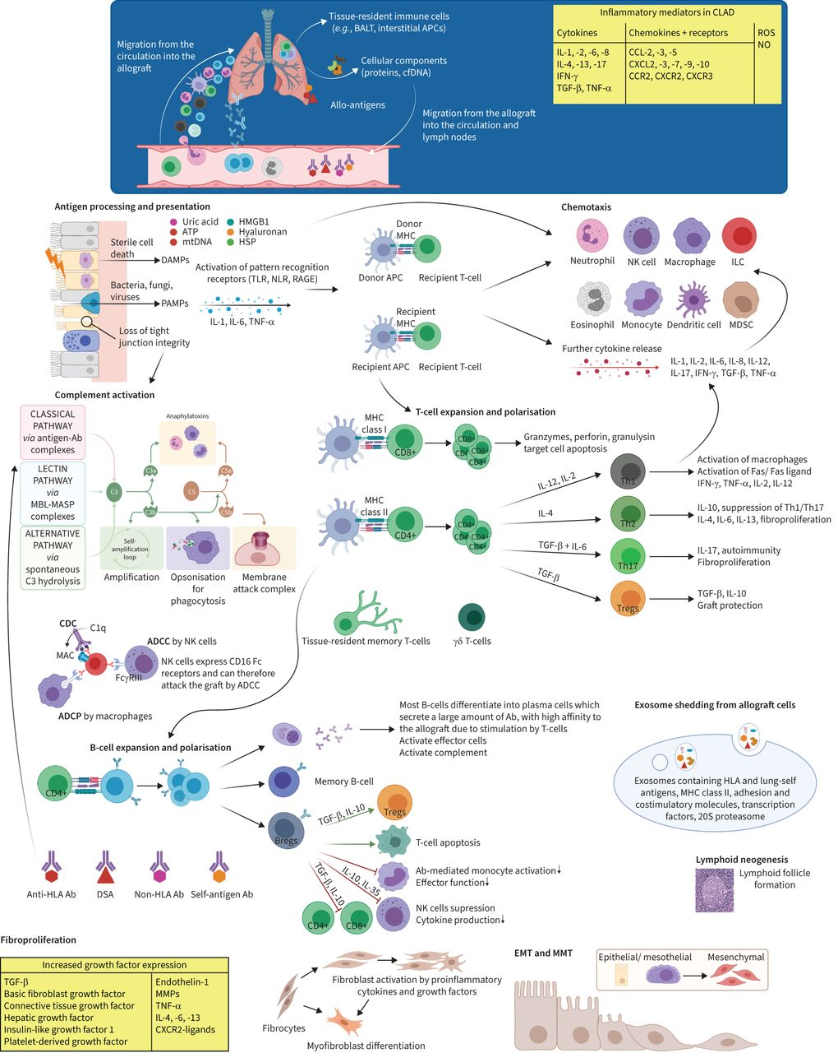
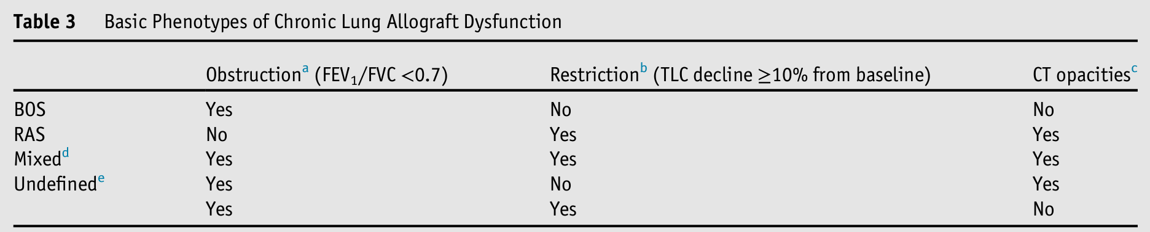
Rationale – CLAD and BOS
CLAD
Major concern after LTx
Phenotyped into BOS, RAS, mixed, undefined
Role of recurrent infections
Bos et al. Eur Respir Rev. 2022.
Verleden et al. J Heart Lung Transplant. 2019.

Slide 3
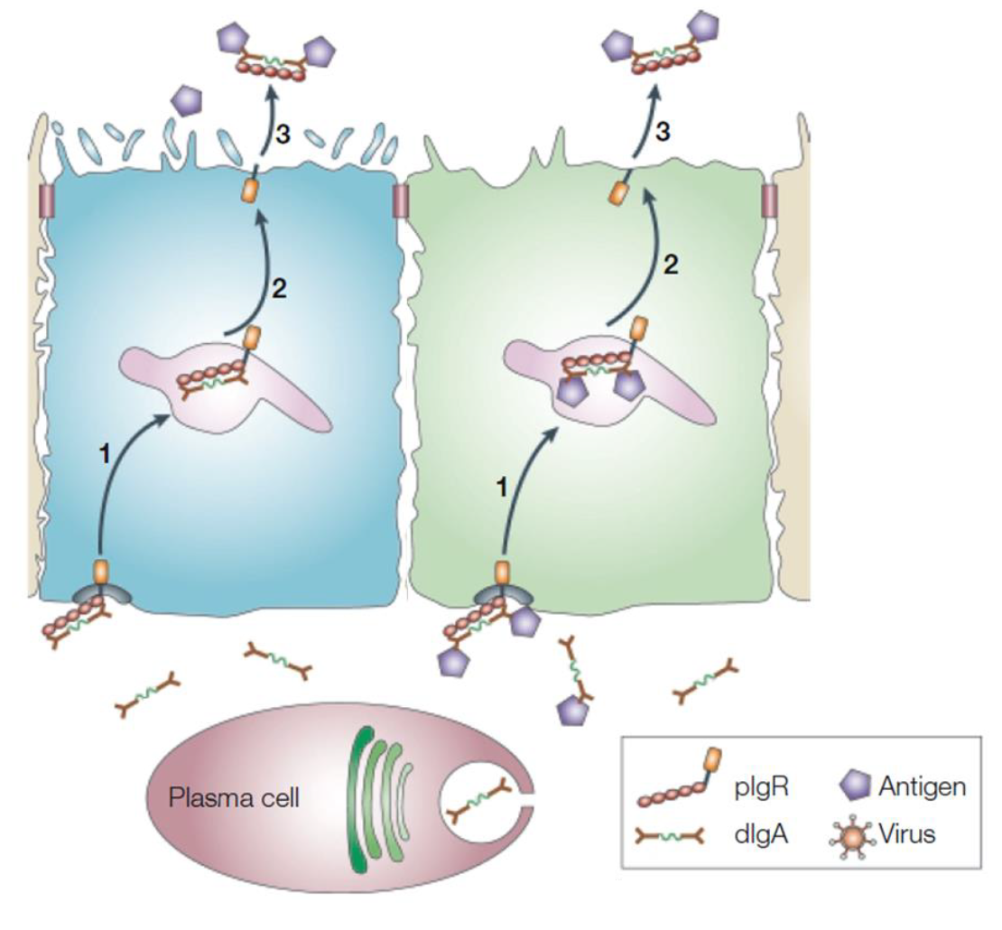
Rationale – pIgR/S-IgA system
Polymeric Ig receptor (pIgR) /
secretory IgA (S-IgA) system
Provides S-IgA in mucosal secretions
Immune exclusion of auto/allo-Ab
    In the lumen
    In the subepithelial area (auto-Ab?)
Altered in COPD, asthma, CF
Aim. Evaluate pIgR/S-IgA dysfunction as early marker of BOS
Modified from Rojas et al. Nat Rev Mol Cell Biol. 2002.

Slide 4




Study design
6m
12m
5y
Pre-LTx
LTx
V1
V2
5-year outcome
Stable | BOS
Death
Serum
BALF
Cohort for Lung Transplant (COLT)
Tissue
(Biopsy/explants)
Foch
Stable
Pre-BOS
BOS
BOS Expants

Slide 5
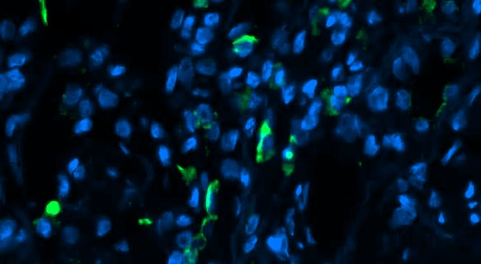
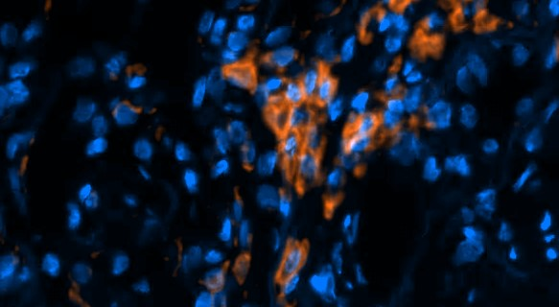
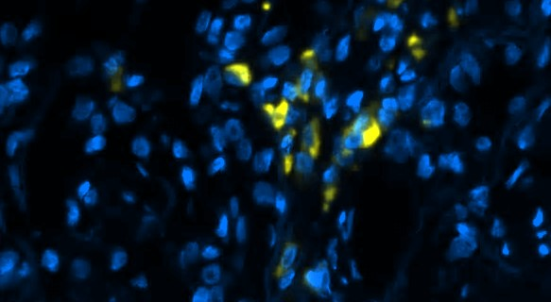
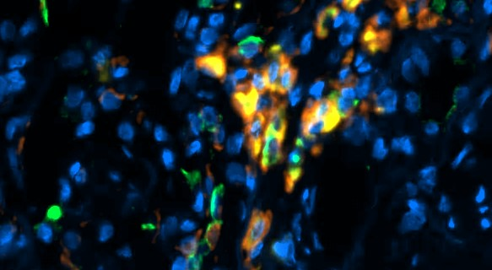
Results
S-IgA
(BALF)
V0 – pre LTx
V1 – 6 mo
V2 – 12 mo
IgA
CD138
IgA⁺ B cells
(tissue)
V1
CD79a
Merge
V2

Slide 6
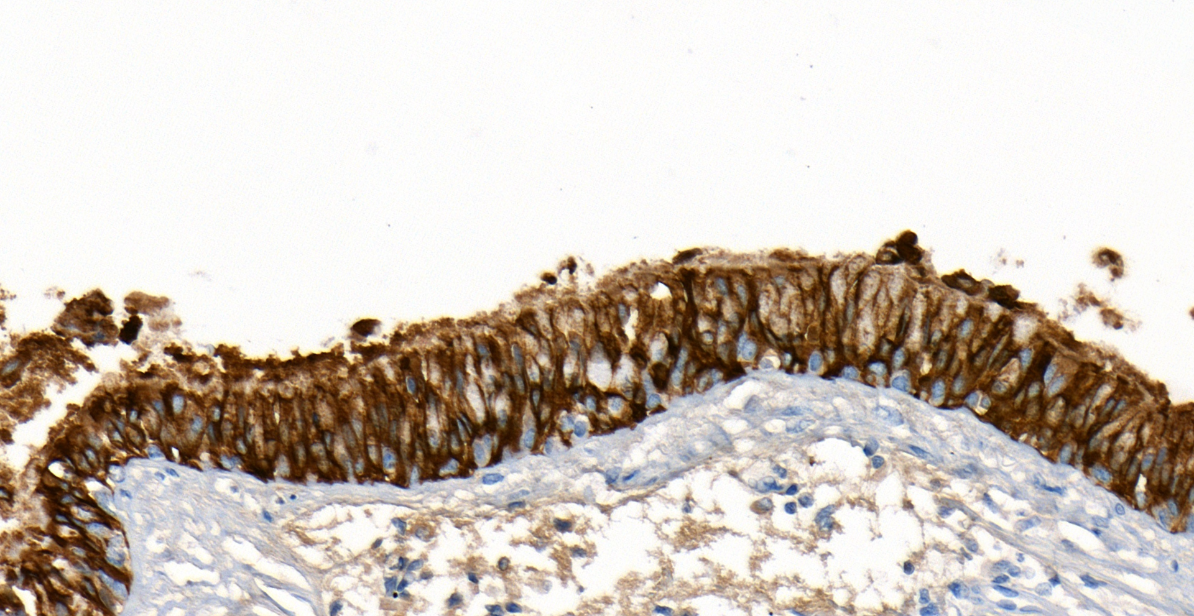
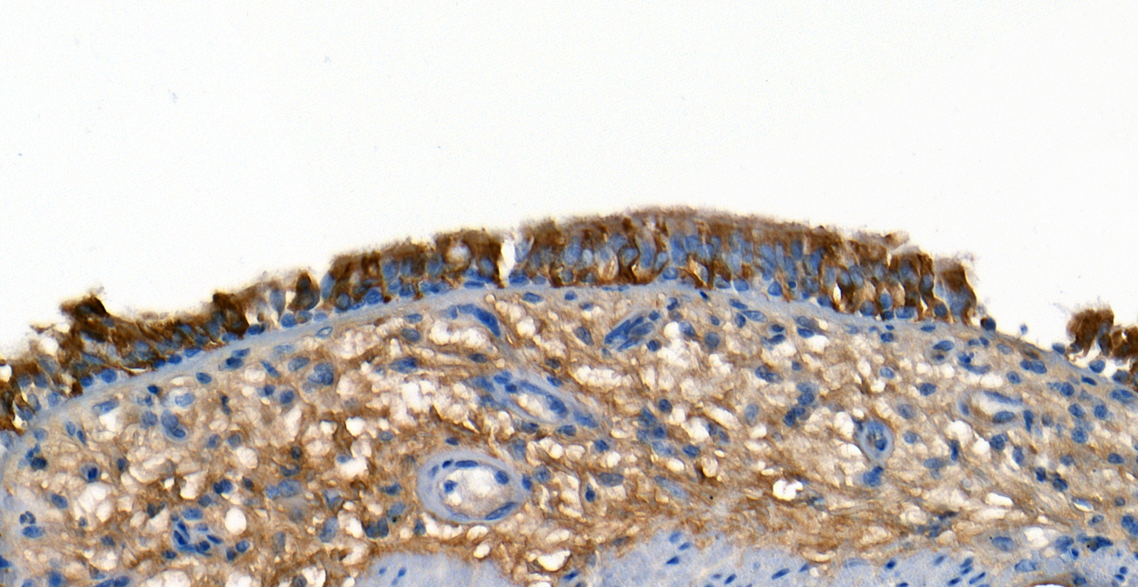
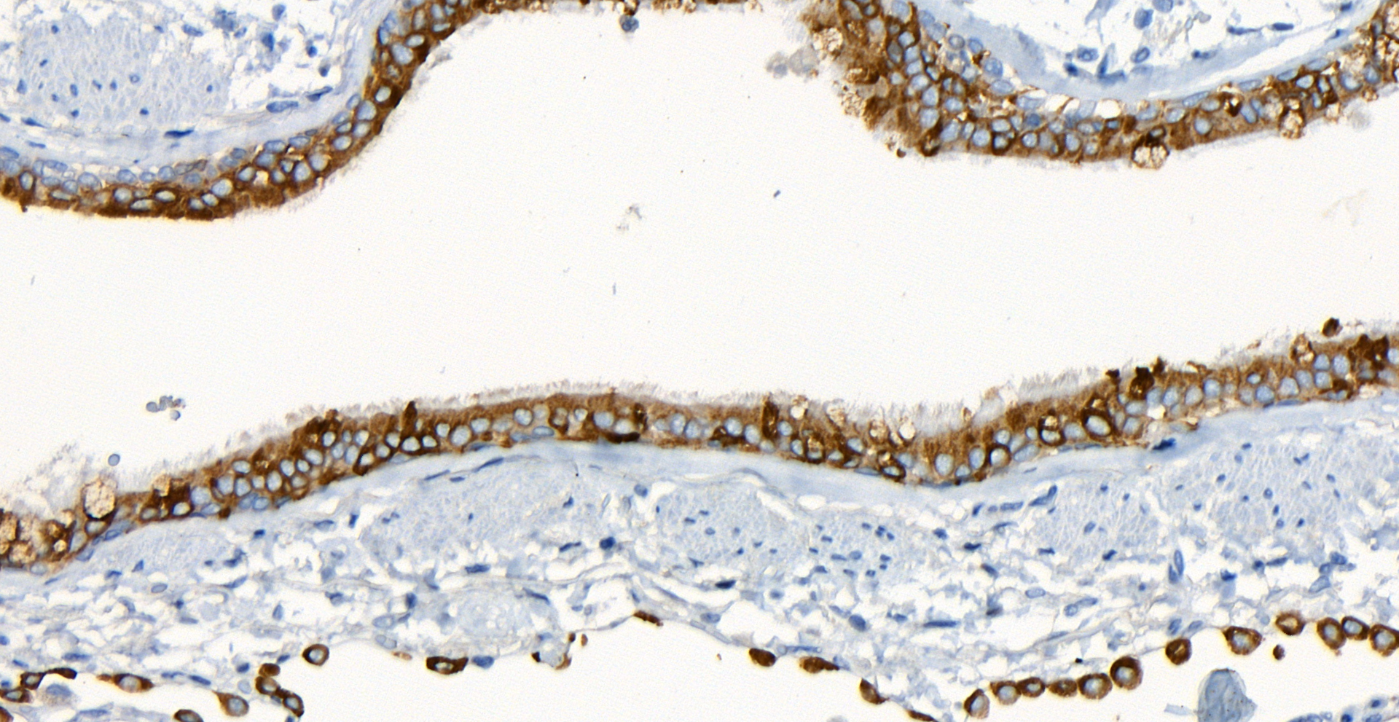
Results
BOS free
SC
(Serum)
V0
pIgR
(tissue)
V0 – pre LTx
V1 – 6 mo
V2 – 12 mo
BOS biopsy
V1
V2
BOS explant

Slide 7
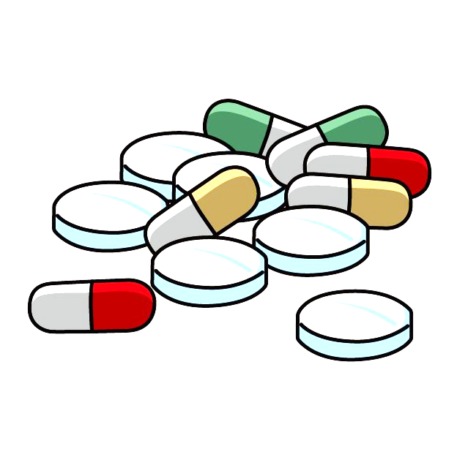
Results
IgA
(Serum)
V0
V1
V2
V0 – pre LTx
V1 – 6 mo
V2 – 12 mo

Slide 8
Conclusions
1
Decreased BALF S-IgA levels
(Prior to BOS diagnosis)
Decreased pIgR expression
(At BOS diagnosis)
Serum
      Increased serum SC
        Local spillover due to barrier dysfunction ?
      Decreased IgA₍₁₎ after LTx
Decreased local IgA immunity
      Increased infections
      Decreased eviction of auto-antibodies
3
2
=
Inflammation > BOS
Modified from
Rojas et al. Nat Rev Mol Cell Biol. 2002.

Slide 9






Acknowledgements
Paris – Hôpital Foch
O. Brugière
A. Vallée
E. Longchampt
Funding sources
Vaincre la Mucoviscidose
Association Grégory Lemarchal
Fondation Mont-Godinne
Brussels – IREC/PNEU
Ch. Pilette
Br. Detry
Th. Planté-Bordeneuve
Paris – INSERM U1152
M. Pretolani
N. Heddebaut
COLT Consortium
A. Foureau

