Slide 1






Imaging the electrocaloric effect at the nanoscale
Valentin Fonck
Jean Spièce
Charalambos Evangeli
Pascal Gehring

Slide 2
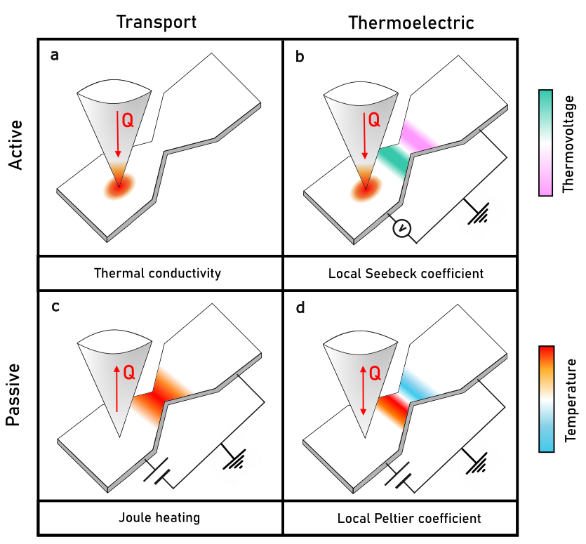
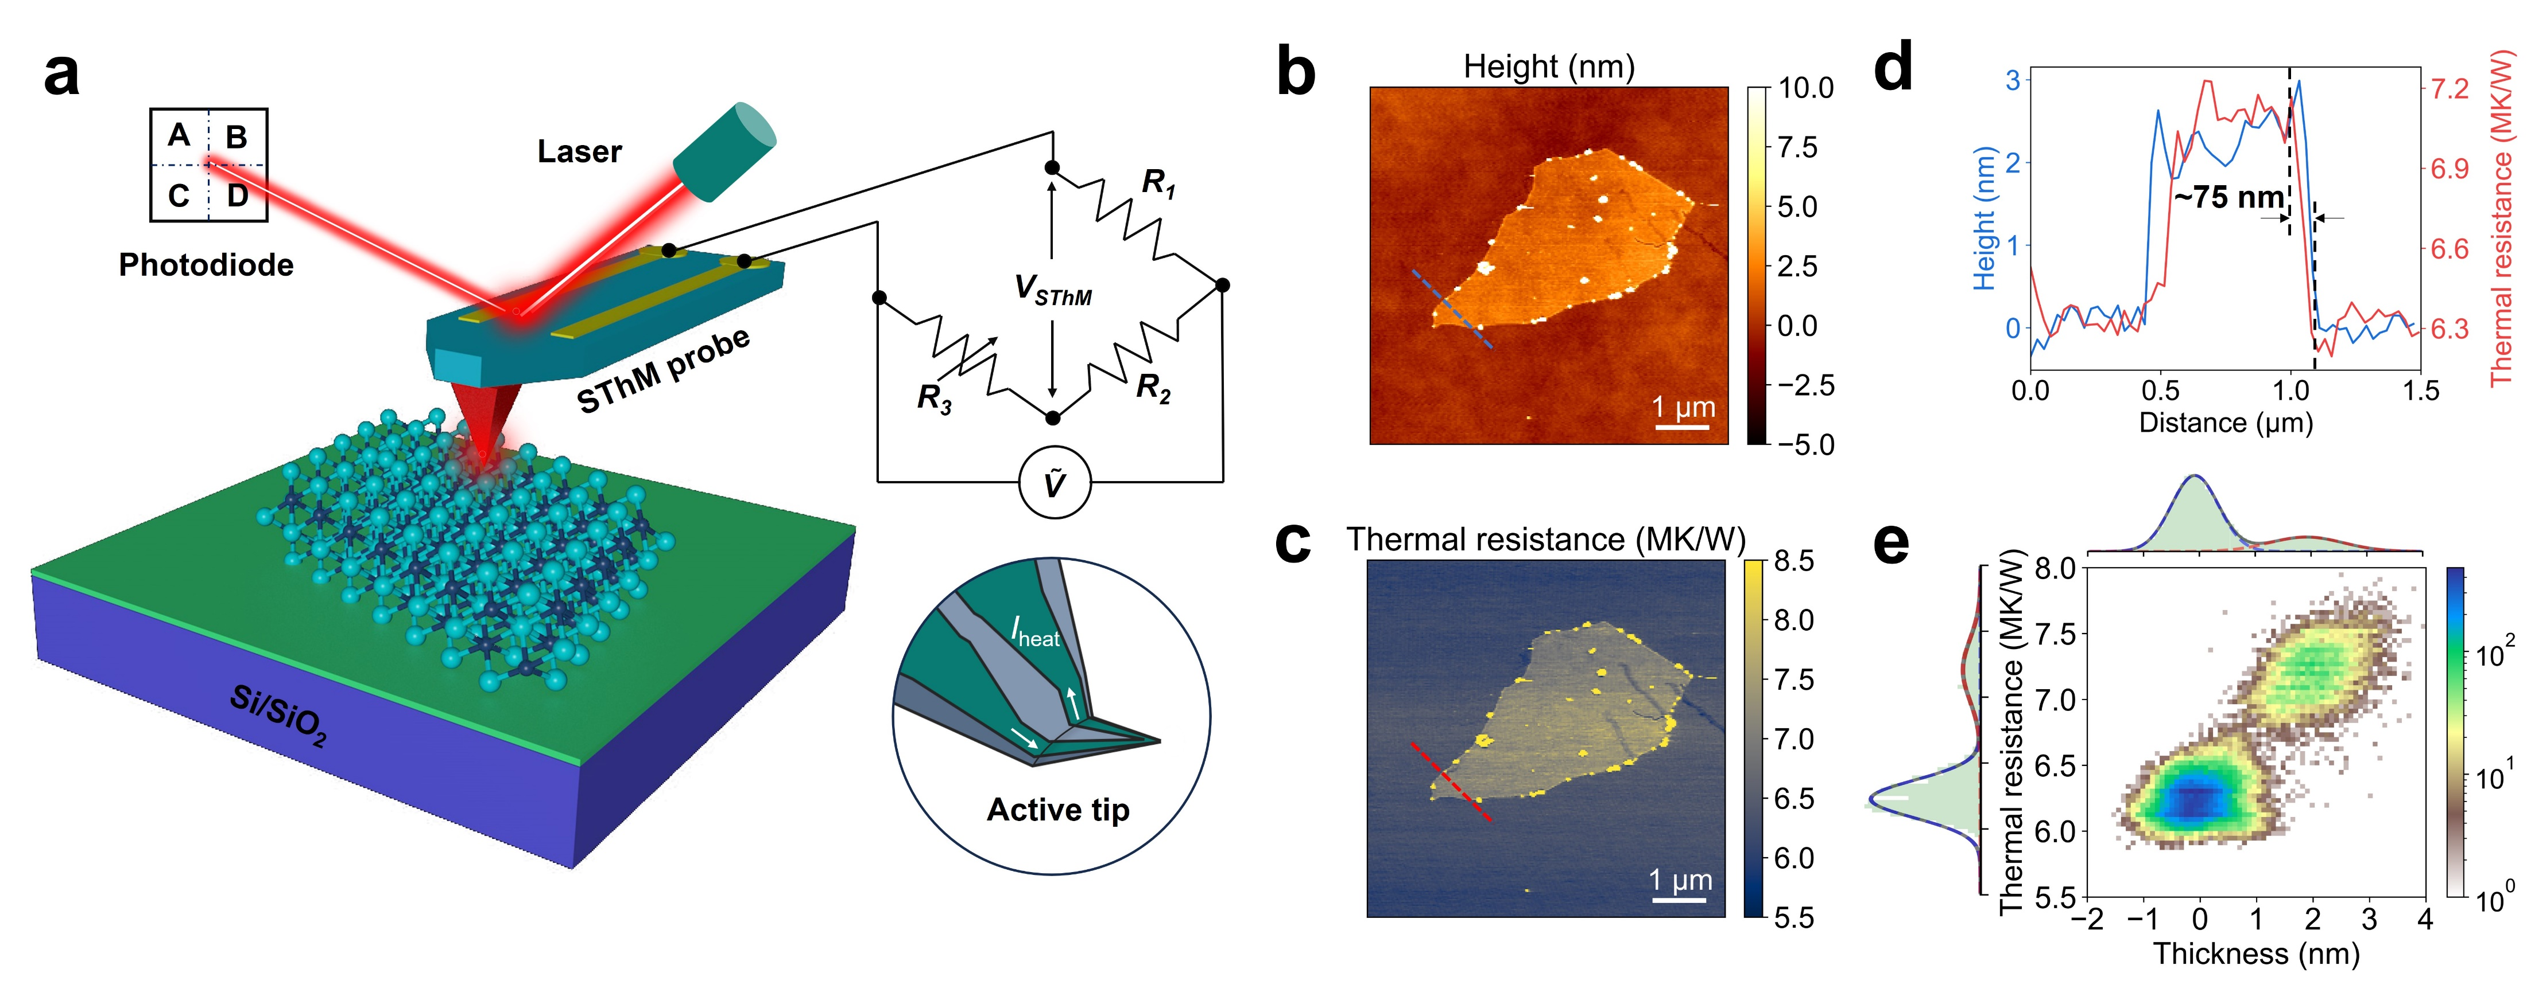

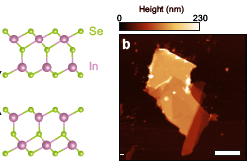
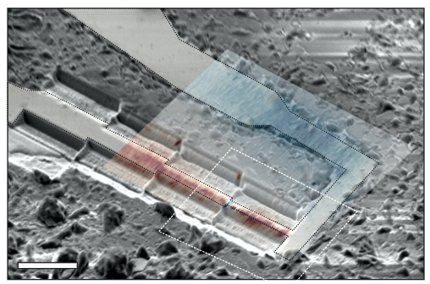
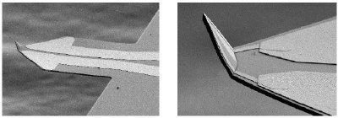
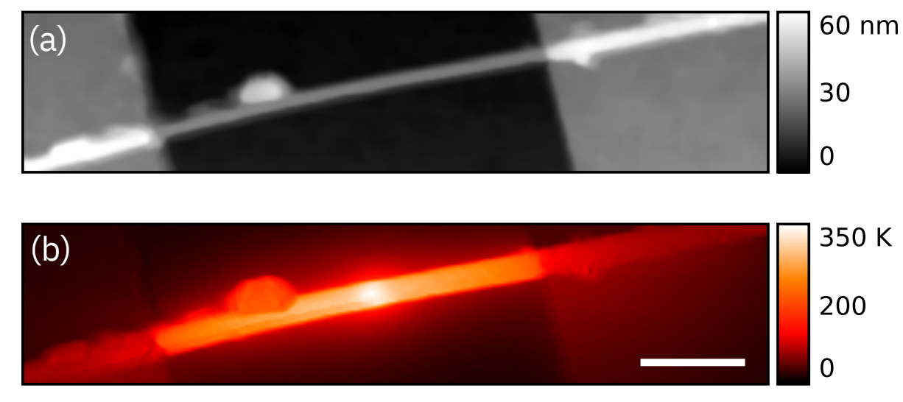
Scanning thermal microscopy
5um
Razeghi, M. et al. Preprint at https://doi.org/10.48550/arXiv.2403.13598 (2024).
Könemann, F. et al. The Journal of Physical Chemistry C 123, (2019).
Spièce, J. et al. Small Methods n/a, 2401715.

Slide 3
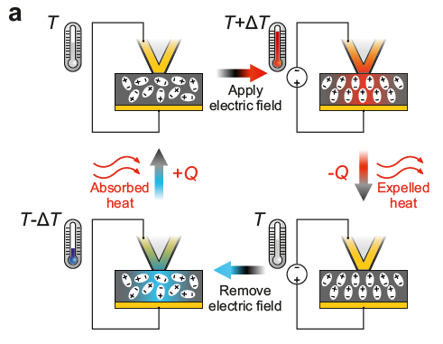



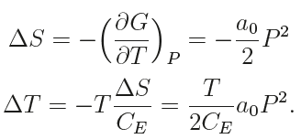
The electrocaloric effect
Thermodynamics
…

Slide 4
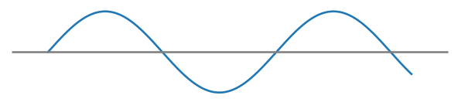
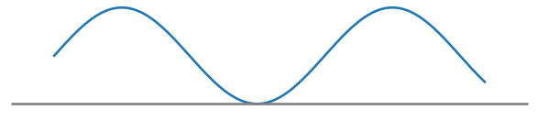

The excitation matters
$$|\vec{E}|$$
2 x f
1 x f

Slide 5
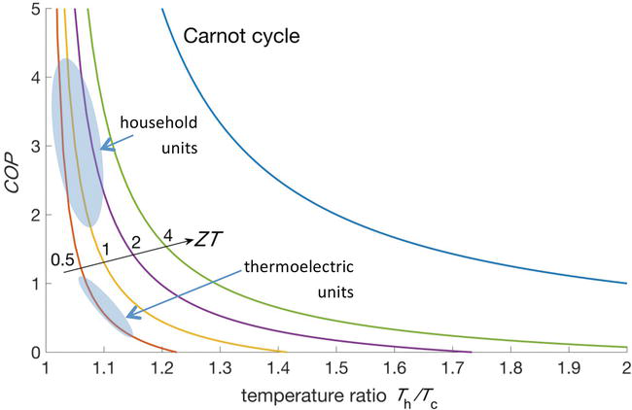
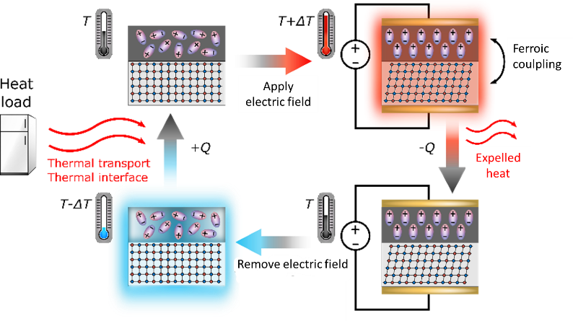
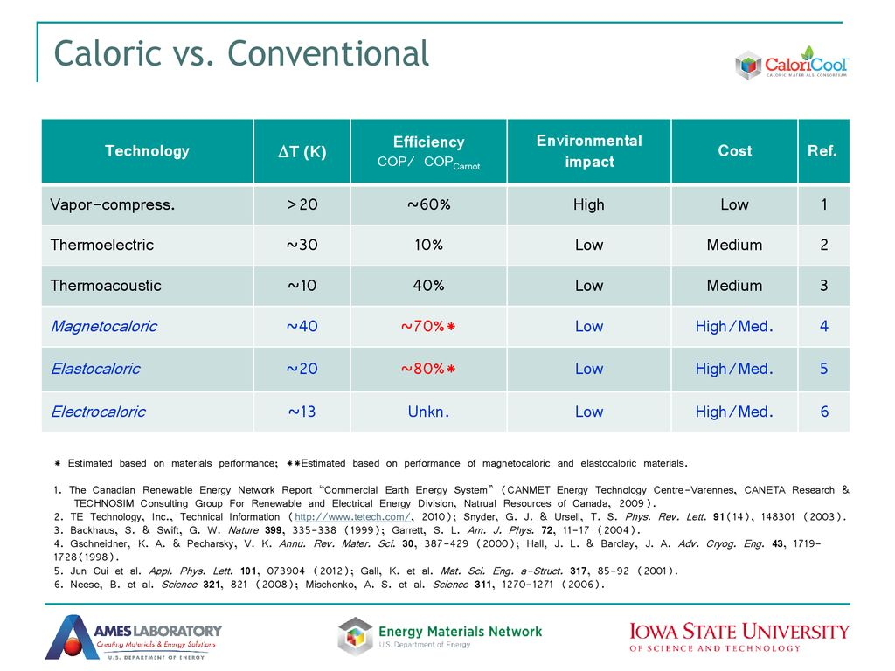
Motivations
I have a dream
Can we build a nanoscale fridge ?

Slide 6
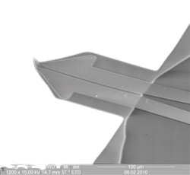


The Holy Trinity
Thermometer
Electric field
Polarisation

Slide 7
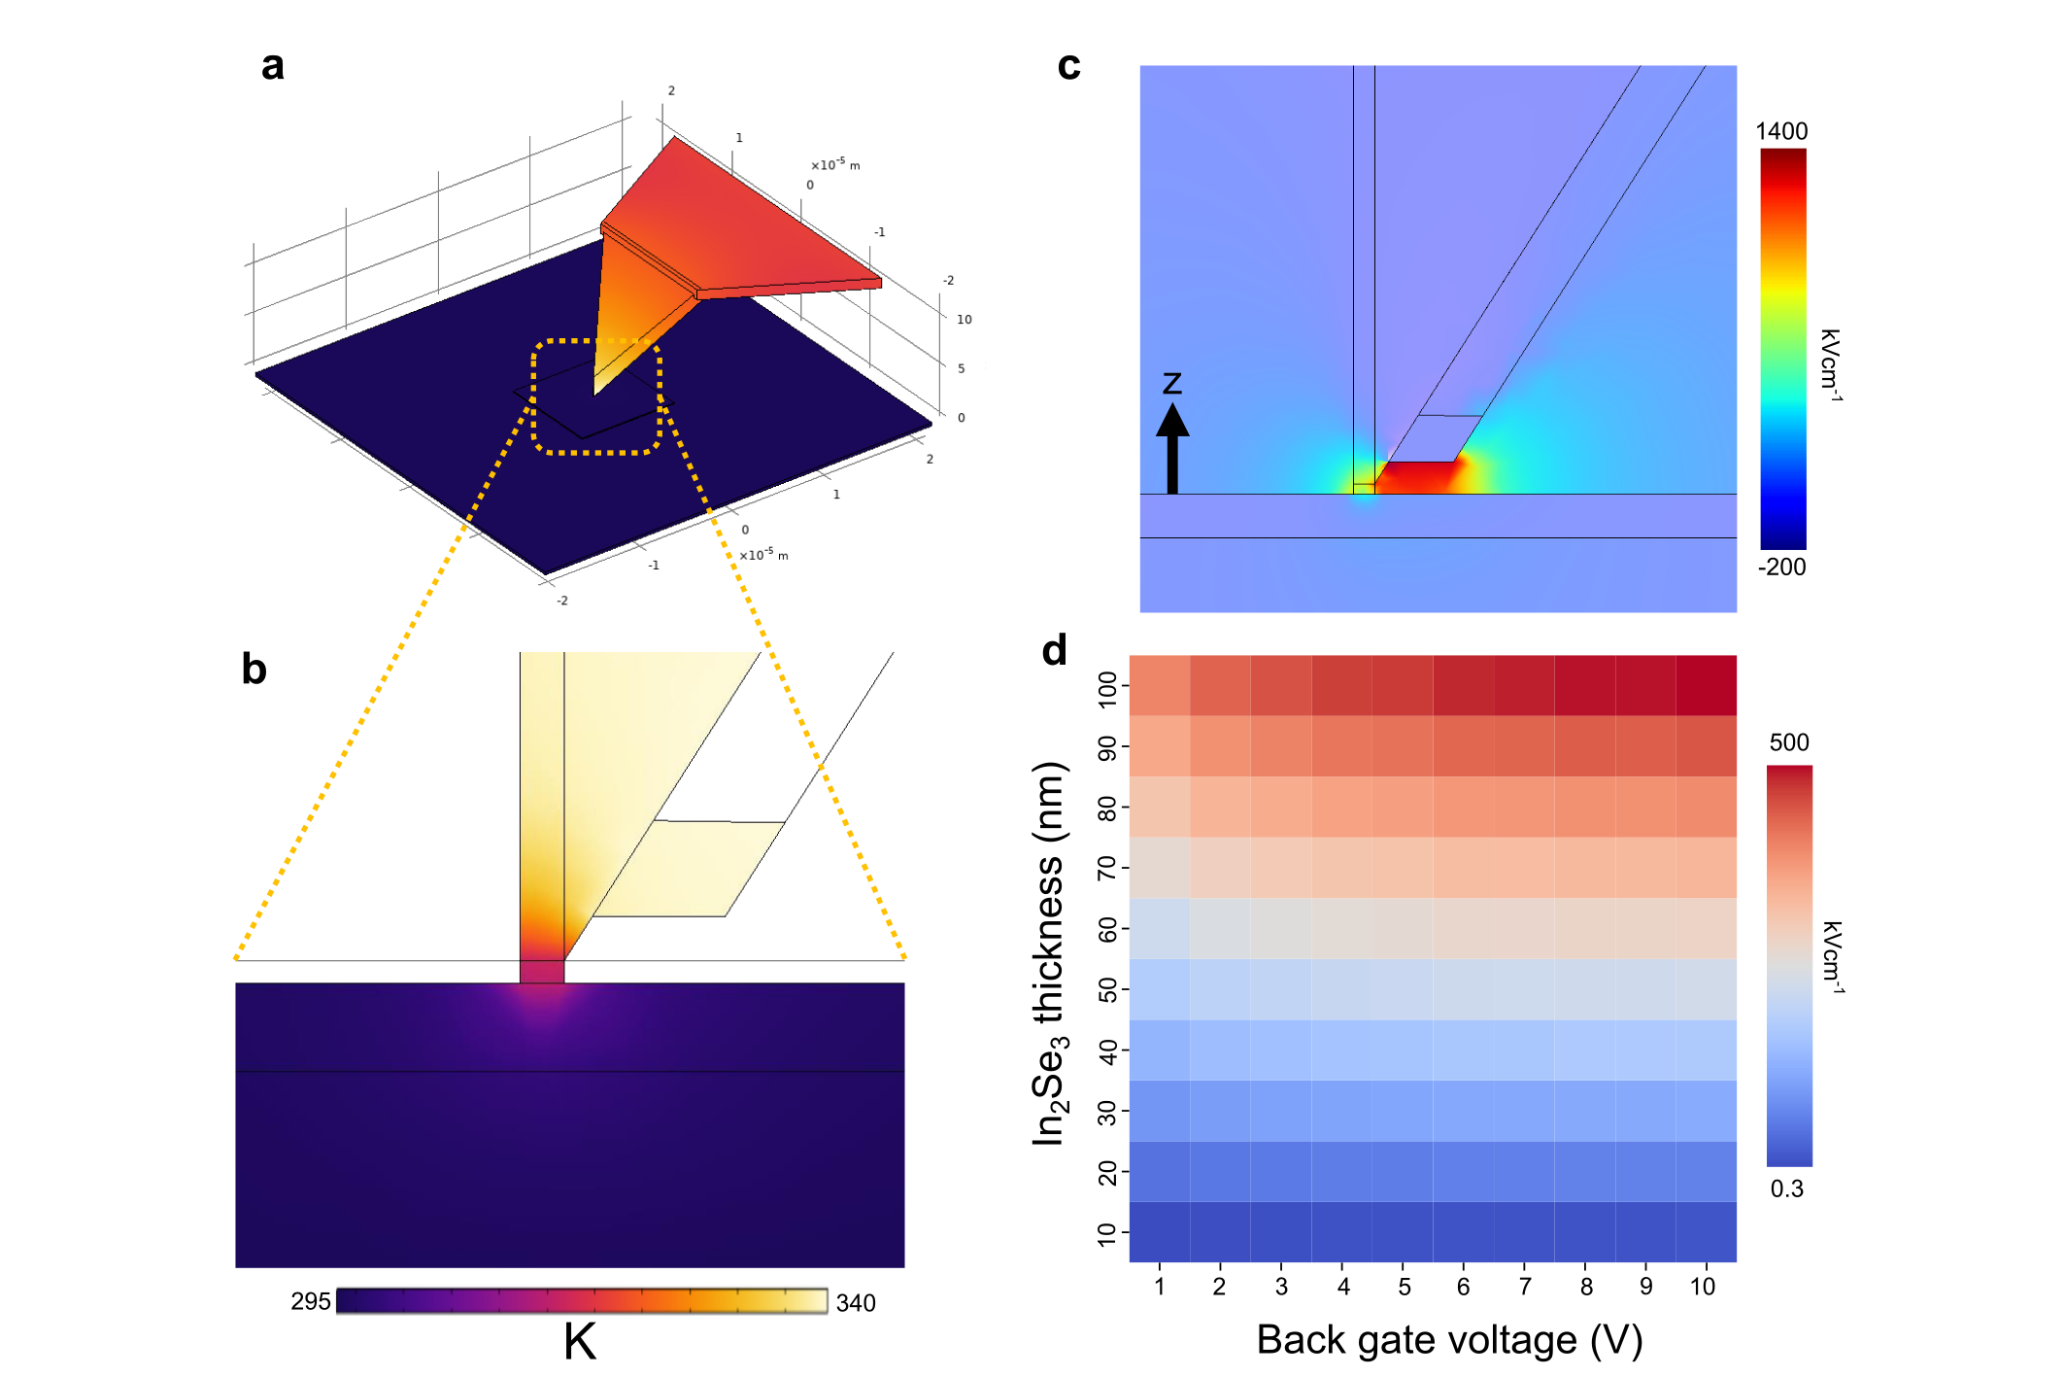


Local electric field
Nanoscale thermometry
Local electric field
Scanning electrocaloric thermometry (SeCT)

Slide 8
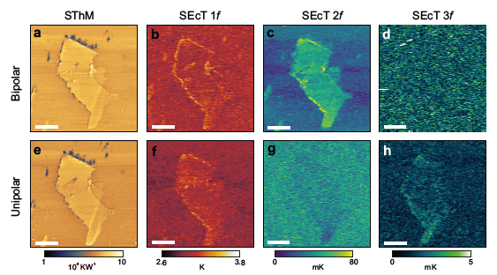
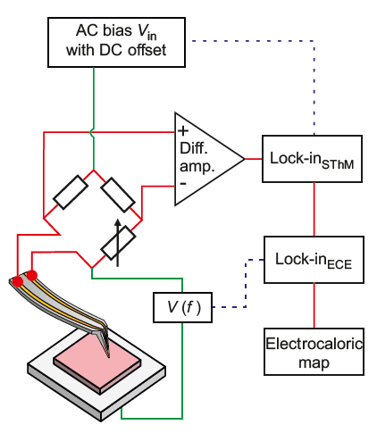
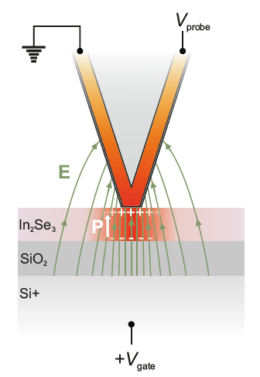

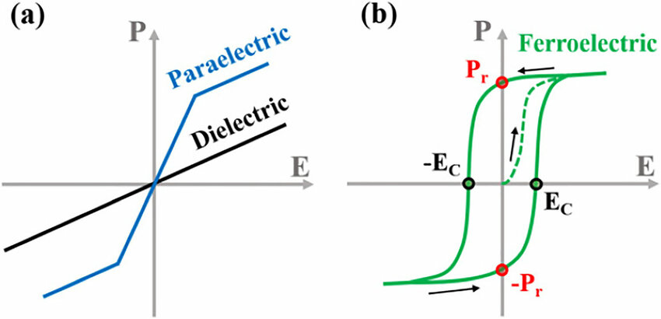


Local imaging
4um
$$P∝εE$$
$$P∝P_{0}+ εE+βE^{2}+γE^{3}+…$$

Slide 9
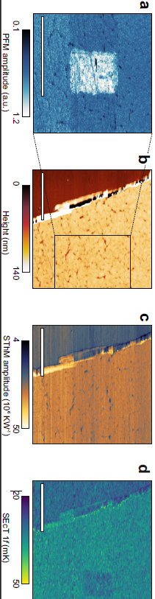
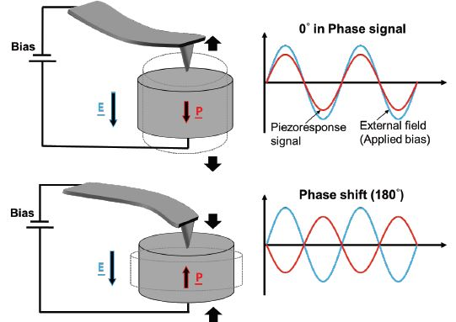

Local writing !
2um
4um
Why does the polarity of the FE film impact the SEcT signal ?

Slide 10
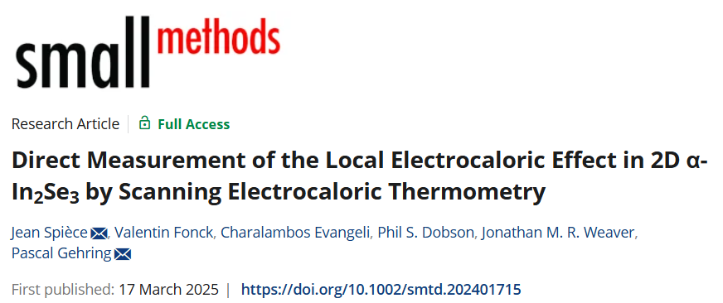
Takeaway message
With this technique we :
Imaged the ECE on the nm scale
Completed the picture using the other signals
(thermal conductivity and piezoforce)
Developed a new technique that can complement the emerging ECE toolbox

Slide 11



