Slide 1








Capturing eye gaze synchrony in a triadic discussion:
A proof-of-concept study
Mariah Matar & Alexandre Heeren
Faculty of Psychology and Educational Sciences,
Université Catholique de Louvain (UCLouvain)
Notes:
Hello everyone,
Today I will talk about methods for capturing eye gaze synchrony in a discussion between three people.

Slide 2
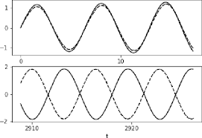
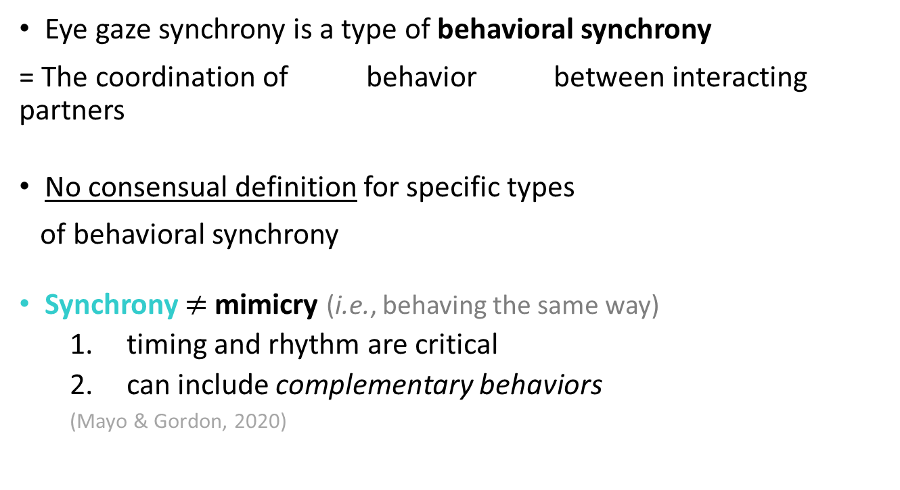
Eye gaze synchrony – DEFINITION (1)
Eye gaze synchrony is a type of behavioral synchrony
= The coordination of behavior between interacting partners
No consensual definition for specific types
of behavioral synchrony
Synchrony $≠$mimicry (i.e., behaving the same way)
  timing and rhythm are critical
  can include complementary behaviors
  (Mayo & Gordon, 2020)
Coordinate, v. = to make many different things work effectively as a whole
eye gaze (attention)
Participant 1
Participant 2
1
Synchrony
(in-phase)
0
lag
t
1
Synchrony
(anti-phase)
0
complementary
t
Notes:
1. First WHAT IS EYE GAZE SYNCHRONY?
2. One way to think of it is as a type of behavioral synchrony. In that sense, eye gaze synchrony refers to the coordination of eye gaze or attention between interacting partners.
3. But what does this mean exactly? What constitutes synchrony depends on the behavior under consideration.
4. Sometimes synchrony is doing the same thing at the same time, but it could also be doing opposite things, like talking and listening. As the title of the presentation suggests, the goal of this study was to try and catch eye gaze synchrony to see what it really is.

Slide 3
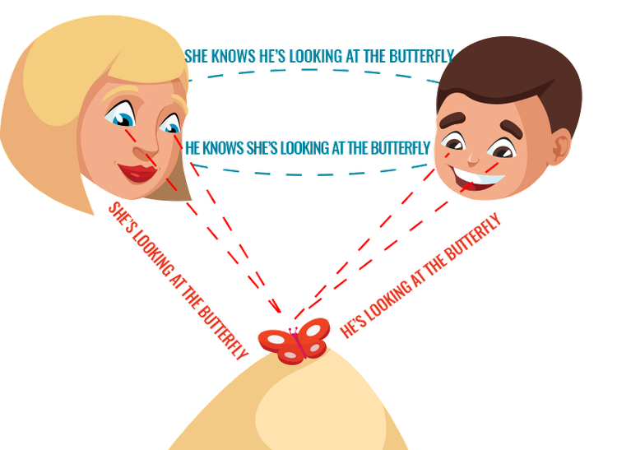
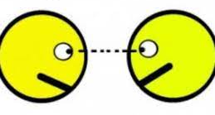
Eye gaze synchrony – DEFINITION (2)
Looking together
common attentional focus
= joint attention
+ mutual awareness
of common attentional focus
(Abney et al., 2020; Shteynberg, 2015)
= shared/coordinated attention
can be a non-visual stimulus
= joint attention + mutual gaze
individual level
interpersonal level
Looking at each other
  monitor partner’s gaze
= direct gaze
(Senju & Johnson, 2009)
… mutually
attend to the relationship
= mutual gaze (face)
= eye contact (eyes)
Notes:
1. Let’s take a look at what it might mean to coordinate one’s gaze with someone in a social interaction.
This could mean looking at the SAME THINGS as the other person, or joint attention. And to know where the other person is looking, I need to LOOK AT THEM or engage in direct gaze.
2. But this is only half the story, the individual level.
3. For there to really be shared or coordinated attention, the other person needs to become aware that I am attending with her. To do so, she needs to look back at me, and this culminates in us mutually gazing at each other.
4. So perhaps eye gaze synchrony can be boiled down to joint attention + mutual gaze.

Slide 4
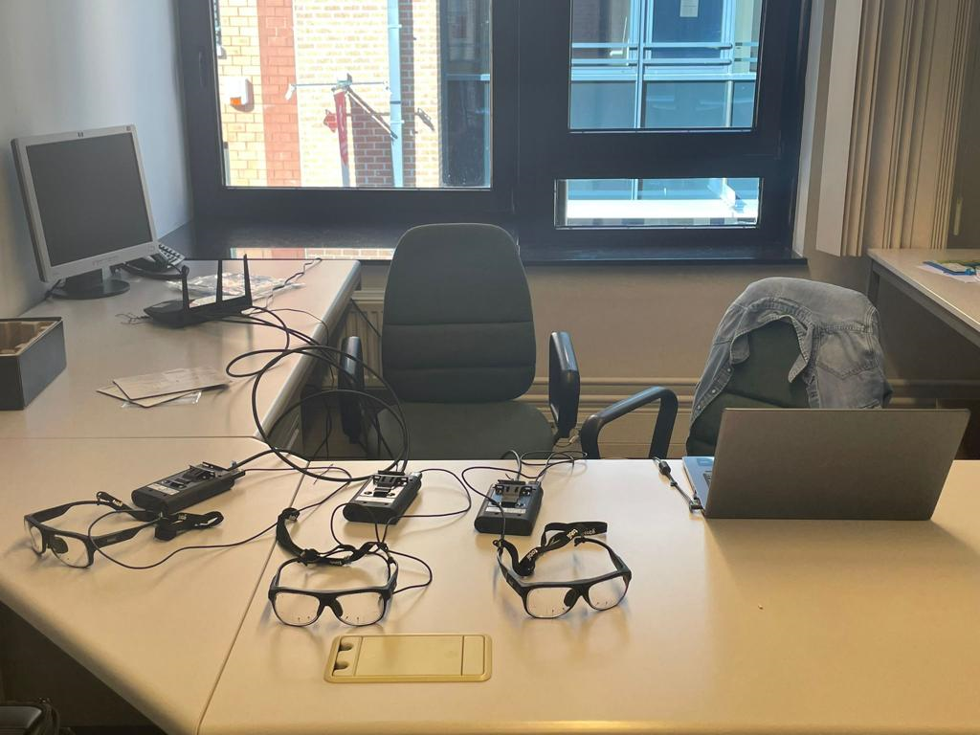



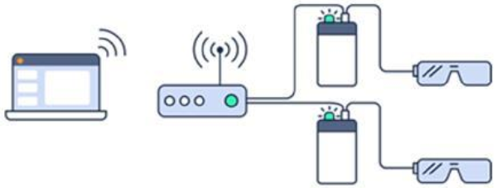
Data synchronization – METHOD
Solution
Router set-up (connect to 1 PC & start recordings simultaneously)
Pros | Cons
No additional pre-processing Good accuracy | Technically demanding
=> 1-10ms latency*
Total latency = 2 ms
→ near-perfect synchronization
Tobii Pro Glasses 3
*Sampling rate = 50 Hz → 1 sample every 20ms
Notes:
Before we measure eye gaze synchrony, we need to synchronize our eye trackers so we can temporally compare participants’ gaze data.
For this purpose, we used a ROUTER SET-UP allowing us to connect 3 eye trackers to the same PC and start the recordings at the same time. This solution is technically demanding, but it has a major advantage: if you can get a fast enough signal, you can have synchronized gaze data without any additional processing.
For this pilot, I got an excellent latency of 1 ms. But in practice, the delay between recording starts can reach up to 10 ms, which is still good, since, a 50 Hz eye tracker samples gaze roughly every 20 ms, and this sampling frequency is sufficient for fixation-based research.

Slide 5

Set-up and Instructions – METHOD
“In this study, you will be having a conversation.
Treat this conversation however you normally would in your daily life. You can talk about anything you like.
Participant 1
Also, because the glasses don’t work as well when you move around, please try to remain still, though you can still gesture and nod your head if that feels natural during your conversation. Please sit straight, do not move the chair, and avoid leaning on the table, as this may introduce inaccuracies into the data.
Table
(1.2 m)
1.5 m
1.5 m
Participant 3
Participant 2
You can continue talking until I come back, around
7 minutes from now.”
1.5 m
(inspired by Wohltjen & Wheatley, 2021)
1 triad: A, T, and P
Notes:
1. In terms of methods, there were only 3 participants, so 1 triad.
They completed a naturalistic discussion task where they could talk about anything they wanted for 7 minutes.
2. Participants were seated in an equilateral triangle configuration, at a fixed distance of 1,5 m with a round table in the middle.
3. Because each one of them was wearing a pair of eye tracking glasses, I had to ask them to sit straight and avoid moving too much to ensure the quality of the data.

Slide 6
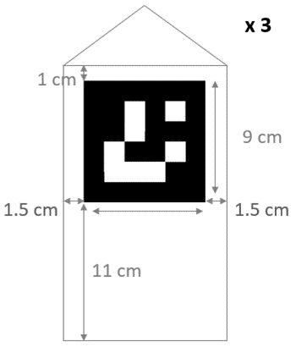
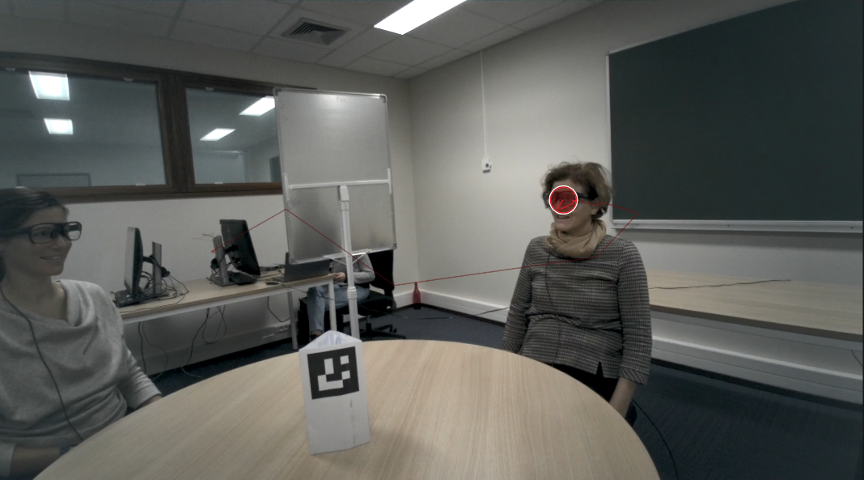
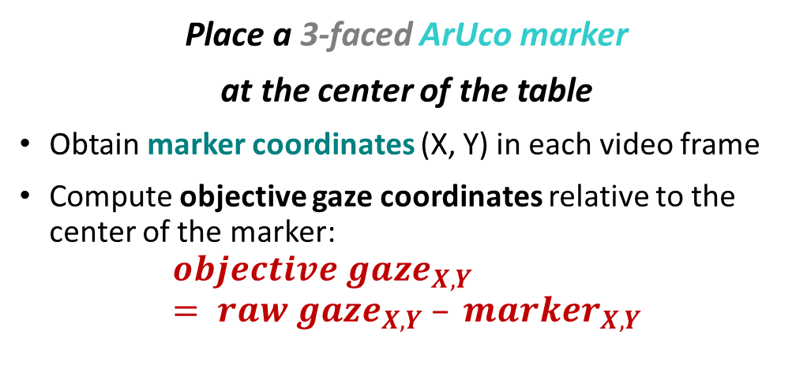
Gaze location – METHOD
O (0, 0)
X
Place a 3-faced ArUco marker
at the center of the table
Obtain marker coordinates (X, Y) in each video frame
Compute objective gaze coordinates relative to the center of the marker:
$$objective gaze_{X,Y} = raw gaze_{X,Y} – marker_{X,Y}$$
Y
CAN locate gaze in 3D space ☺
- within participants (from frame to frame)
- between participants (relative to each other)
O
X_{obj}
Y_{obj}
Notes:
Next, we need a reference point to know where participants are looking. This is because wearable eye trackers take a video of what is in front of the participant, and the origin of the coordinate system, which is the top left corner of the video frame, changes with each head movement.
To solve this problem, I placed 3 ArUco markers at the center of the table, one facing each participant.
Then, I wrote some code to detect the marker in their eye tracking video. With that, I was able to calculate objective gaze coordinates by subtracting the coordinates of the marker center from the gaze coordinates originally returned by the eye tracker.
Since the marker is not moving, these coordinates are independent of head-movement, and we can now locate a participant’s gaze from frame to frame. And because participants’ markers are very close to each other, we can also know where they are looking relative to each other.

Slide 7

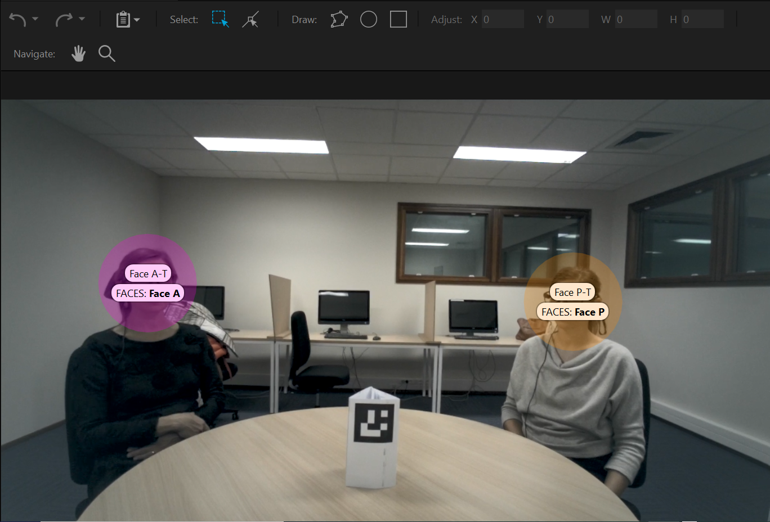
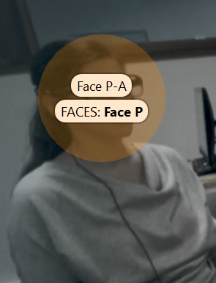
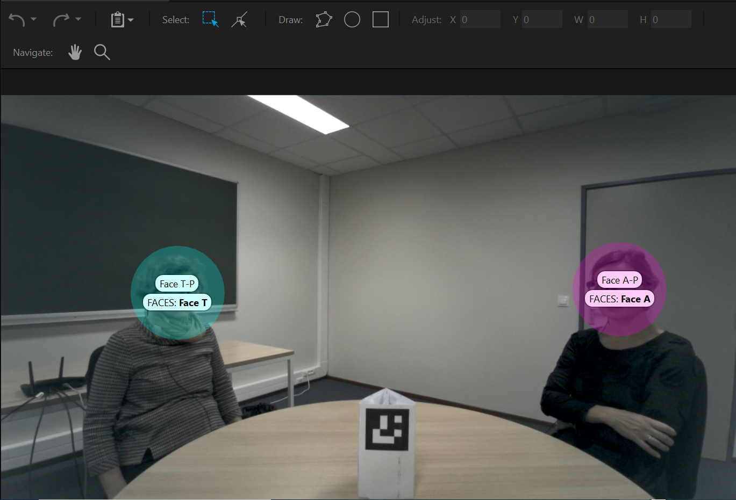
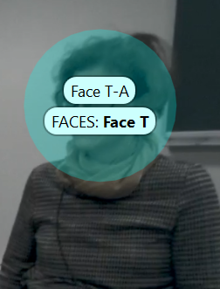

Direct Gaze – FACE AOIs
Snapshot T
Snapshot A
Snapshot A
3 Snapshots
screenshots of visual field
1 per participant
6 Face AOIs
2 per snapshot
dimensions:
  H = 200 px
  W = 200 px
Tobii Pro Lab
Assisted Mapping
Face AOI hit:
  Yes→ 1, No → 0
Notes:
1. Besides computing objective gaze coordinates to measure joint attention, we need to determine when participants are looking at each other’s faces to measure direct and mutual gaze.
2. To do so, I took a snapshot of each participant’s field of view from their scene camera video,
3. And drew circular Areas of Interest around the other two participants’ faces.
4. I then used Tobii Pro Lab’s Assisted Mapping Tool to remap participants’ gaze points to their respective snapshots.
For each face, the software outputs an AOI hit variable that is equal to1 if the gaze point falls within the Face AOI, and 0 otherwise.

Slide 8
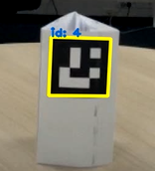
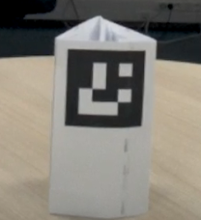
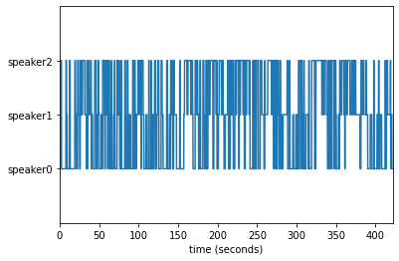
Data Preprocessing – STEPS
Python
  ArUco marker detection in OpenCV
    => Objective gaze coordinates
  Speaker diarization in PyAudioAnalysis*
    => Code speech for each participant:
      Yes → 1, No → 0
  Inspect for nonsensical & missing data
  Interpolate and downsample to 25Hz
  Generate dyadic dataframes:
synchronize
with ET data
*audio files were merged using Audacity
x_T | - x_A | y_T | y_A | FaceA_T | FaceT_A
554.25 | -524.0 | -387.00 | -395.0 | 0 | 1
526.00 | -511.5 | -357.00 | -367.5 | 0 | 1
… | … | … | … | … | …
Left-right correction
Notes:
1. Here are the preprocessing steps I followed after extracting the data from Tobii Pro Lab.
All the preprocessing code was written in Python and will be available on OSF once the preprint is out.
2. First, I used the OpenCV library to detect the ArUco marker in participants’ scene camera video and compute objective gaze coordinates.
3. Then, I ran speaker diarization to code speech for each participant. We will see why we need this in a bit.
The result is a speech variable that is equal to 1 if the participant is speaking and 0 otherwise.
4. For each of these analyses, the outputs had to be synchronized with the eye tracking data.
5. Finally, after interpolating and downsampling to 25Hz, I created dyadic dataframes, where I corrected for the fact that participants are facing each other.

Slide 9
Eye gaze synchrony – OPERATIONALIZATION
 | Correlation-based approach
 | Event-based approach
Direct gaze | Face AOI hit Yes → 1, No → 0
 | Face AOI hit Yes → 1, No → 0
Mutual gaze dyadic | (mv-)SUSY Face AOI hits Windowed Cross-Correlations Lambda max
triadic
 | When 2 participants simultaneously gaze at each other [Face AOI hit (P2_P1) = 1 | Face AOI hit (P1_P2) = 1] → 1, else → 0
Joint attention dyadic | (mv-)SUSY objective gaze coordinates Windowed Cross-Correlations (mean x, y) Lambda max (mean x, y)
triadic
 | When 2 participants jointly gaze at the speaker [Face AOI hit (P3_P1) = 1 | Face AOI hit (P3_P2) = 1 | Speech(P3) = 1] → 1, else → 0
Notes:
Now we are ready to operationalize eye gaze synchrony. In doing so, I wanted to compare two approaches:
a correlation-based approach, where I looked at the correlation between participants’ gaze behaviors, and
an event-based approach, where I simply counted the number of mutual gaze and joint attention events.
2. In both approaches, Direct gaze is operationalized as a Face AOI hit.
3. In the correlation-based approach, I used a method called SUSY for the dyadic level and mv-SUSY for the triadic level. I derived a measure of mutual gaze based on the correlation between participants’ face AOI hits, and a measure of joint attention based on the correlation between their objective gaze coordinates, averaging the results for x and y to obtain a single joint attention score.
4. In the event-based approach, I operationalized mutual gaze as whenever two participants simultaneously gaze at each other’s faces. And Joint attention as whenever two participants jointly gaze at the speaker. Here, we are assuming that a speaker attends to her speech, while listeners gaze at the speaker to attend to the same speech.

Slide 10
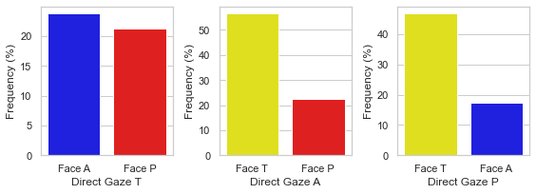
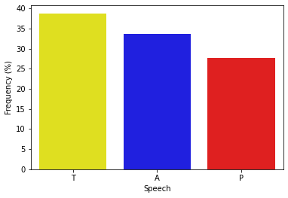
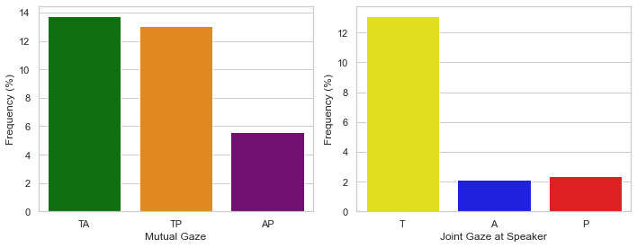
Results – EVENT-BASED APPROACH
T
is the most frequently gazed at
has the most frequent mutual gaze with the other two participants
most frequently elicits joint gaze with her speech
(speaks the most)
highest status
in this conversation
and also in real life !
Notes:
Here are the results obtained with the event-based approach.
In terms of direct gaze, T is the most frequently gazed at, whereas she gazes equally often at the other two participants.
She also has the most mutual gaze with the other two participants, which makes sense given the previous result.
T is also the one who speaks the most and most frequently elicits joint gaze with her speech. This suggests that she has the highest status in this conversation.
Which is interesting because this is also true in real life.

Slide 11
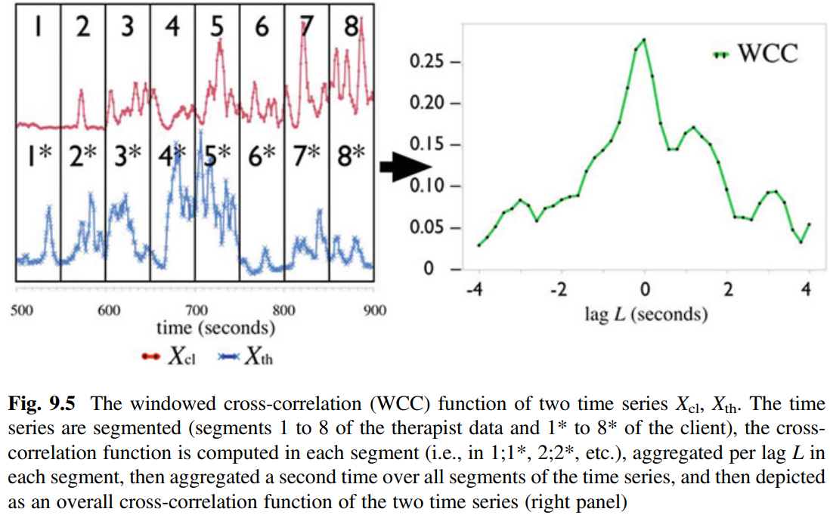


Windowed Cross-Correlations – SUSY
(Tschacher & Haken, 2019; Tschacher & Meier, 2019)
  Surrogate Synchrony (SUSY)
Supports both continuous and categorical variables
Distinguishes between:
  in-phase synchrony
  anti-phase synchrony
Accounts for a possible time lag between participants’ behaviors
→ Can show who is leading the interaction
th is leading ←
→ cl is leading
→ $cor>0$
→ $cor<0$
Notes:
Before I introduce the results of the correlation-based approach, I’d like to say a few words about SUSY. I chose this method for several reasons, the first being that it supports both categorical and continuous variables and accounts for the fact that synchrony could be in-phase or anti-phase.
This is because SUSY relies on correlations. To be more precise, it relies on windowed-cross correlations. Windowed means participants’ time series are divided into time segments or windows, and a correlation is computed for each one of these windows.
Cross-correlation means that these correlations are calculated at different shifts or lags. The result is the green curve on the right, which shows the value of the correlation at each lag. This allows SUSY to account for a possible delay between participants’ behaviors.
This also allows us to see who is leading the interaction.

Slide 12
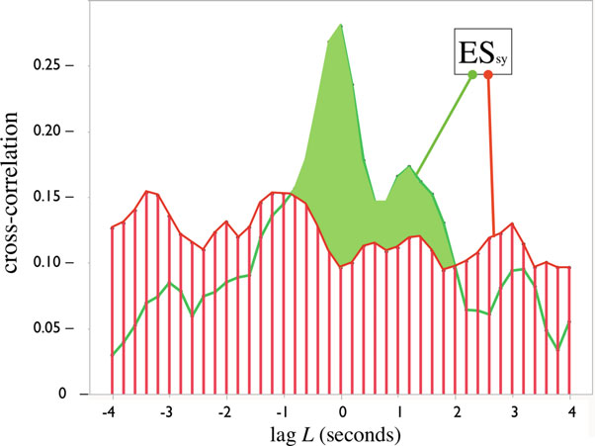
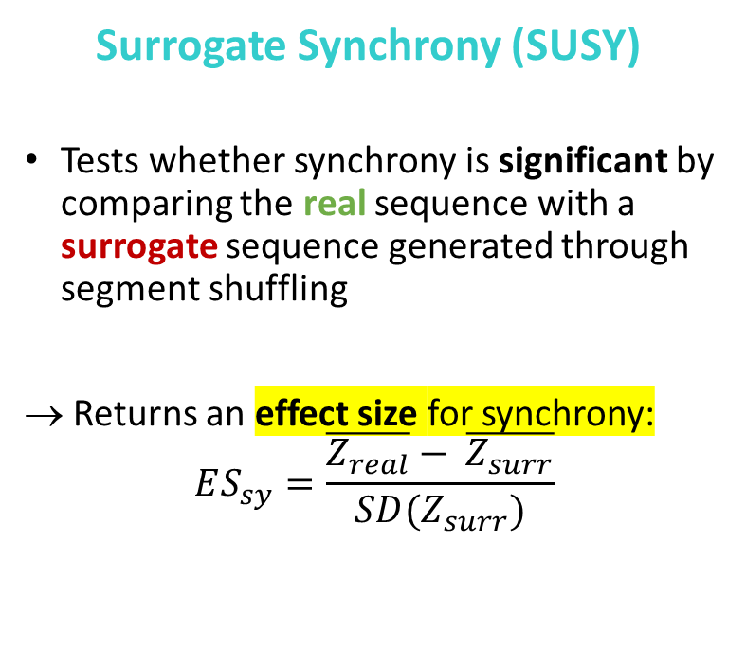
Windowed Cross-Correlations – SUSY
(Tschacher & Haken, 2019; Tschacher & Meier., 2019)
  Surrogate Synchrony (SUSY)
Tests whether synchrony is significant by comparing the real sequence with a surrogate sequence generated through segment shuffling
→ Returns an effect size for synchrony:
$$ES_{sy}=\frac{\overline{Z_{real}}− \overline{Z_{surr}}}{SD(Z_{surr})}$$
Notes:
1. Another advantage of SUSY is that it tests whether synchrony is significant by comparing the real data with surrogate data generated by shuffling the order of segments in one participant’s time series.
2. This yields a standardized effect size that summarizes the level of synchrony across the entire dataset

Slide 13
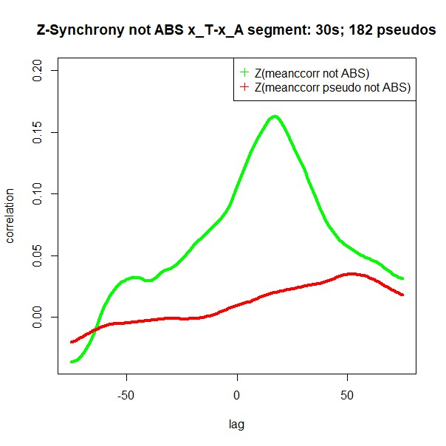
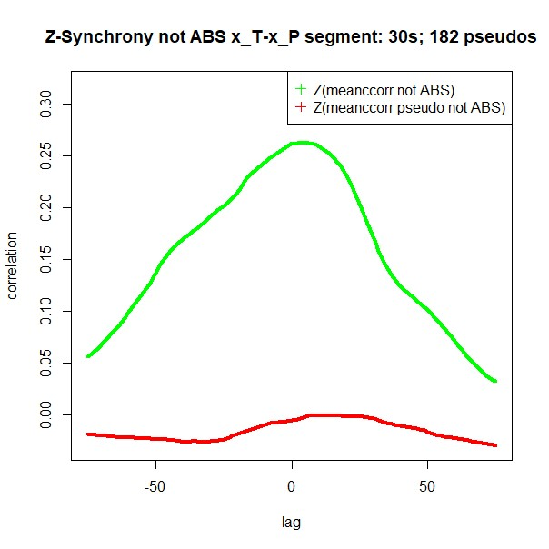
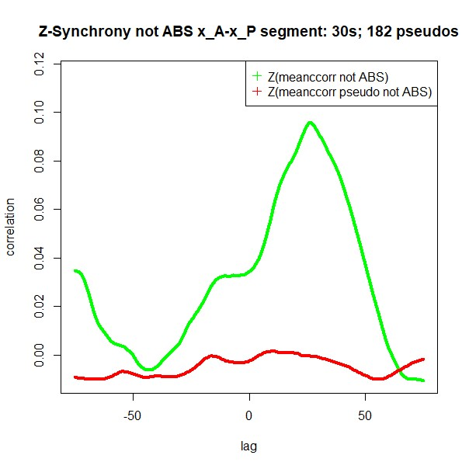
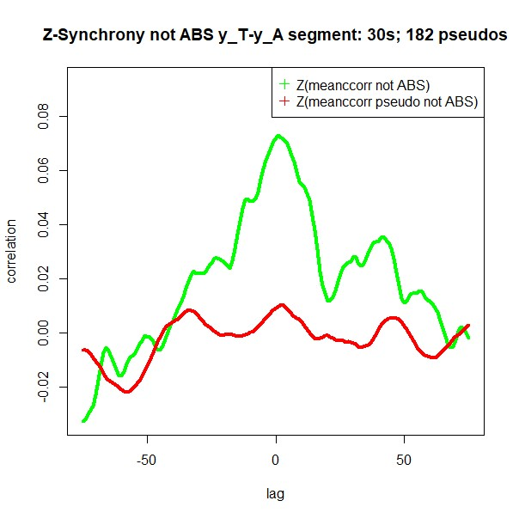
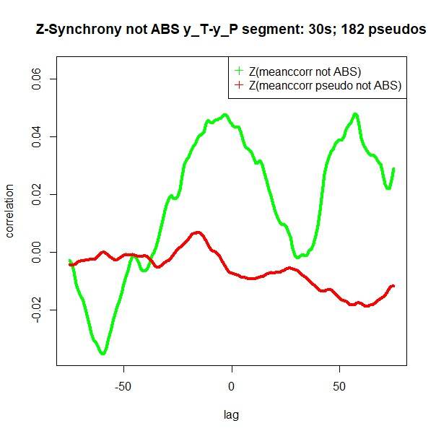
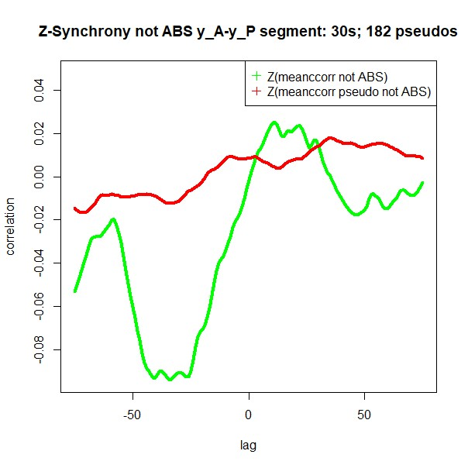
Results – CORRELATION-BASED APPROACH
Dyadic Joint Attention Synchrony
TA
TP
AP
In-phase (positive) for all dyads
More senior participant usually leading:
T > A > P
Nobody is leading
Highest for T and P
  => professor and pupil in real life
Anti-phase synchrony
Notes:
Here are the results obtained with SUSY for joint attention. On the right, you can see the cross-correlation function of gaze coordinates for each dyad in green, plotted against its surrogate in red.
Almost all the green curves are above the red ones, which means participants generally mimic each other in gazing left-and-right as well as up-and-down.
The participant with the highest level of seniority is usually leading, except for T and P.
These two participants also have the highest level of synchrony. This suggests that they have a close relationship. In real life, T and P are PI and assistant.

Slide 14
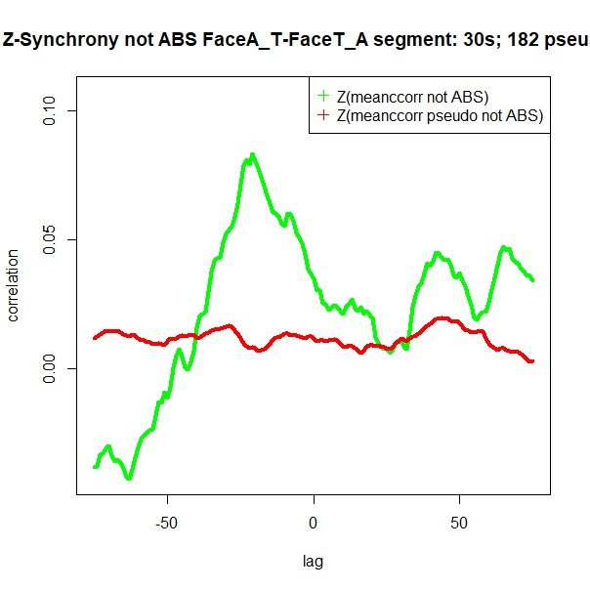
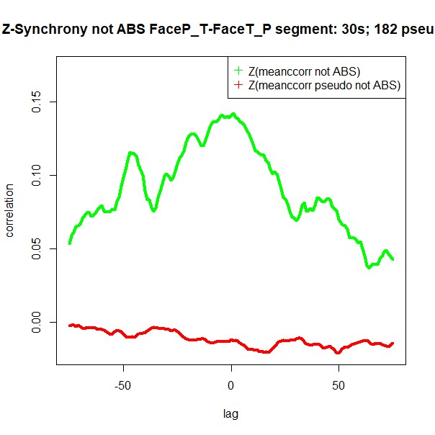
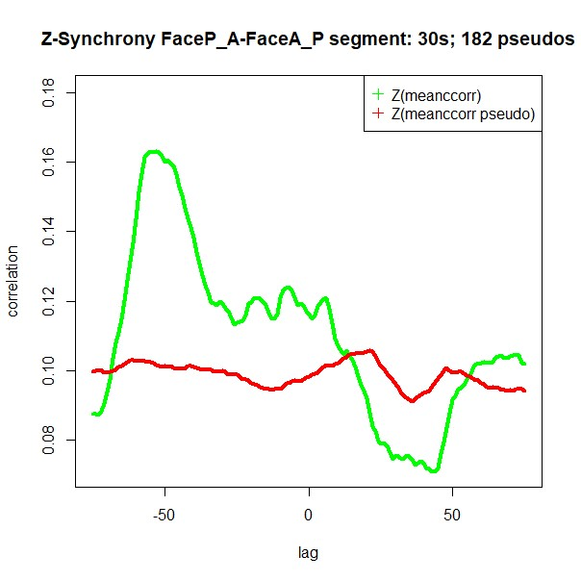
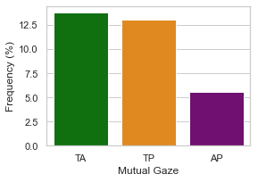
Results – CORRELATION-BASED APPROACH
Dyadic Mutual Gaze Synchrony
TA
TP
AP
Highest for T and P
followed by A and P, then T and A.
Mutual gaze
between T and A is not synchronous
Different results!
Notes:
In terms of mutual gaze, we also have in-phase synchrony with the more senior participant leading, except for TP, where no one is leading and synchrony is the highest.
Interestingly, the result is different from the one obtained with the event-based approach. Although T and A have the highest frequency of mutual gaze events, they have the lowest SUSY effect size for mutual gaze synchrony.
This suggests that their mutual gaze is not synchronous, meaning that T gazing at A is not related to A gazing at T. Mutual gaze between these two participants is just happening by chance.

Slide 15

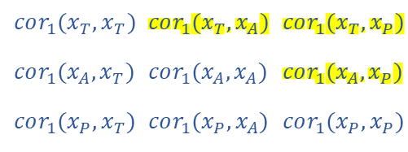
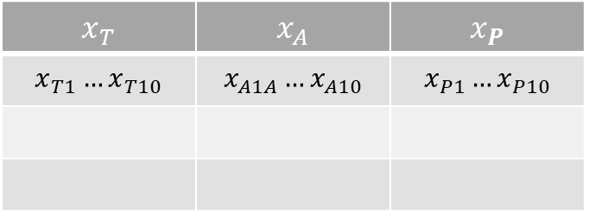


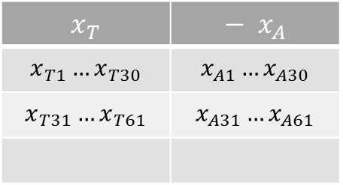
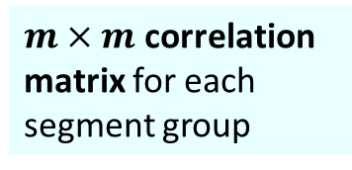
From dyadic to triadic synchrony – mv-SUSY
(Tschacher & Meier., 2021)
Multivariate Surrogate Synchrony (mv-SUSY)
Dyadic synchrony
2 time series
Triadic synchrony
$m = 3$time series
$$x_{T}$$ | $$− x_{A}$$
$$x_{T1}…x_{T30}$$ | $$x_{A1}…x_{A30}$$
$$x_{T31}…x_{T61}$$ | $$x_{A31}…x_{A61}$$
Segment pair 1
$$cor_{1}(x_{T}, x_{A})$$
1 correlation for
each segment pair
Segment pair 2
$$cor_{2}(x_{T}, x_{A})$$
$m×m$correlation matrix for each segment group
$$x_{T}$$ | $$x_{A}$$ | $$x_{P}$$
$$x_{T1}…x_{T10}$$ | $$x_{A1A}…x_{A10}$$ | $$x_{P1}…x_{P10}$$
$$cor_{1}(x_{T}, x_{T})$$ | $$cor_{1}(x_{T}, x_{A})$$ | $$cor_{1}(x_{T}, x_{P})$$
$$cor_{1}(x_{A}, x_{T})$$ | $$cor_{1}(x_{A}, x_{A})$$ | $$cor_{1}(x_{A}, x_{P})$$
$$cor_{1}(x_{P}, x_{T})$$ | $$cor_{1}(x_{P}, x_{A})$$ | $$cor_{1}(x_{P}, x_{P})$$
Segment group 1
Notes:
SUSY can also be applied to multivariate time series. It is just slightly more complicated, since correlation is a pairwise measure: When we have 2 time series, we get 1 correlation for each segment pair.
But when we have 3 or more time series, we get a correlation matrix for each segment group.

Slide 16
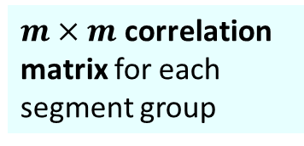

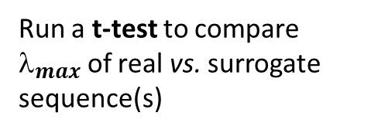
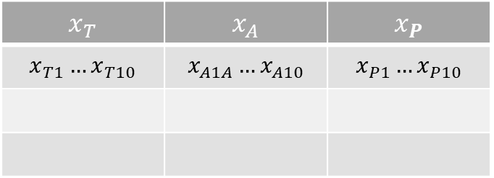
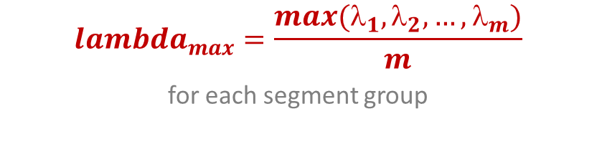

From dyadic to triadic synchrony – mv-SUSY
(Tschacher & Meier., 2021)
Multivariate Surrogate Synchrony
Triadic synchrony
$m = 3$time series
5
Run a t-test to compare $_{max}$ of real vs. surrogate sequence(s)
4
Generate surrogates through segment shuffling
$m×m$correlation matrix for each segment group
$$x_{T}$$ | $$x_{A}$$ | $$x_{P}$$
$$x_{T1}…x_{T10}$$ | $$x_{A1A}…x_{A10}$$ | $$x_{P1}…x_{P10}$$
$$cor_{1}(x_{T}, x_{T})$$ | $$cor_{1}(x_{T}, x_{A})$$ | $$cor_{1}(x_{T}, x_{P})$$
$$cor_{1}(x_{A}, x_{T})$$ | $$cor_{1}(x_{A}, x_{A})$$ | $$cor_{1}(x_{A}, x_{P})$$
$$cor_{1}(x_{P}, x_{T})$$ | $$cor_{1}(x_{P}, x_{A})$$ | $$cor_{1}(x_{P}, x_{P})$$
1
Segment group 1
→ Can be decomposed into $m$ eigenvalues ${\{}_{1},{\text{λ}}_{2},…,λ_{m}\}$
2
= proportion of variance associated with each dimension
$$lambda_{max}=\frac{max(λ_{1},λ_{2},…,λ_{m})}{m}$$
for each segment group
=> Average across segments to get a mean value for the whole time series
3
Notes:
This correlation matrix can be decomposed into m eigenvalues, 3 in the case of a triadic timeseries. Eigenvalues are a concept in linear algebra that is used for dimension reduction. Here, our 3 by 3 correlation matrix is flattened into 3 eigenvalues. To calculate multivariate synchrony, mv-SUSY takes the largest and divides it by the number of time series in the dataset. The result is equal to the proportion of variance accounted for by the most representative dimension in the matrix.
After that, mv-SUSY follows the same steps as regular SUSY, meaning it averages across segments to get a single synchrony score for the entire time series and generates surrogates by shuffling the order of segments in the original dataset.
But in addition to calculating an effect size, mv-SUSY determines whether synchrony in the real time series is statistically significant using a simple t-test.

Slide 17
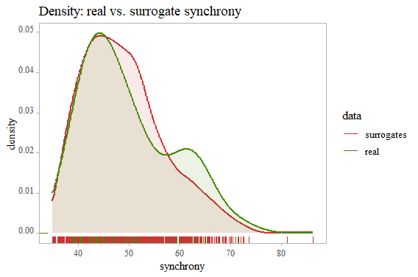
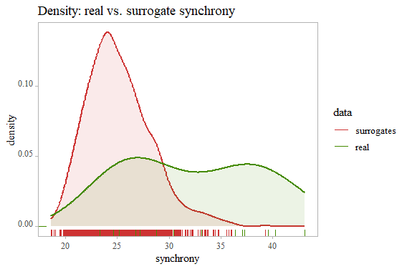
From dyadic to triadic synchrony – mv-SUSY
(Tschacher & Meier., 2021)
Triadic Eye Gaze Synchrony
Joint Attention Synchrony
x : t = -0.56, p = 0.58
y : t = -0.27, p = 0.79
Mutual Gaze Synchrony
Face : t = -2.74, p = .0089
Mutual gaze
→ ns
Joint attention
→ p < .001
Notes:
Here are the results of the triadic eye gaze synchrony analysis done using mv-SUSY
As can be seen on the graphs, there doesn’t seem to be significant joint attention synchrony at triadic level. This result is a bit surprising since we had significant joint attention synchrony at the dyadic level. But this is not a bad thing, since we want a triadic measure of synchrony to be significant only when synchrony is triadic.
On the other hand, mutual gaze synchrony was significant at the triadic level.

Slide 18
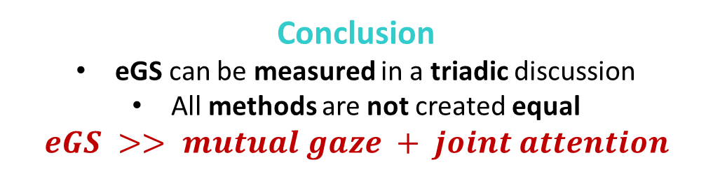
Discussion – EYE GAZE SYNCHRONY (eGS)
Findings
eGS affords insights into :
  Group hierarchy
  - Leader-follower dynamics
  Interpersonal attunement/
  closeness
Different operationalization approaches capture different aspects of the interaction
Limitations
n = 1 triad
Ecological validity
(lab setting, movement restriction)
Pearson’s r not the best statistical method for binary data
Restricted range → inflated values
→ Event-based approach
↓ generalizability
Correlation-based
approach
Conclusion
eGS can be measured in a triadic discussion
All methods are not created equal
$$eGS >> mutual gaze + joint attention$$
Notes:
Let’s go over what we found in this study. We saw that eye gaze synchrony can reveal some interesting information about people.
Depending on the operationalization approach, it may be able to tell us who has the highest status in the group, who is leading, and who is closer with whom.
Of course, we can’t generalize these findings because we have a sample size of 1 and the lab is not the most ecological setting for a social interaction.
Another bigger limitation concerns the fact that SUSY doesn’t offer the option of a correlation method that is more adapted to binary data, which can cast doubt on the results.
In conclusion, eye gaze synchrony can be measured in a discussion between 3 people, even if there is a need for more elaborate statistical methods. Moreover, eye gaze synchrony is more than just how many times people end up looking at each other or at the same things. To have real synchrony, their behaviors must be correlated. TIMING IS EVERYTHING.

Slide 19




Thank you for your attention
QUESTIONS
osf.io/vs5j7
mariah.matar@uclouvain.be
Notes:
Thank you for your attention!
I will be uploading the preprint and all the code to OSF
Are there any questions?

Slide 20
References
Abney, D. H., Suanda, S. H., Smith, L. B., & Yu, C. (2020). What are the building blocks of parent–infant coordinated attention in free‐flowing interaction? Infancy, 25(6), 871–887. https://doi.org/10.1111/infa.12365
Garrido-Jurado, S., Muñoz-Salinas, R., Madrid-Cuevas, F. J., & Marín-Jiménez, M. J. (2014). Automatic generation and detection of highly reliable fiducial markers under occlusion. Pattern Recognition, 47(6), 2280–2292. https://doi.org/10.1016/j.patcog.2014.01.005
Mayo, O., & Gordon, I. (2020). In and out of synchrony—Behavioral and physiological dynamics of dyadic interpersonal coordination. Psychophysiology, 57(6). https://doi.org/10.1111/psyp.13574
Meier, D., & Tschacher, W. (2021). Beyond dyadic coupling: the method of Multivariate Surrogate Synchrony (mv-SUSY). Entropy, 23(11), 1385. https://doi.org/10.3390/e23111385
Senju, A., & Johnson, M. H. (2009). The eye contact effect: mechanisms and development. Trends in Cognitive Sciences, 13(3), 127–134. https://doi.org/10.1016/j.tics.2008.11.009
Shteynberg, G. (n.d.). Shared attention. Perspectives on Psychological Science, 10(5), 579–590. https://doi.org/10.1177/1745691615589104
Stephenson, L., Edwards, S. G., & Bayliss, A. P. (2021). From gaze perception to social cognition: the Shared-Attention System. Perspectives on Psychological Science, 16(3), 553–576. https://doi.org/10.1177/1745691620953773
Tschacher, W., & Haken, H. (2019). The process of Psychotherapy: causation and chance. https://boris.unibe.ch/135577/
Tschacher, W., Tschacher, N., & Stukenbrock, A. (2021). Eye Synchrony: A Method to Capture Mutual and Joint Attention in Social Eye Movements. Nonlinear Dynamics, Psychology, and Life Sciences, 25(3), 309–333. https://europepmc.org/article/MED/34173733
Wohltjen, S., & Wheatley, T. (2021). Eye contact marks the rise and fall of shared attention in conversation. Proceedings of the National Academy of Sciences of the United States of America, 118(37). https://doi.org/10.1073/pnas.2106645118

Slide 21


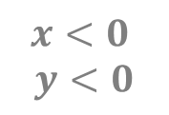


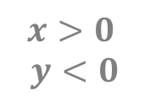


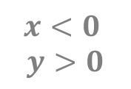

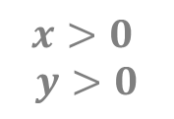

FAQ 1 – WHY AVERAGE X AND Y?
Same distance
The problem with Euclidian distance
=> very different locations
$$x<0$$
$$y<0$$
$$x>0$$
$$y<0$$
$$(−2,−1)$$
$$(+2,−1)$$
$$d$$
$$d$$
x
$$d$$
$$d$$
$$x<0$$
$$y>0$$
$$(−2,+1)$$
$$(+2,+1)$$
$$x>0$$
$$y>0$$
y

Slide 22



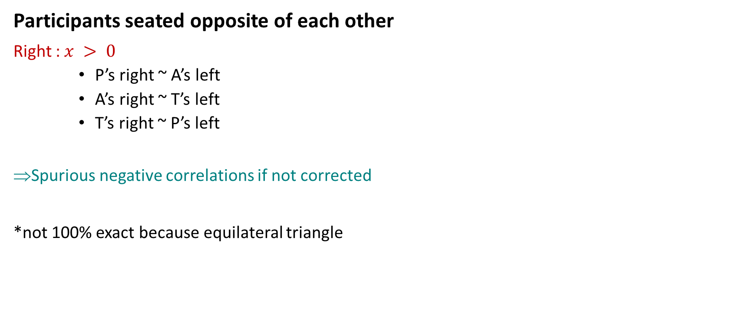

FAQ 2 – WHY APPLY LEFT-RIGHT CORRECTION
Participants seated opposite of each other
Right : $x > 0$
    P’s right ~ A’s left
    A’s right ~ T’s left
    T’s right ~ P’s left
Spurious negative correlations if not corrected
*not 100% exact because equilateral triangle
Left : $x < 0$
P
R
L
R
T
A
L
L
R

Slide 23
FAQ 3 – WHY SUSY (NOT ANOTHER METHOD)
Advantages
Richness
  lots of information for n=1
Versatility
  relevant to different types of data
Ease of application
  → R packages “SUSY” and “mv-SUSY”
Disadvantages
Complexity
  → Sophisticated methods (esp. mv-SUSY)
Low specificity
  e.g. no methods for binary data
Lack of flexibility
  1 function to run the whole analysis
  = not “tweakable”

