Slide 2

Promoting speaking fluency of learners of German as foreign language
through digital game-based learning
Bailing He
May 2024
FIAL/IL&C/TeAMM research group
Teaching and Acquiring Multilingualism and Multiliteracies

Slide 3
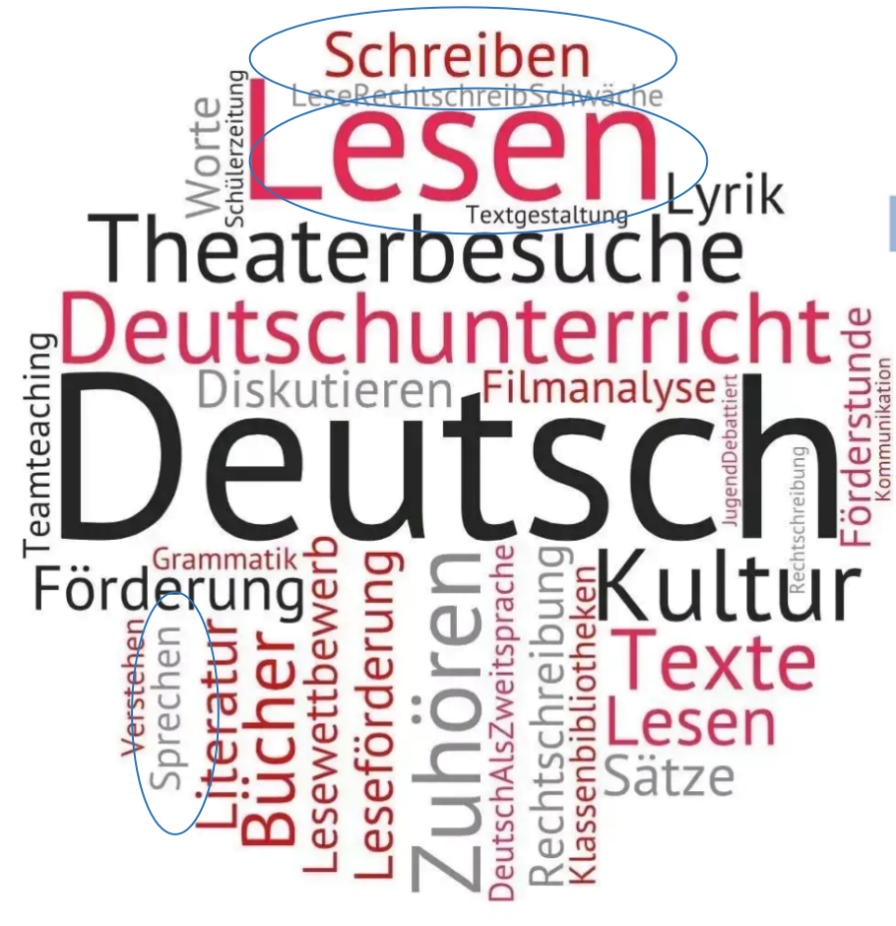

1. Introduction
Interest in learning German remains high, with over 15.4 million people worldwide engaged in this process (Goethe-Institut, 2020).

Slide 4

2. Theoretical Background
Over the past 30 years, the appeal of digital games for second language (L2) learning has grown significantly (Aquah et al., 2020, Thompson et al., 2020) and has been increasingly implemented in or out of language classrooms to enhance learners’ L2 speaking ability.
Advantages: Immersive exposure, reduced anxiety, increased use of the target language.Better outcomes compared to traditional language learning: longer learning times, higher motivation, increased sense of self-efficacy (Hung et al., 2018).
Digital game-based learning：

Slide 5
2. Theoretical Background
L2 Fluency:
Dynamic nature and the multiple complex causes of language development processes (Larsen-Freeman 2019, Moss and Hartel 2016)
Three levels of fluency: 1) cognitive fluency “the efficiency of operation of the underlying processes responsible for the production of utterances” (Segalowitz 2010, p.165); 2) utterance fluency “features of utterances that reflect the speaker’s cognitive fluency” (Segalowitz, 2010, p. 165), i.e. the flow of speech(Segalowitz, 2010, p. 165); 3）perceived fluency refers to the impression of listeners of utterance fluency in actual discourse(de Jong et al. 2012).
Psycholinguist aspects and learner variables: perceived L2 fluency by L1 speakers, (Pinget et al., 2014); correlation between L1 and L2 fluency indicators (Duran-Karaoz & Tavakoli, 2020; de Jong et al., 2013). Interaction of communication can better explain learners’ L2 fluency development (Larsen-Freeman, 2015).

Slide 6

2.Goals
To explore the potential of digital game-based learning to promote speaking fluency in the L2 German among students.
To better understand how cognitive and affective factors modulate speaking fluency development in L2 German.
To provide an empirically tested pedagogical solution to the lack of fluency of students in their L2 German.

Slide 7
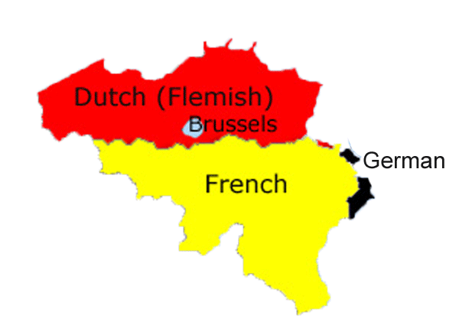

3.Sample
Seven students from a Belgian University
German as L2, A2 level of Common European Framework of Reference for Languages (CEFR)

Slide 8
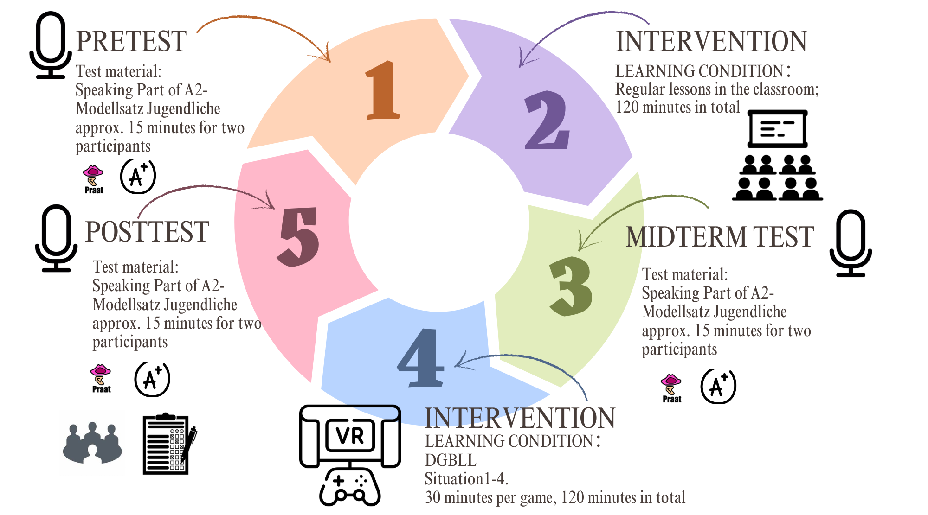
4. Methods

Slide 9
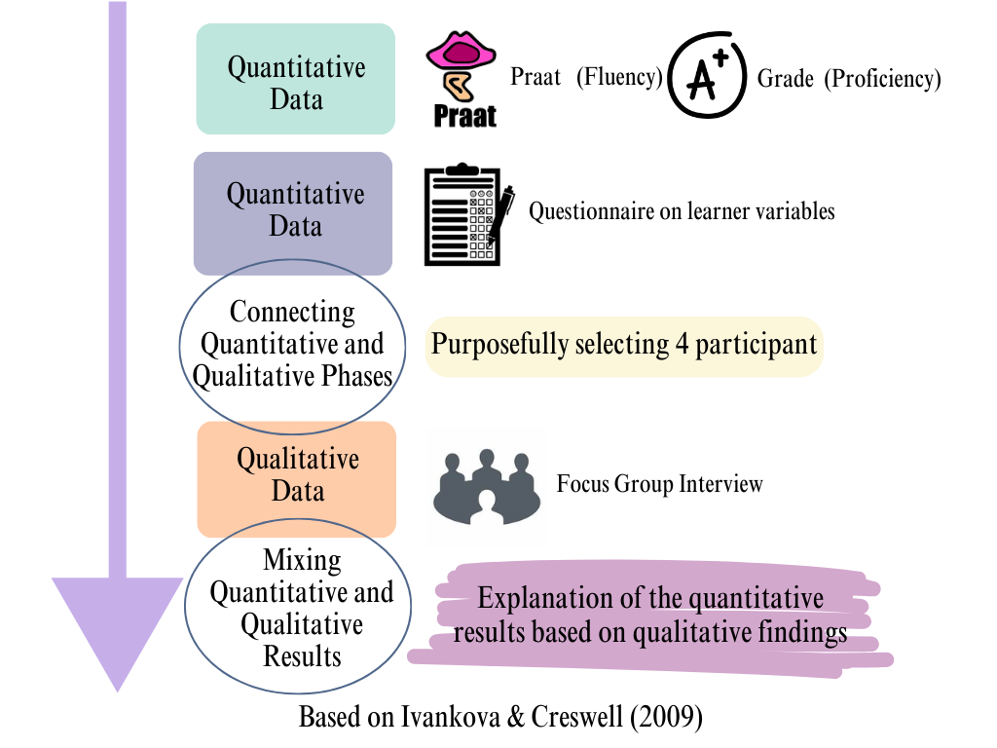
4. Methods
Explanatory mixed-methods intervention study with a within-group design
1. Using standardized speaking tasks and a PRAAT script (Boersma & Weenink, 2007) for fluency measurement and questionnaires will gather data on language attitudes.
2. Quantitative data analysis will involve a two-way ANCOVA, while a focus-group interview will provide qualitative insights into practical and pedagogical challenges faced during e-learning sessions.

Slide 10

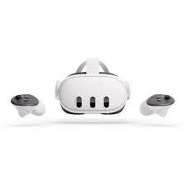
5.Materials: VR-based game
"The Travel Kit"
This immersive experience facilitates collaborative language learning through action-oriented gameplay set in four distinct daily life scenarios, all centered around the same storyline.

Slide 11
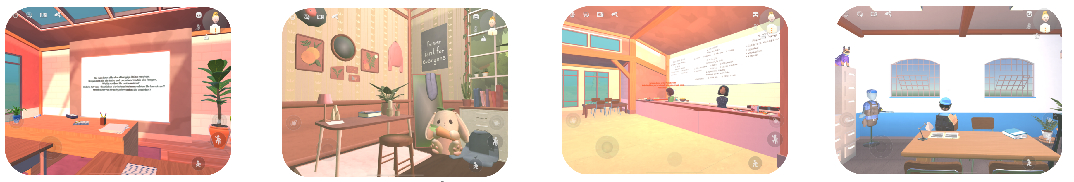
5.Materials: VR-based game
"The Travel Kit"
The four scenarios allow for practicing interactive speaking ability and related linguistic phenomena relevant to A2 level (CFR): In the Classroom, Before Departure, In the Restaurant, At the Police station.
Future extensions: Track learning progress through tests and badge system.

Slide 12
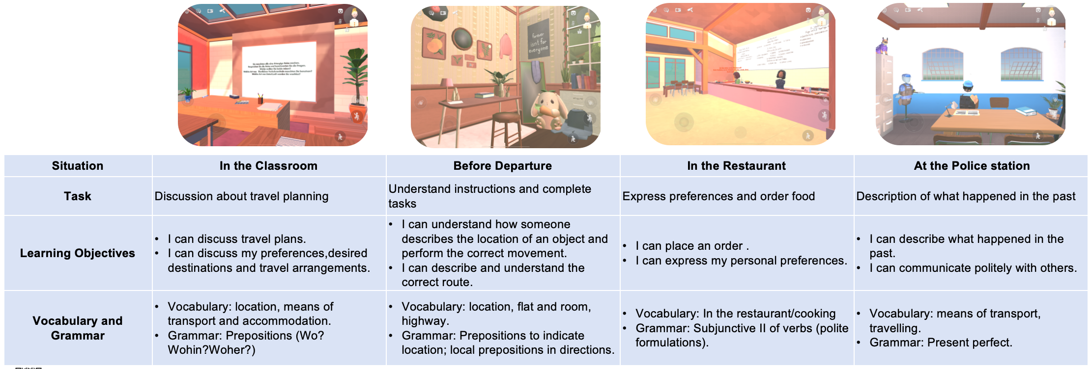
5.Materials: VR-based game
"The Travel Kit"

Slide 13


QR CODE FOR THE GAME DEMOSTRATION VIDEOS AND REFERENCES

