Slide 1
Current research on the Spanish Flu in Belgium
Emmanuel Debruyne
Leipzig, 3 February 2023

Slide 2
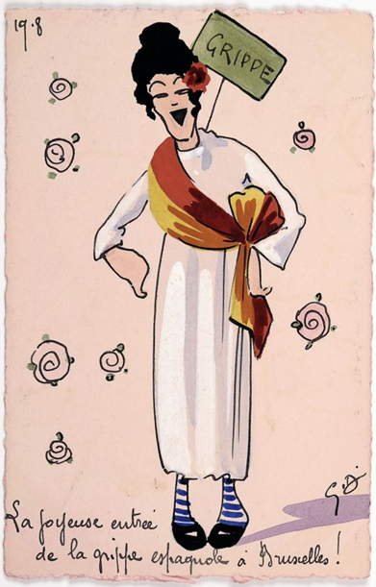
Current research on the Spanish Flu in Belgium – The Three Waves
1. 1918-2014. The first century-long wave of historical research – A short summary
2. 2014-2019: The Centenary - A scattered wave
3. 2020-…: The ongoing research – A crossing wave

Slide 3
1. 1918-2014. The first century-long wave of historical research – A short summary
גאָרנישט
Nekas
Rien Niets Nothing Nichts
Nic
нічого
ничего
Nimic
Nicość

Slide 4
1. 1918-2014. The first century-long wave of historical research – A short summary
A conscience of the Flu in the turmoil of the time?
“After a dreadful night, our dear Denise poisoned by the cruel influenza [...], our beloved daughter suddenly died without agony at ten minutes to two, plunging us into the deepest of all our pains. [...] Our hearts are not set on war bulletins, on our more or less imminent deliverance, nor on the rumours that are circulating in the region.”
Notary Adolphe Hambye’s diary, Mons, 25th October 1918.
(« Après une nuit affreuse, notre chère Denise empoisonnée par la cruelle grippe […], notre fille bien-aimée s’éteint tout-à-coup sans agonie à deux heures moins dix minutes, nous plongeant dans la plus profonde de toutes nos douleurs. […] Nous n’avons pas le cœur disposé à nous occuper des bulletins de guerre, de notre délivrance plus ou moins prochaine ni des bruits qui ont cours dans la région. »)
An individual and familial memory, but no collective memory.

Slide 5
2. 2014-2019: The Centenary - A scattered wave
Scramble to the sources and international litterature.
Small-scale and dispersed works
  Demography of WW1 in Belgium.
  Local studies.
  Master dissertations.
    Laurine Hendrickx, Public representations of the Spanish Flu (UAntwerpen, 2017).
    Benjamin BRULARD, Epidemiology and perceptions of the Spanish Flu (UCLouvain, 2018).
International conference The 1918 influenza pandemic: Historical and biomedical reflections, February 2019.
Brulard’s attempt to reconstruct the spreading of the second wave.

Slide 6
3. 2020-…: The ongoing research – A crossing wave
A research crossing the borders…
  Coordinateded between Flemish and French-speaking universities.
  Inserted in international research.
  Interdisciplinary.
  Conceiving the Spanish Flu in the broader history of epidemics
A first collective article…
I. Devos (e.a), « The Spanish Flu in Belgium, 1918-1919: A State of the Art », Historical Social Research, 2021…

Slide 7


3. 2020-…: The ongoing research – A crossing wave
… and a bunch of new projects
  EPIBEL (Belspo).
  EPidemics and Inequalities in BELgium from the Plague to Covid-19: What can we learn about societal resilience?
  INEQKILL (EOS = FNRS + FWO).
  HOW INEQUALITY KILLS. TWO CENTURIES OF SOCIAL AND SPATIAL DISPARITIES IN ALL-CAUSE AND CAUSE-SPECIFIC MORTALITY IN BELGIUM (1800-2025)
  PDR Inequality (FNRS - UCLouvain)
  PDR Grippe espagnole (FNRS - UCLouvain)
  A UCLouvain master’s research seminar

Slide 8


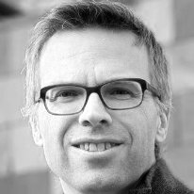




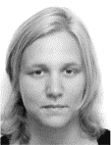
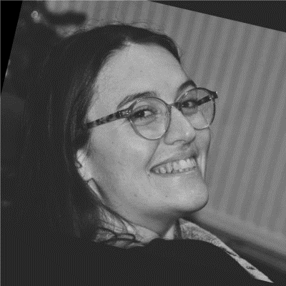
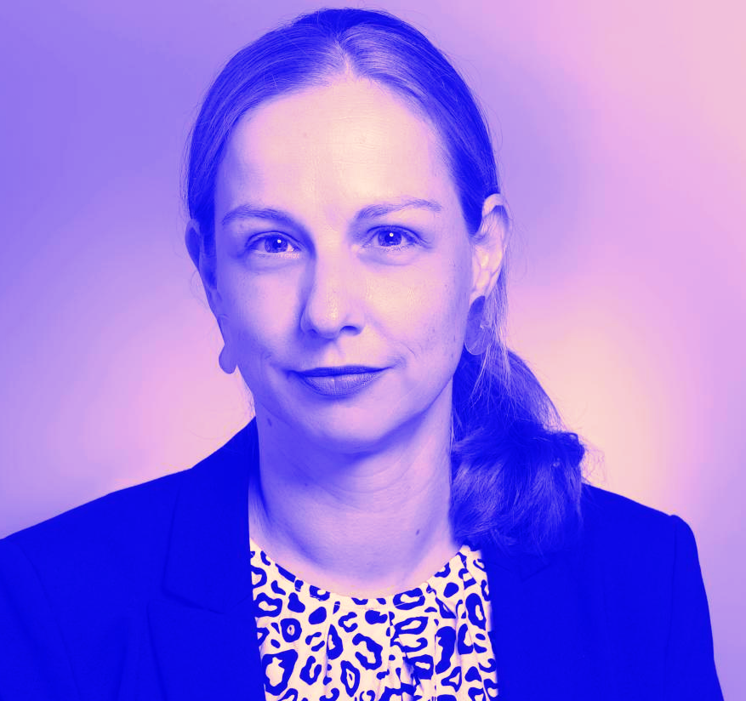
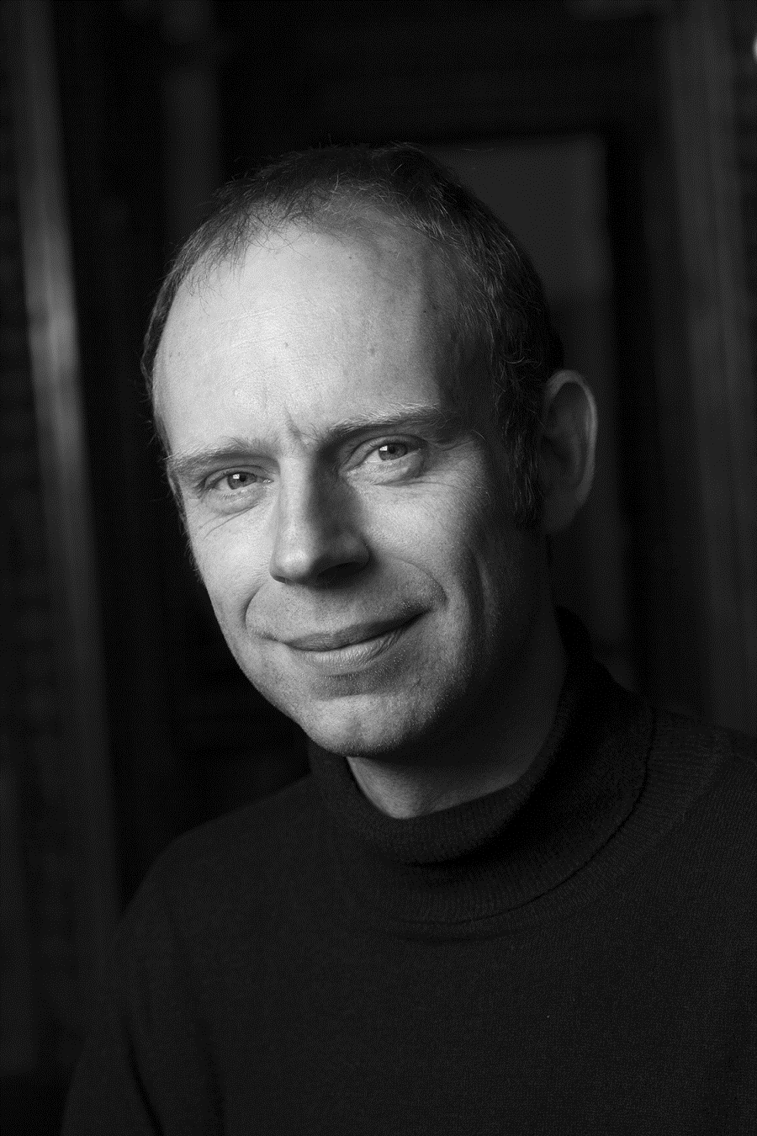
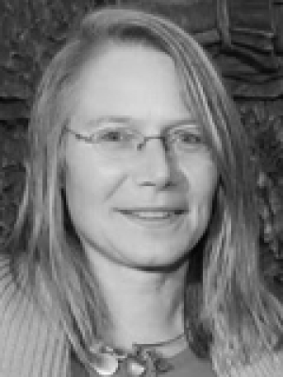
3. 2021-…: The ongoing research – A crossing wave
EPIBEL
INEQKILL
Pr. Tim Soens
UGent
Head of EPIBEL
Pr. Sylvie Gadeyne
VUB
Head of INEQKILL
Pr. Isabelle Devos
UGent
Pr. Thierry Eggerickx
UCLouvain
PDR Inequalities
Pr. Sophie Vanwambeke
UCLouvain
Mélanie Bourguignon
UCLouvain
Ilona Dauw
UCLouvain + ULeipzig
Pr. Maren Röger
ULeipzig
Research Seminary Spanish Flu
PDR Spanish Flu
(Follow-up committee)
Pr. Laurence van Ypersele
UCLouvain
Pr. Emmanuel Debruyne
UCLouvain

Slide 9

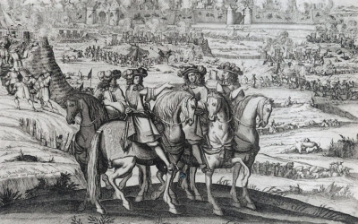
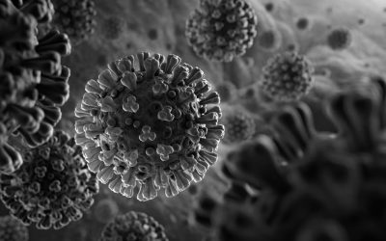
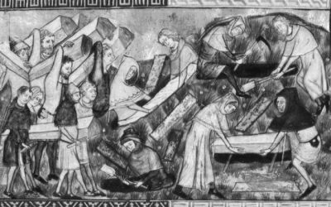
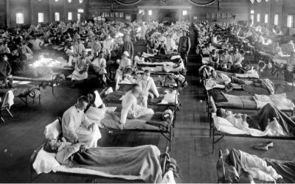
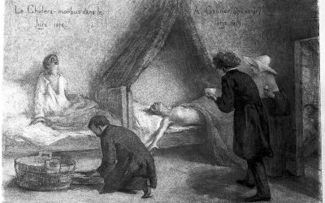
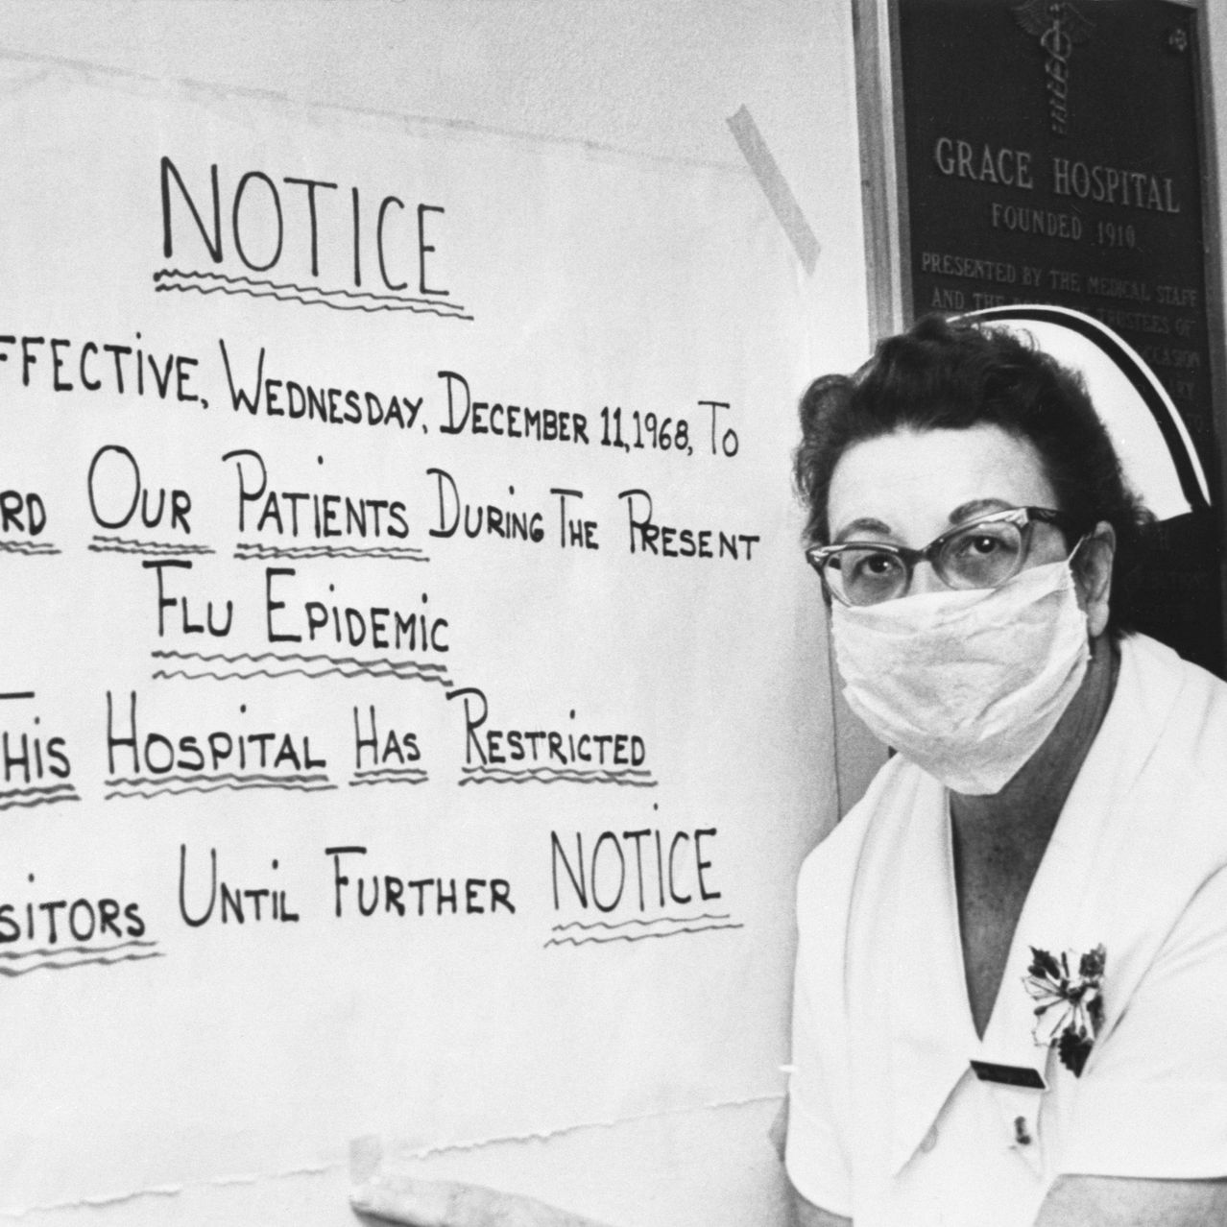
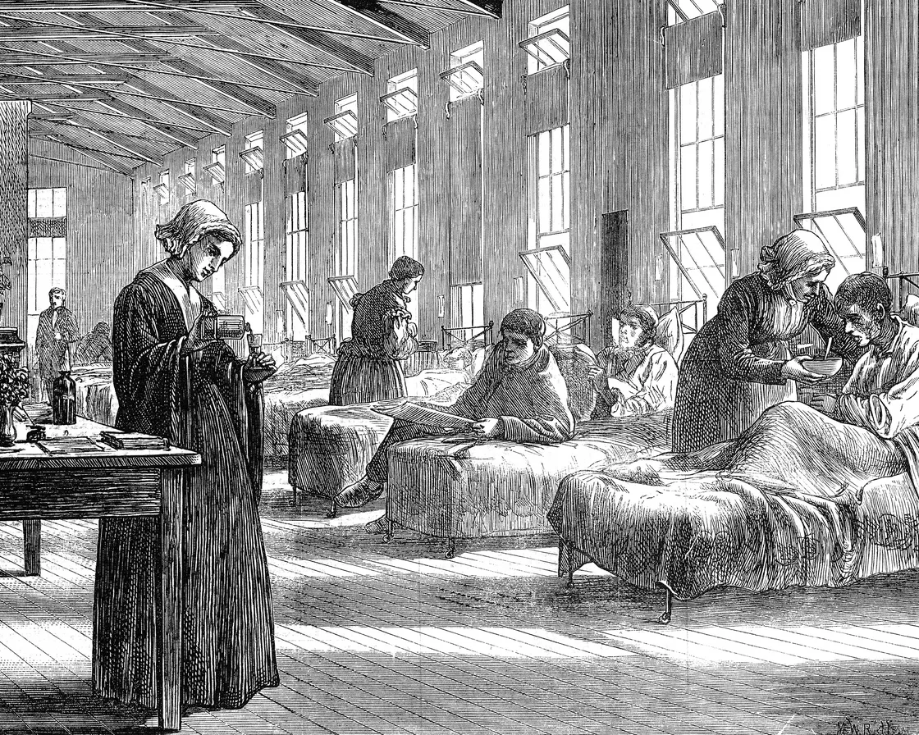
3. 2021-…: The ongoing research – A crossing wave
INEQKILL
EPIBEL
PDR Spanish Flu
Research Seminary Spanish Flu
PDR Inequalities

Slide 10
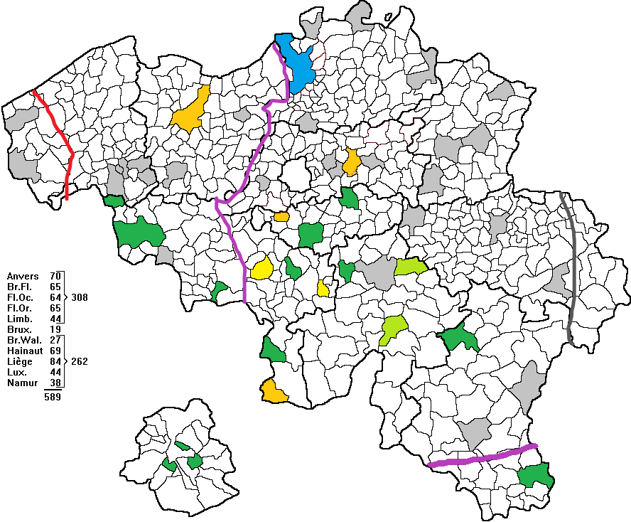
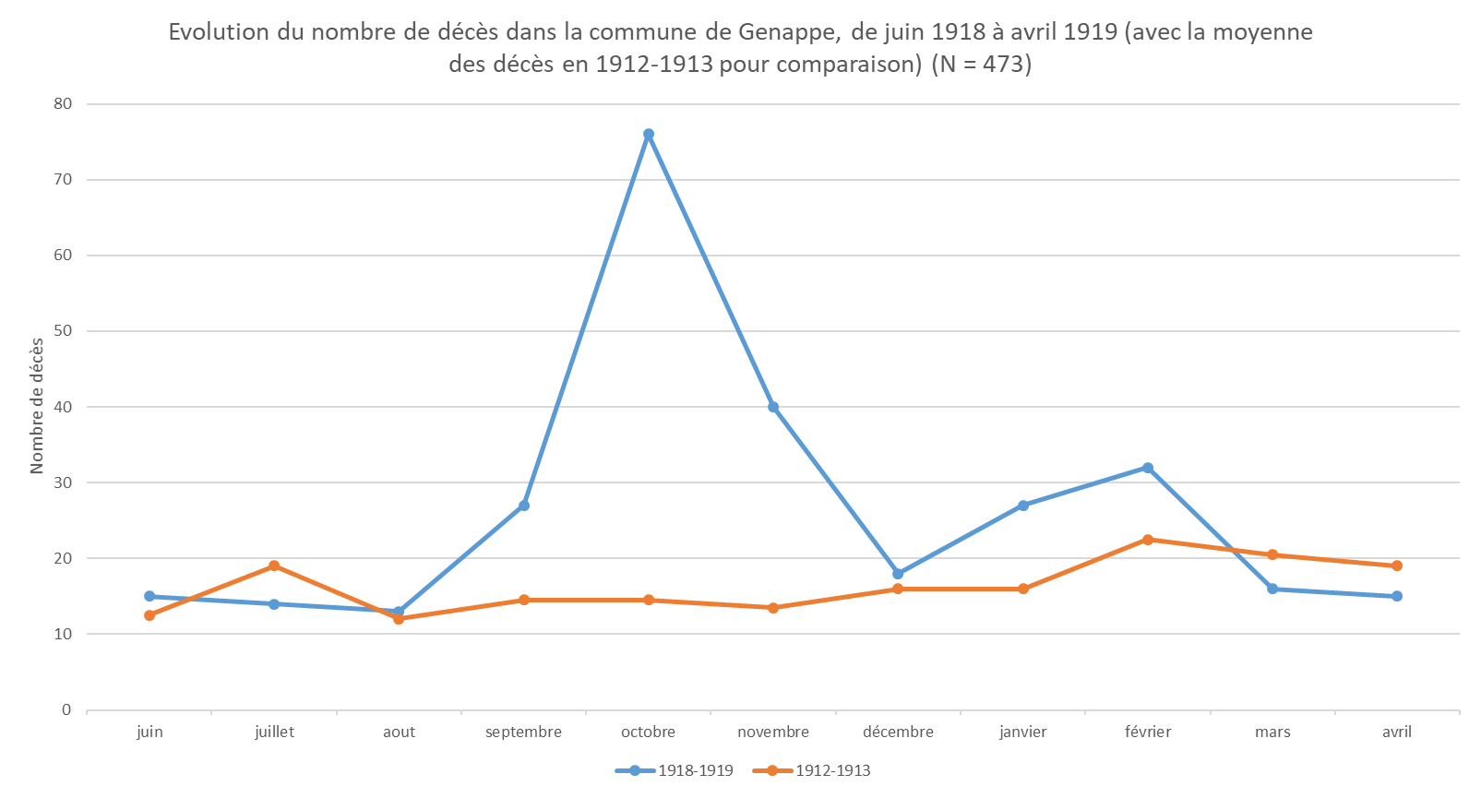
3. 2021-…: The ongoing research – A crossing wave

Slide 11


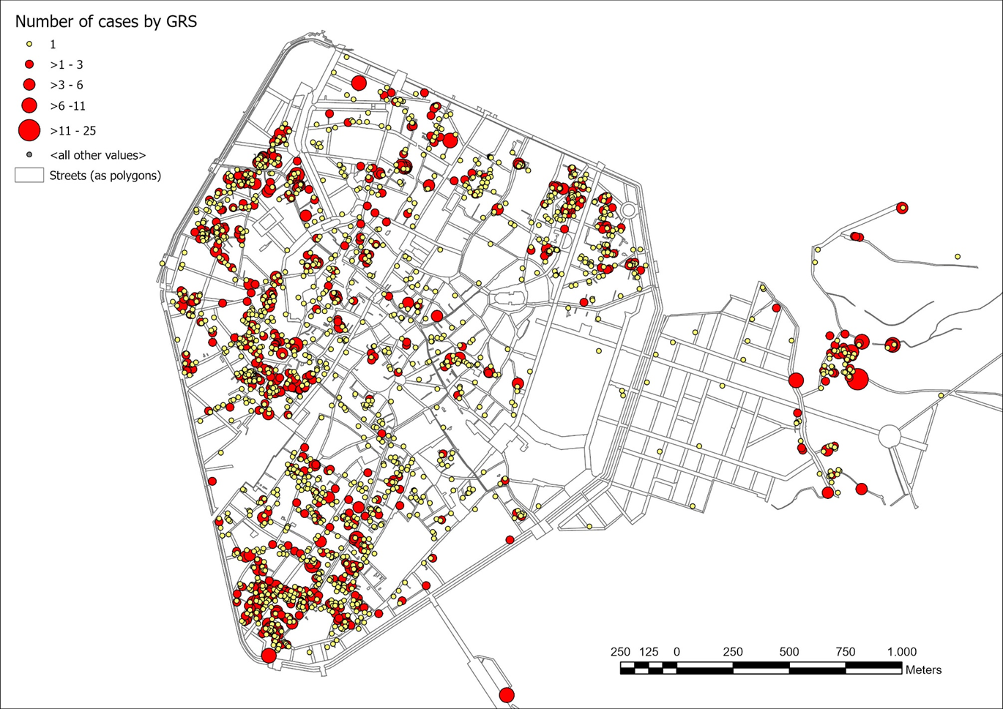
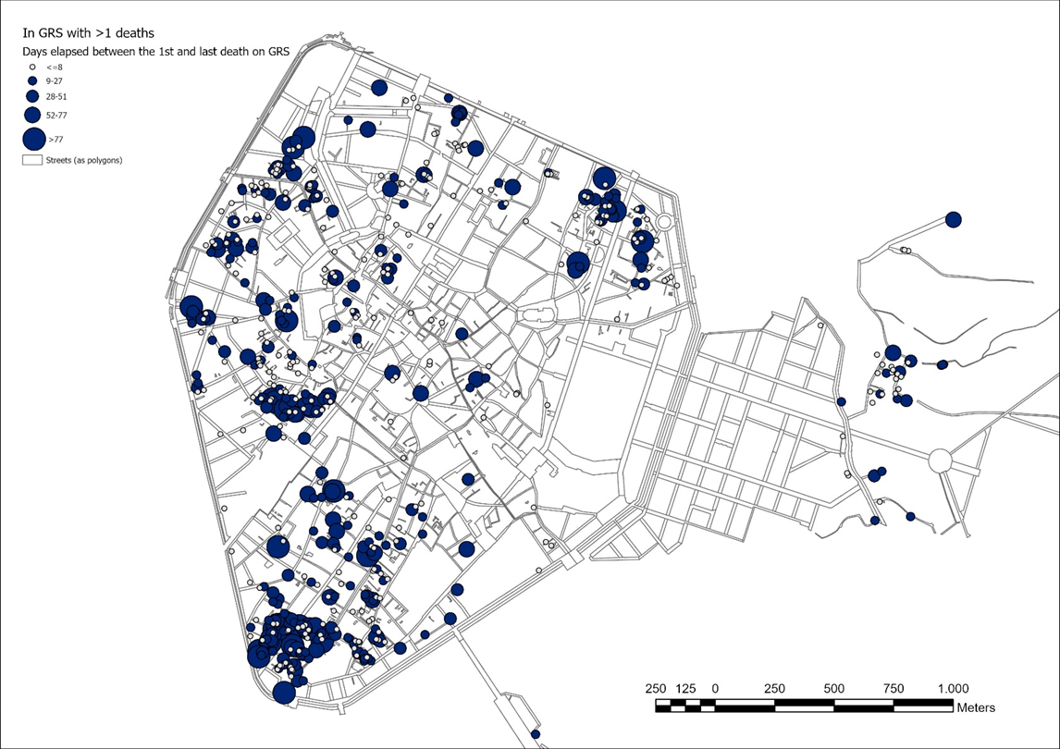
3. 2021-…: The ongoing research – A crossing wave
Cholera, 1866

