Slide 1



The GW-method approaches for molecules and automatization for solids
M.J. van Setten
Institute of Condensed Matter and Nanosciences,
Université catholique de Louvain, Belgium

Slide 2
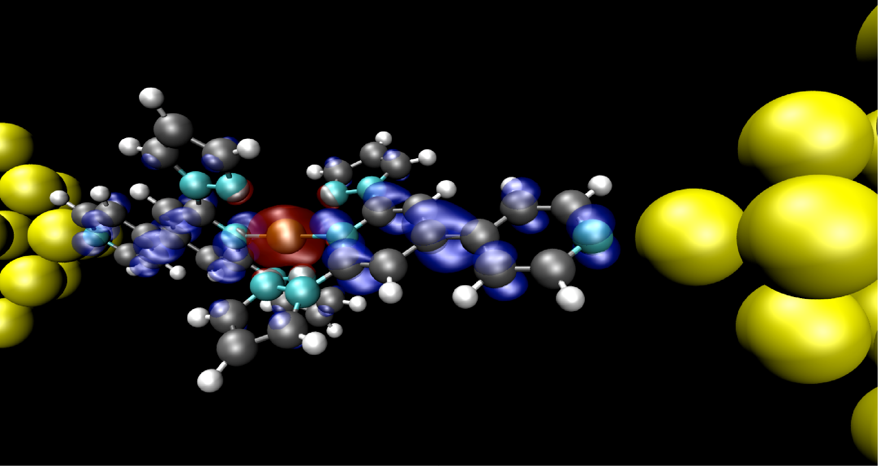

Slide 3
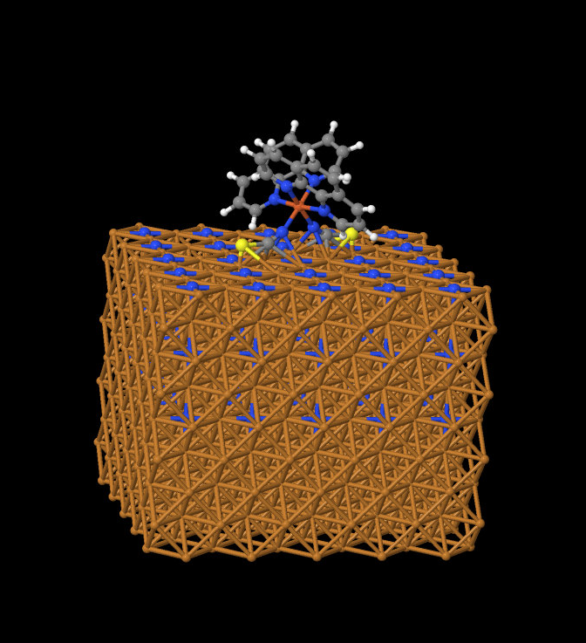

Slide 4
Computational approaches
Density functional theory
  Maps the many particle problem into a single particle problem
  Scalar effective potential V_{xc}(r)
  Applicable to large systems: > 2000 atoms
  Broadly used across many fields of sciences
  Description of electronic levels (charge transfer), long range interactions, no proper fundamental band gaps
GW-method
  Replace the potential by a self-energy matrix: V_{xc}(r) → Σ(r,r’,E)
  Becoming increasingly available for bulk solids
  Significantly improved description of electronic levels (charge transfer), long range interactions, and band gaps
Notes:
Improved experimental conditions

Slide 5
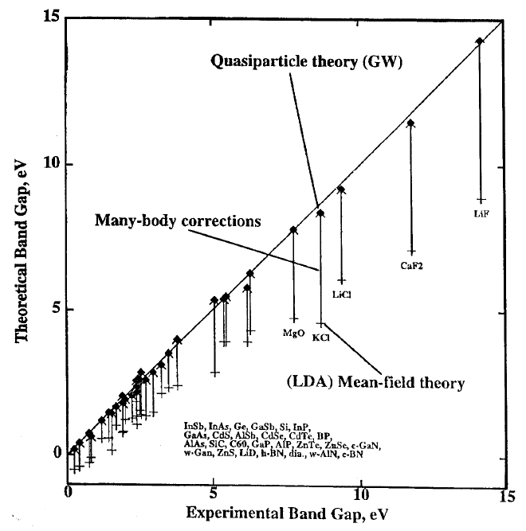
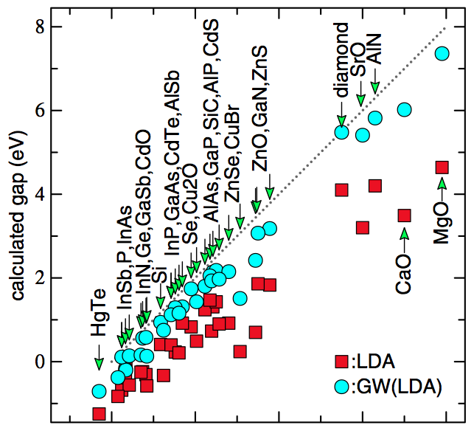

GW for solids: Bandgaps
VAN SCHILFGAARDE PRL 96, 226402 (2006)
HEDIN J PHYS, COND MAT. 11 R489 (SHIRLEY)

Slide 6
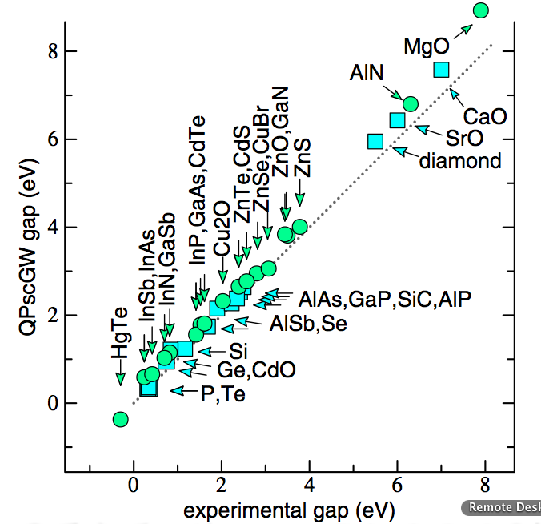
scGW for solids: Bandgaps
KRESSE PRB 75, 235102
VAN SCHILFGAARDE PRL 96, 226402 (2006)

Slide 7
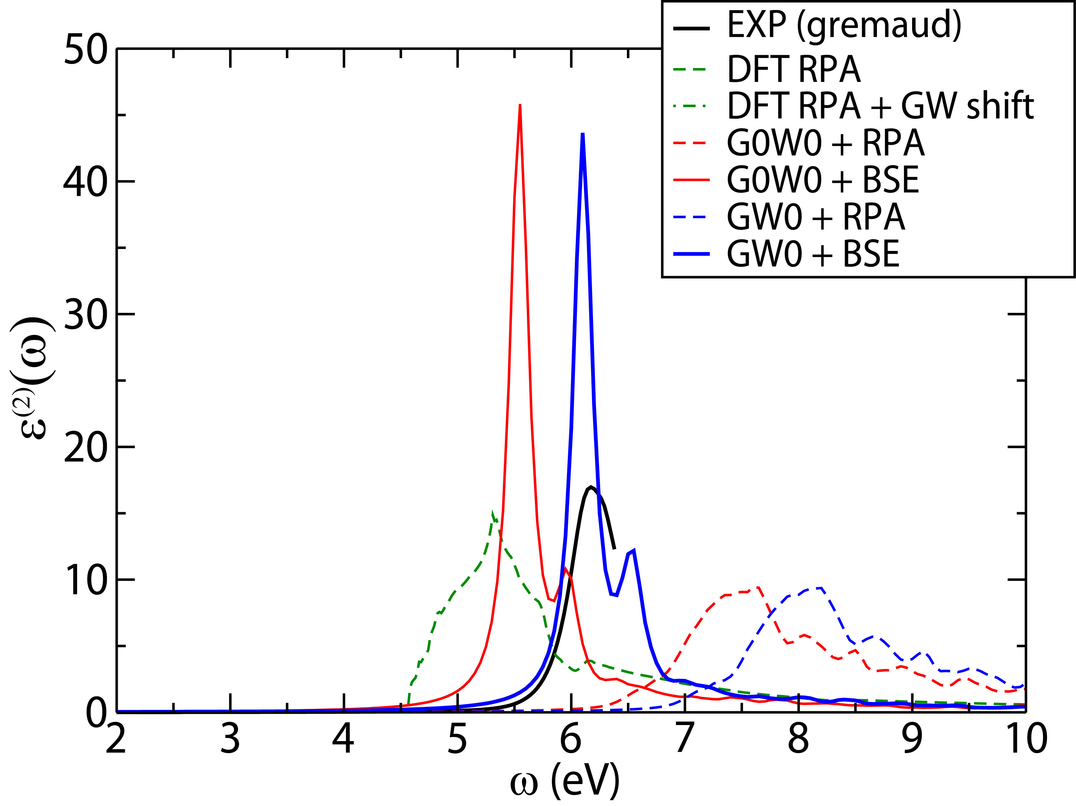
GW + BSE for solids: optical excitations
Silicon
NaH
G₀W₀ + BSE
Exp
DFT + RPA
G₀W₀ + RPA
ONIDA, Rev Mod Phys 74, 601
VAN SETTEN PRB 83, 035422

Slide 8
GW

Slide 9
KS v.s. Quasi-Particle equation
HEDIN Phys Rev 139, A796, HYBERTSEN and LOUIE PRB 34, 5390
Electron density parameterized by KS single particle states
Notes:
At this point all is exact, now we need a way to calculate Sigma

Slide 10
KS v.s. Quasi-Particle equation
Greens function obeying the Dyson equation
In spectral representation, expressed in terms of quasi-particle states leads to the quasi particle equation:
HEDIN Phys Rev 139, A796, HYBERTSEN and LOUIE PRB 34, 5390

Slide 11
KS v.s. Quasi-Particle equation
HEDIN Phys Rev 139, A796, HYBERTSEN and LOUIE PRB 34, 5390
Electron density parameterized by KS single particle states
Greens function in spectral representation, expressed in terms of quasi-particle states leads to the quasi particle equation:
The quasi-particle energies are the electron removal and addition energies
Notes:
At this point all is exact, now we need a way to calculate Sigma

Slide 12
KS v.s. Quasi-Particle equation
V_{xc}: exchange correlation potential
Σ: self-energy
HEDIN Phys Rev 139, A796, HYBERTSEN and LOUIE PRB 34, 5390
Electron density parameterized by KS single particle states
Greens function in spectral representation, expressed in terms of quasi-particle states leads to the quasi particle equation:
The quasi-particle energies are the electron removal and addition energies
Notes:
At this point all is exact, now we need a way to calculate Sigma

Slide 13
Zeroth order quasi particle equation
Full quasi particle equation
0th order corrections (diagonal elements only)
Linearized 0th order corrections

Slide 14
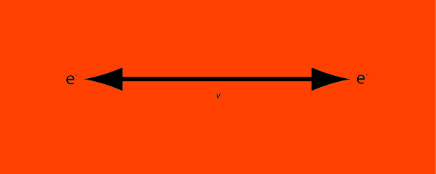
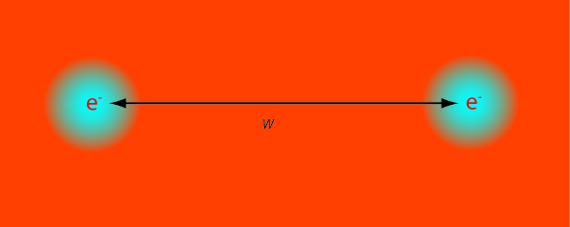
Advantages
There is a closed set of equations for the self-energy
Perturbative expansion in terms of the screened interaction in stead of the bare Coulomb interaction
The quasi-particle energies are the electron removal and addition energies
Extension to charge neutral excitations via the Bethe-Salpeter equation
Bare Coulomb interaction
Screened Coulomb interaction

Slide 15
Hedin Equations
  Space time notation
  (the numbers indicate a contracted space, time and spin index)
HEDIN Phys Rev 139, A796

Slide 16
Hedin Equations
  Space time notation
  (the numbers indicate a contracted space, time and spin index)
  Neglecting the second term in the vertex function
  leads to the GW approximation for the self-energy
  Fourier transformed to frequency domain:
HEDIN Phys Rev 139, A796

Slide 17
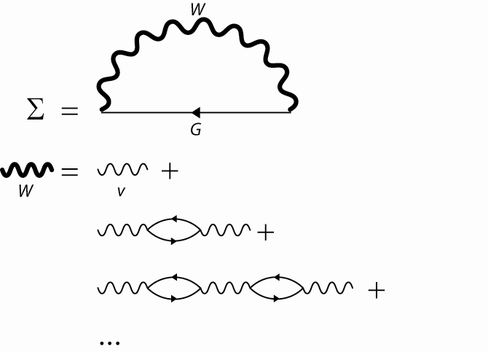
In diagrams

Slide 18
Molecular systems

Slide 19
Analytic integration
Calculate the self-energy only once from KS-DFT energies and orbitals
Notes:
Because of our spectral approach we can now evaluate these last experssions analitically

Slide 20
Analytic integration
Spectral representation of the
reducible polarization function
from TD-KS response equation
m labels excitations
Calculate the self-energy only once from KS-DFT energies and orbitals
Notes:
Because of our spectral approach we can now evaluate these last experssions analitically

Slide 21
Reducible response function
transition densities
Generalized Dyson equation
As used in TDHF and TDDFT
RPA or TDDFT version of the orbital rotation Hessians
For all m : Formally N⁶
Exploiting local basis N⁴

Slide 22
G₀W₀ and linearized QP equation
Calculate the self-energy only once from KS-DFT energies and orbitals
Linearized 0th order Quasi-Particle equation
Notes:
Because of our spectral approach we can now evaluate these last experssions analitically

Slide 23
Matrix elements
Matrix elements to be calculated
Implemented in TURBOMOLE (escf)
Very efficient evaluation of electron-electron integrals:
  (Contracted) Gaussian basis sets
  Resolution of the Identity (RI) method
MVS, F. Weigend, F Evers
JCTC 11, 232 (2013)

Slide 24
Plasmon pole
  Approximate the response by one single pole
  Calculate response at a few imaginary frequencies
  Analytic continuation to the real axis
  Calculate Sigma analytically
  Cheap
  Many different approaches
  Justification for complex systems

Slide 25
Analytic continuation
  Calculate the GW integral on the imaginary axis
  Fit an n-pole expansion for Sigma in the entire complex plane
Allows for a more detailed sigma
Can be made exact
May take many poles to converge

Slide 26
Benchmark set for molecules: GW100
Collaboration KIT Karlsruhe, FHI Berlin and
Berkeley Lab US DoE
  TURBOMOLE:
  Gaussian basis sets, spectral representation via Casida
  FHI-Aims:
  numerical local orbitals, analytic continuation
  BerkeleyGW:
  plane waves, plasmon pole and real frequency integration
  5 different ways to evaluate the self-energy
well converged all electron reference values for IP and EA

Slide 27
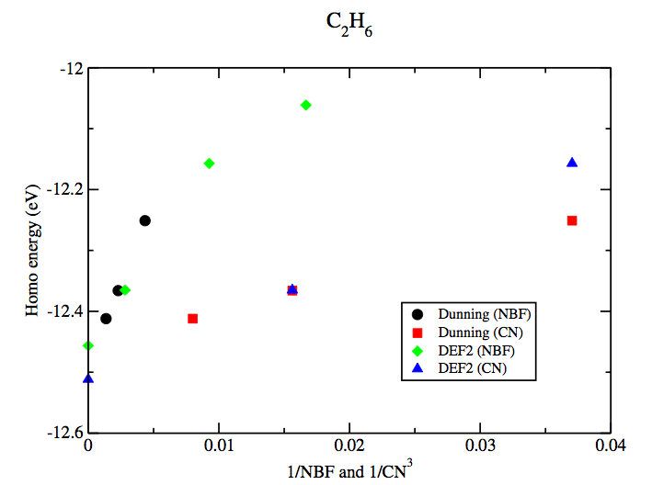
Basis-set extrapolation
SVP
TZVP
T
Q
QZVP
5

Slide 28
Hard to converge

Slide 29
Problems when solving the QPE
x

Slide 30
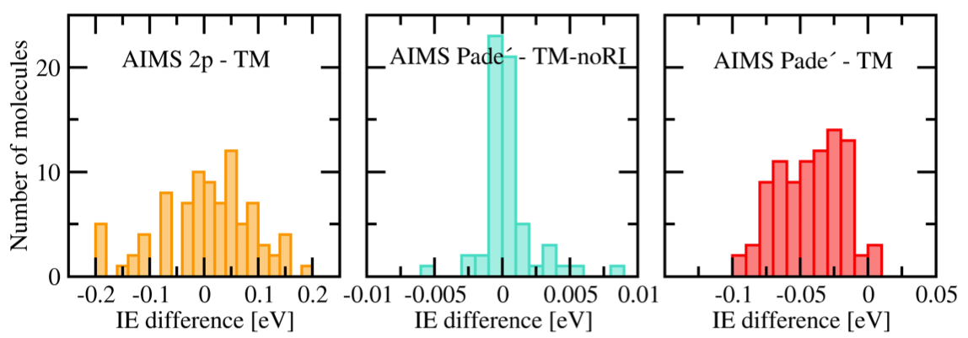
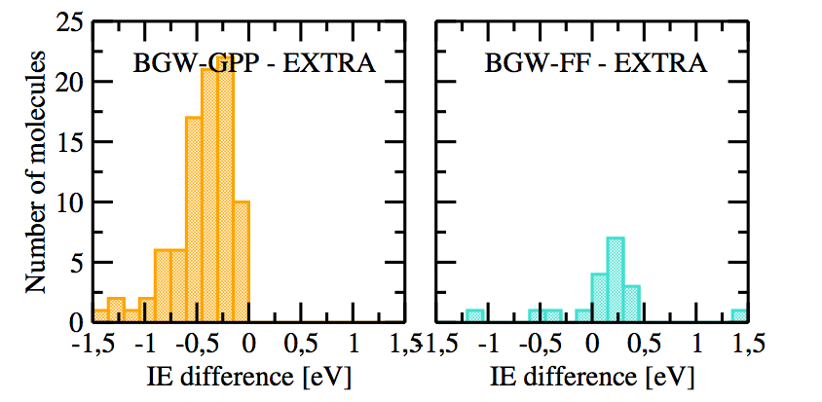
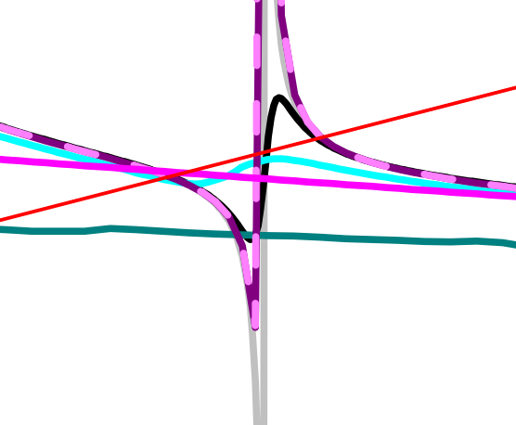
Method agreement

Slide 31
Some numbers
0.65 eV overestimation by plasmon pole
0.32 eV underestimation at QZVP level for the LUMO
0.12 eV underestimation at QZVP level for the HOMO
0.12 eV error by two pole analytic continuation
0.10 eV error by introducing a
150 eV cutoff on empty states and a
544 eV cutoff on the dielectric matrix
0.05 eV overestimation by RI auxiliary basis functions
0.05 eV error by introducing a 400 eV cutoff on the spectral representation of the response function

Slide 32
Further steps

Slide 33
Approximations within G₀W₀
Plasmon pole / model response
Analytic continuation / numerical integration
Neglect of semi-core state contributions / pseudo potentials

Slide 34
Approximations within G₀W₀
Plasmon pole / model response
Analytic continuation / numerical integration
Neglect of semi-core state contributions / pseudo potentials
Linearized quasi particle equation (< 0.1 eV)
RI approximation (< 0.1 eV)
Difference RPA / TDDFT response (~ 0.1 eV)

Slide 35
Approximations within G₀W₀
Plasmon pole / model response
Analytic continuation / numerical integration
Neglect of semi-core state contributions / pseudo potentials
Linearized quasi particle equation (< 0.1 eV)
RI approximation (< 0.1 eV)
Difference RPA / TDDFT response (~ 0.1 eV)
Off-diagonal elements
  > Perturbative correction
Neglect of self-consistency
  > Quasi-particle self-consistency
  > Partial self-consistency

Slide 36
(partial) self-consistency
G₀W₀
Same computational cost
G_{fo}W₀
foGW
No off-diagonal elements
GW₀
qpGW
Single screening calculation
Starting point independent

Slide 37
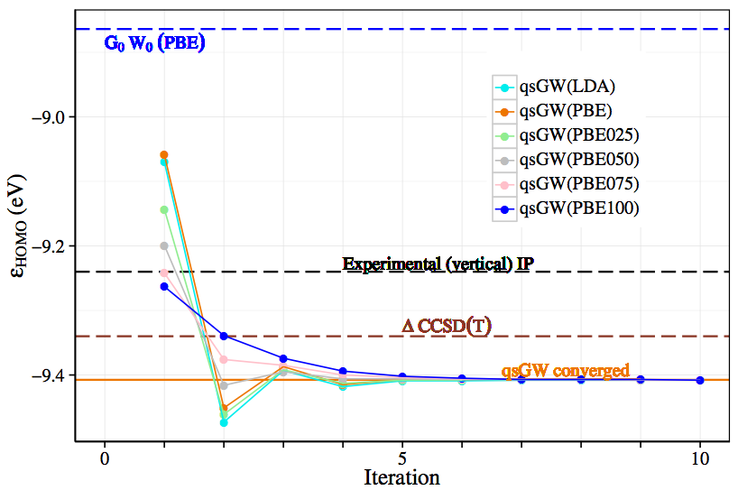
qsGW
Notes:
Benzene

Slide 38
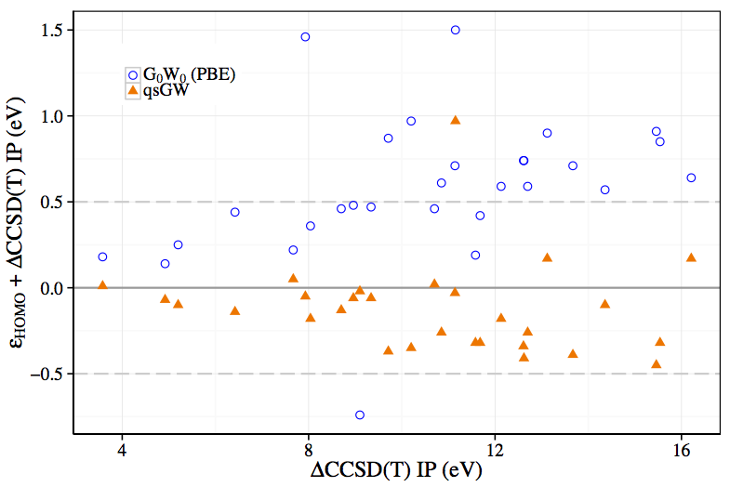
qsGW
Notes:
Thiadiazole

Slide 39
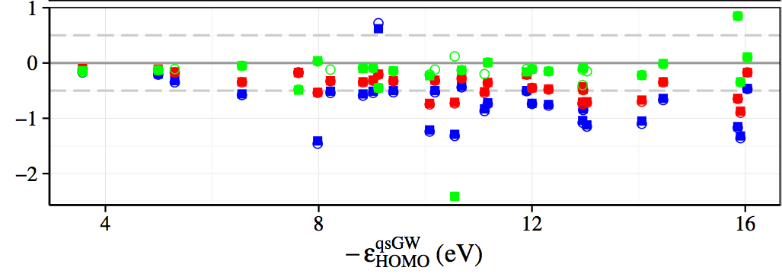
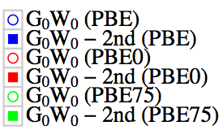
G₀W₀

Slide 40
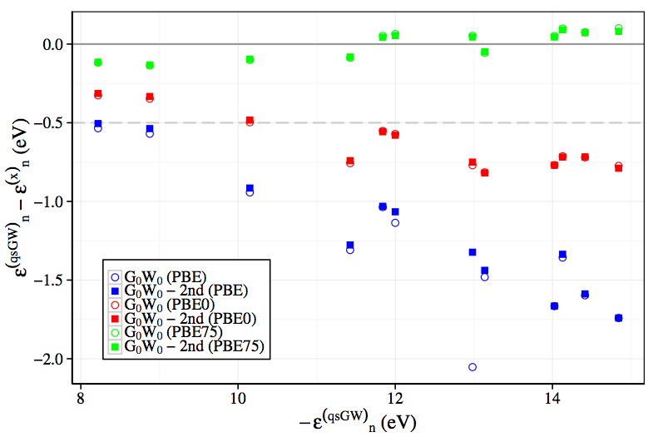
G₀W₀

Slide 41
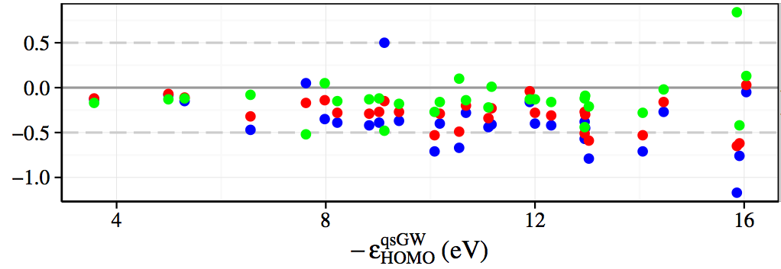

G_{fo}W₀

Slide 42
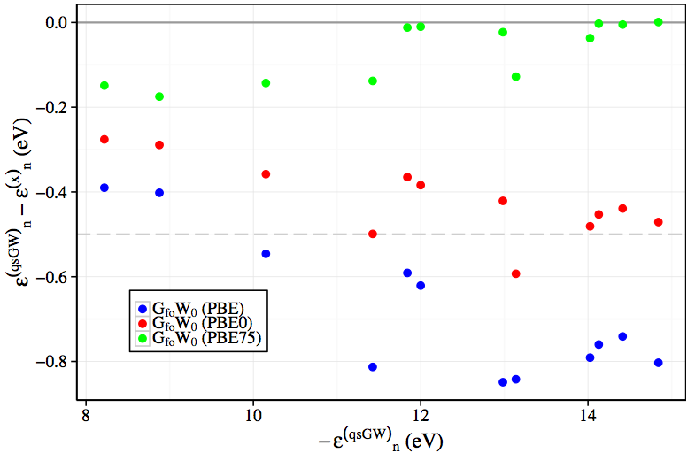
G_{fo}W₀

Slide 43
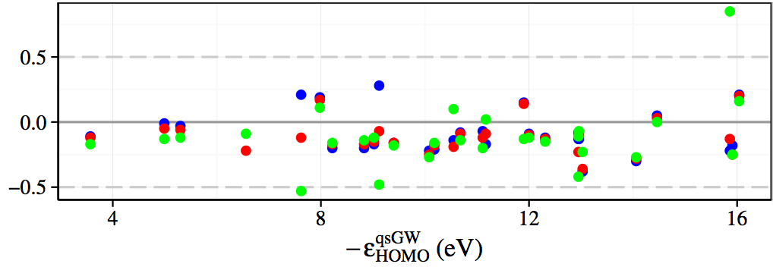

foGW
Notes:
butene
isobuthene

Slide 44
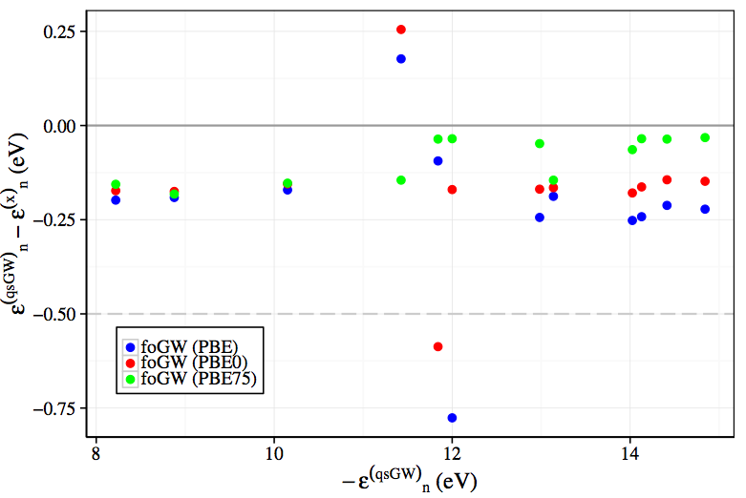
foGW
Notes:
butene
isobuthene

Slide 45
(partial) self-consistency
@PBE
Mean Absolute Deviation (sigma²)
G₀W₀
0.75 (0.20)
0.18 (0.05)
Optimized starting point
G_{fo}W₀
foGW
0.43 (0.09)
0.21 (0.06)
0.17 (0.03)
0.15 (0.02)
GW₀
qpGW
Single screening calculation
0.22 (0.07)
wrt CCSD(T)
Notes:
Left pbe75 right pbe0

Slide 46
Approximations within G₀W₀
Plasmon pole / model response
Analytic continuation / numerical integration
Neglect of semi-core state contributions / pseudo potentials
Linearized quasi particle equation (< 0.1 eV)
RI approximation (< 0.1 eV)
Difference RPA / TDDFT response (~ 0.1 eV)
Off-diagonal elements
Self-consistency
Beyond GW …

Slide 47


High-throughput GW
Notes:
Lausanne AAS 25 mins

Slide 48
High-throughput GW
from a structure
without any human intervention
to converged GW results
Automatic calculations
Screening for new compounds
Database building
Uniform results
No human bias

Slide 49
Baby sitting
Determine optimal parallelization settings
Create input
Automatically submit jobs (to the right queue)
Monitor job status
Detect and fix errors
Restart

Slide 50
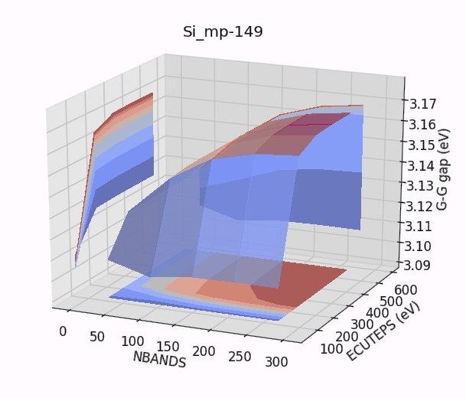
Convergence studies
Energy cutoffs
Kpoints
Smearing
Bands
….

Slide 51
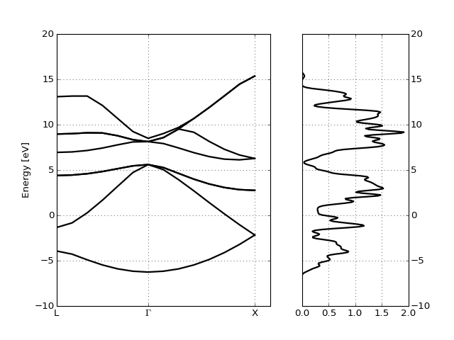
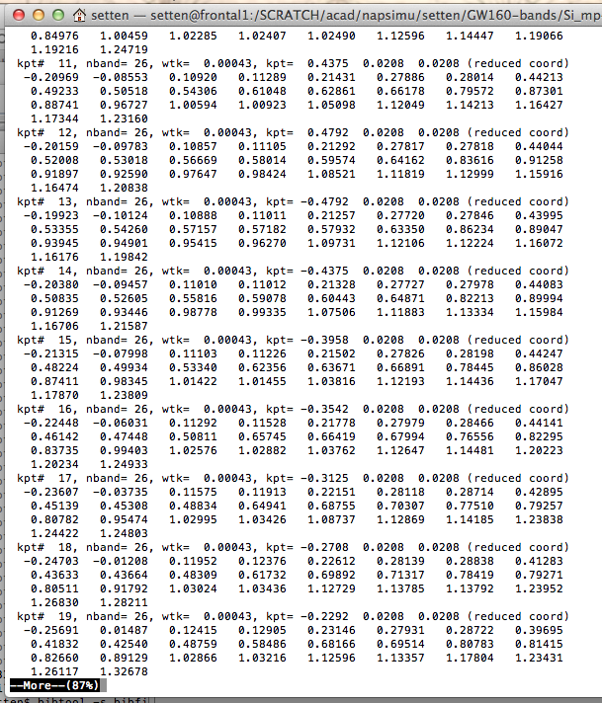
Post processing
nscf_ebands = abiopen("si_nscf_GSR.nc").ebands
gs_ebands = abiopen("si_scf_GSR.nc").ebands
nscf_ebands.plot_with_edos(gs_ebands.get_edos())

Slide 52
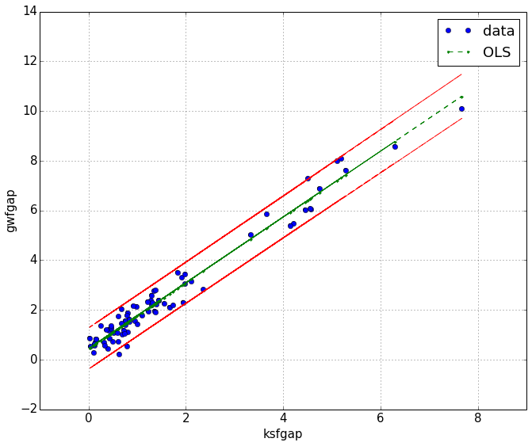
Automatically for many structures
for structure in database:
ebands_input(structure, pseudos=ONCVPSP_GGA)
for structure in database:
ebands_input(structure, pseudos=ONCVPSP_GGA)
for structure in database:
ebands_input(structure, pseudos=ONCVPSP_GGA)

Slide 53
GW in High Throughput
‘additional’ difficulties as compared to DFT
  Pseudo potentials
  4 step calculation
  N⁴ scaling
  No ‘safe’ parameter set (converged results for all)
  No ‘safe’ computational settings (# cpu’s, memory, time, ...)
Notes:
Pseudo potentials well tested for ground state, for gw this is not so clear ..

Slide 54

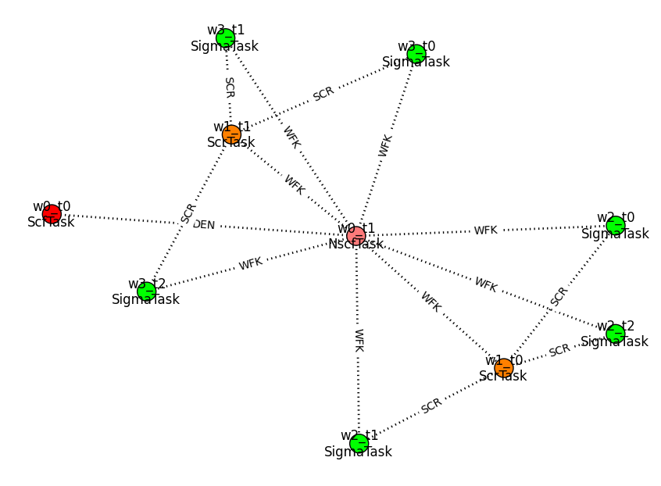
based Python package
Workflow management
ABINIT I/O
Post processing
Flow generation:
GUI or scripted

Slide 55
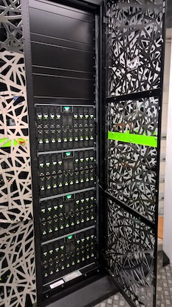
SLURM
PBSPro
Torque
SGE
…
Scheduling the flow on the cluster
Error handling
Convergence testing

Slide 56


Interactive analysis
and presentation of
results
Storing results:
query-able entries
+ netcdf data files
(via gridfs)

Slide 57
Automatic GW flow
On a low k-point density (2x2x2):
  Set of single parameter ground state convergence studies
  Grid of nbands X encuteps
  For each nbands find converged encuteps
  For the converged encuteps find the converged nbands
  if not found > extend grid and retest
On the final high k-point density:
  Test derivatives.
  (in most cases the high density derivatives turn out smaller)
  Post process
  (create scissor, apply scissor, plots, statistical analysis…)
(pw cutoff, …)

Slide 58
Convergence study
On a low k-point density (2x2x2):
  Set of single parameter ground state convergence studies
  Grid of nbands X encuteps
  For each nbands find converged encuteps
  For the converged encuteps find the converged nbands
  if not found > extend grid and retest
On the final high k-point density:
  Test derivatives.
  (in most cases the high density derivatives turn out smaller)
  Post process
  (create scissor, apply scissor, plots, statistical analysis…)
(pw cutoff, …)

Slide 59
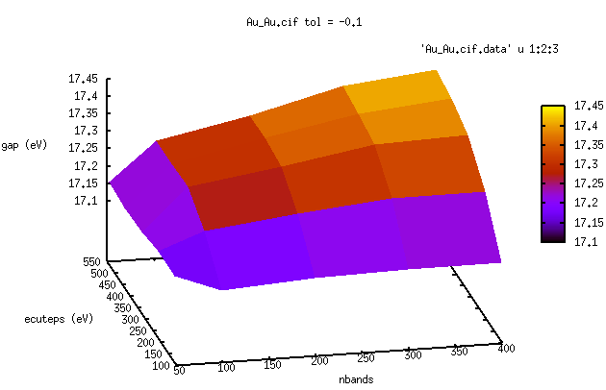
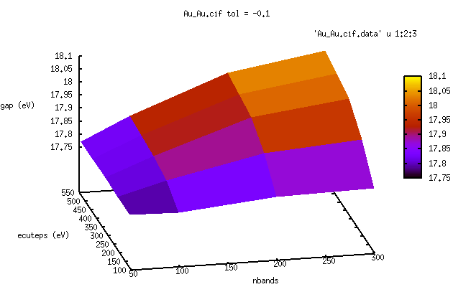
Gold
2x2x2 kpoint mesh
14x14x14 kpoint mesh
Notes:
It actually works: the shape of the surface calculated at 222 is the same as the on calculated

Slide 60
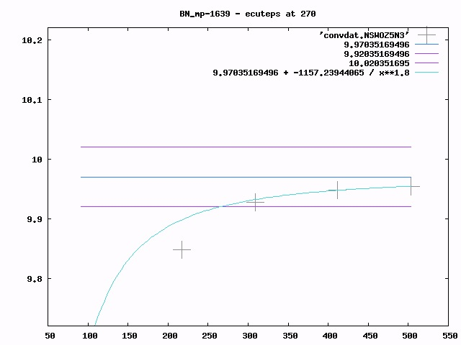
G-G
gap
(eV)

Slide 61
Automatic GW flow
On a low k-point density (2x2x2):
  Set of single parameter ground state convergence studies
  Grid of nbands X encuteps
  For each nbands find converged encuteps
  For the converged encuteps find the converged nbands
  if not found > extend grid and retest
On the final high k-point density:
  Test derivatives.
  (in most cases the high density derivatives turn out smaller)
  Post process
  (create scissor, apply scissor, plots, statistical analysis…)
(pw cutoff, …)

Slide 62
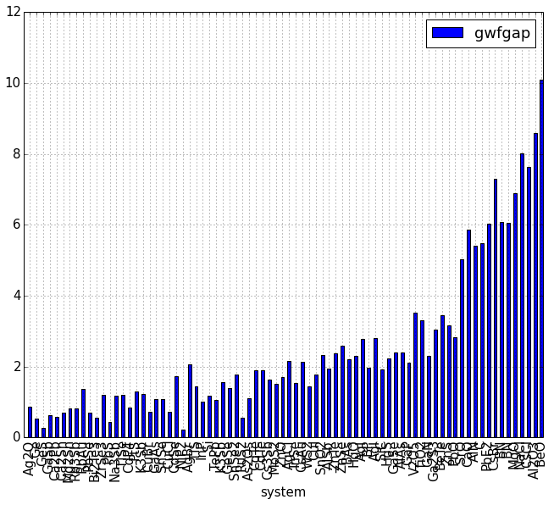
First application: GW160
~ 160 solids, including the not so usual suspects
Settings:
  Godby – Needs PP
  Tolerance 0.1 eV
~ 100 done at this point

Slide 63
correlation: 0.983
R-squared: 0.966
coefficients
const: 0.4507 (0.063)
ksfgap: 1.3227 (0.028)

Slide 64
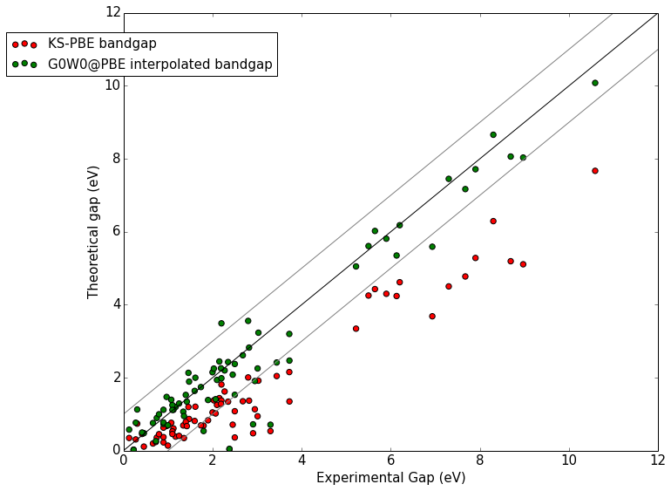

Slide 65
d-states Cu, Cd

Slide 66
Heavy elements Te, Pd
d-states Cu, Cd

Slide 67
Experimental gaps are room temperature
Heavy elements Te, Pd
d-states Cu, Cd

Slide 68
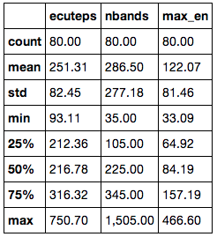
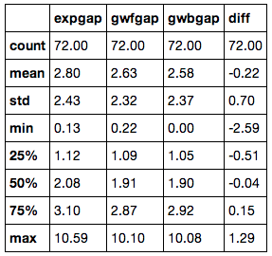
Some Statistics
Parameters for convergence [eV]
G₀W₀@PBE performance (T_{room} exp) [eV]

Slide 69
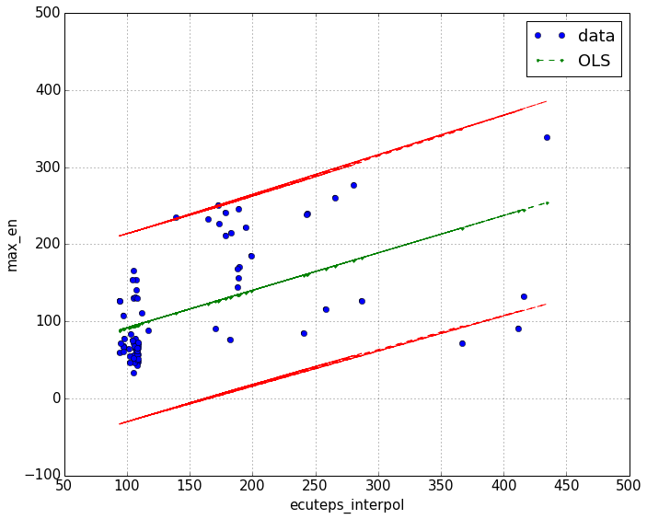
Empty states v.s. Sigma cutoff

Slide 70



Collaborators
Matteo Giantomassi
Geoffroy Hautier
Gian-Marco Rignanese
Xavier Gonze
Don Hamann
Ferdinand Kaplan
Florian Weigend
Ferdinand Evers
Fabio Caruso (FHI Berlin)
Patrick Rinke (FHI Berlin)
Sahar Sharifhades (Berkeley Lab)
Jeffey Neaton (Berkeley Lab)

Slide 71

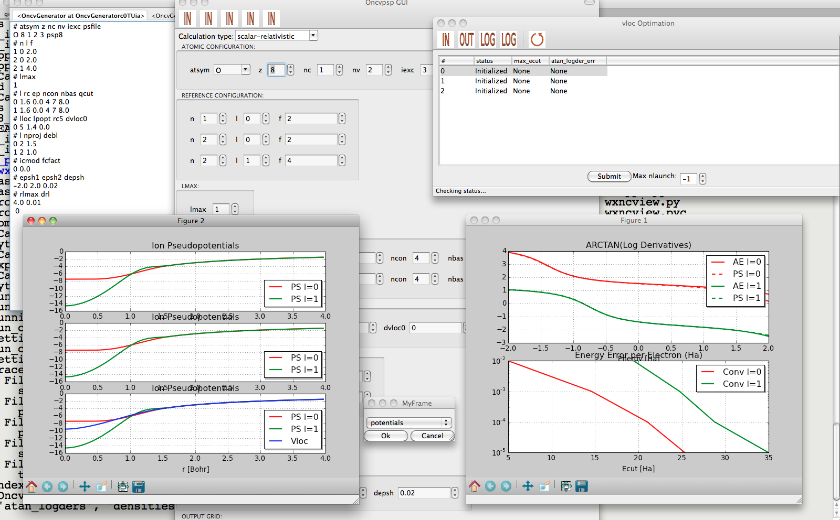
Pseudo Dojo
Optimized Norm Conserving Vanderbild Pseudo Potentials
  multiple projectors
  multiple gradient constraints
Don Hamann (PRB 88, 085117 (2013))
Package to facilitate PSP
generation
Graphical interface
Automatized testing (6)
Log derivatives made to agree up to 8 Ha
http://www.pseudo-dojo.org/dojo.html
Notes:
Multiple projectors > more degrees of freedom to fix the scattering in the empty space
Log derivatives can be made to match the all electrons ones well beyond 8 H

Slide 72
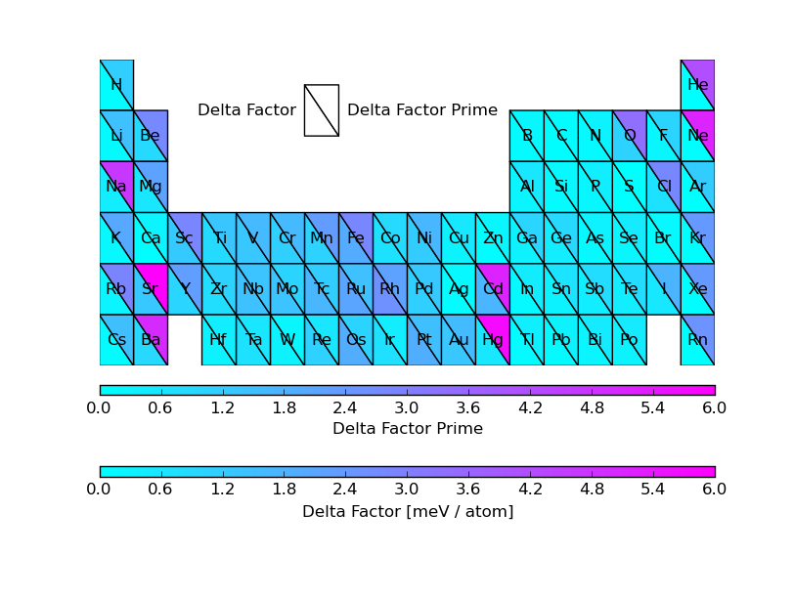
ONCVPSP PDv0.2
(Comparing EOS against AE reference)
[meV]
Mean low cutoff 27 Ha (std 12 Ha), normal cutoff 33 Ha (std 13 Ha)

Slide 73
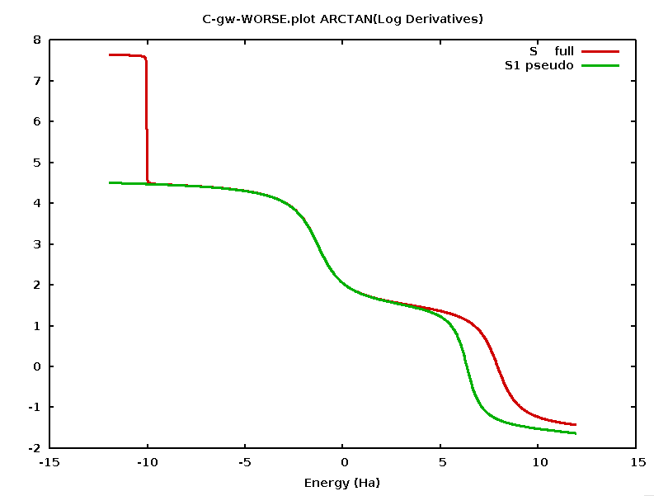
Carbon
log derivatives
Ghost state
Single projector PP

Slide 74
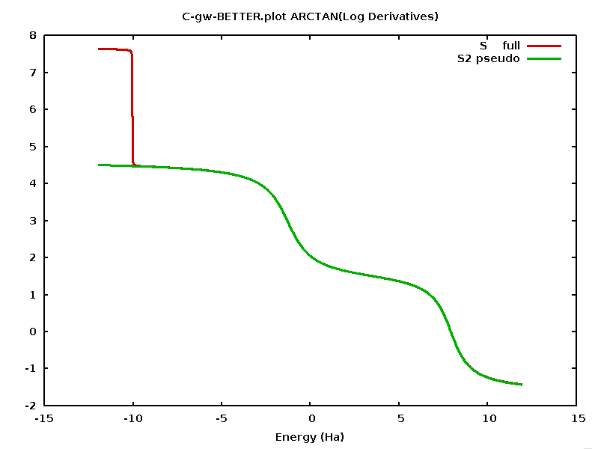
Carbon
log derivatives
2 projector PP
Ghost state
Single projector PP

Slide 75
Benchmark set for molecules: GW100
Collaboration KIT Karlsruhe, FHI Berlin and
Berkeley Lab US DoE
  TURBOMOLE:
  Gaussian basis sets, spectral representation via Casida
  FHI-Aims:
  numerical local orbitals, analytic continuation
  BerkeleyGW:
  plane waves, plasmon pole and real frequency integration
  5 different ways to evaluate the self-energy
Strictly converged all-electron reference values for IP and EA
Test PP results against all electron references for molecular systems
Sternheimer GW in Abinit

Slide 76


GW in High Throughput
‘additional’ difficulties
  Pseudo potentials
  4 step calculation
  N⁴ scaling
  No ‘safe’ parameter set (converged results for all)
  No ‘safe’ computational settings (# cpu’s, memory, time, ...)
DFT babysitting problem
Notes:
Pseudo potentials well tested for ground state, for gw this is not so clear ..

Slide 77
GW in High Throughput
‘additional’ difficulties
  Pseudo potentials
  4 step calculation
  N⁴ scaling
  No ‘safe’ parameter set (converged results for all)
  No ‘safe’ computational settings (# cpu’s, memory, time, ...)
GW babysitting problem
Notes:
Pseudo potentials well tested for ground state, for gw this is not so clear ..

Slide 78












GW in High Throughput
‘additional’ difficulties
  4 step calculation
  N⁴ scaling
  No ‘safe’ parameter set (converged results for all)
  No ‘safe’ computational settings (# cpu’s, memory, time, ...)
  Pseudo potentials ?
GW babysitting problem
Notes:
Pseudo potentials well tested for ground state, for gw this is not so clear ..

Slide 79
Summarizing

Slide 80
Storing flows in a database

Slide 81
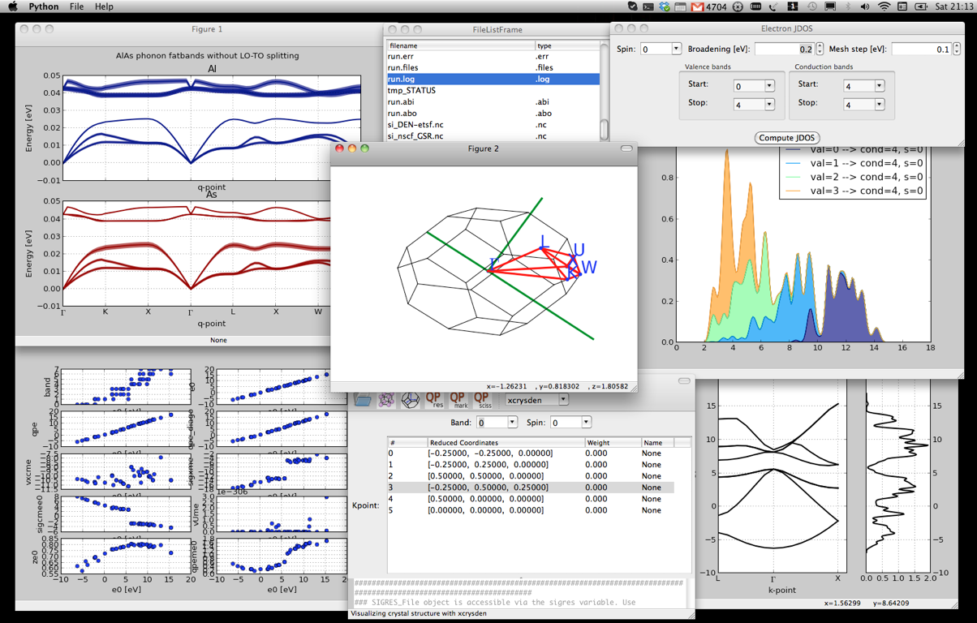
Graphical interfaces

Slide 82
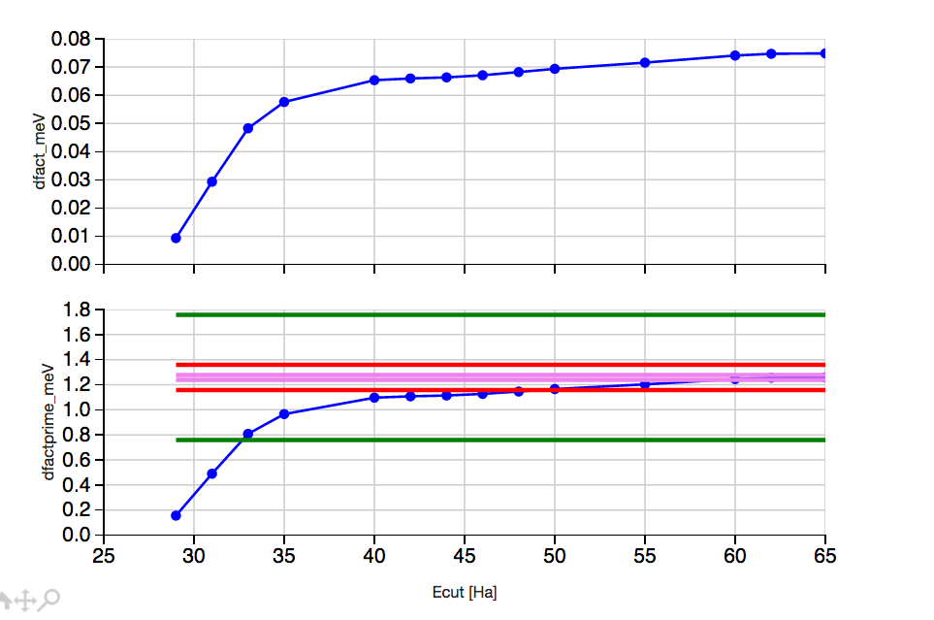

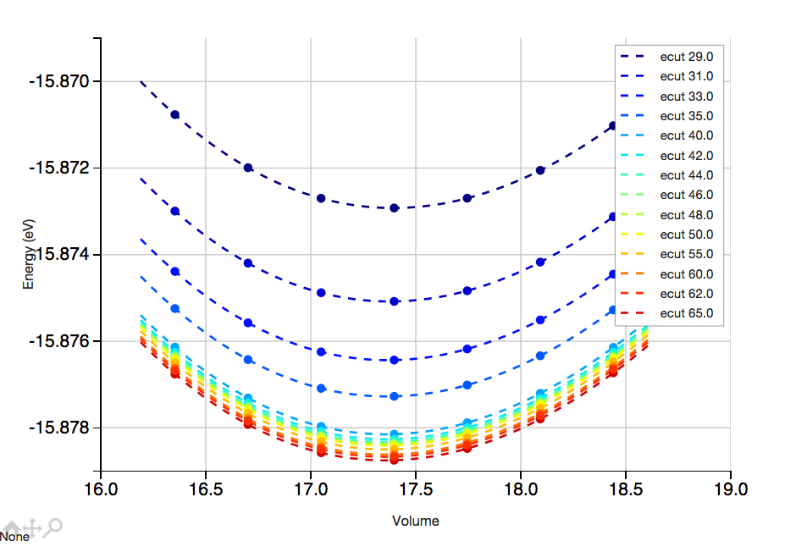
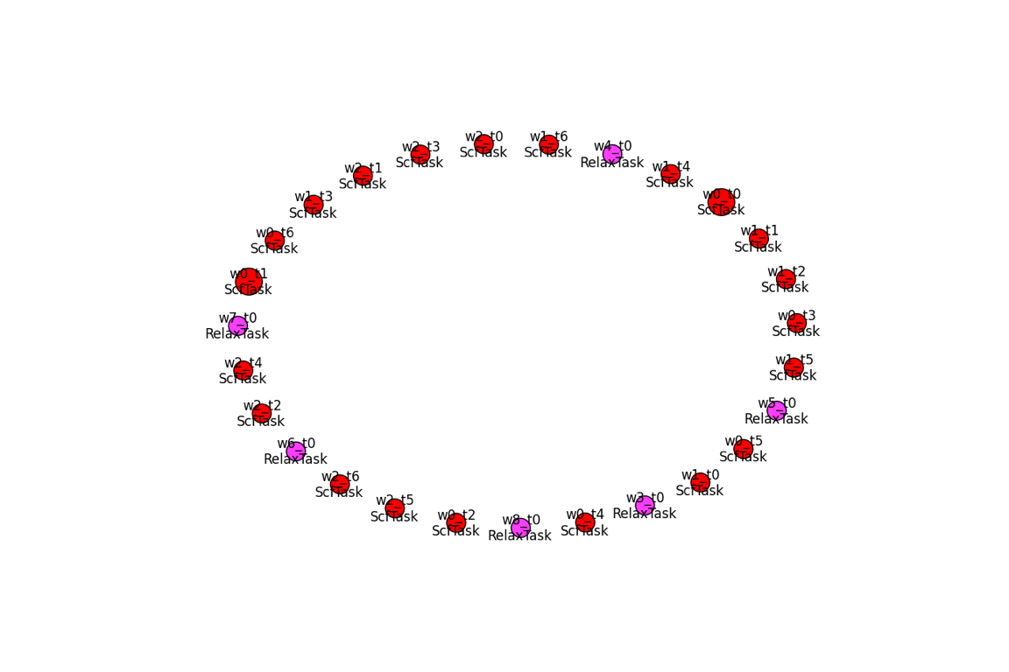
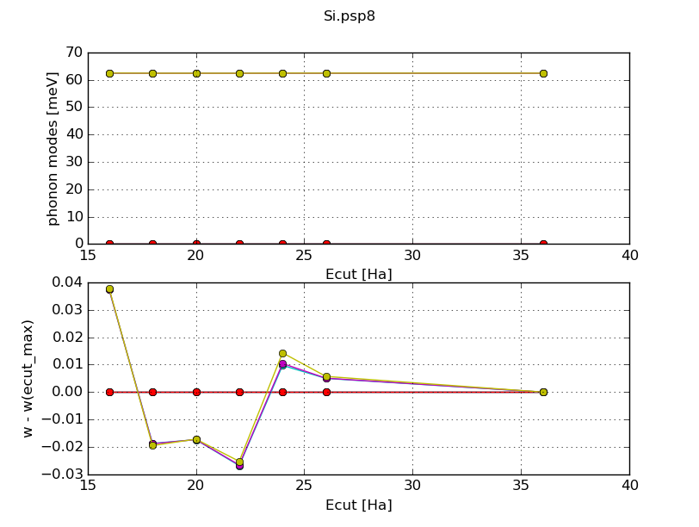
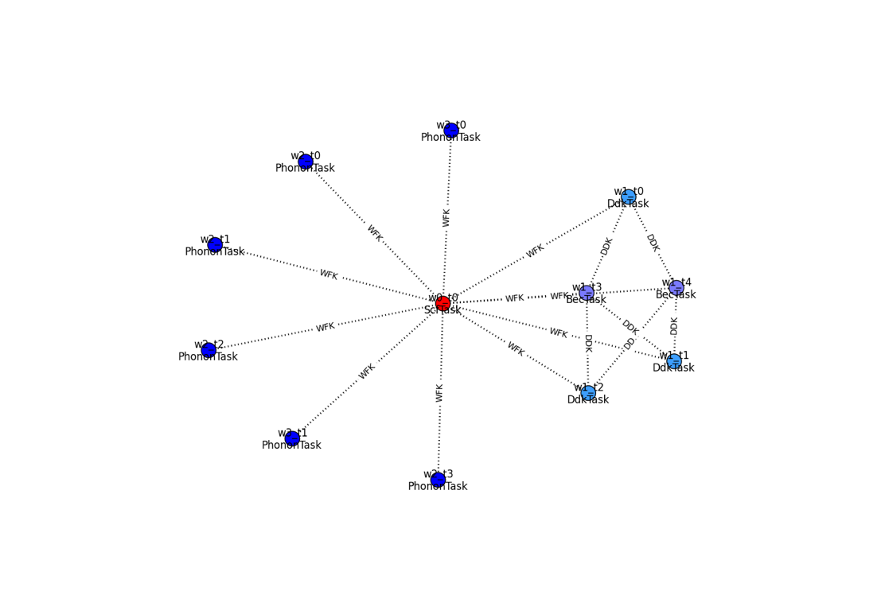
EOS
Flows
Ipython notebook with full info: H-high.ipynb

Slide 83
Collaborators
Florian Weigend (KIT Karlsruhe)
Ferdinand Evers (KIT Karlsruhe)
Fabio Caruso (FHI Berlin)
Patrick Rinke (FHI Berlin)
Sahar Sharifhades (Berkeley Lab)
Jeffey Neaton (Berkeley Lab)

Slide 84




Acknowledgements
Prof. F. Evers
Dr. F. Weigend
Dipl.-Phys. F Kaplan
Center for Functional Nanostructures

Slide 85
KS v.s. Quasi-Particle equation
Electron density parameterized by KS single particle states
Greens function in spectral representation, expressed in terms of quasi-particle states leads to the quasi particle equation:
The quasi-particle energies are the electron removal and addition energies
Local exchange-correlation potential
Non-local energy dependent
non-hermitian self-energy
HEDIN Phys Rev 139, A796, HYBERTSEN and LOUIE PRB 34, 5390
Notes:
At this point all is exact, now we need a way to calculate Sigma

Slide 86
GW wrapper
Python package that wraps around the ab-initio code
Options
    What kind of GW
    Convergence tolerance
Some list of structures > ‘fully’ converged GW results

Slide 87
2D convergence problem

Slide 88

Python package for:
post-processing Abinit results
generating input files automatically
creating and executing workflows (relaxations, phonons, benchmarking, convergence studies, PP testing, GW ...)
(I)Python(notebook) based tutorials
High throughput flows and high performance flows
Why python?
relatively easy to use and to learn
interactive environment (IPython, notebooks, GUIs)
excellent support for scientific applications (scipy, pandas, matplotlib...)
ecosystem
tons of other libraries

Slide 89
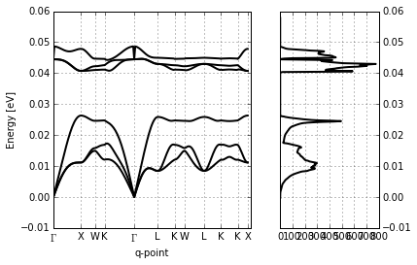
DFPT

Slide 90
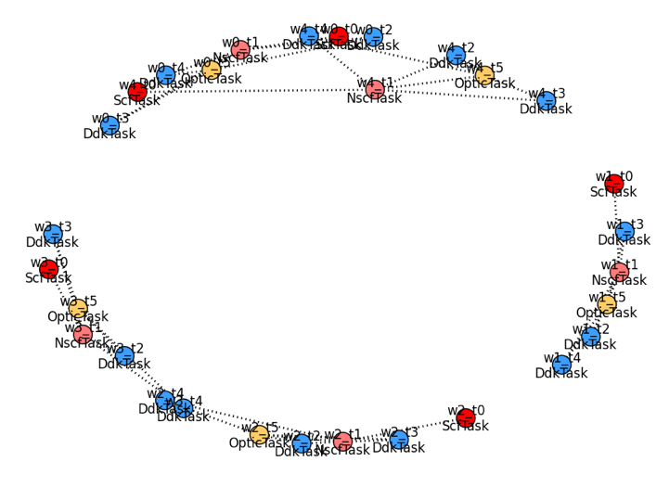
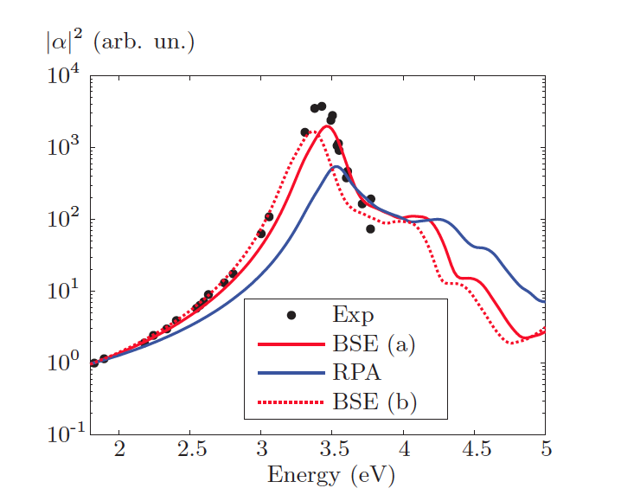
Raman with frozen phonon

Slide 91
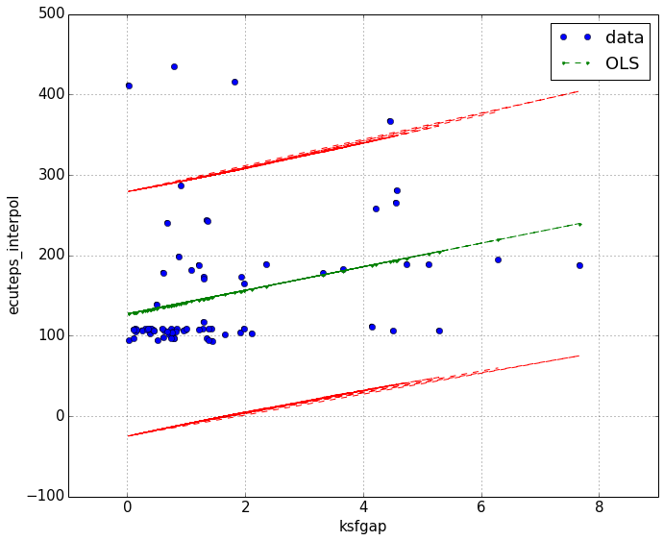
Ecuteps ?

Slide 92
Abipy for teaching
Different users

Slide 93


Slide 94
Test results and Benchmarking
Test set including:
  H₂, N₂, F₂, Li₂, Na₂, Cs₂
  NH₃, SiH₄, SF₄
  LiH, BF, CO₂, H₂O
  Au₂, Au₄
  Acetone, Acrolein, Ethylene, Isobutane
  Methane – Butane, Benzene – Naphthacene
Method comparison
Basis-set convergence
Functional dependence

Slide 95
Method comparison ionization potentials

Slide 96
Method comparison electron affinities

Slide 97
G₀W₀ basis-set convergence
QZVP
TZVP
SVP
Tested for all molecules
In general linear extrapolation possible
especially to the DEF2 results
TZVPP in this test set converged within
0.25 eV
Extrapolated results
TZVPP
cc-pV5Z
cc-pVTZ
cc-pVDZ
cc-pVQZ

Slide 98

Basis set convergence
Deviation from the extrapolated results

Slide 99
G₀W₀ Functional dependence
Differences between G₀W₀ results (Δ) are much smaller than deviations between the respective DFT results
Largest differences for LiH, H₂O and hydrocarbons with OH groups

Slide 100

Open shell systems
Collinear case
  Matrices are
  spin-diagonal
  Screening comes
  from both spin
  channels

Slide 101


Slide 102


Slide 103


Slide 104


+
9.2
ONCVPSP potentials from the Pseudo-Dojo
Mn. Minimum at Ar
0.07
0.02
0.14
0.91
1.04
0.47
0.29
0.99
0.29
0.05
0.44
0.36
0.44
1.02
1.04
0.05
0.72
0.01
0.18
0.10
1.23
0.90
1.25
3.53
11.7
5.31
2.10
1.18
0.85
0.10
0.33
0.24
0.11
0.17
0.04
0.03
0.28
1.33
1.02
0.79
1.43
1.42
1.68
1.78
2.01
1.22
0.52
1.86
0.07
0.47
0.54
0.41
0.68
0.04
0.95
0.37
0.73
2.71
0.68
0.88
1.39
2.45
0.58
0.38
0.21
0.17
0.21
0.28
0.05
http://www.pseudo-dojo.org

Slide 105

Table of ONCVPSPs
NC with/without semi-core states
Good log derivative up to 3-5 Ha
Validated with DF, GBRV tests, Phonons
Deltafactor:
1.0 meV
(best pseudo for each element, including Mn!)
1.6 meV
(all pseudos)
Mn

