Slide 1

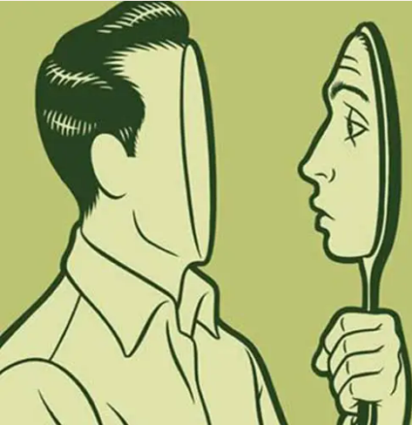




What does self-priority mean?
Behavioural correlates of self-priority in
perspective taking
BIGOT Alix
In collaboration with

Slide 2
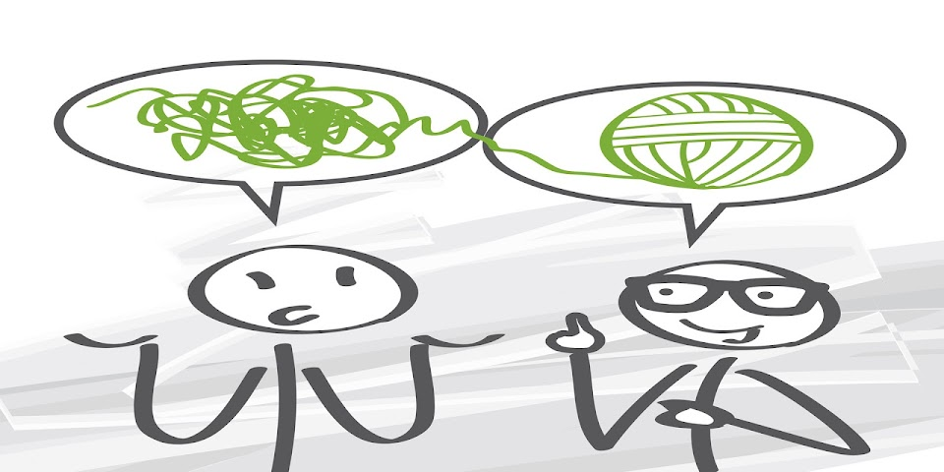

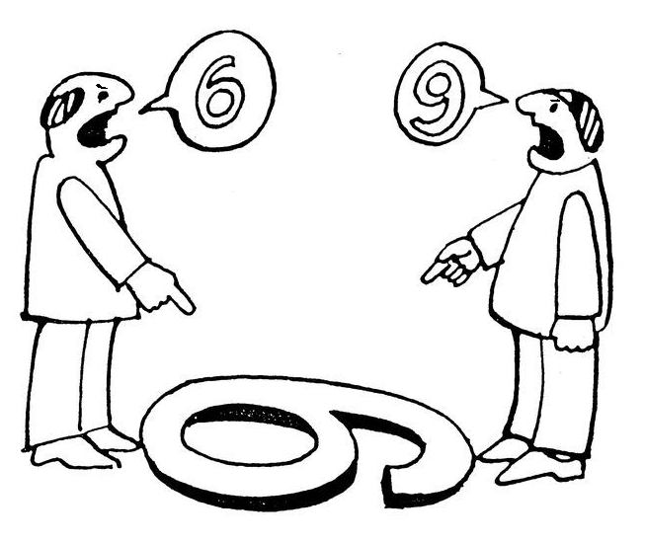


Introduction: what is perspective-taking ?
« understand each other »
SOCIAL COGNITION
« choosing a present »
Put yourself in someone else’s shoes
« negociate »
« comforting someone »
Intro – Method – Results: SOP – Results: Empathy – Results: Narcissism – Conclusion

Slide 3



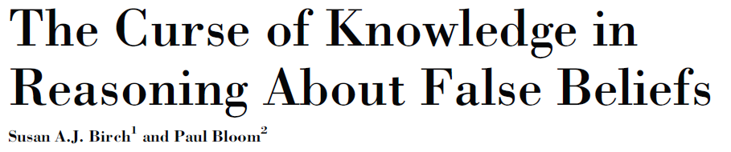


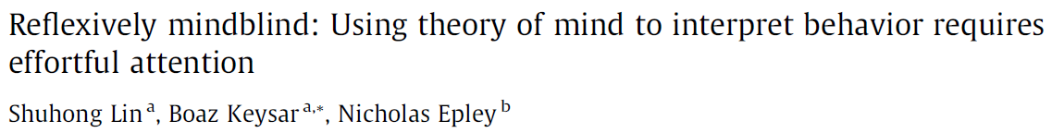
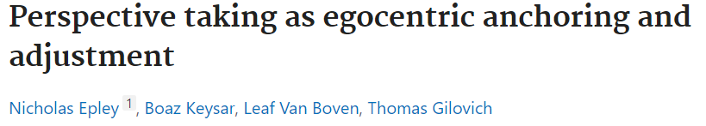
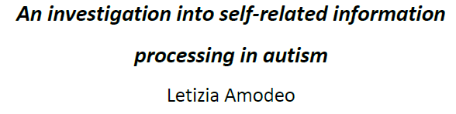
Introduction: what is self-priority ?
SELF-PRIORITY
See also:
SELF
OTHER
Intro – Method – Results: SOP – Results: Empathy – Results: Narcissism – Conclusion
Notes:
→ In this context, the self-priority would reflect a tendency to adopt more easily your own perspective as compared to the other’s.
→ In other word, self-priority reflects the attentional tendency to focus more on your own perspective.
Contrasted assumptions
Enhanced integrity of the self
Self absorbtion / ellicit intereference in social situations

Slide 4
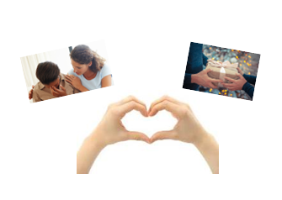
Introduction: what is self-priority ?
?
SELF-PRIORITY
Empathy
Narcissism
SELF
OTHER
Intro – Method – Results: SOP – Results: Empathy – Results: Narcissism – Conclusion
Notes:
Self as a bridge to the other OR the self as an obstacle to the other
Vision positive qui est self-prio = nécessaire construire le self → nécessaire pour comprendre les autres donc empathique
Autre vision serait qu’etre self prio nous rend moins attentif aux autres et self-absorbed
Potentiellement plus en discussion: SOP bloque la prise de perspective
P 51 compte de dia dans la thèse Laetitia (plusieurs taches)
Disucssion fin ils discutent du + et du – de positif p183: lien avec autisme
Si on compare le self-priority a quelque chose de plus neutre (outre narcissism), alors ca pourrait etre positif
Parfois self-prio est inadapté très context dépendant!! Self en retrait par rapport à l’autre
On calcule le self en comparaison à l’autre
Potentiellement on est capable de changer selon les contextes
Changer les curseurs de sp parce que la tâche le demande
Opposé 2 hypothèses:SOP = ego = mal
SOP = positif → ref word henryk

Slide 5
Method: sample and measures
Visual perspective-taking task (level 1; VPT)
Self-priority and self-priority congruent
Interpersonal Reactivity Index (IRI)
EC, PT and total score
Narcissistic Personality Inventory (NPI)
Leadership, grandiosity, entitlement and total score
Narcissistic Admiration and Rivalry Questionnaire (NARQ)
Strive for uniqueness, grandiosity, supremacy, admiration
N = 1496 healthy participants
  876 women
  620 men
Mean age = 27,09yo (±10,81)
no difference between genders
Intro – Method – Results: SOP – Results: Empathy – Results: Narcissism – Conclusion

Slide 6
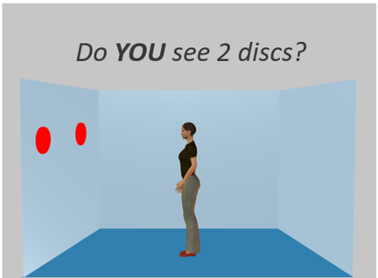
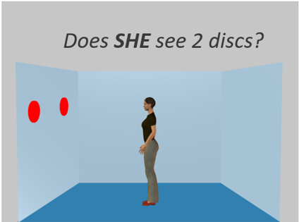
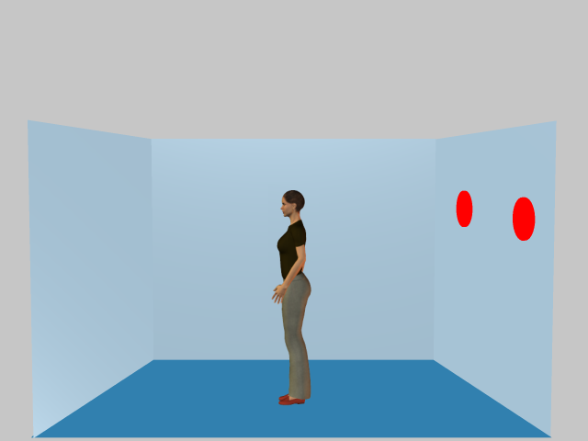
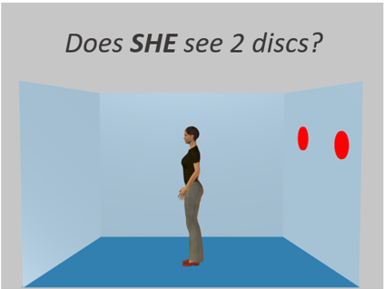
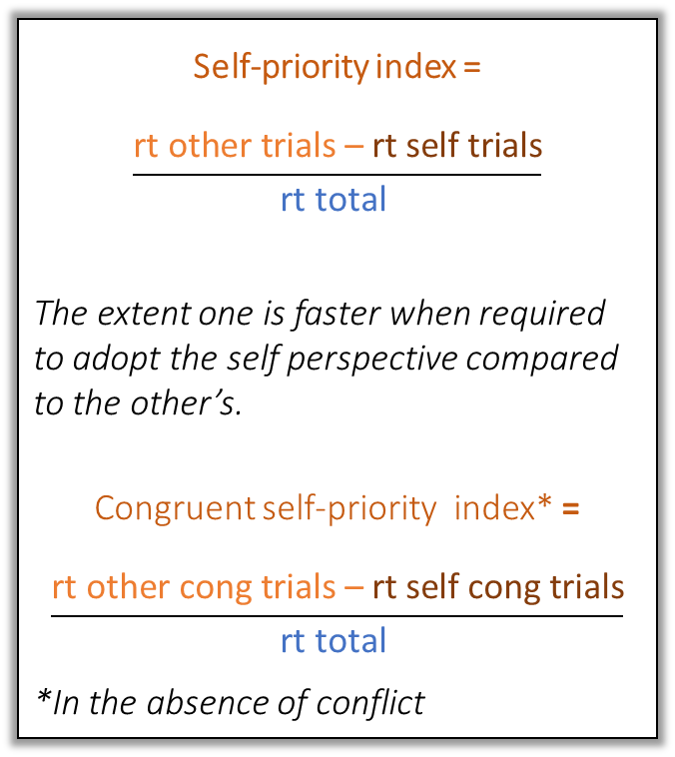
Method: how to measure self-priority ?
Attentional priority
Self-priority index =
$$\frac{\text{rt} \text{other} \text{trials}\text{ – }\text{rt} \text{self} \text{trials}}{\text{rt} \text{total} }$$
The extent one is faster when required to adopt the self perspective compared to the other’s.
Congruent self-priority index* =
$$\frac{\text{rt} \text{other} \text{cong} \text{trials}\text{ – }\text{rt} \text{self} \text{cong} \text{trials}}{\text{rt} \text{total} }$$
*In the absence of conflict
Self-Perspective
Other-Perspective
Samson et al., 2010
Congruent
Congruency
Do YOU see 2 discs?
Incongruent
Intro – Method – Results: SOP – Results: Empathy – Results: Narcissism – Conclusion
Notes:
« dans son format le plus simple »

Slide 7
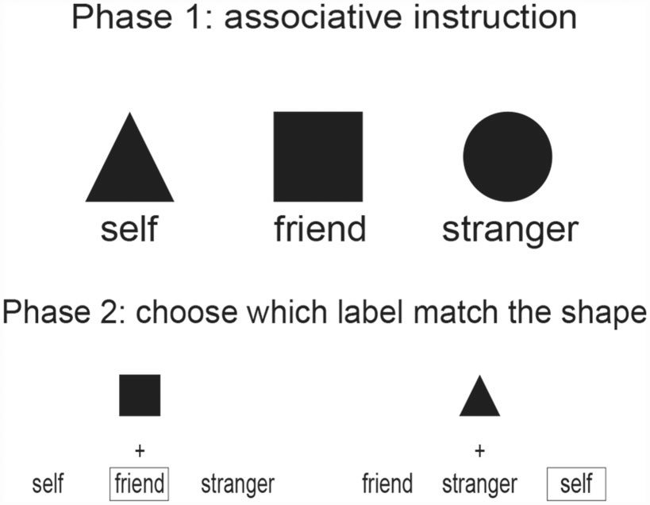
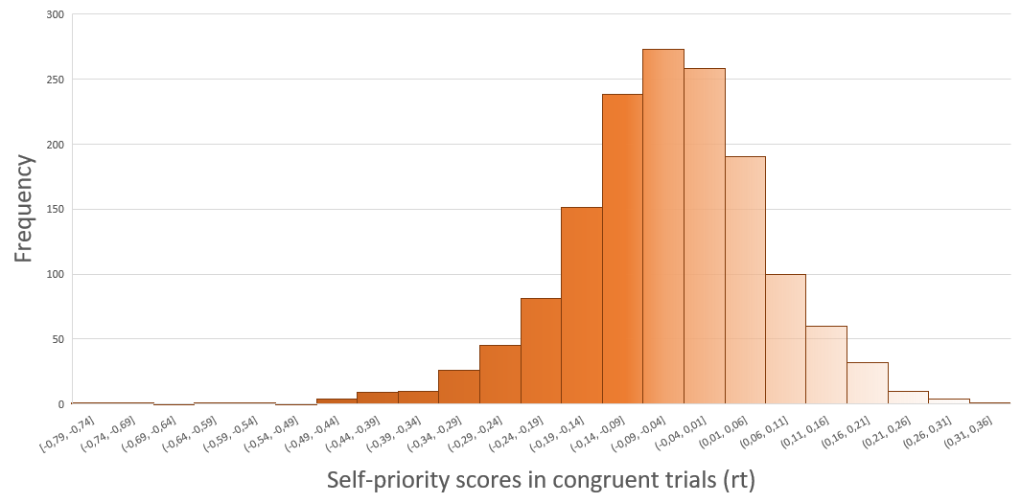
Results: Distribution of self-priority scores
Sui and Humphreys, 2015
N = 1496
Intro – Method – Results: SOP – Results: Empathy – Results: Narcissism – Conclusion
Notes:
This is what is presented on this graph : you have the distribution of our participant’s self-priority scores, but only in congruent trials
The main idea of this slide is to show you that, when using a score that is the most similar to the majority of the past self-priority task, we can already observe that there is a high variability in terms of focus tendency.

Slide 8
Results: Distribution of self-priority scores
Other-centred participants
N = 1496
Intro – Method – Results: SOP – Results: Empathy – Results: Narcissism – Conclusion
Notes:
And you can see approximately 70% of our sample are actually more other-oriented, which contrasts with what is usually observed in the literature

Slide 9
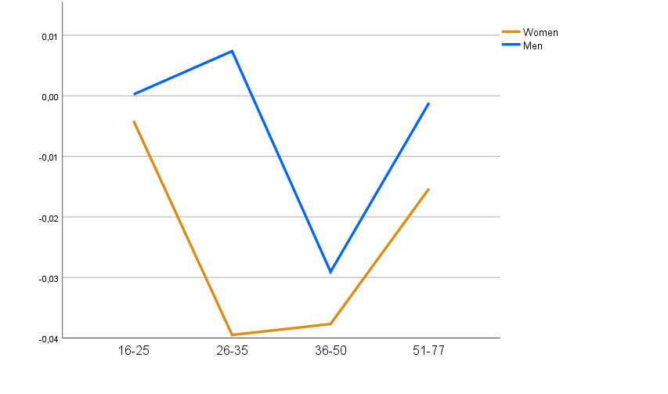
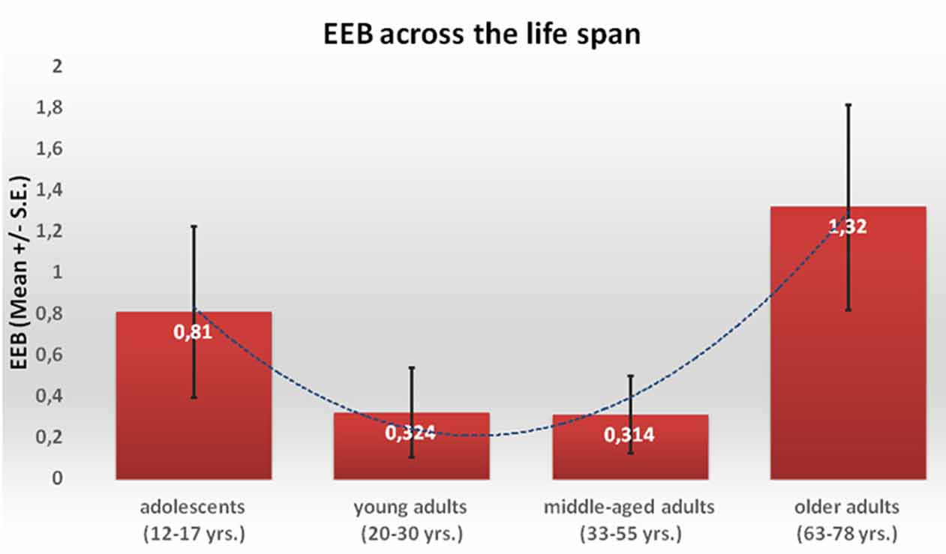
Results: Self-priority according to gender and age
SELF
Men tend to be more self-centred than women (e.g., Kirkland et al.,2013)
t(1494) = 2.203; p = .028
Quadratic relation between age and self-priority (Riva et al., 2016)
  Bage² = 5.400E-5; p = .007
Between 26 and 35yo, women tend to decrease on self-priority while men tend to increase
t(206) = 3.020; p = .003
Self-priority index scores
OTHER
Age
Intro – Method – Results: SOP – Results: Empathy – Results: Narcissism – Conclusion
Notes:
Inconsistencies in the litt, however large sample here, and this provide some strong evidence of the existence of such an effect going in that direction in social contexts specifically
The consistency between our results suggests that using the VPT is actually a valid method to capture the self-priority tendency

Slide 10
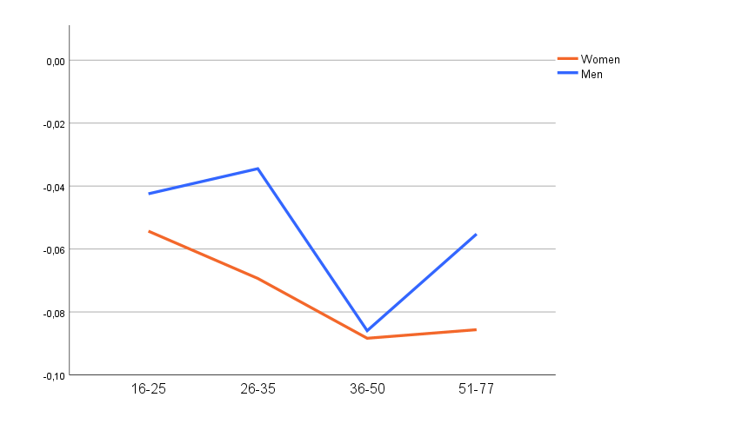
Results: Self-priority con according to gender and age
Self-priority con scores
Age
Intro – Method – Results: SOP – Results: Empathy – Results: Narcissism – Conclusion
Notes:
Age: Significant differences only between
16-25 yo and 36-50 yo

Slide 11
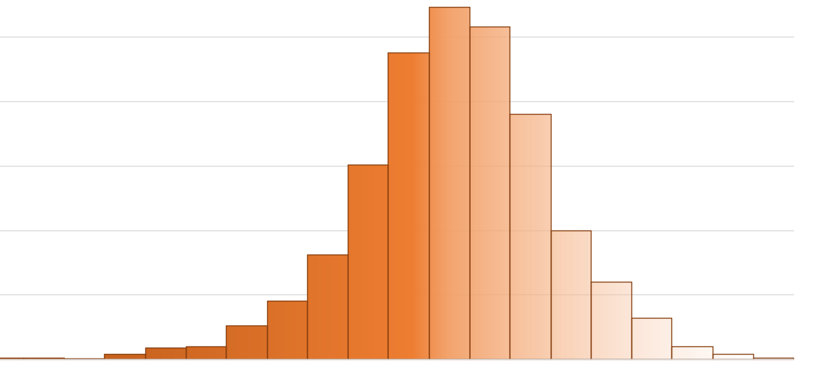
Results: Self-priority
Do we tend to prioritize our own perspective ?
X
Large variety of profiles’ tendency
Individuals tend to be more focused on the other’s perspective than on the self
Intro – Method – Results: SOP – Results: Empathy – Results: Narcissism – Conclusion
Notes:
There is rather a large variety of profiles
+ more other centred

Slide 12
Results: Empathic tendencies (IRI)
Self-priority
    Total score
    Empathic concern
    Perspective-taking
r(453) = -0.113; p = .016
WOMEN: r(241) = -.186; p = .004
MEN
Other-oriented
WOMEN: r(241) = -.164; p = .011
MEN
Other-oriented
WOMEN: r(241) = -.142; p = .028
MEN
Other-oriented
Intro – Method – Results: SOP – Results: Empathy – Results: Narcissism – Conclusion
Notes:
To answer whether self priority can be considered as a bridge toward the other, we used total score….
Variance homogeneity checked for all variables
Not due to mathematical reasons
Significant difference between men and women on EC and total (women negative; men positive)

Slide 13

Results: Empathic tendencies (IRI)
Is self-priority beneficial in social contexts ?
Tendency to self-prioritize is negatively associated with empathic behaviors
Specifically observed in women: better coherence between behaviors and self-assessment ?
Intro – Method – Results: SOP – Results: Empathy – Results: Narcissism – Conclusion
Notes:
Sig t-test between men and women on EC:
In women, more other centred = more EC
In men, less other-centred = more EC
→ Men need to first pay attention to themselves to then be able to pay attention to others (== emotional awarness ?)

Slide 14
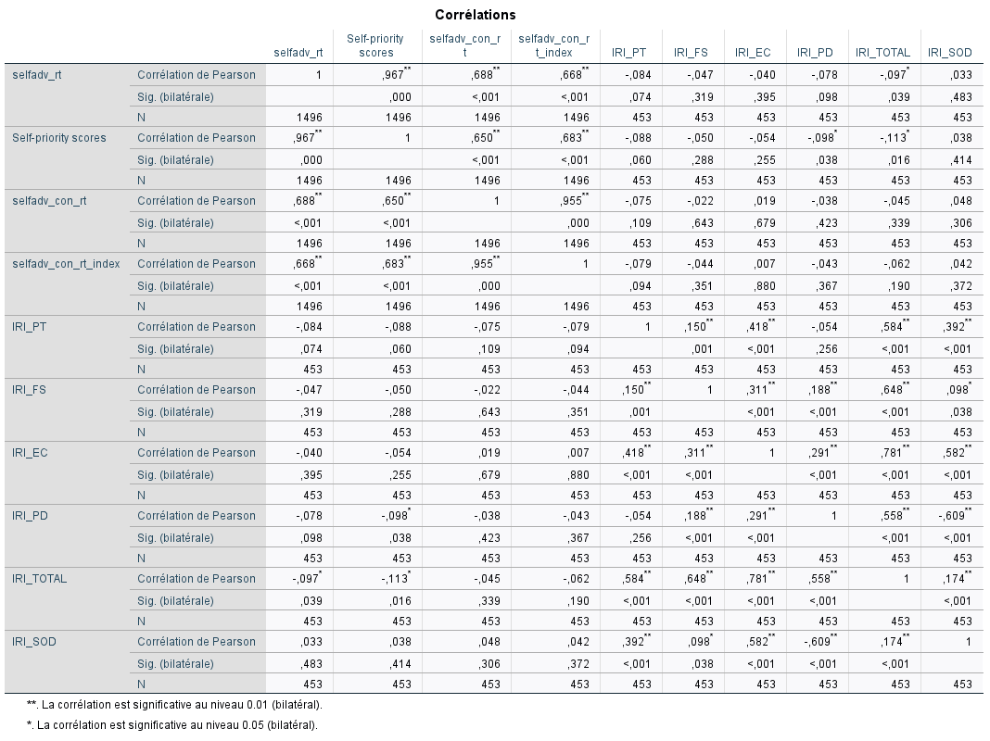

Slide 15
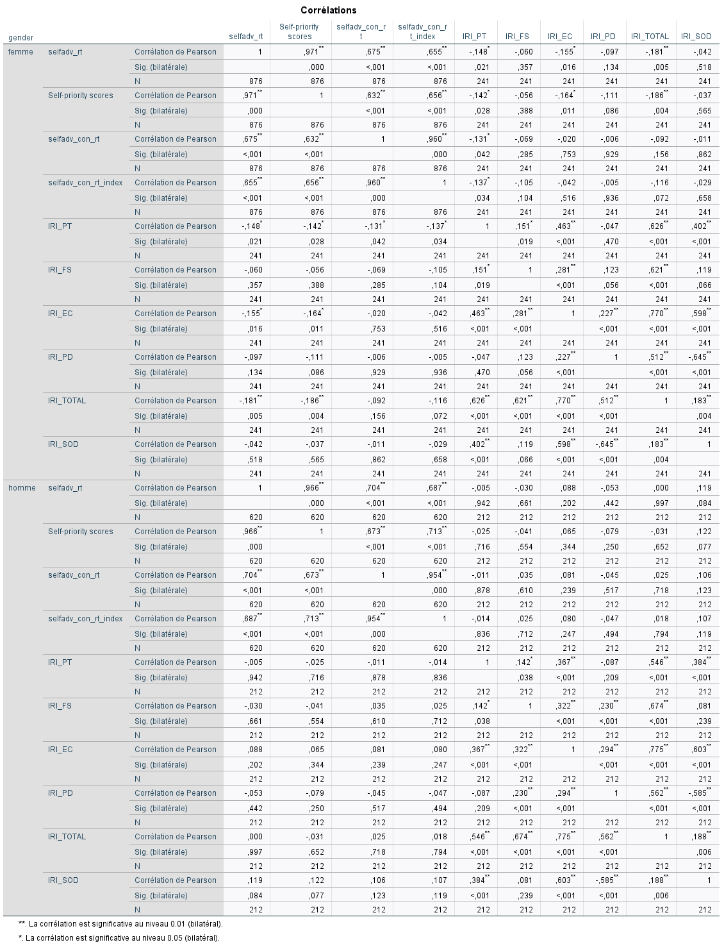

Slide 16
Results: Narcissism (NPI)
Self-priority
    Total score
    Leadership-authority
    Grandiose-exhibitionism
    Entitlement-exploitativeness
r(722) = 0.106; p = .004
Self-oriented
r(303) = 0.210; p > .001
Self-oriented
r(303) = 0.210; p > .001
Self-oriented
r(303) = 0.224; p > .001
Self-oriented
Intro – Method – Results: SOP – Results: Empathy – Results: Narcissism – Conclusion
Notes:
Alternative assumption was that self-prio referred to a tendency to be more self-absorbed
No correlation find in men, women: all of them
Variance homogeneity checked for all variables : only leadership and exploit OK
T-test with welsh correction when necessary: only total and leadership scores sig (men > women; correlation goes the same direction)
Not due to mathematical reasons
Correlation sig at the sample scale: type 1 error (false positive) or increasing power due to combined variance ?
In both men and women, age negatively correlated

Slide 17
Results: Narcissism (NARQ)
Self-priority
    Strive for uniqueness
    Grandiosity
    Supremacy
    Admiration
r(208) = 0.140; p = .043
Self-oriented
r(208) = 0.161; p = .020
Self-oriented
r(208) = 0.183; p = .008
Self-oriented
r(627) = 0.097; p = .015
Self-oriented
Intro – Method – Results: SOP – Results: Empathy – Results: Narcissism – Conclusion
Notes:
Only admiration significantly associated in women
Nothing significant in men
→ All the sample is required to highlight correlations (not driven by men or women)
Only on admiration score did men and women differ significantly
In women, correlation between age and grandiosity (-) supremacy (-) admiration (-) total (-)
Men: admiration (-) and total (-)

Slide 18
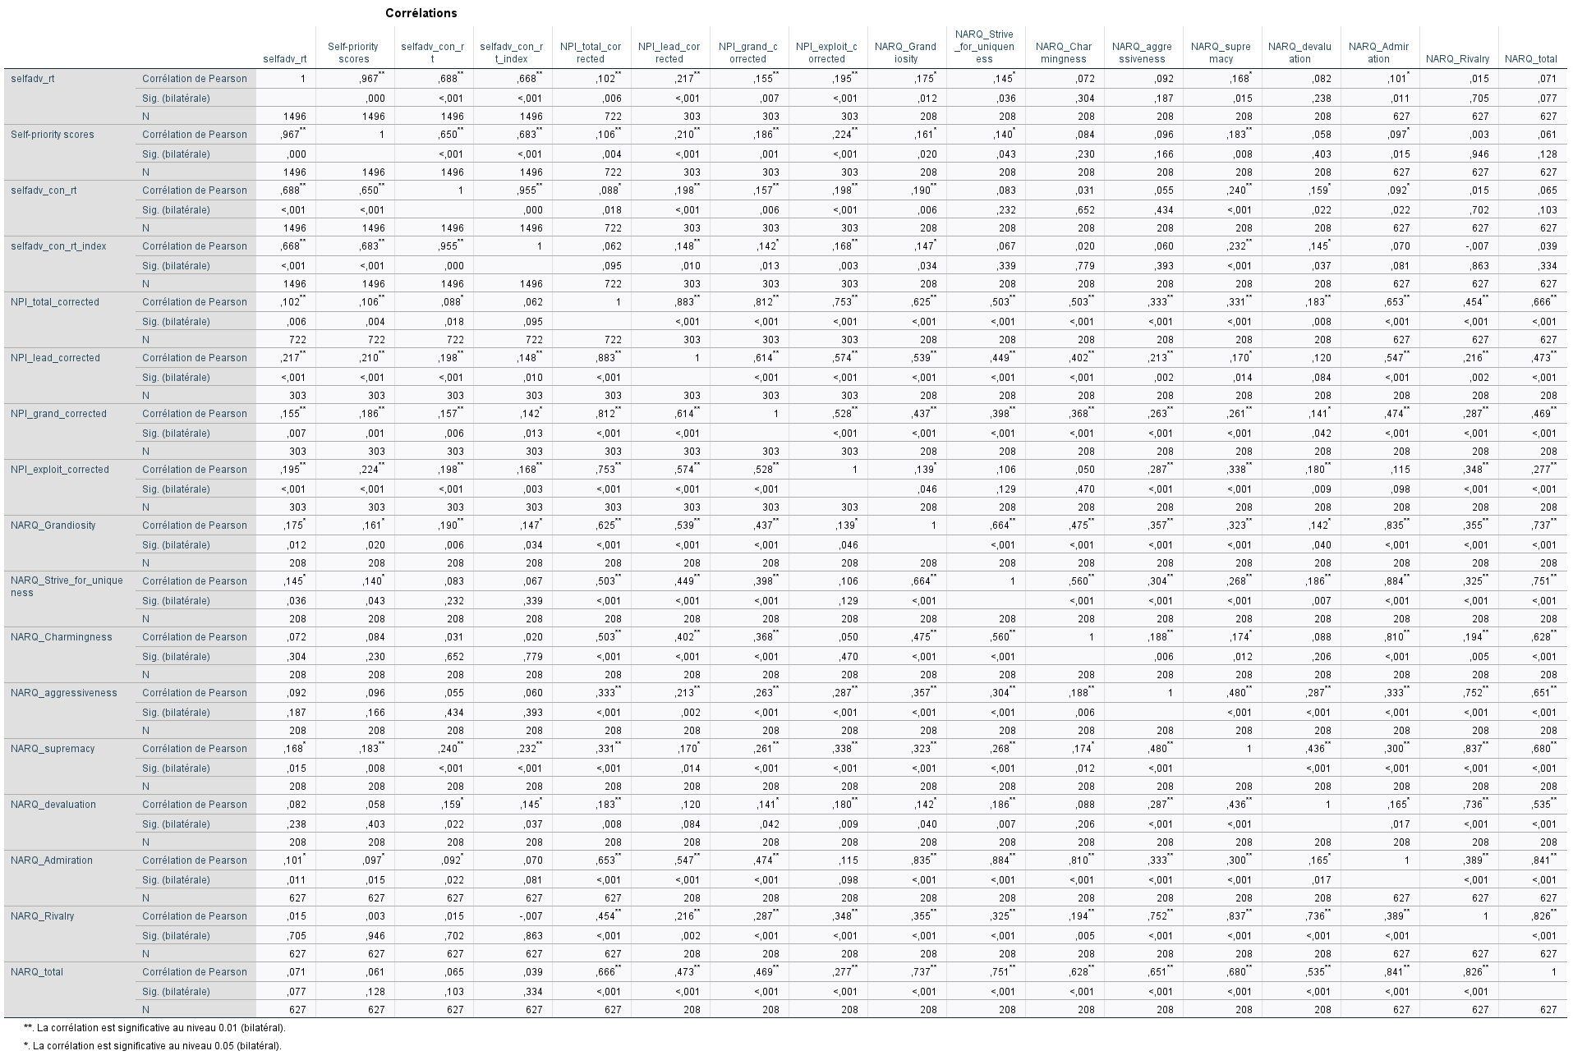
Results: narcissism

Slide 19
Results: Narcissism
Is self-priority beneficial in social contexts ?
Tendency to self-prioritize positively associated with narcissism
Self-priority reflects the tendency to report higher self-absorption
Intro – Method – Results: SOP – Results: Empathy – Results: Narcissism – Conclusion
Notes:
These findings answer as well the question is self prio beneficial in social contexts: it would seem that being self-centred is associated with more narcissism tendency
QUID AGENTIC

Slide 20



Conclusion: what is self-priority ?
X
?
SELF-PRIORITY
Self-priority is associated with poor (social) outcomes
Observed in social context specifically
High variability
Only in opposition to the other
Higher proportion of other-centred individuals in social contexts
Intro – Method – Results: SOP – Results: Empathy – Results: Narcissism – Conclusion
Notes:
To recap, what did we learn based on these results:
First take home message is a bad news: self-prioritization in social contexts does not seem to be a good thing ++ narcissism person
This bad news is fortunately a bit moderated by the fact that detriment effect might be specific to social contexts

Slide 21

Thank you for your attention !
Alix.bigot@uclouvain.be

Slide 22
References
Back, M. D., Küfner, A. C. P., Dufner, M., Gerlach, T. M., Rauthmann, J. F., & Denissen, J. J. A. (2014). Narcissistic Admiration and Rivalry Questionnaire [dataset]. https://doi.org/10.1037/t27810-000
Barelds, D. P. H., & Dijkstra, P. (2010). Narcissistic Personality Inventory: Structure of the adapted Dutch version. Scandinavian Journal of Psychology, 51(2), 132–138. https://doi.org/10.1111/j.1467-9450.2009.00737.x
Birch, S. A. J., & Bloom, P. (2007). The Curse of Knowledge in Reasoning About False Beliefs. Psychological Science, 18(5), 382–386. https://doi.org/10.1111/j.1467-9280.2007.01909.x
Cunningham, S. J., & Turk, D. J. (2017). Editorial: A Review of Self-Processing Biases in Cognition. Quarterly Journal of Experimental Psychology, 70(6), 987–995. https://doi.org/10.1080/17470218.2016.1276609
Davis, M. H. (1983). Measuring individual differences in empathy: Evidence for a multidimensional approach. Journal of Personality and Social Psychology, 44, 113–126. https://doi.org/10.1037/0022-3514.44.1.113
Epley, N., Keysar, B., Van Boven, L., & Gilovich, T. (2004). Perspective Taking as Egocentric Anchoring and Adjustment. Journal of Personality and Social Psychology, 87(3), 327–339. https://doi.org/10.1037/0022-3514.87.3.327
Fennis, B. M. (2011). Can’t get over me: Ego depletion attenuates prosocial effects of perspective taking. European Journal of Social Psychology, 41(5), 580–585. https://doi.org/10.1002/ejsp.828
Kirkland, R., Peterson, E., Baker, C., Miller, S., & Pulos, S. (2013). Meta-analysis reveals adult female superiority in “Reading the Mind in the Eyes Test.” North American Journal of Psychology, 15, 449–458.
Lin, S., Keysar, B., & Epley, N. (2010). Reflexively mindblind: Using theory of mind to interpret behavior requires effortful attention. Journal of Experimental Social Psychology, 46(3), 551–556. https://doi.org/10.1016/j.jesp.2009.12.019
Lind, S. E. (2010). Memory and the self in autism: A review and theoretical framework. Autism, 14(5), 430–456. https://doi.org/10.1177/1362361309358700
Riva, F., Triscoli, C., Lamm, C., Carnaghi, A., & Silani, G. (2016). Emotional Egocentricity Bias Across the Life-Span. Frontiers in Aging Neuroscience, 8. https://doi.org/10.3389/fnagi.2016.00074
Samson, D., Apperly, I. A., Braithwaite, J. J., Andrews, B. J., & Bodley Scott, S. E. (2010). Seeing it their way: Evidence for rapid and involuntary computation of what other people see. Journal of Experimental Psychology: Human Perception and Performance, 36, 1255–1266. https://doi.org/10.1037/a0018729
Sui, J., & Humphreys, G. W. (2015). The Integrative Self: How Self-Reference Integrates Perception and Memory. Trends in Cognitive Sciences, 19(12), 719–728. https://doi.org/10.1016/j.tics.2015.08.015

