Slide 1

Immunogenicity of two doses of ChAdOx1 nCoV-19 vaccine
in Lung Transplant Recipients
Dr François Carlier, MD PhD
CHU UCL Namur Lung Transplant Centre
Belgium

Slide 2
Relevant Financial Relationship Disclosure Statement
Immunogenicity of two doses of ChAdOx1 nCoV-19 vaccine in Lung Transplant Recipients
Dr François Carlier
I do not have any relationships with ACCME defined ineligible companies to report.
I will not discuss off-label use and/or investigational use of any drugs or devices.

Slide 3
Rationale
1. Covid death toll in LTx recipients is very high (± 20%)
2. Vaccination in LTx recipients provides mediocre results
  mRNA-based vaccines : ± 25% after 2 doses, ± 40% after 3 doses
3. No LTx recipients dedicated study (SOT recipients)
4. No ChAdOx1 study in LTx recipients
Myers et al, Transplant Infectious Diseases, 2020
Boyarsky et al, JAMA, 2021
Magnusson et al, Transplant International, 2021
Messika et al, Transplantation, 2021
Saez-Giménez et al, Am J Transplant, 2021

Slide 4
Goals of the study
Assess the immunogenicity of a two-dose regimen ChAdOx1 nCoV-19 vaccine in LTx recipients
Assess the immunogenicity of a booster dose (BNT162b2)

Slide 5
Flowchart

Slide 6
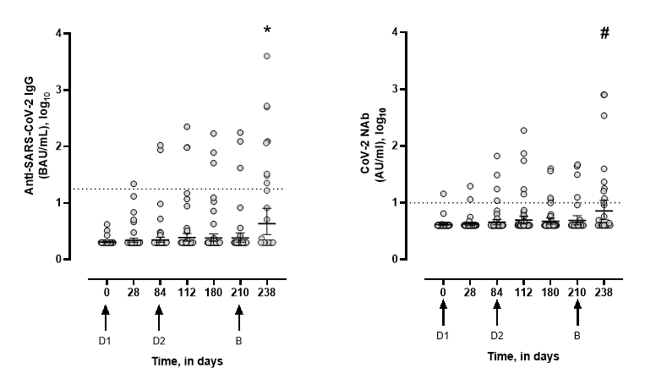
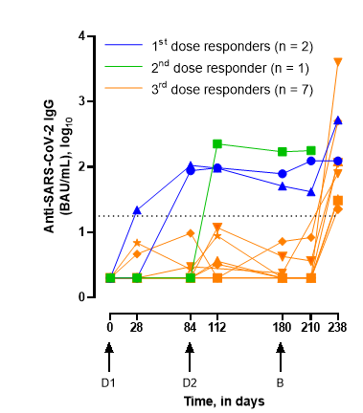
Results
32%
8%
2%

Slide 7
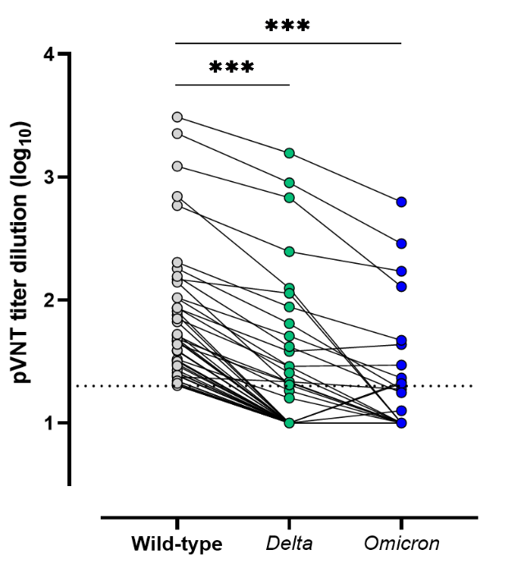
 | Seropositive with neutralization capacities (sVNT), (9) | Seronegative, (19)
Age, years 18-59 ≥60 | 2 7 | 3 16
Sex Female Male | 6 3 | 6 13
Time since transplant, years <1 >1 | 0 9 | 4 15
Initial respiratory disease COPD Pulmonary fibrosis Other | 8 0 1 | 13 3 3
Methylprednisolone 2-6 mg/day ≥8 mg/day | 9 0 | 15 4
Calcineurin inhibitors Tacrolimus Ciclosporine Others Mycophenolate mofetil Azathioprine Everolimus | 8 1 1 5 2 | 17 2 14 3 0
Results (2)
Poorer responses observed in
  Patients treated with MMF (7% versus 70%)
  Daily CS dose > 8mg methylprednisolone (0% versus 38%)
Reduced neutralization against Delta and Omicron variants

Slide 8
ChAdOx1 nCoV-19 vaccination course induces poor immune response in LTRs
BNT162b2 booster strongly enhances immune response
  > 4th dose?
MMF / high CS doses impede immune response
  > Should MMF be stopped/switched before
  anti-SARS-CoV-2 vaccination?
Conclusions
Acknowledgements
Emilie Catry
Melanie Closset
Jonathan Douxfils
Michel Dumonceaux
Damien Frérotte
Patrick Evrard
Julien Favresse
Constant Gillot
François Mullier
Contact
Dr François Carlier
francois.carlier@chuuclnamur.uclouvain.be
+32 81 42 33 60
Scharringa et al, Expert Rev Clin Pharmacol, 2021

