Slide 1
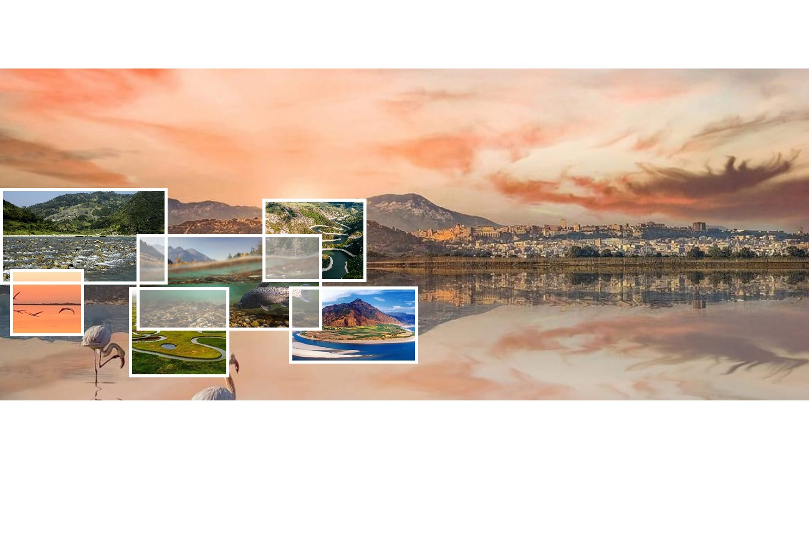





YMC 2023
M.S. YALIN MEMORIAL COLLOQUIUM 2023:
Flow-sediment-biota Interactions
In Fluvial system: recent research trends
Closing parameters of morphodynamical models without trial-and-error
Robin Meurice, Sandra Soares-Frazão
UCLouvain
robin.meurice@uclouvain.be –
Notes:
Hello everyone, I’m Robin Meurice from UCLouvain in Belgium and my talk today will concern a procedure to find a closure formulation for parameters of morphodynamical models without requiring trial-and-error.

Slide 2

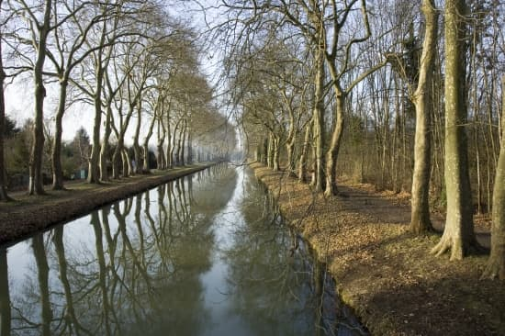
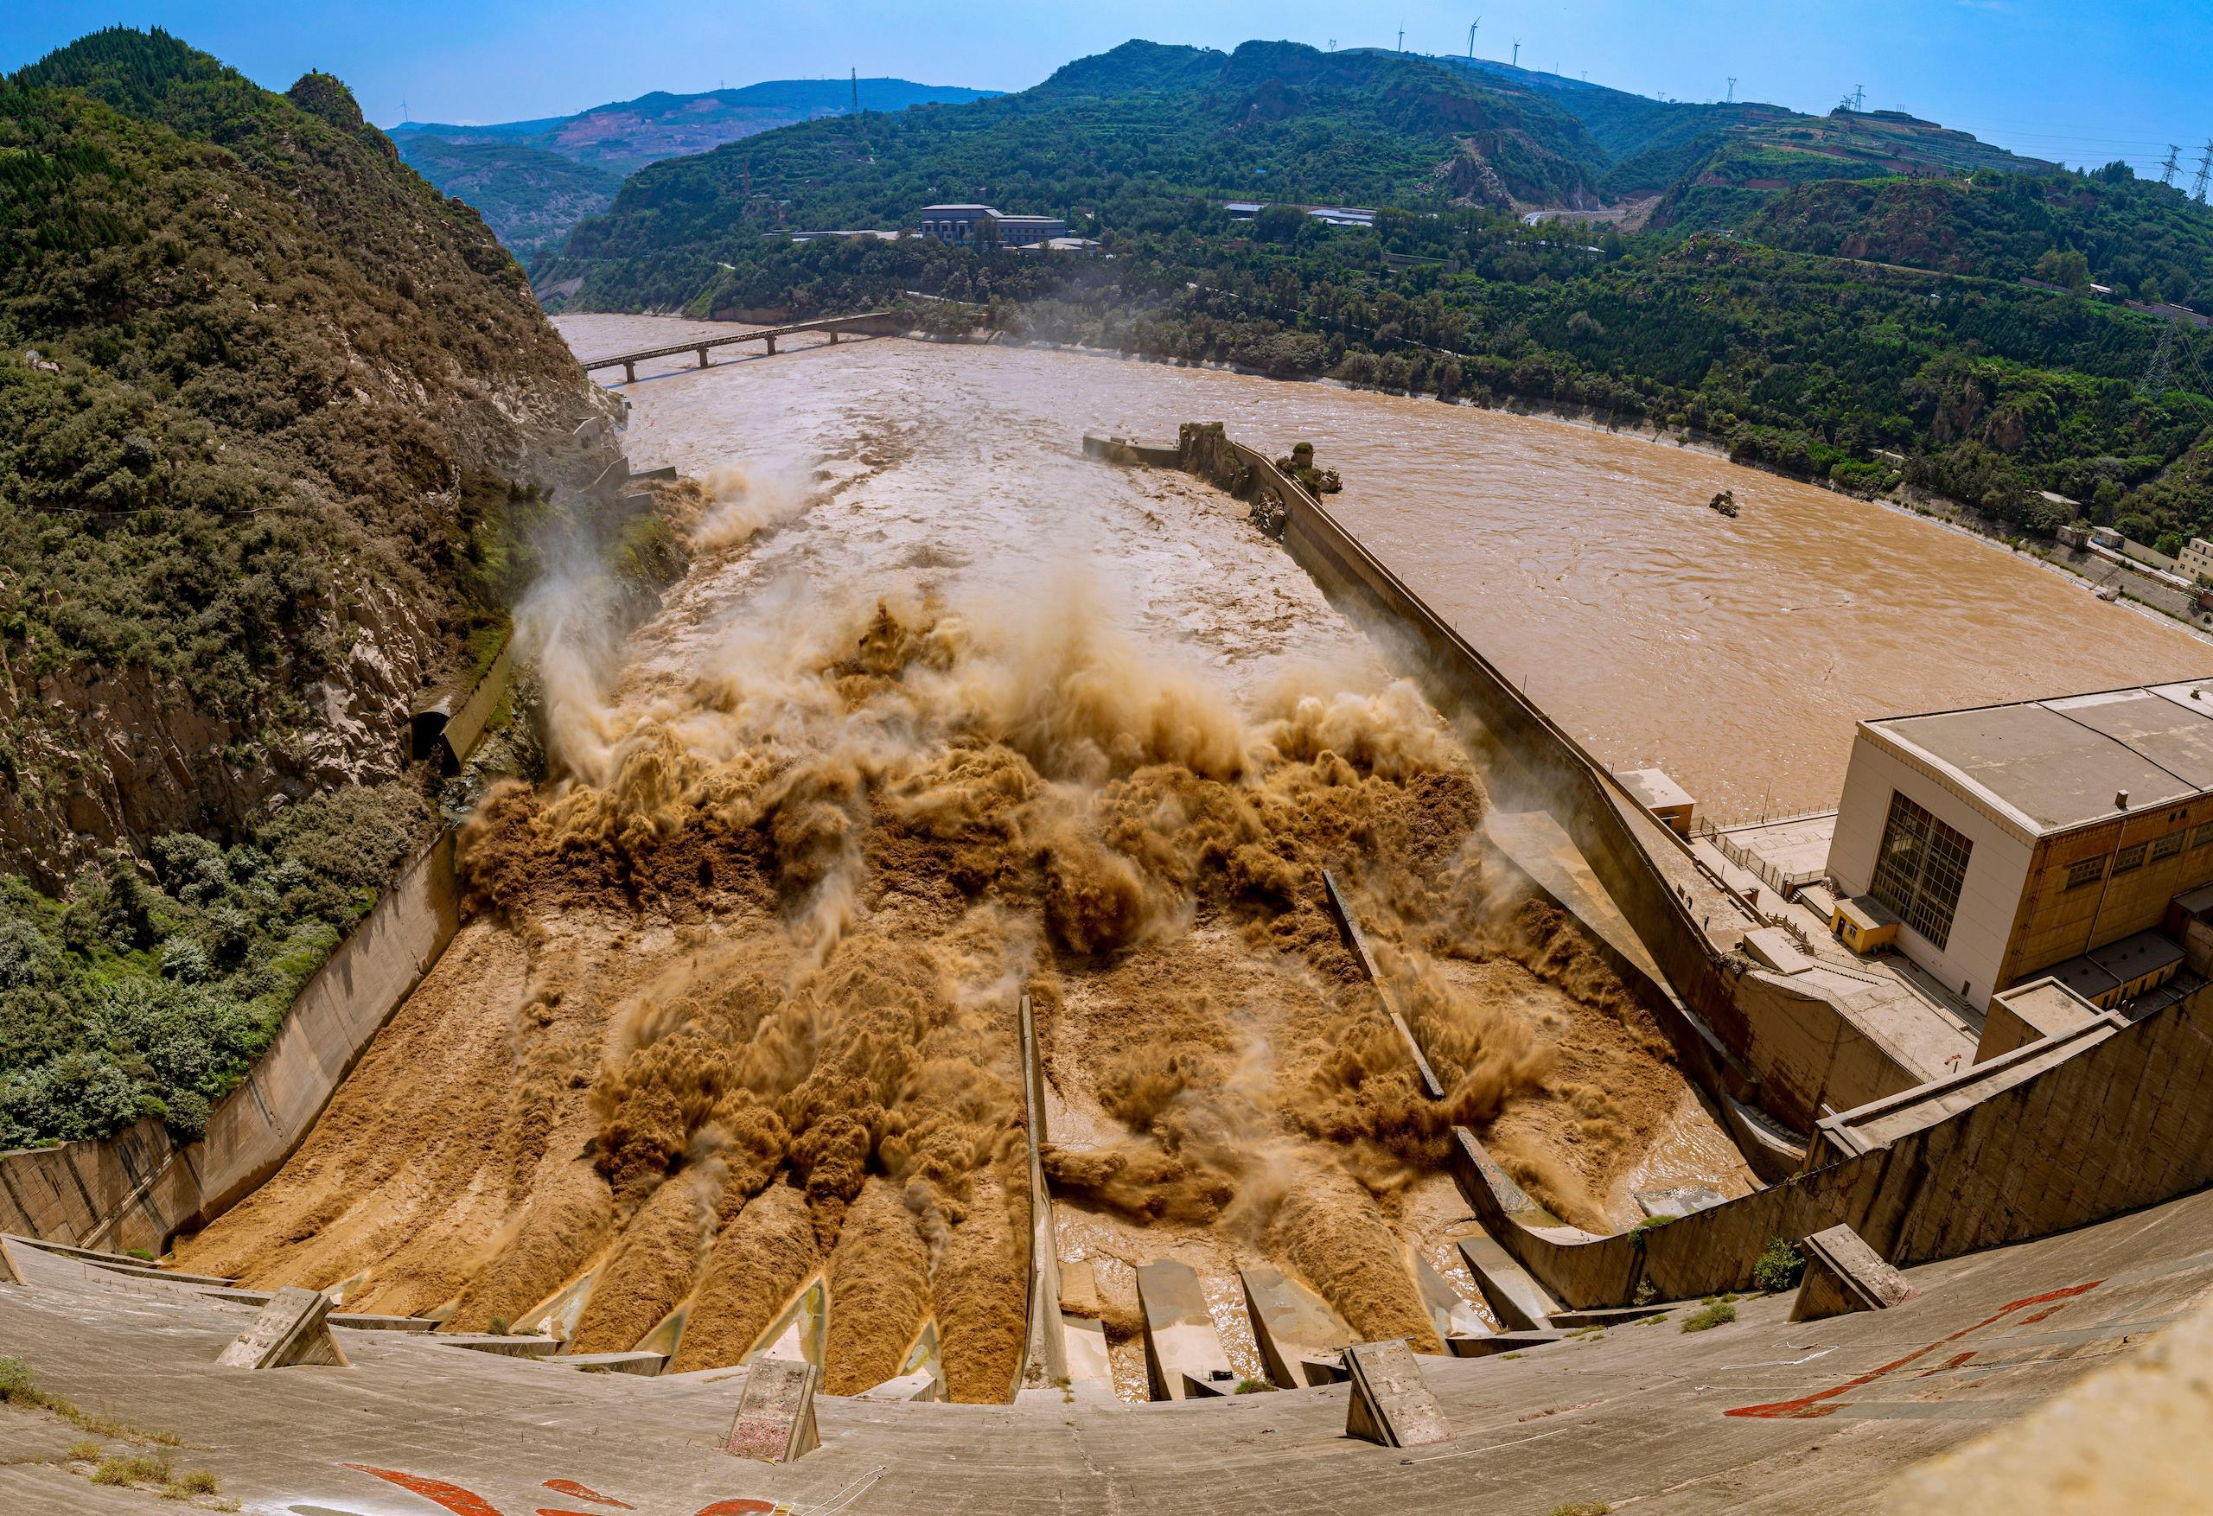
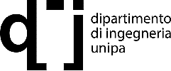
Limits of the shallow water equations
Briare Canal, France
Sanmenxia dam on the Yellow River, China
Closing parameters of morphodynamical models without trial-and-error
Robin Meurice & Sandra Soares-Frazão
2
Notes:
As you know, most river flow simulations are performed by solving the very widely known shallow water equations. These equations are very practical because they can solve both permanent and transient flows. Moreover, they usually only require the calibration of one single parameter, a Manning-like coefficient, for which empirical closure formulations exist. For example, they constitute a very useful tool to simulate the flow of a channelized river such as that in the left picture.
Nevertheless, for more complex flows involving large quantities of sediment such as dam flushes as those on the Yellow River in the right picture for example, the shallow water equations may become overly simplifying and hence, provide inaccurate results.

Slide 3
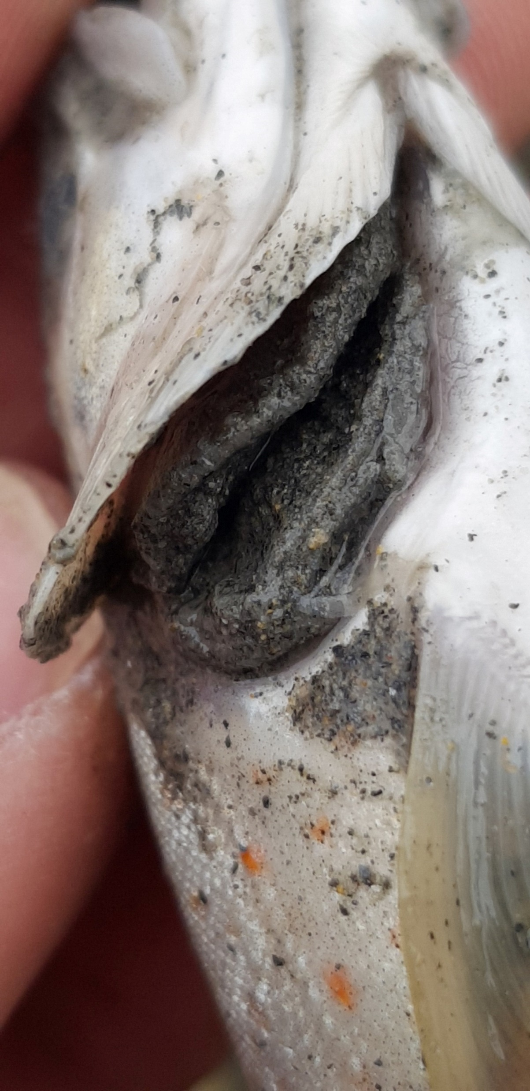
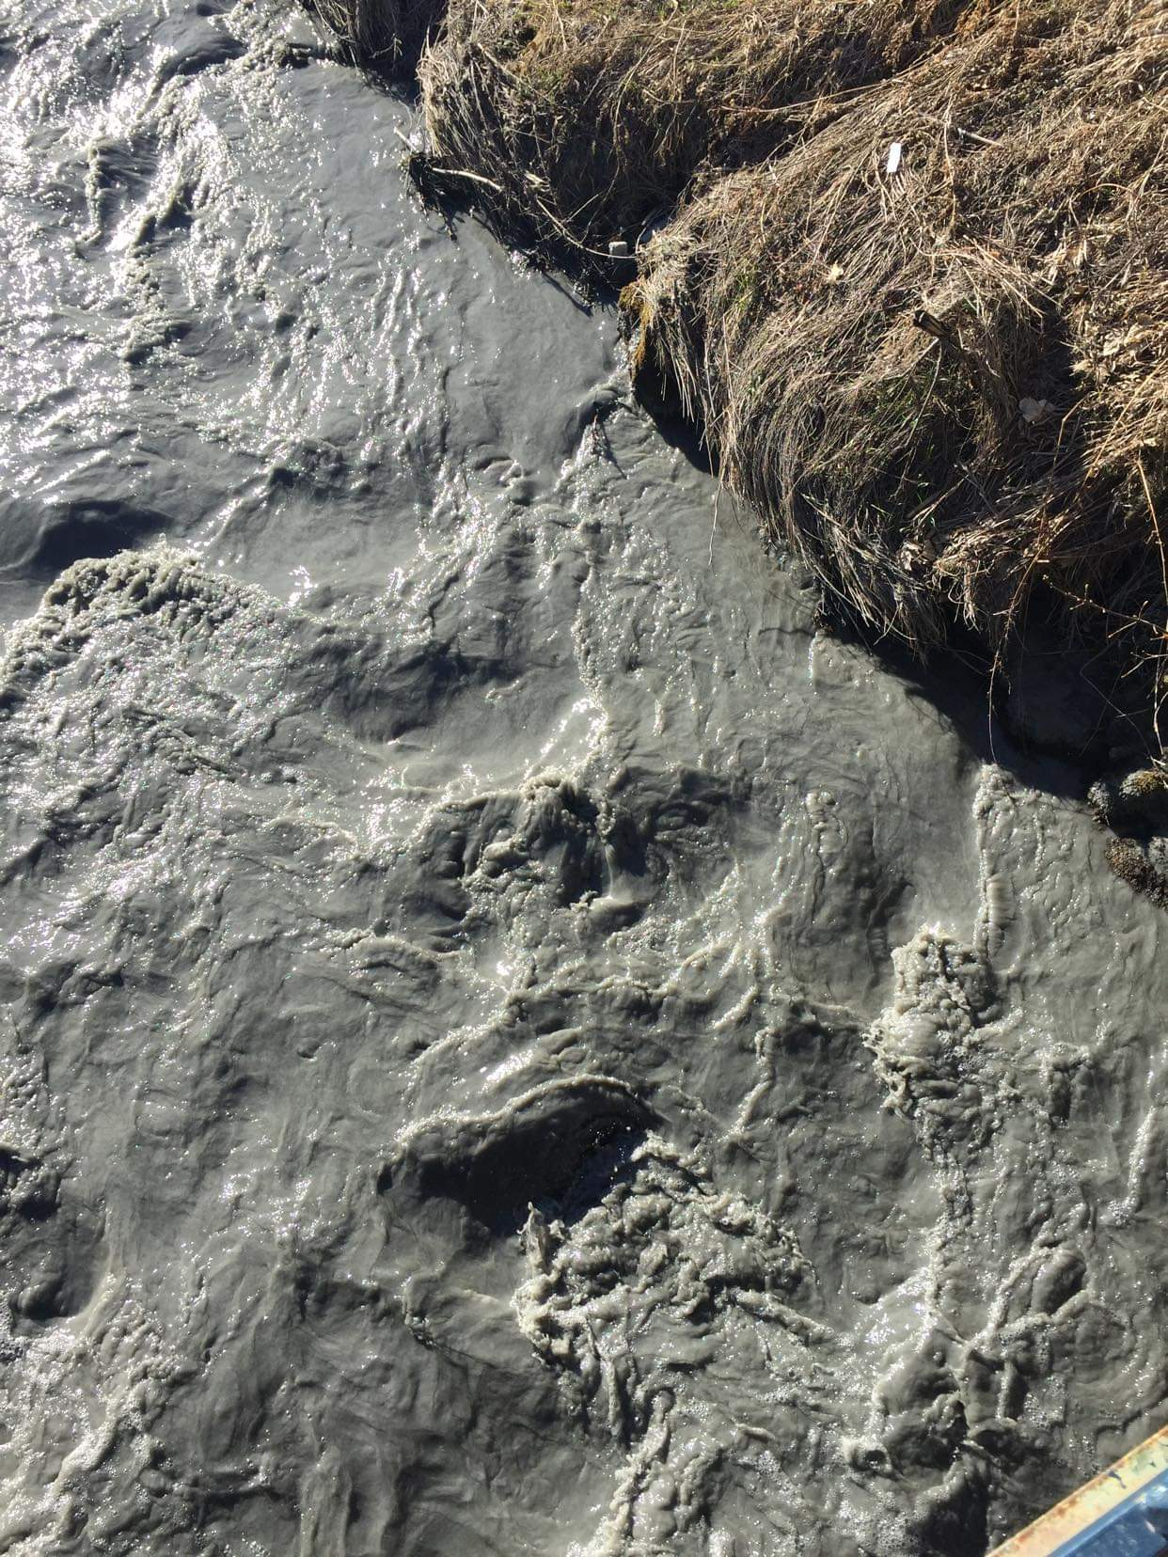
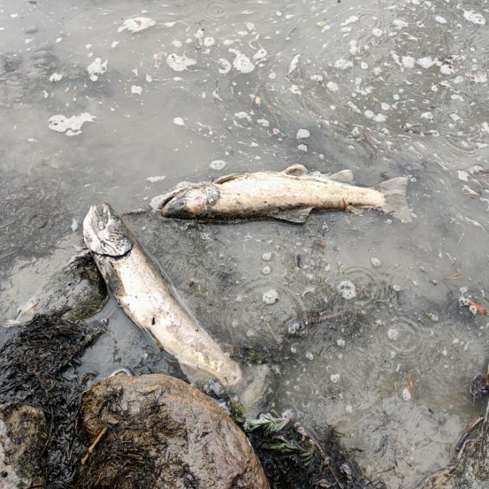
Limits of the shallow water equations
Fédération de Pêche des Hautes-Alpes, 2022
Closing parameters of morphodynamical models without trial-and-error
Robin Meurice & Sandra Soares-Frazão
3
Notes:
Furthermore, we may be interested in more information than the water depth and discharge only. Here you can see a few pictures that were captured on the Durance river after a flush on one of its tributaries in April 2022. The very high concentration of sediment in the water led to a depletion of the oxygen rate in the river and the sealing of the fish’s gills and hence a massive death rate among the fish population. A numerical model coping with the concentration in sediment and its inertia could be a better tool here to reproduce the flow and a fortiori to optimize future dam flushes in order to avoid such environmental disasters.
In the rest of this talk, I will present you a model able to cope with the sediment’s inertia and dedicated to handling transient flows such as dam flushes. Yet, since it is more complex than the shallow water equations, it has more parameters to calibrate. And we will see how to circumvent a river specific calibration to use it as a predictive tool on any river.

Slide 4




Outline
Methods
  Description of the model and its parameters
  Description of the closing procedure
  Pre-processing
  Numerical experiment
  Machine-learning algorithm
Results
  Application to a 1D dam-break on a PVC bed
  Application to a 2D dam-break on a sand bed
General procedure
Application of the procedure to the model
Closing parameters of morphodynamical models without trial-and-error
Robin Meurice & Sandra Soares-Frazão
4
Notes:
So, after this introduction, I will briefly present you the model that I have been developing so far during my thesis and I will insist on the model parameter that still needs to be calibrated. As no closure formulation looks to be existing in the literature for this parameter, I will propose you a procedure that can be used to close any last model parameter of any similar morphodynamical model. I will explain how to prepare the procedure, present the numerical experiment that can be done and explain how we can use machine-learning to build a closure formulation.
By the way, every time you will find a puzzle piece on the slide, it will mean that the contents of this slide can be applied to any model while a hammer will mean that I only speak for my model.
After the description of that closing procedure, I will briefly show you some results, both in 1 and 2 dimensions.

Slide 5
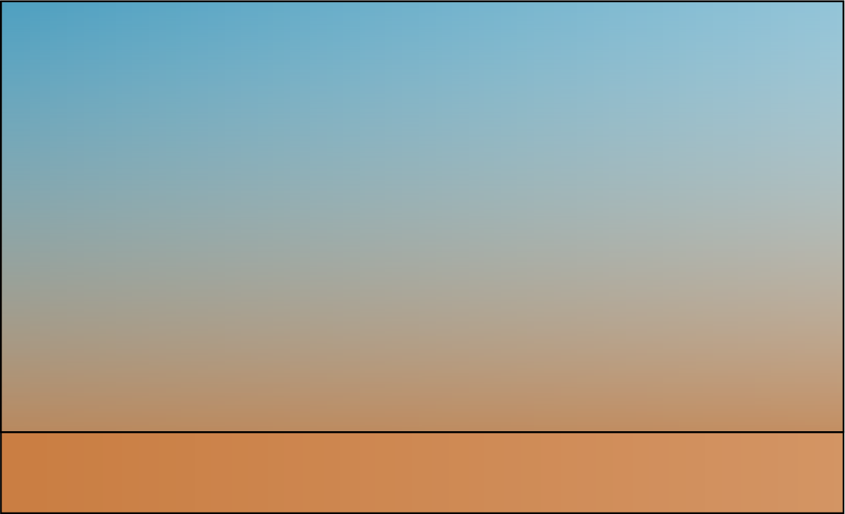
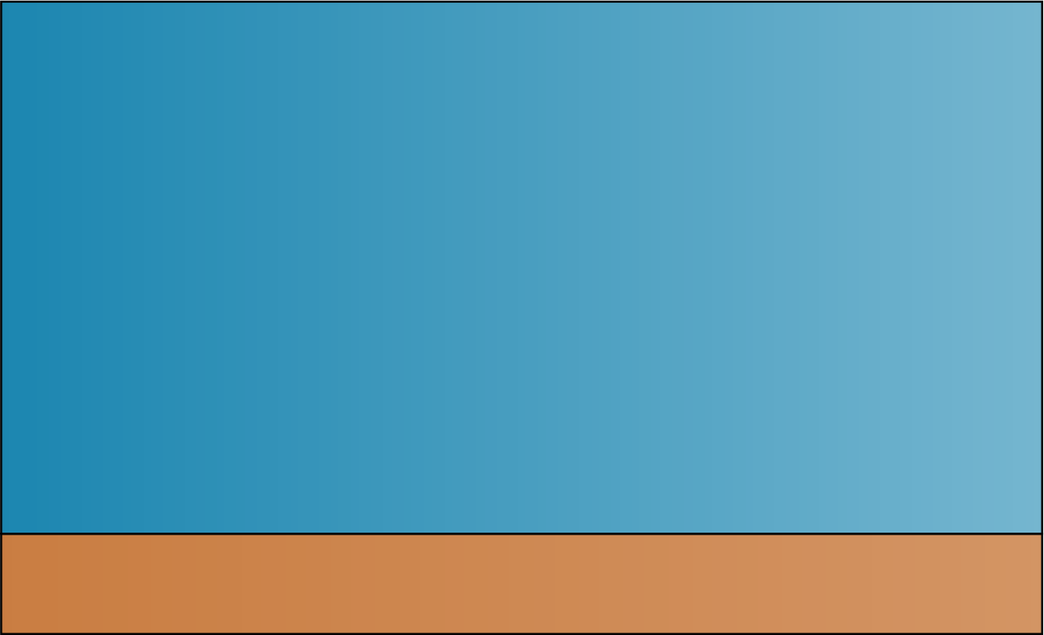
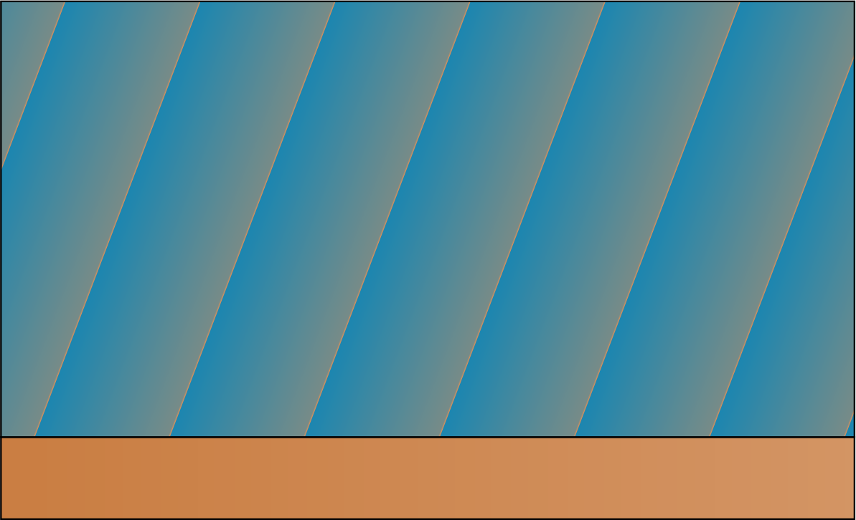
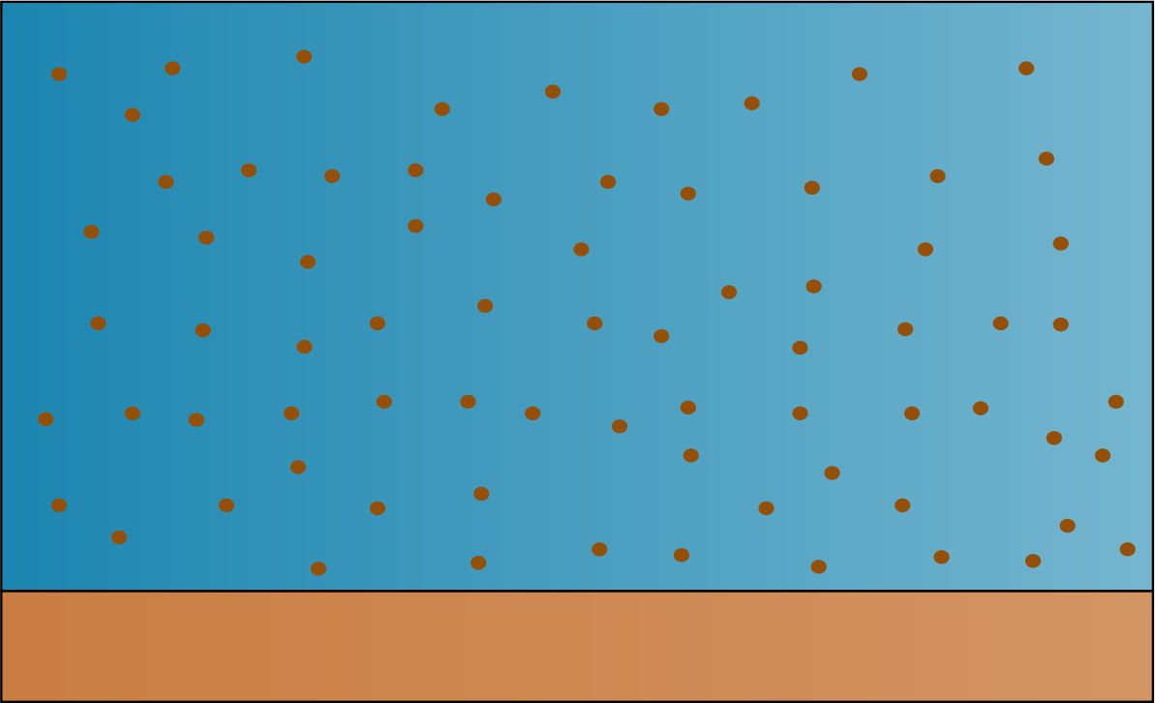
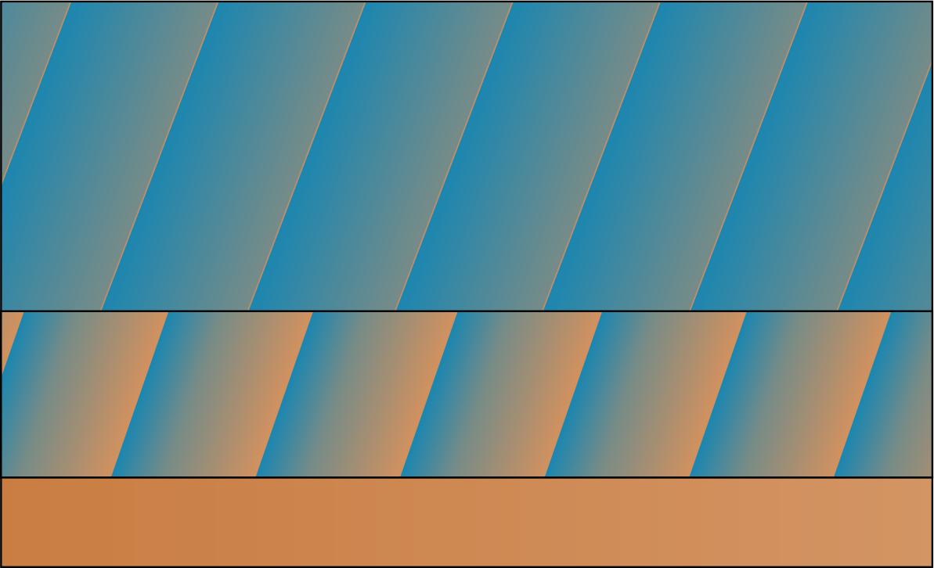
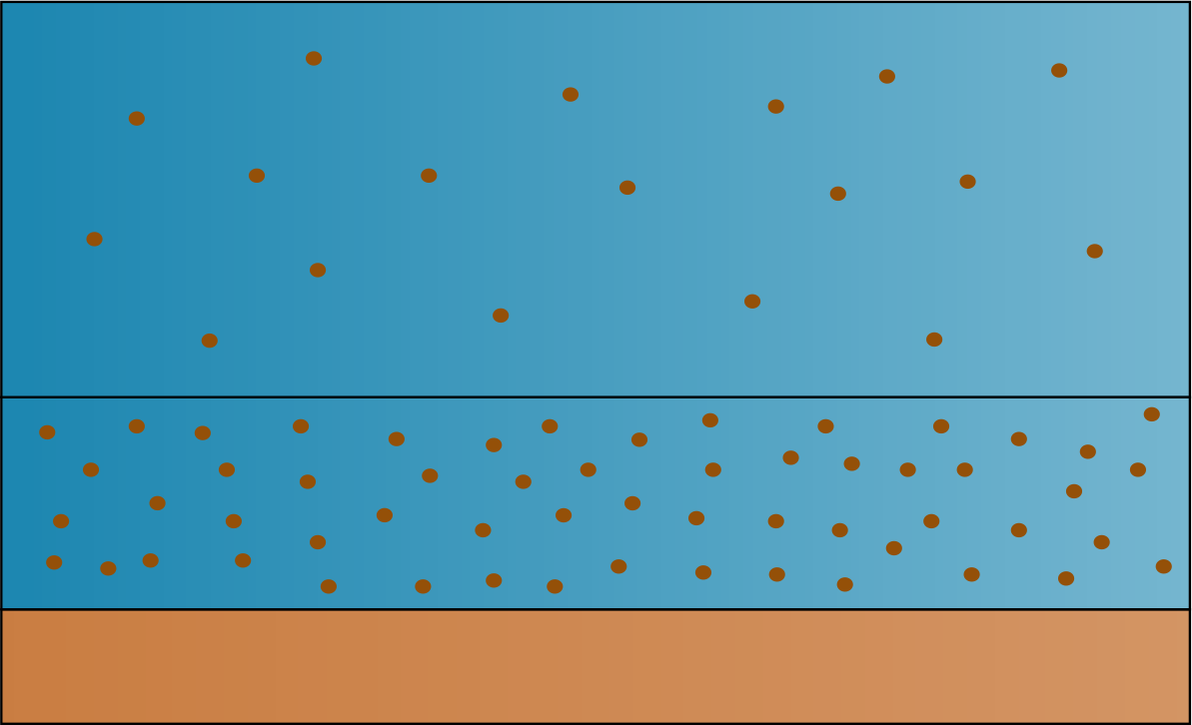
Considered 2D models
z
C
Real situation
Bedload
Mixture
2P2L
Two-phase
Two-layer
Two-phase/two-layer
Closing parameters of morphodynamical models without trial-and-error
Robin Meurice & Sandra Soares-Frazão
5
Notes:
To properly simulate transient flows highly-laden with sediment, the very common shallow-water models coupled with the Exner equation or bedload models will very likely show their limitations.
In the case of a flush, the concentration in sediment can be so important that a pure column of water becomes an overly simplifying assumption. We can hence either consider a homogeneous mixture or a two-phase flow made of water and sediment, each phase having its own density and inertia. Momentum exchanges between the two phases are hence made through drag.
Moreover, the bedload models only consider transport along the water bed while the real concentration profile admits non-negligible concentrations at some distance from the bed, before decreasing significantly. To cope with this concentration curve while remaining in 2D, we can divide the column into two layers following this approximate line, where we have an inflexion point.
If we combine both approaches, we end up with a two-phase/two-layer model such as the one I have been developing and that I will hereinafter refer to as the 2P2L model.

Slide 6
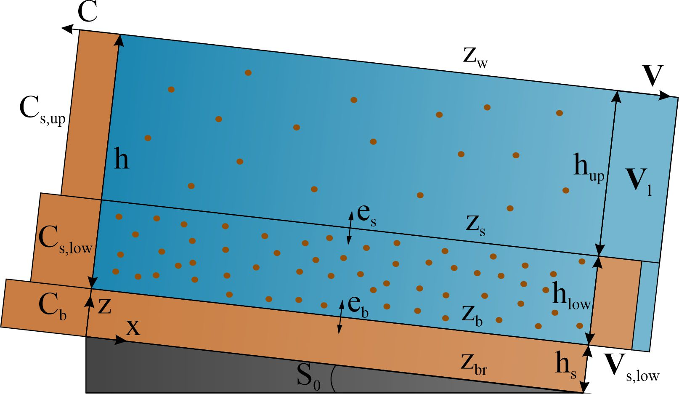
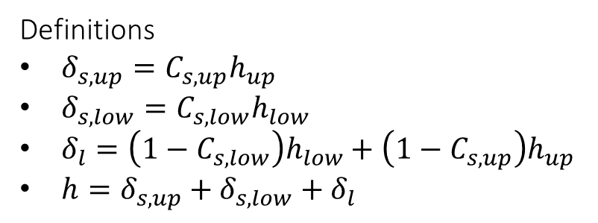
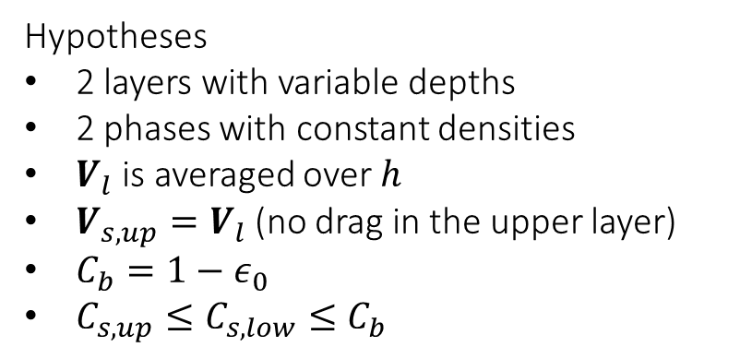
Description of the 2P2L model
Definitions
$δ_{s,up}=C_{s,up}h_{up}$
$δ_{s,low}=C_{s,low}h_{low}$
$δ_{l}=\left(1−C_{s,low}\right)h_{low}+\left(1−C_{s,up}\right)h_{up}$
$h=δ_{s,up}+δ_{s,low}+δ_{l}$
Hypotheses
2 layers with variable depths
2 phases with constant densities
$V_{l}$ is averaged over $h$
$V_{s,up}=V_{l}$ (no drag in the upper layer)
$C_{b}=1−ε_{0}$
$C_{s,up}≤C_{s,low}≤C_{b}$
Closing parameters of morphodynamical models without trial-and-error
Robin Meurice & Sandra Soares-Frazão
6
Notes:
The 2P2L model is a 2D finite-volume model whose velocity is averaged over the water depth. Above a non-erodible bed layer lies a finite and erodible layer of sediment of constant concentration. Above that layer lies the water column, split into two layers of variable concentrations. While the velocity of the sediment in the lower layer is different from that of the water, there is no drag assumed between the sediment in the upper layer and the water. Furthermore, the velocity of the water is averaged over the whole water column rather than over each layer, to reduce computational efforts.
The volumic fraction of the depth associated with each component (two for the sediment in the upper and lower layer and one for the water) is represented by the greek letter delta. The sum of these three volumic fractions corresponds to the water depth of the whole water column h.

Slide 7
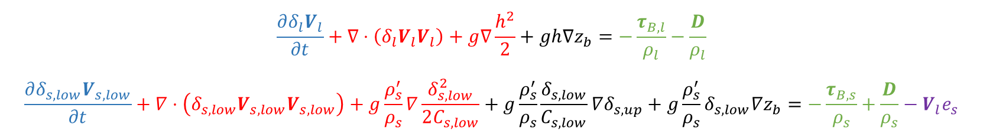
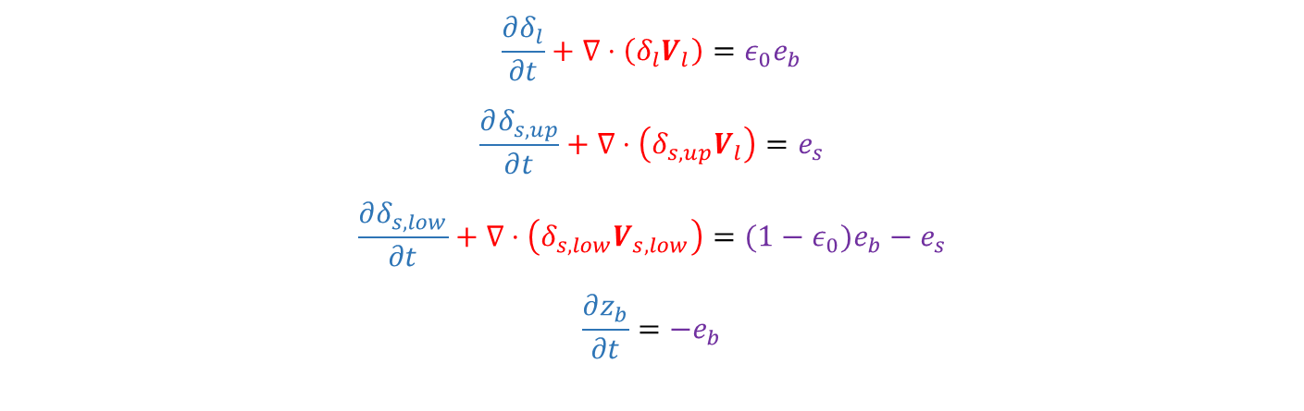
2P2L equations
$$\frac{∂δ_{l}}{∂t}+∇⋅\left(δ_{l}V_{l}\right)=ε_{0}e_{b}$$
$$\frac{∂δ_{s,up}}{∂t}+∇⋅\left(δ_{s,up}V_{l}\right)=e_{s}$$
$$\frac{∂δ_{s,low}}{∂t}+∇⋅\left(δ_{s,low}V_{s,low}\right)={(1−ε}_{0})e_{b}−e_{s}$$ $$\frac{∂z_{b}}{∂t}=−e_{b}$$
Mass conservation equations
$$\frac{∂δ_{l}V_{l}}{∂t}+∇⋅\left(δ_{l}V_{l}V_{l}\right)+g∇\frac{h^{2}}{2}+gh∇z_{b}=−\frac{τ_{B,l}}{ρ_{l}}−\frac{D}{ρ_{l}}$$
$$\frac{∂δ_{s,low}V_{s,low}}{∂t}+∇⋅\left(δ_{s,low}V_{s,low}V_{s,low}\right)+g\frac{ρ_{s}^{′}}{ρ_{s}}∇\frac{δ_{s,low}^{2}}{2C_{s,low}}+g\frac{ρ_{s}^{′}}{ρ_{s}}\frac{δ_{s,low}}{C_{s,low}}∇δ_{s,up}+g\frac{ρ_{s}^{′}}{ρ_{s}}δ_{s,low}∇z_{b}=−\frac{τ_{B,s}}{ρ_{s}}+\frac{D}{ρ_{s}}−V_{l}e_{s}$$
Momentum conservation equations
Closing parameters of morphodynamical models without trial-and-error
Robin Meurice & Sandra Soares-Frazão
7
Notes:
Altogether, the model counts 8 governing equations. 4 equations of mass and 4 equations of momentum conservation, as it is a 2D model.
Besides the blue temporal evolution terms, we find red advection terms, black slope terms, green friction and drag terms and finally purple mass exchange source terms.
But this is not very important for the rest of this presentation.

Slide 8

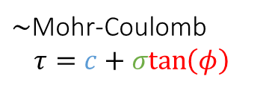


Friction source terms
$$τ_{B,l}=\frac{ρ_{l}n^{2}V_{l}\left|V_{l}\right|}{h^{1/3}}$$
Shear exerted by the water
Shear exerted by the solid phase
$$τ_{B,s}={βρ}_{s}V_{s,low}\left|V_{s,low}\right|+g\left(ρ_{s}−ρ_{l}\right){(δ}_{s,low}+δ_{s,up})\frac{V_{s,low}}{|V_{s,low}|}μ_{d}$$
Bed resistance
$τ_{B}$ = $τ_{c}+g\left(ρ_{s}−ρ_{l}\right){(δ}_{s,low}+δ_{s,up})μ_{s}$
$\sim$Mohr-Coulomb
$$τ=c+σtan\left(φ\right)$$
Friction coefficients
$$μ_{d}<μ_{s}$$
Closing parameters of morphodynamical models without trial-and-error
Robin Meurice & Sandra Soares-Frazão
8
Notes:
And for the rest of this presentation, we will actually mainly focus on the friction source term. These friction terms need to be closed by any experimental or theoretical formulation.
The friction exerted by the water on the bed is often and efficiently closed by the Manning formulation and this is what we will use here as well.
Following the work made by Di Cristo and her colleagues in 2016, I closed the shear exerted by the solid phase on the bed with an expression combining a Manning-like term accounting for the interactions between particles and a Mohr-Coulomb-like term depending on the weight of the sediment lying on the bed and a dynamic friction coefficient mud.
The bed resistance to these shears follows the same Mohr-Coulomb approach but uses a static friction coefficient mus.
The whole problem concerns these two friction coefficients, framed in red, as no value or closure formulation looks to exist in the literature for each of them. We should hence calibrate both of them. Yet, we can find a relation between these two parameters so that mu_d becomes the only parameter that still needs to be calibrated. Consequently, a trial-and-error calibration on past measures needs to be accomplished before any study of a river to close mu_d for that river. A blind prediction of the consequences of any flush on a river is hence not possible as this coefficient needs to be calibrated for every river.

Slide 9
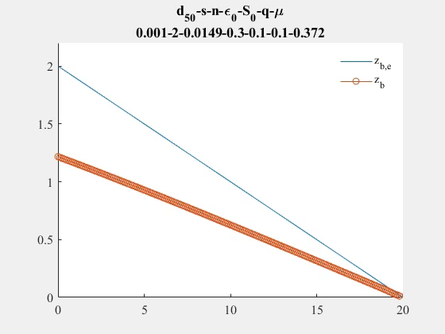
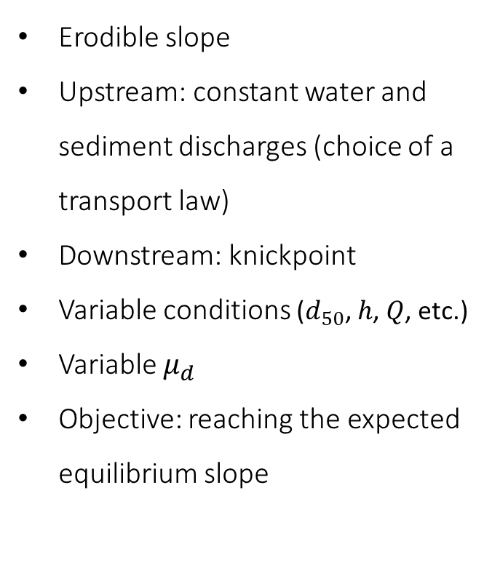

Closing parameters with a numerical experiment
Erodible slope
Upstream: constant water and sediment discharges (choice of a transport law)
Downstream: knickpoint
Variable conditions ($d_{50}$, $h$, $Q$, etc.)
Variable $μ_{d}$
Objective: reaching the expected equilibrium slope
$$d$$
Closing parameters of morphodynamical models without trial-and-error
Robin Meurice & Sandra Soares-Frazão
9
Notes:
To close this last parameter mu_d, I hence made a numerical experiment which consisted in feeding from upstream an erodible slope with constant water and sediment discharges, based on any transport law from the literature such as that of Meyer-Peter & Müller for example. Downstream, a non-erodible knickpoint ensures the complete transmission of water and sediment beyond a weir.
As explained later, I generated different flow situations and for each of them, I incremented the value of my lasting parameter, mu_d until the equilibrium slope of my model, in orange, reached the slope expected by the transport law that was chosen, in blue. Every time that the equilibrium slope became equal to the expected one, an optimal value for the considered situation could be found.

Slide 10
Optimisation procedure for any transport law
Generating the situations
Optimisation of $μ_{d}$ - numerical experiment
Optimisation of 𝜇_𝑑 - numerical experiment
Closures for $μ_{d}$
Closures for 𝜇_𝑑
Application to test cases and validation
Calculation of the solid discharge
Computation of the weights
Box-Cox Transformation
K-fold cross-validation
2P2L
JMP
Closing parameters of morphodynamical models without trial-and-error
Robin Meurice & Sandra Soares-Frazão
10
Notes:
This experiment is actually at the centre of a whole procedure that I went through for several transport laws. The closure for mu_d depending indeed on the chosen transport law.
You can find on this slide the whole procedure. Dark brown boxes correspond to numerical simulations made with the 2P2L model, while light brown boxes are steps performed with the help of JMP, which is a statistiscal software that we can also use to design experiments.
But before running the experiment, the first step consists in generating the situations with JMP.

Slide 11
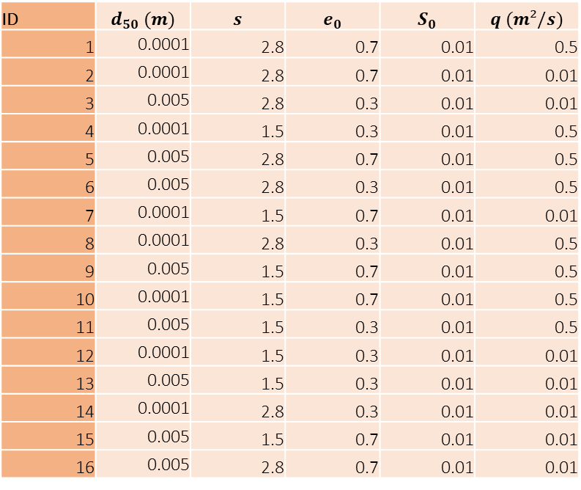
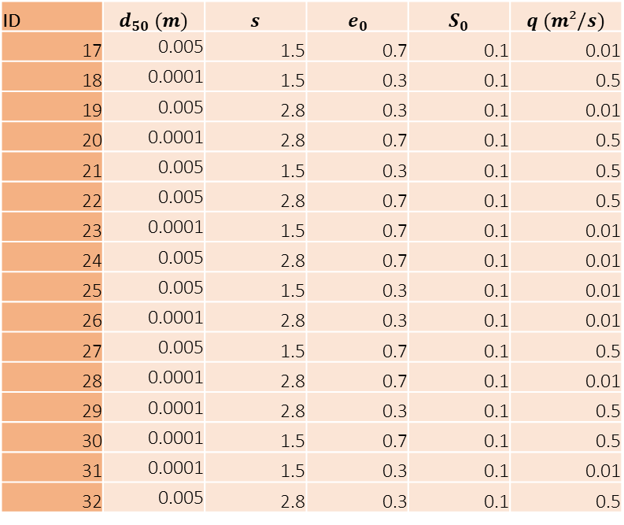
Step 1: Generating the situations
ID | $$d_{50} (m)$$ | $$s$$ | $$e_{0}$$ | $$S_{0}$$ | $$q (m²/s)$$
1 | 0.0001 | 2.8 | 0.7 | 0.01 | 0.5
2 | 0.0001 | 2.8 | 0.7 | 0.01 | 0.01
3 | 0.005 | 2.8 | 0.3 | 0.01 | 0.01
4 | 0.0001 | 1.5 | 0.3 | 0.01 | 0.5
5 | 0.005 | 2.8 | 0.7 | 0.01 | 0.5
6 | 0.005 | 2.8 | 0.3 | 0.01 | 0.5
7 | 0.0001 | 1.5 | 0.7 | 0.01 | 0.01
8 | 0.0001 | 2.8 | 0.3 | 0.01 | 0.5
9 | 0.005 | 1.5 | 0.7 | 0.01 | 0.5
10 | 0.0001 | 1.5 | 0.7 | 0.01 | 0.5
11 | 0.005 | 1.5 | 0.3 | 0.01 | 0.5
12 | 0.0001 | 1.5 | 0.3 | 0.01 | 0.01
13 | 0.005 | 1.5 | 0.3 | 0.01 | 0.01
14 | 0.0001 | 2.8 | 0.3 | 0.01 | 0.01
15 | 0.005 | 1.5 | 0.7 | 0.01 | 0.01
16 | 0.005 | 2.8 | 0.7 | 0.01 | 0.01
ID | $$d_{50} (m)$$ | $$s$$ | $$e_{0}$$ | $$S_{0}$$ | $$q (m²/s)$$
17 | 0.005 | 1.5 | 0.7 | 0.1 | 0.01
18 | 0.0001 | 1.5 | 0.3 | 0.1 | 0.5
19 | 0.005 | 2.8 | 0.3 | 0.1 | 0.01
20 | 0.0001 | 2.8 | 0.7 | 0.1 | 0.5
21 | 0.005 | 1.5 | 0.3 | 0.1 | 0.5
22 | 0.005 | 2.8 | 0.7 | 0.1 | 0.5
23 | 0.0001 | 1.5 | 0.7 | 0.1 | 0.01
24 | 0.005 | 2.8 | 0.7 | 0.1 | 0.01
25 | 0.005 | 1.5 | 0.3 | 0.1 | 0.01
26 | 0.0001 | 2.8 | 0.3 | 0.1 | 0.01
27 | 0.005 | 1.5 | 0.7 | 0.1 | 0.5
28 | 0.0001 | 2.8 | 0.7 | 0.1 | 0.01
29 | 0.0001 | 2.8 | 0.3 | 0.1 | 0.5
30 | 0.0001 | 1.5 | 0.7 | 0.1 | 0.5
31 | 0.0001 | 1.5 | 0.3 | 0.1 | 0.01
32 | 0.005 | 2.8 | 0.3 | 0.1 | 0.5
Closing parameters of morphodynamical models without trial-and-error
Robin Meurice & Sandra Soares-Frazão
11
Notes:
I call a situation a set of flow and grain parameter values that will lead to a different optimal value for our parameter mu_d.
I chose to vary 5 different flow or grain parameters, i.e. the median grain diameter d50, the grain relative density s, the porosity of the bed, e0, the expected slope of the bed S0 and the water discharge q. At the end of the procedure, I then used non-dimensional numbers, functions of these parameters, to derive a linear regression model that will close my mu_d parameter.
Here, since there are 5 different factors, and if we want to detect any first-order effect, the best design of experiment would be to consider 32 experiments, with two values for each factor, which is called a full factorial design. Yet, for a more complete overview of natural flows though, I doubled the experiment with other factor values. I hence ran the model under 64 situations.

Slide 12
Optimisation procedure for any transport law
Generating the situations
Optimisation of $μ_{d}$ - numerical experiment
Optimisation of 𝜇_𝑑 - numerical experiment
Closures for $μ_{d}$
Closures for 𝜇_𝑑
Application to test cases and validation
Calculation of the solid discharge
Computation of the weights
Box-Cox Transformation
K-fold cross-validation
2P2L
JMP
Closing parameters of morphodynamical models without trial-and-error
Robin Meurice & Sandra Soares-Frazão
12
Notes:
Now that we have our situations, we can compute the solid discharge with which we will feed the flume to reach the slope that we expect.

Slide 13
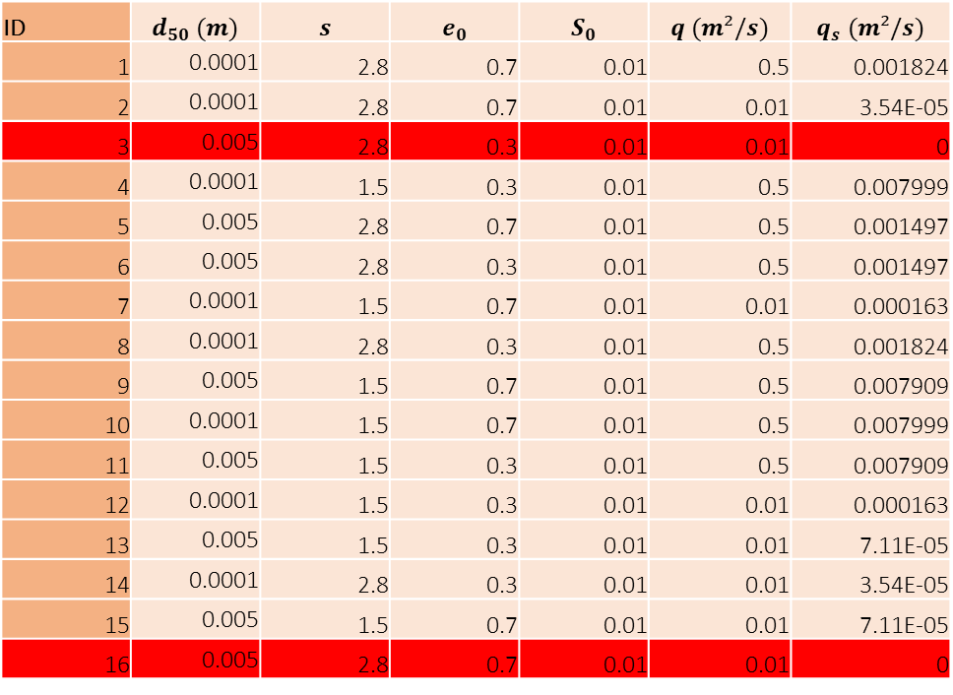
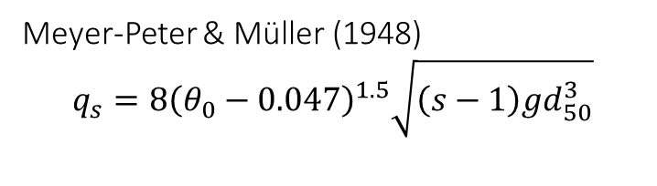
Step 2: Solid discharge computation
ID | $$d_{50} (m)$$ | $$s$$ | $$e_{0}$$ | $$S_{0}$$ | $$q (m²/s)$$ | $$q_{s} (m²/s)$$
1 | 0.0001 | 2.8 | 0.7 | 0.01 | 0.5 | 0.001824
2 | 0.0001 | 2.8 | 0.7 | 0.01 | 0.01 | 3.54E-05
3 | 0.005 | 2.8 | 0.3 | 0.01 | 0.01 | 0
4 | 0.0001 | 1.5 | 0.3 | 0.01 | 0.5 | 0.007999
5 | 0.005 | 2.8 | 0.7 | 0.01 | 0.5 | 0.001497
6 | 0.005 | 2.8 | 0.3 | 0.01 | 0.5 | 0.001497
7 | 0.0001 | 1.5 | 0.7 | 0.01 | 0.01 | 0.000163
8 | 0.0001 | 2.8 | 0.3 | 0.01 | 0.5 | 0.001824
9 | 0.005 | 1.5 | 0.7 | 0.01 | 0.5 | 0.007909
10 | 0.0001 | 1.5 | 0.7 | 0.01 | 0.5 | 0.007999
11 | 0.005 | 1.5 | 0.3 | 0.01 | 0.5 | 0.007909
12 | 0.0001 | 1.5 | 0.3 | 0.01 | 0.01 | 0.000163
13 | 0.005 | 1.5 | 0.3 | 0.01 | 0.01 | 7.11E-05
14 | 0.0001 | 2.8 | 0.3 | 0.01 | 0.01 | 3.54E-05
15 | 0.005 | 1.5 | 0.7 | 0.01 | 0.01 | 7.11E-05
16 | 0.005 | 2.8 | 0.7 | 0.01 | 0.01 | 0
Meyer-Peter & Müller (1948)
$$q_{s}=8{\left(θ_{0}−0.047\right)}^{1.5}\sqrt{\left(s−1\right)gd_{50}^{3}}$$
Closing parameters of morphodynamical models without trial-and-error
Robin Meurice & Sandra Soares-Frazão
13
Notes:
To do so, we may use any closure formulation from the literature, either for bedload, suspension, or both at the same time. Here, you can find an example with that of Meyer-Peter & Müller.
Among these situations, two of them are indicated in red because they will give no solid discharge and can hence be excluded from the situation set. If we have zero transport capacity, it is indeed impossible to determine which value is optimal as all values will provide the same results.

Slide 14
Optimisation procedure for any transport law
Generating the situations
Optimisation of $μ_{d}$ - numerical experiment
Optimisation of 𝜇_𝑑 - numerical experiment
Closures for $μ_{d}$
Closures for 𝜇_𝑑
Application to test cases and validation
Calculation of the solid discharge
Computation of the weights
Box-Cox Transformation
K-fold cross-validation
2P2L
JMP
Closing parameters of morphodynamical models without trial-and-error
Robin Meurice & Sandra Soares-Frazão
14
Notes:
Once the situations were determined and the solid discharges computed, the experiment can be conducted. For all situations, the model will run one simulation for each value of mu_d. Considering our 64 situations and roughly 200 different values of mu_d, this step corresponds to 12800 simulations for one single transport law. If you want to follow this procedure, you’d better use a remote server with high computing capacities.

Slide 15
Optimisation procedure for any transport law
Generating the situations
Optimisation of $μ_{d}$ - numerical experiment
Optimisation of 𝜇_𝑑 - numerical experiment
Closures for $μ_{d}$
Closures for 𝜇_𝑑
Application to test cases and validation
Calculation of the solid discharge
Computation of the weights
Box-Cox Transformation
K-fold cross-validation
2P2L
JMP
Closing parameters of morphodynamical models without trial-and-error
Robin Meurice & Sandra Soares-Frazão
15
Notes:
Yet, even optimal values do not provide perfect results. To give more importance to some results, I attribute weights to my results.

Slide 16
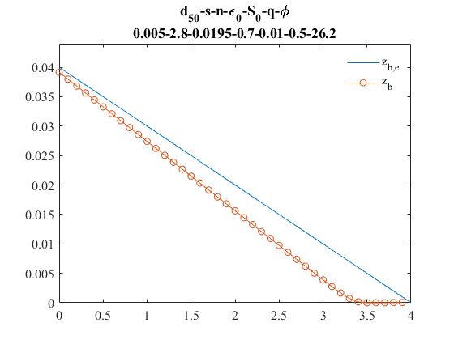
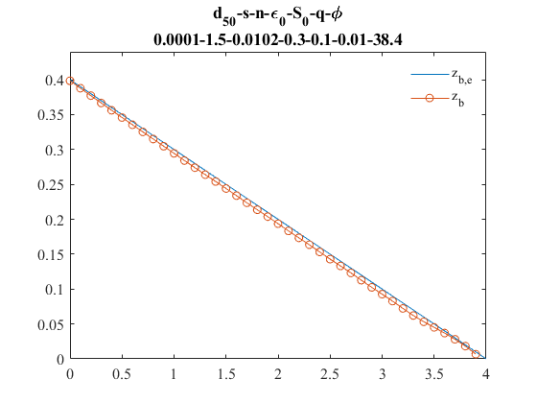
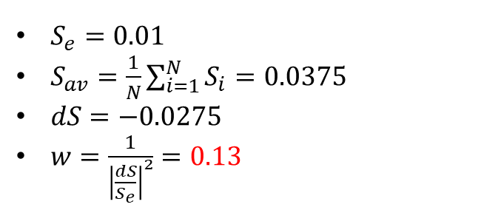


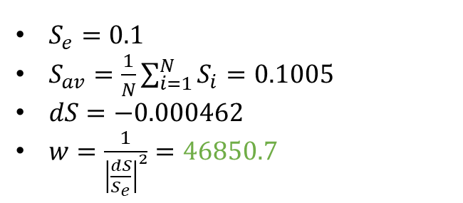






Step 4: Computation of the weights
$$μ$$
$$μ$$
$$0.492$$
$$0.793$$
$$S_{e}$$
$$S_{e}$$
$$S_{i}$$
$$S_{i}$$
$S_{e}=0.01$
$S_{av}=\frac{1}{N}\sum_{i=1}^{N}{S_{i}}=0.0375$
$dS=−0.0275$
$w=\frac{1}{{\left|\frac{dS}{S_{e}}\right|}^{2}}=0.13$
$S_{e}=0.1$
$S_{av}=\frac{1}{N}\sum_{i=1}^{N}{S_{i}}=0.1005$
$dS=−0.000462$
$w=\frac{1}{{\left|\frac{dS}{S_{e}}\right|}^{2}}=46850.7$
Closing parameters of morphodynamical models without trial-and-error
Robin Meurice & Sandra Soares-Frazão
16
Notes:
These weights are inversely proportional to the square of the difference between the equilibrium slope and the expected one, normalized by the square of the expected slope. Basically, the mu_d values that correspond to equilibrium slopes really close to the expected one will have much more weight when determining the closure formulation. For example here, the optimal value for the situation on the right will have much more influence on the closure formulation of mu_d than that of the situation on the left.

Slide 17
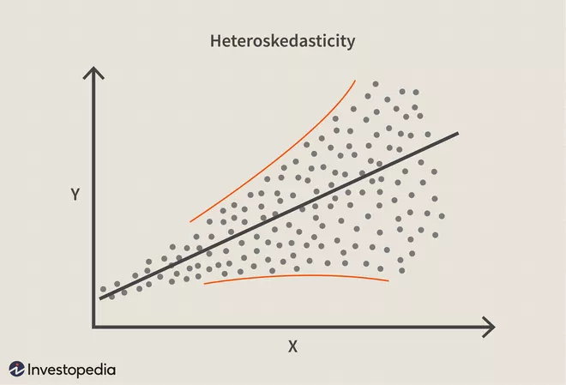
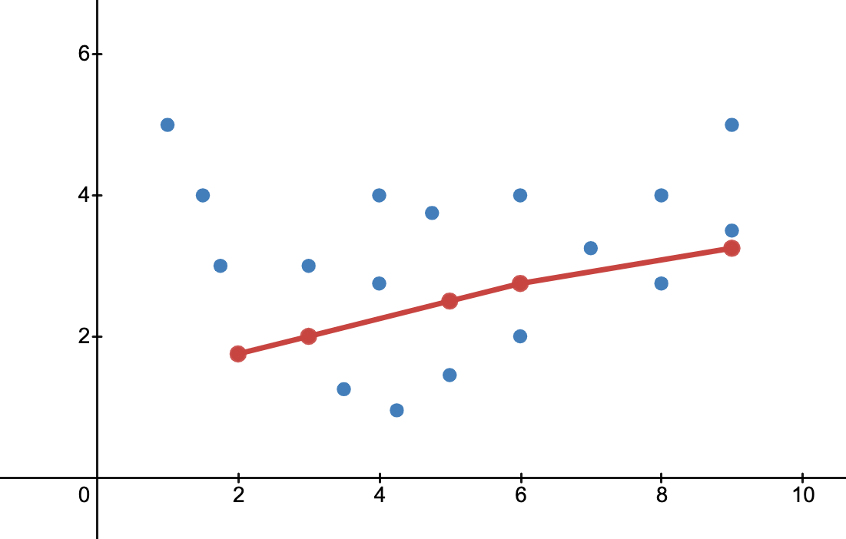
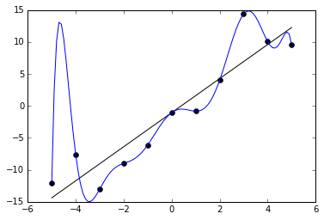
Construction of a predictive model
Two problems to consider
Normal distribution and constant variance ➔ Box-Cox Transformation
Balance between underfitting and overfitting ➔ k-fold cross-validation
Underfitting
Overfitting
Closing parameters of morphodynamical models without trial-and-error
Robin Meurice & Sandra Soares-Frazão
17
Notes:
Ok, so now that the results were obtained, we can post-process them, to find a closure formulation for our parameter. Yet, two difficulties arise.
First, the optimal values of mu_d show heteroskedasticity, which means that they do not follow a normal distribution and have no constant variance. However, to construct a linear regression model, the variables should ideally have these properties. To solve that issue, we can use a Box-Cox transformation as I will explain afterwards.
Secondly, we must make sure that we capture the behaviour of the data accurately enough, that there is no underfitting, and that we do not capture noise, that we avoid overfitting. To address this problem, we can use machine learning and especially, a k-fold cross-validation algorithm.

Slide 18
Optimisation procedure for any transport law
Generating the situations
Optimisation of $μ_{d}$ - numerical experiment
Optimisation of 𝜇_𝑑 - numerical experiment
Closures for $μ_{d}$
Closures for 𝜇_𝑑
Application to test cases and validation
Calculation of the solid discharge
Computation of the weights
Box-Cox Transformation
K-fold cross-validation
2P2L
JMP
Closing parameters of morphodynamical models without trial-and-error
Robin Meurice & Sandra Soares-Frazão
18
Notes:
So before running the algorithm to derive a linear regression model, I transformed my results with a Box-Cox transformation.

Slide 19
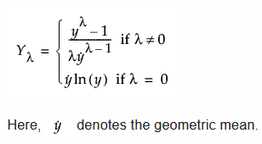
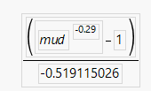
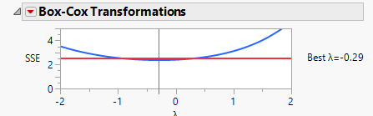



Step 5: Box-Cox transformation
Distribution of $μ_{d}$
Theory
Application
Distribution of $μ_{d,BC}$
$$μ_{d,BC}=$$
Closing parameters of morphodynamical models without trial-and-error
Robin Meurice & Sandra Soares-Frazão
19
Notes:
The goal is to transform the variables to make them follow a normal distribution.
You can see on the left panel that our mu_d variables do not really follow a normal distribution.
In the centre of the slide, you can find at the top the theoretical expression of the transformation which uses a parameter called lambda and that a software such as JMP is able to optimize to minimize the difference between our transformed distribution and a normal one. Right below that expression, you can find the transformation that was used to transform the data in the left panel into those in the right panel.
And on the right, you can see that, after applying such a transformation, the variables are almost normally distributed.
Now, we can use these variables to derive a linear regression model.

Slide 20
Optimisation procedure for any transport law
Generating the situations
Optimisation of $μ_{d}$ - numerical experiment
Optimisation of 𝜇_𝑑 - numerical experiment
Closures for $μ_{d}$
Closures for 𝜇_𝑑
Application to test cases and validation
Calculation of the solid discharge
Computation of the weights
Box-Cox Transformation
K-fold cross-validation
2P2L
JMP
Closing parameters of morphodynamical models without trial-and-error
Robin Meurice & Sandra Soares-Frazão
20
Notes:
This linear regression model will be built using a machine learning algorithm that is called k-fold cross-validation. This algorithm is perfectly suited to limited datasets. And since here, we have, at most, 64 results for each transport law, we can clearly say that our dataset is limited.

Slide 21
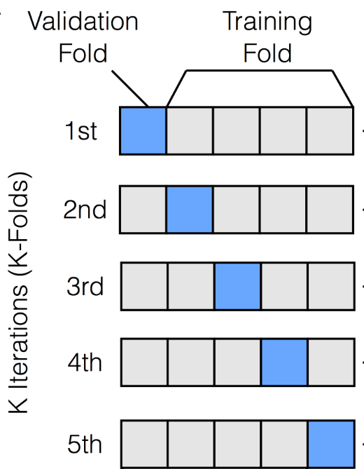
Step 6: Closing with machine learning
Random division between a training (75%) and a test set (25%)
K-fold cross validation on the training set
  Random division of the training set in k folds
  Select one fold as the validation set
  Train on the k-1 other folds
  Retain the R² for that iteration
  Perform again steps 2-4 with different folds as validation sets
  Select the model with the best R² on the validation set
Apply the model to the test set and ensure a sufficient R²
Closing parameters of morphodynamical models without trial-and-error
Robin Meurice & Sandra Soares-Frazão
21
Notes:
This algorithm consists in randomly dividing the dataset into a training and a test set.
The training set is then subdivided into k folds or dataset chunks.
A fold will then be used as a validation set while the other k-1 folds will be used to train a regression model. The model that gives the best R² value for that validation set will be retained.
Then, each fold is alternatively used as the validation set while the others are used to train k-1 other models.
When all folds were used as validation sets, the models that gave the best R² values on the different validation sets are applied to the remaining test set. The model that gives the best R² value on that set will be selected as the final regression model and hence the closure formulation for mu_d.
For a dataset limited to a few points only, the resulting model may rather strongly depend on the random separation between a training and a test set. To cope with this, it is possible to run the algorithm several times and to average the final linear models.

Slide 22
Optimisation procedure for any transport law
Generating the situations
Optimisation of $μ_{d}$ - numerical experiment
Optimisation of 𝜇_𝑑 - numerical experiment
Closures for $μ_{d}$
Closures for 𝜇_𝑑
Application to test cases and validation
Calculation of the solid discharge
Computation of the weights
Box-Cox Transformation
K-fold cross-validation
2P2L
JMP
Closing parameters of morphodynamical models without trial-and-error
Robin Meurice & Sandra Soares-Frazão
22
Notes:
When the algorithm was done with determining the best regression model, I could have a look at it.

Slide 23


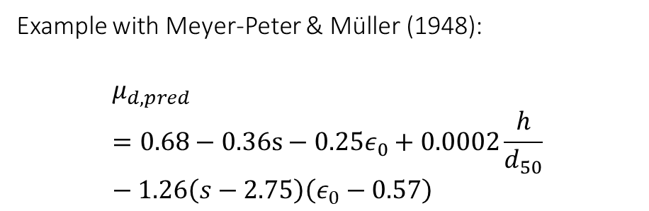
Step 7: Developing a closure equation for $μ_{d}$
Objective: maximise $R_{test}^{2}$ with $μ_{d}=f\left(s,ε_{0},S_{0},\frac{h}{d_{50}},Fr\right)$
Example with Meyer-Peter & Müller (1948):
$$μ_{d,pred}=0.68−0.36s−0.25ε_{0}+0.0002\frac{h}{d_{50}}−1.26\left(s−2.75\right)\left(ε_{0}−0.57\right)$$
$$μ_{d,obs}$$
Source | R² | RMSE
Training Set | 0.99 | 0.013
Test Set | 0.55 | 0.06
$$μ_{d,pred}$$
Closing parameters of morphodynamical models without trial-and-error
Robin Meurice & Sandra Soares-Frazão
23
Notes:
Here, you can see an example for the transport law of MPM. As you can see, these closure formulations can become a bit nasty, but they keep very easy to be implemented in a numerical model. As I said earlier, they are functions of non-dimensional numbers that are themselves functions of the parameters that we varied through the different situations.
To avoid underfitting, the R² value of the training set must be high enough. This is achieved pretty easily if you consider not only the first-order terms but also their interactions. The problem is to avoid overfitting. If the R² value of the test set is low while that of the training set is high, it means that the training set was overfitted. For example, you can see that the R² square value on the test set was only of 0.55 with that regression model for that transport law. On the right panel, you can see that indeed, a significant part of the actual optimal values, determined with the numerical experiment, could not be explained by the regression model in red. Nevertheless, the overall tendency is ok. It is probably a better idea to have R² values superior to 0.7 both on the training and the test sets, rather than a fantastic R² value on the training set and a bad one on the test set.

Slide 24
Optimisation procedure for any transport law
Generating the situations
Optimisation of $μ_{d}$ - numerical experiment
Optimisation of 𝜇_𝑑 - numerical experiment
Closures for $μ_{d}$
Closures for 𝜇_𝑑
Application to test cases and validation
Calculation of the solid discharge
Computation of the weights
Box-Cox Transformation
K-fold cross-validation
2P2L
JMP
Closing parameters of morphodynamical models without trial-and-error
Robin Meurice & Sandra Soares-Frazão
24
Notes:
After finding a closure formulation for mu_d, it is finally time to apply it and run any test case.

Slide 25
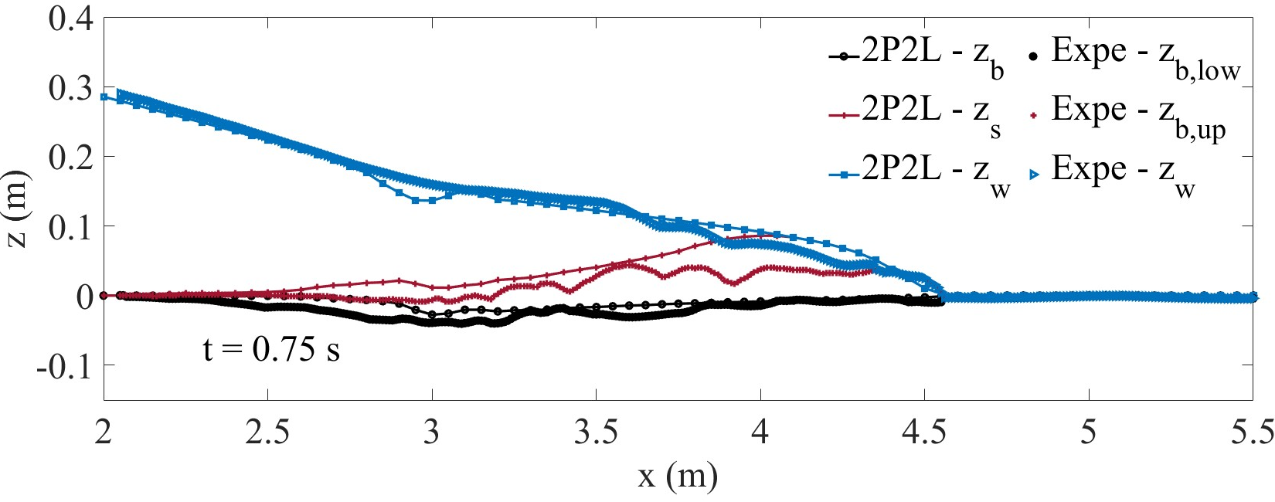
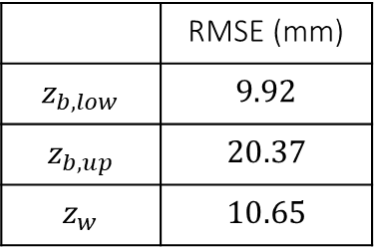
Application: Spinewine & Zech (2007) – PVC
Meyer Peter & Müller (1948)
 | RMSE (mm)
$$z_{b,low}$$ | $$9.92$$
$$z_{b,up}$$ | $$20.37$$
$$z_{w}$$ | $$10.65$$
Closing parameters of morphodynamical models without trial-and-error
Robin Meurice & Sandra Soares-Frazão
25
Notes:
Here, I will show you the results I obtained with the transport law of MPM for a 1D dam break on an erodible bed made of PVC pellets.
The black curves correspond to the bed, the red ones to the upper limit of the intense transport layer, and the blue ones to the water surface. Although measuring the water surface is easy, determining the limits of the transport layer is more difficult and there is uncertainty around them. A perfect match between the model and the experimental results for these two lower curves is not expected. Nevertheless, we can see that all the curves are rather well predicted, especially that of the water surface whose position in time is more certain. The 2P2L model looks to be able to accurately handle the inertia of the liquid and solid phases in the case of high transport.

Slide 26
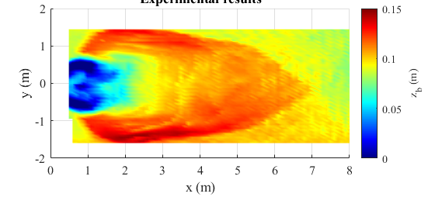
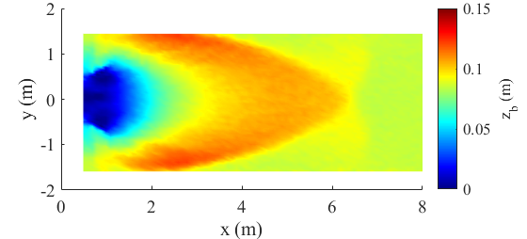
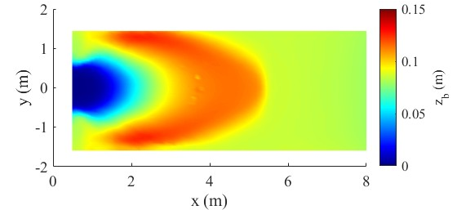
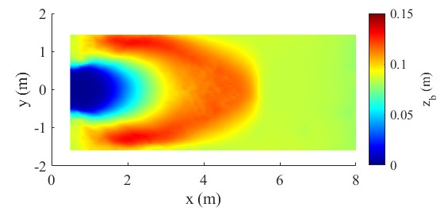



Application: NSF-PIRE – Test 1
Experimental
Bedload
$$RMS{E_{z}}_{b}=1.99 cm$$
2P2L – Ribberink
2P2L – MPM
$$RMS{E_{z}}_{b}=1.84 cm$$
$$RMS{E_{z}}_{b}=1.84 cm$$
Closing parameters of morphodynamical models without trial-and-error
Robin Meurice & Sandra Soares-Frazão
26
Notes:
Now, let’s have a look at another test case in which a dam breaks and releases water over a wide erodible floodplain made of sand. Here, the results at equilibrium are considered. The flow leads to an eroded pit right after the dam and deposes much along the sides of the flume. 7 m from the dam, the deposits join to form the tip of an arrow.
In the upper right corner, you can see the results obtained with a simple bedload model, while the two lower panels show the results for the 2P2L model, obtained with two different solid discharge closure formulations. Although these two are not able to reproduce the tip of the arrow, they much better estimate the deposition along the sides of the flume, which results in a lower RMSE than for the bedload model.
So it appears that our calibration procedure leads to satisfactory results and can constitute a useful tool to circumvent trial-and-error.

Slide 27
Conclusion
Tool
Constraints
Solution
Problem
Simulating complex flows highly laden with sediment
A 2D numerical model to simulate dam-flushes and optimize them
Being able to be used as a predictive tool
Closing the last unknown parameter with a numerical experiment and machine learning
Uncertainties
Performance of the model with high suspension
Avoiding a trial-and-error calibration
Closing parameters of morphodynamical models without trial-and-error
Robin Meurice & Sandra Soares-Frazão
27
Notes:
To resume this presentation, we started with a problem which concerns the inability of the shallow water equations to properly simulate flows highly laden with sediment.
To address this problem, we proposed to develop a two-phase/two-layer finite volume model that is supposed to be able to reproduce dam flushes and eventually, to be used as a predictive and optimization tool.
The problem is that such a model with unclosed parameters cannot be properly used as a blind predictive tool since it needs ad-hoc calibrations made by trial-and-error and which are based on previously obtained data.
To solve that problem, we proposed a procedure involving a numerical experiment and machine learning to close the last parameter of the model. I want to stress that this procedure could be applied to any morphodynamical model for which one single parameter still needs to be closed.
Finally, the model gave satisfactory results with large particles that mostly travel along the bed but its performance still needs to be assessed in the case of high suspension. In that perspective, laboratory experiments and real case simulations still need to be performed.

Slide 28
YMC 2023
M.S. YALIN MEMORIAL COLLOQUIUM 2023:
Flow-sediment-biota Interactions
In Fluvial system: recent research trends
Thank you for your attention
Robin Meurice, Sandra Soares-Frazão
UCLouvain
robin.meurice@uclouvain.be –
Notes:
Thank you very much for your attention and please do not hesitate to ask questions!

