Slide 1

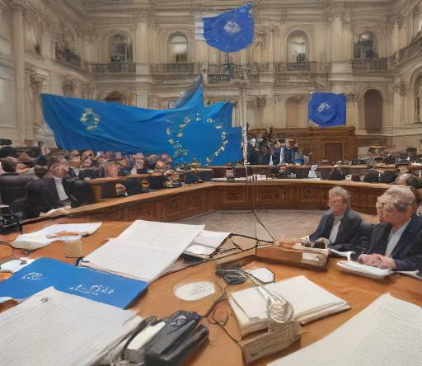
Monitoring ‘constitutional quality’ in Accession States
Jonathan Bauerschmidt

Slide 2
Overview of the presentation
I. Bases for ‘constitutional quality’ monitoring
II. ‘Constitutional quality’ in the Enlargement Process
III. ‘Constitutional quality’ post Accession
IV. Conclusion

Slide 3
I. Bases for ‘constitutional quality’ monitoring
1. Copenhagen criteria (EUCO 1993)
EU Membership requires: “stability of institutions guaranteeing democracy, the rule of law and respect for and protection of minorities”, economic criteria and capacity to implement acquis
Union’s capacity to absorb new members
2. Article 49 TEU
“Any European State which respects the values referred to in Article 2 and is committed to promoting them may apply to become a member of the Union.”
Articles 49 & 2 TEU contain non-regression principle, C‑896/19, Repubblika, paras 64-5 internally, has also effects externally
3. Council of Europe, Venice Commission and ECtHR
4. Constitutions of Accession States

Slide 4
II. ‘Constitutional quality’ in the Enlargement Process
1. Enlargement process
Article 49 TEU envisages a hybrid process comprising a Union arm (1) and an intergovernmental arm (2)
Many informal steps laid down in precedents and Negotiating Framework (details diverge)
2. Examining chapters and clusters
Negotiations are structured around 6 clusters and 33 chapters
Most important is cluster 1 on “Fundamentals”, comprising Judiciary, Justice, Financial control, functioning of democratic institutions etc. (opened first, closed last)
Core of the ‘constitutional quality’ monitoring

Slide 5
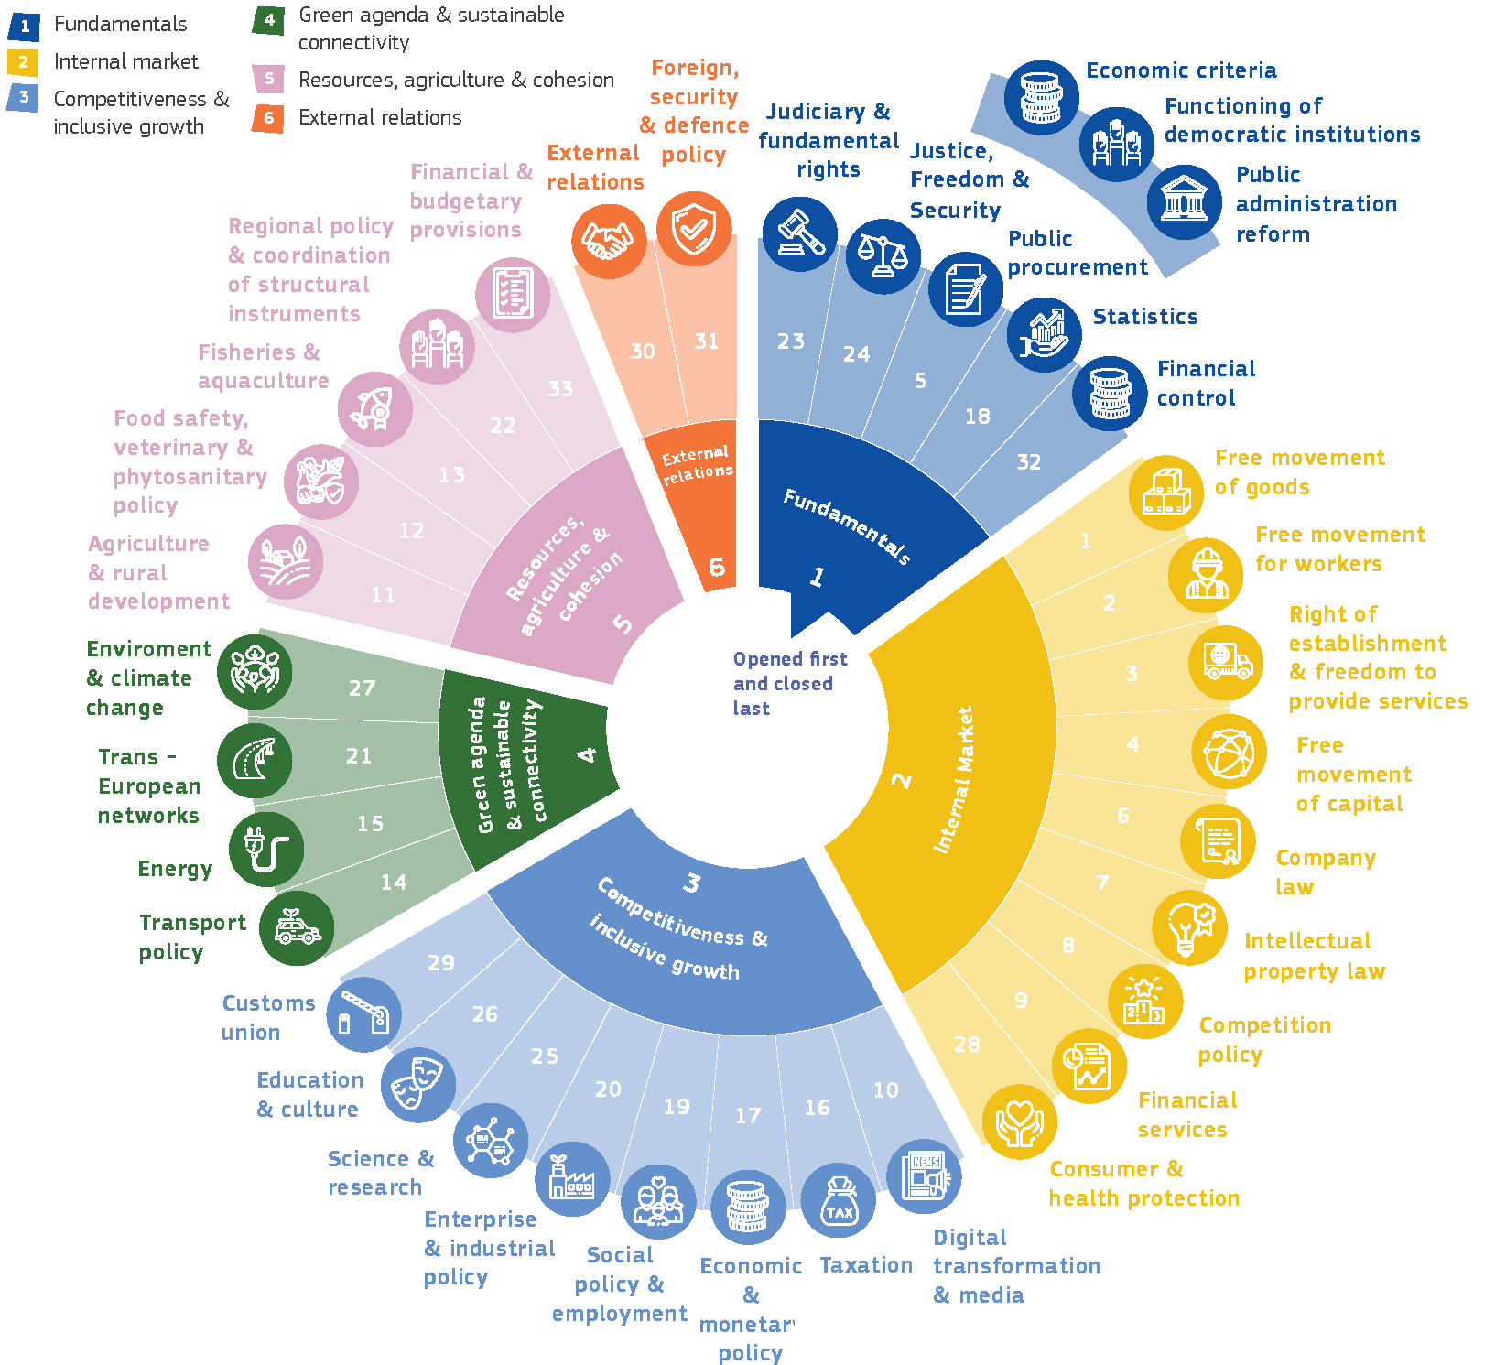
II. ‘Constitutional quality’ in the Enlargement Process

Slide 6
II. ‘Constitutional quality’ in the Enlargement Process
3. Corrective measures & IPA
In case of serious or persistent breach of EU values, corrective measures could be initiated by COM or 1/3 of MSs (NM & AL only one MS) and would require QMV by Council to be stopped (reversed QMV); strong incentive to stay on ‘enlargement path’
Instrument for Pre-Accession Assistance – IPA III € 14.1 bn
4. Institutional engineering: Broadening RoL Report
COM President in State of the Union 13/9/2023: “open the Rule of Law Reports to those accession countries which get up to speed even faster”
AL, MO, NM, Serbia will be in 2024 RoL Report
There will be discussion in General Affairs Council in fall:
  Outside of enlargement and outside of RoL Dialogue

Slide 7
III. ‘Constitutional quality’ post Accession
1. Cooperation and Verification Mechanism (CVM)
Foreseen in Accession Treaties for BG and RO, established by COM Decisions in 2006
Esp. judiciary and fight against corruption; yearly reports by COM
In Council Conclusions until 2019 and then Presidency Reports
Political connection to Schengen Accession, repeal in Sept. 2023
Joined Cases C‑83/19 e.a., Asociaţia ‘Forumul Judecătorilor din România’, repeated non-regression principle (para. 162) and held that RO must take into account COM Reports and may not adopt measures that could jeopardise results prescribed (para. 177)
2. Many other (internal) tools
Budgetary conditionality (poss. more types of conditionality)
Must be capacity to implement the EU acquis

Slide 8
IV. Conclusion
Normative framework exists to monitor ‘constitutional quality’ before, during and post accession
Need for continuous reform since challenges change and risks evolve (institutional engineering)
Coherence and interdependence between accession and internal reform
Legitimacy for enlargement will depend as much on the EU’s ability to monitor ‘constitutional quality’ of Accession States, as it depends on monitoring ‘constitutional quality’ of EU Member States (and taking action if necessary).
Constitutional identity of the EU in Article 2 TEU is as relevant for Member States as it is for Accession States

Slide 9

Thank you!
Jonathan.Bauerschmidt@consilium.europa.eu

