Slide 1
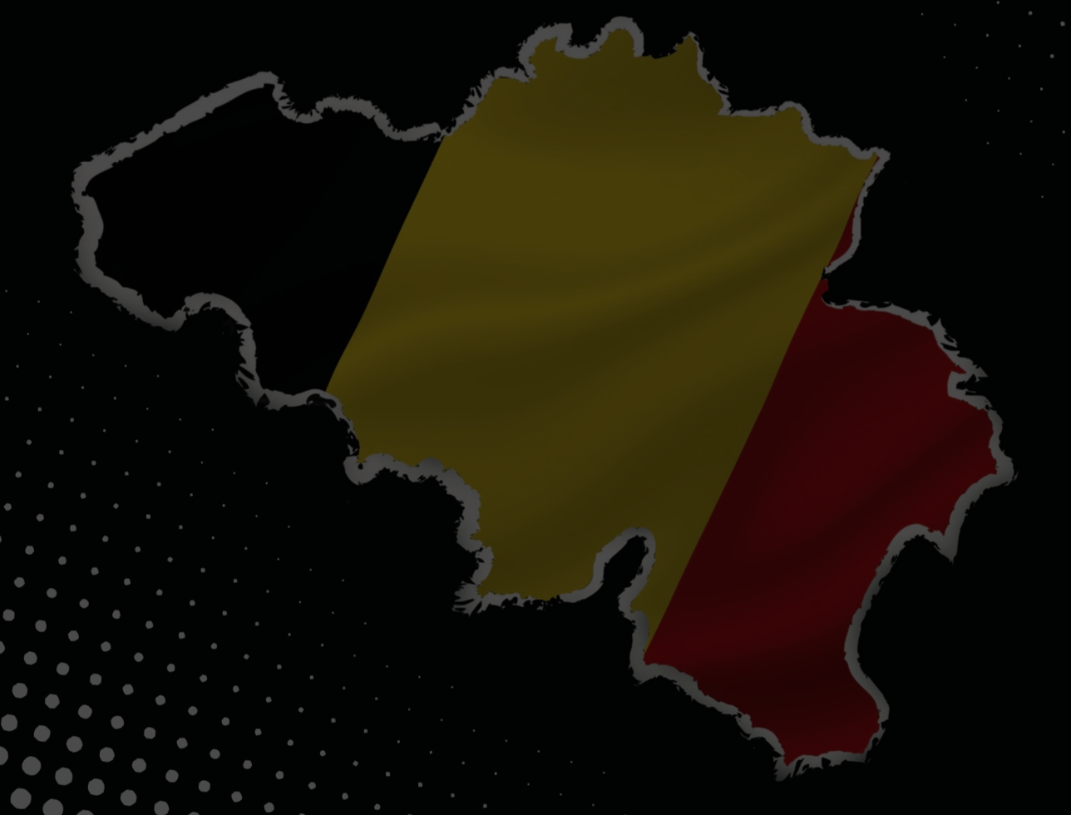
COST Action Constitution-making and deliberative democracy
What’s going on in Belgium?
Belgium’s representative democracy and constitutional change:
  Referendums are prohibited but popular consultations at the local level and at the regional level in Wallonia
  Only parliamentarians can revise the Constitution
  Key role of political parties – coalition governments
  Multi-level Belgium: local, provincial, regional, federal and European → room for innovation at each level
Since 2000’s, introduction of participatory and deliberative practices:
  Citizen panels, as one-shot initiatives from the executives
  Organized mainly by two foundations (King Baudouin F. & F. for Future Generations)
In 2011: the G1000
  Large-scale and multi-body deliberative experiments
  Initiated by citizens – no institutional plug-in
In the wake of the G1000, political uptake:
  Participation increasingly in political discourse
  Parliaments have organised citizen panels
  Debates about randomly selected parliamentarians
  Revision of – parts of – the Constitution with citizen participation?
MC Members from Belgium: Marie Dufrasne, Andrea Felicetti, Jean-Benoit Pilet, Min Reuchamps
The German-speaking Community to go one step further:
  Permanent randomly selected body with agenda-setting power
  Next to elected parliament
Followed by Brussels and Wallonia in their government declaration:
  Mixed parliamentary committees (MPs and citizens)
  Climate convention
  German-speaking model at the local level
  In Brussels: 1 MP (Agora) with sortition as primary objective
This draft: 17 October 2019
What’s next?

