Slide 1



Automated digital quantification of parenchymal lung fibrosis in COVID-19 related and -unrelated ARDS
SIZ Congress – 15/06/2022
Dr L. Gerard

Slide 2
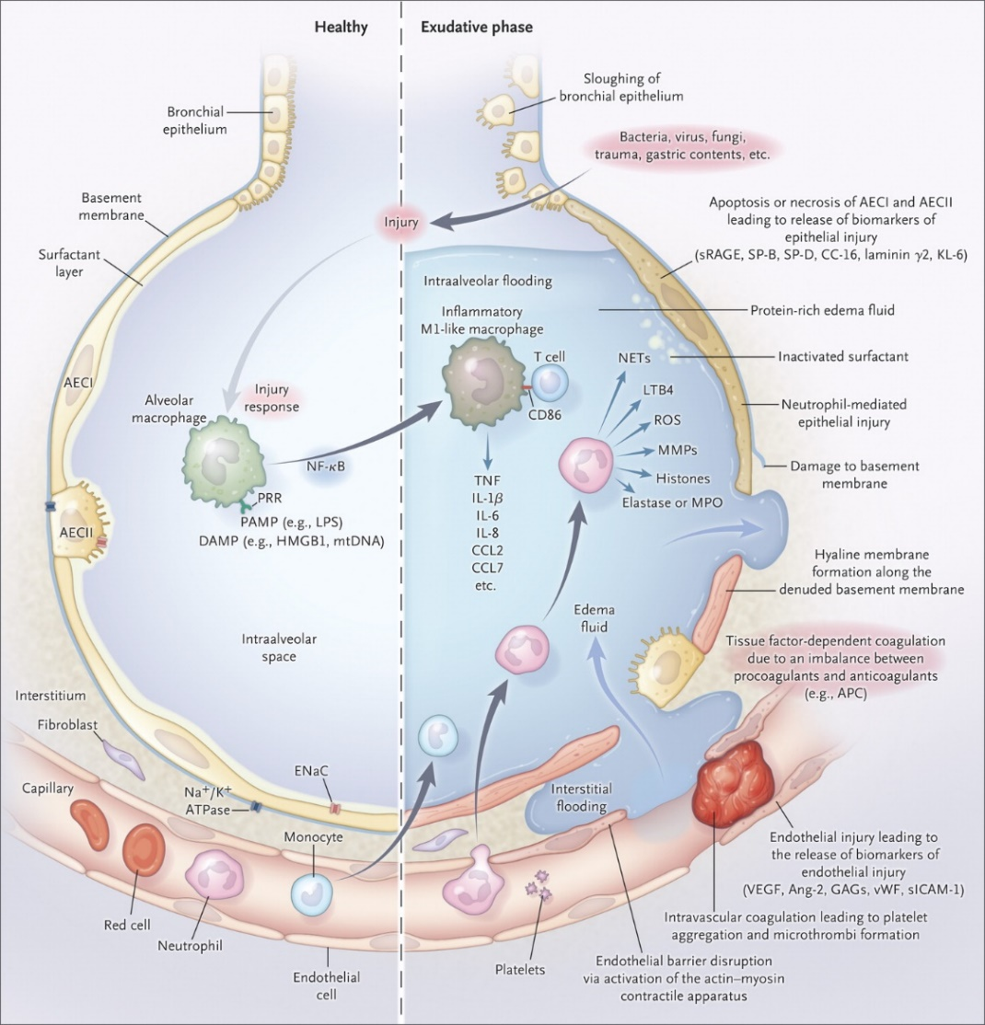
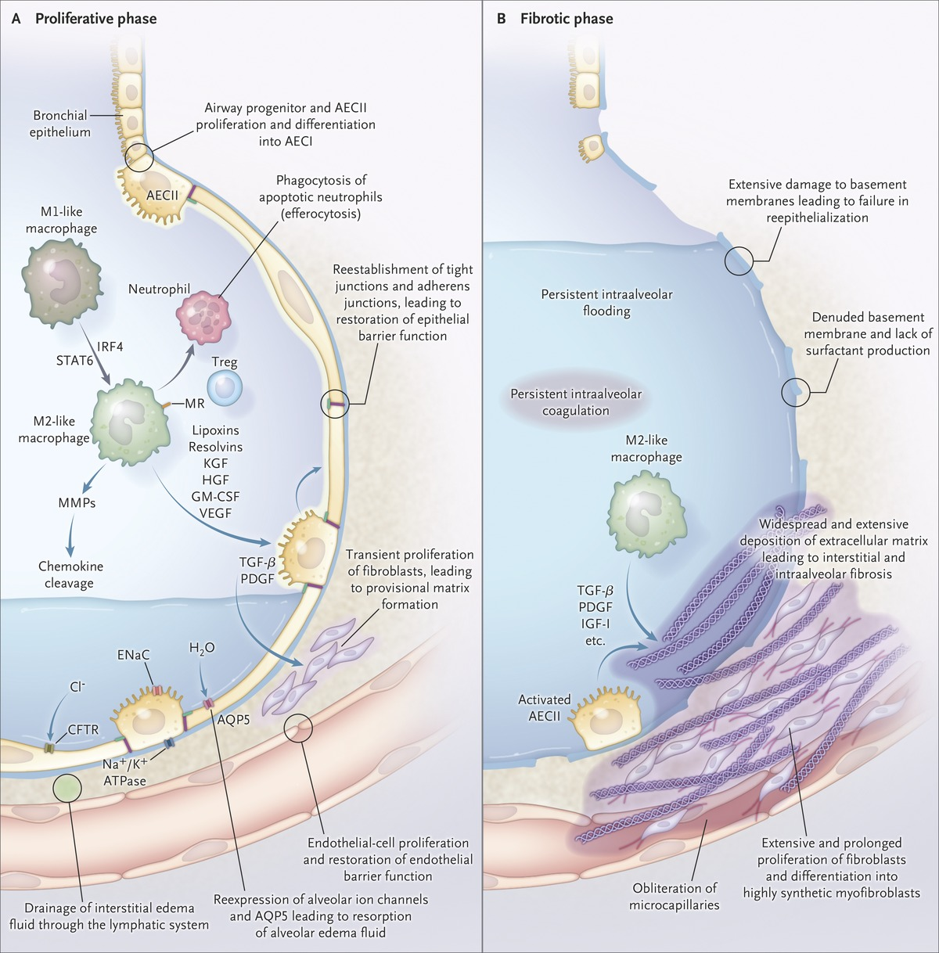
Background
Thompson BT et al. N Engl J Med 2017;377:562-572
Main objective: to characterize and to quantify lung parenchymal fibrosis in patients with ARDS (COVID-related or not)
Notes:
Two separate barriers form the alveolar–capillary barrier, the microvascular endothelium and the alveolar epithelium . The normal alveolar epithelium is composed of two types of cells (Fig. 3). Flat type I cells make up 90 percent of the alveolar surface area and are easily injured. Cuboidal type II cells make up the remaining 10 percent of the alveolar surface area and are more resistant to injury; their functions include surfactant production, ion transport, and proliferation and differentiation to type I cells after injury.
In the acute phase, there will be formation of protein-rich hyaline membranes on the denuded basement membrane.
The Healthy Lung and the Exudative Phase of ARDS. The healthy lung is shown on the left, and the exudative phase of ARDS is shown on the right. Injury is initiated by either direct or indirect insults to the delicate alveolar structure of the distal lung and associated microvasculature. In the exudative phase, resident alveolar macrophages are activated, leading to the release of potent proinflammatory mediators and chemokines that promote the accumulation of neutrophils and monocytes. Activated neutrophils further contribute to injury by releasing toxic mediators. The resultant injury leads to loss of barrier function, as well as interstitial and intraalveolar flooding. Tumor necrosis factor (TNF)–mediated expression of tissue factor promotes platelet aggregation and microthrombus formation, as well as intraalveolar coagulation and hyaline-membrane formation.

Slide 3

Background
Why would fibrosis quantification in the lungs of patients with COVID/ARDS be useful?
To study the pathogenesis of ARDS-induced fibrosis in the lung (COVID!)
To evaluate anti-fibrotic strategies (corticosteroids?)
To validate non-invasive diagnostic tools (scanner, NT-Procollagen III in BAL/serum)
No simple, reliable, observer-independent technique available!
Hydroxyproline quantification on tissue homogenate (slow, no distinction between tissue compartments)
Histopathological grading of fibrosis (Ashcroft scale).
  Not validated in human ARDS (>< lung fibrosis)
  Semi-quantitative
  Mainly used in animal models
  Observer-dependent

Slide 4
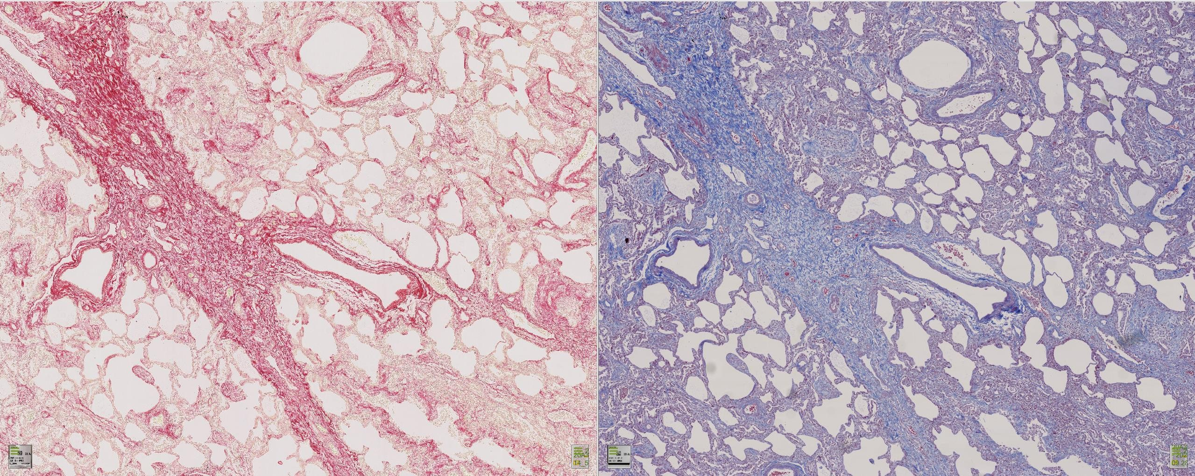
Background
Fast
Cheap
Reproducible
Two techniques to stain collagen fibers: Picrosirius Red (PSR) and Trichrome Blue (TCB)
Picro Sirius Red
Trichrome Blue
How to quantify collagen deposition?
Notes:
Male, 73 years old. Death due to COVID-19 severe ARDS, 12 days > ICU admission
(6 days of invasive mechanical ventilation)

Slide 5
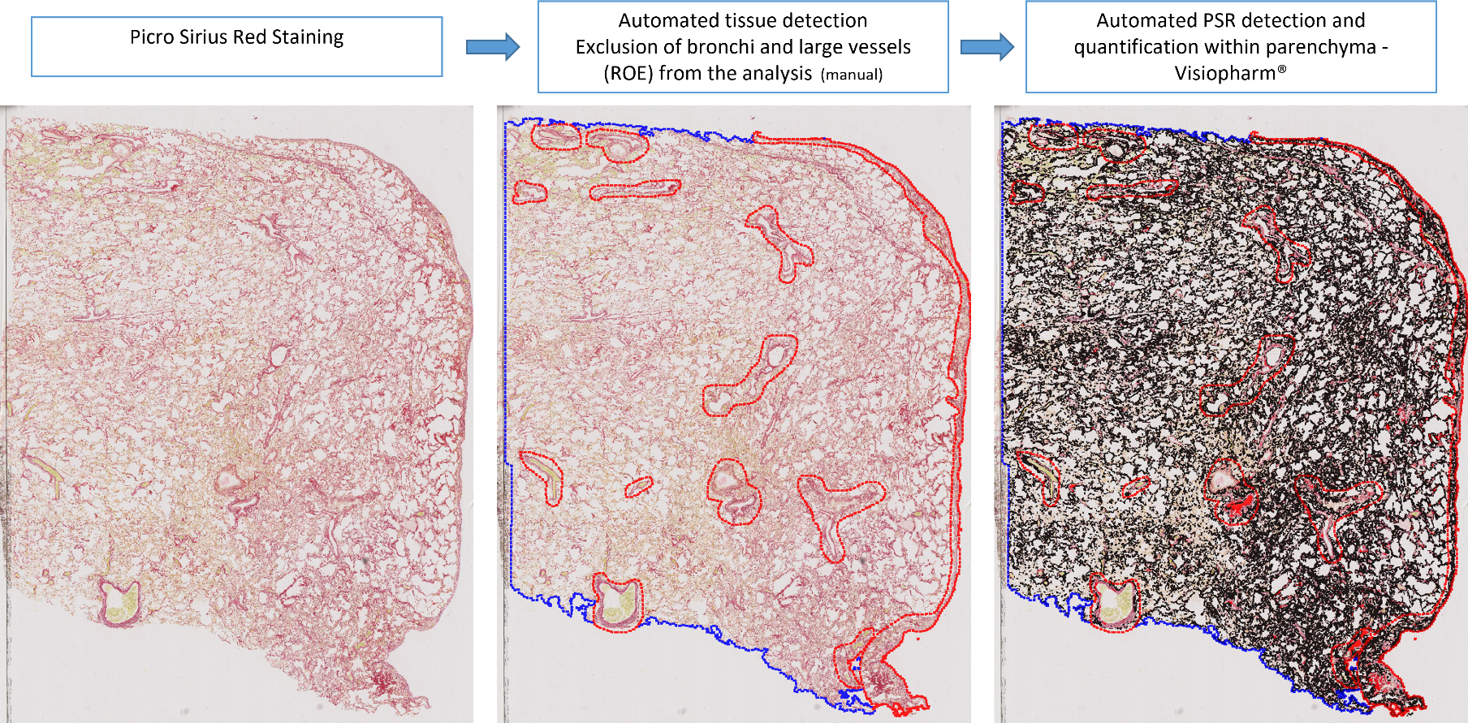
Background
Recently validated robust, operator independent, tissue transposable digital method for fibrosis quantification
Accessible material (paraffin sections)
Standard method (PSR)
Standard imaging system (brightfield scanner)
Advanced Image analysis software

Slide 6
PSR staining of lung parenchyma
Automated detection of PSR staining within parenchyma (treshold)
Quantification: positive area detected out of the area analyzed (expressed in %) and referred to as collagen proportionate area (CPA).

Slide 7
Background - Methods
PSR allows Morphological classification of fibers according to compactness
Optimized algorithm (noise substraction) – segmentation according to intensity of staining and pixel homogeneity (automated)
Strongly stained and plain segments = compact fibers (→ old)
Weakly stained and loose segments = scattered fibers (→ young)
Mainly validated in animal models…
No biological correlate for this morphological classification!
Courtoy et al, Biomolecules, 2020

Slide 8
Background: Automated Fibrosis quantification using PSR in the lung: clinical evidence
In IPF
3 explants from HPS
3 explants from IPF
4 biopsies from IPF
L. Tresta et al. Frontiers in Medicine 2021
Good correlation with
Ashcroft Score
Correlation with clinical parameters
«automated digital quantification provides accurate, reliable and reader-independent continuous measurements of fibrosis severity in entire lung tissue sections”
In COVID
Fibrosis highly heterogenous
Weak correlation with CT radiographic scores (good sensitivity but moderate specificity)
10 patients, 30 cryobiopsies
Comparison with CT-Scanner
L Ball et al. Int. J. Mol. Sci. 2021
Notes:
3 patients with HPS (explants), 3 patients with fibrosis (explants) and 4 patients with fibrosis (biopsies)
HPS is an autosomal recessive disorder characterized by improper biogenesis of lysosome-related organelles. Frequently associated with lung fibrosis. Highly prevalent in Puerto Rico.
Dans étude COVID, corrélation avec imagerie. Pas de groupe contrôle. Pas de lien avec paramètres cliniques.

Slide 9
Results
Patients deceased with COVID-related ARDS between March 19 and May 4, 2020
N=19
Patients diagnosed with ARDS based on ICD-9 coding between January 2007 and March 2020
N=875
COVID-related ARDS
COVID-unrelated ARDS
No autopsy performed
N=3
No biopsy performed
N=808
Patients with lung sample available for PSR quantification
N=16
Open Lung biopsy performed
N=67
Technical issues with PSR quantification
N=2
No sample available for PSR staining
N=11
Patients included in the analysis
N=14
Patients with sample available for PSR
N= 56
PaO2/FiO2 ratio > 120
N=43
Patients included in the analysis
N=13

Slide 10
Results
Comparison of lung samples from COVID-related ARDS (n=14, March→May 2020) with COVID-unrelated severe ARDS(n=13, 2007→2020) and controls (n=12, 2019)
 | Controls (n=12) | ARDS (n=13) | COVID (n=14)
Age, median (IQR), years | 57.5 (36-68) | 61 (50-78) | 60.5 (54-74)
Male, n (%) | 7 (58) | 6 (46) | 9 (64)
Body Mass Index (kg/m²), median (IQR) | 24 (21-27) | 25 (23-27) | 27 (24-31)
Hypertension, n (%) | 2 (16) | 2 (15) | 7 (50)
Diabetes, n (%) | 1 (8) | 2 (15) | 2 (14)
Active smoking, n (%) | 5 (42) | 2 (15) | 1 (7)
Chronic obstructive pulmonary disease, n (%) | 0 | 0 | 1 (7)
Other chronic respiratory disease, n (%) | 1 (8) | 0 | 0
Active neoplasia, n (%) | 12 (100) | 2 (15)* | 0*
APACHE II, median (IQR) |  | 15 (11-22) | 17 (10-20)
SOFA, median (IQR) |  | 5 (4-6.5) | 5.5 (4-9)
Cause of ARDS, n (%) COVID-19 Pneumonia Sepsis (of extra-pulmonary origin) Other |  | 0 5 (38.5) 1 (7.7) 7 (53.8) | 14 (100)& 0 0 0
Adjunctive treatments before tissue sample, n (%) Invasive mechanical ventilation Prone positioning Inhaled Nitric oxide NMBA ECMO Vasopressors Renal replacement therapy |  | 13 (100) 6 (46.2) 4 (30.8) 1 (7.7) 0 5 (38.5) 0 | 13 (93) 13 (93)& 13 (93)& 11 (79) & 3 (21) 13 (93) & 4 (28)&
 | Controls (n=12) | ARDS (n=13) | COVID (n=14)
Type of tissue sampling, n (%) Post mortem autopsy Open-Lung Biopsy Surgical lobectomy | 0 0 12 (100) | 0 13 (100)* 0 | 14 (100)*& 0 0
Diffuse alveolar damage on pathological examination, n (%) | 0 | 8 (61.5) | 13 (93)
PaO2/FIO2 ratio (day of sample), mmHg |  | 96 (79-104) | 73 (53-88)
PaCO2 (day of sample), mmHg |  | 55 (43-64) | 76 (61-86)&
PEEP (day of sample), cmH2O |  | 10 (9-12) | 12 (8-14)
Tidal volume (ml/kg PBW) |  | 6.6 (5.2-8.9) | 6.3 (5.3-6.7)
Duration between MV initiation and tissue sampling, median (IQR), days |  | 5 (1.5-11.5) | 13 (6-24)&
Day 28 mortality, n (%) |  | 6 (46.2) | 11 (79)&
Day 90 mortality, n (%) |  | 9 (69.2) | 14 (100)
ICU LOS, days |  | 16 (12-32) | 16.5 (9.5-26)

Slide 11
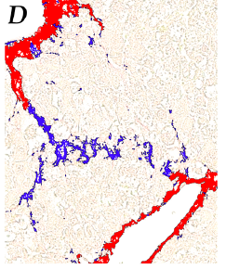
Results
« Compact » collagen fibers
All collagen Fibers
Stats: Mann-Whitney
Stats: Kruskall-Wallis
« Scattered » collagen fibers
Stats: Mann-Whitney
Stats: Kruskall-Wallis
Stats: Mann-Whitney
Stats: Kruskall-Wallis

Slide 12
Results
Correlation with disease severity - duration
Good correlation of CPA (scattered) with disease severity
No significant correlation of CPA with MV duration

Slide 13
Conclusions
PSR staining allows robust and reliable quantification of collagen deposition in human lung tissue and allows to distinguish between « compact » (old) and « scattered » (young) collagen fibers
Total CPA (all collagen fibers) increases in ARDS compared to controls
  No difference between COVID-related and COVID-unrelated ARDS
Dramatic increase of « scattered » (young) fibers in all ARDS patients, with no significant difference between COVID-related or -unrelated ARDS
Scattered fibers correlate with disease severity in all ARDS patients
  No correlation with disease/MV duration
Fibrosis in COVID-related ARDS does not seem accelerated or more extensive in comparison with COVID-unrelated ARDS

Slide 14
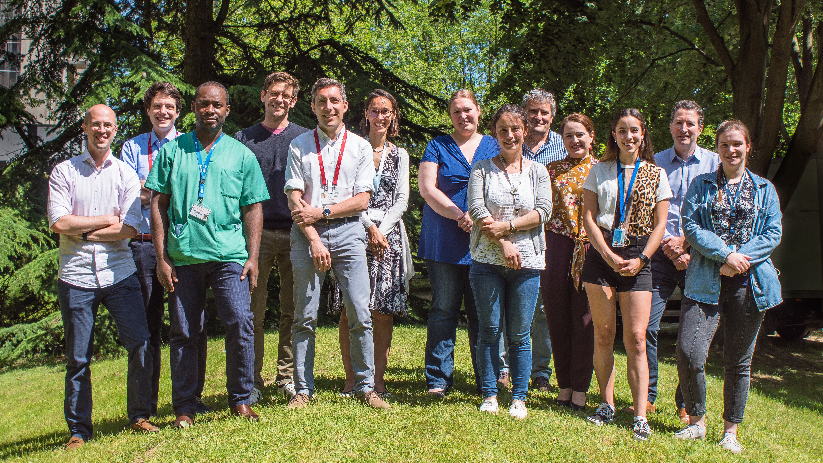

Acknowledgements
PNEU-IREC lab:
  C. Pilette, MD PhD
  A. Froidure, MD PhD
  S. Gohy, MD PhD
  F. Aboubakar, MD PhD
  F. Carlier, MD
  T. Plante Bordeneuve, MD
  B. Detry
2IP-IREC lab:
  Caroline Bouzin
  Guillaume Courtoy
CUSL – Pathology department
  Delphine Hoton
Fundings:
  Fondation Nationale pour la Recherche Scientifique

Slide 15
Perspectives
Biological significance of scattered fibers?
  Staining for Collagen I, III, Elastin and superposition with PSR → Coexpression?

Slide 16
All non-COVID ARDS
Non COVID ARDS with paO2/FiO2 < 120 mmHg

