Slide 1
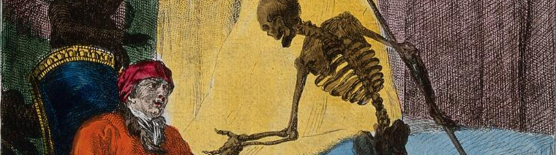



Suicides in Belgium from the 19th to the 20th century : a spatial analysis
Audrey Plavsic
PhD student DEMO - UCLouvain - Belgium

Slide 2
Research questions
Specific spatial distribution of suicide ?
Evolution over time ?
Men ≠ women ?
Effects of WW1 & WW2 ? Economic crisis ?

Slide 3
Literature on suicide risk factors
Men > Women
Age
Unemployment
Living alone : single > widow > divorced >>> married (+ children)
Urban > rural
War ▼
Economic crisis▲

Slide 4

Data collection & methods

Slide 5
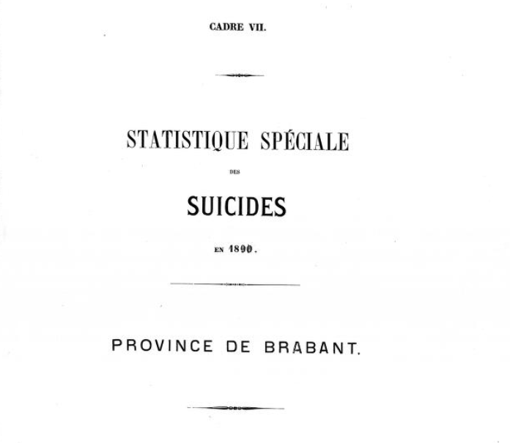

Slide 6
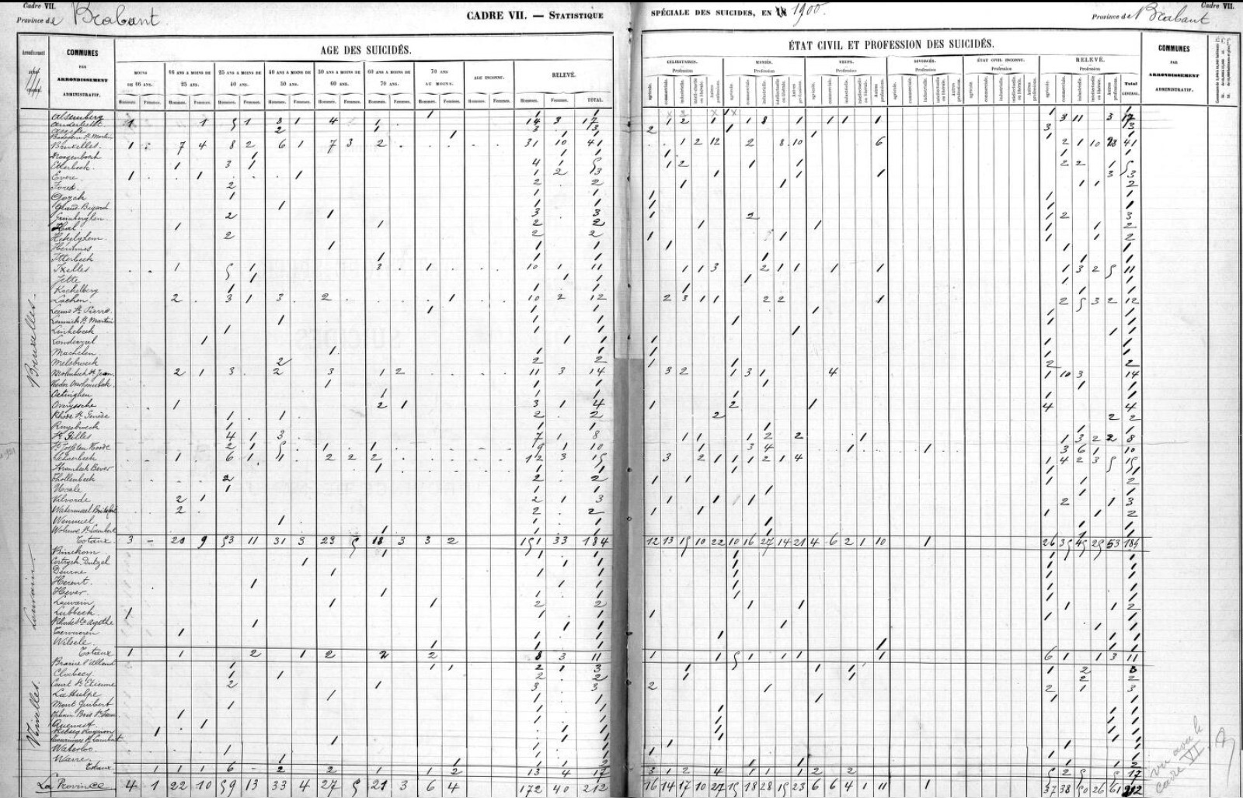

Slide 7
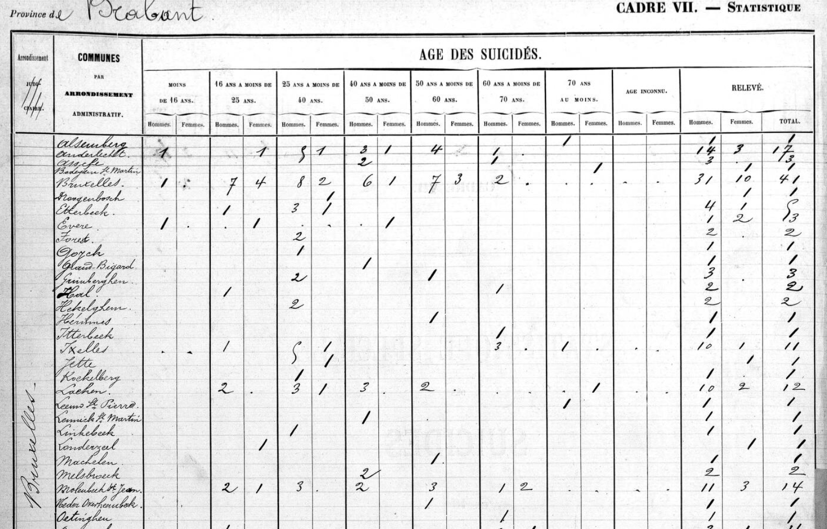

Slide 8
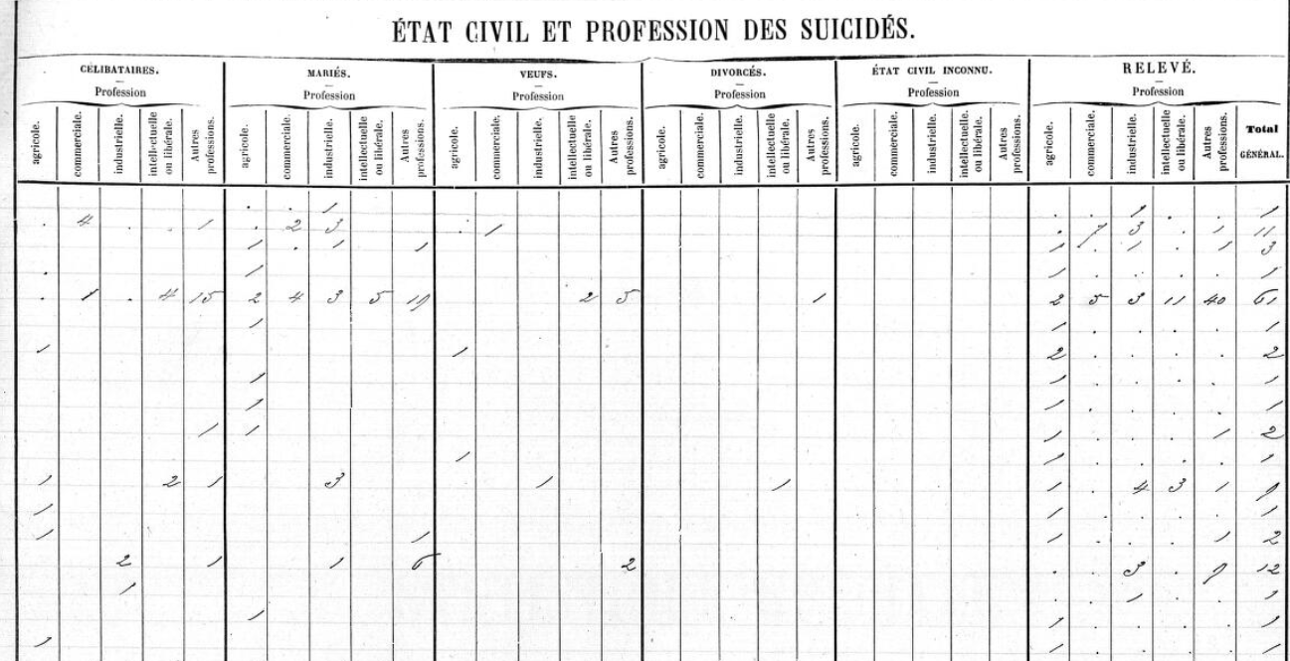

Slide 9
Method
Suicides by municipalities (2617 in 1900), aggregated by districts (41 in 1900) by age groups and sex
Districts population : censuses
  1890
  1900
  1910
  1920
  1930
  1947
Direct standardisation by age : population of Belgium in 1910, by sex
→ eliminates age structure effects

Slide 10
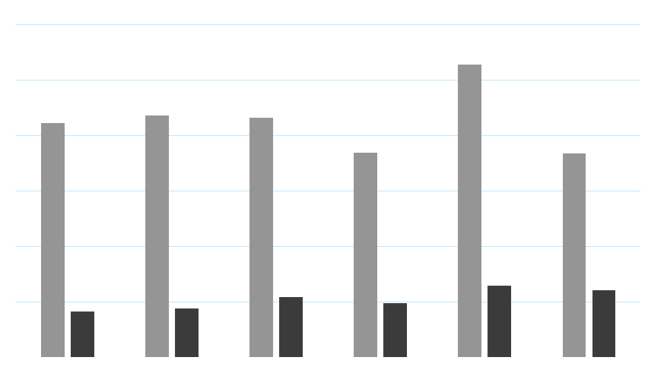
Descriptive statistics

Slide 11
Sample
29 years of data from 1888 to 1949
29.730 suicides in Belgium
23.368 men ( 79 % )
6.362 women ( 21 % )

Slide 12
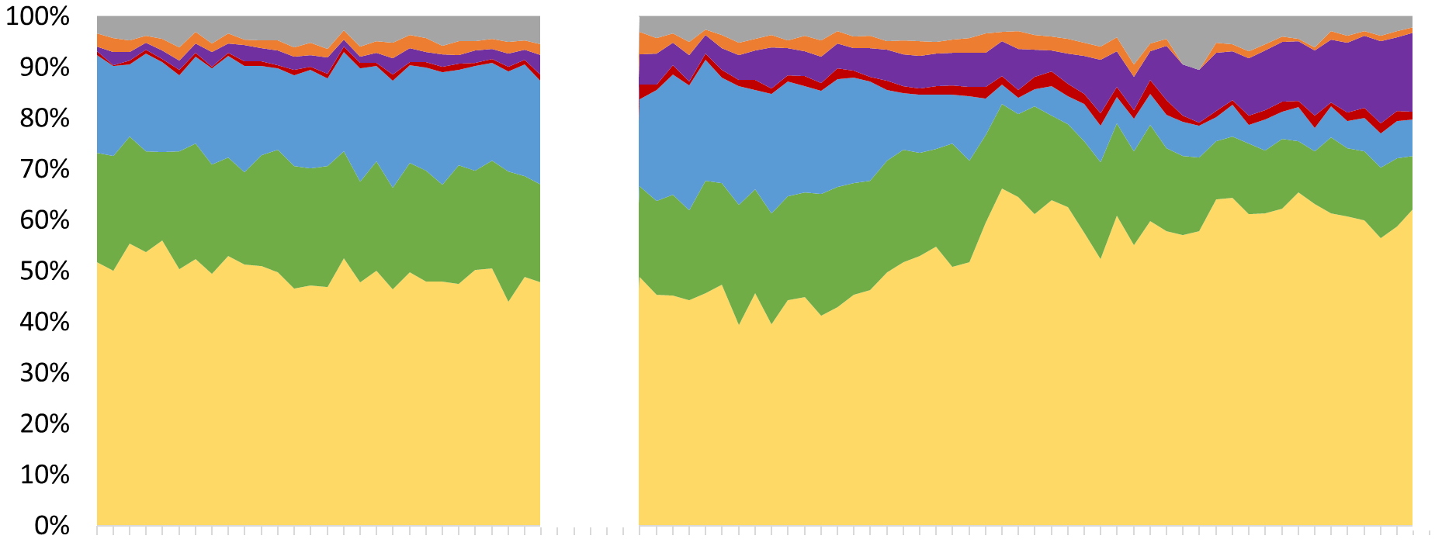
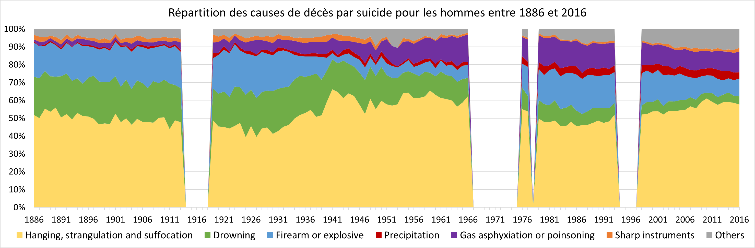
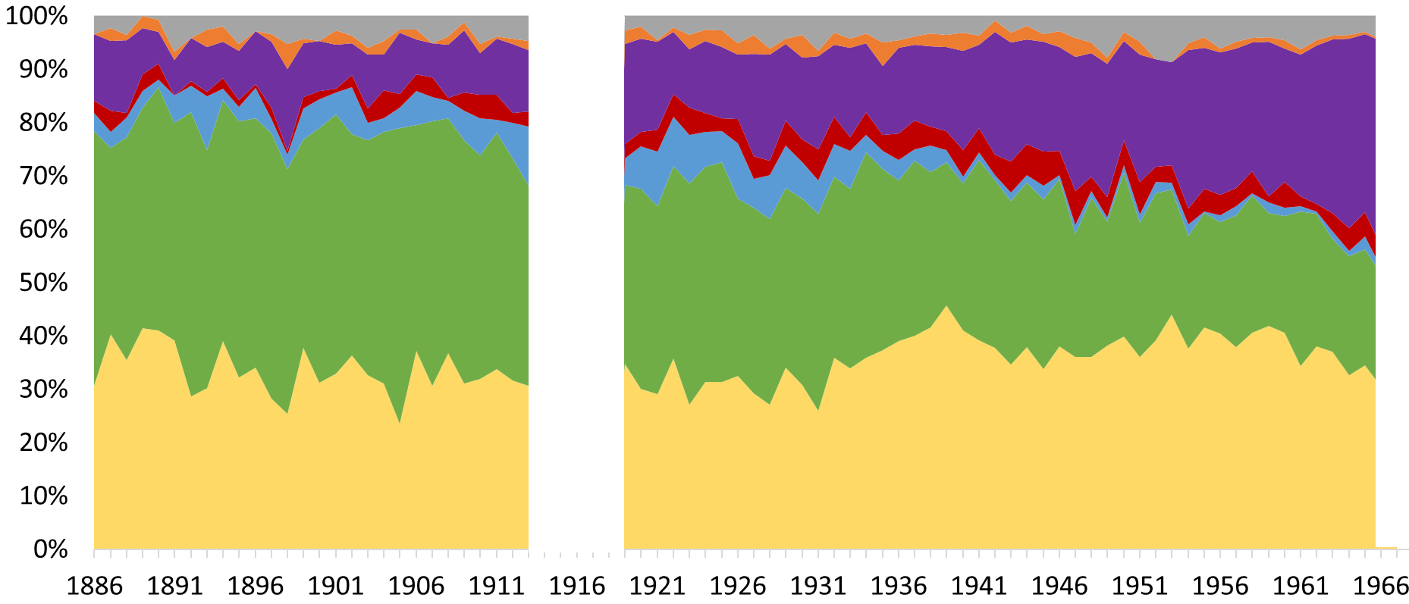
Distribution of suicides by cause in Belgium (1886-1966)
WOMEN MEN
(Plavsic & Van Cleemput, 2020)

Slide 13
Crude suicide mortality rates from 1886 to 1960 in Belgium (per 100.000 inhabitants)

Slide 14
Direct standardisation rates of suicides in Belgium for 100.000 inhabitants per year

Slide 15
Direct standardisation rates of suicides by age groups in Belgium for 100.000 men

Slide 16
Direct standardisation rates of suicides by age groups in Belgium for 100.000 women

Slide 17
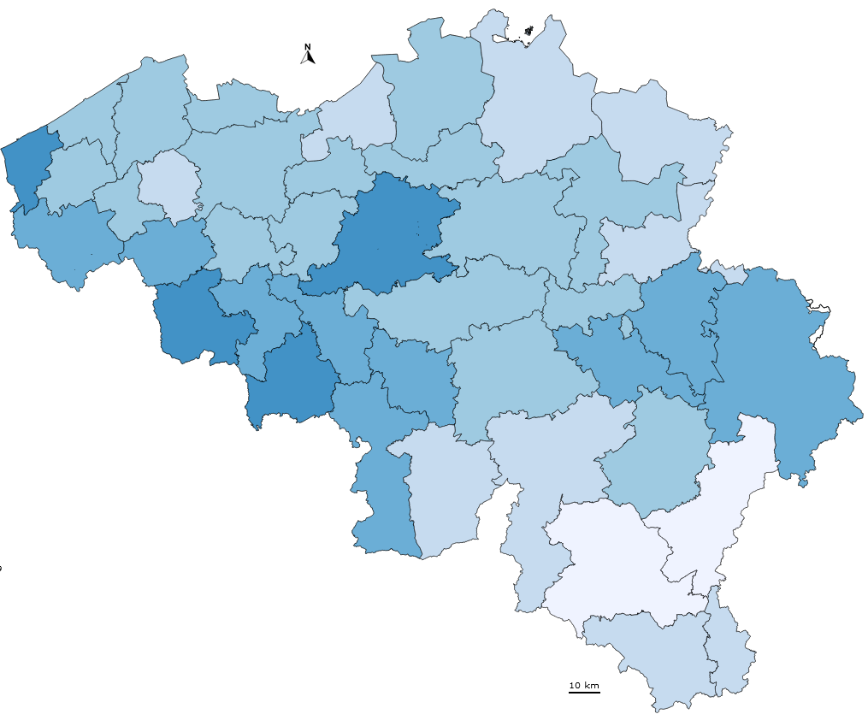
Spatial analysis

Slide 18
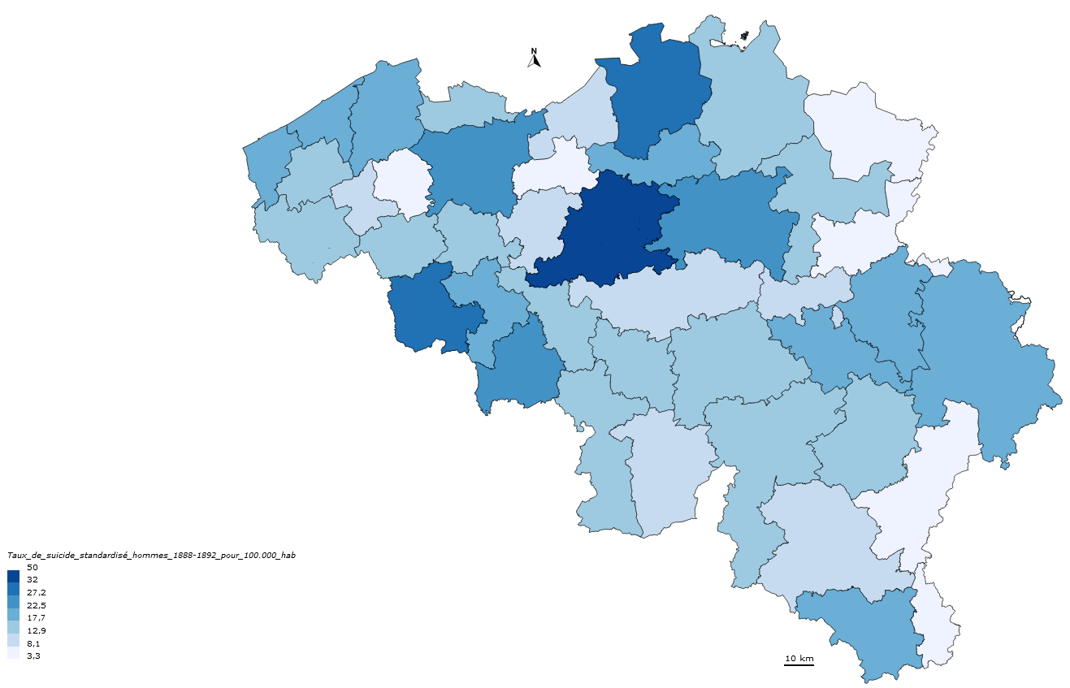

Suicides in Belgium : men
1888-1892
Standardized rates per year for 100.000 men

Slide 19
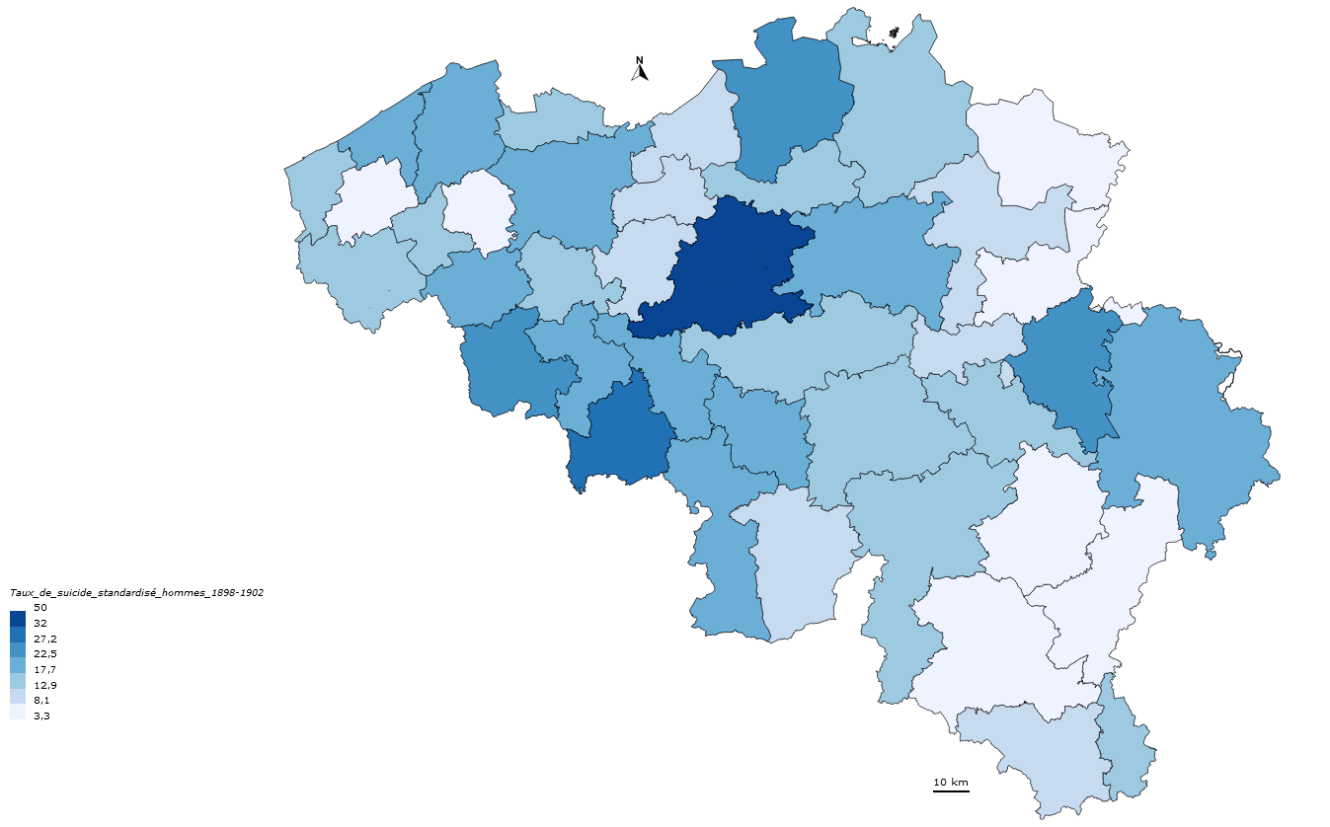
Standardized rates per year for 100.000 men
Suicides in Belgium : men
1898-1902

Slide 20
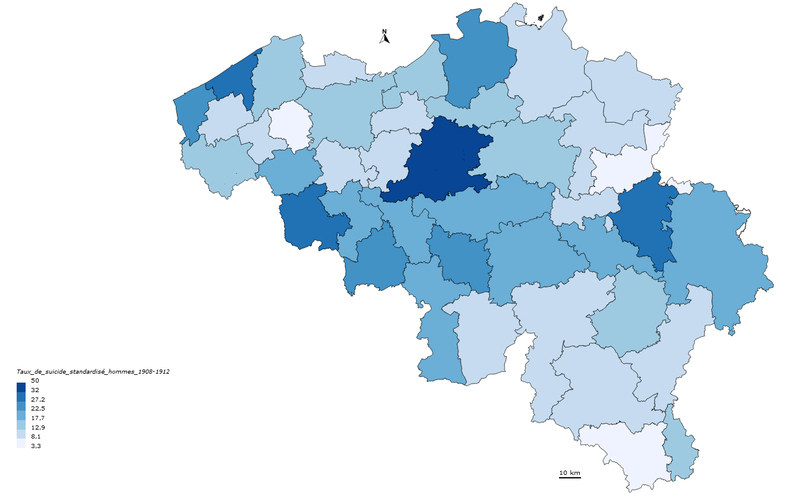
Standardized rates per year for 100.000 men
Suicides in Belgium : men
1908-1912

Slide 21
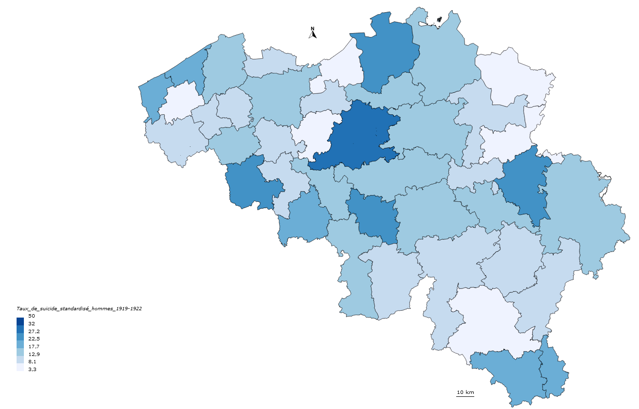
Standardized rates per year for 100.000 men
Suicides in Belgium : men
1919-1922

Slide 22
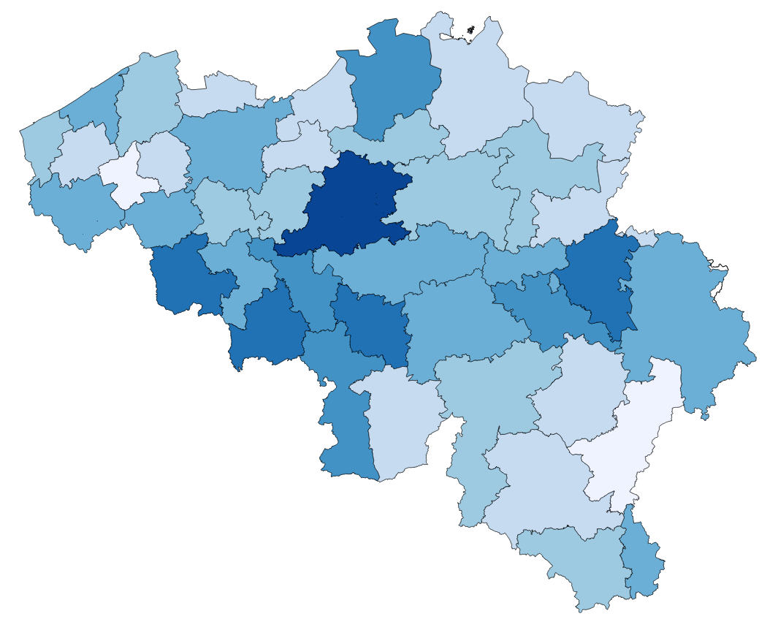
Standardized rates per year for 100.000 men
Suicides in Belgium : men
1928-1932

Slide 23
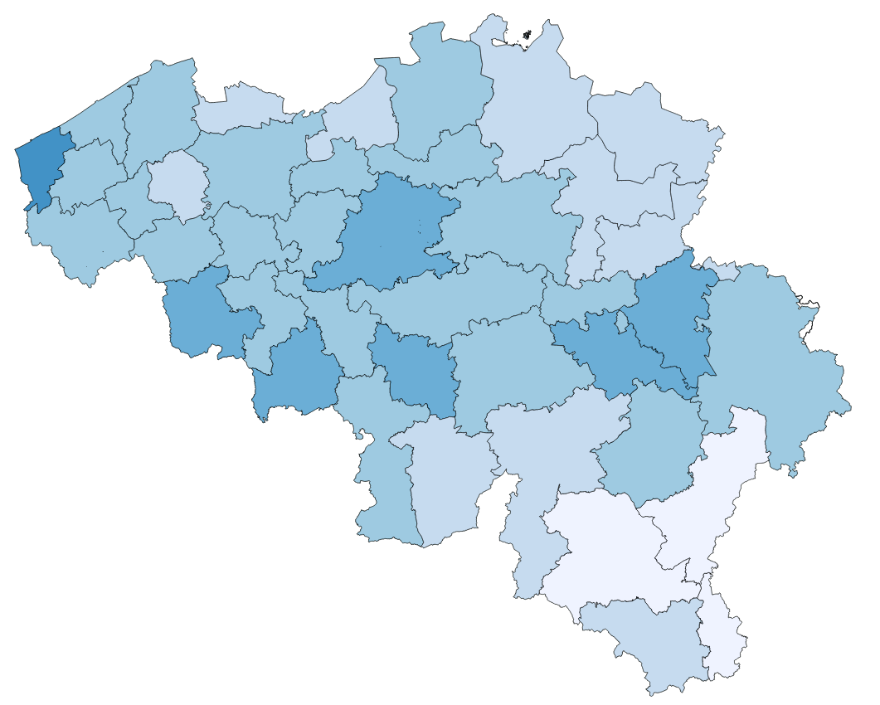
Standardized rates per year for 100.000 men
Suicides in Belgium : men
1945-1949

Slide 24
Standardized suicide rates per year for 100.000 men
1888-1892
1898-1902
1908-1912
1919-1922
1928-1932
1945-1949

Slide 25
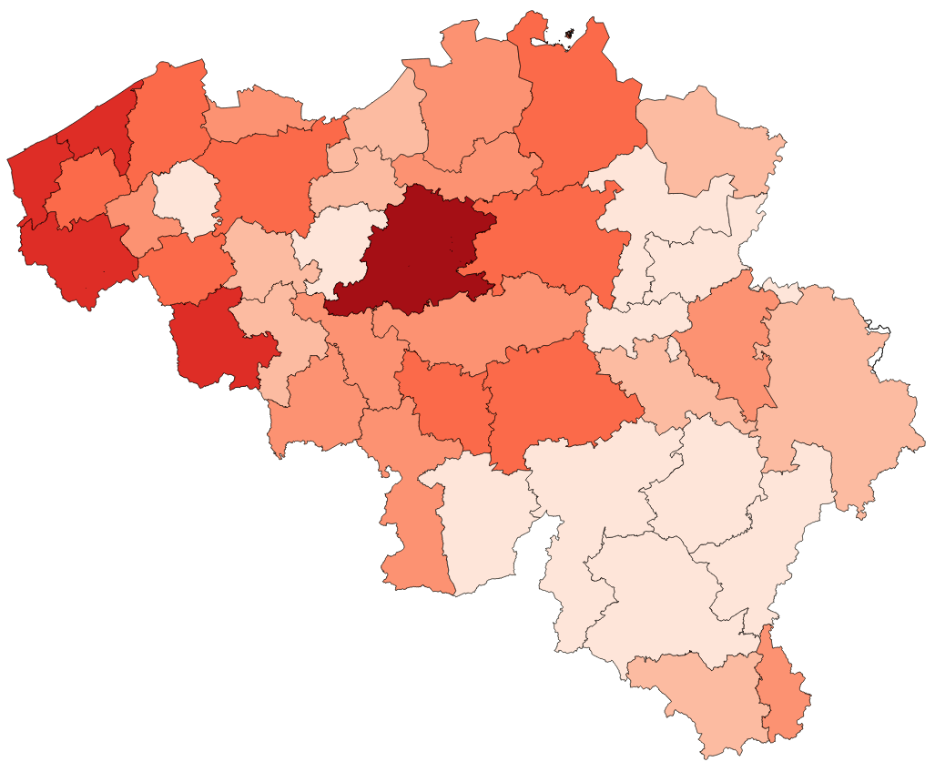

Standardized rates per year for 100.000 women
Suicides in Belgium : women
1888-1892

Slide 26
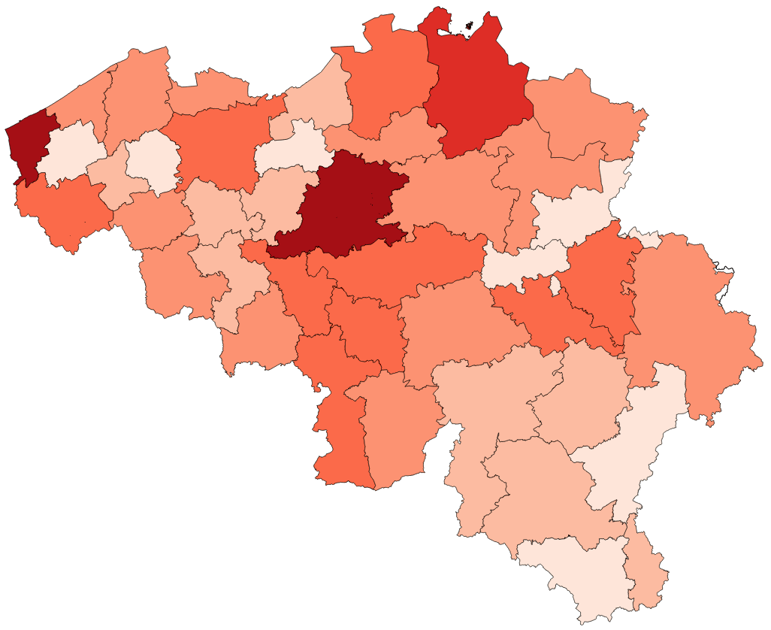
Standardized rates per year for 100.000 women
Suicides in Belgium : women
1898-1902

Slide 27
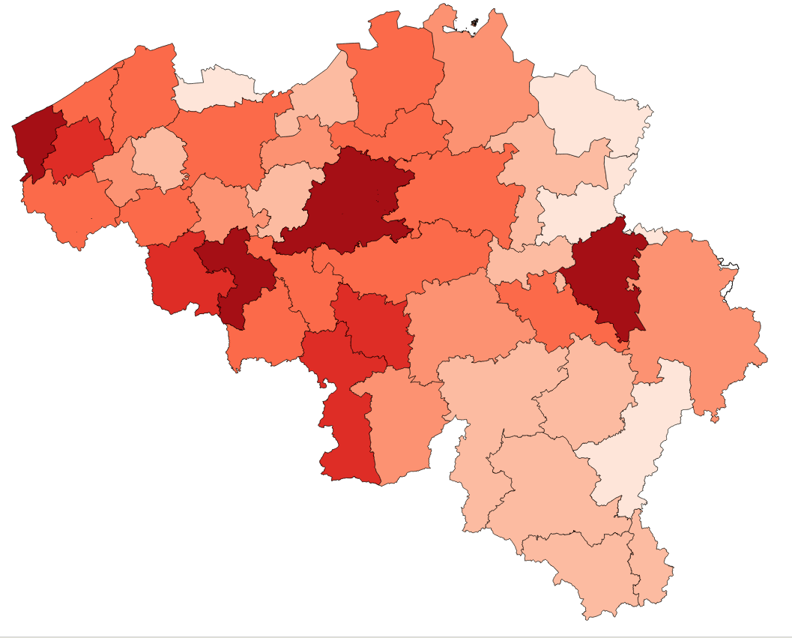
Standardized rates per year for 100.000 women
Suicides in Belgium : women
1908-1912

Slide 28
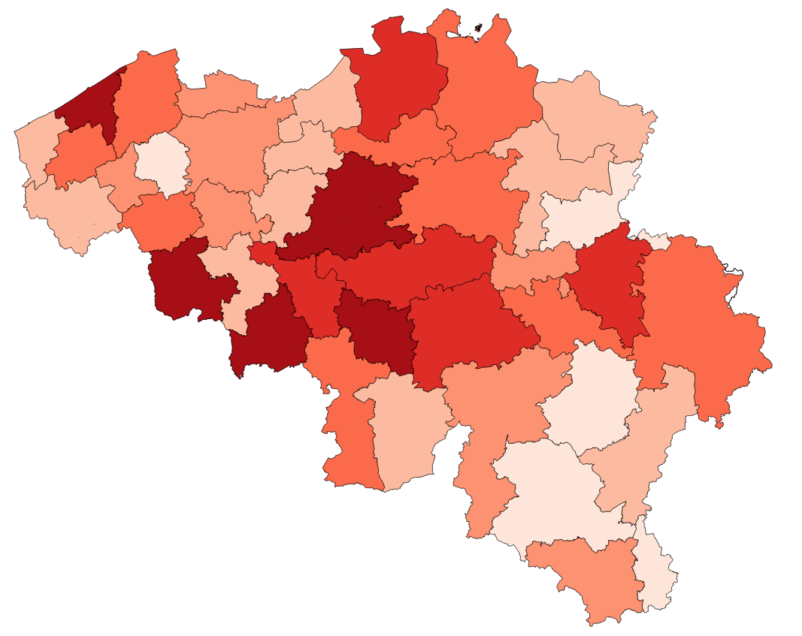
Standardized rates per year for 100.000 women
Suicides in Belgium : women
1919-1922

Slide 29
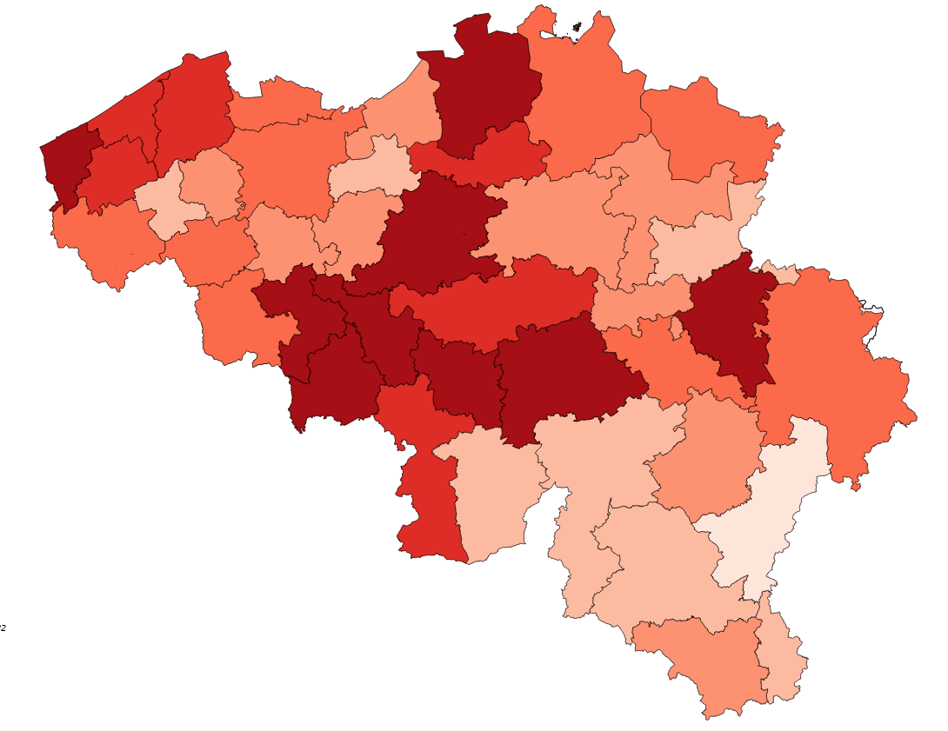
Standardized rates per year for 100.000 women
Suicides in Belgium : women
1928-1932

Slide 30
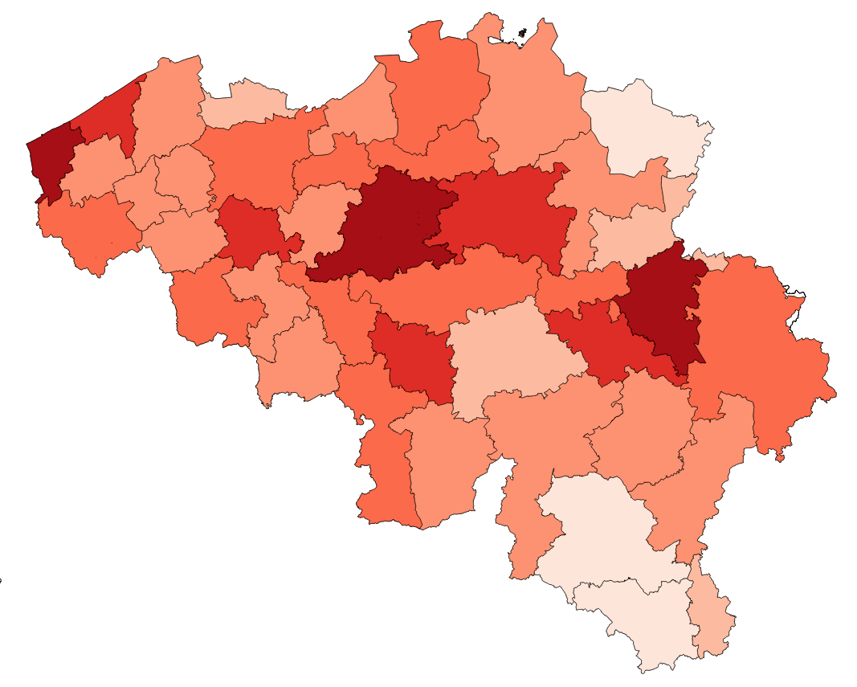
Standardized rates per year for 100.000 women
Suicides in Belgium : women
1945-1949

Slide 31
Standardized suicide rates per year for 100.000 women
1888-1892
1898-1902
1908-1912
1919-1922
1928-1932
1945-1949

Slide 32
To do
Analysis about profession and civil status

Slide 33
Difficulties:
- Differences in the profession categorisation
Suicides:
- Agricole
- Commerciale
- Industrielle
- Intellectuelle ou libérale
- Autres professions
Census:
- Agriculture et forêts
- Pêche
- Industrie
- Commerce
- Professions libérales
- Fonctions et emplois dépendants de l’Etat
- Service de la maison, des biens et des personnes
- Professions insuffisamment déterminées

Slide 34
Difficulties:
- Differences in the profession categorisation
Suicides:
- Agricole
- Commerciale
- Industrielle
- Intellectuelle ou libérale
- Autres professions
Census:
- Agriculture et forêts
- Pêche
- Industrie
- Commerce
- Professions libérales
- Fonctions et emplois dépendants de l’Etat
- Service de la maison, des biens et des personnes
- Professions insuffisamment déterminées
- Definition of categories: aidants?
- Women

Slide 37
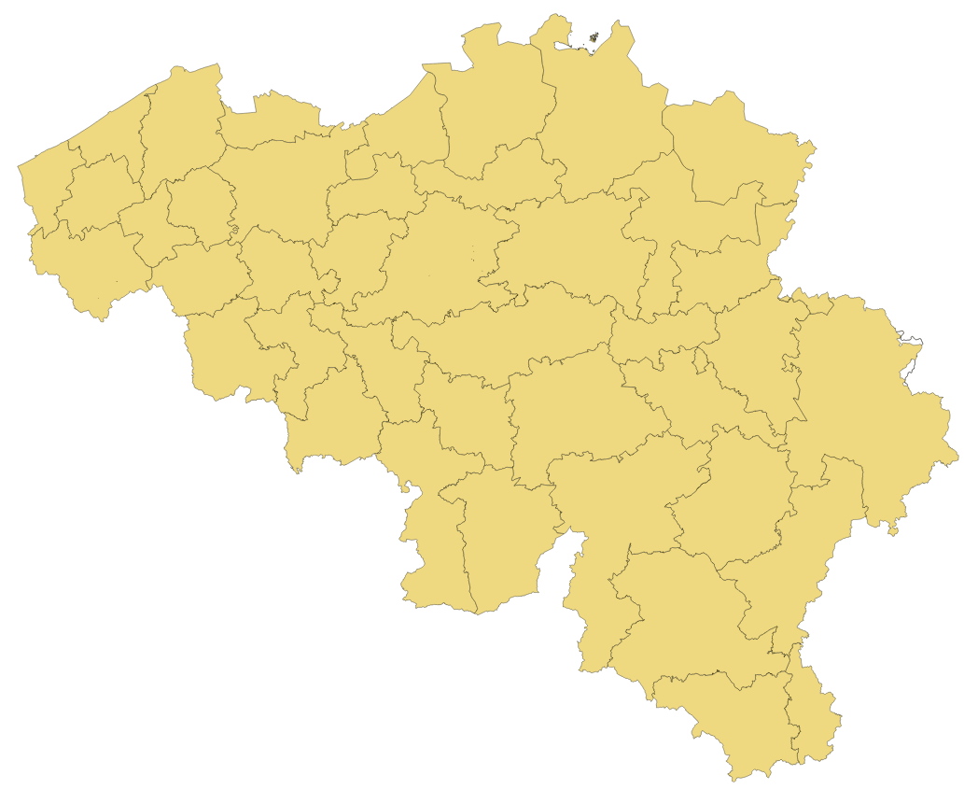
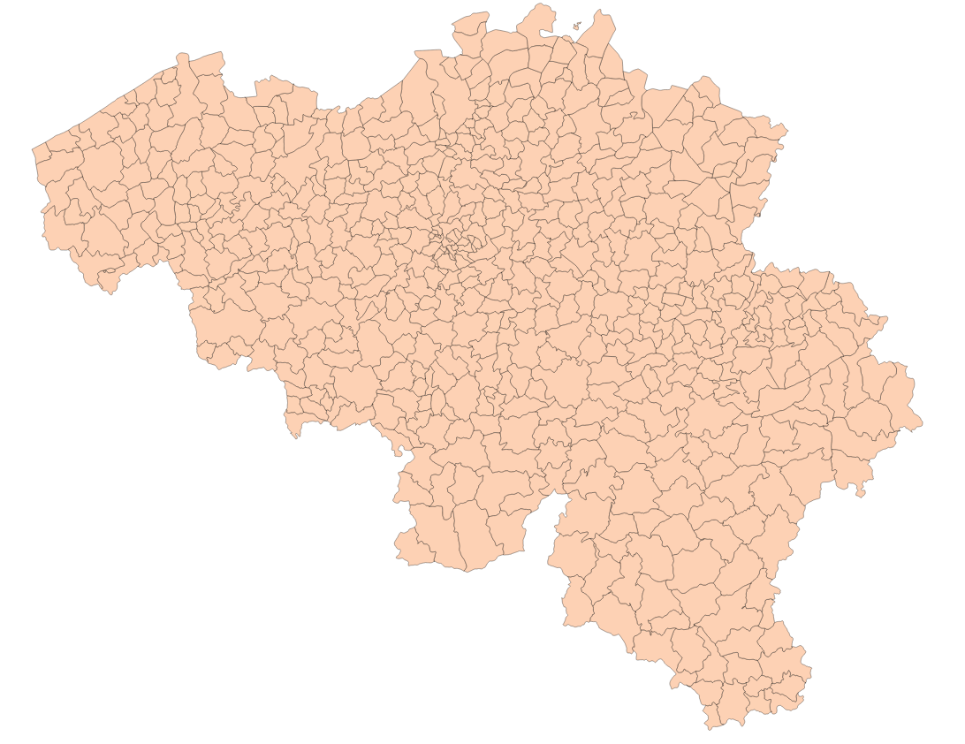
To do
Analysis about profession and civil status
Get population statistics at the municipality level to make more precise maps

Slide 38
To do
Analysis about profession and civil status
Get population statistics at the municipality level to make more precise maps
Spatial analysis
Use individual data from some municipalities

Slide 39
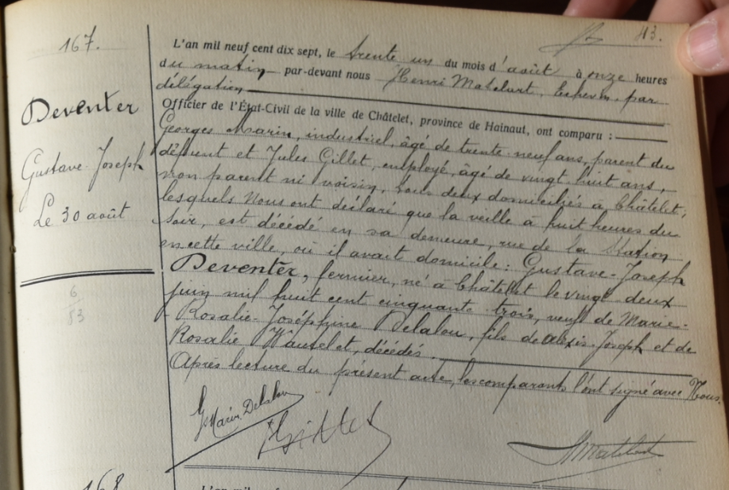
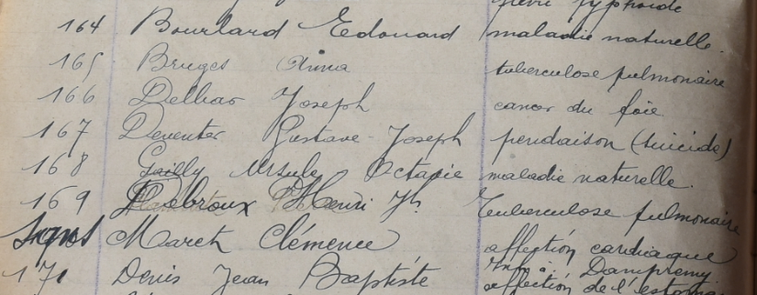

Slide 40
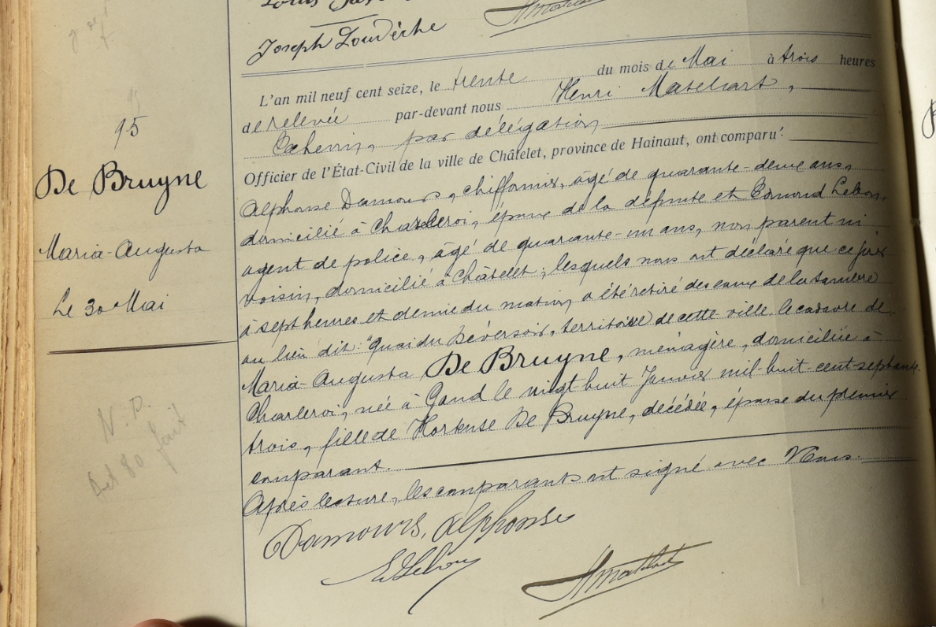
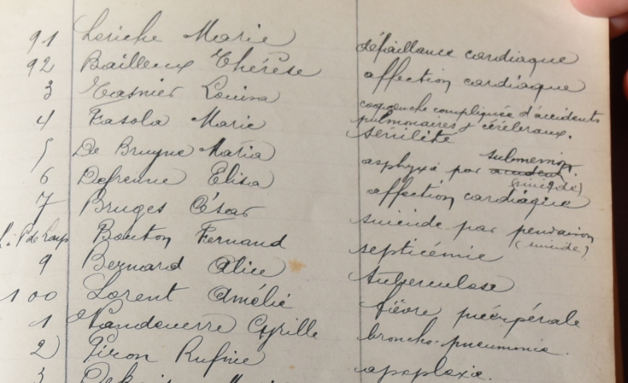

Slide 41
To do
Analysis about profession and civil status
Get population statistics at the municipality level to make more precise maps
Spatial analysis
Use individual data from some municipalities

Slide 42

audrey.plavsic@uclouvain.be

