Slide 1
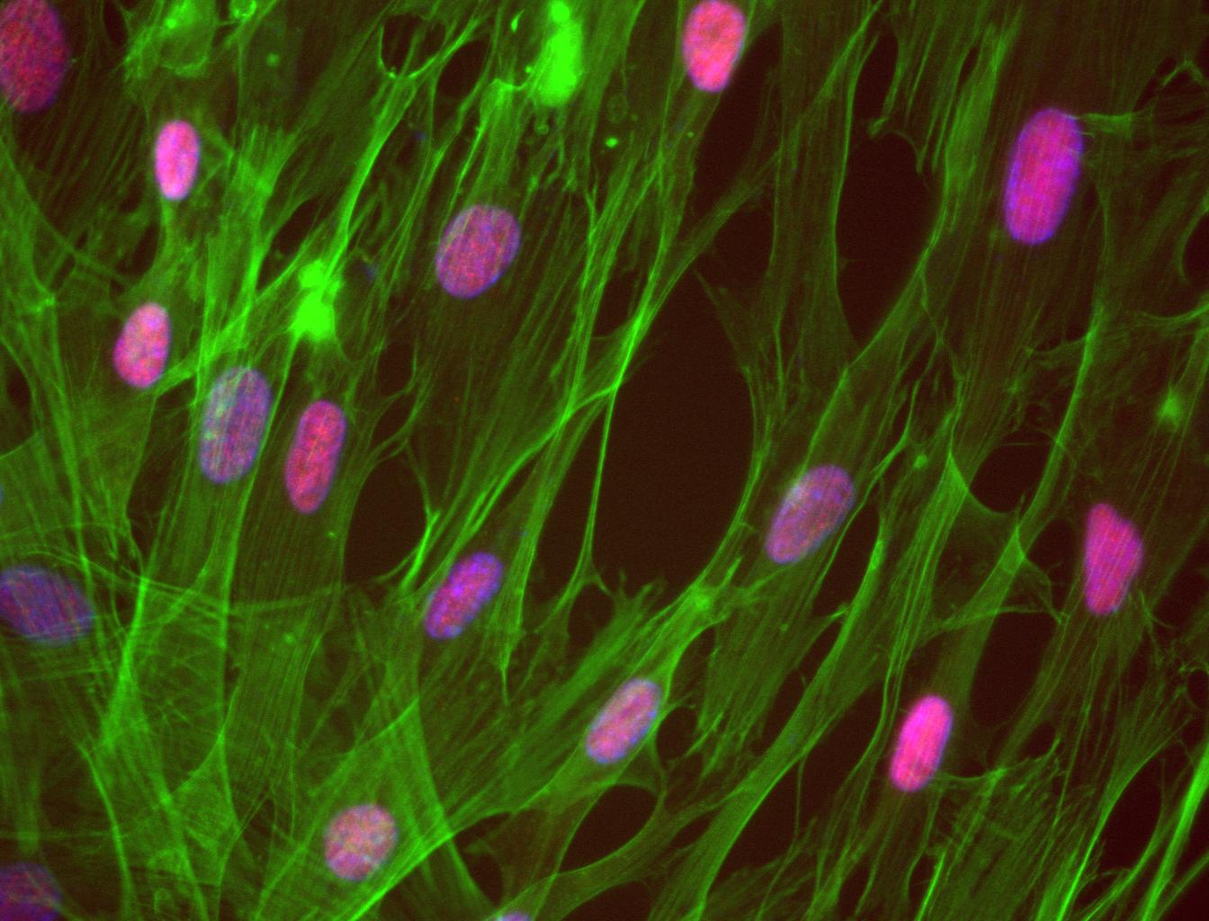




Mesenchymal transcription factor PRRX1
A master regulator of IPF fibroblasts
Antoine Froidure, MD, PhD
INSERM U1152 – Team 3
ICLAF, Dublin, September 26th 2016

Slide 2
Disclosure statement
I have no conflict of interest
to disclose in relation with the presented work.
I have been supported by
a joint ERS/EMBO long-term research fellowship.

Slide 3
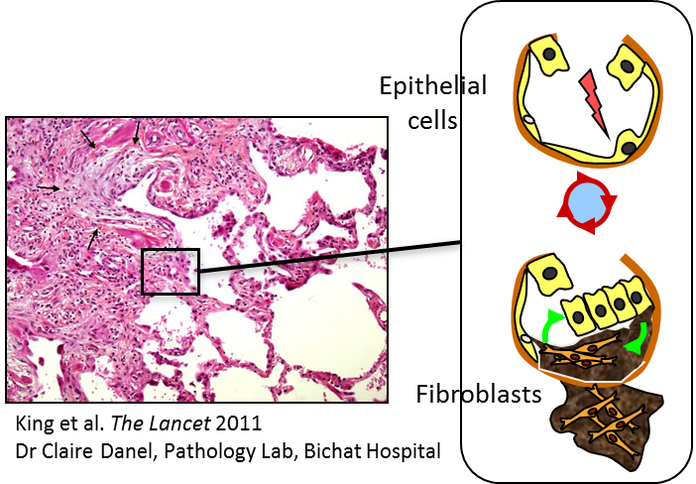
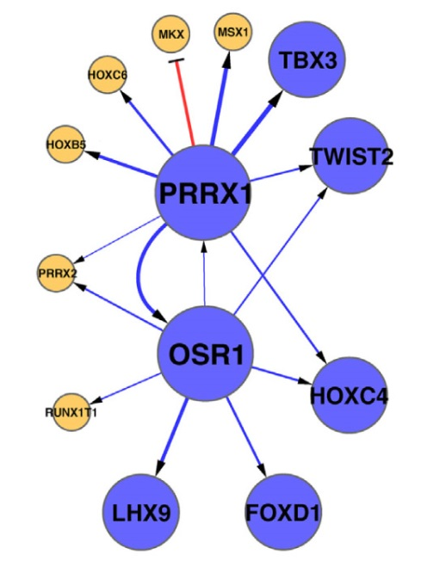
PRRX1 and idiopathic pulmonary fibrosis (IPF)
Background
Aim and hypothesis
Results
Perspectives
PRRX1 stands at the center
of a transcriptional network
regulating fibroblast phenotype
In silico data mining
PRRX1 mRNA is overexpressed in IPF lungs
(NCBI GeodataSet GSE412301)
PRRX1 expression is linked to « rapid progressors » (Selman et al. Plos One 2007)
Tumaru et al. Nucleic Acids Res 2014

Slide 4
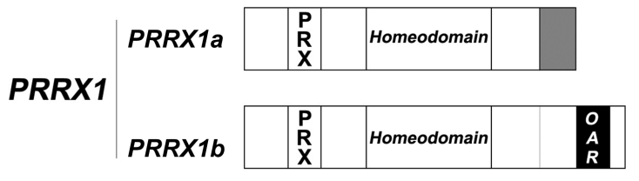
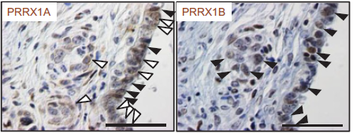
Paired-related homeobox proteins (PRRX) 1
Background
Aim and hypothesis
Results
Conclusions
PRRX1 gene encodes for PRRX1a and PRRX1b
PRRX1 transcription factors are involved in mesenchymal cell fate during development
  Prrx1^{-/-} mice: Hypoplastic lungs and vascular defects (Ihida-Stansbury et al. Circ Res 2004)
Aberrant PRRX1 expression in cancer is linked to cell migration and EMT
Pancreatic adenocarcinoma,
Takano et al. Genes Dev 2016

Slide 5
Hypothesis
Background
Aim and hypothesis
Results
Conclusions
PRRX1 is implicated in IPF development and progression
PRRX1 modulates fibroblast phenotype in IPF
Objectives
To confirm PRRX1 expression in IPF lung samples
(slices, homogenates and fibroblast biobank)
To study PRRX1 effect on fibroblast phenotype and function (loss/gain of function experiments)
To decipher PRRX1 regulation by microenvironment
(in vitro stimulations)

Slide 6
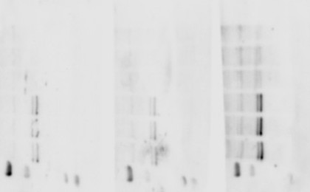
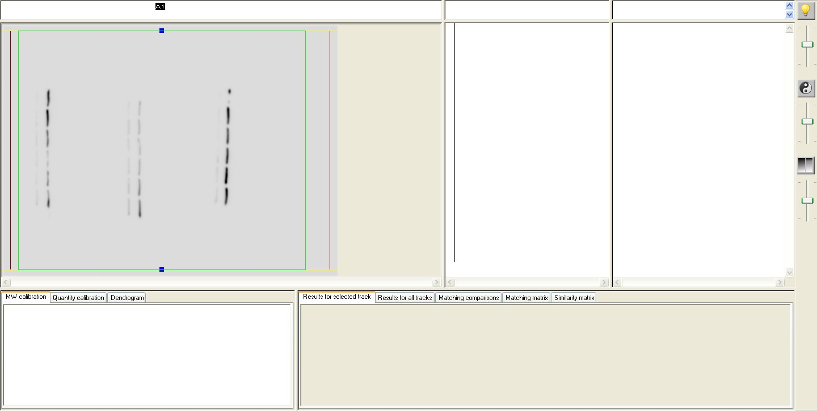
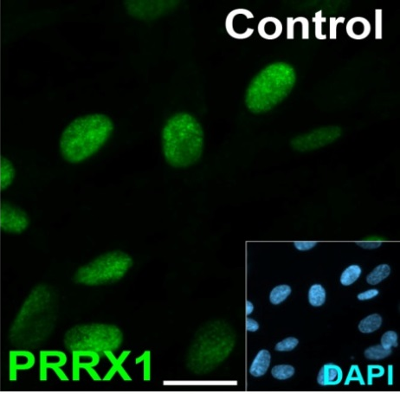

PRRX1 expression in IPF lung and fibroblasts
Background
Aim and hypothesis
Results
Conclusions
Human lung homogenates and slices
Primary human lung fibroblasts
Control
IPF
PRRX1
(27 kDa)
1b
1a
GAPDH
(37 kDa)
Control
IPF
PRRX1
PRRX1
Notes:
Ajouter fibros and lung + quantification

Slide 7
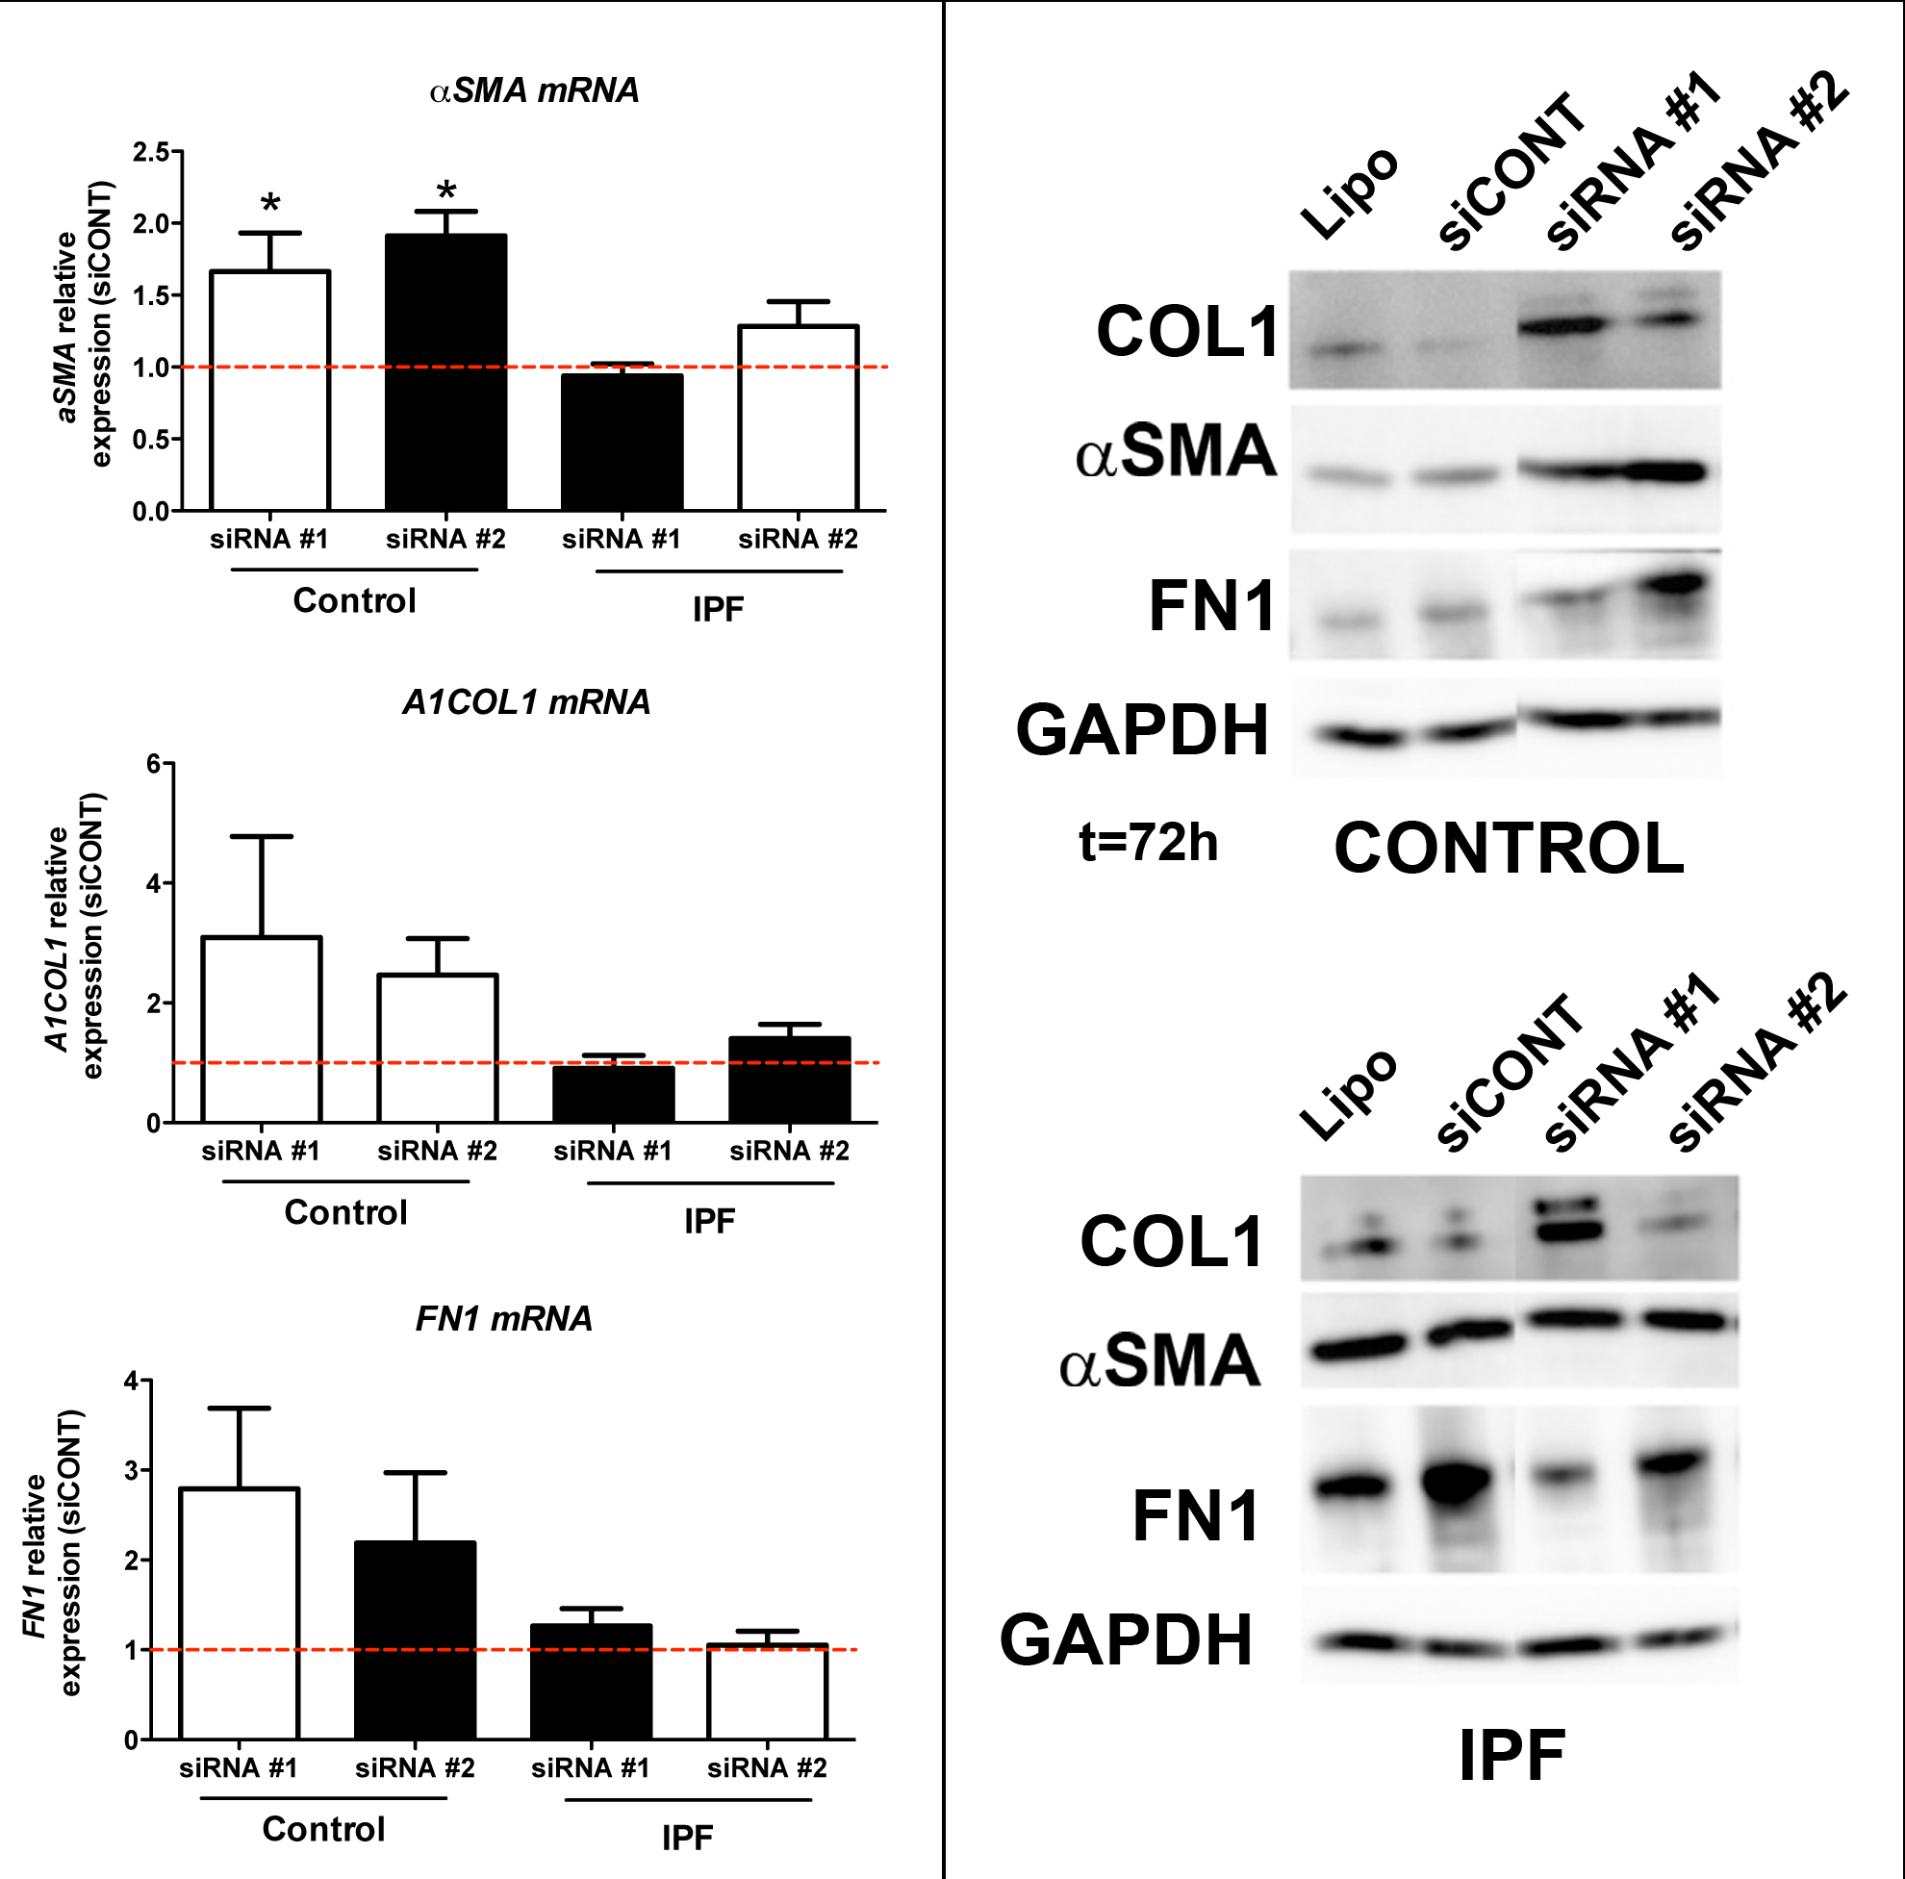
PRRX1 modulates fibroblast differentiation
Background
Aim and hypothesis
Results
Conclusions
Control lung fibroblasts

Slide 8
PRRX1 does not affect IPF fibroblast differentiation
Background
Aim and hypothesis
Results
Conclusions
IPF lung fibroblasts

Slide 9
PRRX1 promotes fibroblast survival
Background
Aim and hypothesis
Results
Conclusions
Serum starvation
h -24
h0
h24
h48
h72
Seeding (200k cells)
Transfection
Cell count
Control lung fibroblasts
IPF lung fibroblasts

Slide 10
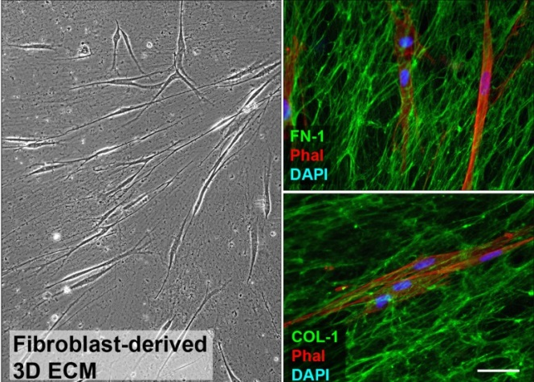
Is PRRX1 expression modulated by extracellular matrix?
Background
Aim and hypothesis
Results
Conclusions
Fibroblast culture (C/IPF)
on 2% gelatin coating
Matrix
seeding with control fibroblast
8 days
Cell lysis
2 days
PRRX1 mRNA
+ Imatinib 10 µg/mL
+ PDGFR Inhib V 10 nM
Castelló-Cros R et al. Methods Mol Biol 2009
Ball et al. Stem Cells 2012

Slide 11
PRRX1 is induced by IPF fibroblast-derived matrix
Background
Aim and hypothesis
Results
Conclusions

Slide 12
PRRX1 induction by matrix is PDGF-dependent
Background
Aim and hypothesis
Results
Conclusions

Slide 13
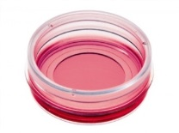
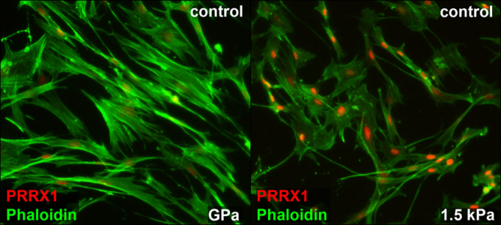
PRRX1 is modulated by matrix stiffness
Background
Aim and hypothesis
Results
Conclusions
Elastic Modulus
2 Gpa 28 kPa 1.5 kPa
Plastic IPF lung Control lung
Fibronectin-1
coating
Variable EM (1.5, 28 or 2.10⁶ kPa)

Slide 14
PRRX1 is modulated by Rho/ROCK and PGE2
Background
Aim and hypothesis
Results
Conclusions
Zhou et al. J Clin Invest 2013
Liu et al. J Cell Biol 2010
2 Gpa Elastic modulus 1.5 kPa
Rho/ROCK
PTGS2
(COX2)
+ Fasudil 35 µM
+ NS398 10 µM

Slide 15
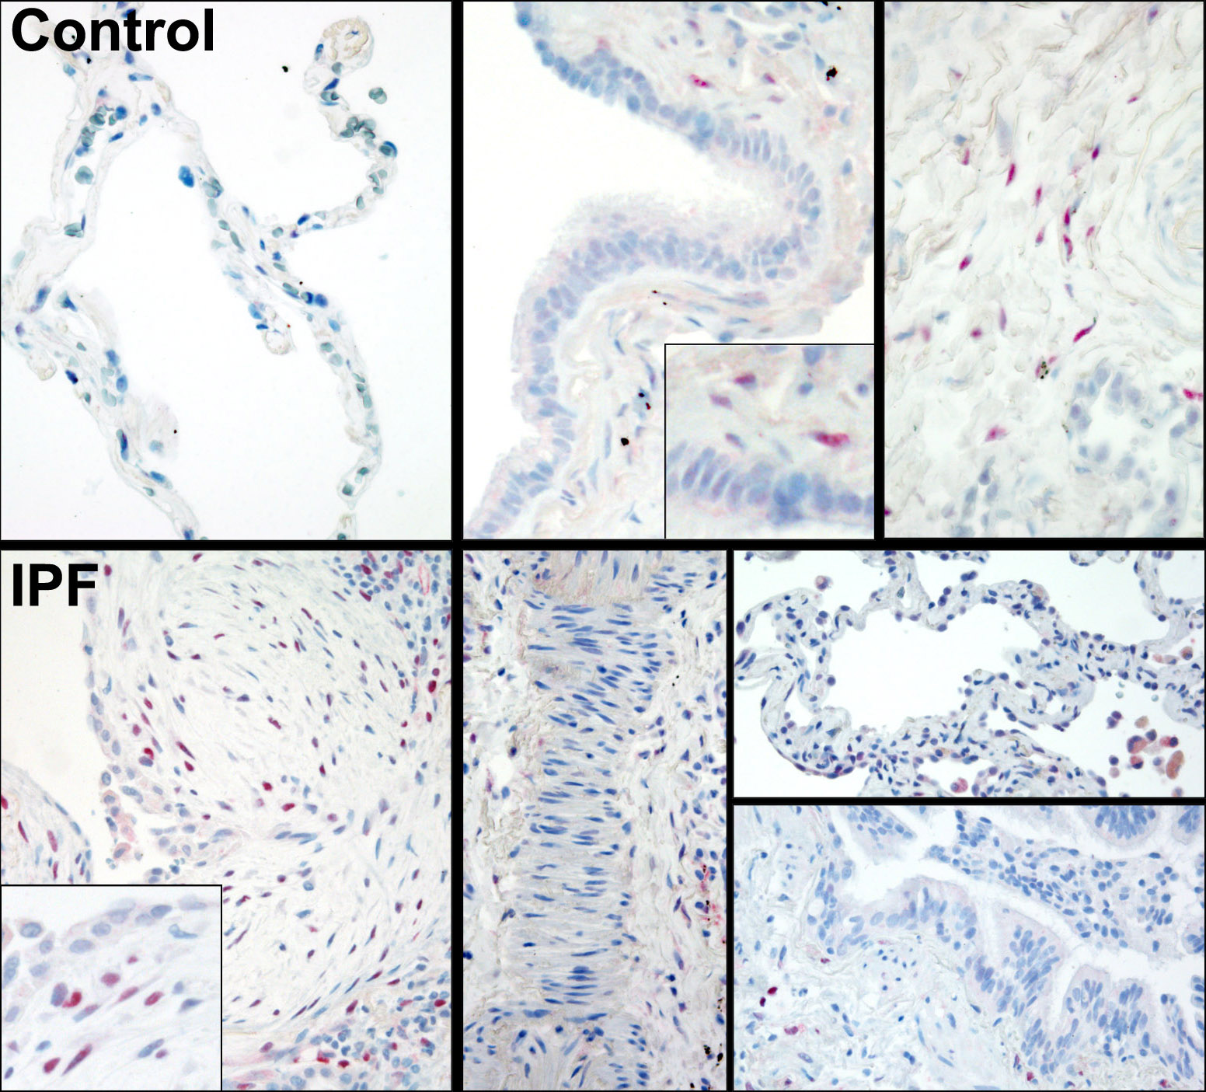
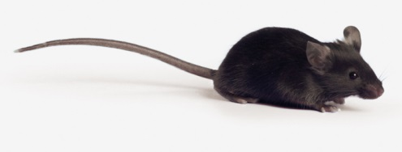
Conclusions: overview on PRRX1 in lung fibroblasts
Background
Aim and hypothesis
Results
Conclusions
IPF ECM-associated growth factors
PDGF
PTGS2
PRRX1
Rho/ROCK
Substrate
stiffness
IPF
Fibroblast focus
Myofibroblastic
Differentiation
Survival
Perspectives: In vivo experiments on PRRX1 are ongoing.

Slide 16
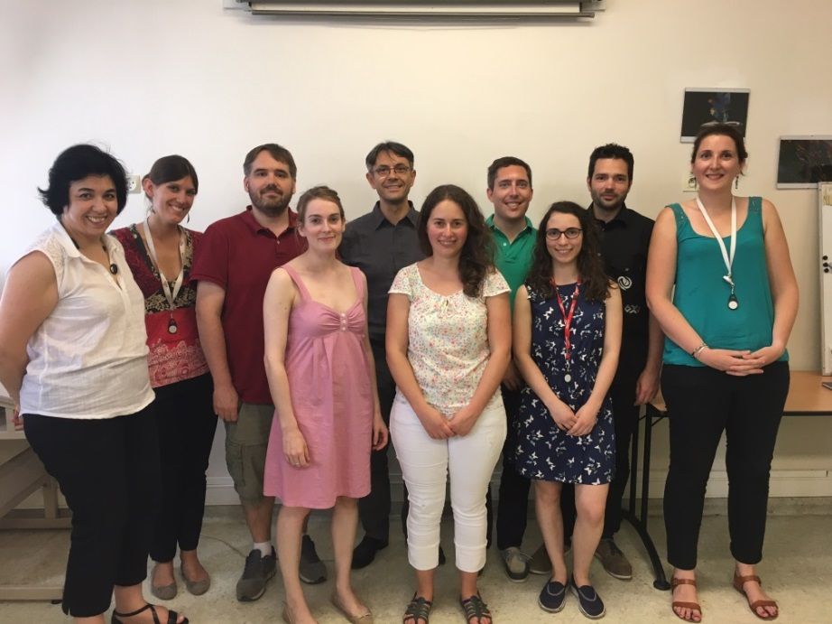







Inserm U1152 – Team 3
«Inflammation and lung fibrogenesis»
Prof. Bruno Crestani
PRRX1 project:
Dr A. Mailleux
Dr A. Froidure
E. Marchal-Duval
M. Jaillet
M. Ghanem
Dr L. Giersh
Dr A. Joannes
Bichat-Claude Bernard Hospital
Chirurgie thoracique:
Prof. Y. Castier
Dr P. Mordant
Anatomopathologie:
Dr C. Danel
Dr A. Cazes
Pneumologie A:
Prof. B. Crestani
Prof. M. Aubier
Dr M-C Dombret
Pneumologie B:
Prof. H. Mal
Dr M. Garnier
Dr M. Dehoux
Dr C. Quesnel
Dr R. Borie
Dr A. Justet
Dr J. W. Duitman
A. Menou
P. Flajolet
S. Moog

