Slide 1

Zero-Tillage Soil
Pore Architecture &
Atrazine Efficacy
Luke Wardak

Slide 2
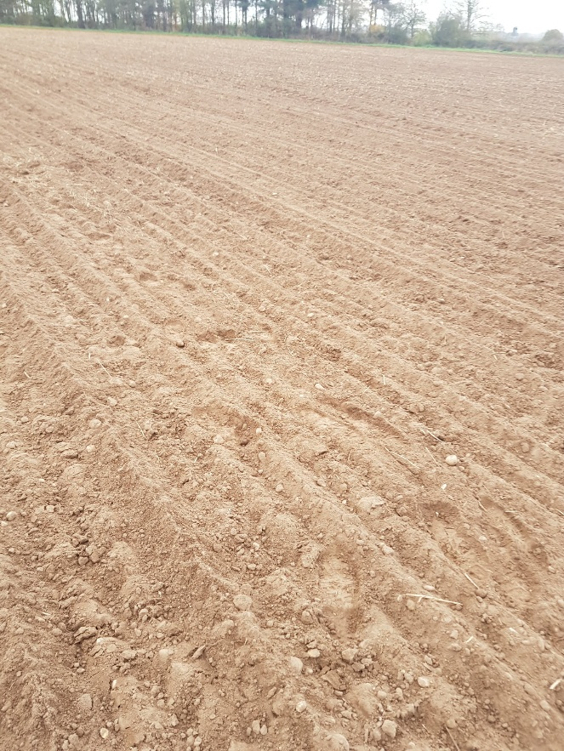
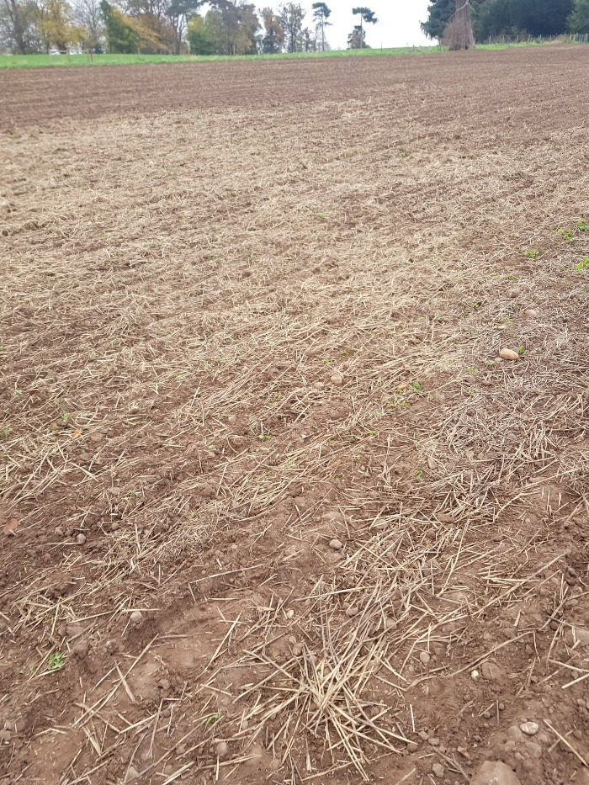
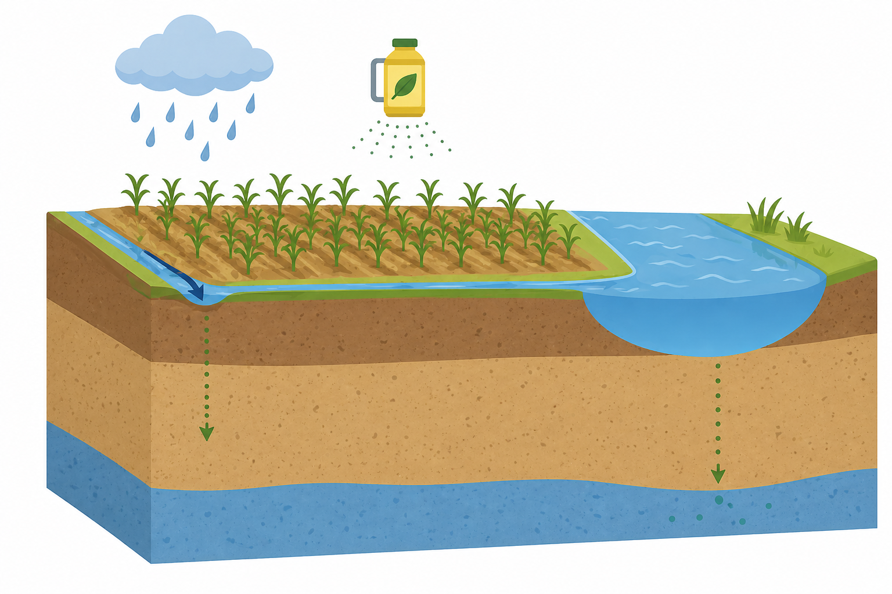
Why zero-tillage (ZT) research?
Ploughing
Zero-tillage lack of mechanical weed control
Reliance on herbicides
Evidence to suggest agrochemicals work differently when using conservation approaches
To understand transport dynamics, pore structure is key
Zero-tillage
Runoff
Leaching
Notes:
Promote soil health by preventing disturbance
No mechanical means of controlling weed pressure
Agrochemicals perform differently on ZT soils
We thought - Pore architecture

Slide 3
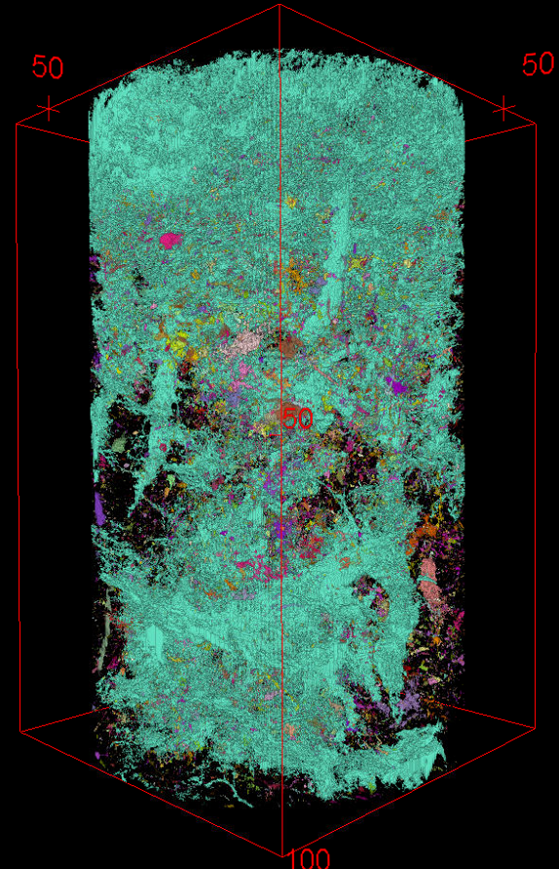
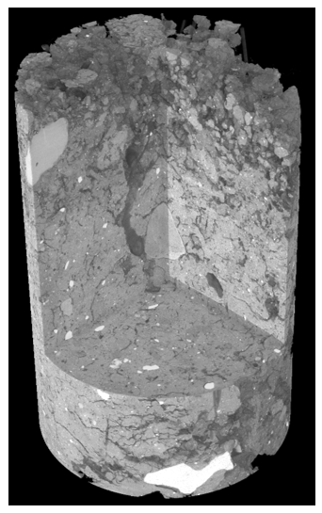
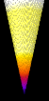
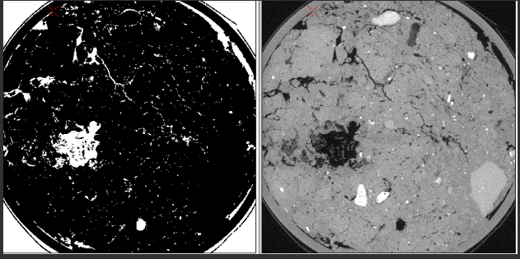
X-ray Computed Tomography – key 3D concepts
Connectivity: number of redundant ‘handles’ or ‘loops’ in an object
Connectivity density: connectivity per unit volume
Example: The largest macropore in the 250,000 mm³ soil column contained 250,000 connections
= 1.0 mm⁻³
Cyan = Largest connected cluster
1
2
3D reconstruction of a soil column
Inset – binary transformation (white = pores)
Notes:
We used X-ray computed tomnography to understand pores in soil
Few key definitions – connectivity
Loops – soil per volume, orders of magnitude higher
One large cluster
Thickness label pixels colours to help visualise and quantify

Slide 4
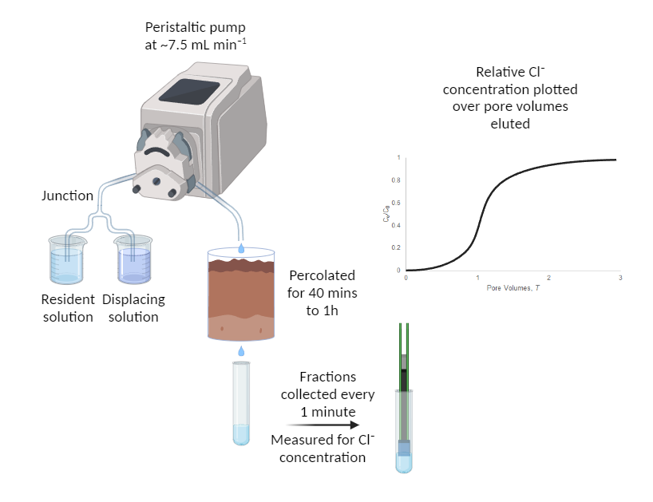
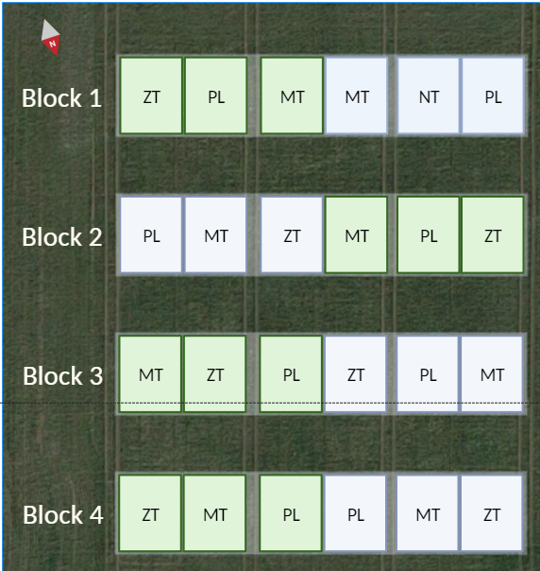
Experimental setup
What can soil from a local paired experimental site tell us about soil structure?
Random block design
  Started in Alskaf et al., 2014
± tillage, ± residue
undisturbed samples taken 2021
X-ray Computed Tomography
solute breakthrough (displacement)
Figure 1. Experimental site layout including the tillage and residue management regimes (ZT: Zero-tillage; PL: Ploughed; MT: Minimum Tillage; Green: Residue retained; Purple: Residue removed
Wardak, D. Luke R., et al. “Zero-Tillage Induces Significant Changes to the Soil Pore Network and Hydraulic Function after 7 Years.” Geoderma, vol. 447, 2024, p. 116934, https://doi.org/10.1016/j.geoderma.2024.116934.
Notes:
Our expt
Solute breakthrough using a low conc resident then changing to a higher conc displacement solution, tracking chloride ions over time

Slide 5


Zero-till visualised biostructures
Ploughed Zero-tilled
Notes:
As image rotates, removing visual small pores
Biostructures – cylindrical thick pores acting like tubes

Slide 6
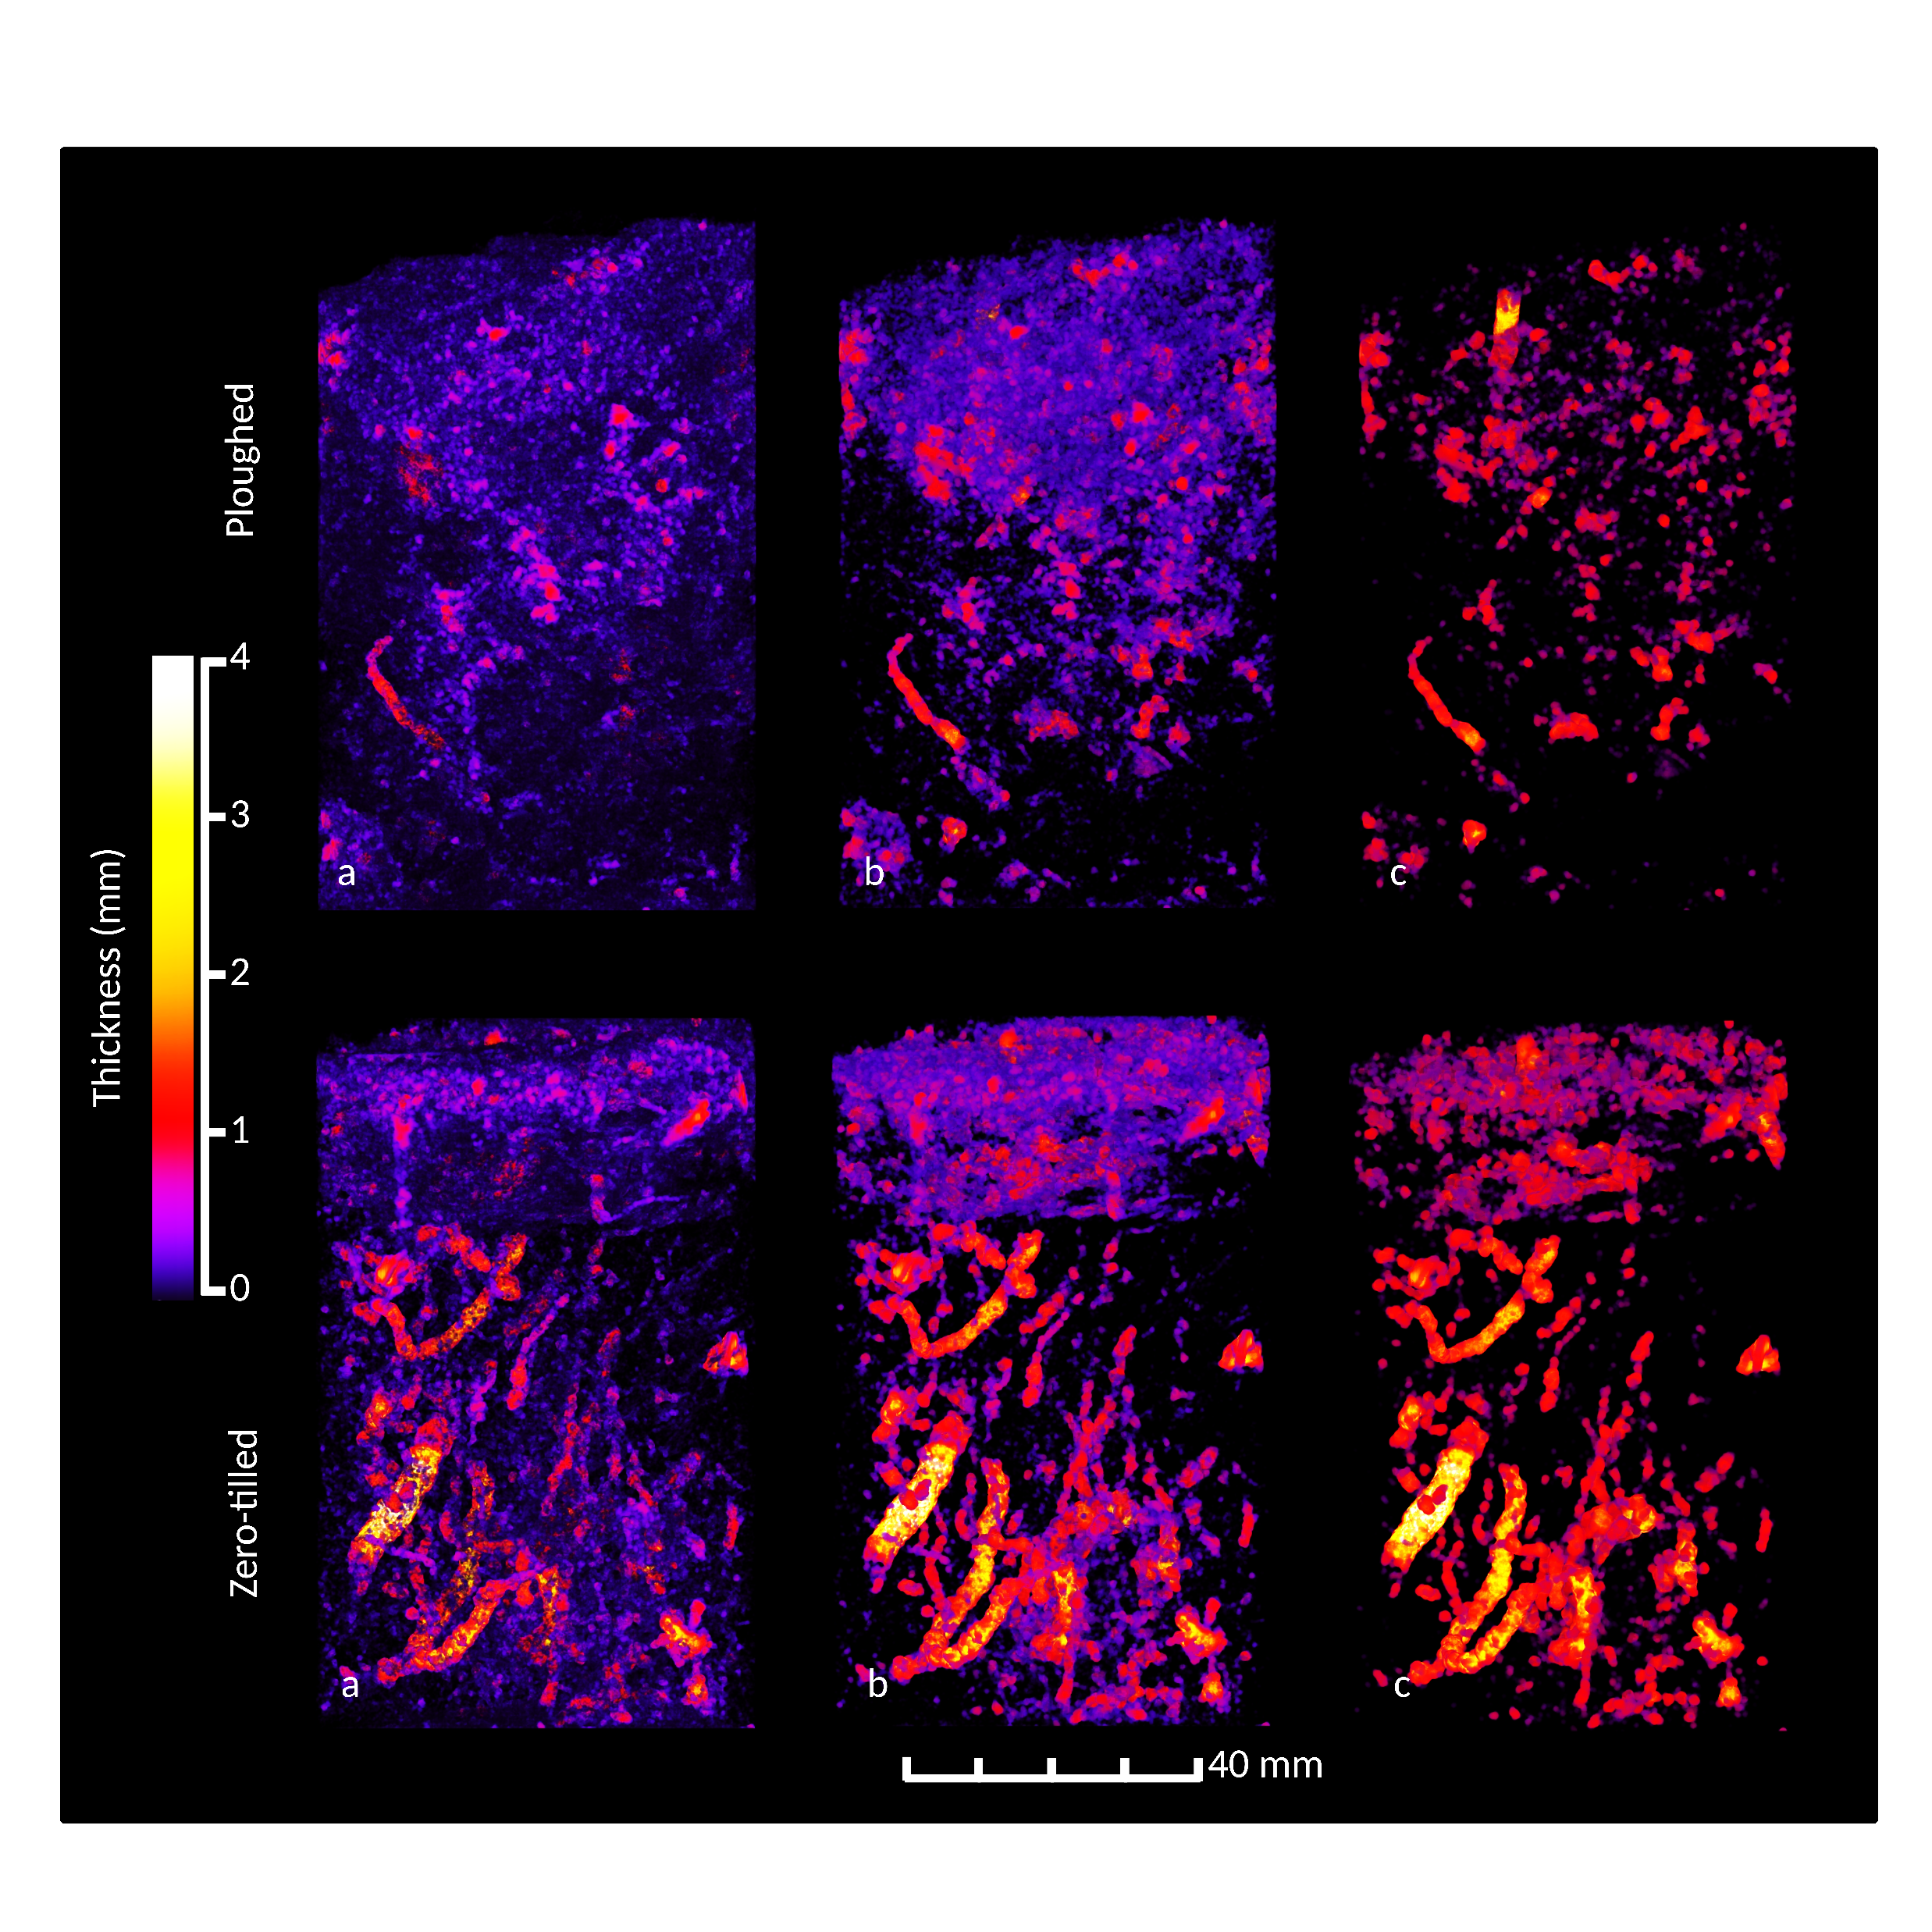
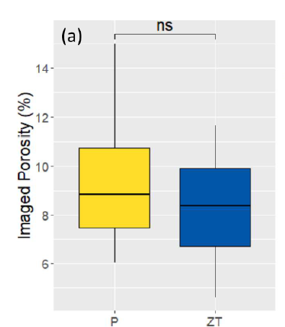
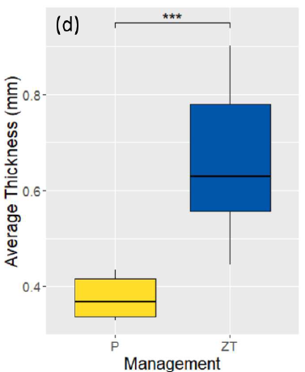

Basic assessment insufficient
6
Notes:
Porosity the same, but the way the pores are distributed changes, with thicker pores in ZT

Slide 7
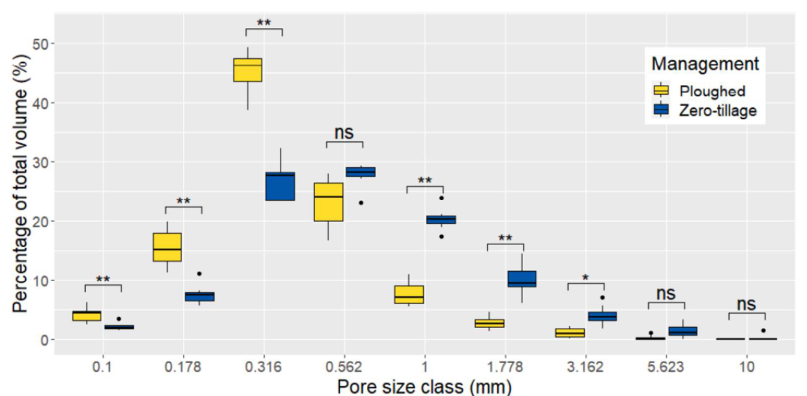
Pore size distribution trade-off towards larger pores
Notes:
Shift in ZT tillage towards larger pores where smaller pores are traded off, as a % of total pore volume

Slide 8
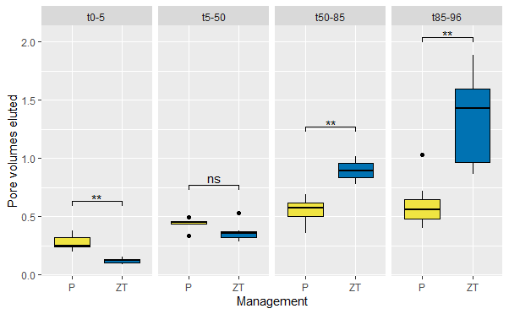
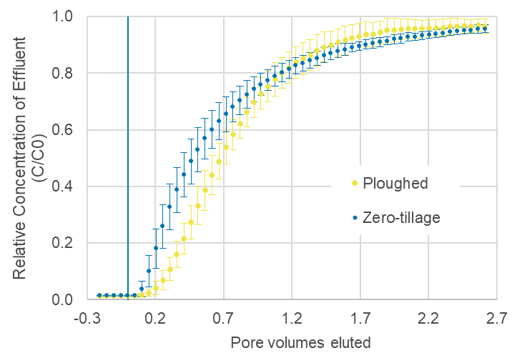
Shift towards faster pref. flow
5%-arrival time
full pore water displacement
8
Notes:
Functionally different too, faster initial detection and long tailing indicative of pref flow
Faster 5% arrival and slower full pore water displacement

Slide 9
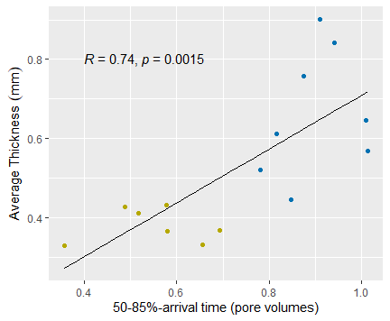
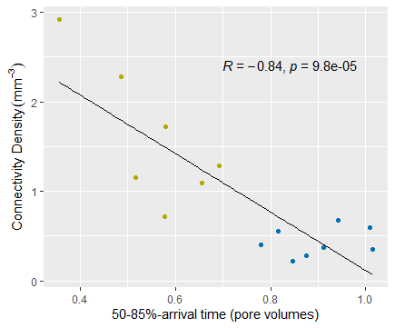
Correlations between structure and transport
Faster pref. transport
Pore thickness
Slower full pore water displacement
Pore connectivity
Slower pref. transport
Faster full pore water displacement
Notes:
Soil with the largest pores had smallest arrival times, and the longest displacement times
Soil with the highest connectivity had the slowest preferential flow, and faster full displacement

Slide 10
Pesticide bio-efficacy study background
Previous understanding
ZT induces structural differences in pore network which promote preferential flow
There is an innate reliance of ZT on herbicides for weed control
ZT can negatively affect bio-efficacy, especially of more mobile chemicals (e.g. in runoff - Elias et al., 2018)
3D X-ray insights to interactions between efficacy and pore structure
Justifications
Atrazine (banned in EU due to failure to demonstrate safe levels) – soil applied pre- & post-emergence
Can formulation effect on transport dynamics, i.e. to reduce mobility?
Small seeded Amaranthus retroflexus, ideal plant model
  Kaplan-Meier Mean Survival Time
  Plant dry mass (at end-point)
  Plant total length (at end-point)
Wardak, D. Luke R., et al. “Zero-Tillage Induces Reduced Bio-Efficacy Against Weed Species Amaranthus Retroflexus L. Dependent on Atrazine Formulation.” Agronomy, vol. 15, no. 2, Jan. 2025, p. 360, https://doi.org/10.3390/agronomy15020360.
Elias, D., Wang, L., Jacinthe, P.-A., 2018. A meta-analysis of pesticide loss in runoff under conventional tillage and no-till management. Environ Monit Assess 190, 79. https://doi.org/10.1007/s10661-017-6441-1
Notes:
So that wraps up the first experiment, we showed that ZT has these structural differences that correlate with hydraulic behaviour.
Innate reliance on herbicides, and coupled with evidence of reduced efficacy especially in mobile agrochemicals
Atrazine banned in EU but globally relevant - #2 applied #1 lost in americas
Formulation (way of packaging and delivering a chemical) used to improve efficacy?
Tracked survival of weed species over time, alongside plant biomass and growth height

Slide 11
Tillage effect - lower atrazine effectiveness in ZT soil
As expected, increasing concentration lowers plant survival & growth
Higher dry mass and total plant length in ZT
Higher mean survival time in ZT
Notes:
Increasing concentration reduces plant survival, biomass and height.
Higher plant growth traits in ZT

Slide 12
Formulation effect: Alternative performance
Suspension concentrate (SC)
Emulsifiable concentrate (EC)
Sig. higher modelled survivability for seeds in ZT soil in both formulations
Indication that performance of EC better in ZT but worse in ploughed
Notes:
Both formulations performed better in ploughed soil. With the SC performing slightly better in ploughed, but the EC slightly better in ZT.

Slide 13
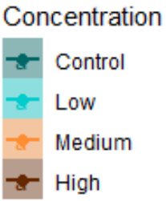
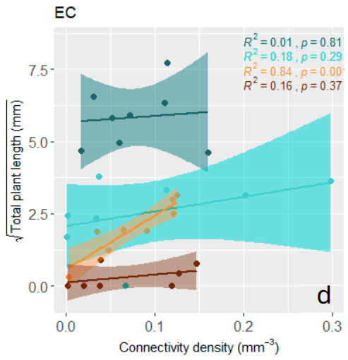
Relationships at non-limiting concentrations
Suspension concentrate (SC)
Control (dark green) null relationship
High application rate (red) similar
Plant success traits of low (cyan) and medium (orange) rates correlated with pore network properties
In 1st case, thicker pores significantly correlated with higher survival time at low SC concentration
In 2nd case, higher connectivity led to higher plant length at medium EC concentration
Different relationships with structural indicators under different formulations!
Emulsifiable concentrate (EC)
Mean survival time (days)
Notes:
Regardless of differences in pore network structure, plant success was uniform.
As concentration increases, we see a relationship with thickness – potentially as the thicker pores allow flowing water to carry away some of the suspended herbicide, enough to enable plant growth, whereas less thick pores don’t allow this transport.
At the highest concentration, we again see no relationship, potentially despite thicker pores, enough pesticide remains in the root zone to sufficiently impact weeds
As we showed previously, connectivity density was negatively associated with preferential flow, (the more connections, the slower pore water velocity, the more dispersion).
But contrary to what we expect, in this case, a higher connectivity improved plant success, which may suggest sorption and dispersion as drivers that reduce root-local dosage for EC

Slide 14
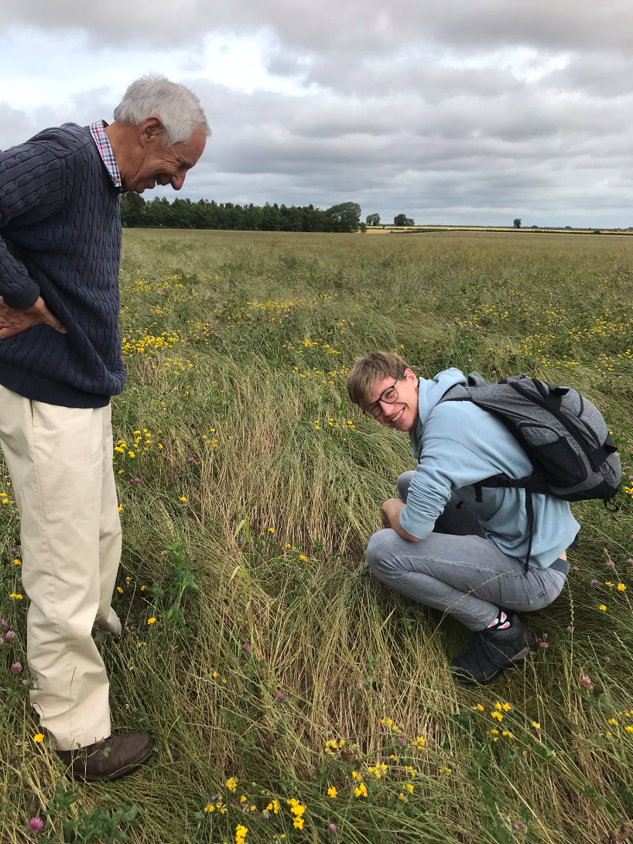




Conclusions
Contact me: daniel.wardak@uclouvain.be
Preferential transport occurs at a higher rate in our zero-tilled soil
Ubiquitous relationships between preferential transport of inert tracer and thickness/connectivity of pores
Atrazine efficacy is reduced in zero-tillage, in both emulsifiable and particulate-based suspension concentrate
Relationships with physical structure only occurred at non-limiting concentrations, and varied between the formulation type
Expt 1
Expt 2
Current project:
Read the full studies!
Affiliation:
Notes:
Pref flow faster in ZT
Relationships between pref flow and pore network structural indicators (thickness and connectivity)
Atrazine efficacy reduced in ZT
Some relationships between pore structural properties and efficacy, but different for alternative formulation types.
If you’re interested to read in more detail, please find the studies here.
Thanks very much for listening.

