Slide 1





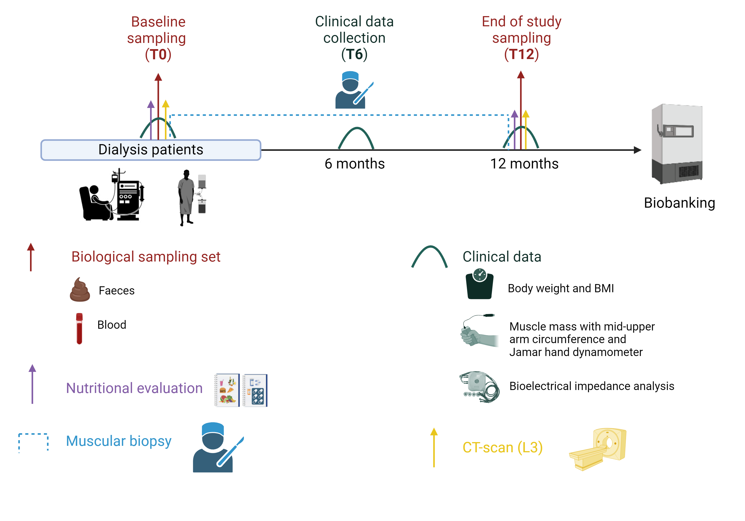
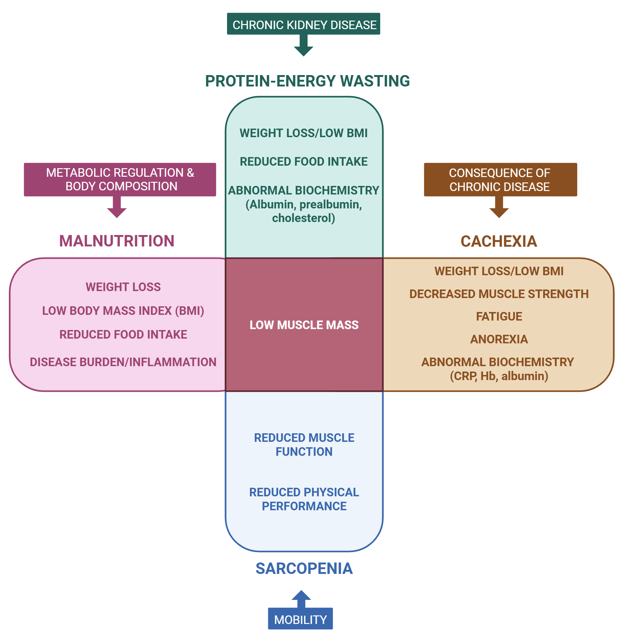
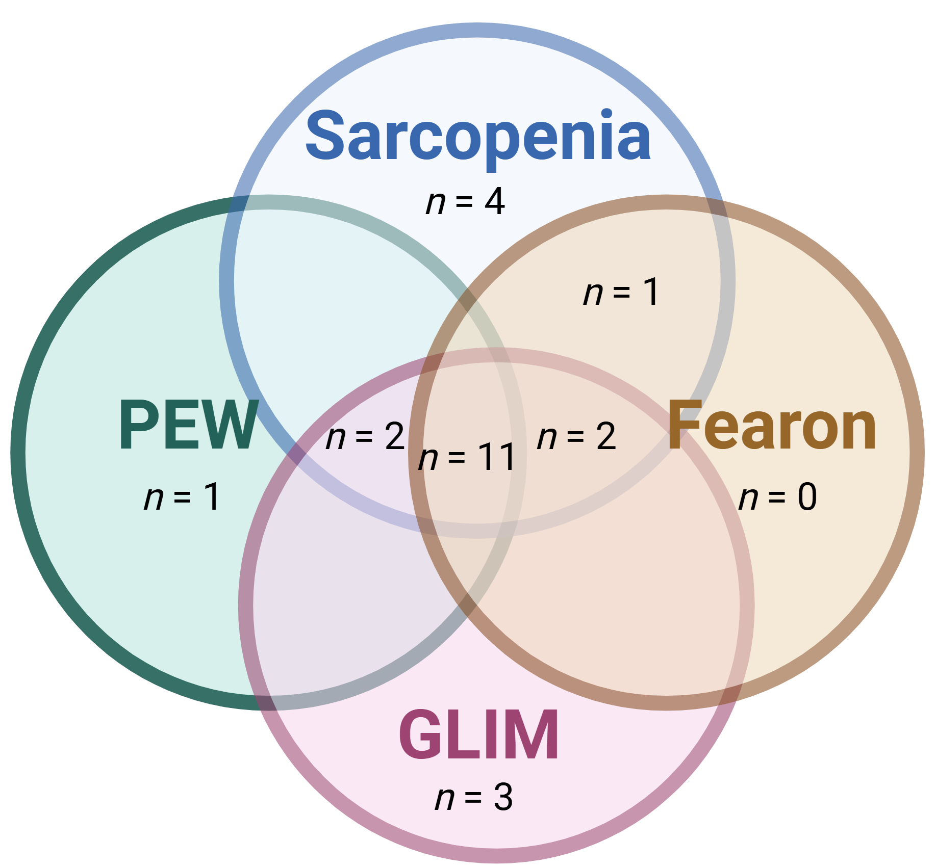
Chronic kidney disease-associated cachexia and other wasting syndromes: Definitional challenges and interactions with gut microbiome,
uremic toxins and inflammation.
Inès Dufour^{1,2}, Eric Goffin^{2*}, Laure B. Bindels^{1,3*}
¹Metabolism and Nutrition Research Group, Louvain Drug Research Institute, Université catholique de Louvain, Brussels, Belgium; ²Department of Nephrology, Cliniques universitaires Saint-Luc, Université catholique de Louvain, Brussels, Belgium; ³Welbio Department, WEL Research Institute, Wavre, Belgium
* Co-senior authors
Introduction
In patients with chronic kidney disease (CKD), several syndromes related to muscle wasting can be observed, including malnutrition, protein-energy wasting (PEW), cachexia and sarcopenia. Although these conditions share overlapping features, they differ in underlying mechanisms, diagnostic criteria and reversibility. In practice, these distinctions are often blurred, leading to inconsistent prevalence and suboptimal management. Among them, cachexia represents a particularly severe form, associated with poor outcomes. Inflammation and uremic toxins are recognized as central drivers of CKD-associated cachexia, but their interplay with the gut microbiome remains poorly understood.
Methods
The DYNAMICA study (NCT06986265) is designed to investigate the links between cachexia, gut microbiome, inflammation and uremic toxins in CKD patients under dialysis. A prospective cohort of 157 patients treated with peritoneal dialysis or hemodialysis (in-center, self-care satellite and home-based) is being established. Each patient undergoes deep phenotyping including evaluation of cachexia and body composition by bioelectrical impedance analysis and CT scan (L3), with one-year follow-up. Fecal and blood samples are collected to characterize gut microbiota, uremic toxins and inflammatory markers. Incidence of cachexia and other wasting syndromes will be compared using multiple definitions (GLIM for malnutrition, ISRNM for PEW, EWGSOP for sarcopenia, oncology-derived criteria for cachexia). Comparisons will be made between cachectic and non-cachectic patients in terms of gut microbiota, inflammatory markers, uremic toxins, dialysis dose and modality. In vitro experiments will assess the effects of uremic toxins on muscle cells, with in vivo validation through human muscle biopsies.
Results
Preliminary analyses (40 patients) are presented, focusing on definitional overlaps and discrepancies in identifying wasting syndromes.
Figure 1 – Protocol of the DYNAMICA study.
Figure 2 – Overlap and distinctions between sarcopenia, malnutrition, protein-energy wasting and cachexia.
Figure 3 – Prevalence of cachexia and other wasting syndromes depending on the definition.
Sarcopenia | 57%
Malnutrition (GLIM) | 52%
PEW | 35%
Cachexia (Fearon) | 35%
Figure 4 – Venn diagram showing the overlaps between sarcopenia, PEW, malnutrition and cachexia in our dialysis patient cohort.
Conclusions
This study will provide the first longitudinal evaluation of cachexia, inflammation, uremic toxins and gut microbiota in dialysis patients. By integrating clinical, biological and mechanistic approaches, DYNAMICA aims to clarify definitions and pathophysiology of CKD-associated wasting syndromes and pave the way for rationally-designed microbiome-based interventions.
Contact: ines.dufour@saintluc.uclouvain.be

