Slide 1



The legal status of AI systems in the EU: personhood, thinghood or otherwise?

Slide 2

“If there is one assumption that seems to have organized human experience from its very beginnings it is that of a division between persons and things. […]
A watershed divides the world of life, cutting it into two areas defined by their mutual opposition. You either stand on this side of the divide, with the persons, or on the other side, with the things: there is no segment in between to unite them.”
Roberto Esposito, Persons and things: from the Body’s Point of View, Polity Press, 2015.

Slide 3
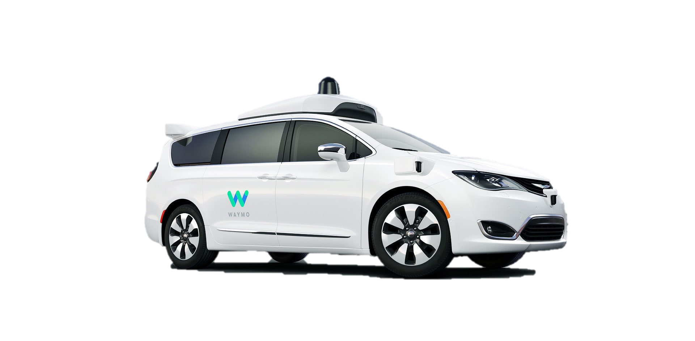

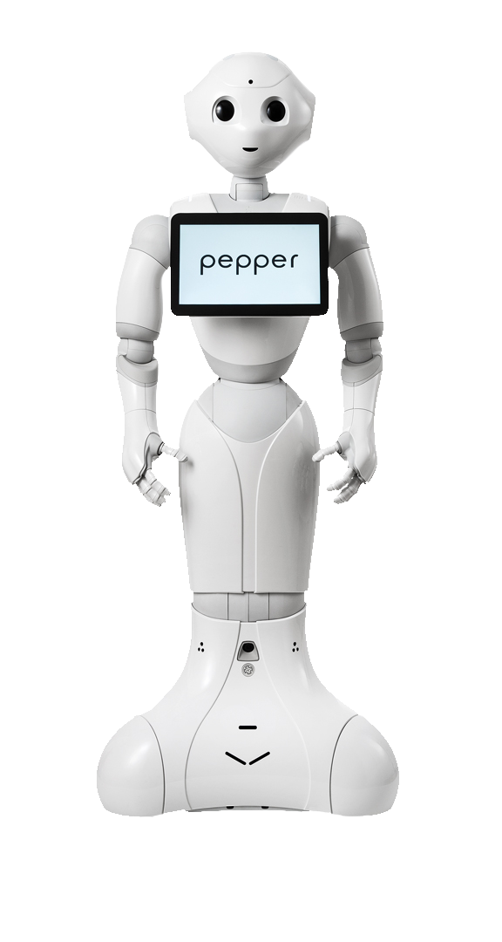




Slide 4
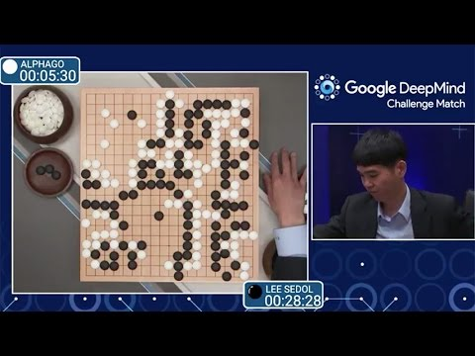
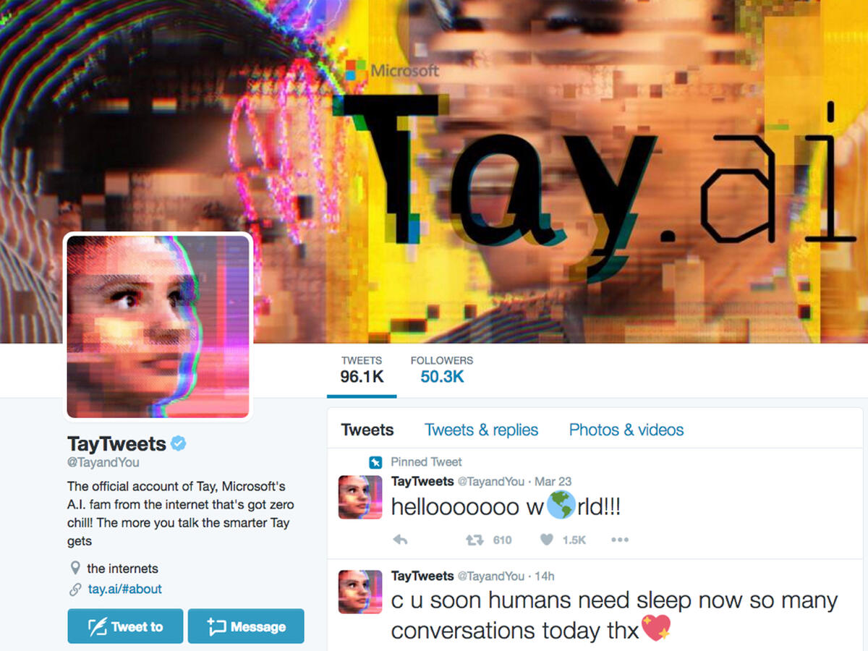
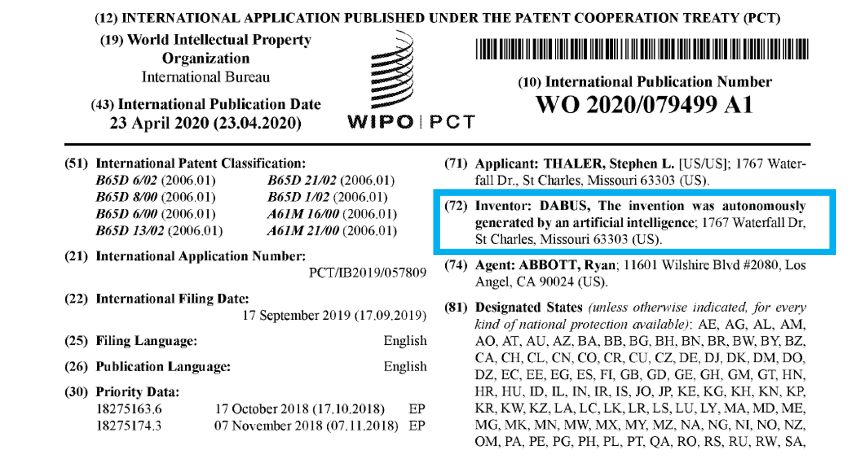
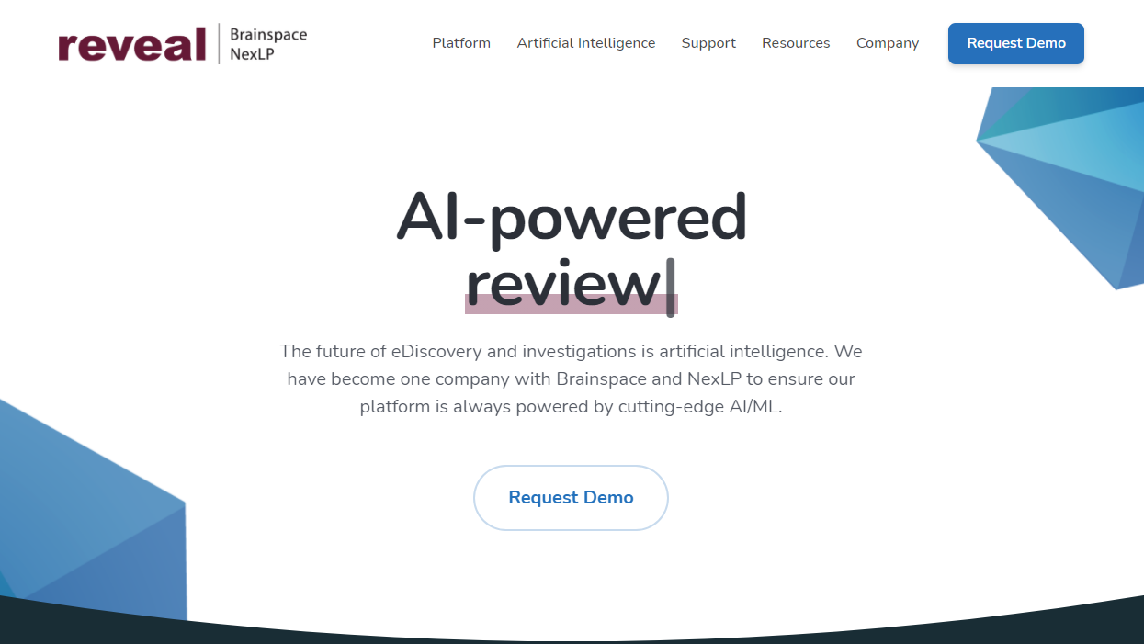

Slide 5
But surely AI systems are things…
Autonomy
Self-learning
Multiple legal issues:
Liability
Discrimination
Intellectual property
Lack of procedural safeguards
Adaptivity
Why do these features matter?
Lack of a definition of AI
Assumption that these are salient features for status ascription
They are also highly anthropomorphic characteristics, uncommon in ‘mere things’

Slide 6
Research goals
Determining how to change existing law to best accommodate societal changes brought on by the use of AI systems and contribute to balancing the interests of all stakeholders.
For that purpose, legal status ascription is the necessary first step because it determines what law is applicable to AI systems, as well as - broadly - how law needs to change to apply to them.
This is ‘the status question’.

Slide 7
FROM A certain outlook on how law relates to reality…
Faithful rendition
Law is a matter of accurately framing realities
Reinterpretation
Law is a matter of procuring legal convenience
…to answering the question “what are AI systems in legal terms?”
Law is such because of …
Law is such for/in order to…

Slide 8
Levels of abstraction
Law in general
Legal ontology
Meta-institutional
Institutional

Slide 9
Levels of abstraction
Law in general
Legal ontology
Meta-institutional
Institutional

Slide 10
The Status Quo: Juridical Humanism
A set of philosophical assumptions that include the anthropocentric image of the world in which human beings occupy an exceptional position.
Our species is distinguished from nature by a sharp metaphysical divide. Namely, we are endowed with reason and dignity that elevate us above all other creatures.
Legal systems are exclusively human creations and should solely serve the human good. This results not only from the brute fact that legal rules are laid down by human beings, but also, or even more so, from the inherent moral value of a human creature as an end in itself.
Following that, each human individual has to be recognized as a person capable of holding his or her own rights, protected and enforced by the law.

Slide 11
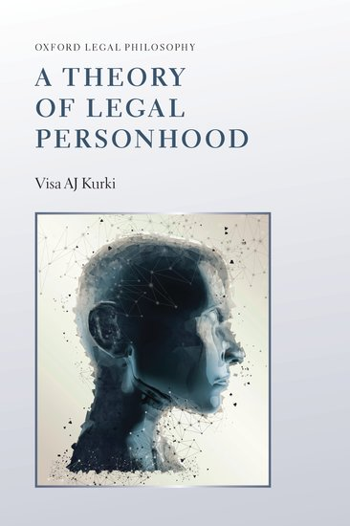
Criticizing the status quo
The apparent immobility of law as to the binary nature of legal status – the alternative between persons and things
The fraught history of denying legal personhood to certain categories of human beings (slaves, women), as well as attributing it to non-humans (ships, idols or rivers) (Solaiman, 2017)
The theoretical inconsistencies of the ‘Orthodox view’ of legal personhood and the proposed solution: the ‘Bundle theory’ of legal personhood (Kurki, 2019)
The déréification of animals

Slide 12
disrupting the Person-thing binary
Legal status
Other
!?
Person
Thing
If legal status as it stands today is too restrictive to deal with AI systems
AND
If tinkering with traditional legal instruments is not enough to tackle the novel risks of AI systems
THEN
Innovation in terms of legal status is needed

Slide 13
Levels of abstraction
Law in general
Legal ontology
Meta-institutional
Institutional

Slide 14
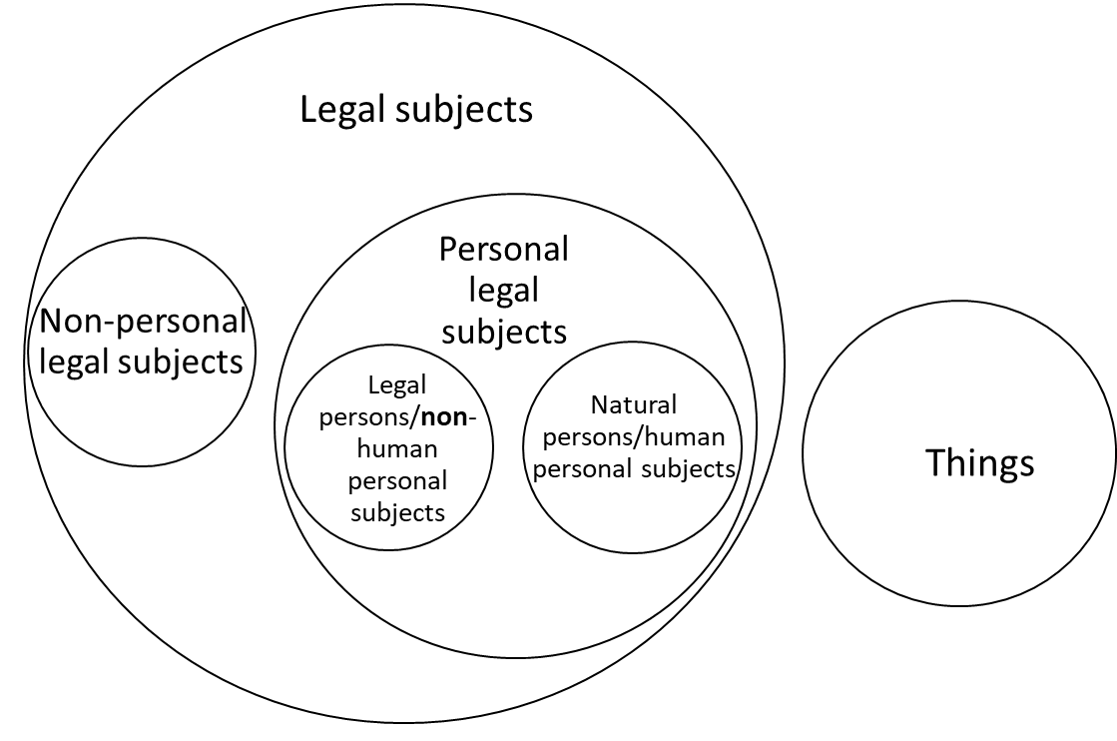
A Venn diagram of legal status

Slide 15
Levels of abstraction
Law in general
Legal ontology
Meta-institutional
Institutional

Slide 16
…TOWARDS A CONCEPTUAL FRAMEWORK OF LEGAL STATUS AND ITS APPLICATION TO AI
Monism
A single set of conditions always triggers the same implications and on the same rationale
Pluralism
Multiple conditions may exist, triggering different implications, based on different background reasons.
I try to expand a conceptual framework already proposed for legal personhood of AI (Novelli, 2021) to legal status in general, incorporating reflections on what “thinghood” might be as a legal concept, as well as reflections on how the person-thing binary might in fact need to become a status gradient.

Slide 17
A Venn diagram of legal status

Slide 18
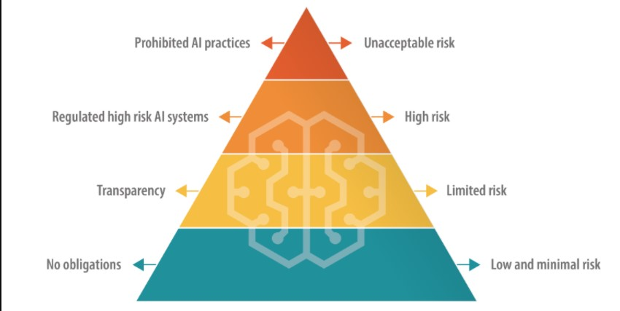
Thinghood
This is the current approach in the AI Act proposal: a product safety risk regulation of use.
Problematic definition of AI
Problematic conformity assessments through standards
Possible liability gaps not addressed
Limited enforceability (no rights for affected individuals)

Slide 19
…To go back to Legal theory for a minute…
Realism
Law is based on existing essential conditions
Legalism
Law is artifice
Realists are usually divided into religionists, rationalists or naturalists
Legalists are usually divided into: fictionalists, imputation theorists and neo-institutionalists

Slide 20
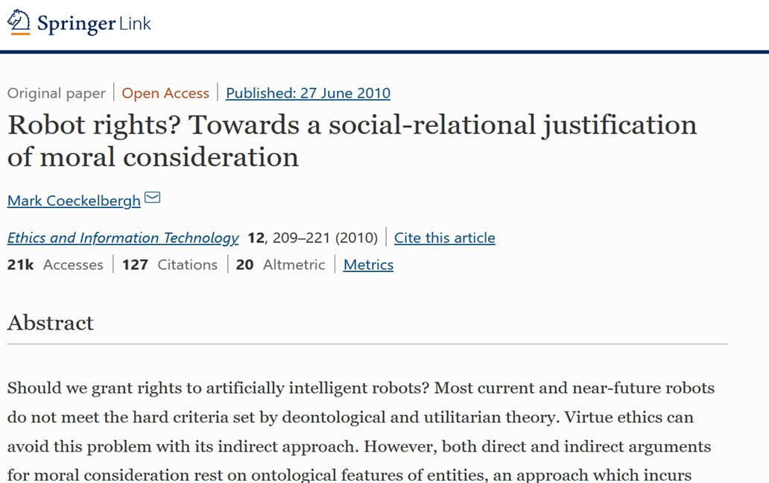
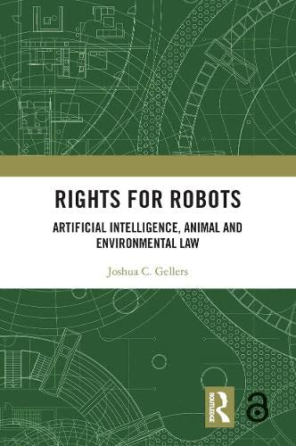
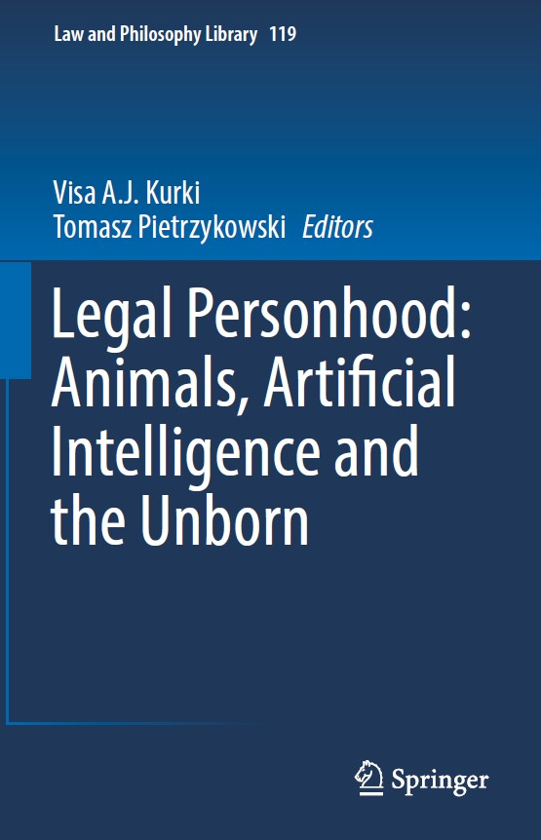
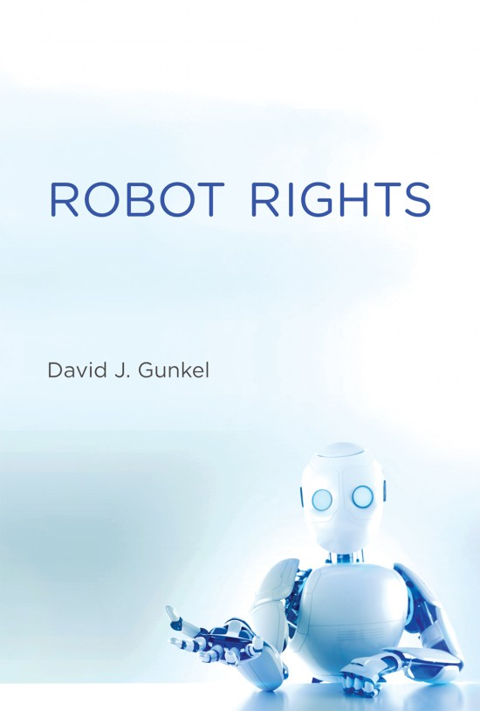
The relational approach
Relationalists: legal status is not determined by the possession of specific intrinsic traits or capacities, but rather linked with membership in a “community of recognition” (Silva, 2017).

Slide 21
Levels of abstraction
Law in general
Legal ontology
Meta-institutional
Institutional

Slide 22

First STOP: Gradient legal personhood
Legal personhood is a complex attribute, a ‘gradable, discrete, discontinuous, multifaceted, and fluid’ (Wojtczak, 2021).
Gradient is a more suited metaphor for legal personhood since it it gestures at a variable number elements of different types – such as responsibilities, rights, competences and so on - which can be added or taken away by a lawmaker as suited to the function of the entity to which it is attributed (so it has a qualitative aspect too).
A wardrobe of the legal imagination, stocked with custom made rights (Hohfeld, 1919) that change to suit their bearer and are meant to weave them into the fabric of society (Hunt Botting, 2021)

Slide 23

OTHER
What other options are there?
Non-personal subjects of law (Pietrzykowski, 2017)
Attributing only specific rights, for ex. giving domestic social robots, like Alexa, the right to privacy for the purposes of protecting the family’s personal data. (Bensoussan & Bensoussan, 2018)
The peculiar case of peculium (Bryson, 2009; 2017)
A specific type of partial legal capacity was proposed for service robots, endowing them with the limited set of legal capacities necessary for their duties as servants and nothing more (Schirmer, 2019)
Endowing AI with legal subjectivity (Wojtczak, 2021)
Limited status of AI systems as subjects in contract law without them being full legal persons (Kurki, 2022)

Slide 24

Thank you for your attention! diana.mocanu@uclouvain.be
@dianamocanum

