Slide 1
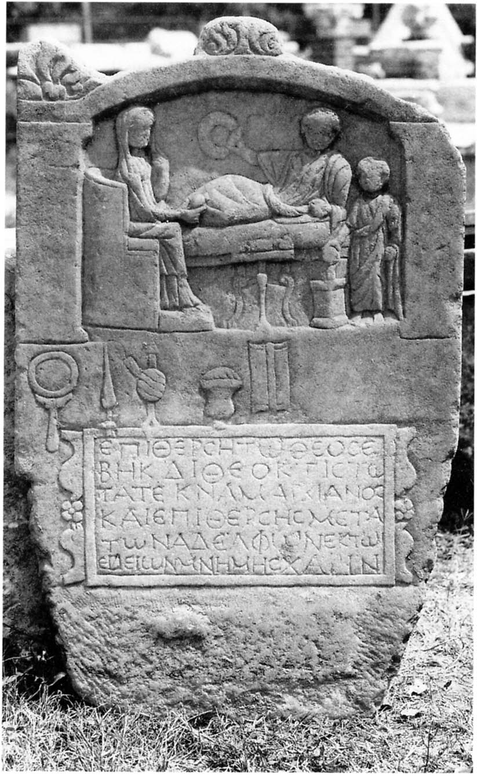

When Virtue Becomes a Name
θεοσέβεια and Women’s Agency in Greek Inscripitions
Ellen De Doncker, UCLouvain, Chargée de recherche F.R.S.-FNRS
EuARe, Rome, July 2026

Slide 2
Plan
θεοσέβεια and θεοσεβής: an overview
Ambiguity
Inscriptions: θεοσέβεια and θεοσεβής as categories for female religious agency
Conclusion

Slide 3
1. θεοσέβεια and θεοσεβής: an overview

Slide 4
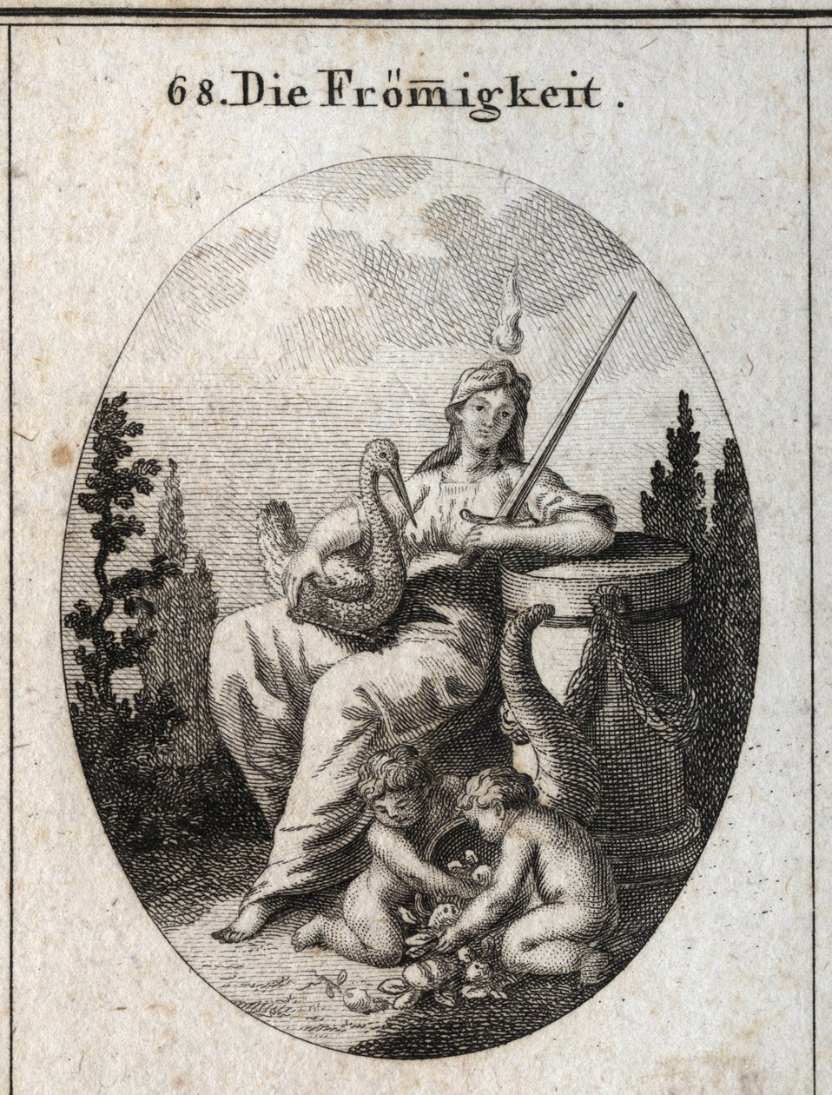
1. θεοσέβεια and θεοσεβής: an overview
Greek literature
θεοσέβεια = concrete, practical form of reverence toward the divine
  Xenophon (Anab. 2.6.26): contrasts Menon’s crookedness vs. the one “who exults in θεοσέβεια, truthfulness, and justice”
  δεισιδαιμονία “fear of the divine” initially stands close to θεοσέβεια: proper religious respect (e.g.; Xenophon Cyr. 3.3.58
  related to εὐσέβεια, “piety” in its full Greek range (reverence toward gods, ritual correctness, and especially the moral and civic obligations sanctioned by religion, e.g., Aeschylus, Eum. 525–526; Plato, Euthphr. 12e–13c; Xenophon, Mem. 1.4.16–17)
    Yet θεοσέβεια appears later and is narrower: practical and cultic reverence directed toward the gods, lacking εὐσέβεια’s broader ethical and civic scope.
θεοσεβής describes persons, actions, or even objects marked by visible reverence toward the gods: observance of sacrifice, purity rules, or dietary practices.
  Herodotus applies it to individuals and peoples: Croesus is θεοσεβής (1.86), and the Egyptians are exceptionally so (2.37).
  Euripides uses it of a trustworthy, god-fearing man (Alc. 604–5) and of a pious chorus member who initiates prayer (Iph. Taur. 268).
  From Xenophon onward, θεοσεβής acquires ethical depth: imitating the θεοσεβής cannot lead to impiety (Ages. 10.2; Cyr. 8.1.25) and is linked with moral excellence (Cyn. 12.16).

Slide 5
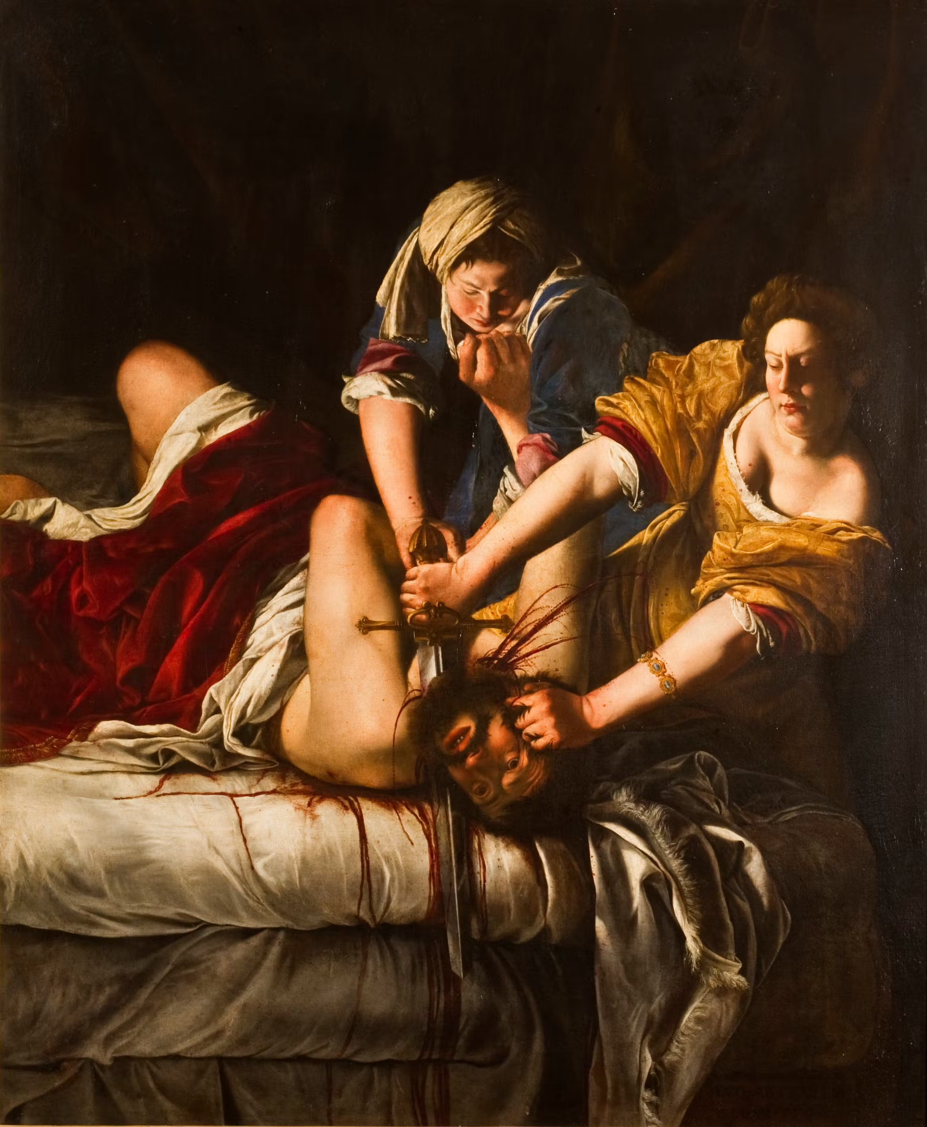
1. θεοσέβεια and θεοσεβής: an overview
b) LXX
θεοσέβεια: Gen 20:11; 4 Macc 7:6, 22; 17:15; Job 28:28; Sir 1:25; Bar 5:4.
  scarcity is striking, vs. frequent occurrence of φόβος θεοῦ
  ethical, moral, or Hellenistic nuances.
θεοσεβής Exod 18:21, Judith 11:17; 4 Macc 15:28; 16:11; Job 1:1, 8; 2:3.
  φοβούμενος (τὸν) κύριον is more usual.
  distinguishing the moral and religious qualities of individuals which can be men or women, Jews or non-Jews.
  broadness of the term, and its general positive sense, appreciated by Jews and non-Jews alike.
  Jdt 11:17: Judith self-identifies as θεοσεβής in her dialogue with the foreign general Holofernes, in order to persuade him of her supposed good intentions, thereby employing a term understandable to Holofernes and carrying the positive tone of piety and devotion
  4 Macc: applied to mother of the martyrs, θεοσεβής might stress the religious aspect, her Jewish devotion expressed in extreme perseverance, modelled on the piety of Abraham.

Slide 6
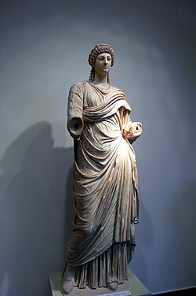
1. θεοσέβεια and θεοσεβής: an overview
c) Jewish Greek literature
θεοσέβεια less common than θεοσεβής.
  Philo esteems θεοσέβεια as the greatest of the virtues (Opif. 154:6; Congr. 131; Abr. 114-115: exemplified by Abraham’s hospitality), and the fairest possession (Fug. 150:2).
  θεοσέβεια functions essentially as a synonym for εὐσέβεια, expressing the same notion of devoted service to God.
Θεοσεβής: more often
  Josephus: collective and individual use: the Israelites are called θεοσεβεῖς (Ant. 12.284), as are King David (Ant. 7.130, 153), King Hezekiah (Ant. 9.260), and John Hyrcanus in correspondence with Mark Antony (Ant. 14.308).
  Notably, the Gentile Poppaea, Nero’s wife, is described as θεοσεβής (Ant. 20.195–96) because of her support for the Jewish delegation concerning a temple wall in Jerusalem. The adjective denotes sympathy and patronage rather than formal religious (Jewish) affiliation
  Test. Naph. 1:10, where a non-Israelite ancestor is described as θεοσεβής, ἐλεύθερος καὶ εὐγενής, emphasizing next to religious reverence also moral integrity and social status.
  Jos. Asen.: in the speech of Pentefres, Aseneth’s Egyptian father, presenting Joseph as an ideal husband: “θεοσεβὴς καὶ σώφρων … δυνατὸς ἐν σοφίᾳ καὶ ἐπιστήμῃ” (4:7). Here, spoken by a non-Jew, θεοσεβής acknowledges Joseph’s religious distinctiveness positively.
    These usages parallel LXX Job 1:1, 8; 2:3 (→ 3c) and Josephus’ description of Poppaea, showing that also non-Jews could be called θεοσεβής when aligned with Jewish ethical ideals.

Slide 7
1. θεοσέβεια and θεοσεβής : an overview
d) NT
θεοσεβής: only once in NT = Jn 9:31.
  healed man’s reply: being θεοσεβής = condition for God’s hearing, inseparable from doing God’s will.
θεοσέβεια: only once = 1 Tim 2:10
  women “who profess θεοσέβεια must demonstrate this “through good work, instead of fancy clothes (v. 9).
  θεοσέβεια =
    not an inner attitude,
    nor a matter of extravagance,
    but a publicly verifiable commitment.
  social context (list of luxury clothes v. 9): milieu of well-to-do women,
  institution of Greco-Roman civic life: public promise (ἐπαγγελία, pollicitatio) = formal ritual in which affluent citizens contribute to public expenditures
Ωσαύτως [καὶ] γυναῖκας ἐν καταστολῇ κοσμίῳ μετὰ αἰδοῦς καὶ σωφροσύνης κοσμεῖν ἑαυτάς, μὴ ἐν πλέγμασιν καὶ χρυσίῳ ἢ μαργαρίταις ἢ ἱματισμῷ πολυτελεῖ, ¹⁰ ἀλλ’ ὃ πρέπει γυναιξὶν ἐπαγγελλομέναις θεοσέβειαν, δι’ ἔργων ἀγαθῶν.
1Tim. 2:9 Likewise the women are to dress in suitable apparel, with modesty and self-control. Their adornment must not be with braided hair and gold or pearls or expensive clothing, ¹⁰ but with good deeds, as is proper for women who profess reverence for God.

Slide 8
1. θεοσέβεια and θεοσεβής : an overview
e) Early Christian literature
In early Christian literature, θεοσέβεια and θεοσεβής gradually become a technical designation for Christianity, especially in apologetic contexts;
  especially with Justin Martyr, θεοσέβεια grows into a polemical concept:
  Justin calls Christians the true “nation,” τὸ ἔθνος τὸ θεοσεβὲς καὶ δίκαιον (Dial. 91.3), and insists that the “true piety” (ἡ ἀληθινὴ θεοσέβεια) is known only through Christ (Dial. 110.2).

Slide 9
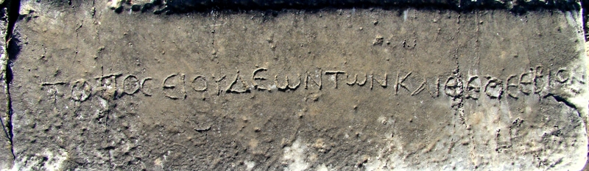
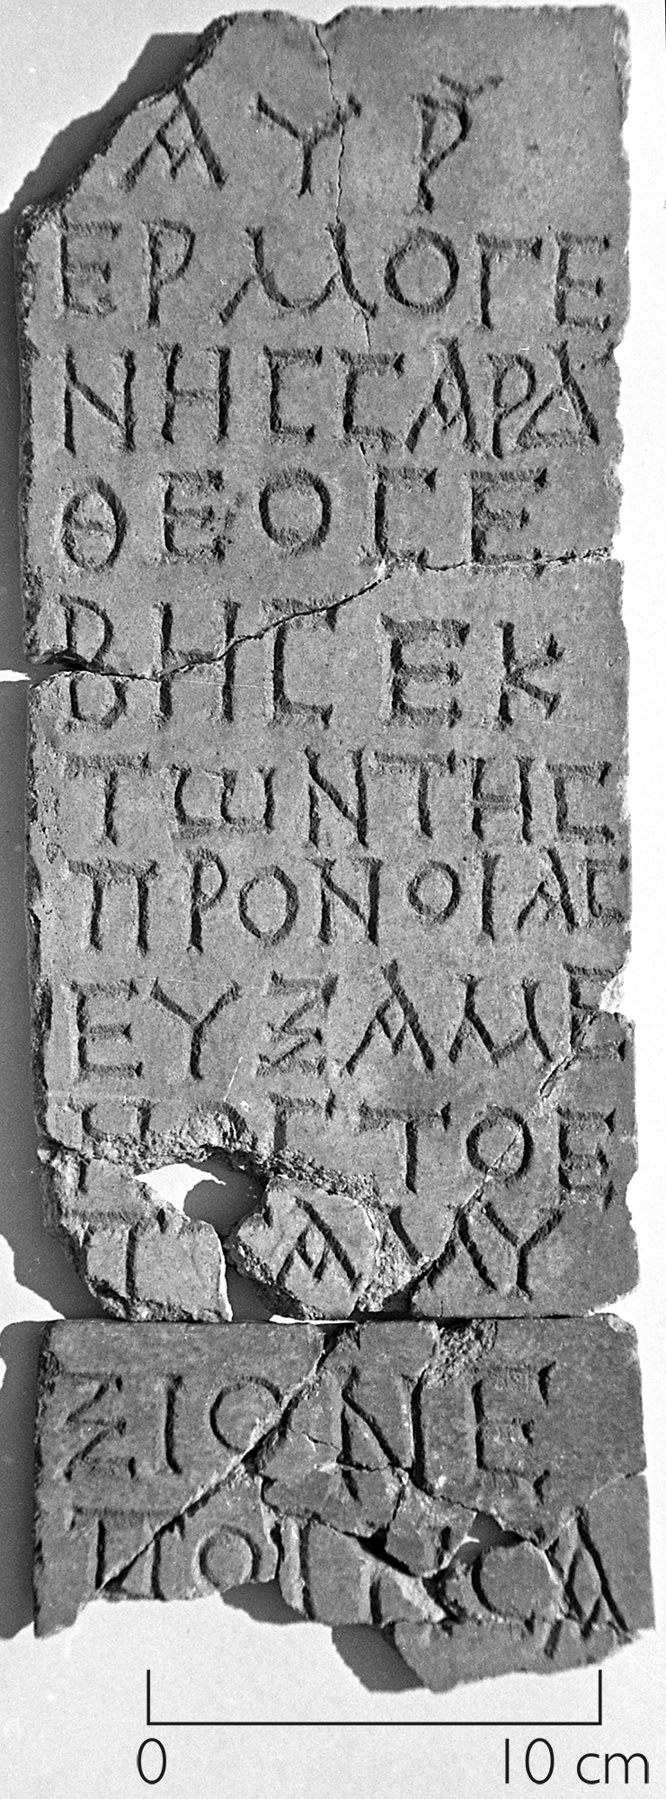
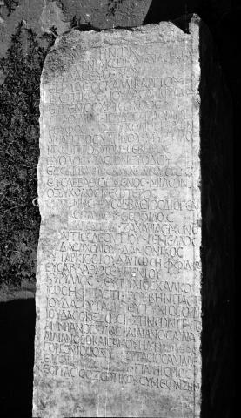
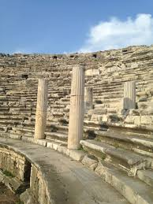
θεοσέβεια and θεοσεβής:
an overview
f) Three major “obscure” epigraphic dossiers
Inscription in theatre of Milete
Τόπος Ἰουδαίων τῶν καὶ θεοσεβίων
Aphrodisias marble
καὶ ὅσοι θεοσεβεῖς + list of +/- 50 names
Sardes inscriptions
Votive inscriptions qualifying multiple benefactors as θεοσεβής
Αὐρήλιος Εὐλόγιος θεοσεβής εὐξὴν ἔτελεσα
The adjective θεοσεβής is not by itself a distinctive marker. It functions rather as a term to value shared religious participation, without a sharp statutary clarification

Slide 10
2. Ambiguity

Slide 11



1998
2025
2026

Slide 12
2. Ambiguity
“God-fearer” (θεοσεβής)
  Often understood as non-Jews associated with Jewish communities, attracted to Jewish monotheism, ethics, or worship, without becoming full proselytes.
  This interpretation may reflect an imposed narrative.
Key Question:
  Is this intermediate identity a genuine ancient reality, or the product of a modern reading of an ancient vocabulary?

Slide 13
2. Ambiguity
Evidence
Theory about “godfearers”

Slide 14
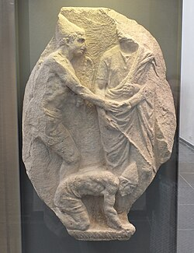
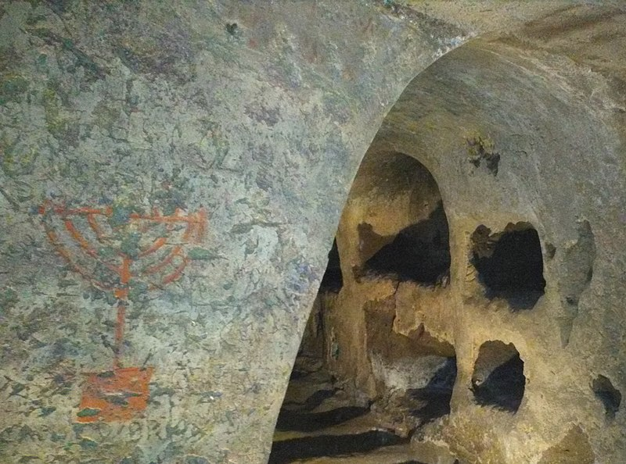
2. Ambiguity
θεοσεβής in ‘pagan’ contexts
Strabo, Geogr. 7.3.4 : piety? Behaviour (vegetarians, no women)?
2. θεοσεβής in indetermined contexts
Inscription “Marcus teusebes” in Jewish catacomb in Venosa
Manumission of Elpias (1st c. CE, Panticapaeum), CIRB 71
  Jews and godfearers as distinct groups?
  Or hendiadys?
(first line largely illegible). . . set free my house-bred slave, Elpis (or: Elpias, a masculine name), in the prayer-house, so that (s)he is to be undisturbed and not subject to control by any heir, apart from attendance at the prayer-house, with the synagogue of the Judeans and god-fearers being designated joint guardians.
[— — —]κ̣α̣ | κου ἀφίημι ἐπὶ τῆς προσευ|χῆς Ἐλπία[ν — —]α[․]της θρεπτῆ̣[ς] {Ἐλπία{δ}α [ἐμ]α[υ]της θρεπτ[ὴν] (Bellen and IJO)} {Ἐλπία{ν} [ἐμ]α[υ]της θρεπτ[ὸν] (Levinskaya)} | ὅπως ἐστὶν ἀπαρενόχλητος || καὶ ἀνεπίληπτος ἀπὸ παντὸς | κληρονόμου χωρὶς τοῦ προσ|καρτερεῖν τῇ προσευχῇ ἐπι|τροπευούσης τῆς συναγω|γῆς τῶν Ἰουδαίων καὶ θεὸν || σέβων.

Slide 15
2. Ambiguity
θεοσεβ-
The term does not allow us to identify a stable social group
Inscriptions show how “piety” was expressed in antiquity
θεοσεβής functioned less as an identity marker than as a means of religious positioning
Its ambiguity was precisely what made it effective
“piety”
Abstract virtue?
No! Agency is central!
  Bertram, TDNT: “θεοσέβεια refers not so much to an inner attitude or state of mind as to pious behaviour, religious practice or devotion to God.”
  This is especially visibe in inscriptions where θεοσεβής applies to women and θεοσέβεια is used as their proper name (not as abstract virtue)

Slide 16
3. Inscriptions:
θεοσέβεια and θεοσεβής as categories for female religious agency

Slide 17
3. Inscriptions & Women
Funerary stela of Epitherses (Bithynia)
Ἐπιθέρσῃ τῷ θεοσέ-
βῃ κ⟨α⟩ὶ Θεοκτίστῃ
τὰ τέκνα Μαγκιανὸς
καὶ Ἐπιθέρσης μετὰ
τῶν ἀδελφῶν ἐκ τῶν
εἰδείων μνήμης χάριν
iconography and formula are fully pagan,
Yet: alternative interpretations as Christian, Jewish, or belonging to the Θεὸς Ὕψιστος cult

Slide 18
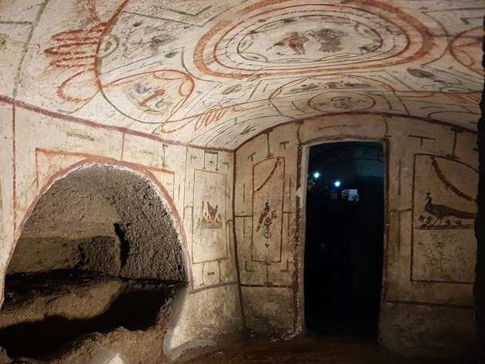
3. Inscriptions & Women
b) Inscription at the Jewish Catacomb of Vigna Randanini (Rome, 3rd–4th cent. C.E.)
damaged,
lacks the name of the deceased,
its reconstruction ([Ιο]δεα προση[λυτο … θ]εοσεβ[η]ς) is conjectural

Slide 19

3. Inscriptions & Women
c) Dedication to Capitolina (Tralles; IJO 2.27 = CIG 2429, mid 3rd cent. C.E)
Καπετωλῖνα
ή ἀξιολογ(ωτάτη) καὶ
⸢θ⸣εοσεβ(ὴς) ⸢π⸣οιήσα-
σα τὸ πᾶμ ⸢β⸣άθρο[ν]
ἐσκούτλωσα τ[ὸν]
⸢ἀ⸣ναβασμὸν ὑπ[ὲρ]
εὐχῆς ἑαυτῆς [καὶ]
πεδίων τε ⸢κα⸣ὶ ἐγ-
γόνων. εὐλογία.
Capitolina, the highly respected and God­fearing, had the whole foundation built
and then covered the staircase (with marble) because of her own, her children’s and grandchildren’s vows. Blessing.

Slide 20
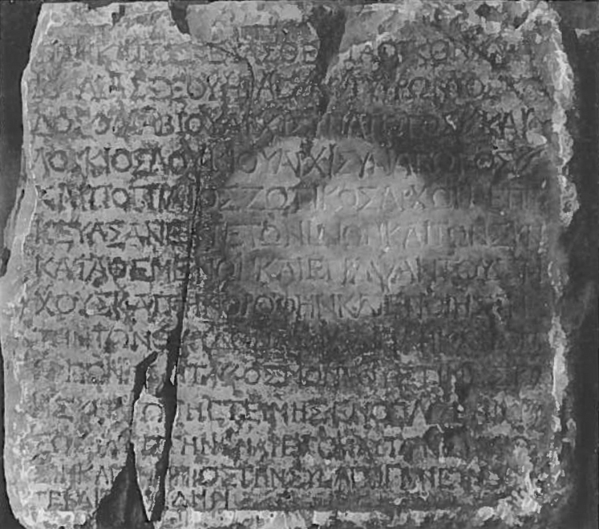
The building (oikos), which was built by Julia Severa, was renovated by P. Tyrronius Klados, head of the synagogue for life, Lucius son of Lucius, also head of the synagogue, and Popilius Zotikos, leader, from their own resources and from the common deposit. They decorated the walls and ceiling, made the windows secure, and (10) took care of all the rest of the decoration. The synagogue honoured them with a gilded shield because of their virtuous disposition, goodwill, and diligence in relation to the synagogue.
τὸν κατασκευασθέ[ν]τ̣α ο[ἶ]κον ὑπ̣ὸ̣ | Ἰουλίας Σεουήρας Π̣. Τυρρώνιος Κλά|δος ὁ διὰ βίου ἀρχισυνάγωγος καὶ | Λούκιος Λουκίου ἀρχισυνάγωγος || καὶ Ποπίλιος Ζωτικὸς ἄρχων ἐπεσ|κεύασαν ἔκ τε τῶν ἰδίων καὶ τῶν συν|καταθεμένων καὶ ἔγραψαν τοὺς τοί|χους καὶ τὴν ὀροφὴν καὶ ἐποίησαν | τὴν τῶν θυρίδων ἀσφάλειαν καὶ τὸν || [λυ]πὸν πάντα κόσμον, οὕστινας κα[ὶ] | ἡ συναγωγὴ ἐτείμησεν ὅπλῳ ἐπιχρύ|σῳ διά τε τὴν ἐνάρετον αὐτῶν δ̣[ι]ά̣θ[ε̣]|σ̣ιν καὶ τὴν π̣ρ̣ὸς τὴν συναγωγὴν εὔνο̣ι̣ά̣ν | τε και σ̣[που]δήν.
Cf. Akmoneia (Phrygia, Asia Minor), ca. 100 CE
AGRW 145 = GRA 113 = IJO II 168

Slide 21
3. Inscriptions & Women
c) Dedication to Clodia Cognita
(Tralles; IJO 2.27 = CIG 2429, mid 3rd cent. C.E)
ἐπεὶ Κλωδία Αὔλου θυγάτηρ
Κόγνιτα, γυνὴ δὲ Ποπλίου Οὐ-
ηδίου Δη̣μάδου, σωφροσύνῃ
καὶ ἀρετῇ διαφέρουσα εὐσεβέσ-
τατα διάκειται πρὸς τοὺς θεοὺς
ἡμῶν καὶ τοῖς ἀπὸ τῆς ἰδίας τύχης
ἀπάργμασιν κοσμεῖ τὸ ἱερὸν καὶ χρυ-
σοῖς ἀναθήμασιν καὶ θαλασσίοις
ὕφεσ[ι] καὶ τοῖς ἄλλοις ποικίλως
πᾶσιν, οὐθὲν π[αρ]αλείπουσα τῶν εἰς
τειμὴν καὶ θεοσέβηαν
…
δεδόχθαι τῆι
βουλῇ ἐπῃνῆσθαί τε καὶ τετει-
μῆσθαι Κλωδίαν Αὔ⟨λ⟩ου θυγα-
τέρα Κόγνιταν διά τε τὴν
ἰδίαν αὐτῆς εὐσέβηαν καὶ
σωφροσύνην καὶ διὰ τὴν τοῦ
ἀνδρὸς αὐτῆς ἀρετὴν καὶ
εἶναι αὐτὴν ἐν ἀποδοχῇ τῇ
μεγίστῃ παρὰ τῆι πόλει
Since Clodia Cognita, daughter of Aulus and wife of Publius Vedius Demades, is distinguished by her modesty and virtue, and conducts herself in the most pious manner toward our gods; and since she adorns the sanctuary with first-fruits from her own fortune, with golden votive offerings, sea-woven textiles, and many other splendid gifts of every kind, leaving nothing undone that pertains to honour and godliness;
…
it is resolved that the council shall praise and honour Clodia Cognita, daughter of Aulus, on account of her personal piety and modesty, as well as the virtue of her husband, and that she shall enjoy the highest esteem from the city.

Slide 22
3. Inscriptions & Women
d) Inscriptions with Θεοσέβεια as proper name
In Attica, it occurs among a series of names:
  “Θεοσέβεια ⋮ Καλλιάδου Ἀναφλυστίου” (IG II² 5752, 340–317 B.C.E.).
Later, it is used as a Christian name
  Laodicea: Flavios (?) Alexandros and Θεοσεβίῃ ἔνθα κατάκιτε (ICG 241 = SEG 15:818, 400–500 C.E.)
  Zoe with her sister Theosebia, “the most devout virgin” (σὺν Θεοσεβίῃ εὐλαβ. παρθένῳ: ICG 507, 350–400 C.E.), linking θεοσέβεια with εὐλάβεια.
  In Corinth, Ioulianos commemorates his partner Theosebia the Corinthian (IG IV² 3.1614, 4th/5th cent. C.E.)
  in Phrygia, Mestrianos’ daughter is Θεοσεβίης (ICG 1576, 5th–7th cent. C.E.).
  A Christian graffito from Epheseos invokes God for Leontios and Θεο[σεβ]ία (IEph 1285.14 = ICG 4554, 5th–7th cent. C.E.).

Slide 23
4. Conclusion

Slide 24
4. Conclusion
θεοσέβεια and θεοσεβής functioned from an early period as valuative categories for female religious agency
  Often treated as abstract markers of “piety,”
  BUT these terms emerge in literary, epigraphic, and Christian contexts as publicly legible, socially consequential descriptors, applied to women as actors, patrons, commemorators, and moral exemplars.
Funerary and dedicatory inscriptions present women not only as recipients of remembrance but as agents of commemoration and devotion, whose θεοσέβεια is materially inscribed and socially acknowledged (e.g. ICG 241; ICG 507; ICG 1576).
  The recurrence of Theosebeia as a female name, alongside the adjectival attribution θεοσεβής, shows how piety itself could be embodied, named, and gendered without being confined to domestic or silent roles.
  Read alongside 1 Timothy 2:10, where women who “profess θεοσέβεια” are expected to demonstrate it through visible deeds, these inscriptions illuminate a shared moral grammar in which female religiosity is performative, public, and evaluative.

Slide 25
Thank you!

