Slide 1
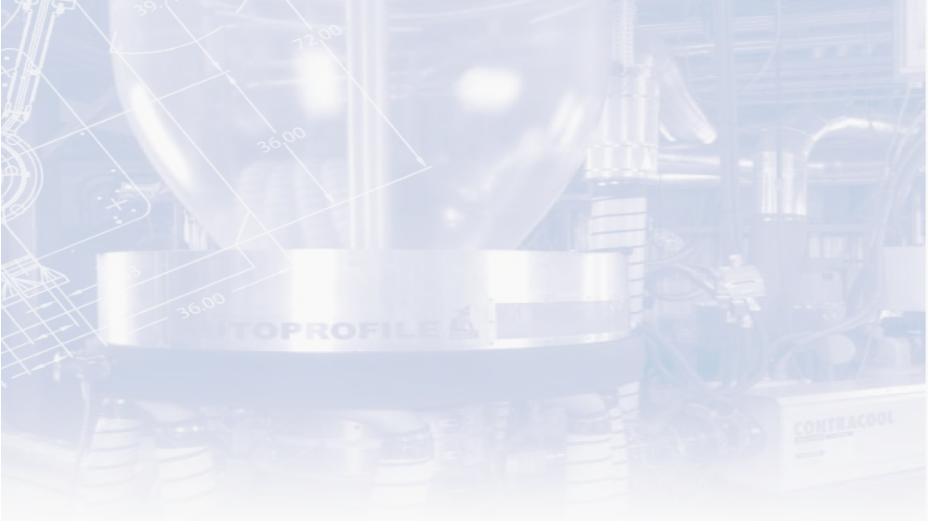


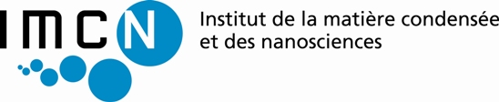
“Investigating the linear and nonlinear rheology of model
polymer melts”
Alexis André
Promotors : Christian Clasen¹, Evelyne Van Ruymbeke²
1. SMaRT, Department of Chemical Engineering, KU Leuven, Leuven, Belgium
2. BSMA/IMCN, Université catholique de Louvain, Louvain-la-Neuve, Belgium

Slide 2

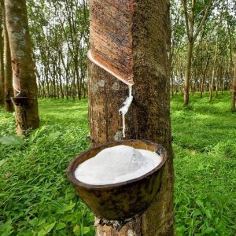
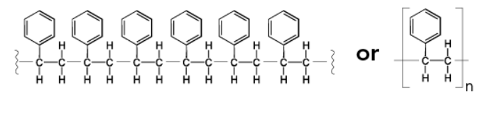
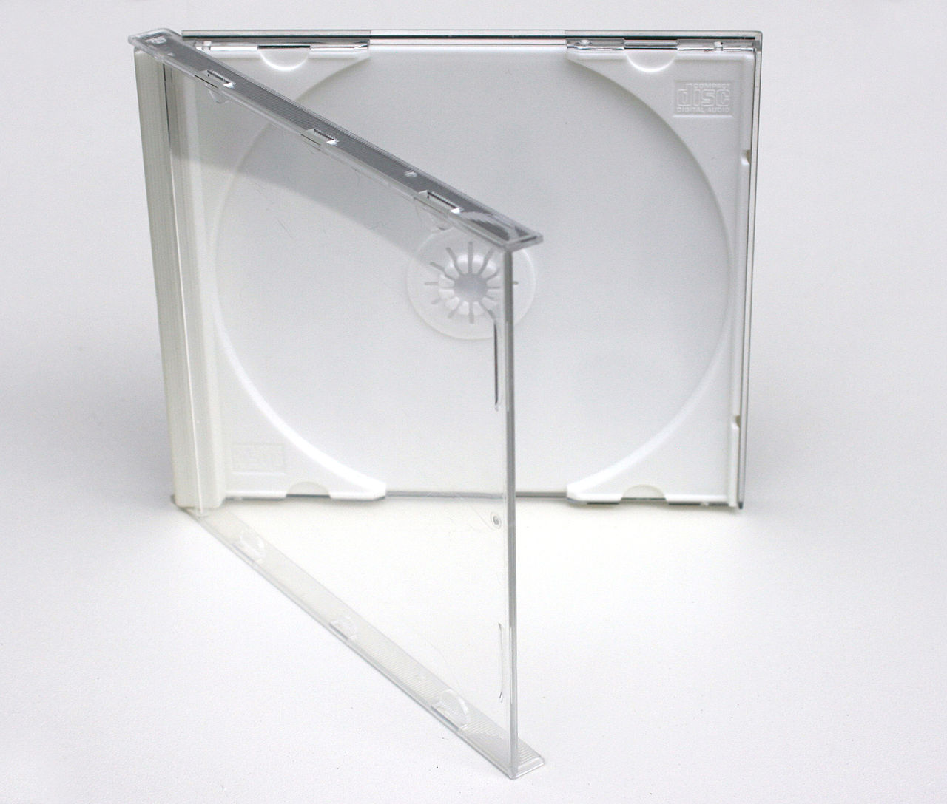
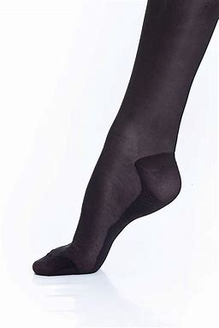

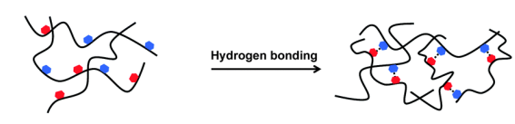
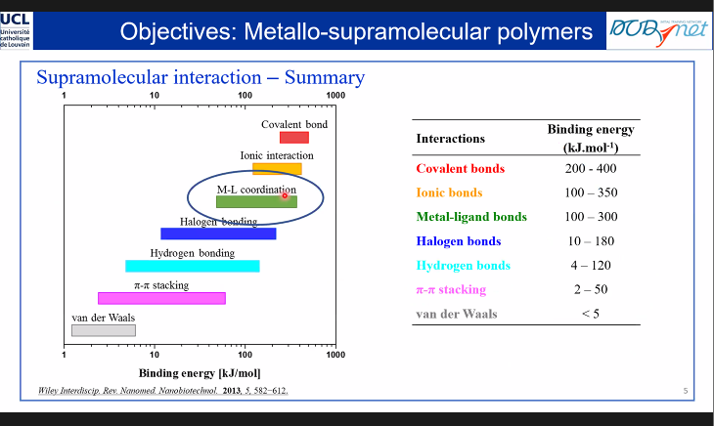
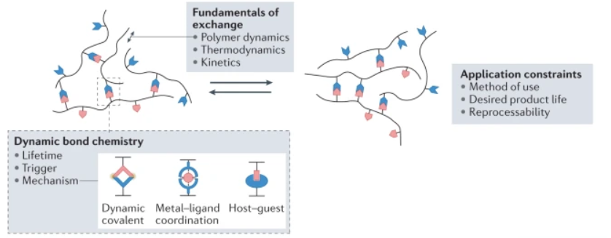

https://www.bbau.ac.in/dept/Chemistry/TM/MCH%20301%20Superamolecular%20Chemistry%20DoC.pdf
Dynamic and reconfigurable materials from reversible network interactions
https://olsenlab.mit.edu/research/dynamics/#:~:text=Associative%20polymers%20contain%20sticky%20groups,responsive%20and%20self%2Dhealing%20abilities.
What is a polymer ?
Let's break down the title into different parts…
“Investigating the linear and nonlinear rheology of model polymer melts”
Poly + mer, from Ancient Greeks πολύς (polus) ‘many’ and μέρος (meros) ‘part’
Monomer
$n$ times
Synthetic polymer
Natural polymer
DNA
Silk spider
Natural latex
Polystyrene
Nylon
2
Polymers are macromolecules made of many « monomers »
Rubinstein, M., and A. N. Semenov, “Dynamics of entangled solutions of associating polymers,” Macromolecules 34, 1058–1068 (2001)

Slide 3
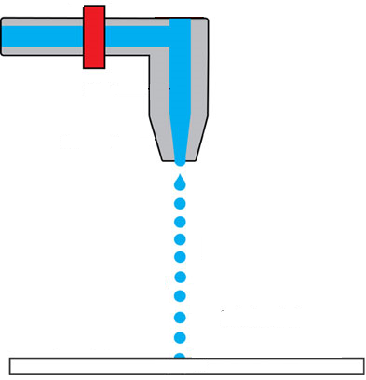
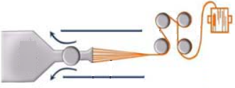
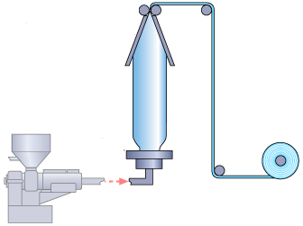
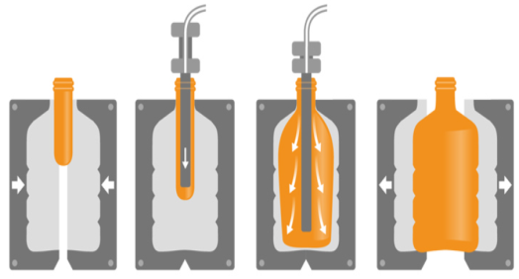
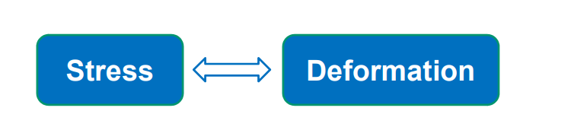
Diverse processing methods
Int
Polymers are light, easy to process and to incorporate into a variety of forms
In polymer industry, melt processing is widely used
Main steps are :
      Heating
      Flowing
      Shaping
      Cooling
Melt spinning
3D printing
Inkjet printing process
Stretch blow molding
Film Blowing
3
[1] T. Shahid, PhD thesis, UCLouvain (2018).
[2] Downloaded on 21/06/2019 from https://www.britannica.com/technology/melt-spinning-materials-processing
[3] Downloaded on 25/09/2019 from https://robinsonpackaging.com/plastic-packaging/injection-stretch-blow-moulding/
[4] C. Bailly, E. Van Ruymbeke, Transparent du cours « LMAPR2018 : Rheometry and Polymer Processing »., 2018-2019,
Deformation
Notes:
Models based on the models given in class for the shear and elongational flow.
For the shear flow : the lower plate stays still while the upper one moves. So v_x(0) = 0. The flow is established so the only velocity (in 2D) is parallel to the plates and varies only along x (stationary flow, each cross section, same velocity profile).
For shear flow : 1D example shown. Velocity of center doesn’t change. The rest is strtched proportionally to the strain rate (called hecnky strain rate). Of course, since 1D, only 1 velocity component depending on one direction.
Both can be generalized in 3D.

Slide 4
Diverse processing methods
Int
Polymers are light, easy to process and to incorporate into a variety of forms
In polymer industry, melt processing is widely used
Main steps are :
      Heating
      Flowing
      Shaping
      Cooling
Melt spinning
3D printing
Inkjet printing process
Control of the flow:
Stress
Deformation
Stretch blow molding
Film Blowing
4
[1] T. Shahid, PhD thesis, UCLouvain (2018).
[2] Downloaded on 21/06/2019 from https://www.britannica.com/technology/melt-spinning-materials-processing
[3] Downloaded on 25/09/2019 from https://robinsonpackaging.com/plastic-packaging/injection-stretch-blow-moulding/
[4] C. Bailly, E. Van Ruymbeke, Transparent du cours « LMAPR2018 : Rheometry and Polymer Processing »., 2018-2019,
Deformation
Notes:
Models based on the models given in class for the shear and elongational flow.
For the shear flow : the lower plate stays still while the upper one moves. So v_x(0) = 0. The flow is established so the only velocity (in 2D) is parallel to the plates and varies only along x (stationary flow, each cross section, same velocity profile).
For shear flow : 1D example shown. Velocity of center doesn’t change. The rest is strtched proportionally to the strain rate (called hecnky strain rate). Of course, since 1D, only 1 velocity component depending on one direction.
Both can be generalized in 3D.

Slide 5
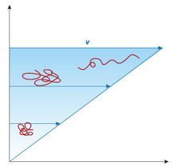
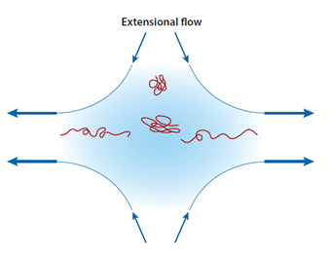
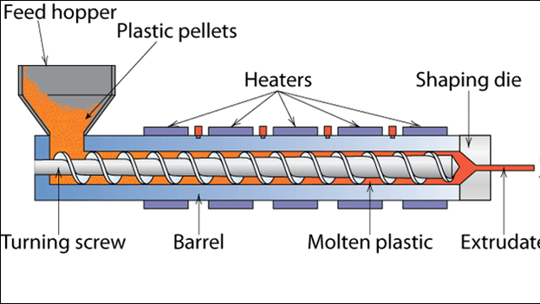
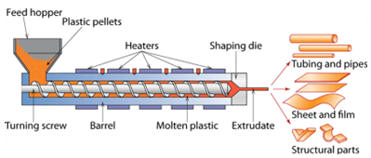
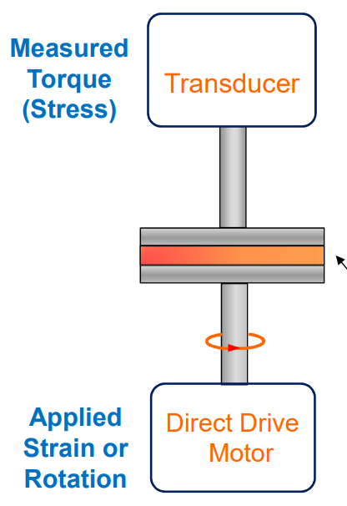
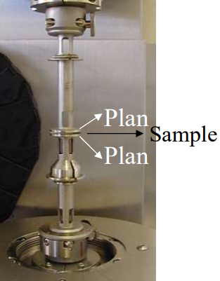
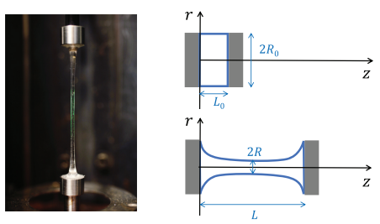

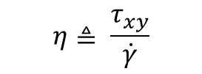

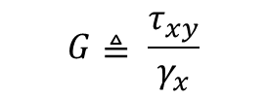
https://www.bbau.ac.in/dept/Chemistry/TM/MCH%20301%20Superamolecular%20Chemistry%20DoC.pdf
Dynamic and reconfigurable materials from reversible network interactions
Shear and extensional flow
Polymer processing techniques are generally dominated either by shear or extension
Shear flow
Extensional flow
Measurements with a rotational rheometer
Measurements with a Filament stretching rheometer
$$η≜ \frac{τ_{xy}}{\dot{γ}}$$
$$η_{E}≜ \frac{σ_{zz} −σ_{rr}}{\dot{ε}}$$
$$G≜ \frac{τ_{xy}}{γ_{x}}$$
5
$$x\left(t\right)=\dot{y γ t}$$
Rubinstein, M., and A. N. Semenov, “Dynamics of entangled solutions of associating polymers,” Macromolecules 34, 1058–1068 (2001)

Slide 6
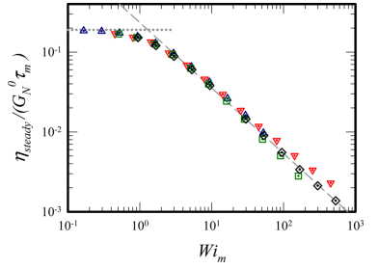
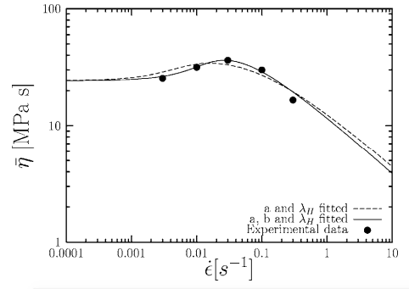
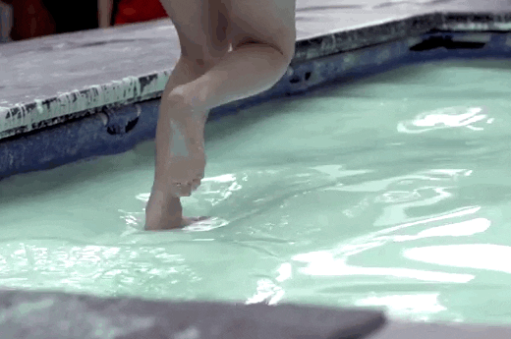
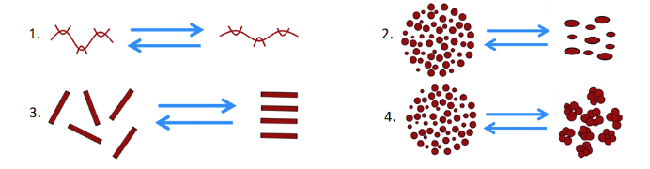



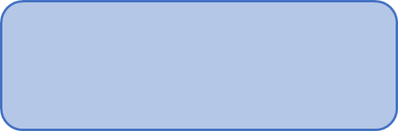



Linear and nonlinear rheology
Int
“Investigating the linear and nonlinear rheology of model polymer melts”
Non linear regime
Linear rheology
PS melts
$$η=η\left(\dot{γ}\right)$$
$$η_{E}=η_{E}\left(\dot{ε}\right)$$
&
$η,η_{E}$ = cst
Shear thickening fluid (Pourquoi ?)
PS melts
Microstructure is at equilibrium
$$=\dot{γ }τ$$
Costanzo et al. Macromol. 2016
My focus : What is happening
at the molecular level?
Change of $η$ due to change of microstructure
Theories generally fail in this regime
6
Theories generally fail in this regime
Nielsen et al. J. Rheol. 2006
Flow deforms chains faster that they can relax
Theories generally fail in this regime
What is happening at the molecular level?
Notes:
Models based on the models given in class for the shear and elongational flow.
For the shear flow : the lower plate stays still while the upper one moves. So v_x(0) = 0. The flow is established so the only velocity (in 2D) is parallel to the plates and varies only along x (stationary flow, each cross section, same velocity profile).
For shear flow : 1D example shown. Velocity of center doesn’t change. The rest is strtched proportionally to the strain rate (called hecnky strain rate). Of course, since 1D, only 1 velocity component depending on one direction.
Both can be generalized in 3D.

Slide 7
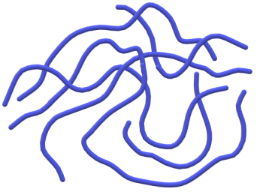
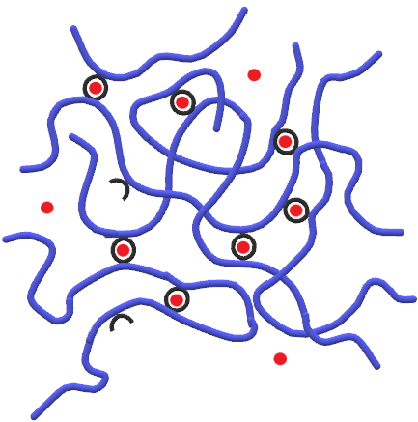
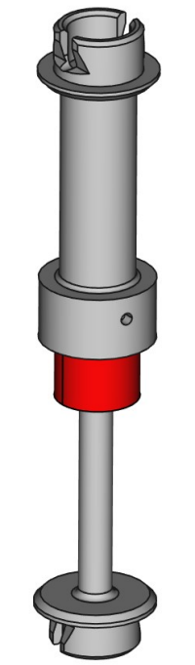
Outline
Int
My PhD consist of two main parts:
1. Characterisation and modeling
2. Design of a rheometer
Entangled polymer melts
Supramolecular polymers
Orthogonal superposition rheology
7
Notes:
Models based on the models given in class for the shear and elongational flow.
For the shear flow : the lower plate stays still while the upper one moves. So v_x(0) = 0. The flow is established so the only velocity (in 2D) is parallel to the plates and varies only along x (stationary flow, each cross section, same velocity profile).
For shear flow : 1D example shown. Velocity of center doesn’t change. The rest is strtched proportionally to the strain rate (called hecnky strain rate). Of course, since 1D, only 1 velocity component depending on one direction.
Both can be generalized in 3D.

Slide 8
Outline
Int
My PhD consist of two main parts:
1. Characterisation and modeling
2. Design of a rheometer
Entangled polymer melts
Supramolecular polymers
Orthogonal superposition rheology
8
Notes:
Models based on the models given in class for the shear and elongational flow.
For the shear flow : the lower plate stays still while the upper one moves. So v_x(0) = 0. The flow is established so the only velocity (in 2D) is parallel to the plates and varies only along x (stationary flow, each cross section, same velocity profile).
For shear flow : 1D example shown. Velocity of center doesn’t change. The rest is strtched proportionally to the strain rate (called hecnky strain rate). Of course, since 1D, only 1 velocity component depending on one direction.
Both can be generalized in 3D.

Slide 9
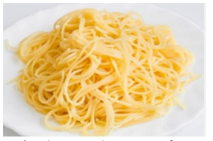
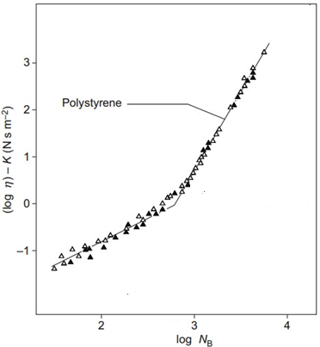
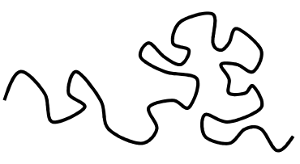
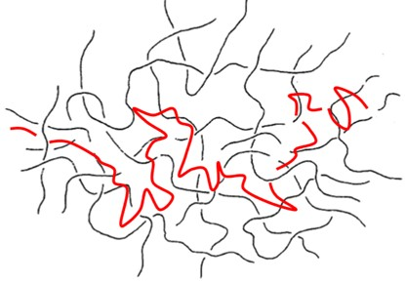
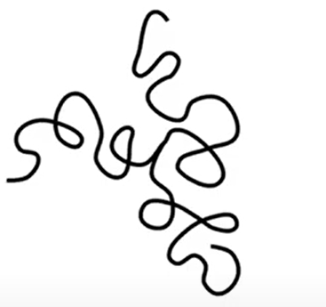
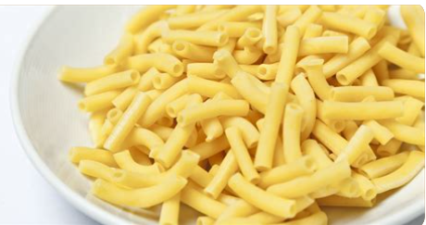

https://www.bbau.ac.in/dept/Chemistry/TM/MCH%20301%20Superamolecular%20Chemistry%20DoC.pdf
Dynamic and reconfigurable materials from reversible network interactions
https://olsenlab.mit.edu/research/dynamics/#:~:text=Associative%20polymers%20contain%20sticky%20groups,responsive%20and%20self%2Dhealing%20abilities.
Rheology of entangled polymers
How do scientists visualize polymers ?
  Polymer are long and flexible chains
3.4
Spaghetti
  Polymer chains entangle
1
$$M_{C}$$
Macaroni
9
Rubinstein, M., and A. N. Semenov, “Dynamics of entangled solutions of associating polymers,” Macromolecules 34, 1058–1068 (2001)

Slide 10
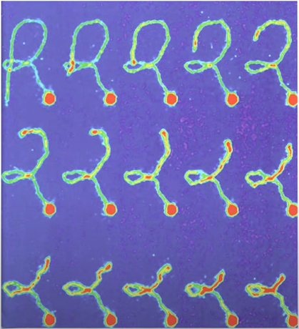
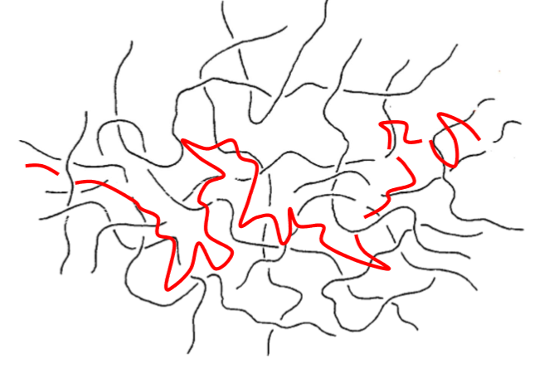
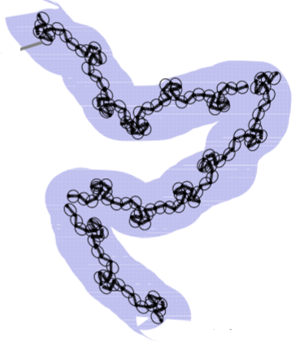
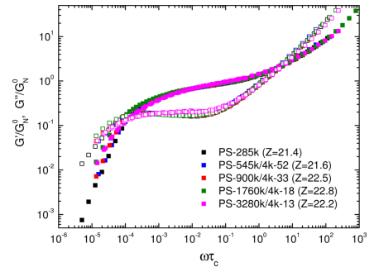




The tube model in the linear regime
Entanglements confine each chain in a tube-like region with a lifetime
Tube-like motion of a DNA molecule
$$τ_{d}$$
Test chain entangled
Tube model
Doi & Edwards, 1986.
Perkins, T.; Smith, D.; Chu, S. Science, 1994
Linear response of entangled polymers
3 parameters suffice to describe entirely the spectrum of relaxation times
Number of entanglements
$$Z≜M/M_{e}$$
Network stress-scale
$${G_{e}=ρRT/M}_{e}$$
Network timescale
$$τ_{e}$$
Huang et al. Macromol. 2013
Notes:
For shear flow : 1D example shown. Velocity of center doesn’t change. The rest is strtched proportionally to the strain rate (called hecnky strain rate). Of course, since 1D, only 1 velocity component depending on one direction.
Both can be generalized in 3D.

Slide 11
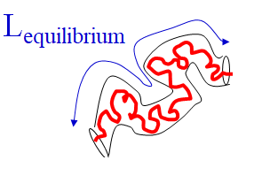


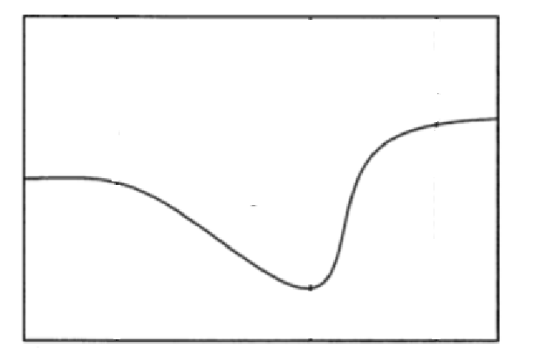
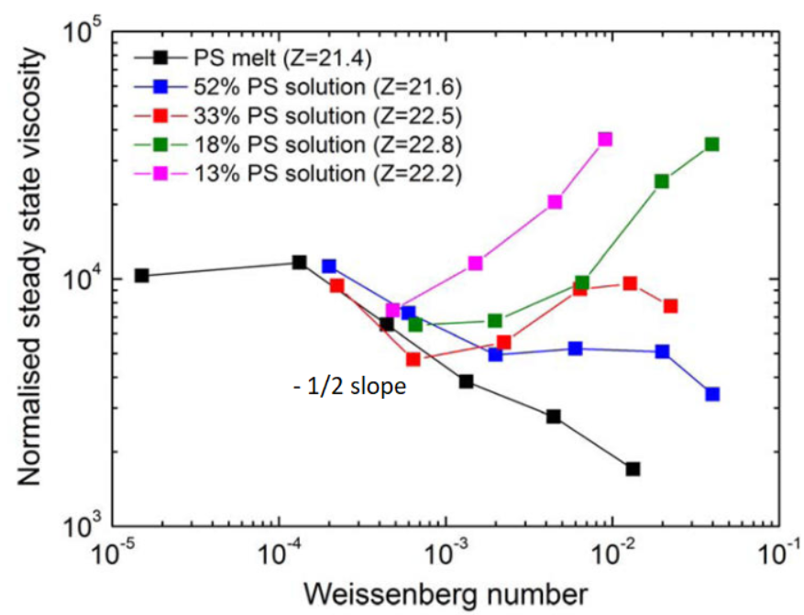
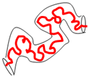












The tube model in the nonlinear regime
Flow competes with spectrum of relaxation time
$$\sim$$
$$\dot{ε},\dot{γ}$$
$$\sim$$
$$1/τ_{R}$$
$$>$$
$$>$$
$\dot{ε},\dot{γ}$ $1/τ_{d}$
This view fails in the non-linear regime…
Prediction as per DEMG model
Experimental results
$$η_{E,st}$$
I
II
III
IV
$$\dot{ε}$$
$$= \dot{ε} τ_{R}$$
Huang et al. Macromol. 2013
Notes:
Models based on the models given in class for the shear and elongational flow.
For the shear flow : the lower plate stays still while the upper one moves. So v_x(0) = 0. The flow is established so the only velocity (in 2D) is parallel to the plates and varies only along x (stationary flow, each cross section, same velocity profile).
For shear flow : 1D example shown. Velocity of center doesn’t change. The rest is strtched proportionally to the strain rate (called hecnky strain rate). Of course, since 1D, only 1 velocity component depending on one direction.
Both can be generalized in 3D.

Slide 12
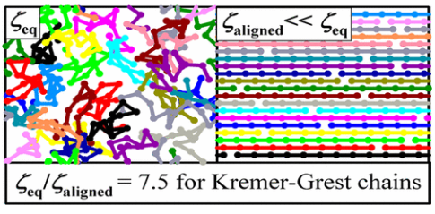




Extension of the tube model to NLVE
Introduction
Potential causes :
1. Alignement - Induced reduction of the monomeric friction
Yaoita et al., Macromol. 2012
Molecular dynamics simulations
When $\dot{ε }≫ \frac{1}{τ_{R}}$, local environment becomes anisotropic
reduction of the monomeric friction $ζ<ζ_{o}$
reduction of $τ_{d}$ and $τ_{R}$
Ianniruberto & Marrucci, Macromol. 2020
2. Deviation from the fluctuation dissipation theorem
Matsumiya & Watanabe, Prog. Polym. Sci. 2020
$$\left\langle F_{therm}\left(n,t\right)\right\rangle =0$$
$$\left\langle F_{therm}\left(n,t\right)F_{therm}\left(m,t′\right)\right\rangle =B\left(t\right)δ_{nm}δ\left(t−t^{′}\right)I$$
with
$B_{eq}=2ζ_{eq}k_{B}T$
12
Notes:
Models based on the models given in class for the shear and elongational flow.
For the shear flow : the lower plate stays still while the upper one moves. So v_x(0) = 0. The flow is established so the only velocity (in 2D) is parallel to the plates and varies only along x (stationary flow, each cross section, same velocity profile).
For shear flow : 1D example shown. Velocity of center doesn’t change. The rest is strtched proportionally to the strain rate (called hecnky strain rate). Of course, since 1D, only 1 velocity component depending on one direction.
Both can be generalized in 3D.

Slide 13
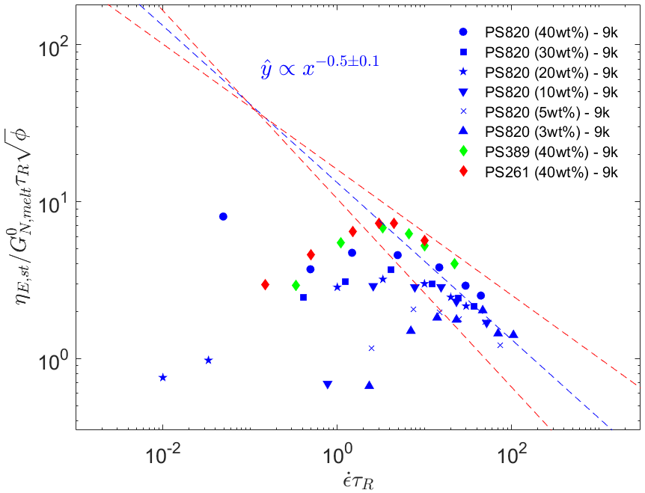
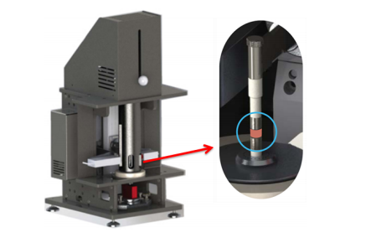


Extension of the tube model to NLVE
Extensional rheology of entangled polymer melts
Extensional viscosity of polymeric solutions
Filament Stretching Rheometer (FSR)
www.rheofilament.com (September 18, 2021)
$$η_{E,st}∝\sqrt{φ}M_{w}$$
13
Notes:
Models based on the models given in class for the shear and elongational flow.
For the shear flow : the lower plate stays still while the upper one moves. So v_x(0) = 0. The flow is established so the only velocity (in 2D) is parallel to the plates and varies only along x (stationary flow, each cross section, same velocity profile).
For shear flow : 1D example shown. Velocity of center doesn’t change. The rest is strtched proportionally to the strain rate (called hecnky strain rate). Of course, since 1D, only 1 velocity component depending on one direction.
Both can be generalized in 3D.

Slide 14
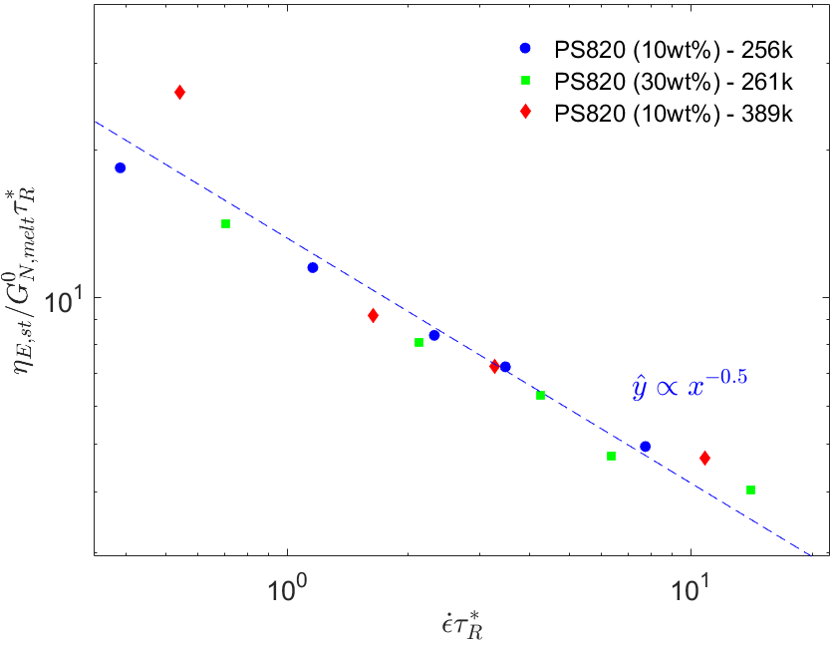
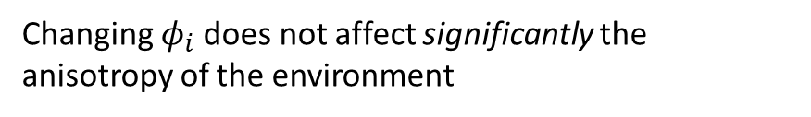






Outline
Extensional rheology of entangled polymer melts
Change of scaling laws in agreement with $ζ$reduction :
Extensional viscosity of bimodal melts
Polymeric solutions
Dilution makes the environment less anisotropic
Chain stretching
$$φ$$
when
$η_{E,st}∝φ^{x_{sol}}$with $x_{sol}<1$
$$τ_{R}^{∗}={\left(\sum_{i}{φ_{i}\sqrt{τ_{R,i}}}\right)}^{2}$$
Bimodal systems
Changing $φ_{i}$does not affect significantly the anisotropy of the environment
$$η_{E,st}∝ \sum_{i}{φ_{i}M_{w,i}}$$
$η_{E,st}∝φ^{x_{bi}}$with $x_{bi}≈1>x_{sol}$

Slide 15
Outline
Int
My PhD consist of three parts:
1. Characterisation and modeling
2. Design of a rheometer
Entangled polymer melts
Supramolecular polymers
Orthogonal superposition rheology
15
Notes:
Models based on the models given in class for the shear and elongational flow.
For the shear flow : the lower plate stays still while the upper one moves. So v_x(0) = 0. The flow is established so the only velocity (in 2D) is parallel to the plates and varies only along x (stationary flow, each cross section, same velocity profile).
For shear flow : 1D example shown. Velocity of center doesn’t change. The rest is strtched proportionally to the strain rate (called hecnky strain rate). Of course, since 1D, only 1 velocity component depending on one direction.
Both can be generalized in 3D.

Slide 16



https://www.bbau.ac.in/dept/Chemistry/TM/MCH%20301%20Superamolecular%20Chemistry%20DoC.pdf
Dynamic and reconfigurable materials from reversible network interactions
https://olsenlab.mit.edu/research/dynamics/#:~:text=Associative%20polymers%20contain%20sticky%20groups,responsive%20and%20self%2Dhealing%20abilities.
Supramolecular chemistry : Transient polymer networks
« Chemistry beyond the molecule » : The supramolecular interactions
Introduction of inter-chain interactions into polymers
Physical bonds vs chemical bonds
Reproduced from Wu, S.; Chen, Q. Macromolecules 2022, 55, 697–714.
Adapted from Wiley Interdiscip. Rev. Nanomed. Nanobiotechnol. 2013, 5, 582-621.
$$τ_{lifetime}∝\exp\left(\frac{E_{a}}{RT}\right)$$
16
Rubinstein, M., and A. N. Semenov, “Dynamics of entangled solutions of associating polymers,” Macromolecules 34, 1058–1068 (2001)

Slide 17















https://www.bbau.ac.in/dept/Chemistry/TM/MCH%20301%20Superamolecular%20Chemistry%20DoC.pdf
Dynamic and reconfigurable materials from reversible network interactions
https://olsenlab.mit.edu/research/dynamics/#:~:text=Associative%20polymers%20contain%20sticky%20groups,responsive%20and%20self%2Dhealing%20abilities.
Supramolecular chemistry : Transient polymer networks
Many possible applications:
2. Self-healable materials/Super-adhesive
1. Enhancing toughness of materials
:
Ionic bonds
:
&
Covalent bonds
Leibler et al. Nature 2008, 451, 977–980.
3. Thermal responsiveness
:
Meijer et al. Science 1997, 278, 1601-1604.
Suo et al. Nature 2012, 489, 133–136.
17
Rubinstein, M., and A. N. Semenov, “Dynamics of entangled solutions of associating polymers,” Macromolecules 34, 1058–1068 (2001)

Slide 18




Supramolecular polymers: transient polymer networks
1. Terpyridine (tpy) groups
Supramolecular bonds
<
+
Metal ions
Terpyridine-modified poly(n-butyl acrylate)
2. 2-ureido-4[1H]-pyrimidinone (Upy) groups
Cui, K. & Gong, J. P. J. Rheol. 2022.
18

Slide 19















Linear Viscoelasticity : $Zn^{2+}$- based systems
Linear rheology :
Plate-plate geometries
$$T_{ref}=25°C$$
$$[Zn^{2+}]$$
Formation of a dense network
Emergence of a rubbery plateau
$$T=−10°C$$
Ions
Delay of the longest relaxation time
19
PnBA25k - 11Tpy
Changer Magenta -> Rouse
Pente
$$T=80°C$$
$$T=40°C$$
$$T=25°C$$
$$T=25°C$$

Slide 20




Linear Viscoelasticity : $Zn^{2+}$- based systems
Effect of the nature of ions
$$T_{ref}=25°C$$
vs
Deficiency
Dissociation

Slide 21
Linear Viscoelasticity : $Zn^{2+}$- based systems
Effect of the nature of ions
$$T_{ref}=25°C$$
Segmental motion
vs
Deficiency
Dissociation

Slide 22


Linear Viscoelasticity : $Zn^{2+}$- based systems
Effect of the nature of ions
$$T_{ref}=25°C$$
Dissociation of bonds
Segmental motion
$$Cu(II)$$
leads to bonds much more stable than does
$$Zn(II)$$
vs
Deficiency
Dissociation

Slide 23




Linear Viscoelasticity : Thermal responsiveness
Changing the nature of ions also allows to tune the thermal responsiveness
$$T_{ref}=25°C$$
$$τ_{lifetime}∝\exp\left(\frac{E_{a}}{RT}\right)$$
 | Neutral | Cu(II) | Zn(II)
$E_{a}[kJ/mol$] | 51.2 | 49.4 | -
vs
Deficiency
Dissociation

Slide 24




























Linear Viscoelasticity : $Zn^{2+}$- based systems
Unentangled chains : Sticky Rouse model
Modelling
$$s_{1}$$
$$ζ_{0}$$
$$ζ_{1}$$
$$s_{2}$$
$$ζ_{0}Ξ\frac{∂R}{∂t}=− κAR+F_{B}I$$
$$s_{n−1}$$
$$R_{n,n−1}$$
$$≈$$
$$ζ_{0}$$
$$s_{N −1}$$
$$ζ_{0}$$
$$ζ_{1}$$
$$s_{n}$$
$F_{viscous}$
$F_{spring}$
$F_{thermal}$
$$ζ_{0}$$
$$s_{n +1}$$
$$ζ_{0}$$
$$s_{N}$$
Jiang et al. Macromol. 2021
Baxandall . Macromol. 1988
Entangled chains : Sticky reptation model
$$≈$$
$$τ_{d}^{∗}$$
Tube with a lifetime
Doi & Edwards . Theory of polymer dynamics. 1986
24
vs
Dissociation
$$T_{ref}=25°C$$
M : $Zn(II)$
$$[Zn^{2+}]$$

Slide 25







Steady shear measurements : Method
Nonlinear shear rheology techniques for polymer melt
Cone-Partitioned-Plate geometry (CPP)
Plate-plate geometries
Translation stages for alignement
Outer hollowed parallel plate
Cone-partitioned-plate geometries
Inner parallel plate
Polymer sample
Cone geometry
Upper flat plate
(Image from : Costanzo et al., Macromolecules, (2016).)
25

Slide 26



Steady shear measurements : Method
Nonlinear shear rheology techniques
Cone-Partitioned-Plate geometry (CPP)
Plate-plate geometries
Translation stages for alignement
Outer hollowed parallel plate
Cone-partitioned-plate geometries
Inner parallel plate
Polymer sample
Cone geometry
Upper flat plate
Inward propagation of edge fracture
CPP measures only the inner part
(Image from : Costanzo et al., Macromolecules, (2016).)
26

Slide 27










Nonlinear Viscoelasticity : $Zn^{2+}$- based systems
PnBA25k – 7tpy
PnBA25k - 7Tpy – 0.75 eq. $Zn^{2+}$
$$T=−10°C$$
$$T=25°C$$
+
Metal Ions
($Zn^{2+})$
Transient strain hardening is revealed
Stretching of the network strands :
27

Slide 28





Nonlinear shear rheology: $Zn^{2+}$- based systems
Experimentally observed features in nonlinear shear regime:
1. Validity of TTS principle
2. Yield strain independent of $\dot{γ}$
3. Breakdown of the Cox-Merz rule
28

Slide 29
Outline
Int
My PhD consist of three parts:
1. Characterisation and modeling
2. Design of a rheometer
Entangled polymer melts
Supramolecular polymers
Orthogonal superposition rheology
29
Notes:
Models based on the models given in class for the shear and elongational flow.
For the shear flow : the lower plate stays still while the upper one moves. So v_x(0) = 0. The flow is established so the only velocity (in 2D) is parallel to the plates and varies only along x (stationary flow, each cross section, same velocity profile).
For shear flow : 1D example shown. Velocity of center doesn’t change. The rest is strtched proportionally to the strain rate (called hecnky strain rate). Of course, since 1D, only 1 velocity component depending on one direction.
Both can be generalized in 3D.

Slide 30





Orthogonal superposition (OSP) rheology
Objective : Measure the response of polymer melts under orthogonal superposition flow
3
$$\dot{γ}$$
$$x_{1}\left(t\right)=x_{1}\left(t^{′}\right)+x_{2}\left(t\right)\dot{γ}(t−t^{′})$$
1
$$x_{2}\left(t\right)=x_{2}\left(t^{′}\right)$$
2
Simu + Linear perturabtion
$$\dot{γ}$$
$${ x}_{3}\left(t\right)=x_{3}\left(t^{′}\right)+γ_{0}(\sin{ωt −\sin{ωt^{′}) x_{2}(t)}}$$
Entangled associative polymers
Spectral analysis of the flow
30
Hendrickx, J. PhD thesis 2019

Slide 31







Superposition rheology
Predictions of orthogonal moduli of an unentangled melts using a bead-spring model from the literature
Predictions of ${G′}_{⊥}$ and $G_{⊥}^{′′}$
Master curves
Constitutive model from Sato et al. Phys. Fluid 2021
$$τ_{p}=\frac{τ_{p,eq }}{a^{∗}}=τ_{p,eq }\frac{r_{ζ}}{r_{κ}}$$
$${G′}_{⊥}=\frac{ν_{unrel}k_{B}T}{b^{∗}}=ν_{unrel}k_{B}T\frac{r_{B}}{r_{ζ}}$$
&
31
Horizontal shift :
$$a^{∗}=\frac{r_{κ}}{r_{ζ}}$$
$$G\left(t\right)≈\frac{ρRT}{M}\sum_{p=1}^{n}{\exp\left(\frac{−t}{τ_{p}}\right)}$$

Slide 32









OSP design
The design is composed of three main components:
1. Flow cell: Annular Couette cell
2. Drive: TA ARES-G2
3. Shafts
$$ω_{0}$$
$$z(t)$$
Force rebalance
transducer
$$z(t)$$
Servo-motor
$$ω_{0}$$
www.tainstruments.com (August 1, 2023)
$$ω_{0}$$

Slide 33


Orthogonal superposition (OSP) rheology
Flow cell : Annular Couette flow with inner cylinder rotating and outer cylinder oscillating in axial direction.
Simu + Linear perturabtion
Relative error for power-law fluid
33

Slide 34



Outline
Conclusion
We obtained scaling laws for entangled melts in nonlinear extensional flow which confirms the hypothesis of $ζ$reduction:
Polymeric solutions
Bimodal melts
$$η_{E,st}∝\sqrt{φ}M_{w}$$
$$η_{E,st}∝ \sum_{i}{φ_{i}M_{w,i}}$$
We modeled the linear rheology of unentangled and entangled associative polymers using a bead-spring model
and a home-made sticky reptation model.
We observed transient thickening, an yield strain independent of $\dot{γ},$ and a confirmation of the validity of TTS for unentangled associative polymers in nonlinear shear.
We proposed and validated by CFD a new design of a rheometer tool to perform OSP measurements
34
We showed characteristic features in the rheology unentangled associative polymers such as constant yield strain, TTS validity and transient hardening.
We were able to model the linear rheology of unentangled and entangled associative polymers using a statistical sticky Rouse model and a home-made sticky reptation model
Perspectives
Validate the orthogonal superposition flow cell
Analyse SAXS data of Pr. Kell Mortensen
Writing of the manuscript

Slide 35
https://www.bbau.ac.in/dept/Chemistry/TM/MCH%20301%20Superamolecular%20Chemistry%20DoC.pdf
Dynamic and reconfigurable materials from reversible network interactions
https://olsenlab.mit.edu/research/dynamics/#:~:text=Associative%20polymers%20contain%20sticky%20groups,responsive%20and%20self%2Dhealing%20abilities.
Acknowledgements
  Thank you blablabla
35
Rubinstein, M., and A. N. Semenov, “Dynamics of entangled solutions of associating polymers,” Macromolecules 34, 1058–1068 (2001)

Slide 36



https://www.bbau.ac.in/dept/Chemistry/TM/MCH%20301%20Superamolecular%20Chemistry%20DoC.pdf
Dynamic and reconfigurable materials from reversible network interactions
https://olsenlab.mit.edu/research/dynamics/#:~:text=Associative%20polymers%20contain%20sticky%20groups,responsive%20and%20self%2Dhealing%20abilities.
Supramolecular chemistry : Transient polymer networks
« Chemistry beyond the molecule » : The supramolecular interactions
Physical bonds vs chemical bonds
+
: Ligand
Metal ions
In nature…
Harrington, M. J. et al., Science, 328(5975), 216–220 (2010)
Cui, K., and J. P. Gong, J. Rheol. 66, 1093 (2022)
36

Slide 37

Supramolecular polymers: transient polymer networks
Supramolecular bonds
1. Terpyridine (tpy) groups
Chapter 5 and 6
Terpyridine-modified poly(n-butyl acrylate)
Cui, K. & Gong, J. P. J. Rheol. 2022.
: $Zn\left(II\right)and Cu(II)$
37
Lability

Slide 38









Linear viscoelasticity: $Zn^{2+}$- based networks
1. Unentangled polymers
2. Entangled polymers
(Chapter 6)
(Chapter 5)
PnBA25k - 11Tpy
PnBA140k - 13Tpy
$$…$$
$$\frac{ρRT}{M_{s}}$$
 | ^{1 eq.} | ^{0.75 eq.} | ^{0.5 eq.} | ^{0.25 eq.} | ^{0.125 eq.}
$$E_{a} [kJ/mol]$$ | 81.4 | 67.6 | 61.5 | 36.9 | 36.4
$E_{a}=27.1 kJ/mol$
Large reinforcement
Saturation of $τ_{rel}$ and $G_{N}^{0}$
38

Slide 39










Linear viscoelasticity: ${Cu}^{2+}$- based systems
1. Unentangled polymers
2. Entangled polymers
PnBA25k - 11Tpy
PnBA140k - 13Tpy
0.5 eq. $Cu(II)$
$$T=25°C$$
0.5 eq. $Cu(II)$
0.5 eq. $Zn(II)$
0.5 eq. $Zn(II)$
Zn(II) ions are much more labile than Cu(II) ions
39

Slide 40



















Outline
Modeling: the sticky reptation model
2. Constraint Release
3 ingredients for the modelling of entangled supramolecular polymers
Time marching algorithm
$$τ_{rep}\left(x,t_{i+1}\right)$$
1. Reptation
$$F(t_{i})$$
$$τ_{fluc}(x,t_{i+1})$$
Sticky reptation model
$$t>τ_{S}$$
$$t_{i}$$
$$\sim$$
$$t_{i+1}$$
$$p_{surv}\left(x,t_{i+1}\right)={ p}_{surv}\left(x,t_{i}\right){ × p}_{surv}\left(x,{[t}_{i},t_{i+1}]\right)$$
van Ruymbeke, E. et al. Macromolecules 2006
$${τ_{d}^{∗}}^{−1}$$
$$τ_{S}^{−1}$$
$$τ_{e}^{−1}$$
$$G^{′}$$
3. Contour Length Fluctuation
$$0.5$$
$$0.5$$
$$2$$
$$τ_{f,k}=\left(\frac{τ_{s}}{p_{free}^{k\left(x\right)}+\left(1−p_{free}\right)k\left(x\right)p_{free}^{k\left(x\right)−1}}\right)$$
$${τ_{e}^{∗}}^{−1}$$
$$ω$$
Leibler, L. et al. Macromol. 1991
40

Slide 41














Modeling: the sticky reptation model
The resulting model provides a decent fit of experimental data
0.75 eq. $Zn(II)$
0.5 eq. $Cu(II)$
$$M_{e}=18 kg/mol$$
$$M_{e}=18 kg/mol$$
$$M_{XX}=13 kg/mol$$
$$M_{XX}=13 kg/mol$$
Literature data
PI – 84k – U1
PSMA108k – 3.7%Na
$$M_{e}=15 kg/mol$$
$$M_{XX}=2 kg/mol$$
$$M_{e}=4.5 kg/mol$$
Sticky CLF
$$M_{XX}=6 kg/mol$$
Stepwise CLF
41
Data from Gold et al. J. Rheol. 2017
Data from Kim et al. Macromolecules 1994
Notes:
Models based on the models given in class for the shear and elongational flow.
For the shear flow : the lower plate stays still while the upper one moves. So v_x(0) = 0. The flow is established so the only velocity (in 2D) is parallel to the plates and varies only along x (stationary flow, each cross section, same velocity profile).
For shear flow : 1D example shown. Velocity of center doesn’t change. The rest is strtched proportionally to the strain rate (called hecnky strain rate). Of course, since 1D, only 1 velocity component depending on one direction.
Both can be generalized in 3D.

Slide 42
Supramolecular polymers: transient polymer networks
Supramolecular bonds
1. Terpyridine (tpy) groups
Chapter 5 and 6
Synthesised by Flanco Zhuge & Rowanne Lyons (UCLouvain)
2. 2-ureido-4[1H]-pyrimidinone (Upy) groups
Chapter 4
Synthesised by Jente Verjans (UGent)
Cui, K. & Gong, J. P. J. Rheol. 2022.
42

Slide 43








Linear Viscoelasticity: Upy - based systems
Unentangled associative polymers
$$T_{ref}=40°C$$
$$T_{ref}=70°C$$
$$T_{ref}=80°C$$
PBA | PB | PMA
$$33−37$$ | $$31.6 −36$$ | $$\text{36.5 }\text{−}\text{ 44.5 }$$
$E_{a}$ [$kJ/mol$]
No significant effect of the backbone on the strength of the physical bonds
43
($T_{g,PBA}<T_{g,PB}<T_{g,PMA}$)

Slide 44











Modeling: the sticky Rouse model
Modeling of the linear responses using a bead-spring model
PMA – U10
Fast dynamics $\left(τ<τ_{S}\right)$
Slow dynamics $\left(τ≥τ_{S}\right)$
$$ζ_{0}$$
$$ζ_{1}$$
$$ζ_{1}$$
$$∞$$
$$k_{0}$$
$$ζ_{0}$$
$$ζ_{1}$$
$$∞$$
$$ζ_{1}$$
$$ζ_{1}$$
$$ζ_{0}$$
$$ζ_{0}$$
$$ζ_{1}$$
$$ζ_{0}$$
$$ζ_{1}$$
$$ζ_{i}= \left\{\begin{aligned}ζ_{0} if normal beads \\ ∞ if sticky beads\end{aligned}\right.$$
$$κ_{i} =\frac{3k_{B}T}{{n_{i}b}^{2}}$$
$$ζ_{i}=ζ_{1}$$
$$κ_{i}=k_{0}$$
$$and$$
$$G\left(t\right)={G_{KWW}\left(t\right)+G_{fast}\left(t\right)+G}_{slow}\left(t\right)$$
+ correction for non-affine fluctuations
Liu, H. et al . J. Rheol 2022
44

Slide 45
Modeling: the sticky Rouse model
Modeling of the linear responses using a bead-spring model
PMA – U10
Fast dynamics $\left(τ<τ_{S}\right)$
Slow dynamics $\left(τ≥τ_{S}\right)$
$$ζ_{0}$$
$$ζ_{1}$$
$$ζ_{1}$$
$$∞$$
$$k_{0}$$
$$ζ_{0}$$
$$ζ_{1}$$
$$∞$$
$$ζ_{1}$$
$$ζ_{1}$$
$$ζ_{0}$$
$$ζ_{0}$$
$$ζ_{1}$$
$$ζ_{0}$$
$$ζ_{1}$$
$$ζ_{i}= \left\{\begin{aligned}ζ_{0} if normal beads \\ ∞ if sticky beads\end{aligned}\right.$$
$$κ_{i} =\frac{3k_{B}T}{{n_{i}b}^{2}}$$
$$ζ_{i}=ζ_{1}$$
$$κ_{i}=k_{0}$$
$$and$$
$$G\left(t\right)={G_{KWW}\left(t\right)+G_{fast}\left(t\right)+G}_{slow}\left(t\right)$$
+ correction for non-affine fluctuations
Liu, H. et al . J. Rheol 2022
45

Slide 46
https://www.bbau.ac.in/dept/Chemistry/TM/MCH%20301%20Superamolecular%20Chemistry%20DoC.pdf
Dynamic and reconfigurable materials from reversible network interactions
https://olsenlab.mit.edu/research/dynamics/#:~:text=Associative%20polymers%20contain%20sticky%20groups,responsive%20and%20self%2Dhealing%20abilities.
Supramolecular chemistry : Transient polymer networks
« Chemistry beyond the molecule » : The supramolecular interactions
Physical bonds vs chemical bonds
Formation of a dynamic and reversible polymeric network
Properties :
Self-healing properties
Stimuli responsive
High tunability (Stiffness, toughness & relaxation time)
…
Cui, K., and J. P. Gong, J. Rheol. 66, 1093 (2022)
46
(see for example : Seiffert . Adv. Polym. Sci. 2015, 268, 288.)
Rubinstein, M., and A. N. Semenov, “Dynamics of entangled solutions of associating polymers,” Macromolecules 34, 1058–1068 (2001)

Slide 47

https://www.bbau.ac.in/dept/Chemistry/TM/MCH%20301%20Superamolecular%20Chemistry%20DoC.pdf
Dynamic and reconfigurable materials from reversible network interactions
https://olsenlab.mit.edu/research/dynamics/#:~:text=Associative%20polymers%20contain%20sticky%20groups,responsive%20and%20self%2Dhealing%20abilities.
Rheology of entangled polymers
How do scientists visualize polymers ?
  1. Rouse model
3.4
Spaghetti
2. The tube model
1
$$M_{C}$$
Macaroni
47
Rubinstein, M., and A. N. Semenov, “Dynamics of entangled solutions of associating polymers,” Macromolecules 34, 1058–1068 (2001)

Slide 48
https://www.bbau.ac.in/dept/Chemistry/TM/MCH%20301%20Superamolecular%20Chemistry%20DoC.pdf
Dynamic and reconfigurable materials from reversible network interactions
https://olsenlab.mit.edu/research/dynamics/#:~:text=Associative%20polymers%20contain%20sticky%20groups,responsive%20and%20self%2Dhealing%20abilities.
Supramolecular chemistry : Transient polymer networks
  Associative polymers
48
Rubinstein, M., and A. N. Semenov, “Dynamics of entangled solutions of associating polymers,” Macromolecules 34, 1058–1068 (2001)

Slide 49
https://www.bbau.ac.in/dept/Chemistry/TM/MCH%20301%20Superamolecular%20Chemistry%20DoC.pdf
Dynamic and reconfigurable materials from reversible network interactions
https://olsenlab.mit.edu/research/dynamics/#:~:text=Associative%20polymers%20contain%20sticky%20groups,responsive%20and%20self%2Dhealing%20abilities.
Supramolecular chemistry : Transient polymer networks
  Conclusion
49
Rubinstein, M., and A. N. Semenov, “Dynamics of entangled solutions of associating polymers,” Macromolecules 34, 1058–1068 (2001)

Slide 50







Rouse and tube models
The Rouse model
Stress depends on the orientation of the polymeric chains
$→$ After a step strain, chains need to renew their conformation to relax
Unentangled polymer
$$σ_{chain}∝28 k_{B}T$$
$$σ_{chain}∝14 k_{B}T$$
$$\vec{r(t)}$$
Relaxation in a time $τ_{R}∝ \frac{<Δr^{2}\left(t\right)>}{D}$ $∝M^{2}$
$$σ_{chain}∝9 k_{B}T$$
$$t$$
50

Slide 51

https://www.bbau.ac.in/dept/Chemistry/TM/MCH%20301%20Superamolecular%20Chemistry%20DoC.pdf
Dynamic and reconfigurable materials from reversible network interactions
https://olsenlab.mit.edu/research/dynamics/#:~:text=Associative%20polymers%20contain%20sticky%20groups,responsive%20and%20self%2Dhealing%20abilities.
Supramolecular chemistry : Transient polymer networks
Many possible applications
2. Self-healable materials/Super-adhesive
1. Enhancing toughness of materials
:
Ionic bonds
o
H
:
N
&
Covalent bonds
Leibler et al. Nature 2008, 451, 977–980.
3. Thermal responsiveness
:
Suo et al. Nature 2012, 489, 133–136.
51
Meijer et al. Science 1997, 278, 1601-1604.
Rubinstein, M., and A. N. Semenov, “Dynamics of entangled solutions of associating polymers,” Macromolecules 34, 1058–1068 (2001)

Slide 52







Modelling : the Rouse model
Rouse model in linear flow
$$ζ_{0}$$
$$ζ_{1}$$
$$s_{2}$$
$$ζ_{0}Ξ\frac{∂R}{∂t}=− κAR+F_{B}I$$
$$s_{1}$$
$$R_{n,n−1}$$
$$≈$$
$$s_{n−1}$$
$$ζ_{0}$$
$$s_{N −1}$$
$F_{viscous}$
$F_{spring}$
$F_{thermal}$
$$ζ_{0}$$
$$ζ_{1}$$
$$s_{n}$$
Jiang et al. Macromol. 2021
$$ζ_{0}$$
$$s_{n +1}$$
Connectivity matrix
Friction force
$$ζ_{0}$$
$$s_{N}$$
$$A=\left[\begin{matrix}\begin{matrix}1 \\ −1 \\ \end{matrix} & \begin{matrix}\begin{matrix}−1 & \begin{matrix} & \begin{matrix} & \end{matrix}\end{matrix}\end{matrix} \\ \begin{matrix}2 & \begin{matrix}−1 & \begin{matrix} & \end{matrix}\end{matrix}\end{matrix} \\ \begin{matrix} & \begin{matrix}… & \begin{matrix} & \end{matrix}\end{matrix}\end{matrix}\end{matrix} \\ \begin{matrix} \\ \end{matrix} & \begin{matrix}\begin{matrix} \\ \end{matrix} & \begin{matrix}\begin{matrix}−1 \\ \end{matrix} & \begin{matrix}\begin{matrix}2 \\ −1\end{matrix} & \begin{matrix}−1 \\ 1\end{matrix}\end{matrix}\end{matrix}\end{matrix}\end{matrix}\right]$$
    $$Ξ=\left[\begin{matrix}\begin{matrix}δ_{1} & \\ & δ_{2}\end{matrix} & \begin{matrix} & \\ & \end{matrix} \\ \begin{matrix} & \\ & \end{matrix} & \begin{matrix}… & \\ & δ_{N}\end{matrix}\end{matrix}\right]$$
$$δ_{i}=\frac{ζ_{i}}{ζ_{0}}$$
with
Brownian force
$$\left\langle f_{B}\left(n,t\right)\right\rangle =0$$
$$\left\langle f_{B,α}\left(n,t\right)f_{B,β}\left(m,t′\right)\right\rangle =2ζ_{N}k_{B}Tδ_{nm}δ_{αβ}δ\left(t−t^{′}\right)I$$
Dissipation-Fluctuation correlation
52
Distribution of stickers and molar mass

Slide 53






The Rouse model
Int
The Rouse model :
Scaling laws
$$τ_{4}=τ_{R}$$
$$τ_{2}=τ_{R}/4$$
$$τ_{1}=τ_{R}$$
$$G\left(t\right)=\frac{ρRT}{M_{w}}\sum_{p=1}^{N}{\exp\left(−\frac{t}{τ_{p}}\right)}$$
$$τ_{p}= {\left(\frac{N}{p}\right)}^{2}τ_{0}$$
with
Unentangled PnBA (27 kg/mol)
53
[5]
Notes:
Models based on the models given in class for the shear and elongational flow.
For the shear flow : the lower plate stays still while the upper one moves. So v_x(0) = 0. The flow is established so the only velocity (in 2D) is parallel to the plates and varies only along x (stationary flow, each cross section, same velocity profile).
For shear flow : 1D example shown. Velocity of center doesn’t change. The rest is strtched proportionally to the strain rate (called hecnky strain rate). Of course, since 1D, only 1 velocity component depending on one direction.
Both can be generalized in 3D.

Slide 54
https://www.bbau.ac.in/dept/Chemistry/TM/MCH%20301%20Superamolecular%20Chemistry%20DoC.pdf
Dynamic and reconfigurable materials from reversible network interactions
https://olsenlab.mit.edu/research/dynamics/#:~:text=Associative%20polymers%20contain%20sticky%20groups,responsive%20and%20self%2Dhealing%20abilities.
Supramolecular chemistry : Transient polymer networks
« Chemistry beyond the molecule » : The supramolecular interactions
Introduction of inter-chain interactions into polymers
Physical bonds vs chemical bonds
Reproduced from Wu, S.; Chen, Q. Macromolecules 2022, 55, 697–714.
Adapted from Wiley Interdiscip. Rev. Nanomed. Nanobiotechnol. 2013, 5, 582-621.
$$τ_{lifetime}∝\exp\left(\frac{E_{a}}{RT}\right)$$
54
Rubinstein, M., and A. N. Semenov, “Dynamics of entangled solutions of associating polymers,” Macromolecules 34, 1058–1068 (2001)

Slide 55
https://www.bbau.ac.in/dept/Chemistry/TM/MCH%20301%20Superamolecular%20Chemistry%20DoC.pdf
Dynamic and reconfigurable materials from reversible network interactions
https://olsenlab.mit.edu/research/dynamics/#:~:text=Associative%20polymers%20contain%20sticky%20groups,responsive%20and%20self%2Dhealing%20abilities.
Supramolecular chemistry : Transient polymer networks
2. Self-healable materials/Super-adhesive
Many possible applications
1. Enhancing toughness of materials
o
H
N
Leibler et al. Nature 2008, 451, 977–980.
3. Thermal responsiveness
:
Ionic bonds
:
&
Covalent bonds
Suo et al. Nature 2012, 489, 133–136.
55
Meijer et al. Science 1997, 278, 1601-1604.
Rubinstein, M., and A. N. Semenov, “Dynamics of entangled solutions of associating polymers,” Macromolecules 34, 1058–1068 (2001)

Slide 56

https://www.bbau.ac.in/dept/Chemistry/TM/MCH%20301%20Superamolecular%20Chemistry%20DoC.pdf
Dynamic and reconfigurable materials from reversible network interactions
https://olsenlab.mit.edu/research/dynamics/#:~:text=Associative%20polymers%20contain%20sticky%20groups,responsive%20and%20self%2Dhealing%20abilities.
Material of interest
Physical bonds vs chemical bonds
<
+
Metal ions
M : $Zn(II) and Cu(II)$
Terpyridine-modified poly(n-butyl acrylate)
Group of Pr. Charles-André Fustin
How can we assess the network dynamics of supramolecular polymers?
Adapted from Wiley Interdiscip. Rev. Nanomed. Nanobiotechnol. 2013, 5, 582-621.
56

Slide 57
Linear Viscoelasticity : $Zn^{2+}$- based systems
Method :
Plate-plate geometries
$$T_{ref}=25°C$$
$$[Zn^{2+}]$$
Formation of a dense network
Emergence of a rubbery plateau
$$T=−10°C$$
Ions
Delay of the longest relaxation time
57
PnBA25k - 11Tpy
Changer Magenta -> Rouse
Pente
$$T=80°C$$
$$T=40°C$$
$$T=25°C$$
$$T=25°C$$

Slide 58
Linear Viscoelasticity : $Zn^{2+}$- based systems
Effect of the nature of ions
$$T_{ref}=25°C$$
vs
Deficiency
Dissociation

Slide 59
Linear Viscoelasticity : $Zn^{2+}$- based systems
Effect of the nature of ions
$$T_{ref}=25°C$$
Segmental motion
vs
Deficiency
Dissociation

Slide 60
Linear Viscoelasticity : $Zn^{2+}$- based systems
Effect of the nature of ions
$$T_{ref}=25°C$$
Dissociation of bonds
Segmental motion
$$Cu(II)$$
leads to bonds much more stable than does
$$Zn(II)$$
vs
Deficiency
Dissociation

Slide 61
Linear Viscoelasticity : $Zn^{2+}$- based systems
Unentangled chains : Sticky Rouse model
Modelling
$$s_{1}$$
$$ζ_{0}$$
$$ζ_{1}$$
$$s_{2}$$
$$ζ_{0}Ξ\frac{∂R}{∂t}=− κAR+F_{B}I$$
$$s_{n−1}$$
$$R_{n,n−1}$$
$$≈$$
$$ζ_{0}$$
$$s_{N −1}$$
$$ζ_{0}$$
$$ζ_{1}$$
$$s_{n}$$
$F_{viscous}$
$F_{spring}$
$F_{thermal}$
$$ζ_{0}$$
$$s_{n +1}$$
$$ζ_{0}$$
$$s_{N}$$
Jiang et al. Macromol. 2021
Baxandall . Macromol. 1988
Entangled chains : Sticky reptation model
$$≈$$
$$τ_{d}^{∗}$$
Tube with a lifetime
Doi & Edwards . Theory of polymer dynamics. 1986
61
vs
Dissociation
$$T_{ref}=25°C$$
M : $Zn(II)$
$$[Zn^{2+}]$$

Slide 62




Nonlinear Viscoelasticity : $Zn^{2+}$- based systems
Yield strain
$$T=50°C$$
$$T=50°C$$
$$\dot{γ}$$
Transient strain hardening is revealed
Stretching of the network strands :
62

Slide 63







Nonlinear Viscoelasticity : $Zn^{2+}$- based systems
Yield strain
$$\frac{fb}{k_{B}T}$$
Force-induced dissociation
$$T=50°C$$
Strain controlled
$$L^{∗}$$
$$γ_{Max}$$
Thermal dissociation
Strain-rate controlled
$$Wi=\dot{γ}τ_{S}$$
63

Slide 64


Orthogonal superposition (OSP) rheology
Investigation in the nonlinear regime
Measure the response of polymer melts under orthogonal superposition flow
3
$$\dot{γ}$$
$$x_{1}\left(t\right)=x_{1}\left(t^{′}\right)+x_{2}\left(t\right)\dot{γ}(t−t^{′})$$
Simu + Linear perturabtion
1
$$x_{2}\left(t\right)=x_{2}\left(t^{′}\right)$$
2
$$\dot{γ}$$
$${ x}_{3}\left(t\right)=x_{3}\left(t^{′}\right)+γ_{0}(\sin{ωt −\sin{ωt^{′}) x_{2}(t)}}$$
Entangled associative polymers
Spectral analysis of the flow
Information on chain conformations
[1]
64
[1] Jan Hendrickx, PhD thesis

Slide 65








The tube model
Int
Entangled polymer
$$τ_{0}<t<τ_{e}$$
$$t>τ_{e}$$
$$L_{eq}$$
$$τ_{e}$$
$$G\left(t\right)=\frac{ρRT}{M_{w}}\sum_{p=\frac{N}{N_{e}}+1}^{N}{\exp\left(−\frac{t}{τ_{p}}\right)}+\frac{ρRT}{M_{e}}F(t)$$
Modelling of the surrounding chains by a tube
Relaxation in a time $τ_{d}$ $∝ \frac{L_{eq}^{2}}{D_{e}}$ $∝M^{3}$
65
Notes:
Models based on the models given in class for the shear and elongational flow.
For the shear flow : the lower plate stays still while the upper one moves. So v_x(0) = 0. The flow is established so the only velocity (in 2D) is parallel to the plates and varies only along x (stationary flow, each cross section, same velocity profile).
For shear flow : 1D example shown. Velocity of center doesn’t change. The rest is strtched proportionally to the strain rate (called hecnky strain rate). Of course, since 1D, only 1 velocity component depending on one direction.
Both can be generalized in 3D.

Slide 66





The tube model
Int
3 mechanisms : Orientation relaxation (LVE)
1. Reptation
2. Contour Length Fluctuation (CLF)
3. Thermal Constraint Release
Scaling laws
Relaxation in a time $τ_{d}$ $∝M^{3−3.4}φ^{1−14}$
Zero-shear viscosity $η_{0}∝M^{3−3.4}φ^{3−3.4 }$
66
Entangled PS (820 kg/mol - 30wt%)
Notes:
Models based on the models given in class for the shear and elongational flow.
For the shear flow : the lower plate stays still while the upper one moves. So v_x(0) = 0. The flow is established so the only velocity (in 2D) is parallel to the plates and varies only along x (stationary flow, each cross section, same velocity profile).
For shear flow : 1D example shown. Velocity of center doesn’t change. The rest is strtched proportionally to the strain rate (called hecnky strain rate). Of course, since 1D, only 1 velocity component depending on one direction.
Both can be generalized in 3D.

Slide 67




Orthogonal superposition (OSP) rheology
Flow cell : Annular Couette flow with inner cylinder rotating and outer cylinder oscillating in axial direction.
Flow cell
Upper shaft
Lower shaft
Simu + Linear perturabtion
Small axial
Amplitude oscillation
$$ω_{0}$$
$$z(t)$$
Large steady state
rotation
67

Slide 68




Design of an Orthogonal Superposition Rheometer
Loading of the cell
Problems
Bubbles
Concentricity
68

Slide 69

Conclusion
Associative systems can be used to tune $τ_{rel}$and $G_{N}^{0}$
$$[Zn^{2+}]$$
Molecular models are used to understand the linear viscoelastic response and provide design guideline
Nonlinear viscoelastic responses are used to understand bond breaking
Questions? Suggestions? Remarks?
Development of a new technique for polymer melt to obtain the spectrum of relaxation times under nonlinear condition
69
Sticky Rouse model fits well unentangled associative in the Rouse
Sticky Reptation model with a “delayed CLF” fits the data well in the Rouse and the terminal regime but is less successful in the rubbery plateau

Slide 70
Design of an Orthogonal Superposition Rheometer
Loading of the cell
Problems
Bubbles
Concentricity
70

Slide 71






Conclusion
Experimental data is in agreement with the idea of reduction
Polymeric solutions
Polydisperse systems
$$η_{E,st}∝\sqrt{φ}M_{w}$$
$$η_{E,st}∝ \sum_{i}{φ_{i}M_{w,i}}$$
Orthogonal Superposition rheology allows to track deviations from the fluctuation - dissipation theorem
$b^{∗}=1 →$
$B_{eq}=2ζ_{eq}k_{B}T$
But the flow cell still need to be built…
71

Slide 72


Nonlinear Viscoelasticity : $Zn^{2+}$- based systems
$$T=25°C$$
$$T=50°C$$
Transient strain hardening is revealed
Thermal and Force-induced dissociation
Stretching of the network strands :

Slide 73









Design of an Orthogonal Superposition Rheometer
Design of a rheometer tool placed on MCR 702e MultiDrive
MCR 702 (SMT)
Flow cell
Upper shaft
Lower shaft
Large steady state
rotation
Small axial
Amplitude oscillation
Inputs :
$N (\sim$ 0.015 rev/s)
$$z \left(\sim 50 μm\right)$$
$$ω (\sim 0.01 to 300 rad/s)$$
73
$$F_{w}=\frac{μ\dot{γ}}{π\left(R_{0}+R_{i}\right)L}$$
$$M=\left(2πLR_{i}^{2}\frac{{2δ}^{2}}{1+δ^{2}}\right)μ\dot{γ}$$

Slide 74






Orthogonal superposition rheology
Yield strain
PnBA25k - 11Tpy – 0.75 eq. $Zn^{2+}$
$$T=50°C$$
$$T=50°C$$
$$T=25°C$$
Thermal and Force-induced dissociation
74

Slide 75


Linear Viscoelasticity : $Zn^{2+}$- based systems
Effect of the density of ions
Effect of the nature of ions
$$T_{ref}=25°C$$
$$[Zn^{2+}]$$
75
Linear response of PnBA25k - 11Tpy
vs
Dissociation

Slide 76







Time – Temperature Superposition (TTS) principle
Test of TTS principle
$$T_{ref}=25°C$$
$$T_{ref}=25°C$$
PnBA25k - 7Tpy - 1eq Zn(II)
Ref. sample
PnBA25k - 7Tpy - 1eq Zn(II)
$$T$$
$$a_{T,Arr}=a_{T,WLF}\exp\left(\frac{E_{a}}{R}\left(\frac{1}{T} −\frac{1}{T_{ref }}\right)\right)$$
$$\log_{10}{a_{T,WLF}}=−\frac{c_{1}^{0}\left(T −T_{ref}\right)}{c_{2}^{0}+\left(T −T_{ref}\right)}$$
Thermorheological complexity
vs
Segmental motion
Dissociation
76

Slide 77
https://www.bbau.ac.in/dept/Chemistry/TM/MCH%20301%20Superamolecular%20Chemistry%20DoC.pdf
Dynamic and reconfigurable materials from reversible network interactions
https://olsenlab.mit.edu/research/dynamics/#:~:text=Associative%20polymers%20contain%20sticky%20groups,responsive%20and%20self%2Dhealing%20abilities.
Supramolecular chemistry : Transient polymer networks
« Chemistry beyond the molecule » : The supramolecular interactions
Physical bonds vs chemical bonds
+
: Ligand
Metal ions
Objective of the work :
How can we assess the flow dynamics
of supramolecular polymers?
Adapted from Cui et al., J. Rheol. 2022
77

Slide 78



Linear Viscoelasticity : $Zn^{2+}$- based systems
Method :
Plate-plate geometries
$$τ=τ_{0}sin \left(ωt+δ\right)$$
$$γ=γ_{0}sin \left(ωt\right)$$
$$τ=γ_{0}\left(G^{′}\left(ω\right)\sin\left(ωt\right)+G^{′}′\left(ω\right)\sin\left(ωt\right)\right)$$
78
Changer Magenta -> Rouse
Pente

Slide 79
Linear Viscoelasticity : $Zn^{2+}$- based systems
PnBA112k-11Tpy
PnBA112k-11Tpy
79
vs
Dissociation

Slide 80





Linear Viscoelasticity : $Zn^{2+}$- based systems
Method :
Plate-plate geometries
$$T=25°C$$
$$T=−10°C$$
$$T=25°C$$
Formation of a dense network
PnBA25k - 11Tpy
Slowing down of the fast relaxation
Emergence of a rubbery plateau
Delay of the longest relaxation time
$$T=80°C$$
$$T=40°C$$
80
Changer Magenta -> Rouse
Pente

Slide 81
Linear Viscoelasticity : $Zn^{2+}$- based systems
Method :
Plate-plate geometries
$$T=25°C$$
$$T=−10°C$$
$$T=25°C$$
PnBA25k - 11Tpy
$$T=80°C$$
$$T=40°C$$
81
Changer Magenta -> Rouse
Pente

Slide 82

Linear Viscoelasticity : $Zn^{2+}$- based systems
Linear response of PnBA25k - 11Tpy
M : $Zn(II)$
82
vs
Dissociation

Slide 83




Focus of the research
Int
Shear rheology
Oscillatory shear rheology
Nonlinear shear rheology
Strain-controlled rheometer
[1]
83
[1] www.anton-paar.com (September, 18 2021)
Notes:
Models based on the models given in class for the shear and elongational flow.
For the shear flow : the lower plate stays still while the upper one moves. So v_x(0) = 0. The flow is established so the only velocity (in 2D) is parallel to the plates and varies only along x (stationary flow, each cross section, same velocity profile).
For shear flow : 1D example shown. Velocity of center doesn’t change. The rest is strtched proportionally to the strain rate (called hecnky strain rate). Of course, since 1D, only 1 velocity component depending on one direction.
Both can be generalized in 3D.

Slide 84
Time – Temperature Superposition (TTS) principle
Test of TTS principle
$$T_{ref}=25°C$$
$$T_{ref}=25°C$$
PnBA25k - 7Tpy - 1eq Zn(II)
Ref. sample
PnBA25k - 7Tpy - 1eq Zn(II)
$$T$$
Thermorheological complexity
vs
Segmental motion
Dissociation
84

Slide 85




Nonlinear Viscoelasticity : $Zn^{2+}$- based systems
PnBA25k – 7tpy
PnBA25k - 7Tpy – 0.75 eq. $Zn^{2+}$
$$T=−10°C$$
$$T=25°C$$
+
Metal Ions
($Zn^{2+})$
Transient strain hardening is revealed
Stretching of the network strands :
85

Slide 86
https://www.bbau.ac.in/dept/Chemistry/TM/MCH%20301%20Superamolecular%20Chemistry%20DoC.pdf
Dynamic and reconfigurable materials from reversible network interactions
https://olsenlab.mit.edu/research/dynamics/#:~:text=Associative%20polymers%20contain%20sticky%20groups,responsive%20and%20self%2Dhealing%20abilities.
Orthogonal superposition rheology
« Chemistry beyond the molecule » : The supramolecular interactions
86
Rubinstein, M., and A. N. Semenov, “Dynamics of entangled solutions of associating polymers,” Macromolecules 34, 1058–1068 (2001)

Slide 87
https://www.bbau.ac.in/dept/Chemistry/TM/MCH%20301%20Superamolecular%20Chemistry%20DoC.pdf
Dynamic and reconfigurable materials from reversible network interactions
https://olsenlab.mit.edu/research/dynamics/#:~:text=Associative%20polymers%20contain%20sticky%20groups,responsive%20and%20self%2Dhealing%20abilities.
Orthogonal superposition rheology
« Chemistry beyond the molecule » : The supramolecular interactions
87
Rubinstein, M., and A. N. Semenov, “Dynamics of entangled solutions of associating polymers,” Macromolecules 34, 1058–1068 (2001)

Slide 88
Conclusion
Yield strain
88

Slide 89


Time – Temperature Superposition (TTS) principle
Test of TTS principle
$$T_{ref}=25°C$$
PnBA25k - 7Tpy - 1eq Zn(II)
Ref. sample
$$T$$
$$\log_{10}{a_{T,WLF}}=−\frac{c_{1}^{0}\left(T −T_{ref}\right)}{c_{2}^{0}+\left(T −T_{ref}\right)}$$
Thermorheological complexity
vs
Segmental motion
Dissociation
89
$$T_{ref}=25°C$$
PnBA25k - 7Tpy - 1eq Zn(II)
$$a_{T,Arr}=a_{T,WLF}\exp\left(\frac{E_{a}}{R}\left(\frac{1}{T} −\frac{1}{T_{ref }}\right)\right)$$

Slide 90

Time – Temperature Superposition (TTS) principle
Test of TTS principle
$$T_{ref}=25°C$$
PnBA25k - 7Tpy - 1eq Zn(II)
$$T_{ref}=25°C$$
Ref. sample
PnBA25k - 7Tpy - 1eq Zn(II)
$$T$$
90
vs
Thermorheological complexity
Segmental motion
Dissociation

Slide 91
Time – Temperature Superposition (TTS) principle
Test of TTS principle
$$T_{ref}=25°C$$
$$T_{ref}=25°C$$
PnBA25k - 7Tpy - 1eq Zn(II)
Ref. sample
PnBA25k - 7Tpy - 1eq Zn(II)
$$T$$
Thermorheological complexity
vs
Segmental motion
Dissociation
91

Slide 92
Nonlinear Viscoelasticity : $Zn^{2+}$- based systems
PnBA25k – 7tpy
PnBA25k - 7Tpy – 0.75 eq. $Zn^{2+}$
$$T=−10°C$$
$$T=25°C$$
+
Metal Ions
($Zn^{2+})$
Transient strain hardening is revealed
Stretching of the network strands :
92

Slide 93
Orthogonal superposition rheology
Yield strain
PnBA25k - 11Tpy – 0.75 eq. $Zn^{2+}$
$$T=50°C$$
$$T=50°C$$
$$T=25°C$$
Thermal and Force-induced dissociation
93

Slide 94
https://www.bbau.ac.in/dept/Chemistry/TM/MCH%20301%20Superamolecular%20Chemistry%20DoC.pdf
Dynamic and reconfigurable materials from reversible network interactions
https://olsenlab.mit.edu/research/dynamics/#:~:text=Associative%20polymers%20contain%20sticky%20groups,responsive%20and%20self%2Dhealing%20abilities.
Supramolecular chemistry : Transient polymer networks
« Chemistry beyond the molecule » : The supramolecular interactions
Physical bonds vs chemical bonds
+
: Ligand
Metal ions
Objective of the work :
How can we tune the flow dynamics
of supramolecular polymers?
Adapted from Cui et al., J. Rheol. 2022
94

Slide 95


Outline
Material of interest
Terpyridine-modified poly(n-butyl acrylate)
Gelation by metal-ligand complexation
Characteristics of the samples
M : $Zn(II) and Cu(II)$
Sample | $M_{n}$ [kg/mol]ª | $Z=\frac{M_{w}}{M_{e}}$ | Functional groups/chain^{b} | $${ T}_{g} \left[°C\right]\text{c}$$
PnBA25k-7Tpy | 25 | - | 7 | -52.1
PnBA25k-11Tpy | 25 | - | 11 | -47.2
PnBA112k-11Tpy | 139 | 7.7 | 13 | -42.1
Lability
Measured via a) GPC b) NMR c) DSC

Slide 96
Linear Viscoelasticity : $Zn^{2+}$- based systems
Method :
Plate-plate geometries
$$T=25°C$$
$$T=−10°C$$
$$T=25°C$$
Formation of a dense network
PnBA25k - 11Tpy
Slowing down of the fast relaxation
Emergence of a rubbery plateau
Delay of the longest relaxation time
$$T=80°C$$
$$T=40°C$$
96
Changer Magenta -> Rouse
Pente

Slide 97
Time – Temperature Superposition (TTS) principle
Test of TTS principle
$$T_{ref}=25°C$$
$$T_{ref}=25°C$$
PnBA25k - 7Tpy - 1eq Zn(II)
Ref. sample
PnBA25k - 7Tpy - 1eq Zn(II)
$$T$$
$$a_{T,Arr}=a_{T,WLF}\exp\left(\frac{E_{a}}{R}\left(\frac{1}{T} −\frac{1}{T_{ref }}\right)\right)$$
$$\log_{10}{a_{T,WLF}}=−\frac{c_{1}^{0}\left(T −T_{ref}\right)}{c_{2}^{0}+\left(T −T_{ref}\right)}$$
Thermorheological complexity
vs
Segmental motion
Dissociation
97

Slide 98











Pseudo-Mastercurves via TTS principle
Building pseudo-mastercurves
PnBA25k - 7Tpy - 1eq Zn(II)
For $T>T_{ref}$
$$a_{T,Arr}(T_{ref})$$
For $T<T_{ref}$
$$a_{T,WLF}(T_{ref})$$
PnBA25k - 7Tpy - 1eq Zn(II)
$$T_{ref}=25°C$$
$$\log{\frac{τ_{S}}{τ_{0}}} ∝\frac{E_{a}}{RT}$$
(see Zhang et al., Macromol. 2016)
98

Slide 99









Linear Viscoelasticity : $Zn^{2+}$- based systems
Linear response of PnBA25k - 11Tpy
$M_{s}$as per rubber elasticity theory
$$T_{ref}=25°C$$
$$G_{N,el}^{0}=\frac{ρRT}{M_{S,eff}}$$
$$[Zn^{2+}]$$
Fits
$$M_{Tpy}$$
Extra-elasticity
Extra-elasticity ?
- Aggregates
- Chain stretch
$$G_{extra}∝k_{B}T/R^{3}$$
99
$$\frac{ρRT}{M_{S,eff}}={10}^{3}∗8.314∗\frac{273,15+25}{2,45}$$
$$2.45=\frac{27}{11}$$

Slide 100









Linear Viscoelasticity : $Zn^{2+}$- based systems
Shifts of PnBA25k - 11Tpy
$$[Zn^{2+}]$$
$$T_{ref}=25°C$$
$$τ_{S}=τ_{ν}(T)\exp\left(\frac{E_{a}}{RT}\right)$$
 | ^{1 eq.} | ^{0.75 eq.} | ^{0.5 eq.} | ^{0.25 eq.} | ^{0.125 eq.}
Tpy 11 | 81.4 | 67.6 | 61.5 | 36.9 | 36.4
Tpy 7 | 51.2 | 49.4 | - | - | -
Association time :
Zhang et al., Macromol. 2016
$E_{a}[kJ/mol$]
$$a_{T}^{′}=a_{T}\exp\left(\frac{E_{a}}{R}\left(\frac{1}{T} −\frac{1}{T_{ref }}\right)\right)$$
100

Slide 101







Linear Viscoelasticity : ${Cu}^{2+}$- based systems
PnBA25k - 11Tpy – 0.5 eq$Cu$(II)
PnBA25k - 11Tpy
$$T_{ref}=25°C$$
$$T_{ref}=25°C$$
0.5 eq $Cu(II)$
0.5 eq $Zn(II)$
Presence of ordered aggregates ?
101

Slide 102
Outline
Linear Viscoelasticity : Entangled systems
Effect of the density of ions
PnBA112k-11Tpy
PnBA112k-11Tpy
Fitted using a home-made sticky reptation model
Ions
Stoechiometric amount
102
Deficiency
0.5 eq.
Excess

Slide 103






Outline
Linear Viscoelasticity : Entangled systems
PnBA112k-11Tpy
1.25 eq. $Cu(II)$
2.5 eq. $Cu(II)$
PnBA112k-11Tpy
PnBA112k-11Tpy
Fitted using a home-made sticky reptation model
Increase of $E_{a}$ at high [${Cu}^{2+}]$
$$Zn(II)$$
is much more labile than
$$Cu(II)$$
103
Semenov, A. N., & Rubinstein, M. Macromolecules 2002, 35(12), 4821–4837.

Slide 104










Linear Viscoelasticity : Entangled systems
1.25 eq. $Cu(II)$
2.5 eq.$Cu(II)$
$$G_{el}=ρRT\left(\frac{1}{M_{e}}+\frac{1}{M_{s}}\right)$$
PnBA112k-11Tpy
PnBA112k-11Tpy
$$G_{extra}=G −G_{el}$$
3 temperature dependences :
$E_{a}=99 kJ/mol$
$E_{a}=146 kJ/mol$
vs
vs
Segmental motion
Motion of the center of mass
(Reptation motion)
Hopping of the aggregates
104
(see for physics : Semenov & Rubinstein, Macromolecules, 2002)

Slide 105
Steady shear measurements : Method
Nonlinear shear rheology techniques for polymer melt
Cone-Partitioned-Plate geometry (CPP)
Plate-plate geometries
Translation stages for alignement
Outer hollowed parallel plate
Cone-partitioned-plate geometries
Inner parallel plate
Polymer sample
Cone geometry
Upper flat plate
(Reproduced from : Costanzo et al., Macromolecules, 2016)
105
(see for physics : Semenov & Rubinstein, Macromolecules, 2002)

Slide 106
Steady shear measurements : Method
Nonlinear shear rheology techniques for polymer melt
Cone-Partitioned-Plate geometry (CPP)
Plate-plate geometries
Translation stages for alignement
Outer hollowed parallel plate
Cone-partitioned-plate geometries
Inner parallel plate
Polymer sample
Cone geometry
Upper flat plate
(Reproduced from : Costanzo et al., Macromolecules, 2016)
Inward propagation of edge fracture
CPP measures only the inner part
106

Slide 107
Nonlinear Viscoelasticity : $Zn^{2+}$- based systems
PnBA25k – 7tpy
PnBA25k - 7Tpy – 0.75 eq. $Zn^{2+}$
$$T=−10°C$$
$$T=25°C$$
+
Metal Ions
($Zn^{2+})$
Transient strain hardening is revealed
Stretching of the network strands :
107

Slide 108
Nonlinear Viscoelasticity : $Zn^{2+}$- based systems
Yield strain
PnBA25k - 11Tpy – 0.75 eq. $Zn^{2+}$
$$T=50°C$$
$$T=50°C$$
$$T=25°C$$
Thermal and Force-induced dissociation
108

Slide 109







Nonlinear Viscoelasticity : $Zn^{2+}$- based systems
Yield strain
$$\frac{fb}{k_{B}T}$$
PnBA25k - 11Tpy – 0.75 eq. $Zn^{2+}$
$$T=50°C$$
$$L^{∗}$$
$$R/Nb$$
$$γ_{Max}$$
$$T=50°C$$
$$T=25°C$$
$$Wi=\dot{γ}τ_{S}$$
Thermal and Force-induced dissociation
109

Slide 110










Nonlinear Viscoelasticity : $Zn^{2+}$- based systems
Effects of the temperature
PnBA25k - 12Tpy – 0.75 eq. $Zn^{2+}$
$$T=40°C$$
$$T_{ref}=50°C$$
TTS principle
$$\frac{η^{+}\left(\frac{t}{a_{T}}\right)}{a_{T}}$$
$$T=50°C$$
$$\&$$
$$\dot{ε}a_{T}$$
110

Slide 111









Nonlinear Viscoelasticity : $Zn^{2+}$- based systems
Violation of Cox-Merz rule for associative polymers
$$η\left(\dot{γ}\right)≈{\left|η^{∗}\left(ω\right)\right|}_{\dot{γ} = ω}$$
PnBA25k - 7Tpy
PnBA25k - 11Tpy
Flow curve
$$T=25°C$$
$$T=50°C$$
$$/2$$
$$/2$$
$$/10$$
References shown at
$$T=−10°C$$
111
$$η\left(\dot{γ}\right)=η\left(ω\right)η\left(\dot{γ}\right)≈{\left|η^{∗}\left(ω\right)\right|}_{\dot{γ} = ω}$$

Slide 112





Conclusion
Associative systems exhibit well the separation of the timescales predicted by the theory
$$T≫$$
$$WLF shift$$
$$Arrhenius shift$$
Playing on the density and the nature of ions allows to tune $τ_{rel}$and $G_{N}^{0}$
$$[Zn^{2+}]$$
But a structure develops at high $[M^{n+}]$…
More characterization methods are needed
Questions? Suggestions? Remarks?
SAXS
Detect the presence of aggregates
$$→$$
Nonlinear data shows transient shear hardening, constant yield strain and TTS
112
Sticky Rouse model fits well unentangled associative in the Rouse
Sticky Reptation model with a “delayed CLF” fits the data well in the Rouse and the terminal regime but is less successful in the rubbery plateau

Slide 113


Conclusion
Thank you for you attention !
Questions, suggestions ?
113

Slide 114
https://www.bbau.ac.in/dept/Chemistry/TM/MCH%20301%20Superamolecular%20Chemistry%20DoC.pdf
Dynamic and reconfigurable materials from reversible network interactions
https://olsenlab.mit.edu/research/dynamics/#:~:text=Associative%20polymers%20contain%20sticky%20groups,responsive%20and%20self%2Dhealing%20abilities.
Supramolecular chemistry : Transient polymer networks
« Chemistry beyond the molecule » : The supramolecular interactions
Physical bonds vs chemical bonds
Formation of a dynamic and reversible polymeric network
Properties :
Self-healing properties
Stimuli responsive
High tunability (Stiffness, Toughness & Relaxation time)
…
Cui, K., and J. P. Gong, J. Rheol. 66, 1093 (2022)
114
(see for example : Seiffert . Adv. Polym. Sci. 2015, 268, 288.)
Rubinstein, M., and A. N. Semenov, “Dynamics of entangled solutions of associating polymers,” Macromolecules 34, 1058–1068 (2001)

Slide 115
https://www.bbau.ac.in/dept/Chemistry/TM/MCH%20301%20Superamolecular%20Chemistry%20DoC.pdf
Dynamic and reconfigurable materials from reversible network interactions
https://olsenlab.mit.edu/research/dynamics/#:~:text=Associative%20polymers%20contain%20sticky%20groups,responsive%20and%20self%2Dhealing%20abilities.
Supramolecular chemistry : Transient polymer networks
« Chemistry beyond the molecule » : The supramolecular interactions
Physical bonds vs chemical bonds
+
: Ligand
Metal ions
In the nature…
Harrington, M. J. et al., Science, 328(5975), 216–220 (2010)
Cui, K., and J. P. Gong, J. Rheol. 66, 1093 (2022)
115

Slide 116

https://www.bbau.ac.in/dept/Chemistry/TM/MCH%20301%20Superamolecular%20Chemistry%20DoC.pdf
Dynamic and reconfigurable materials from reversible network interactions
https://olsenlab.mit.edu/research/dynamics/#:~:text=Associative%20polymers%20contain%20sticky%20groups,responsive%20and%20self%2Dhealing%20abilities.
Supramolecular chemistry : Transient polymer networks
« Chemistry beyond the molecule » : The supramolecular interactions
Physical bonds vs chemical bonds
Formation of a dynamic and reversible polymeric network
Applications :
Self-healing properties
Self healing properties
Adapted from Cui, K., and J. P. Gong, J. Rheol. 66, 1093 (2022)
116
(see for example : Seiffert . Adv. Polym. Sci. 2015, 268, 288.)
Rubinstein, M., and A. N. Semenov, “Dynamics of entangled solutions of associating polymers,” Macromolecules 34, 1058–1068 (2001)

Slide 117



Conclusion
PnBA25k – 12tpy
$$T=−10°C$$
117

Slide 118
















The Sticky Rouse model
The Rouse process
$$(t<τ_{R}/N_{s}^{2})$$
$${τ_{S}}^{−1}$$
$$G^{′}\left(ω\right)$$
Delay
$$\frac{ρRT}{M_{s}}$$
$$1/2$$
$$1/2$$
$$M_{s}$$
$$N_{s}=M_{w}/M_{s}$$
The Sticky Rouse process
$${τ_{R}}^{−1}$$
$$ω$$
$$(t>τ_{s})$$
$${{(N_{s}^{2}τ}_{S})}^{−1}$$
$$M_{s}$$
$$G\left(t\right)=\frac{ρRT}{M_{w}}\left(\sum_{p=N_{s}+1}^{N}{\exp\left(−\frac{2tp^{2}}{τ_{o}N_{i}^{2}}\right)+\sum_{1}^{N_{s}}{\exp\left(−\frac{2tp^{2}}{N_{s}^{2}τ_{S}}\right)}}\right)$$
118

Slide 119
















Outline
The Sticky reptation model
Case
$$M_{s}<M_{e}$$
$${\left(τ_{s}Z_{e}N_{s}^{2}\right)}^{−1}$$
$$τ_{S}^{−1}$$
$$τ_{e}^{−1}$$
$$G^{′}$$
$$0.5$$
$$ρRT\left(1/M_{e}+1/M_{s}\right)$$
$$…$$
$$0.5$$
$$\sim$$
$$ρRT/M_{e}$$
Case
$$M_{s}>M_{e}$$
$$2$$
$$…$$
$$τ_{S}^{−1}{\left(\frac{M_{s}}{M_{e}}\right)}^{2}$$
$$τ_{rep}^{−1}$$
$$ω$$
Leibler et al., Macromol. 1991
Chen et al., J Rheol. 2016
119
Chen, Q., Zhang, Z., & Colby, R. H. Journal of Rheology 2016, 60(6), 1031–1040.
Leibler, L., Rubinstein, M., & Colby, R. H. Macromolecules 1991, 24(16), 4701–4707.

Slide 120















Outline
The Sticky reptation model
Analogy with an entangled polymer $(t>τ_{S})$
$${τ_{d}^{∗}}^{−1}$$
$$τ_{S}^{−1}$$
$$τ_{e}^{−1}$$
$$G^{′}$$
$$τ_{0}$$
$$τ_{S}$$
$τ_{e}^{∗}∝$ ${\left(\frac{Z_{s}}{Z_{e}}\right)}^{2}τ_{S}$
$$0.5$$
$$ρRT\left(1/M_{e}+1/M_{s}\right)$$
$$τ_{e}$$
$$0.5$$
$$\sim$$
$$ρRT/M_{e}$$
$τ_{d}$ $∝τ_{e}Z_{e}^{3}$
$τ_{d}^{∗}∝$ $τ_{e}^{∗}Z_{e}^{3}$
$$2$$
$$t>τ_{S}$$
$$τ_{e}^{∗}$$
$${τ_{e}^{∗}}^{−1}$$
$$τ_{rep}^{−1}$$
$$ω$$
$$τ_{d}^{∗}$$
Tube with a lifetime
Leibler et al., Macromol. 1991
Chen et al., J Rheol. 2016
120
Leibler, L., Rubinstein, M., & Colby, R. H. Macromolecules 1991, 24(16), 4701–4707.
Chen, Q., Zhang, Z., & Colby, R. H. Journal of Rheology 2016, 60(6), 1031–1040.
Leibler, L., Rubinstein, M., & Colby, R. H. Macromolecules 1991, 24(16), 4701–4707.

Slide 121






Material of interest
Elaboration of a metallo-supramolecular bulk polymer (MSBP)
Dilution at high concentration (400 g/l)
Chloride
Solvent
removal
(ZnCl , CuCl ,NiCl ,…)
2
2
2
Free flowing polymeric solution
Free standing organo-gel
Bulk solidsoft elastic
121

Slide 122



Linear Viscoelasticity : ${Cu}^{2+}$- based systems
Introduction of ${Cu}^{2+}$ leads to the formation of a structure…
PnBA25k - 12Tpy – 0.5 eq $Cu^{2+}$
$$T_{ref}=120°C$$
Hardening
122

Slide 123






Linear Viscoelasticity : $Zn^{2+}$- based systems
Method :
Plate-plate geometries
$$T=25°C$$
$$T=−10°C$$
$$T=25°C$$
Formation of a dense network
PnBA27k - 12Tpy
Slowing down of the fast relaxation
Emergence of a rubbery plateau
Delay of the longest relaxation time
$$T=70°C$$
$$T=40°C$$
123
Changer Magenta -> Rouse
Pente

Slide 124





Nonlinear Viscoelasticity : $Zn^{2+}$- based systems
PnBA25k - 12Tpy – 0.75 eq. $Zn^{2+}$
Yield strain $γ_{max}$
$$T=50°C$$
Thermal and Force-induced dissociation
Constant yield strain $γ_{max}$
124

Slide 125
https://www.bbau.ac.in/dept/Chemistry/TM/MCH%20301%20Superamolecular%20Chemistry%20DoC.pdf
Dynamic and reconfigurable materials from reversible network interactions
https://olsenlab.mit.edu/research/dynamics/#:~:text=Associative%20polymers%20contain%20sticky%20groups,responsive%20and%20self%2Dhealing%20abilities.
Supramolecular chemistry : Transient polymer networks
« Chemistry beyond the molecule » : The supramolecular interactions
Physical bonds vs chemical bonds
Formation of a dynamic and reversible polymeric network
Properties :
Self-healing properties
Stimuli responsive
High tunability (Stiffness, Toughness & Relaxation time)
…
Cui, K., and J. P. Gong, J. Rheol. 66, 1093 (2022)
125
Zhuge, F.; Hawke, L. G. D.; Fustin, C.-A.; Gohy, J.-F.; van Ruymbeke, E. Decoding the linear viscoelastic properties of model telechelic metallo-supramolecular polymers. J. Rheol. 2017, 61(6), 1245–1262.
Rubinstein, M., and A. N. Semenov, “Dynamics of entangled solutions of associating polymers,” Macromolecules 34, 1058–1068 (2001)

Slide 126







$$T_{ref}=25°C$$
Time – Temperature superposition principle
Horizontal shift factors :
1eq Zn(II) sample
$$a_{T}^{′}= \frac{τ_{S}\left(T\right)}{τ_{S}\left(T_{ref}\right)}$$
$$τ_{0}\left(T\right)=a_{T_{ref}}{\left(T\right)τ}_{0}\left(T_{ref}\right)$$
Ref. sample
$$T_{ref}=25°C$$
Horizontal shift factors :
$$T$$
$$\log_{10}{a_{T,WLF}}=−\frac{c_{1}^{0}\left(T −T_{ref}\right)}{c_{2}^{0}+\left(T −T_{ref}\right)}$$
1eq Zn(II) sample
$$a_{T,Arr}=a_{T,WLF}\exp\left(\frac{E_{a}}{R}\left(\frac{1}{T} −\frac{1}{T_{ref }}\right)\right)$$
126

Slide 127







Time – Temperature superposition principle
Horizontal shift factors :
$$τ_{0}\left(T\right)=a_{T_{ref}}{\left(T\right)τ}_{0}\left(T_{ref}\right)$$
$$τ_{S}\left(T\right)=a_{T_{ref}}^{′}{\left(T\right)τ}_{S}\left(T_{ref}\right)$$
Horizontal shift factors :
$$T_{ref}=25°C$$
1eq Zn(II) sample
$$T_{ref}=25°C$$
Ref. sample
$$T$$
$$\log_{10}{a_{T,WLF}}=−\frac{c_{1}^{0}\left(T −T_{ref}\right)}{c_{2}^{0}+\left(T −T_{ref}\right)}$$
1eq Zn(II) sample
$$a_{T,Arr}=a_{T,WLF}\exp\left(\frac{E_{a}}{R}\left(\frac{1}{T} −\frac{1}{T_{ref }}\right)\right)$$
127

Slide 128






Time – Temperature superposition principle
$$T_{ref}=25°C$$
Horizontal shift factors :
$$τ_{S}\left(T\right)=a_{T_{ref}}^{′}{\left(T\right)τ}_{S}\left(T_{ref}\right)$$
1eq Zn(II) sample
Ref. sample
$$T_{ref}=25°C$$
1eq Zn(II) sample
$$T$$
$$\log_{10}{a_{T,WLF}}=−\frac{c_{1}^{0}\left(T −T_{ref}\right)}{c_{2}^{0}+\left(T −T_{ref}\right)}$$
$$a_{T,Arr}=a_{T,WLF}\exp\left(\frac{E_{a}}{R}\left(\frac{1}{T} −\frac{1}{T_{ref }}\right)\right)$$
128
Horizontal shift factors :
$$τ_{0}\left(T\right)=a_{T_{ref}}{\left(T\right)τ}_{0}\left(T_{ref}\right)$$

Slide 129







Linear Viscoelasticity : $Zn^{2+}$- based systems
Association time :
$$τ_{S}=τ_{ν}\exp\left(\frac{E_{a}}{RT}\right)$$
Zhang et al., Macromol. 2016
$$a_{T}^{′}=a_{T}\exp\left(\frac{E_{a}}{R}\left(\frac{1}{T} −\frac{1}{T_{ref }}\right)\right)$$
$$[Zn^{2+}]$$
129
Lyons et al.
$E_{a}≈$40 kJ/mol
$$M_{k}=1190 g/mol$$

Slide 130





Linear Viscoelasticity : $Zn^{2+}$- based systems
$$[Zn^{2+}]$$
$$τ_{S}=τ_{ν}\exp\left(\frac{E_{a}}{RT}\right)$$
Association time :
Zhang et al., Macromol. 2016
$$a_{T}^{′}=a_{T}\exp\left(\frac{E_{a}}{R}\left(\frac{1}{T} −\frac{1}{T_{ref }}\right)\right)$$
$E_{a}≈$40 kJ/mol
130
Lyons et al.

Slide 131




Nonlinear Viscoelasticity : $Zn^{2+}$- based systems
Stress-strain curve reveals yield strain
PnBA25k – 7tpy
PnBA25k - 12Tpy – 0.75 eq. $Zn^{2+}$
$$T=50°C$$
Force – induced dissociation
$$T=−10°C$$
Thermal bond dissociation
Force-induced bond dissociation
131

Slide 132
Nonlinear Viscoelasticity : $Zn^{2+}$- based systems
Stress-strain curve reveals yield strain
PnBA25k - 12Tpy – 0.75 eq. $Zn^{2+}$
$$T=50°C$$
Force – induced dissociation
Thermal bond dissociation
132

Slide 133










Nonlinear shear viscosity
Effects of the temperature
$$T=40°C$$
$40°C$ vs $50°C$
$$T=50°C$$
vs
TTS principle
0.397
4.346
0.7042
7.729
vs
vs
1.252
13.75
vs
3.967
24.48
$$T=40°C$$
$$η^{+}/a_{T}$$
vs
$$t/a_{T}$$
7.042
43.46
$$\dot{ε}a_{T}$$
133

Slide 134






Linear Viscoelasticity : $Zn^{2+}$- based systems
Horizontal shift factors
$$T_{ref}=25°C$$
$$E_{a,flow}=E_{a,WLF }+E_{a,cross−link}$$
$$τ_{S}=τ_{ν}\exp\left(\frac{E_{a}}{RT}\right)$$
Association time :
$$a_{T}^{′}=a_{T}\exp\left(\frac{E_{a}}{R}\left(\frac{1}{T} −\frac{1}{T_{ref }}\right)\right)$$
134

Slide 135
Linear Viscoelasticity : $Zn^{2+}$- based systems
135

Slide 136





General objective
Molecular modelling
Tailored polymers
Molecular structure
Viscoelastic properties
(Entanglements and interchain bonds)
136

Slide 137






Outline
Materials : Entangled systems
Terpyridine-modified poly(n-butyl acrylate)
$M_{w}=112$kg/mol
PDI $=1.2$
TPA’s/chain = $11$
Eq. | $$Zn^{2+}$$ | $$Cu^{2+}$$
0.25 | X
0.5 | X | X
0.75 | X | X
1.5 | X | X
2.5 |  | X
M : $Zn^{2+} and Cu^{2+}$
Lability

Slide 138








Material of interest
Poly(n-butyl acrylate)-co- Poly(terpyridine acrylate)
Poly(n-butyl acrylate)
Amorphous & low $T_{g}$
:
Mildly flexible
${(M}_{e }≈15 kg/mol)$
+
Thermal stability ($T_{max}≈300°C)$
Characteristics of the samples
Terpyridine acrylate (TPA)
Sample | $M_{n}$ [kg/mol] | Ð | $Z=\frac{M_{w}}{M_{e}}$ | Functional groups/chain | $${ T}_{g} \left[°C\right]$$
PnBA27k-7Tpy | 25 | 1.18 | - | 7 | 2.2
PnBA27k-12Tpy | 25 | 1.21 | - | 11
PnBA27k-11Tpy | 112 | 1.2 | 7.5 | 11
Terpyridine
High binding affinity
Rich coordination chemistry
Thermal stability ($T_{max}≈180°C)$
138
n-Butyl Acrylate (nBA)

Slide 139


The Sticky Rouse model
Horizontal shift factors :
$$τ_{0}\left(T\right)=a_{T_{ref}}{\left(T\right)τ}_{0}\left(T_{ref}\right)$$
Horizontal shift factors :
$$τ_{S}\left(T\right)=a_{T_{ref}}^{′}{\left(T\right)τ}_{S}\left(T_{ref}\right)$$
$$T_{ref}=25°C$$
1eq Zn(II) sample
$$a_{T,Arr}=a_{T,WLF}\exp\left(\frac{E_{a}}{R}\left(\frac{1}{T} −\frac{1}{T_{ref }}\right)\right)$$
139

Slide 140








Time – Temperature superposition principle
Horizontal shift factors :
$$τ_{0}\left(T\right)=a_{T_{ref}}{\left(T\right)τ}_{0}\left(T_{ref}\right)$$
PBU8
$$c_{1}=5.32$$
$$T_{ref}=80°C$$
$c_{2}=61.36$ K
$$\log_{10}{a_{T}}=−\frac{c_{1}^{0}\left(T −T_{ref}\right)}{c_{2}^{0}+\left(T −T_{ref}\right)}$$
WLF equation :
$$\log_{10}{{a_{T}}_{g}}=−\frac{c_{1}^{0}\left(T_{g} −T_{g,ref}\right)}{c_{2}^{0}+\left(T_{g} −T_{g,ref}\right)}$$
Free volume correction :
Wagner, Rheol. Acta, 2014
140
Wagner, M. H. Rheologica Acta 2014, 53(10-11), 765–777.

Slide 141
Linear Viscoelasticity
$${τ_{S}}^{−1}$$
$$G^{′}\left(ω\right)$$
Delay
+
$$\frac{ρRT}{M_{s}}$$
$$1/2$$
141
$$1/2$$
Terpyridine acrylate (TPA)
PnBA-co-TPA
$$ω$$
$${{(N_{s}^{2}τ}_{S})}^{−1}$$
n-Butyl Acrylate (nBA)

Slide 142







https://www.bbau.ac.in/dept/Chemistry/TM/MCH%20301%20Superamolecular%20Chemistry%20DoC.pdf
Dynamic and reconfigurable materials from reversible network interactions
https://olsenlab.mit.edu/research/dynamics/#:~:text=Associative%20polymers%20contain%20sticky%20groups,responsive%20and%20self%2Dhealing%20abilities.
Supramolecular chemistry : Transient polymer networks
« Chemistry beyond the molecule » : The supramolecular interactions
Physical bonds vs chemical bonds
+
: Ligand
Metal ions
Schematic reaction scheme
$$+$$
$$k_{ass}$$
$$+$$
$$k_{diss}$$
Cui, K., and J. P. Gong, J. Rheol. 66, 1093 (2022)
142
Zhuge, F.; Hawke, L. G. D.; Fustin, C.-A.; Gohy, J.-F.; van Ruymbeke, E. Decoding the linear viscoelastic properties of model telechelic metallo-supramolecular polymers. J. Rheol. 2017, 61(6), 1245–1262.
Rubinstein, M., and A. N. Semenov, “Dynamics of entangled solutions of associating polymers,” Macromolecules 34, 1058–1068 (2001)

Slide 143

Supramolecular chemistry : Reversible networks
« Chemistry beyond the molecule » : The supramolecular interactions
- Stimuli responsive
- Self-healing properties
- Self-healing properties
Wiley Interdiscip. Rev. Nanomed. Nanobiotechnol. 2013, 5, 582−612.
143

Slide 144




Supramolecular chemistry
Summary of supramolecular interactions
Formation of a dynamic and reversible network
+
: Ligand
Metal ions
Elementary reactions
$$+$$
$$k_{ass}$$
$$+$$
$$k_{diss}$$
Wiley Interdiscip. Rev. Nanomed. Nanobiotechnol. 2013, 5, 582−612.
144

Slide 145

Supramolecular chemistry : Reversible networks
Summary of supramolecular interactions
Wiley Interdiscip. Rev. Nanomed. Nanobiotechnol. 2013, 5, 582−612.
145

Slide 146















Material of interest
In the LVE regime, dissociation of crosslinks results in flow
Unentangled chains
Unentangled associative chains
$$s_{2}$$
$${τ_{S}}^{−1}$$
$${\left(τ_{0}{\left(N/N_{s}\right)}^{2}\right)}^{−1}$$
$$s_{1}$$
$$G^{′}\left(ω\right)$$
$$ζ_{0}$$
$$s_{2}$$
$$s_{1}$$
$$ζ_{1}$$
$$s_{n−1}$$
$$r(n,t)$$
Delay
$$s_{N −1}$$
$$R_{n,n−1}$$
$$\frac{ρRT}{M_{s}}$$
$$1/2$$
$$s_{n}$$
$$s_{n−1}$$
$$ζ_{0}$$
$$1/2$$
$$s_{N −1}$$
$$s_{n +1}$$
$$ζ_{1}$$
$$s_{n}$$
$$ζ_{0}$$
$$s_{N}$$
$$ζ_{0}$$
$$s_{n +1}$$
$${{(N_{s}^{2}τ}_{S})}^{−1}$$
$${\left(τ_{0}N^{2}\right)}^{−1}$$
$$ω$$
$$ζ_{0}$$
$$s_{N}$$
146

Slide 147





Material of interest
Unentangled chains
In the LVE regime, dissociation of crosslinks results in flow
$$s_{1}$$
$$s_{2}$$
$$r(n,t)$$
Bead
$${τ_{S}}^{−1}$$
$${\left(τ_{0}{\left(N/N_{s}\right)}^{2}\right)}^{−1}$$
$$s_{n−1}$$
$$G^{′}\left(ω\right)$$
$$s_{N −1}$$
$$s_{n}$$
Delay
$$\frac{ρRT}{M_{s}}$$
$$1/2$$
$$s_{n +1}$$
$$1/2$$
$$s_{N}$$
$${{(N_{s}^{2}τ}_{S})}^{−1}$$
$${\left(τ_{0}N^{2}\right)}^{−1}$$
$$ω$$
147

Slide 148







The Sticky Rouse model
The Rouse process
$$(t<τ_{R}/N_{s}^{2})$$
$${τ_{S}}^{−1}$$
$${\left(τ_{0}{\left(N/N_{s}\right)}^{2}\right)}^{−1}$$
$$G^{′}\left(ω\right)$$
Delay
$$\frac{ρRT}{M_{s}}$$
$$1/2$$
$$1/2$$
$$M_{s}$$
$$N_{s}=M_{w}/M_{s}$$
The Sticky Rouse process
$$ω$$
$$(t>τ_{s})$$
$${{(N_{s}^{2}τ}_{S})}^{−1}$$
$${\left(τ_{0}N^{2}\right)}^{−1}$$
$$M_{s}$$
$$G\left(t\right)=\frac{ρRT}{M_{w}}\left(\sum_{p=N_{s}+1}^{N}{\exp\left(−\frac{2tp^{2}}{τ_{o}N_{i}^{2}}\right)+\sum_{1}^{N_{s}}{\exp\left(−\frac{2tp^{2}}{N_{s}^{2}τ_{S}}\right)}}\right)$$
Baxandall, Macromol. 1989
148
Baxandall, L. G. Macromolecules 1989, 22 (4), 1982–1988.
Chen, Q.; Huang, C.; Weiss, R. A.; Colby, R. H. Macromolecules 2015, 48 (4), 1221–1230.

Slide 149





The Sticky Rouse model
$$T_{ref}=25°C$$
$$\log_{10}{a_{T}}=−\frac{c_{1}^{0}\left(T −T_{ref}\right)}{c_{2}^{0}+\left(T −T_{ref}\right)}$$
WLF equation :
149

Slide 150




Nonlinear shear viscosity
PnBA25k – 7tpy
PnBA25k - 7Tpy – 1 eq. $Zn^{2+}$
$$T_{ref }=−10°C$$
$$T_{ref }=25°C$$
+
Metal Ions
($Zn^{2+})$
Transient shear hardening !
150

Slide 151
Unentangled sticky chains
+
Terpyridine acrylate (TPA)
151
PnBA-co-TPA
n-Butyl Acrylate (nBA)

Slide 152





Materials : Unentangled systems
+
+
=
Metal Ions
($Cu^{2+} and Zn^{2+})$
n-Butyl Acrylate (nBA)
Terpyridine acrylate (TPA)
Metallo-supramolecular
Network
PnBA-co-TPA
Characteristics of the sample
Nonlinear shear measurements
Sample | $M_{n}$ [kg/mol] | Ð | Functional groups/chain | $X^{2+}$/Tpy ratio | $${ T}_{g} \left[°C\right]$$
PnBA27k-7Tpy | 25 | 1.18 | 7 | $Zn^{2+}$ : 0/0.75/1 eq. | 2.2
PnBA27k-12Tpy | 25 | 1.21 | 11 | $Zn^{2+}$ : 0.25/0.5/0.75/1 eq. $Cu^{2+}$: 0.25/0.5 eq/1 eq.
Cone-Partitioned-Plate geometry (CPP)
Snijkers & Vlassopoulos, J. Rheol. 2011
152

Slide 153
Outline
1. Unentangled associative polymers
2. Entangled associative polymers
based on H-bond
based on metal-ligand coordination
153

Slide 154



Materials : Unentangled systems
1,2-polybutadiene - co - ureidopyrimidinone
 | $M_{n}$ [kg/mol] | Upy’s/chain
PB - UPy | 4.5 | 2.2
 | 5.1 | 4
 | 5.1 | 5.3
 | 4.9 | 8.2
Prevents stacking
PB-co-UPy
(via NMR)
154

Slide 155

The Sticky Rouse model
The Rouse process
$$(t<τ_{R}/N_{s}^{2})$$
$${τ_{S}}^{−1}$$
$${\left(τ_{0}{\left(N/N_{s}\right)}^{2}\right)}^{−1}$$
$$G^{′}\left(ω\right)$$
Delay
$$\frac{ρRT}{M_{s}}$$
$$1/2$$
$$1/2$$
$$M_{s}$$
$$N_{s}=M_{w}/M_{s}$$
The Sticky Rouse process
$$ω$$
$$(t>τ_{s})$$
$${{(N_{s}^{2}τ}_{S})}^{−1}$$
$${\left(τ_{0}N^{2}\right)}^{−1}$$
$$M_{s}$$
$$G\left(t\right)=\frac{ρRT}{M_{w}}\left(\sum_{p=N_{s}+1}^{N}{\exp\left(−\frac{2tp^{2}}{τ_{o}N_{i}^{2}}\right)+\sum_{1}^{N_{s}}{\exp\left(−\frac{2tp^{2}}{N_{s}^{2}τ_{S}}\right)}}\right)$$
Baxandall, Macromol. 1989
155
Baxandall, L. G. Macromolecules 1989, 22 (4), 1982–1988.
Chen, Q.; Huang, C.; Weiss, R. A.; Colby, R. H. Macromolecules 2015, 48 (4), 1221–1230.

Slide 156










Linear Viscoelasticity
PBU4
PBU6
$$1/2$$
$$1/2$$
$${τ_{S}}^{−1}$$
$${\left(τ_{0}{\left(N/N_{s}\right)}^{2}\right)}^{−1}$$
$$G^{′}\left(ω\right)$$
Delay
$$\frac{ρRT}{M_{s}}$$
$$1/2$$
$$1/2$$
PBU8
PBU13
$$1/2$$
$$1/2$$
$$ω$$
$${{(N_{s}^{2}τ}_{S})}^{−1}$$
$${\left(τ_{0}N^{2}\right)}^{−1}$$
156

Slide 157
Time – Temperature superposition principle
Horizontal shift factors :
$$τ_{0}\left(T\right)=a_{T_{ref}}{\left(T\right)τ}_{0}\left(T_{ref}\right)$$
PBU8
$$c_{1}=5.32$$
$$T_{ref}=80°C$$
$c_{2}=61.36$ K
$$\log_{10}{a_{T}}=−\frac{c_{1}^{0}\left(T −T_{ref}\right)}{c_{2}^{0}+\left(T −T_{ref}\right)}$$
WLF equation :
$$\log_{10}{{a_{T}}_{g}}=−\frac{c_{1}^{0}\left(T_{g} −T_{g,ref}\right)}{c_{2}^{0}+\left(T_{g} −T_{g,ref}\right)}$$
Free volume correction :
Wagner, Rheol. Acta, 2014
157
Wagner, M. H. Rheologica Acta 2014, 53(10-11), 765–777.

Slide 158










Time – Temperature superposition principle
Horizontal shift factors :
$$τ_{S}\left(T\right)=a_{T_{ref}}^{′}{\left(T\right)τ}_{S}\left(T_{ref}\right)$$
$$E_{a}/R$$
PBU8
PBU8
$$T_{ref}=80°C$$
$$E_{a}=34. 6 kJ/mol$$
$$τ_{S}=τ_{ν}\exp\left(\frac{E_{a}}{RT}\right)$$
Association time :
Zhang et al., Macromol. 2016
$$a_{T}^{′}=a_{T}\exp\left(\frac{E_{a}}{R}\left(\frac{1}{T} −\frac{1}{T_{ref }}\right)\right)$$
158
Zhang, Z.; Liu, C.; Cao, X.; Gao, L.; Chen, Q. Macromolecules 2016, 49 (23), 9192–9202.

Slide 159



Pseudo-Mastercurves
$$T_{ref }=80°C$$
With free volume correction
$τ_{Rel}=N_{s}^{2}τ_{S}$ depends on the number of slow modes, $T_{g}$ and the lifetime of a bond $τ_{S}\left(N_{s}\right)$
$τ_{S}$ decreases with increasing $N_{s}$ which means that the number of returns $N_{ret}$should decrease with $N_{s}$
159

Slide 160










The Sticky Rouse model
$$G\left(t\right)=\frac{ρRT}{M_{w}}\left(\sum_{p=N_{s}+1}^{N}{\exp\left(−\frac{2tp^{2}}{τ_{o}N_{i}^{2}}\right)+\sum_{1}^{N_{s}}{\exp\left(−\frac{2tp^{2}}{N_{s}^{2}τ_{S}}\right)}}\right)$$
PBU6
Molar mass distribution :
$$w\left(M\right)=\frac{1}{Mσ\sqrt{2π}}\exp\left( \frac{−{\left(\log{M} −μ\right)}^{2}}{2σ^{2}}\right)$$
$$μ=\log\left(\frac{M_{w}}{PDI^{3/2} }\right)$$
$$σ=\sqrt{log⁡(PDI)}$$
Sticker distribution :
$$\begin{aligned}& p_{s,i}\left(X=k\right)= \frac{λ_{i}^{k}e^{−λ_{i}}}{k!} \#\end{aligned}$$
$$λ_{i}= \frac{N_{i}}{N_{s,i}}$$
PBU8
PBU13
Fitting Parameters
 | PBU6 | PBU8 | PBU13
$M_{s}$ [g/mol] | 1150 | 900 | 700
$τ_{s}$ [s] | 0.2 | 0.22 | 1.2
$τ_{0}$ [s] | $${1.5×10}^{−5}$$ | $$1.1× {10}^{−4}$$ | $${10}^{−3}$$
160

Slide 161
Outline
Materials : Entangled systems
Terpyridine-modified poly(n-butyl acrylate)
$M_{w}=112$kg/mol
PDI $=1.2$
TPA’s/chain = $11$
Eq. | $$Zn^{2+}$$ | $$Cu^{2+}$$
0.25 | X
0.5 | X | X
0.75 | X | X
1.5 | X | X
2.5 |  | X
M : $Zn^{2+} and Cu^{2+}$
Lability

Slide 162
Outline
The Sticky reptation model
Case
$$M_{s}<M_{e}$$
$${\left(τ_{s}Z_{e}N_{s}^{2}\right)}^{−1}$$
$$τ_{S}^{−1}$$
$$τ_{e}^{−1}$$
$$G^{′}$$
$$0.5$$
$$ρRT\left(1/M_{e}+1/M_{s}\right)$$
$$…$$
$$0.5$$
$$\sim$$
$$ρRT/M_{e}$$
Case
$$M_{s}>M_{e}$$
$$2$$
$$…$$
$$τ_{S}^{−1}{\left(\frac{M_{s}}{M_{e}}\right)}^{2}$$
$$τ_{rep}^{−1}$$
$$ω$$
Leibler et al., Macromol. 1991
Chen et al., J Rheol. 2016
162
Chen, Q., Zhang, Z., & Colby, R. H. Journal of Rheology 2016, 60(6), 1031–1040.
Leibler, L., Rubinstein, M., & Colby, R. H. Macromolecules 1991, 24(16), 4701–4707.

Slide 163
Outline
The Sticky reptation model
Analogy with an entangled polymer $(t>τ_{S})$
$${τ_{d}^{∗}}^{−1}$$
$$τ_{S}^{−1}$$
$$τ_{e}^{−1}$$
$$G^{′}$$
$$τ_{0}$$
$$τ_{S}$$
$τ_{e}^{∗}∝$ ${\left(\frac{Z_{s}}{Z_{e}}\right)}^{2}τ_{S}$
$$0.5$$
$$ρRT\left(1/M_{e}+1/M_{s}\right)$$
$$τ_{e}$$
$$0.5$$
$$\sim$$
$$ρRT/M_{e}$$
$τ_{d}$ $∝τ_{e}Z_{e}^{3}$
$τ_{d}^{∗}∝$ $τ_{e}^{∗}Z_{e}^{3}$
$$2$$
$$t>τ_{S}$$
$$τ_{e}^{∗}$$
$${τ_{e}^{∗}}^{−1}$$
$$τ_{rep}^{−1}$$
$$ω$$
$$τ_{d}^{∗}$$
Tube with a lifetime
Leibler et al., Macromol. 1991
Chen et al., J Rheol. 2016
163
Leibler, L., Rubinstein, M., & Colby, R. H. Macromolecules 1991, 24(16), 4701–4707.
Chen, Q., Zhang, Z., & Colby, R. H. Journal of Rheology 2016, 60(6), 1031–1040.
Leibler, L., Rubinstein, M., & Colby, R. H. Macromolecules 1991, 24(16), 4701–4707.

Slide 164












Outline
Time – Temperature superposition principle
$$0.5 eq. Zn^{2+}$$
$$E_{a}/R$$
,
$$0.5 eq. Zn^{2+}$$
$$0.5 eq. Zn^{2+}$$
$$E_{a,Zn}$$ | $$E_{a,Cu}$$
27.2 | 52.1
$$a_{T}^{′}=a_{T}\exp\left(\frac{E_{a}}{R}\left(\frac{1}{T} −\frac{1}{T_{ref }}\right)\right)$$
kJ/mol
164

Slide 165



Outline
Linear Viscoelasticity
Effect of the density of ions
0.5 eq.
Ions
Deficiency
Stoechiometric amount
165
Excess

Slide 166






Outline
Linear Viscoelasticity
1.25 eq. Cu
2.5 eq. Cu
Effect of the density of ions
Presence of aggregates in the system
Reptation of the chains
Hopping of an aggregate
$E_{h}≫$
No formation of mono-complex
166
Semenov, A. N., & Rubinstein, M. Macromolecules 2002, 35(12), 4821–4837.

Slide 167





Outline
Linear Viscoelasticity
Effect of the nature of the ions
Relaxation times $τ_{w}$
$τ_{rep}$[s] | $τ_{Zn}$ [s] | $τ_{Cu}$ [s]
1 | 75 | 5000
$$Zn(II)$$
is much more labile than
$$Cu(II)$$
167

Slide 168














Modelling
$$G\left(t\right)=G_{Rouse}\left(t\right)+G_{Sticky Rouse}\left(t\right)+G_{Rep}\left(t\right)$$
1. Rouse Regime
$$G_{Rouse }\left(t\right)=\frac{G_{e}}{Z_{e}}\sum_{p={ Z}_{tot}+1}^{N}{\exp\left(−\frac{{2p}^{2}t}{N^{2}τ_{0}}\right)+\frac{G_{e}}{{5Z}_{e}}\sum_{p=\frac{N}{N_{s}}+1}^{Z_{tot}}{\exp\left(−\frac{p^{2}t}{N^{2}τ_{0}}\right)}}$$
$$Z_{tot}=M_{w}\left(\frac{1}{M_{e}}+\frac{1}{M_{s}}\right)$$
$$G_{e}=\frac{ρRT}{M_{e}}$$
with
and
2. Sticky Rouse Regime
$$G^{′}$$
$$G_{sticky Rouse }\left(t\right)=\frac{G_{e}}{Z_{e}}\sum_{p=Z_{e}+1}^{Z_{tot}}{\exp\left(−\frac{{2p}^{2}t}{τ_{S}Z_{s}^{2}}\right)}+\frac{G_{e}}{{5Z}_{e}}\sum_{p=1}^{Z_{e}}{\exp\left(−\frac{p^{2}t}{τ_{S}Z_{s}^{2}}\right)}$$
$$3.$$
$$1.$$
$$2.$$
3. Sticky Reptation (Time-Marching Algorithm)
Van Ruymbeke et al., Macromol. 2006
$$G_{N}^{0}\sum_{i}{φ_{i}}\int_{0}^{1}{p_{fluc}\left(x,t\right)p_{rep}\left(x,t\right)dx_{i}}$$
$$ω$$
$$G_{rep}\left(t\right)=$$
$$p_{rep}(x_{j},t_{i})=\exp\left(\frac{−t_{i}}{τ_{s}Z_{s}^{2}Z_{e}}\right)$$
$$p_{fluc}(x_{j},t_{i})=\left(\frac{−t}{τ_{fluc}(x_{j},t_{i})}\right)$$
Van Ruymbeke, E., Bailly, C., Keunings, R., & Vlassopoulos, D. (2006). Macromolecules, 39(18), 6248–6259.

Slide 169






Modelling
$$G\left(t\right)=G_{Rouse}\left(t\right)+G_{Sticky Rouse}\left(t\right)+G_{Rep}\left(t\right)$$
1. Rouse Regime
$$G_{Rouse }\left(t\right)=\frac{G_{e}}{Z_{e}}\sum_{p={ Z}_{tot}+1}^{N}{\exp\left(−\frac{{2p}^{2}t}{N^{2}τ_{0}}\right)+\frac{G_{e}}{{5Z}_{e}}\sum_{p=\frac{N}{N_{s}}+1}^{Z_{tot}}{\exp\left(−\frac{p^{2}t}{N^{2}τ_{0}}\right)}}$$
$$Z_{tot}=M_{w}\left(\frac{1}{M_{e}}+\frac{1}{M_{s}}\right)$$
$$G_{e}=\frac{ρRT}{M_{e}}$$
with
and
2. Sticky Rouse Regime
$$G^{′}$$
$$G_{sticky Rouse }\left(t\right)=\frac{G_{e}}{Z_{e}}\sum_{p=Z_{e}+1}^{Z_{tot}}{\exp\left(−\frac{{2p}^{2}t}{τ_{S}Z_{s}^{2}}\right)}+\frac{G_{e}}{{5Z}_{e}}\sum_{p=1}^{Z_{e}}{\exp\left(−\frac{p^{2}t}{τ_{S}Z_{s}^{2}}\right)}$$
$$3.$$
$$1.$$
$$2.$$
3. Sticky Reptation (Time-Marching Algorithm)
Van Ruymbeke et al., Macromol. 2006
$$G_{N}^{0}\sum_{i}{φ_{i}}\int_{0}^{1}{p_{fluc}\left(x,t\right)p_{rep}\left(x,t\right)dx_{i}}$$
$$ω$$
$$G_{rep}\left(t\right)=$$
$$p_{rep}(x_{j},t_{i})=\exp\left(\frac{−t_{i}}{τ_{s}Z_{s}^{2}Z_{e}}\right)$$
$$p_{fluc}(x_{j},t_{i})=\left(\frac{−t}{τ_{fluc}(x_{j},t_{i})}\right)$$
169
Van Ruymbeke, E., Bailly, C., Keunings, R., & Vlassopoulos, D. (2006). Macromolecules, 39(18), 6248–6259.

Slide 170



Modelling
$$G\left(t\right)=G_{Rouse}\left(t\right)+G_{Sticky Rouse}\left(t\right)+G_{Rep}\left(t\right)$$
1. Rouse Regime
$$G_{Rouse }\left(t\right)=\frac{G_{e}}{Z_{e}}\sum_{p={ Z}_{tot}+1}^{N}{\exp\left(−\frac{{2p}^{2}t}{N^{2}τ_{0}}\right)+\frac{G_{e}}{{5Z}_{e}}\sum_{p=\frac{N}{N_{s}}+1}^{Z_{tot}}{\exp\left(−\frac{p^{2}t}{N^{2}τ_{0}}\right)}}$$
$$Z_{tot}=M_{w}\left(\frac{1}{M_{e}}+\frac{1}{M_{s}}\right)$$
$$G_{e}=\frac{ρRT}{M_{e}}$$
with
and
2. Sticky Rouse Regime
$$G^{′}$$
$$G_{sticky Rouse }\left(t\right)=\frac{G_{e}}{Z_{e}}\sum_{p=Z_{e}+1}^{Z_{tot}}{\exp\left(−\frac{{2p}^{2}t}{τ_{S}Z_{s}^{2}}\right)}+\frac{G_{e}}{{5Z}_{e}}\sum_{p=1}^{Z_{e}}{\exp\left(−\frac{p^{2}t}{τ_{S}Z_{s}^{2}}\right)}$$
$$3.$$
$$1.$$
$$2.$$
3. Sticky Reptation (Time-Marching Algorithm)
Van Ruymbeke et al., Macromol. 2006
$$G_{N}^{0}\sum_{i}{φ_{i}}\int_{0}^{1}{p_{fluc}\left(x,t\right)p_{rep}\left(x,t\right)dx_{i}}$$
$$ω$$
$$G_{rep}\left(t\right)=$$
$$p_{rep}(x_{j},t_{i})=\exp\left(\frac{−t_{i}}{τ_{s}Z_{s}^{2}Z_{e}}\right)$$
$$p_{fluc}(x_{j},t_{i})=\left(\frac{−t}{τ_{fluc}(x_{j},t_{i})}\right)$$
170
Van Ruymbeke, E., Bailly, C., Keunings, R., & Vlassopoulos, D. (2006). Macromolecules, 39(18), 6248–6259.

Slide 171





Modelling
$$G\left(t\right)=G_{Rouse}\left(t\right)+G_{Sticky Rouse}\left(t\right)+G_{Rep}\left(t\right)$$
1. Rouse Regime
$$G_{Rouse }\left(t\right)=\frac{G_{e}}{Z_{e}}\sum_{p={ Z}_{tot}+1}^{N}{\exp\left(−\frac{{2p}^{2}t}{N^{2}τ_{0}}\right)+\frac{G_{e}}{{5Z}_{e}}\sum_{p=\frac{N}{N_{s}}+1}^{Z_{tot}}{\exp\left(−\frac{p^{2}t}{N^{2}τ_{0}}\right)}}$$
$$Z_{tot}=M_{w}\left(\frac{1}{M_{e}}+\frac{1}{M_{s}}\right)$$
$$G_{e}=\frac{ρRT}{M_{e}}$$
with
and
2. Sticky Rouse Regime
$$G^{′}$$
$$G_{sticky Rouse }\left(t\right)=\frac{G_{e}}{Z_{e}}\sum_{p=Z_{e}+1}^{Z_{tot}}{\exp\left(−\frac{{2p}^{2}t}{τ_{S}Z_{s}^{2}}\right)}+\frac{G_{e}}{{5Z}_{e}}\sum_{p=1}^{Z_{e}}{\exp\left(−\frac{p^{2}t}{τ_{S}Z_{s}^{2}}\right)}$$
$$3.$$
$$1.$$
$$2.$$
3. Sticky Reptation (Time-Marching Algorithm)
Van Ruymbeke et al., Macromol. 2006
$$G_{N}^{0}\sum_{i}{φ_{i}}\int_{0}^{1}{p_{fluc}\left(x,t\right)p_{rep}\left(x,t\right)dx_{i}}$$
$$ω$$
$$G_{rep}\left(t\right)=$$
$$p_{rep}(x_{j},t_{i})=\exp\left(\frac{−t_{i}}{τ_{s}Z_{s}^{2}Z_{e}}\right)$$
$$p_{fluc}(x_{j},t_{i})=\left(\frac{−t}{τ_{fluc}(x_{j},t_{i})}\right)$$
171
Van Ruymbeke, E., Bailly, C., Keunings, R., & Vlassopoulos, D. (2006). Macromolecules, 39(18), 6248–6259.

Slide 172







Modelling
$$G\left(t\right)=G_{Rouse}\left(t\right)+G_{Sticky Rouse}\left(t\right)+G_{Rep}\left(t\right)$$
1. Rouse Regime
$$G_{Rouse }\left(t\right)=\frac{G_{e}}{Z_{e}}\sum_{p={ Z}_{tot}+1}^{N}{\exp\left(−\frac{{2p}^{2}t}{N^{2}τ_{0}}\right)+\frac{G_{e}}{{5Z}_{e}}\sum_{p=\frac{N}{N_{s}}+1}^{Z_{tot}}{\exp\left(−\frac{p^{2}t}{N^{2}τ_{0}}\right)}}$$
$$α$$
$$β$$
$$γ$$
$$δ$$
$$ε$$
$$ζ$$
$$…$$
$$Z_{tot}=M_{w}\left(\frac{1}{M_{e}}+\frac{1}{M_{s}}\right)$$
$$G_{e}=\frac{ρRT}{M_{e}}$$
with
and
2. Sticky Rouse Regime
$$G^{′}$$
$$G_{sticky Rouse }\left(t\right)=\frac{G_{e}}{Z_{e}}\sum_{p=Z_{e}+1}^{Z_{tot}}{\exp\left(−\frac{{2p}^{2}t}{τ_{S}Z_{s}^{2}}\right)}+\frac{G_{e}}{{5Z}_{e}}\sum_{p=1}^{Z_{e}}{\exp\left(−\frac{p^{2}t}{τ_{S}Z_{s}^{2}}\right)}$$
$$3.$$
$$1.$$
$$2.$$
3. Sticky Reptation (Time-Marching Algorithm)
Van Ruymbeke et al., Macromol. 2006
$$G_{N}^{0}\sum_{i}{φ_{i}}\int_{0}^{1}{p_{fluc}\left(x,t\right)p_{rep}\left(x,t\right)dx_{i}}$$
$$ω$$
$$G_{rep}\left(t\right)=$$
$$p_{rep}(x_{j},t_{i})=\exp\left(\frac{−t_{i}}{τ_{s}Z_{s}^{2}Z_{e}}\right)$$
$$p_{fluc}(x_{j},t_{i})=\left(\frac{−t}{τ_{fluc}(x_{j},t_{i})}\right)$$
$$α$$
$$β$$
$$γ$$
$$δ$$
$$ε$$
$$ζ$$
$$…$$
172
Van Ruymbeke, E., Bailly, C., Keunings, R., & Vlassopoulos, D. (2006). Macromolecules, 39(18), 6248–6259.

Slide 173




Modelling: Contour Length Fluctuation
Probability of a « k-strand » :
X
X
X
X
X
X
X
$$p_{k}=p_{free}^{k}×\left(1−p_{free}\right)$$
Probability to be open = p_{free}
Average duration of a « k-strand »
$$τ_{k}=τ_{open}/k$$
$${\left[p\left(t≤τ_{att}\right)\right]}^{k}=\exp\left(−\frac{kt}{τ_{open}}\right)$$
$$τ_{d,k}=\frac{τ_{k}}{p_{k}}=\frac{τ_{open}}{{k×p}_{free}^{k}×\left(1−p_{free}\right)}$$
Average waiting time for seeing a « k-strand » :
173
Notes:
Models based on the models given in class for the shear and elongational flow.
For the shear flow : the lower plate stays still while the upper one moves. So v_x(0) = 0. The flow is established so the only velocity (in 2D) is parallel to the plates and varies only along x (stationary flow, each cross section, same velocity profile).
For shear flow : 1D example shown. Velocity of center doesn’t change. The rest is strtched proportionally to the strain rate (called hecnky strain rate). Of course, since 1D, only 1 velocity component depending on one direction.
Both can be generalized in 3D.

Slide 174



Sticky reptation
« Stepwise CLF »
« Sticky » CLF
CLF
When the lifetime of a « k-strand » > the diffusion time of a « k-strand », CLF stops
$$\frac{τ_{open}}{k_{max}}={\frac{9π^{3}}{16}τ}_{e}{\left(x(k_{max})\right)}^{2}Z^{2}$$
(In case of early fluctuations)
Hypothesis :
$$E_{binding}≫k_{B}T→p≈0→k_{max}≈1$$
Notes:
Models based on the models given in class for the shear and elongational flow.
For the shear flow : the lower plate stays still while the upper one moves. So v_x(0) = 0. The flow is established so the only velocity (in 2D) is parallel to the plates and varies only along x (stationary flow, each cross section, same velocity profile).
For shear flow : 1D example shown. Velocity of center doesn’t change. The rest is strtched proportionally to the strain rate (called hecnky strain rate). Of course, since 1D, only 1 velocity component depending on one direction.
Both can be generalized in 3D.

Slide 175
















Modelling: Contour Length Fluctuation
0.25 eq. Zn
0.75 eq. Zn
Reference
$$M_{s}=28 kg/mol$$
$$M_{s}=13 kg/mol$$
$$τ_{S}=0.4 s$$
$$τ_{S}=0.2 s$$
$$G_{N}^{0}=160 kPa$$
0.5 eq. Zn
0.5 eq. Cu
$$M_{e}=18 kg/mol$$
$$τ_{e}=0.023 s$$
$$M_{s}=15 kg/mol$$
$$M_{s}=15 kg/mol$$
$$τ_{S}=0.25 s$$
$$τ_{S}=4 s$$
175
Notes:
Models based on the models given in class for the shear and elongational flow.
For the shear flow : the lower plate stays still while the upper one moves. So v_x(0) = 0. The flow is established so the only velocity (in 2D) is parallel to the plates and varies only along x (stationary flow, each cross section, same velocity profile).
For shear flow : 1D example shown. Velocity of center doesn’t change. The rest is strtched proportionally to the strain rate (called hecnky strain rate). Of course, since 1D, only 1 velocity component depending on one direction.
Both can be generalized in 3D.

Slide 176


Conclusion
Both systems exhibit the separation of the timescales ($τ_{S} \& τ_{R}$) predicted by the theory
$$0.5 eq. Zn^{2+}$$
$$0.5 eq. Zn^{2+}$$
Sticky Rouse model fits well unentangled associative in the Rouse
By playing on the density and the nature of ions, $τ_{rel}$and the magnitude of the plateau of metallo-supramolecular systems can be tuned
Sticky Reptation model with a “delayed CLF” fits the data well in the Rouse and the terminal regime but is less successful in the rubbery plateau
176

Slide 177
Conclusion
Thank you for you attention !
177

Slide 178









Comparison
Int
$$μ\left(t\right)=\frac{L\left(t\right)}{L_{0}}=\frac{L_{0} −2ΔL}{L_{0}}$$
$$μ\left(t\right)=1 −\frac{C_{μ}}{Z}{\left(\frac{t}{τ_{e}}\right)}^{1/4}$$
Tube-segment occupation function $μ(t)$
(Reptation + CLF)
$$Likthman$$
$$p_{free}=0.01$$
$$τ_{e}=0.003 s$$
178
$$τ_{s}=1 s$$
Notes:
Models based on the models given in class for the shear and elongational flow.
For the shear flow : the lower plate stays still while the upper one moves. So v_x(0) = 0. The flow is established so the only velocity (in 2D) is parallel to the plates and varies only along x (stationary flow, each cross section, same velocity profile).
For shear flow : 1D example shown. Velocity of center doesn’t change. The rest is strtched proportionally to the strain rate (called hecnky strain rate). Of course, since 1D, only 1 velocity component depending on one direction.
Both can be generalized in 3D.

Slide 179


Sticky reptation
Int
$$3$$
$$4$$
$$6$$
$$7$$
$$N_{s}=\frac{N}{S+1}$$
$$1$$
$$2$$
$$5$$
$$…$$
$$S$$
X
Associated sticker
Unassociated sticker
X
X
X
X
X
X
X
X
X
X
X
X
X
X
X
$$k_{1}$$
X
X
-
$${2k}_{1}=1/τ_{open}$$
Lifetime of a free sticker
$$+$$
X
X
$$r_{1}=2k_{1}[X]$$
$$k_{2}$$
$$r_{2}=k_{2} [X]$$
$$k_{2}=1/τ_{s}$$
Lifetime of a closed sticker
-
X
X
X
X
$$+$$
$$τ_{open }=\frac{p_{free}}{1−p_{free}}τ_{S}$$
$$τ_{d,1}=\frac{τ_{k}}{p_{k}}=\frac{τ_{S}}{{\left(1−p_{free}\right)}^{2}} \sim τ_{S}$$
At equilibrium : $r_{1}=r_{2}$
Notes:
Models based on the models given in class for the shear and elongational flow.
For the shear flow : the lower plate stays still while the upper one moves. So v_x(0) = 0. The flow is established so the only velocity (in 2D) is parallel to the plates and varies only along x (stationary flow, each cross section, same velocity profile).
For shear flow : 1D example shown. Velocity of center doesn’t change. The rest is strtched proportionally to the strain rate (called hecnky strain rate). Of course, since 1D, only 1 velocity component depending on one direction.
Both can be generalized in 3D.

Slide 180






Longitudinal modes
X
Unassociated sticker
X
X
0
X
X
0
X
X
0
X
X
0
X
X
X
Associated sticker
Entanglements
0
$$N_{tot}$$
$$\frac{G_{e}}{{5Z}_{e}}\sum_{p=\frac{N}{N_{s}}+1}^{Z_{tot}}{\exp\left(−\frac{p^{2}t}{N^{2}τ_{0}}\right)}$$
X
0
X
0
t < $τ_{S}$ :
X
X
$$N_{S}$$
$$\frac{G_{e}}{5Z_{e}}\sum_{p=1}^{ N/N_{s}}{\exp\left(−\frac{p^{2}tN_{s}^{2}}{{N^{2}τ}_{s}}\right)}$$
0
0
0
X
t $>τ_{S}$:
X
X
X
X
0
X
X
0
0
0
0
0
X
0
X
X
X
X
X
X

