Slide 1



A Two-Phase/Two-Layer Model for Fast and Heavily Loaded Transient Flows
Robin Meurice
Sandra Soares-Frazão

Slide 2
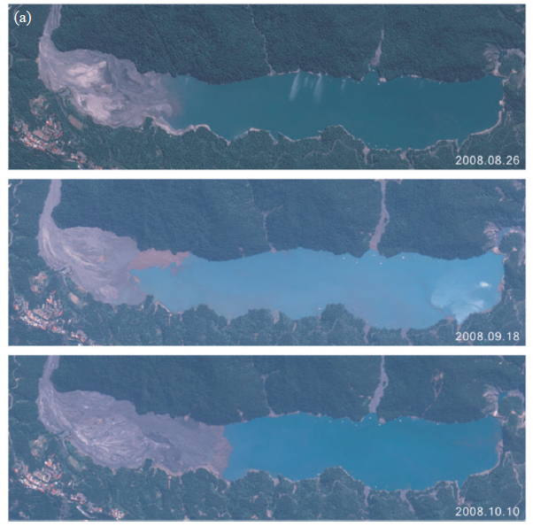
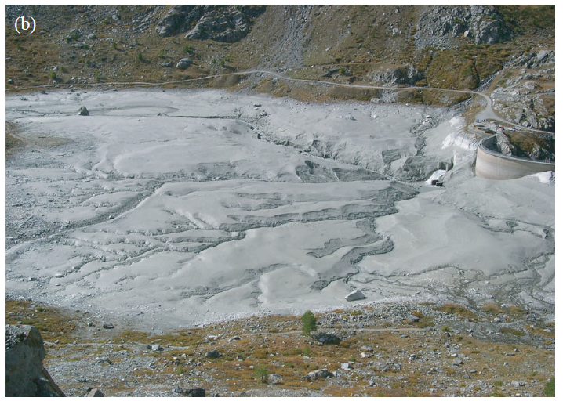
Reservoir of Turtmann, Switzerland
Schleiss et al. (2016)
Reservoir of Wushe, Taiwan

Slide 3
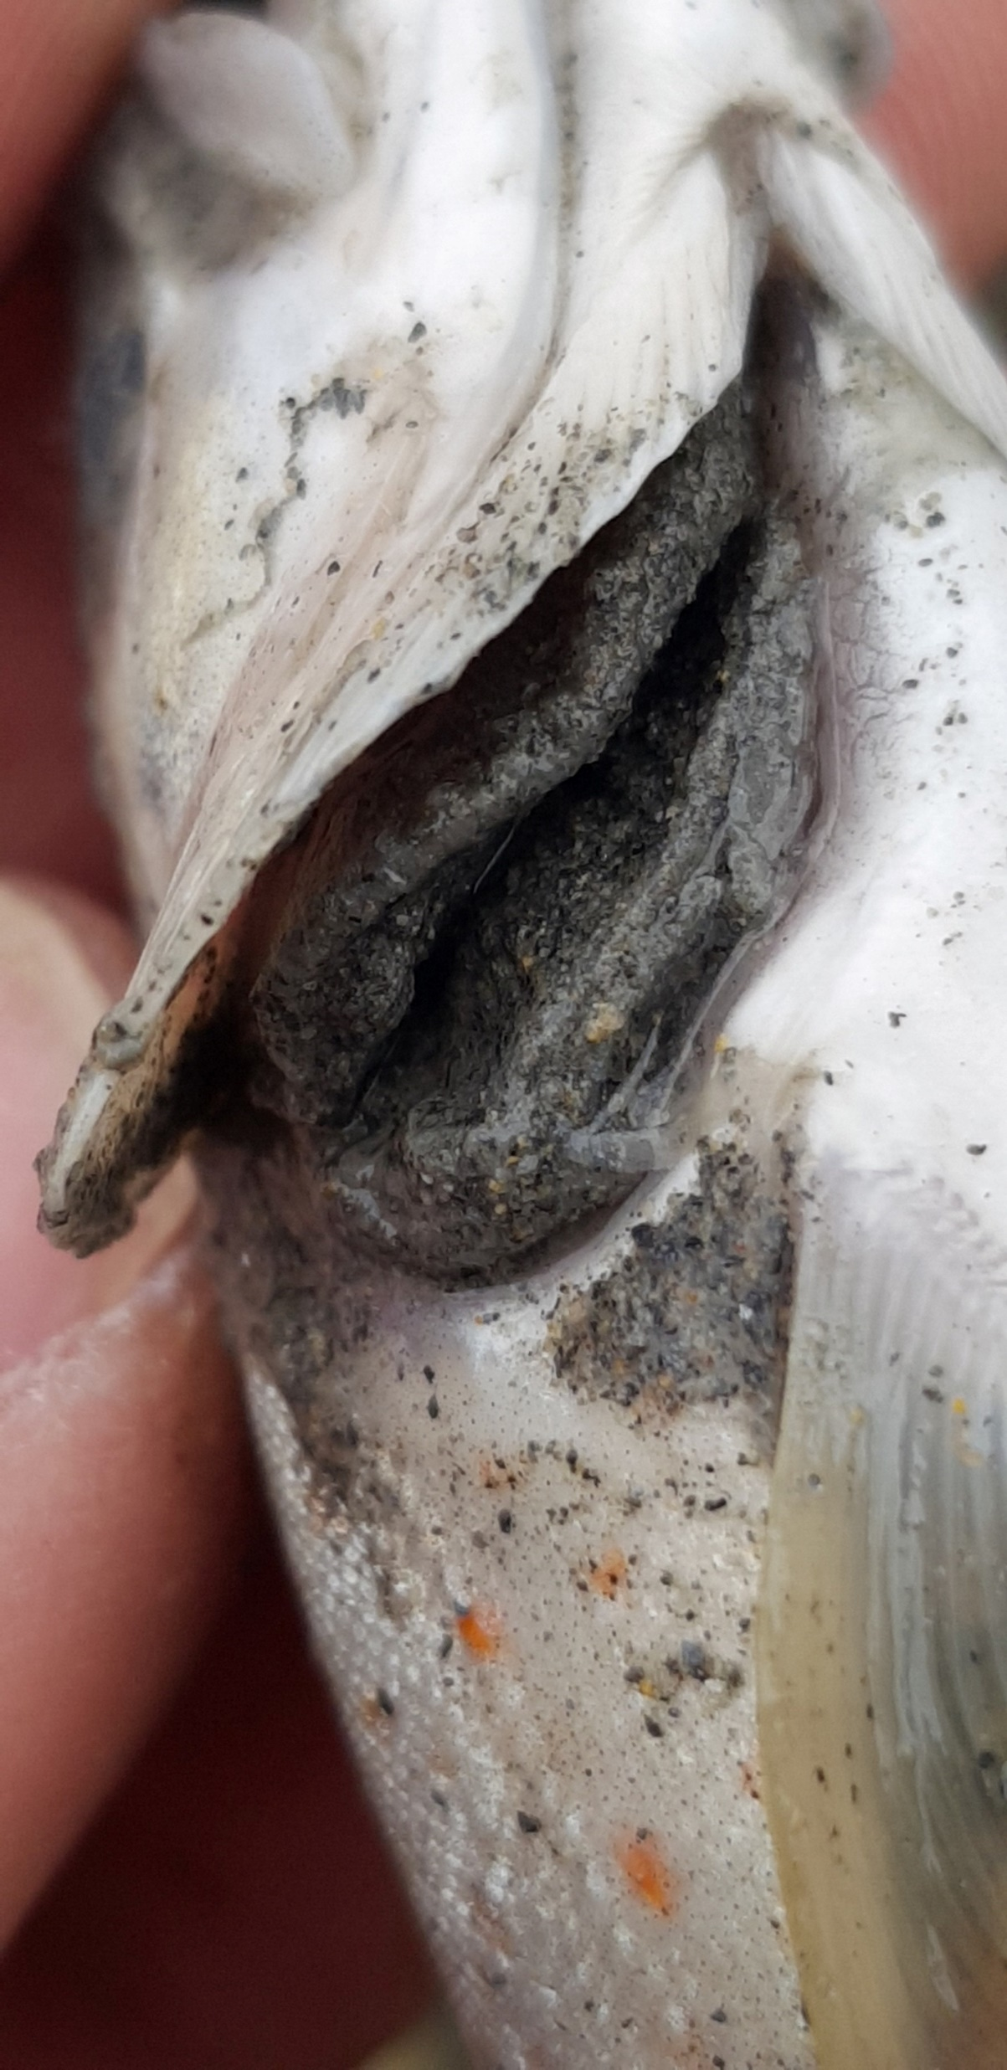
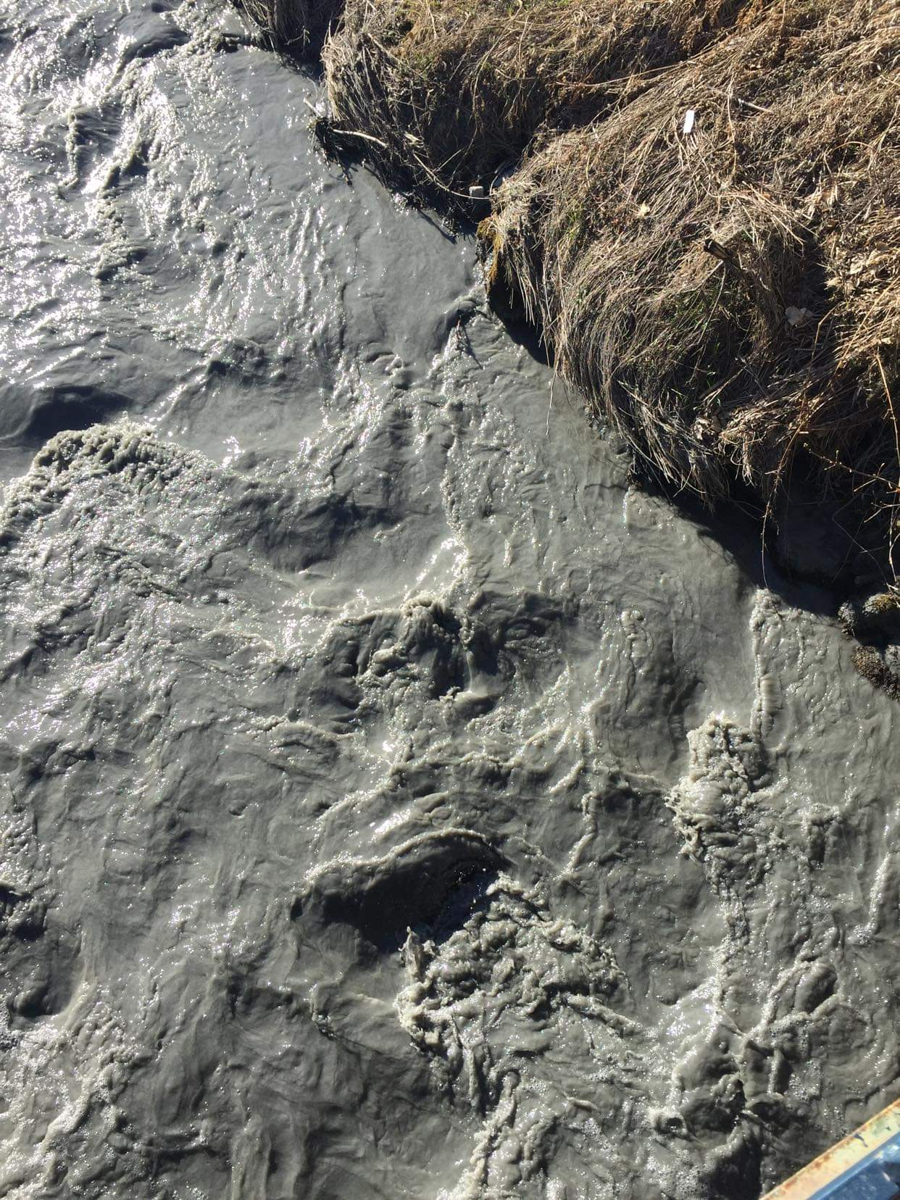
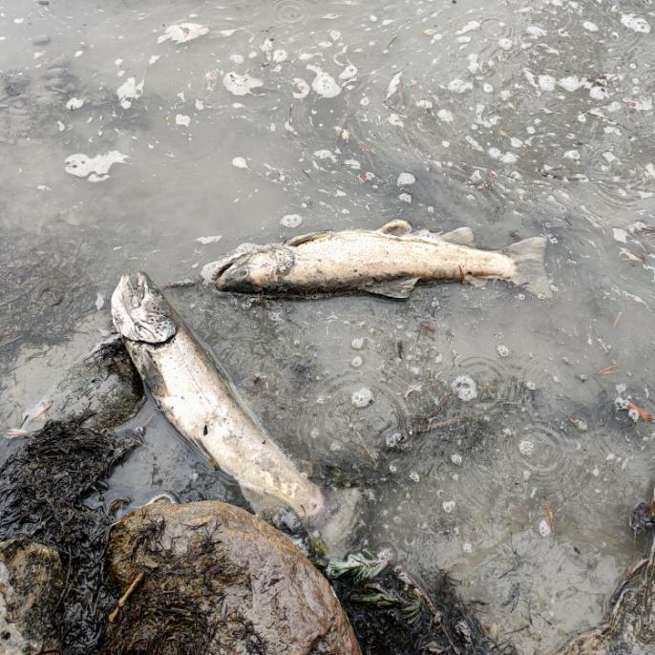
Fishing Federation of the Hautes-Alpes, 2022

Slide 4


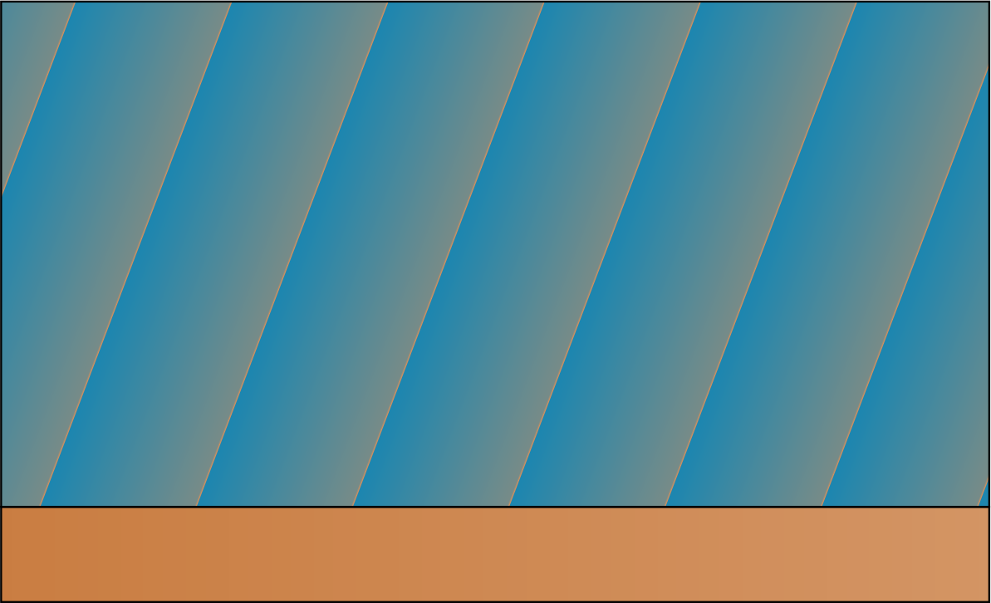
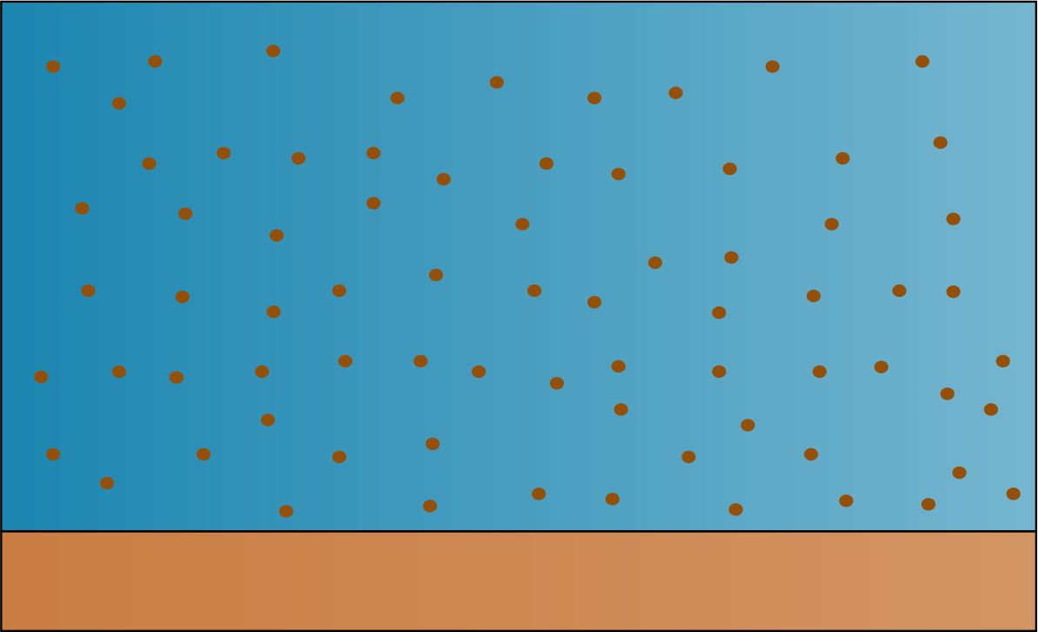
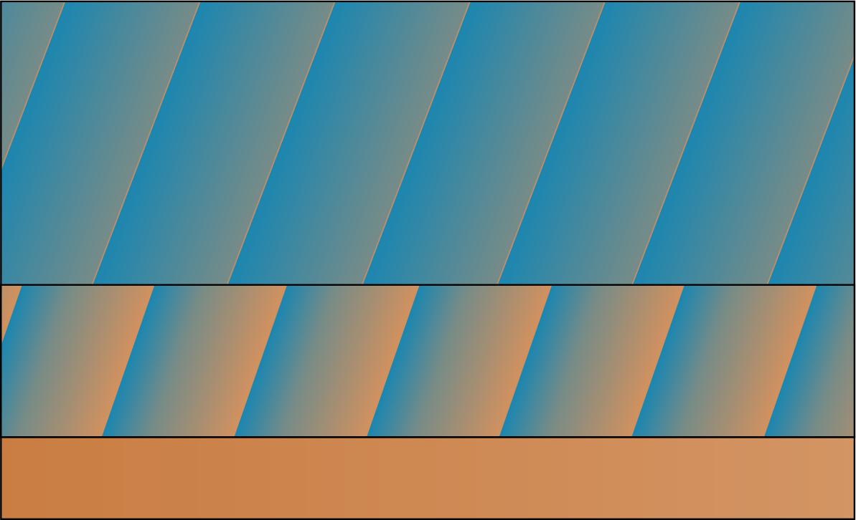
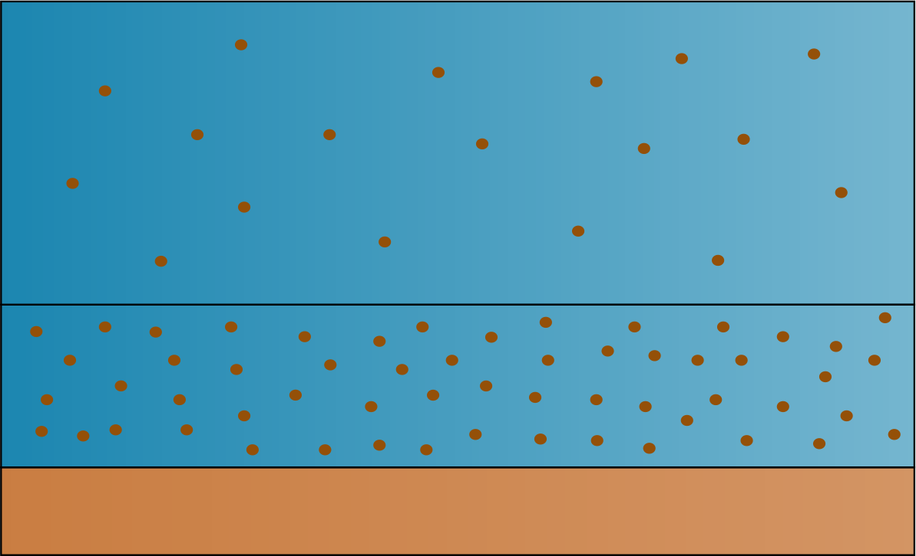
SVE
C
Real situation
Bedload
Homogeneous Mixture
2P2L
Two-Phase
Two-Layer
Two-Phase/Two-Layer

Slide 5
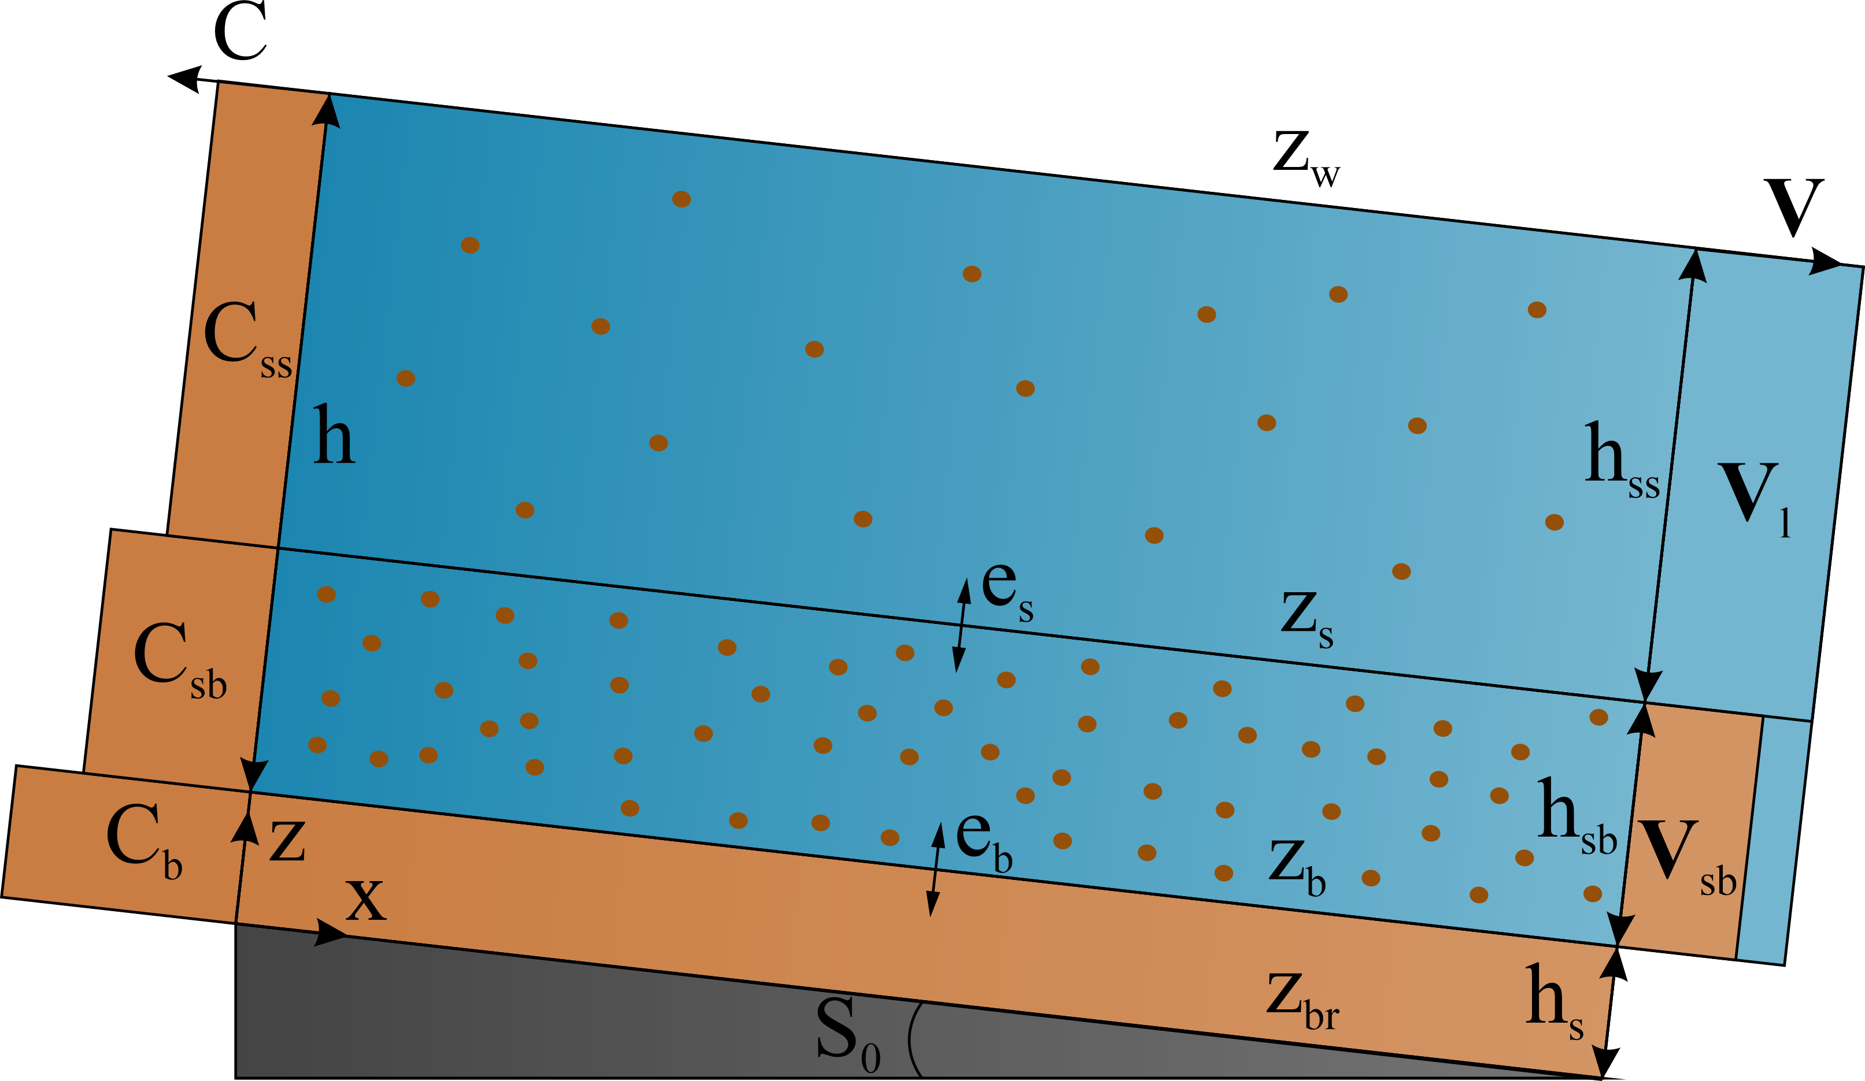
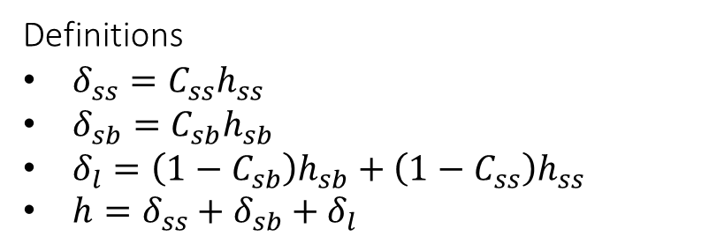
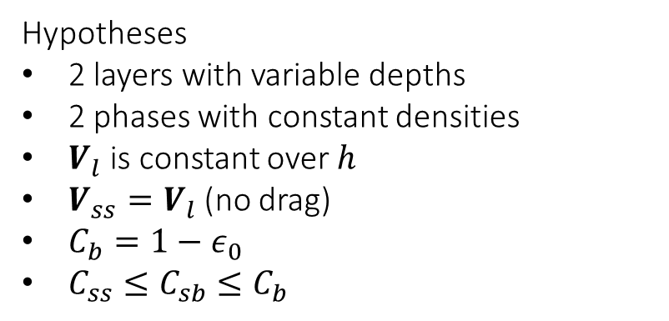
Definitions
$δ_{ss}=C_{ss}h_{ss}$
$δ_{sb}=C_{sb}h_{sb}$
$δ_{l}=\left(1−C_{sb}\right)h_{sb}+\left(1−C_{ss}\right)h_{ss}$
$h=δ_{ss}+δ_{sb}+δ_{l}$
Hypotheses
2 layers with variable depths
2 phases with constant densities
$V_{l}$ is constant over $h$
$V_{ss}=V_{l}$ (no drag)
$C_{b}=1−ε_{0}$
$C_{ss}≤C_{sb}≤C_{b}$
Inspired from Di Cristo et al., 2016
Governing equations
4 equations of mass
4 equations of momentum

Slide 6
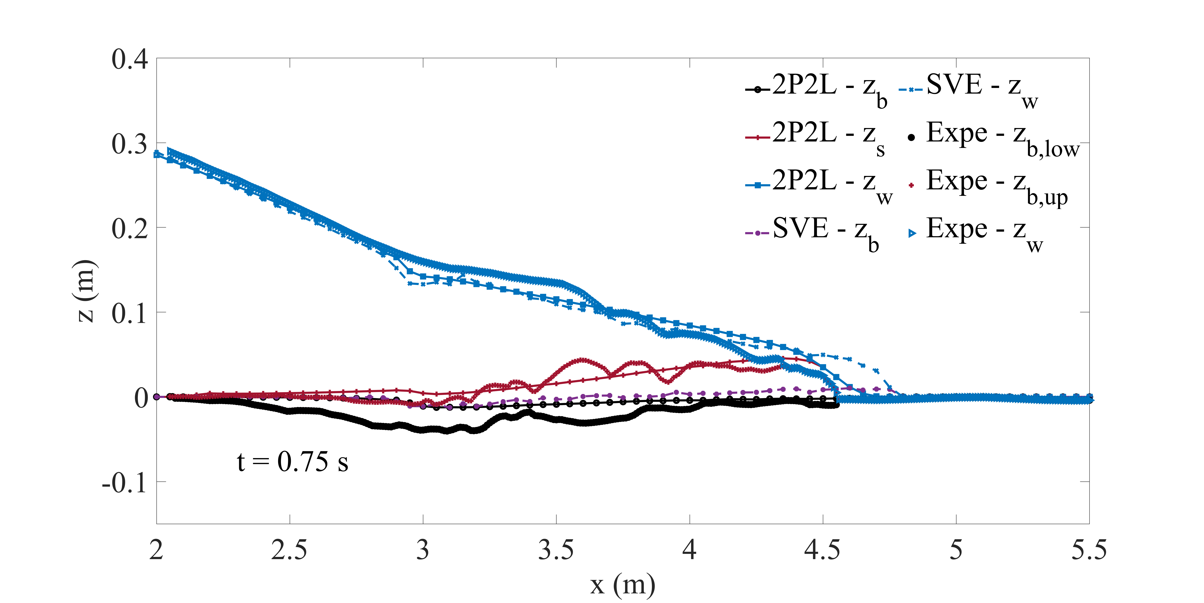
1D Dam-break,
Spinewine & Zech, 2007

Slide 7
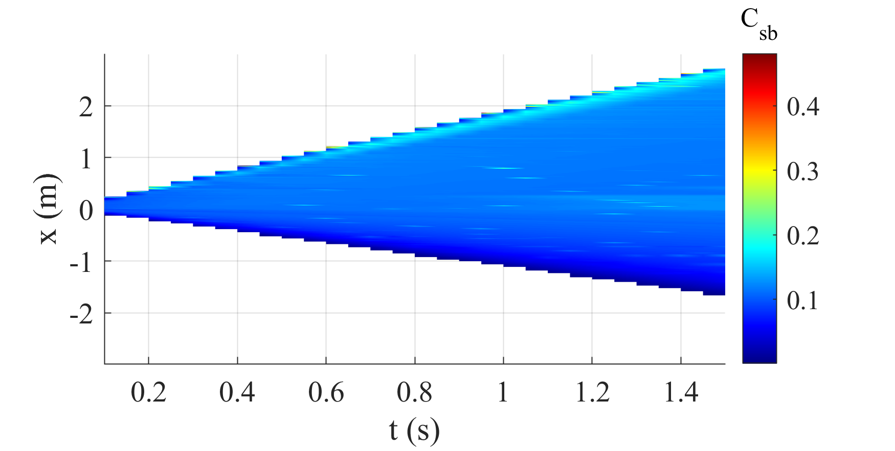
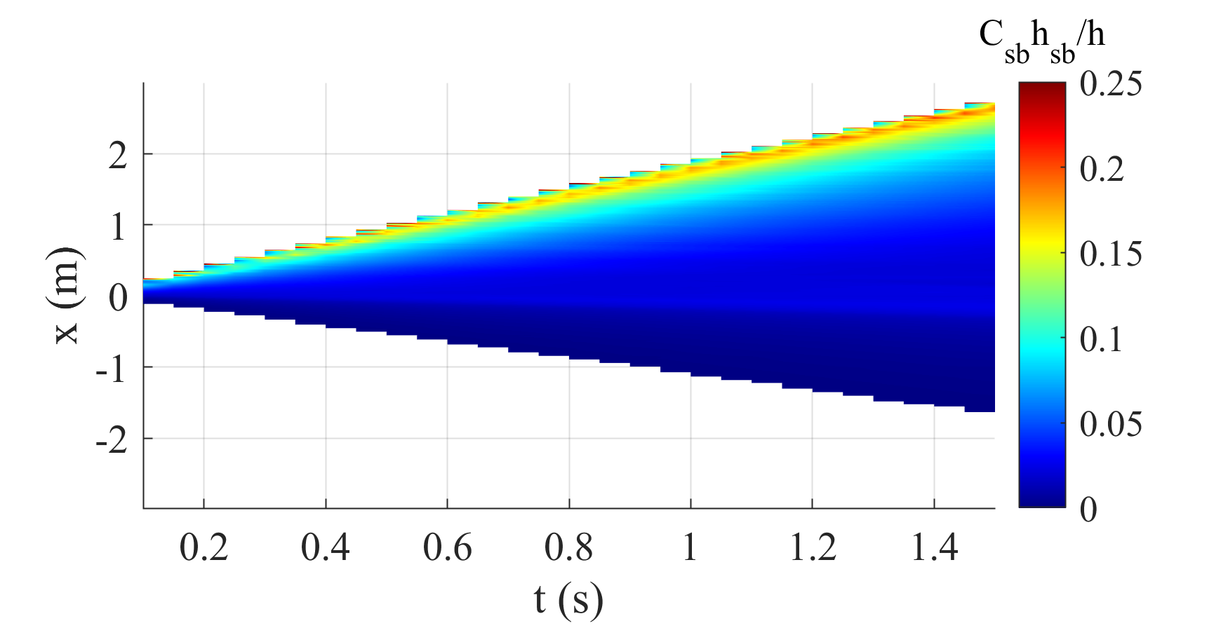
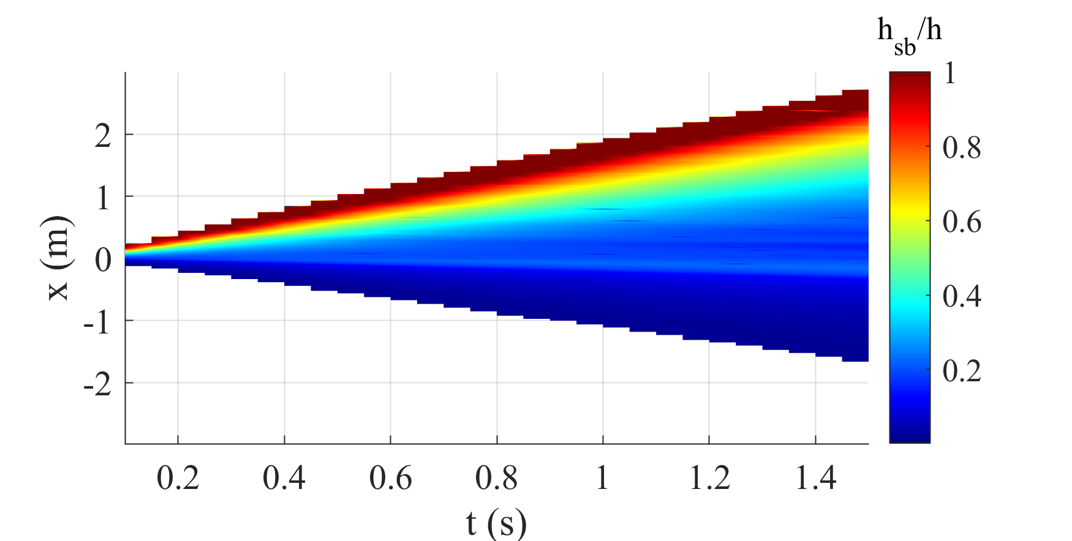

Slide 8
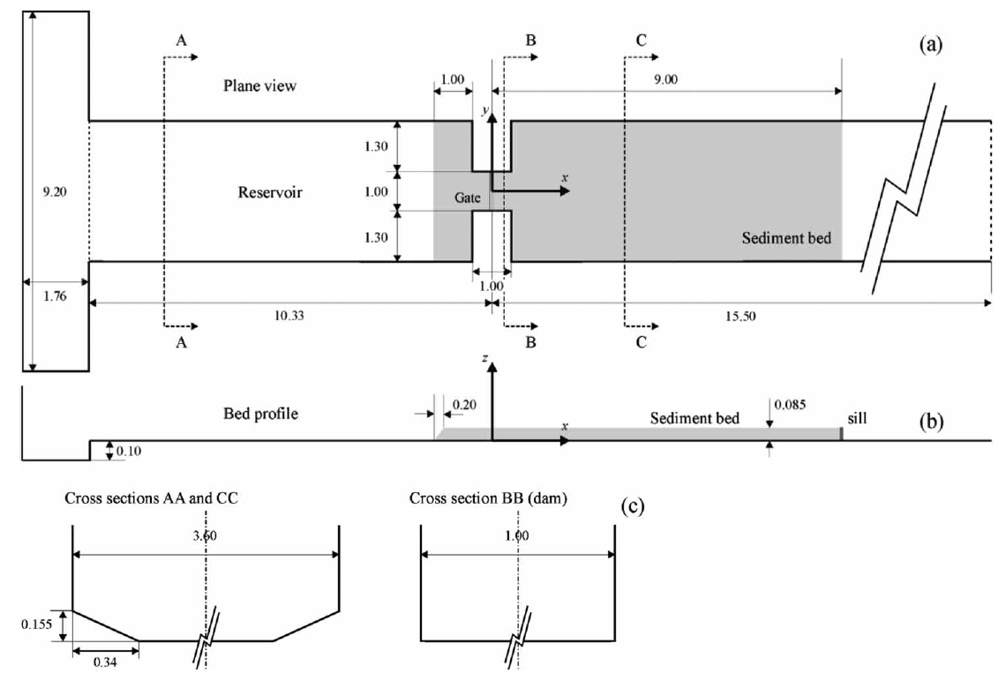
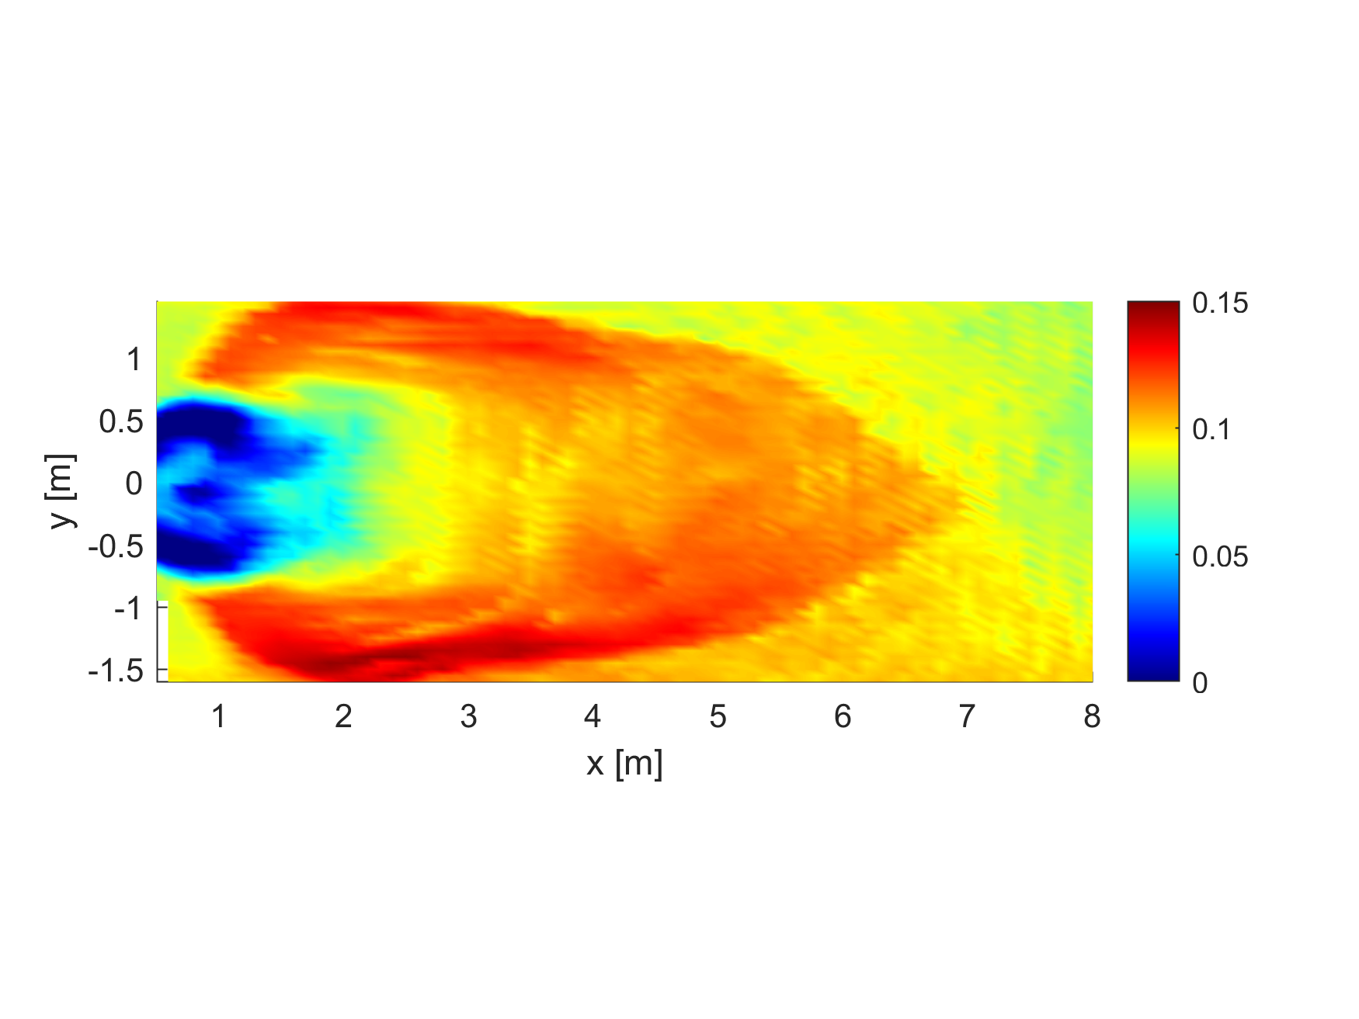


$$y=1.45 m$$
$$y=0.2 m$$
Plan view
Longitudinal cut
Cross sections
Final experimental topography (m)
Soares-Frazão et al., 2012
Soares-Frazão et al., 2012

Slide 9
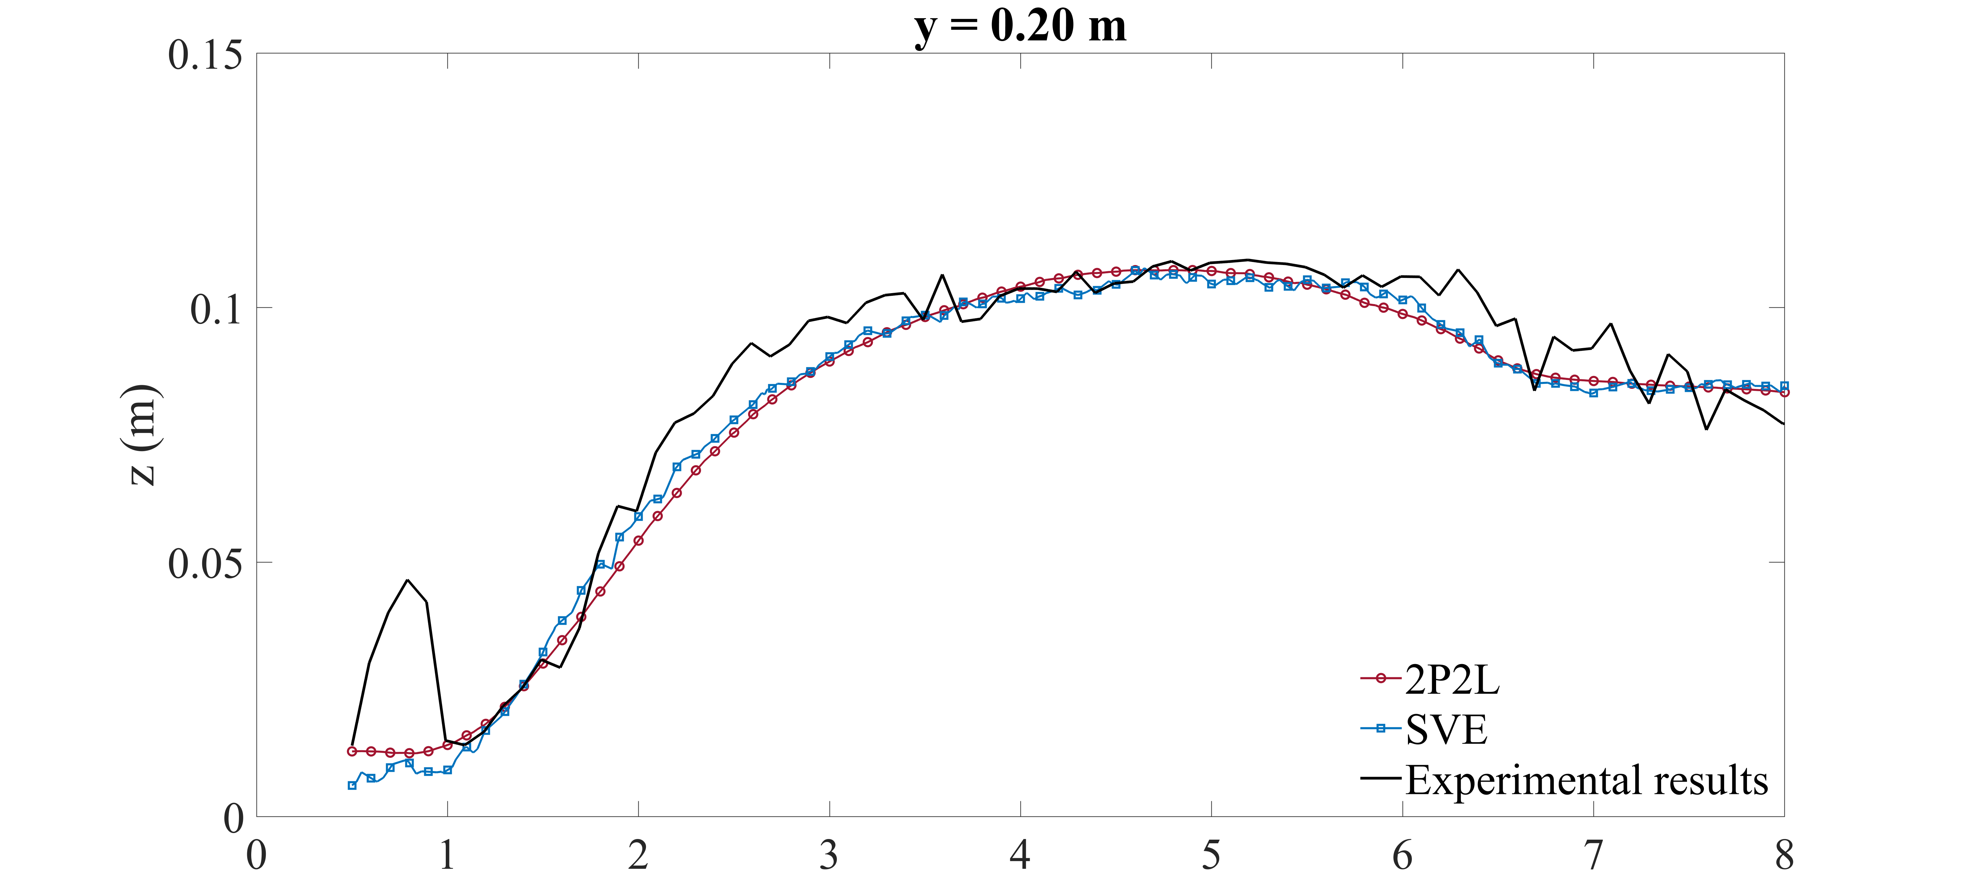
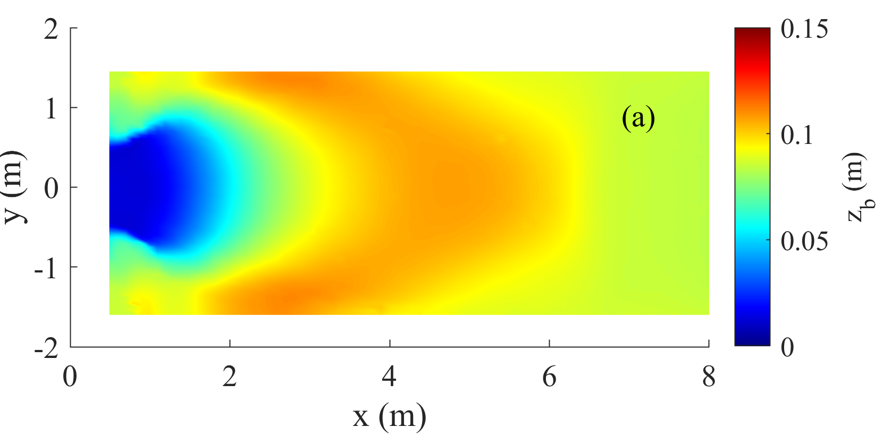
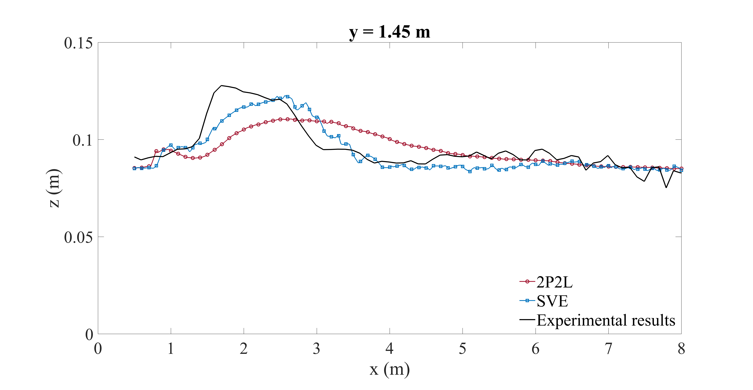


2D topography
Topography profiles
$$y=1.45 m$$
Experimental results, Soares-Frazão et al., 2012
$$y=0.2 m$$
Numerical results, 2P2L

Slide 10
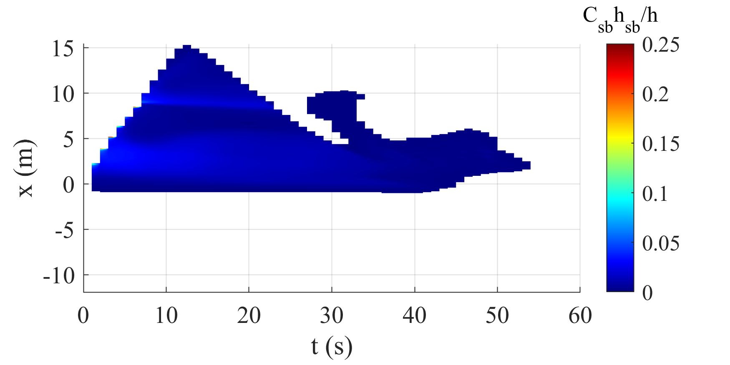
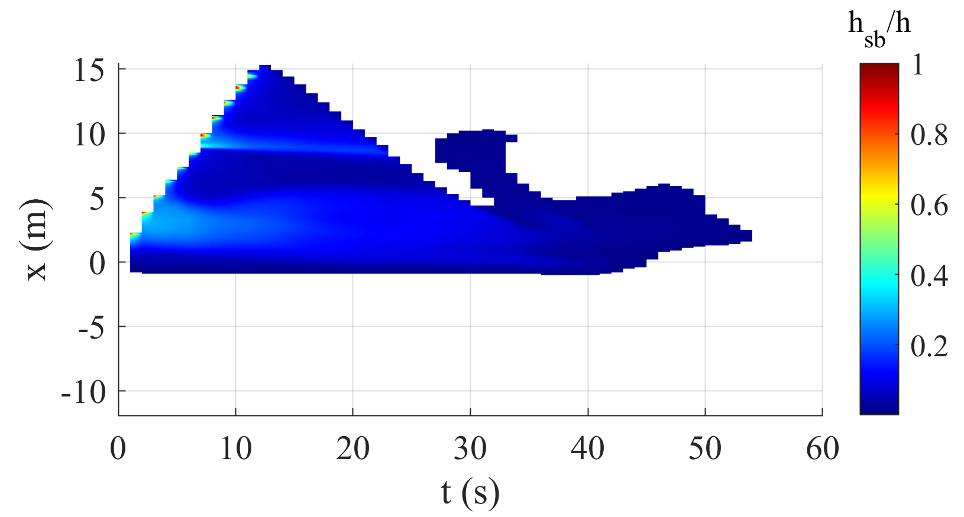


2D dam-break
1D dam-break
$$y=0.2 m$$
$$y=0.2 m$$

Slide 11
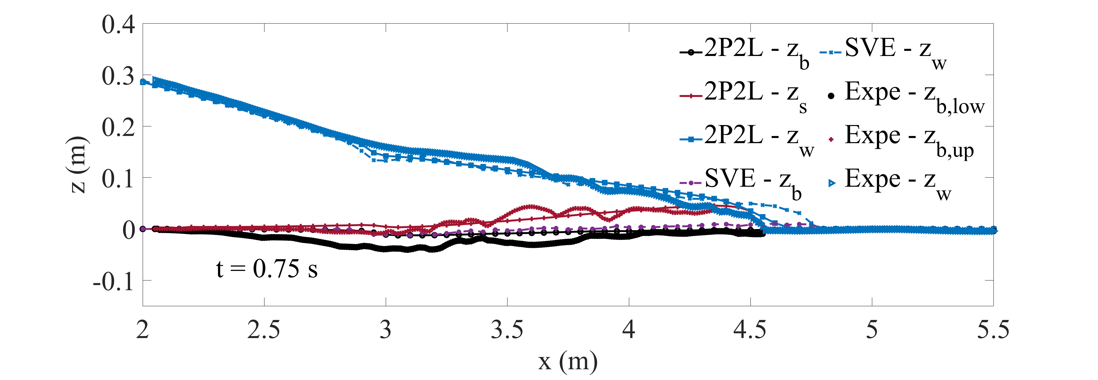
Objective
  Simulate highly-laden transient flows like dam-flushes
Features
  Two-Phase
  Two-Layer
  Variable concentrations
  Two velocities
  Eight governing equations
Results
  Estimates the depth of the transport layer
  Better catches the inertia of the mixture
  More relevant with a high transport

Slide 12
Thank you for your attention
E-mail: robin.meurice@uclouvain.be

Slide 14
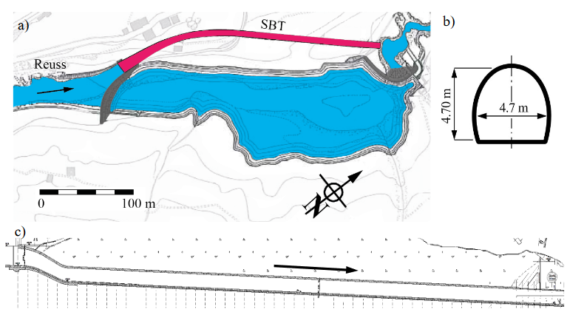
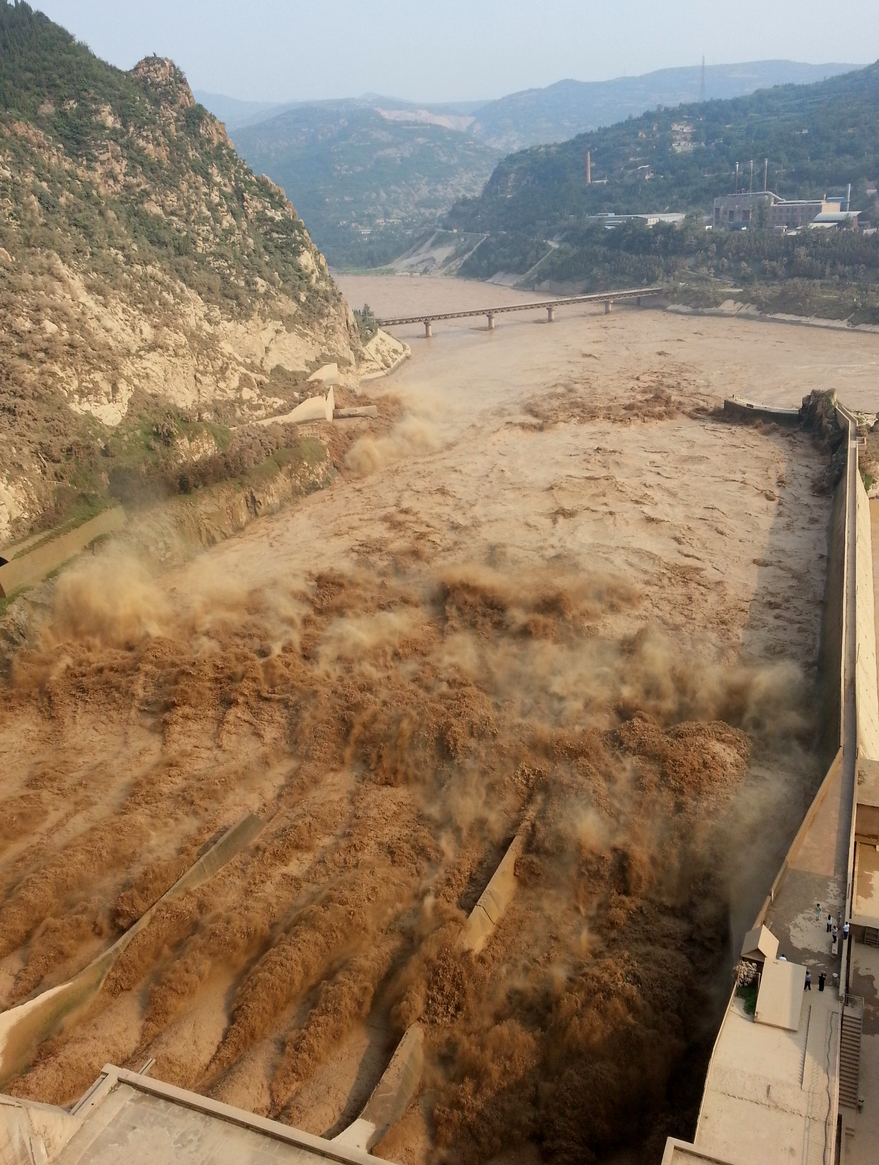
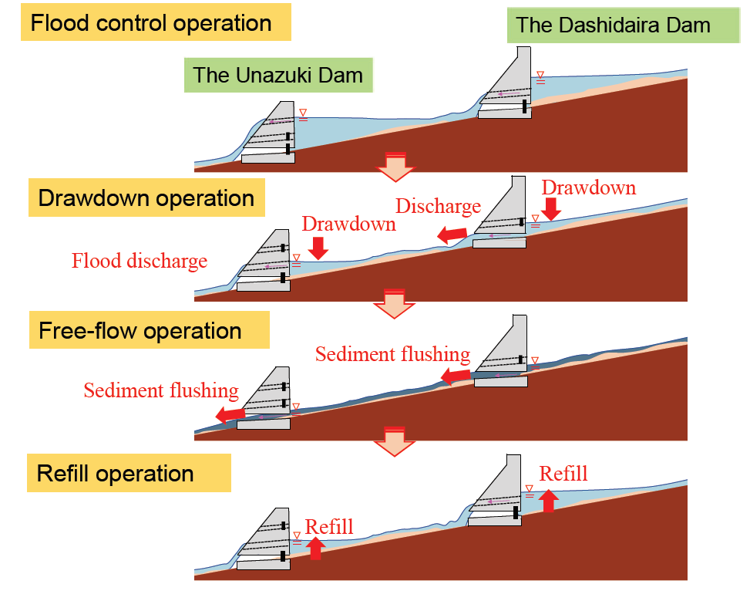
Preventing
Bypass
Offstream reservoir
Sluicing
Removing
Dredging
Flushing
Bypass of Pfaffensprung
Müller-Hagmann, 2018
Dam of Sanmenxia, Yellow River, China
ICOLD (2009)
Flushing operations, Fukuoka & Suzuki (2020)

Slide 15

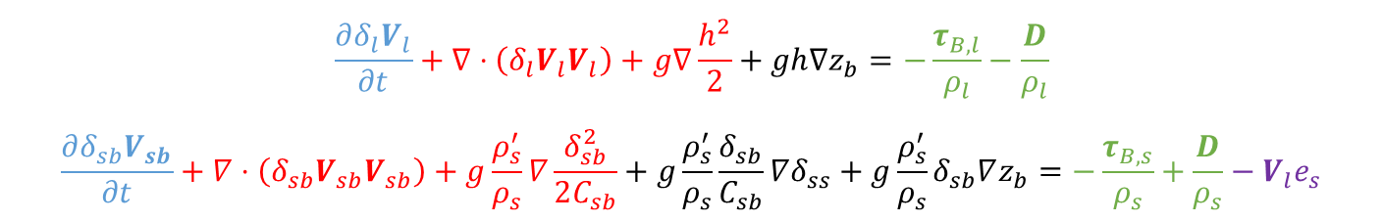
$$\frac{∂δ_{l}}{∂t}+∇⋅\left(δ_{l}V_{l}\right)=ε_{0}e_{b}$$
$$\frac{∂δ_{ss}}{∂t}+∇⋅\left(δ_{ss}V_{l}\right)=e_{s}$$
$$\frac{∂δ_{sb}}{∂t}+∇⋅\left(δ_{sb}V_{sb}\right)={(1−ε}_{0})e_{b}−e_{s}$$ $$\frac{∂z_{b}}{∂t}=−e_{b}$$
Mass conservation
$$\frac{∂δ_{l}V_{l}}{∂t}+∇⋅\left(δ_{l}V_{l}V_{l}\right)+g∇\frac{h^{2}}{2}+gh∇z_{b}=−\frac{τ_{B,l}}{ρ_{l}}−\frac{D}{ρ_{l}}$$
$$\frac{∂δ_{sb}V_{sb}}{∂t}+∇⋅\left(δ_{sb}V_{sb}V_{sb}\right)+g\frac{ρ_{s}^{′}}{ρ_{s}}∇\frac{δ_{sb}^{2}}{2C_{sb}}+g\frac{ρ_{s}^{′}}{ρ_{s}}\frac{δ_{sb}}{C_{sb}}∇δ_{ss}+g\frac{ρ_{s}^{′}}{ρ_{s}}δ_{sb}∇z_{b}=−\frac{τ_{B,s}}{ρ_{s}}+\frac{D}{ρ_{s}}−V_{l}e_{s}$$
Momentum conservation

Slide 16
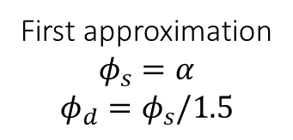
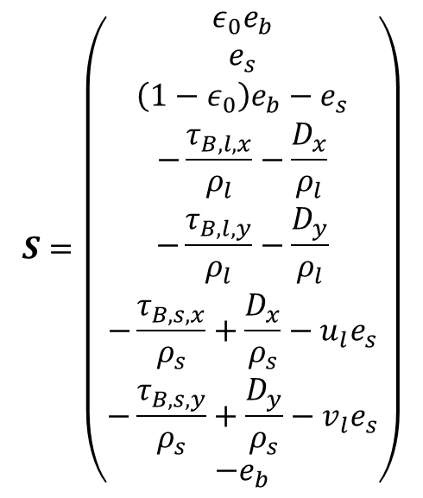




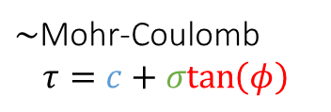
$$S=\left(\begin{matrix}ε_{0}e_{b} \\ e_{s} \\ \left(1−ε_{0}\right)e_{b}−e_{s} \\ −\frac{τ_{B,l,x}}{ρ_{l}}−\frac{D_{x}}{ρ_{l}} \\ −\frac{τ_{B,l,y}}{ρ_{l}}−\frac{D_{y}}{ρ_{l}} \\ −\frac{τ_{B,s,x}}{ρ_{s}}+\frac{D_{x}}{ρ_{s}}−u_{l}e_{s} \\ −\frac{τ_{B,s,y}}{ρ_{s}}+\frac{D_{y}}{ρ_{s}}−v_{l}e_{s} \\ −e_{b}\end{matrix}\right)$$
Stress exerted by the liquid phase
$$τ_{B,l}=\frac{ρ_{l}n^{2}V_{l}\left|V_{l}\right|}{h^{1/3}}$$
Stress exerted by the solid phase
$$τ_{B,s}={βρ}_{s}V_{sb}\left|V_{sb}\right|+g\left(ρ_{s}−ρ_{l}\right){(δ}_{sb}+δ_{ss})\frac{V_{sb}}{|V_{sb}|}μ_{d}$$
Resistance from the bed
$τ_{B}$ = $τ_{c}+g\left(ρ_{s}−ρ_{l}\right){(δ}_{sb}+δ_{ss})μ_{s}$
$\sim$Mohr-Coulomb
$$τ=c+σtan\left(φ\right)$$
Friction coefficients
$μ_{d}=\tan\left(φ_{d}\right)<μ_{s}=tan⁡(φ_{s})$
First approximation
$$φ_{s}=α$$
$$φ_{d}=φ_{s}/1.5$$

Slide 17
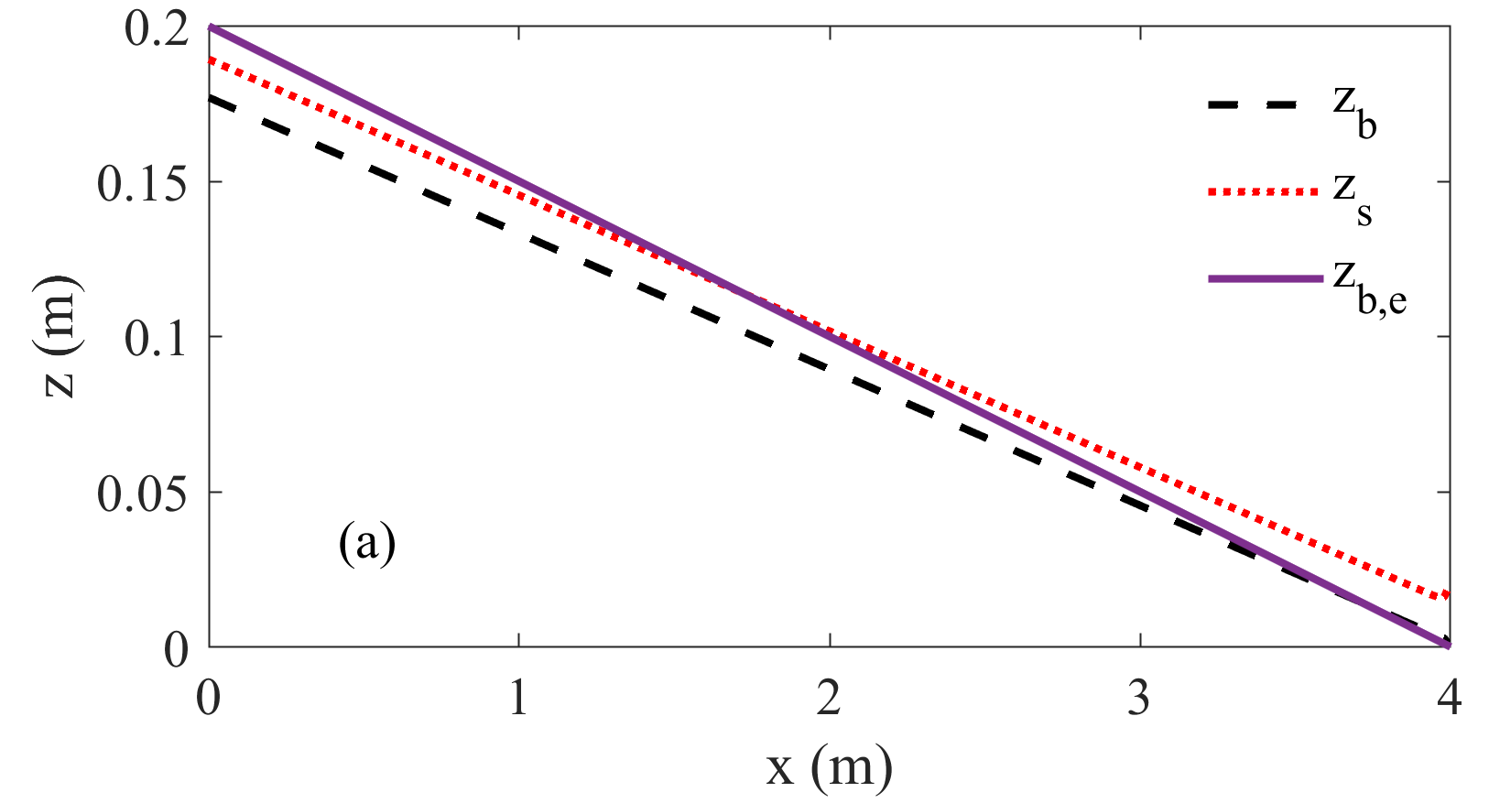
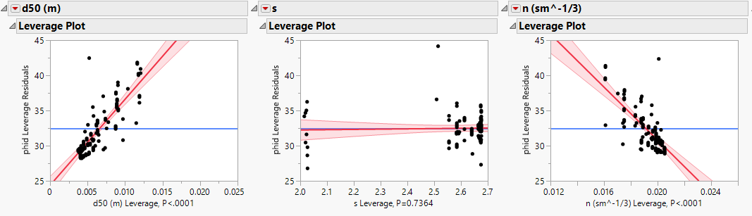
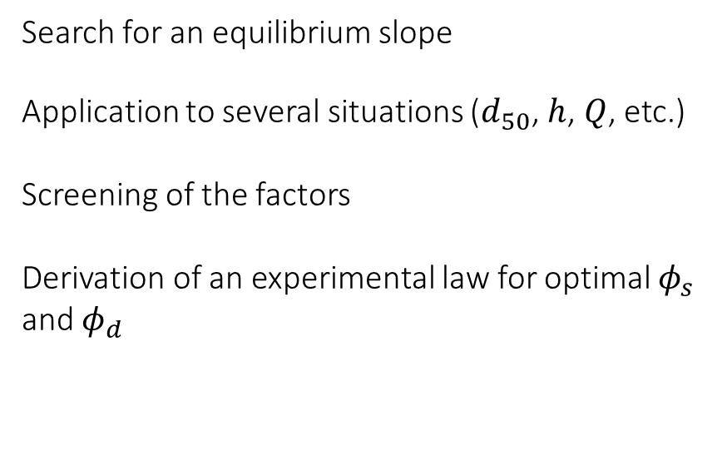
Search for an equilibrium slope
Application to several situations ($d_{50}$, $h$, $Q$, etc.)
Screening of the factors
Derivation of an experimental law for optimal $φ_{s}$ and $φ_{d}$

Slide 18
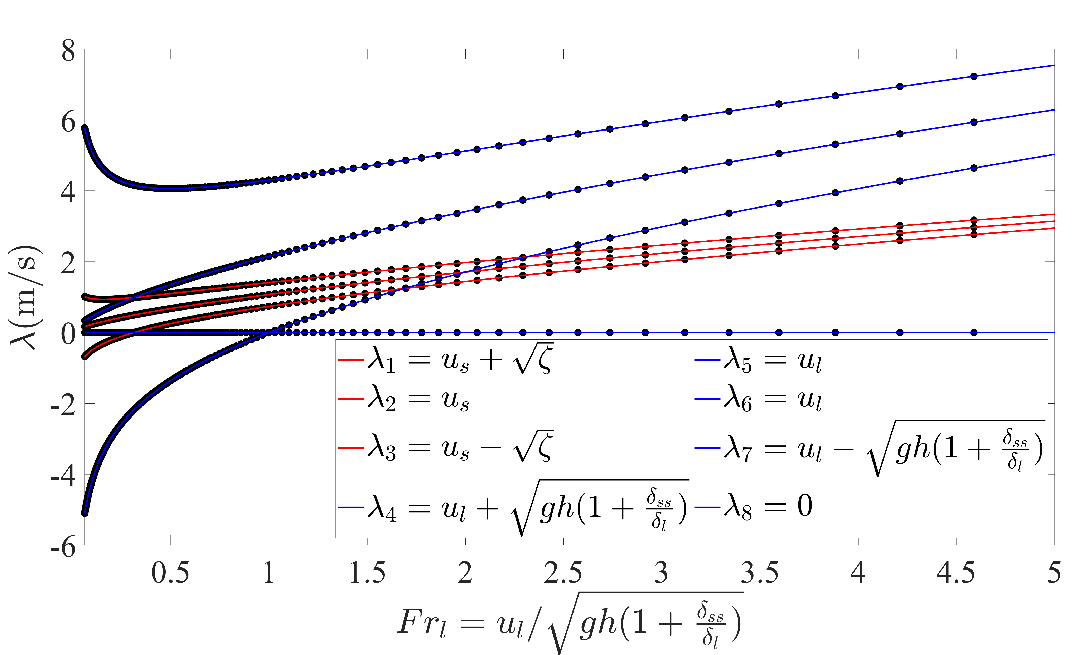
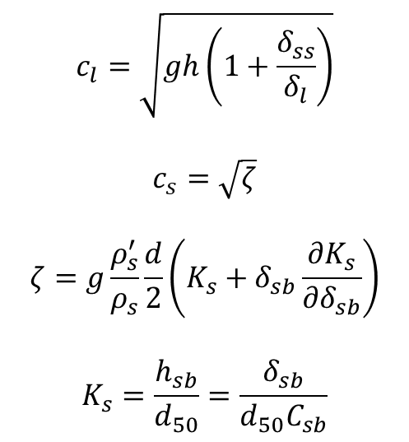
$$c_{l}=\sqrt{gh\left(1+\frac{δ_{ss}}{δ_{l}}\right)}$$
$$c_{s}=\sqrt{ζ}$$
$$ζ=g\frac{ρ_{s}^{′}}{ρ_{s}}\frac{d}{2}\left(K_{s}+δ_{sb}\frac{∂K_{s}}{∂δ_{sb}}\right)$$
$$K_{s}=\frac{h_{sb}}{d_{50}}=\frac{δ_{sb}}{d_{50}C_{sb}}$$

Slide 19
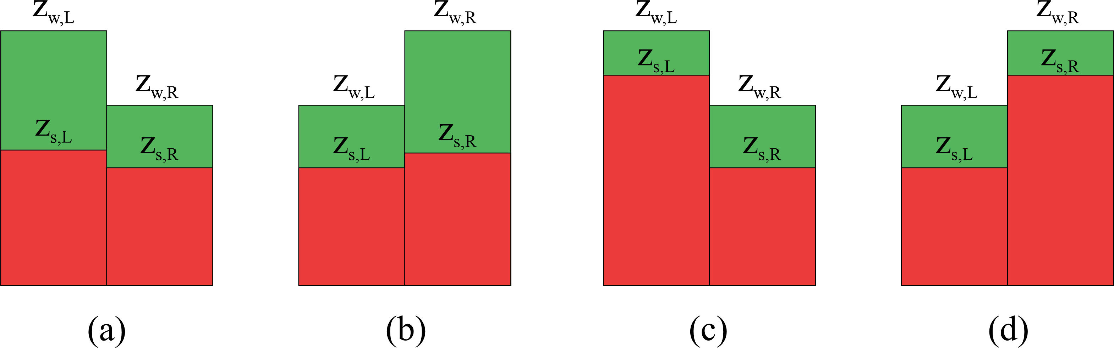
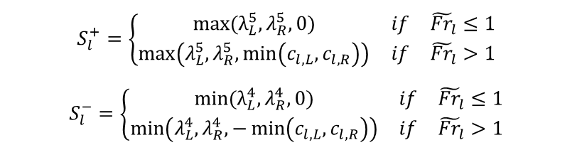
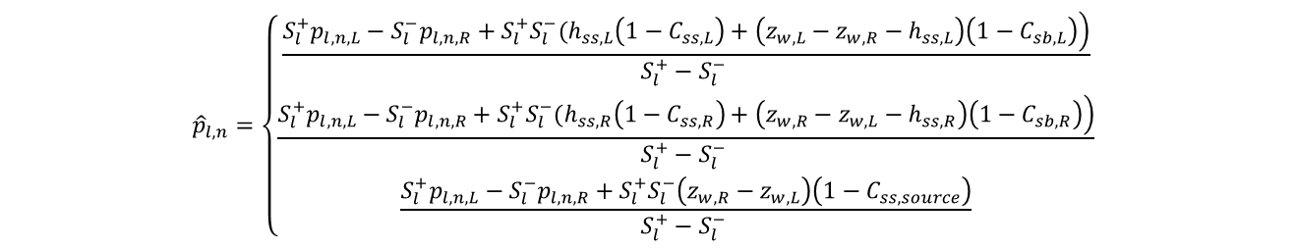
$${\hat{p}}_{l,n}=\left\{\begin{matrix}\frac{\left.S_{l}^{+}p_{l,n,L}−S_{l}^{−}p_{l,n,R}+S_{l}^{+}S_{l}^{−}(h_{ss,L}\left(1−C_{ss,L}\right)+\left(z_{w,L}−z_{w,R}−h_{ss,L}\right)\left(1−C_{sb,L}\right)\right)}{S_{l}^{+}−S_{l}^{−} } \\ \frac{\left.S_{l}^{+}p_{l,n,L}−S_{l}^{−}p_{l,n,R}+S_{l}^{+}S_{l}^{−}(h_{ss,R}\left(1−C_{ss,R}\right)+\left(z_{w,R}−z_{w,L}−h_{ss,R}\right)\left(1−C_{sb,R}\right)\right)}{S_{l}^{+}−S_{l}^{−} } \\ \frac{S_{l}^{+}p_{l,n,L}−S_{l}^{−}p_{l,n,R}+S_{l}^{+}S_{l}^{−}\left(z_{w,R}−z_{w,L}\right)\left(1−C_{ss,source}\right)}{S_{l}^{+}−S_{l}^{−} }\end{matrix} \right.$$
(c)
(d)
(a and b)
$$S_{l}^{+}=\left\{\begin{matrix}max(λ_{L}^{5},λ_{R}^{5},0) & if & {\tilde{Fr}}_{l}≤1 \\ \max\left(λ_{L}^{5},λ_{R}^{5},\min\left(c_{l,L},c_{l,R}\right)\right) & if & {\tilde{Fr}}_{l}>1\end{matrix} \right.$$
$$S_{l}^{−}=\left\{\begin{matrix}min(λ_{L}^{4},λ_{R}^{4},0) & if & {\tilde{Fr}}_{l}≤1 \\ \min\left(λ_{L}^{4},λ_{R}^{4},−\min\left(c_{l,L},c_{l,R}\right)\right) & if & {\tilde{Fr}}_{l}>1\end{matrix} \right.$$

Slide 20
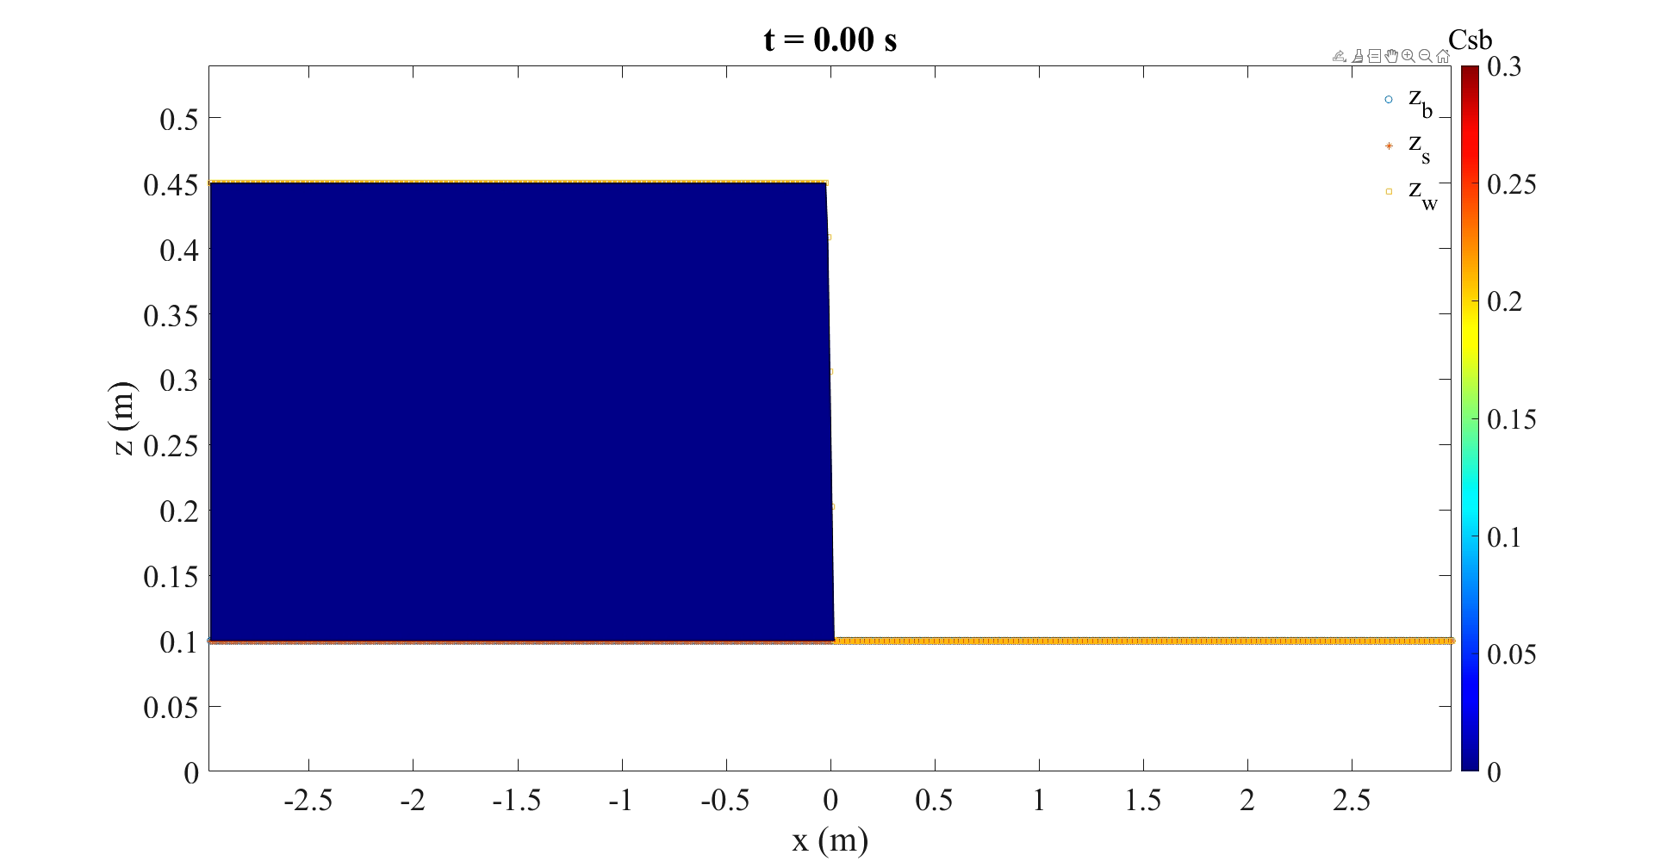

Slide 21
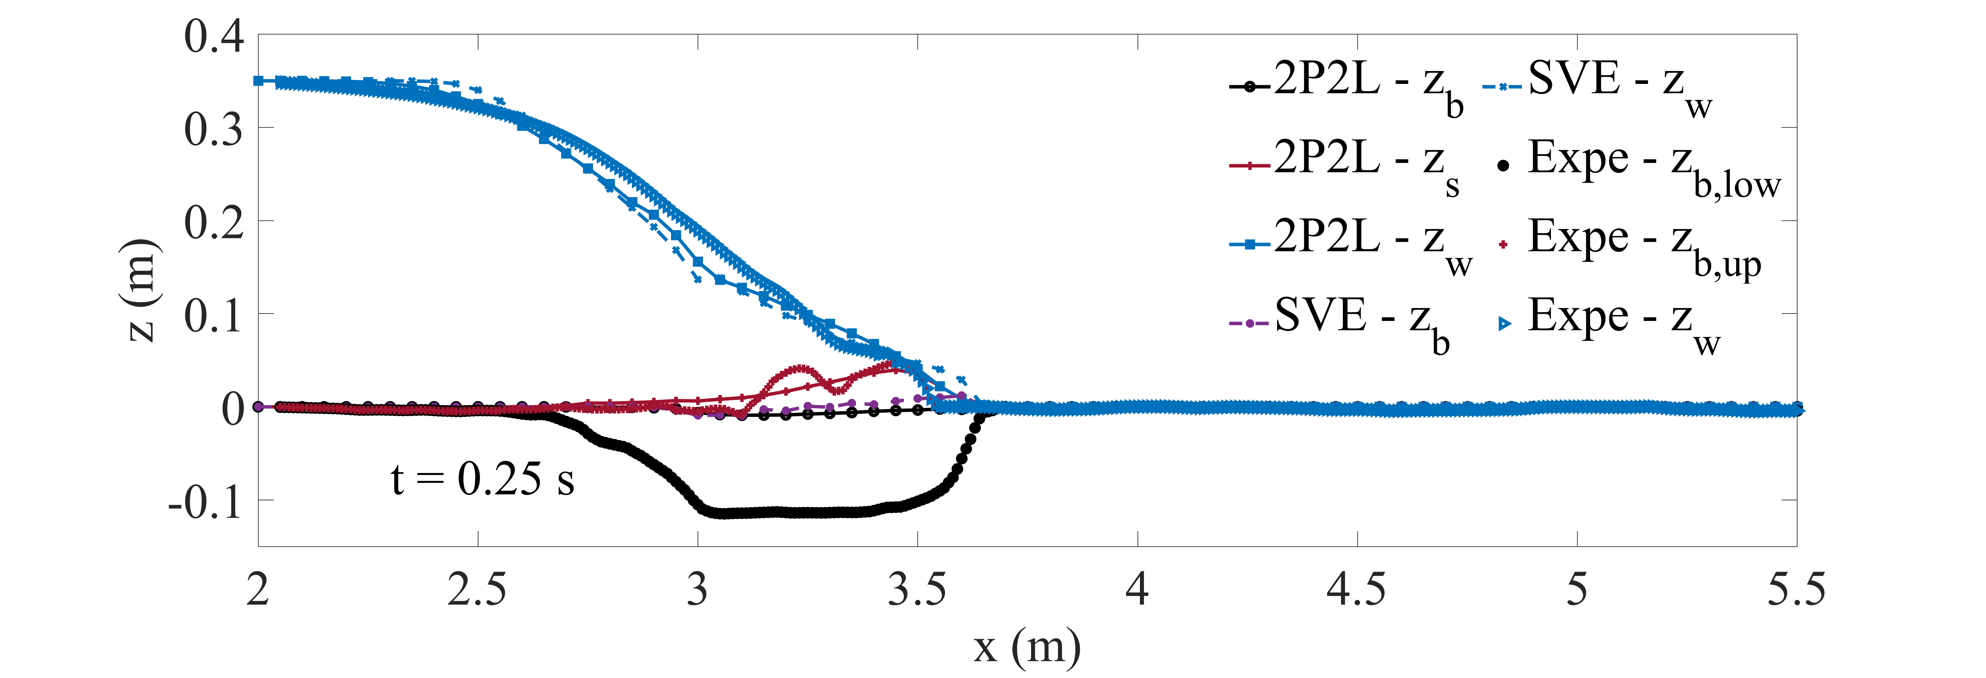
1D Dam-break,
Spinewine & Zech, 2007

