Slide 1


Model parameters: how to get rid of trial and error?
Robin Meurice^{1,2},
Sandra Soares-Frazão¹
¹ Université Catholique de Louvain, Institute of Mechanics, Materials and Civil Engineering, Louvain-la-Neuve, Belgium
² Fonds de la Recherche Scientifique F.R.S.-FNRS
email: robin.meurice@uclouvain.be
Notes:
Hello everyone, thank you for attending my presentation. I am Robin Meurice from UCLouvain in Belgium and today I would like to help morphodynamical modellers with a problem they have already probably faced.

Slide 2
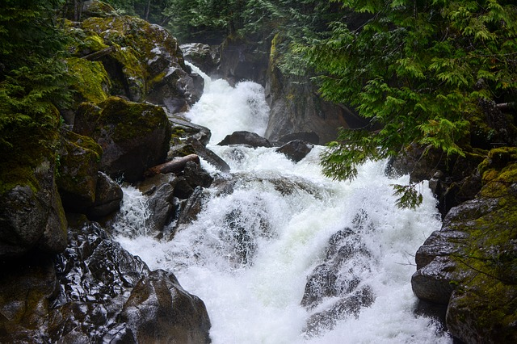
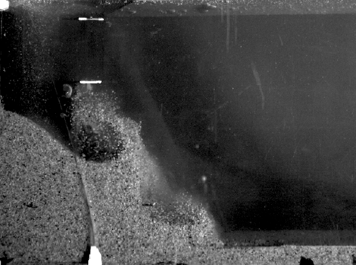
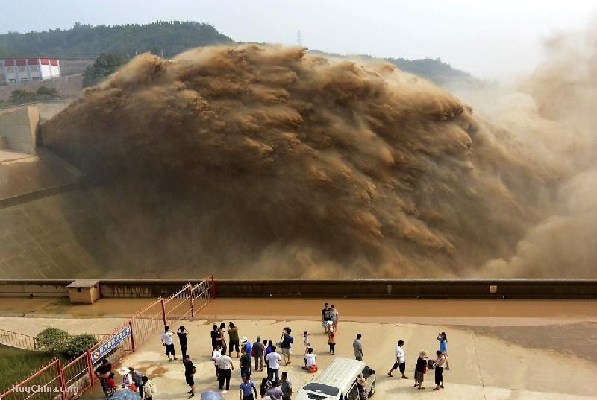
Complex flows need…complex models
Parameters
Closed
Requires extensive field or experimental data to build a generalizable formulation
Tuned
Requires field-specific data to calibrate the model by trial and error
Notes:
The core of the problem is actually the same for every fluid dynamics modeller. It is indeed highly unlikely to have good simulations results with simple models such as the basic shallow water equations if we want to reproduce complex flows such as these turbulent rapids, this collapse of a granular mixture or this dam flush. Satisfactory reproduction results can only be obtained with sufficiently complex models in these cases.
Yet, these complex models often rely on many parameters that can be numerically implemented in two ways.
The first solution consists in closing the parameter with a theoretical or empirical formulation. The problem with this solution is that these formulations were often developed based on flows that do not always correspond to the flows we want to reproduce and there hence might be a problem of generalizability.
The second solution simply consists in tuning the parameter by trial and error. Besides the waste of computational time that it requires, this tuning requires field-specific data. It is hence not possible to use the model to predict results on a river for which data lack.
During this presentation, I will focus on morphodynamics and present you a method that modellers can use to develop closure formulations for parameters that they do not want to tune by trial and error and whose scope corresponds to the kind of flows that they want to reproduce. In this way, they can run their models on rivers for which calibration data do not exist.

Slide 3
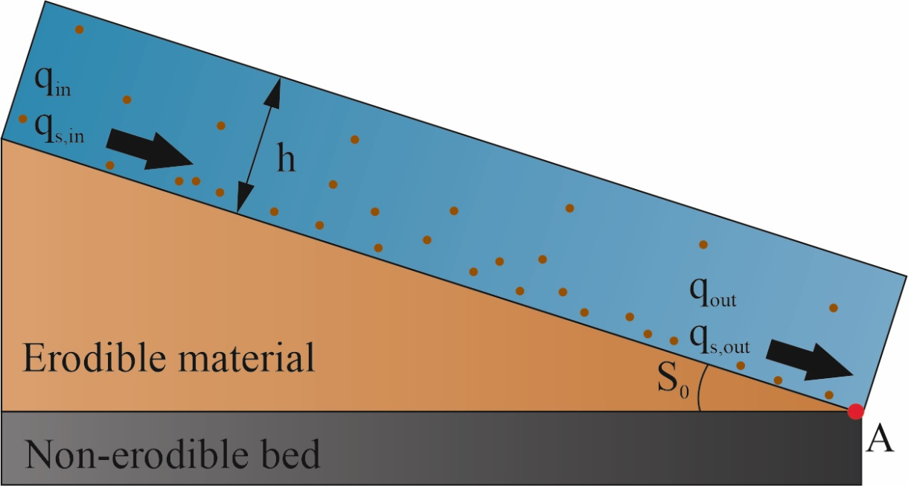
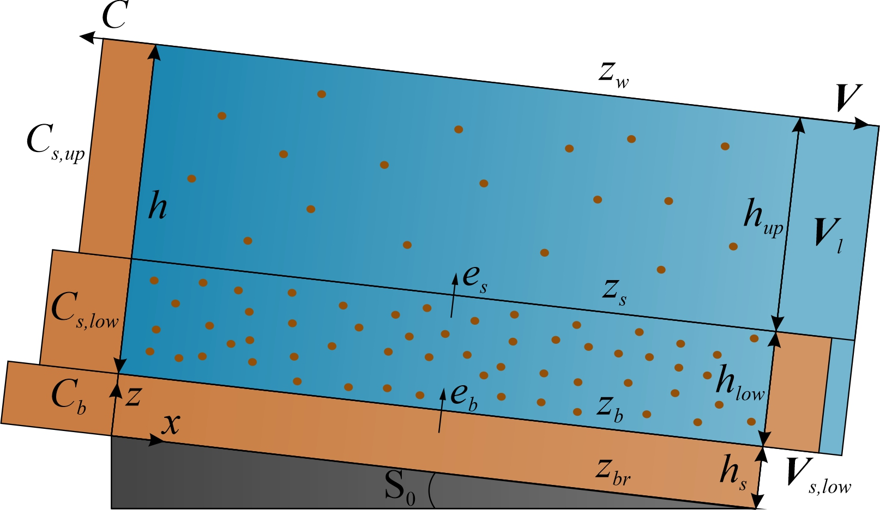
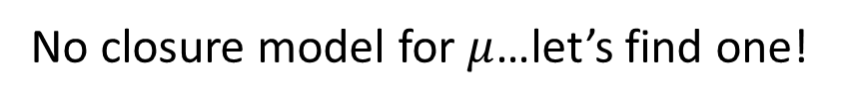
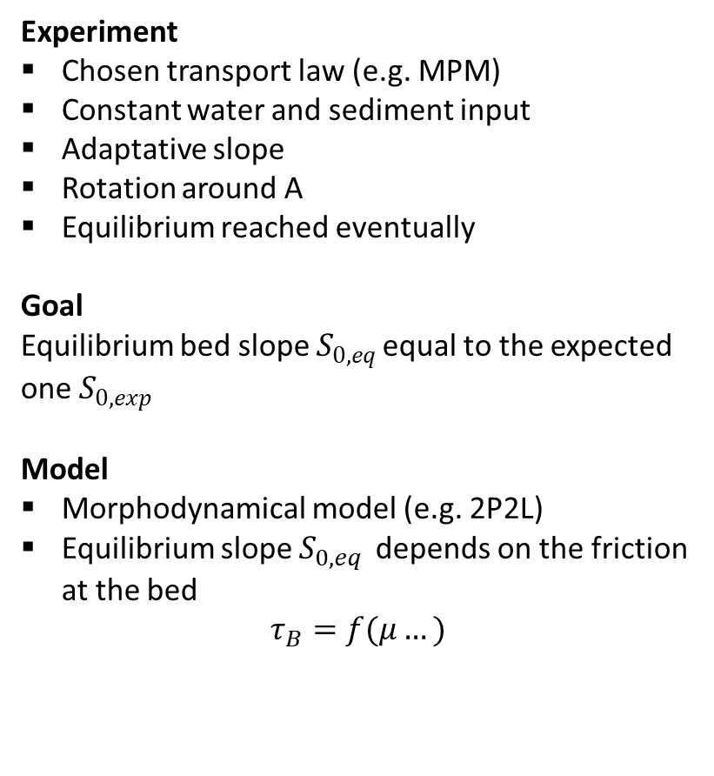
Numerical experiment
Experiment
Chosen transport law (e.g. MPM)
Constant water and sediment input
Adaptative slope
Rotation around A
Equilibrium reached eventually
Goal
Equilibrium bed slope $S_{0,eq }$equal to the expected one $S_{0,exp}$
Model
Morphodynamical model (e.g. 2P2L)
Equilibrium slope $S_{0,eq }$depends on the friction at the bed
$$τ_{B}=f(μ…)$$
No closure model for $μ$…let’s find one!
Notes:
This method is based on a simple numerical experiment. It simply consists in simulating a flow on an inclined erodible slope and to feed the channel with constant water and sediment discharges, according to any transport law from the literature such as that of MPM. Downstream, the bed cannot be eroded and the slope is supposed to adapt by rotation around point A.
The objective of the experiment is to try different values of the parameter that we want to close and to determine the optimal value that leads the model to find an equilibrium slope as close as possible to the slope that can be expected from the solid discharge that is fed from upstream.
Many morphodynamical models are actually eligible for this experiment and can hence follow the methodology presented here. In my case, I used a finite-volume two-phase/two-layer model based on the shallow-water equations and that I have developed and for which no closure exists for the friction coefficient at the bed mu. I will hence show you how to close mu but you could do this with any other parameter.

Slide 4
Methodology: application to the 2P2L model
Generating the situations
Closure of $μ$
Closure of 𝜇
Calculation of the solid discharge
Simulation: search for an optimal $μ$
Simulation: search for an optimal 𝜇
Application to test cases
2P2L
JMP®
Notes:
To do so, you can follow this 5-steps procedure.
Here, I adapted the methodology to my model and objectives. Red steps hence refer to the 2P2L model but it could be yours. You can also notice that I used the JMP software for some steps in blue. This is not mandatory at all but JMP has nice features for data treatment and especially to build regression models.

Slide 5
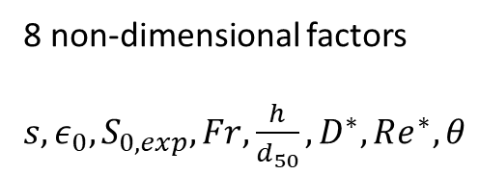
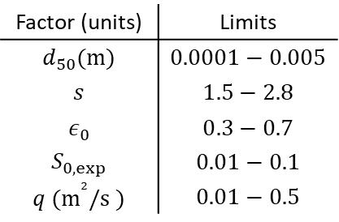
Methodology: application to the 2P2L model
Generating the situations
Closure of $μ$
Closure of 𝜇
Calculation of the solid discharge
Simulation: search for an optimal $μ$
Simulation: search for an optimal 𝜇
Application to test cases
2P2L
JMP®
Situations = random combinations of model constant parameters
Factor (units) | Limits
$$d_{50}(m)$$ | $$0.0001−0.005$$
$$s$$ | $$1.5−2.8$$
$$ε_{0}$$ | $$0.3−0.7$$
$$S_{0,exp}$$ | $$0.01−0.1$$
$$q (m^{²}/s )$$ | $$0.01−0.5$$
8 non-dimensional factors
$s, ε_{0}, S_{0,exp}, Fr,\frac{h}{d_{50}}, D^{∗},Re^{∗},θ$
Notes:
The first step consists in generating situations. What I call a situation simply corresponds to a set of flow and grain conditions that will lead to a particular flow, with a particular slope.
You can see here the 5 different factors that were used to define these situations, the median grain diameter, the relative density of the grains, the porosity of the bed, the expected slope of the numerical experiment, and the water input discharge.
For these 5 factors, I defined limits that corresponded to the limits that I envisionned for my model. Of course, you can choose whatever factor and limits you want.
You can then generate random combinations of factor values between these limits so that each situation corresponds to a unique flow. Ideally, the number of situations should be high enough to make sure that there are enough data points to build a regression model. Typically, I generated 100 situations.
Since mu is a non-dimensional friction coefficient, I combined these factors into 8 non-dimensional factors with their own information about the flow, such as the Froude number of the Reynolds number. The regression model that I later build as a closure model is based on these 8 non-dimensional factors.

Slide 6
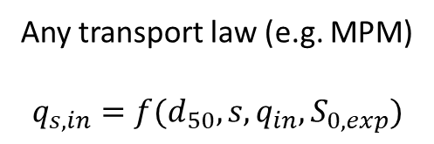
Methodology: application to the 2P2L model
Generating the situations
Closure of $μ$
Closure of 𝜇
Calculation of the solid discharge
Simulation: search for an optimal $μ$
Simulation: search for an optimal 𝜇
Application to test cases
2P2L
JMP®
Any transport law (e.g. MPM)
$$q_{s,in}=f(d_{50},s,q_{in},S_{0,exp})$$
Notes:
Very quickly, the second step simply corresponds to the computation of the solid discharge, considered equal to the transport capacity, according to the chosen transport law, such as MPM for instance. Each situation has a different solid input upstream.

Slide 7
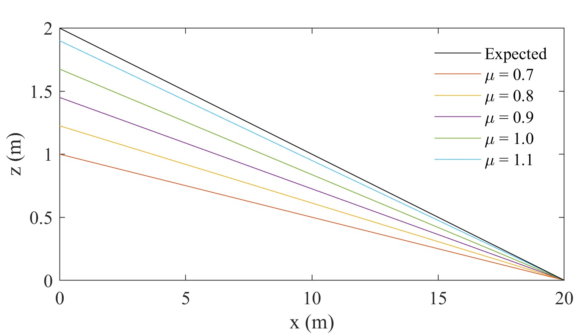
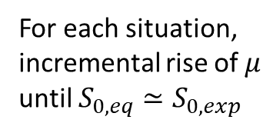

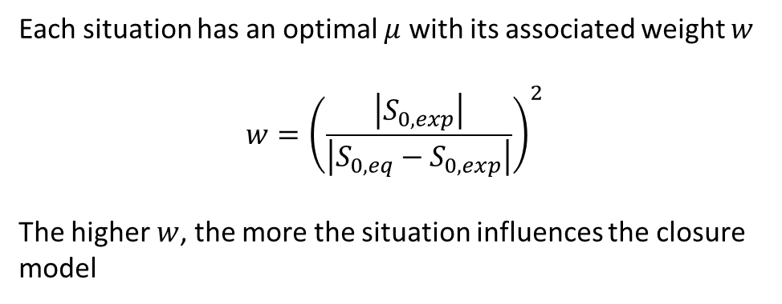
Methodology: application to the 2P2L model
Generating the situations
Closure of $μ$
Closure of 𝜇
Calculation of the solid discharge
Simulation: search for an optimal $μ$
Simulation: search for an optimal 𝜇
Application to test cases
2P2L
JMP®
For each situation, incremental rise of $μ$ until $S_{0,eq}≃S_{0,exp}$
Each situation has an optimal $μ$ with its associated weight $w$
$$w={\left(\frac{\left|S_{0,exp}\right|}{\left|S_{0,eq}−S_{0,exp}\right|}\right)}^{2}$$
The higher $w$, the more the situation influences the closure model
1 situation ➔ several values of $μ$
Notes:
The third step consists in running the experiment itself.
For each situation, we must increase the value of mu until S0,eq comes as close as possible to S0,exp. This means that a very large number of simulations must be run so you’d probably better lauchn a batch of simulations on a remote computer.
As you can see on this graph, every value of mu will lead to a different equilibrium slope. The mu-value that gives the closest slope the black one, the expected one, is the optimal value of mu for that situation.
We can then define a weight for this situation as it is very likely that S0,eq will not be exactly equal to S0,exp for each situation. This weight can be computed as the inverse of the square of the difference between the two slopes, normalized by the square of the expected one to grant situations with unequal slopes the same importance. These weights will be used later, to build the regression model. The heavier w, the more the situation influences the closure model.

Slide 8
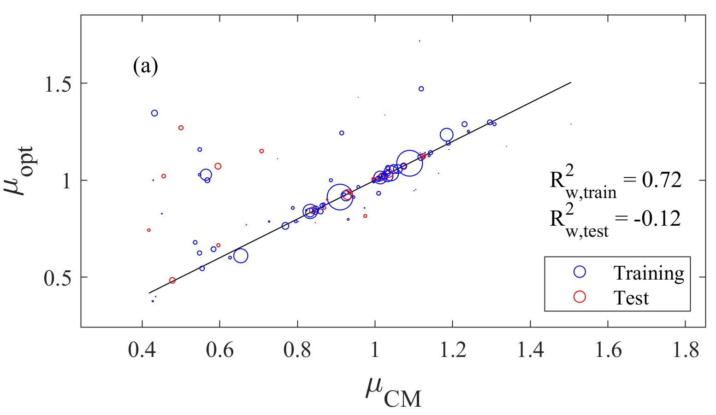
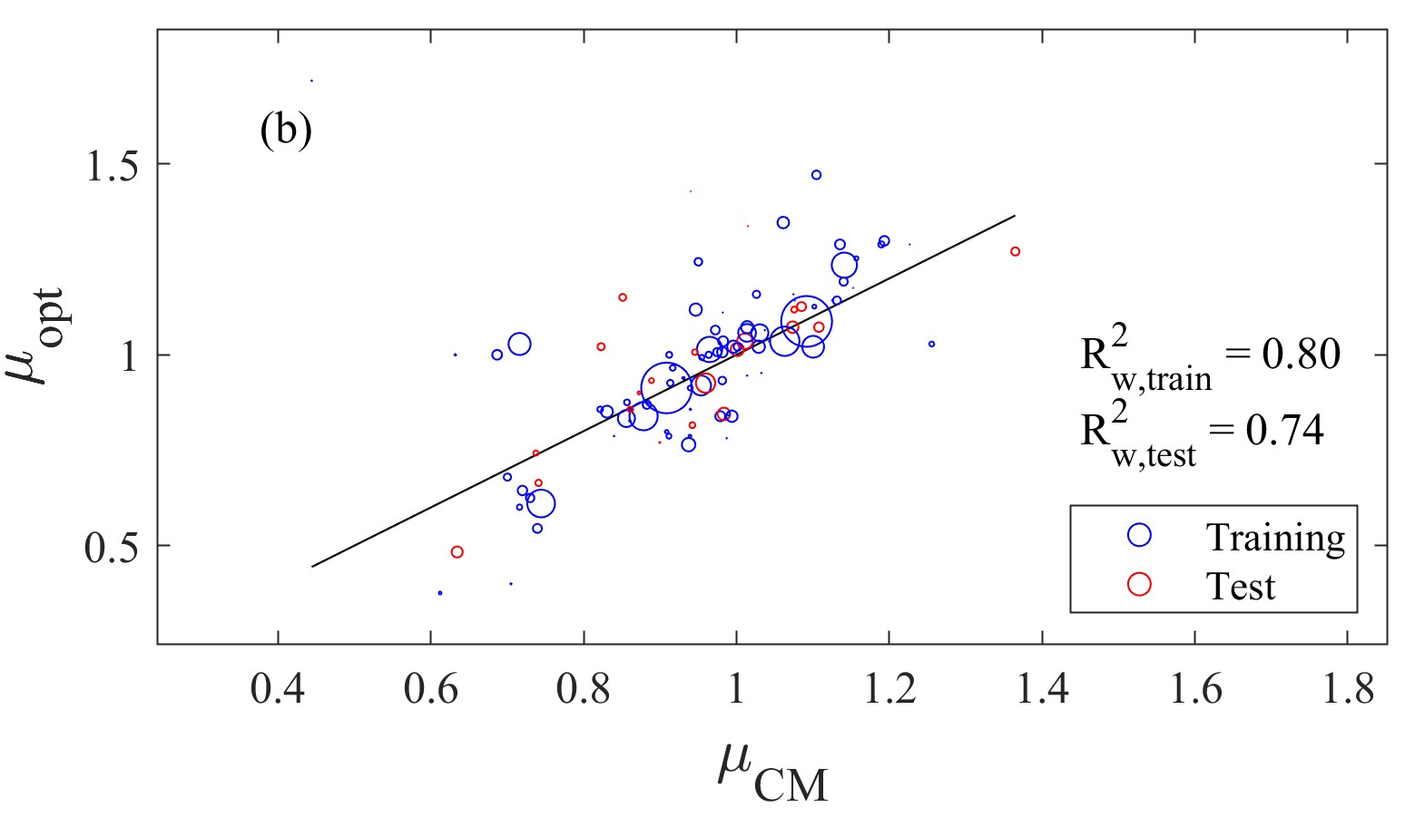
Methodology: application to the 2P2L model
Generating the situations
Closure of $μ$
Closure of 𝜇
Calculation of the solid discharge
Simulation: search for an optimal $μ$
Simulation: search for an optimal 𝜇
Application to test cases
2P2L
JMP®
Development of closure models (CMs) with machine learning and comparison
Notes:
Now, we have our optimal results for each situation and the associated weights. We can hence use JMP or any other software or code to develop closure models. As I wanted the model to be interpretable and easy to implement numerically, I focused on regression models built with a stepwise method but again, you can make a different choice and consider Artificial Neural Networks for example.
Before searching for an appropriate closure model, I split my datapoints in a training and a test set, to keep an eye on overfitting.
Here, you can see the fit of two different models. The closure model on the left graph is a simple model inspired from a paper of Cheng & Zhao who studied the angle of repose of sand, which can be somewhat related to the friction coefficient. The size of the circles represents the weights. The larger the circle, the heavier the weight of the situation. You can see that the training set has a relatively good fit, with a weighted R² of 0.74. Unfortunately, the R² on the test set is terrible which indicates that this simple closure model cannot be used for the entire scope of flows that I consider.
I hence used the machine learning features of JMP to develop another model, represented on the right graph. Here you can see, that there is barely no overfitting and that most of the variability of the optimal mu values can be explained by the closure model.
Rather than using arbitrary values of mu that are constant in time and space, we now have a closure model that adapts to the flow in each cell of the mesh.

Slide 9
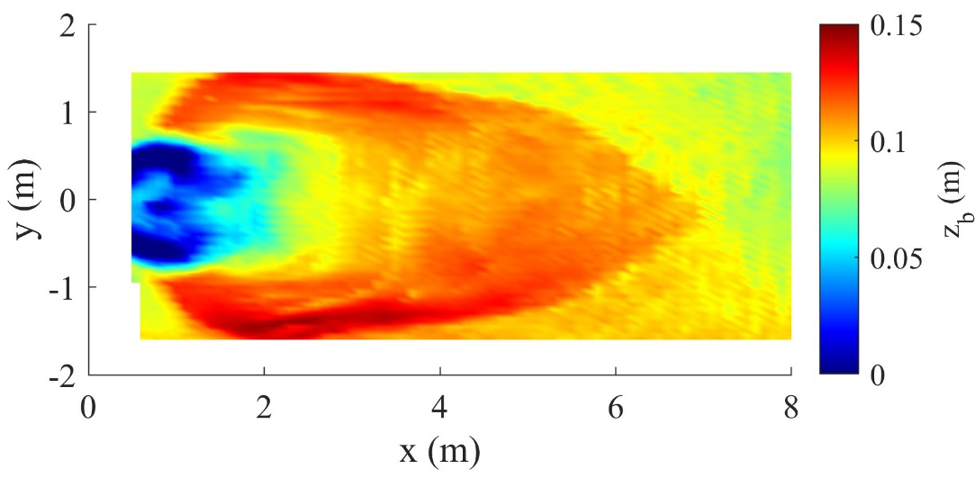
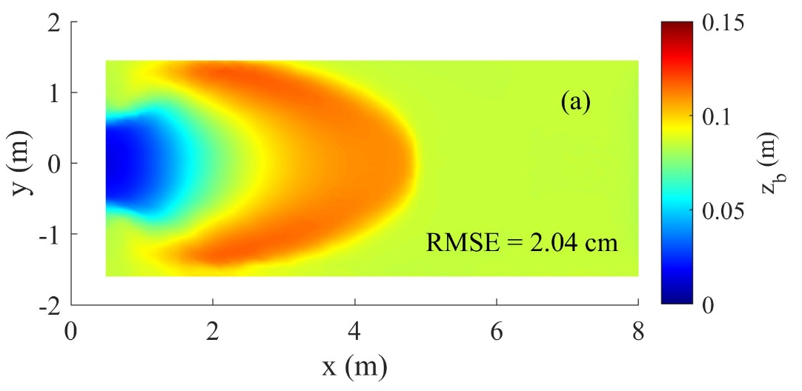
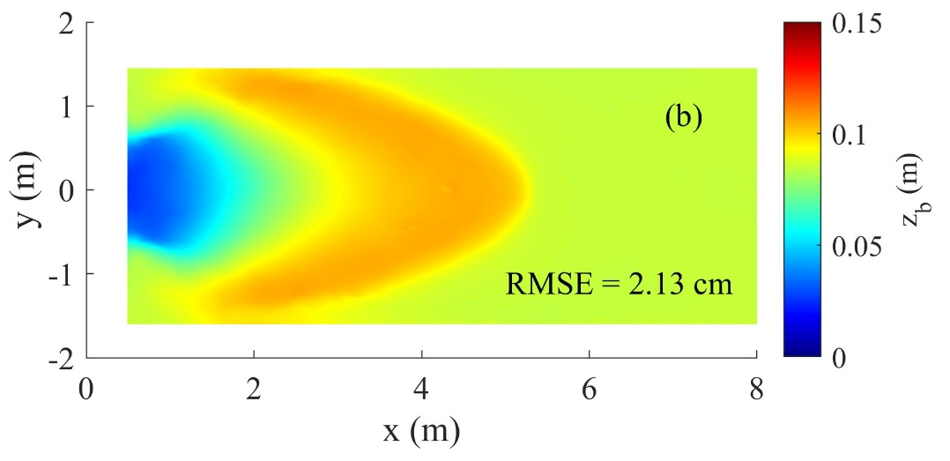
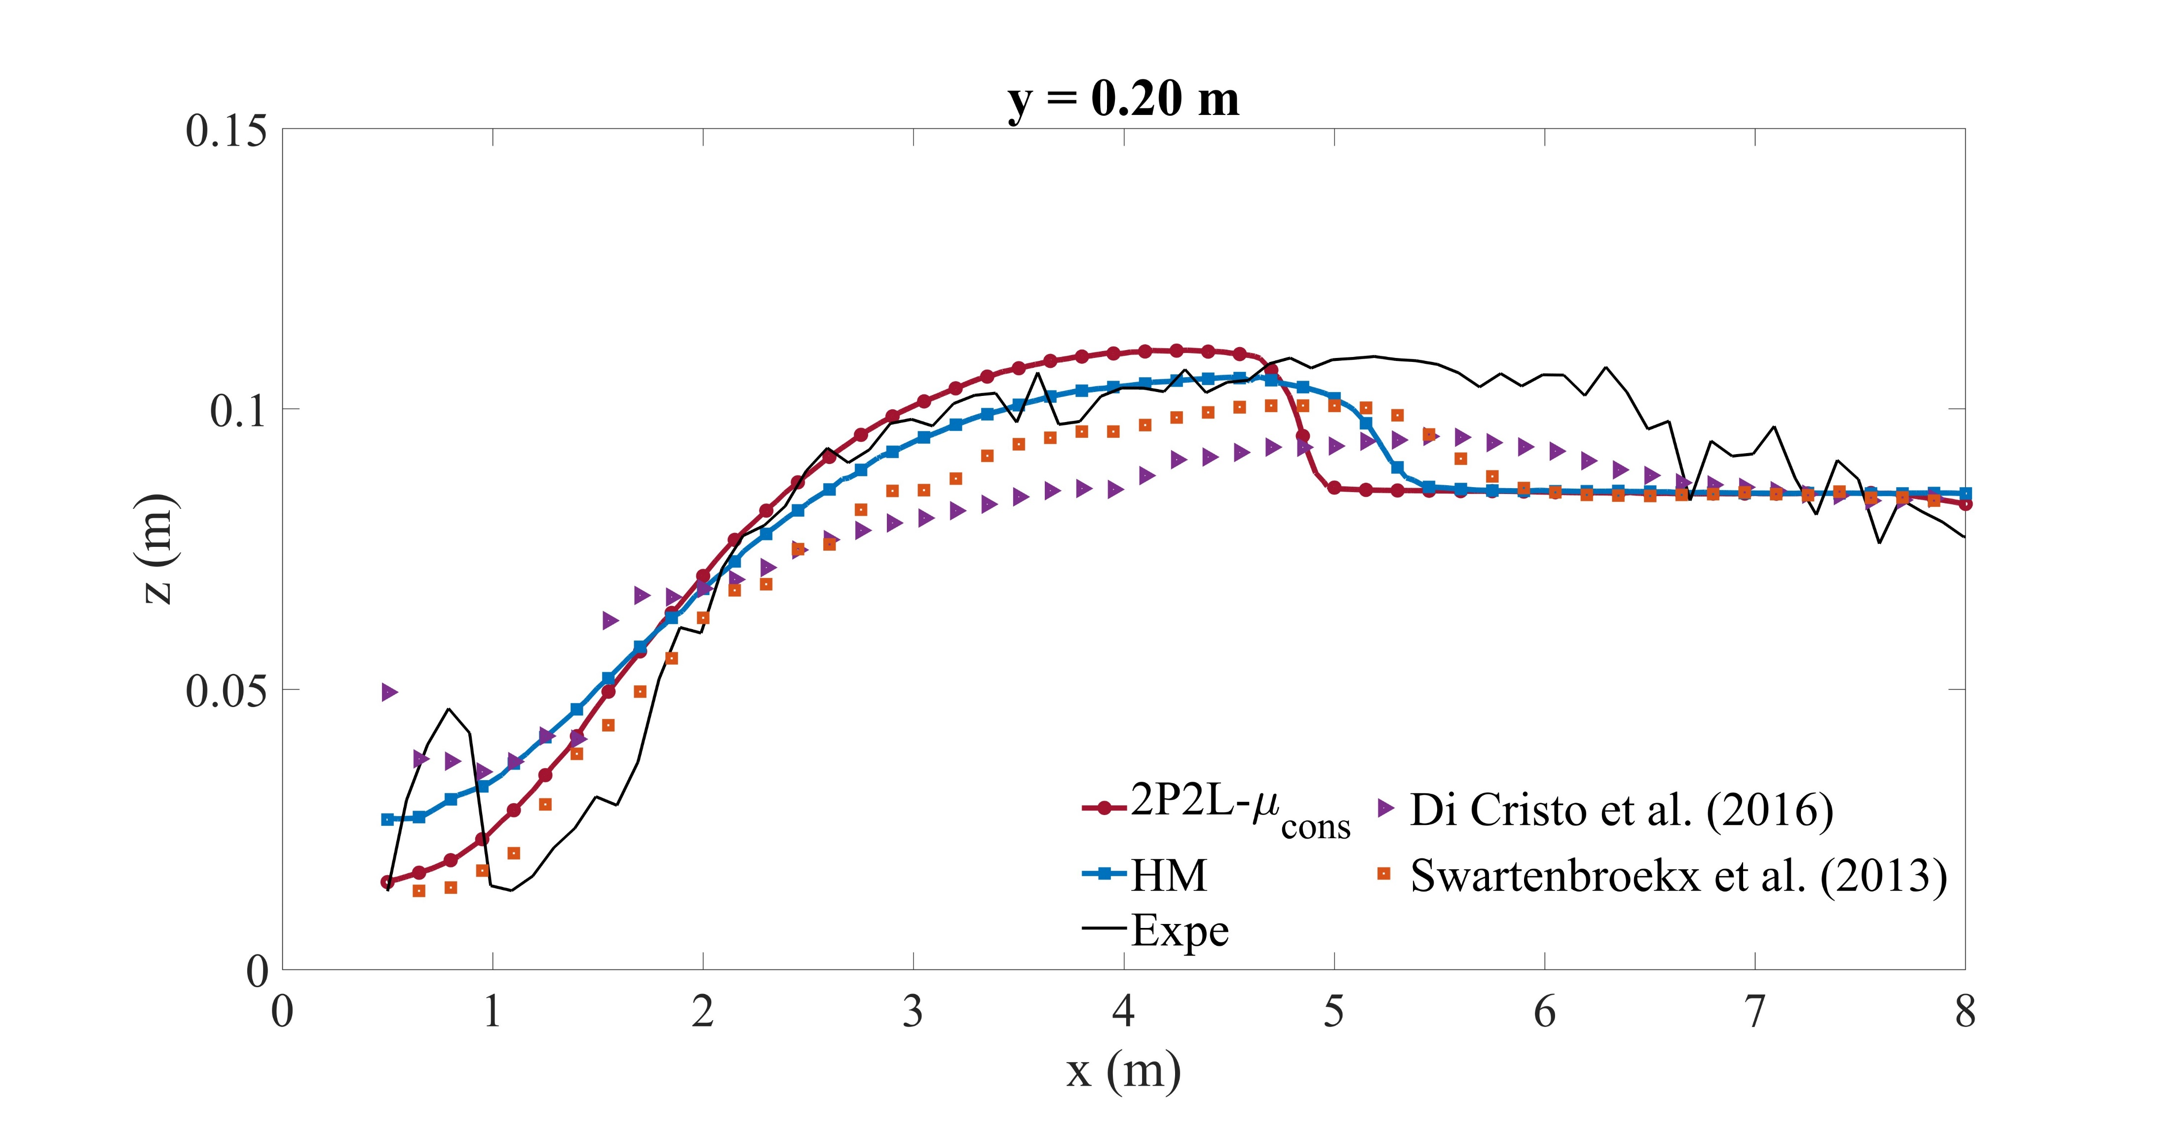
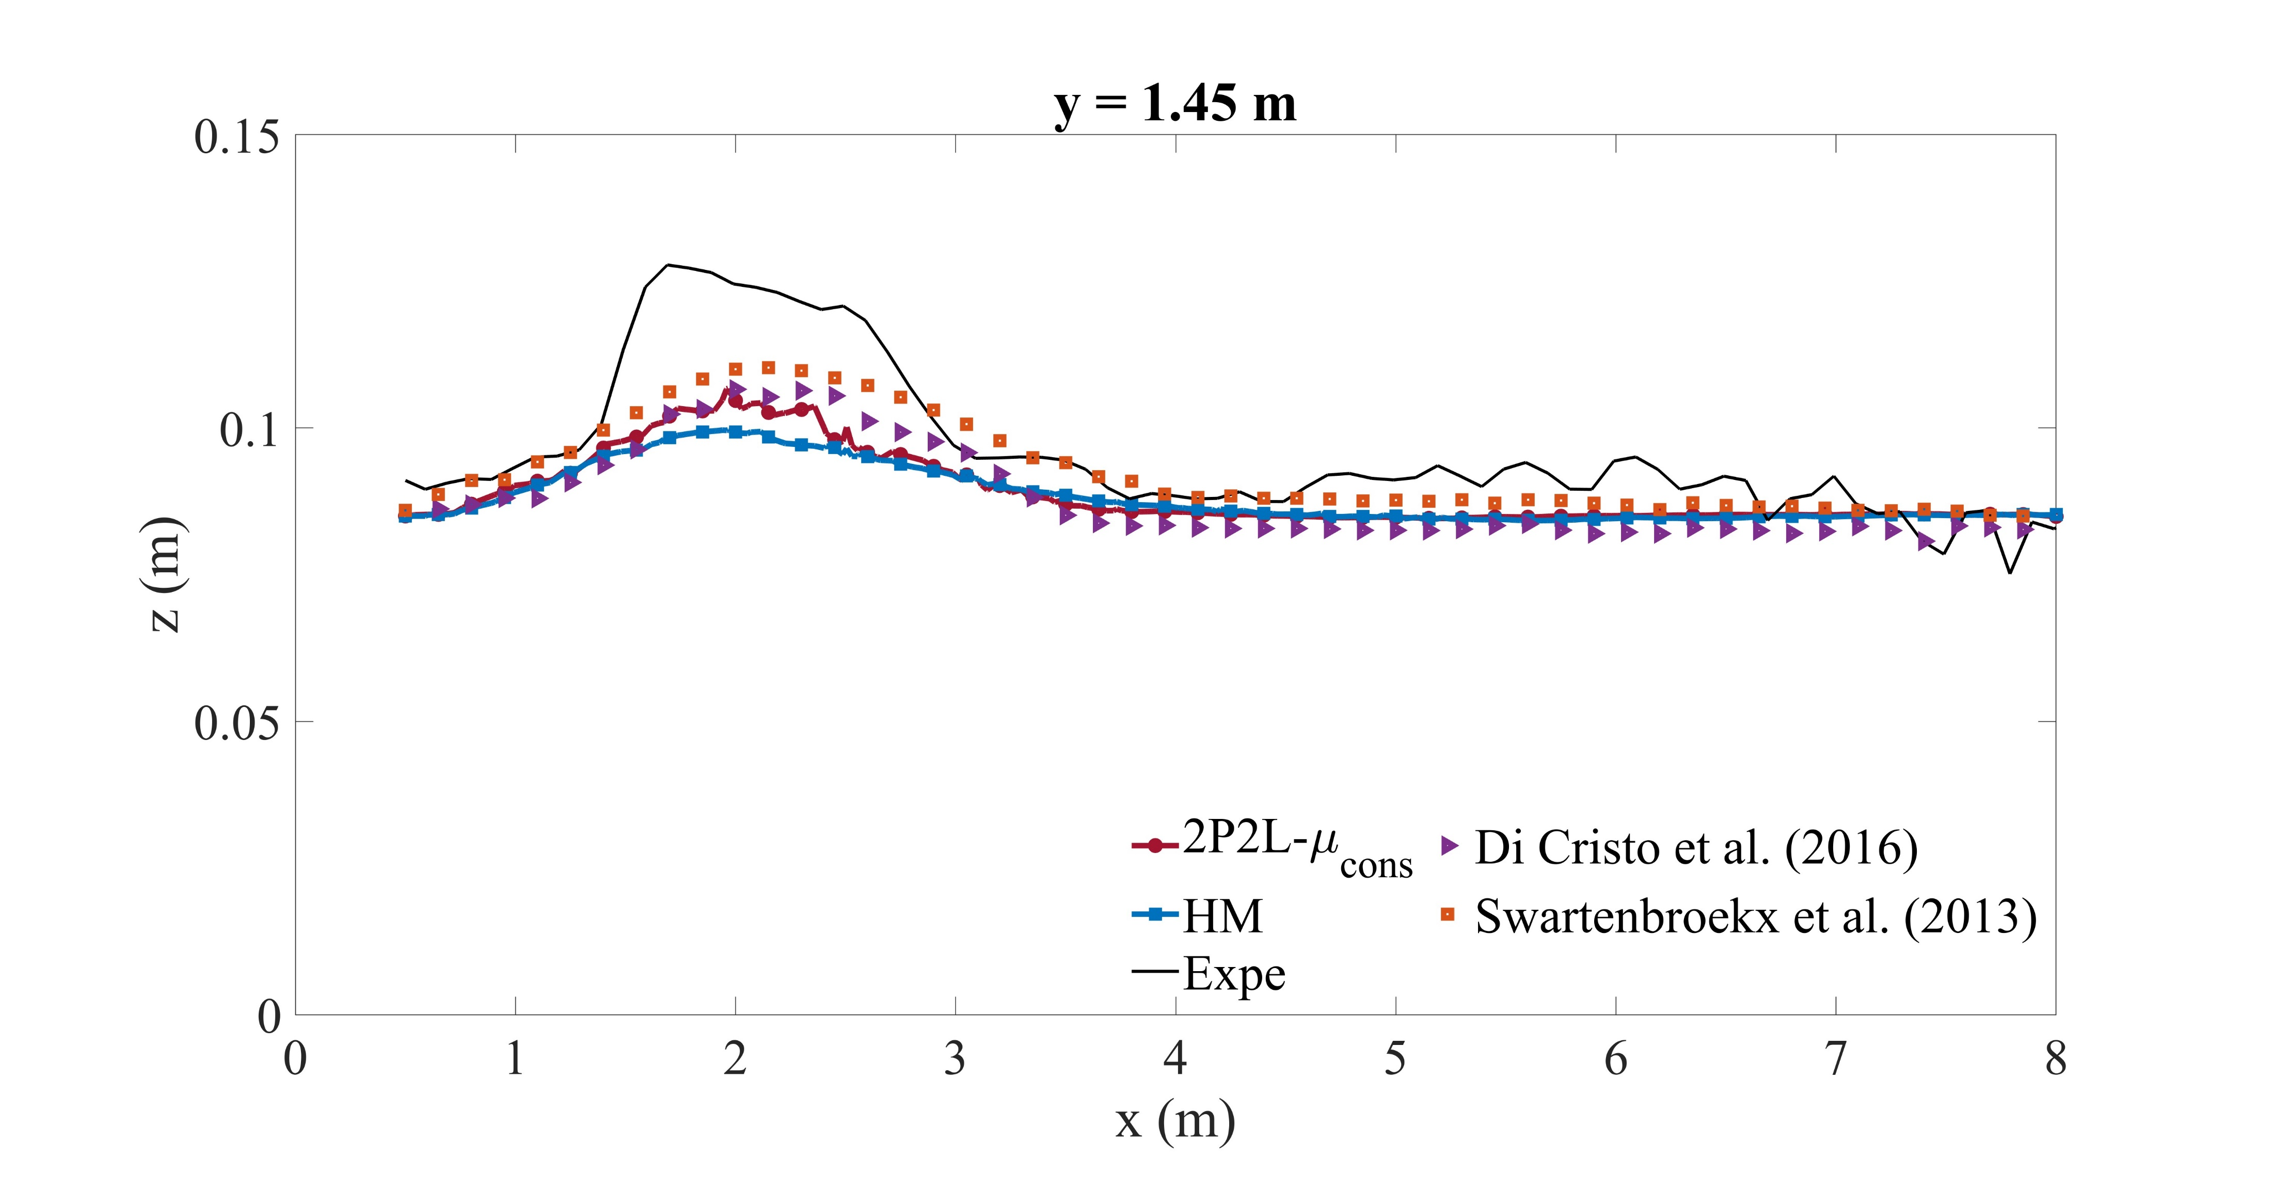



Application of the HM: 2D dam-break
Experimental
2P2L - $μ_{cons}$
Hybrid Model (HM)
$$y=1.45 m$$
$$y=0.20 m$$
Soares-Frazão et al., 2012
Notes:
I implemented this closure model derived with machine learning into my physics-based 2P2L model to build a so-called hybrid model and I applied it to a famous laboratory dam break test case on an erodible bed, discussed by Soares-Frazão in 2012.
At equilibrium, after the passage of the wave, an erosion pit has formed at the toe of the dam, while the sand deposited mainly along the edges of the flume and then joined several metres from the dam’s toe, forming an arrow.
I applied the 2P2L model with a friction coefficient set as a constant value found by trial and error and it was able to reproduce the pit and the deposits but the extent of the arrow is a bit limited.
I then applied my hybrid model, with a variable mu value determined by the implemented closure model, and you can see that the results are rather similar, with an RMSE of the same order of magnitude. The amplitude of the erosion and deposition is lower but the arrow is better reproduced.
The two longitudinal profiles show that the two versions of the model behave rather similarly. We can also see that the hybrid model reaches the same order of accuracy as other evenly complex models from the literature using two layers or two phases but that rely on tunable parameters.
In conclusion, the closure model developed with the procedure that I have presented you today provides reasonable results and makes it possible to circumvent trial and error to tune the model’s parameters.

Slide 10
Conclusion
Objectives
Getting rid of trial and error
Solution
Run a simple numerical morphodynamic experiment
Results
Application to a 2P2L model
Determine the optimal parameter value for each set of flow conditions
Applying the model to flow conditions with uncertain results
Develop a closure model with these self-generated data and machine learning
Development of closure models for friction parameters
2D dam-break: similar performance as optimal constant values and evenly complex models from the literature
Notes:
My goal today was to provide you some ideas to get rid of trial and error in order to apply your models to flow conditions whose outcomes regarding the considered rivers are uncertain.
To do so, I proposed you a methodology to close parameters of morphodynamical models. It is based on a simple numerical experiment that can be run with different values of the parameter to close. The goal is to retrieve the value of the parameter that minimizes the difference between the equilibrium slope and the slope that can be expected based on the sediment discharge fed from upstream. We can then develop a closure model based on the optimal values retrieved for all situations.
I applied this procedure to a two-phase/two-layer flow which lacked a closure formulation for its friction coefficient. I used a stepwise method to derive a weighted regression model that I implemented in my model. I tested this hybrid model on a 2D dam break test case and found out that its performance was similar to that of the model with an optimal constant value for its unclosed friction coefficient and other evenly complex models from the literature

Slide 11
Thank you very much!
Robin Meurice^{1,2},
Sandra Soares-Frazão¹
¹ Université Catholique de Louvain, Institute of Mechanics, Materials and Civil Engineering, Louvain-la-Neuve, Belgium
² Fonds de la Recherche Scientifique F.R.S.-FNRS
email: robin.meurice@uclouvain.be
Notes:
Thank you very much for attending this presentation and please do not hesitate to ask questions

