Slide 1


Roughness vs. Sub-Surface Porosity
Key Factors in Fatigue Behavior of AlSi10Mg LPBF Alloy
van der Rest, Camille and Poncelet, Olivier and Manzano Navarrete, Rodrigo Arturo and Simar Aude.
Leuven Additive Manufacturing Conference 2025
27-28 mai

Slide 2
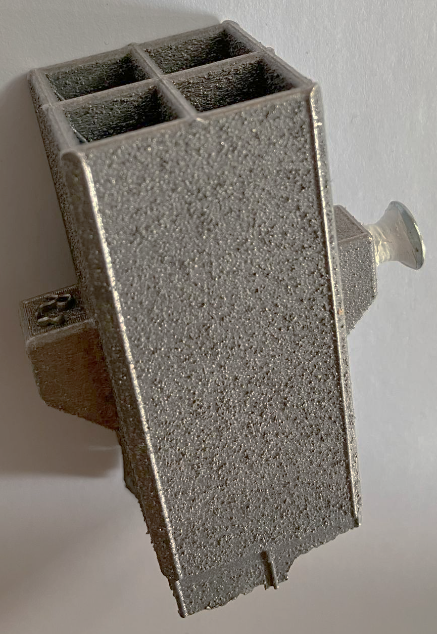

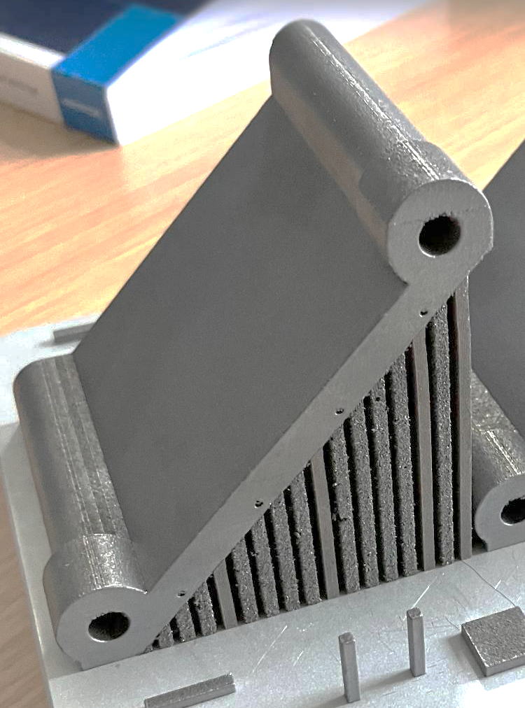
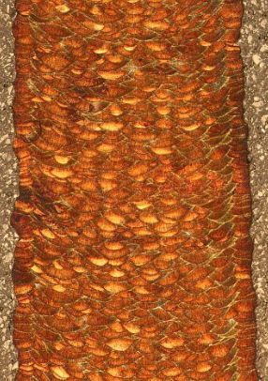
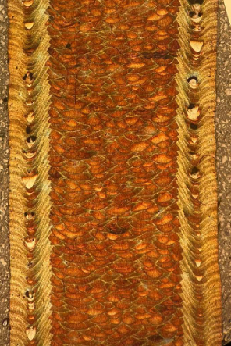
Roughness or sub-surface porosities?
TED = Power / speed
TED contour = TED bulk
TED contour >> TED bulk
High roughness
low porosity
Low roughness
High porosity
Poncelet et. al, 2021
Critical assessment of the impact of process parameters on vertical roughness and hardness of thin walls of AlSi10Mg processed by laser powder bed fusion
Additive Manufacturing
2/14

Slide 3
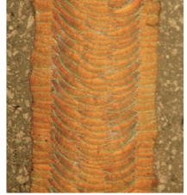
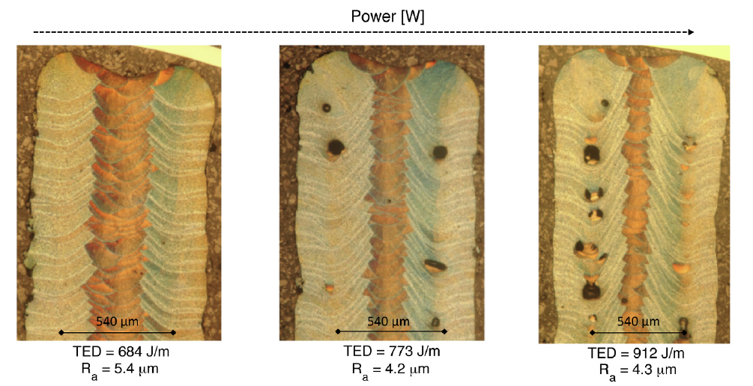
Any trade-off?
Contour TED
540 µm
540 µm
540 µm
high
low
homogeneous
medium
low
inhomogeneous
very low
high
inhomogeneous
Roughness:
Sub-surface porosity:
Microstructure:
Roughness:
Sub-surface porosity :
Microstructure:
Roughness:
Sub-surface porosity :
Microstructure:
3/14
Context and aims
Materials and methods
Results and discussion
4
Conclusion

Slide 4
Manufacturing of tensile and fatigue samples
Fatigue properties
Crack initiation analysis

Slide 5
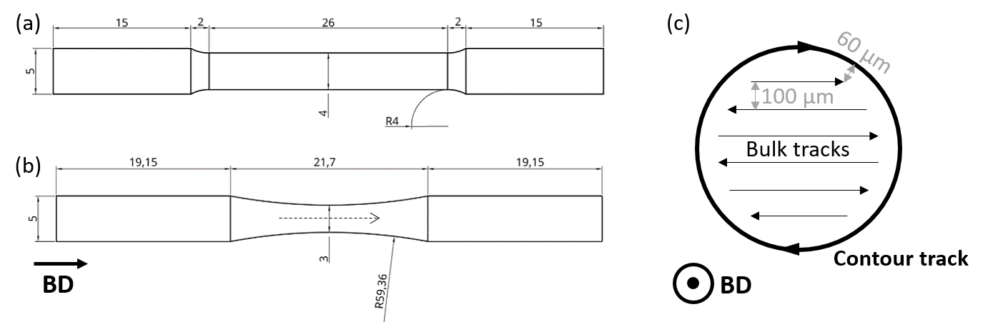
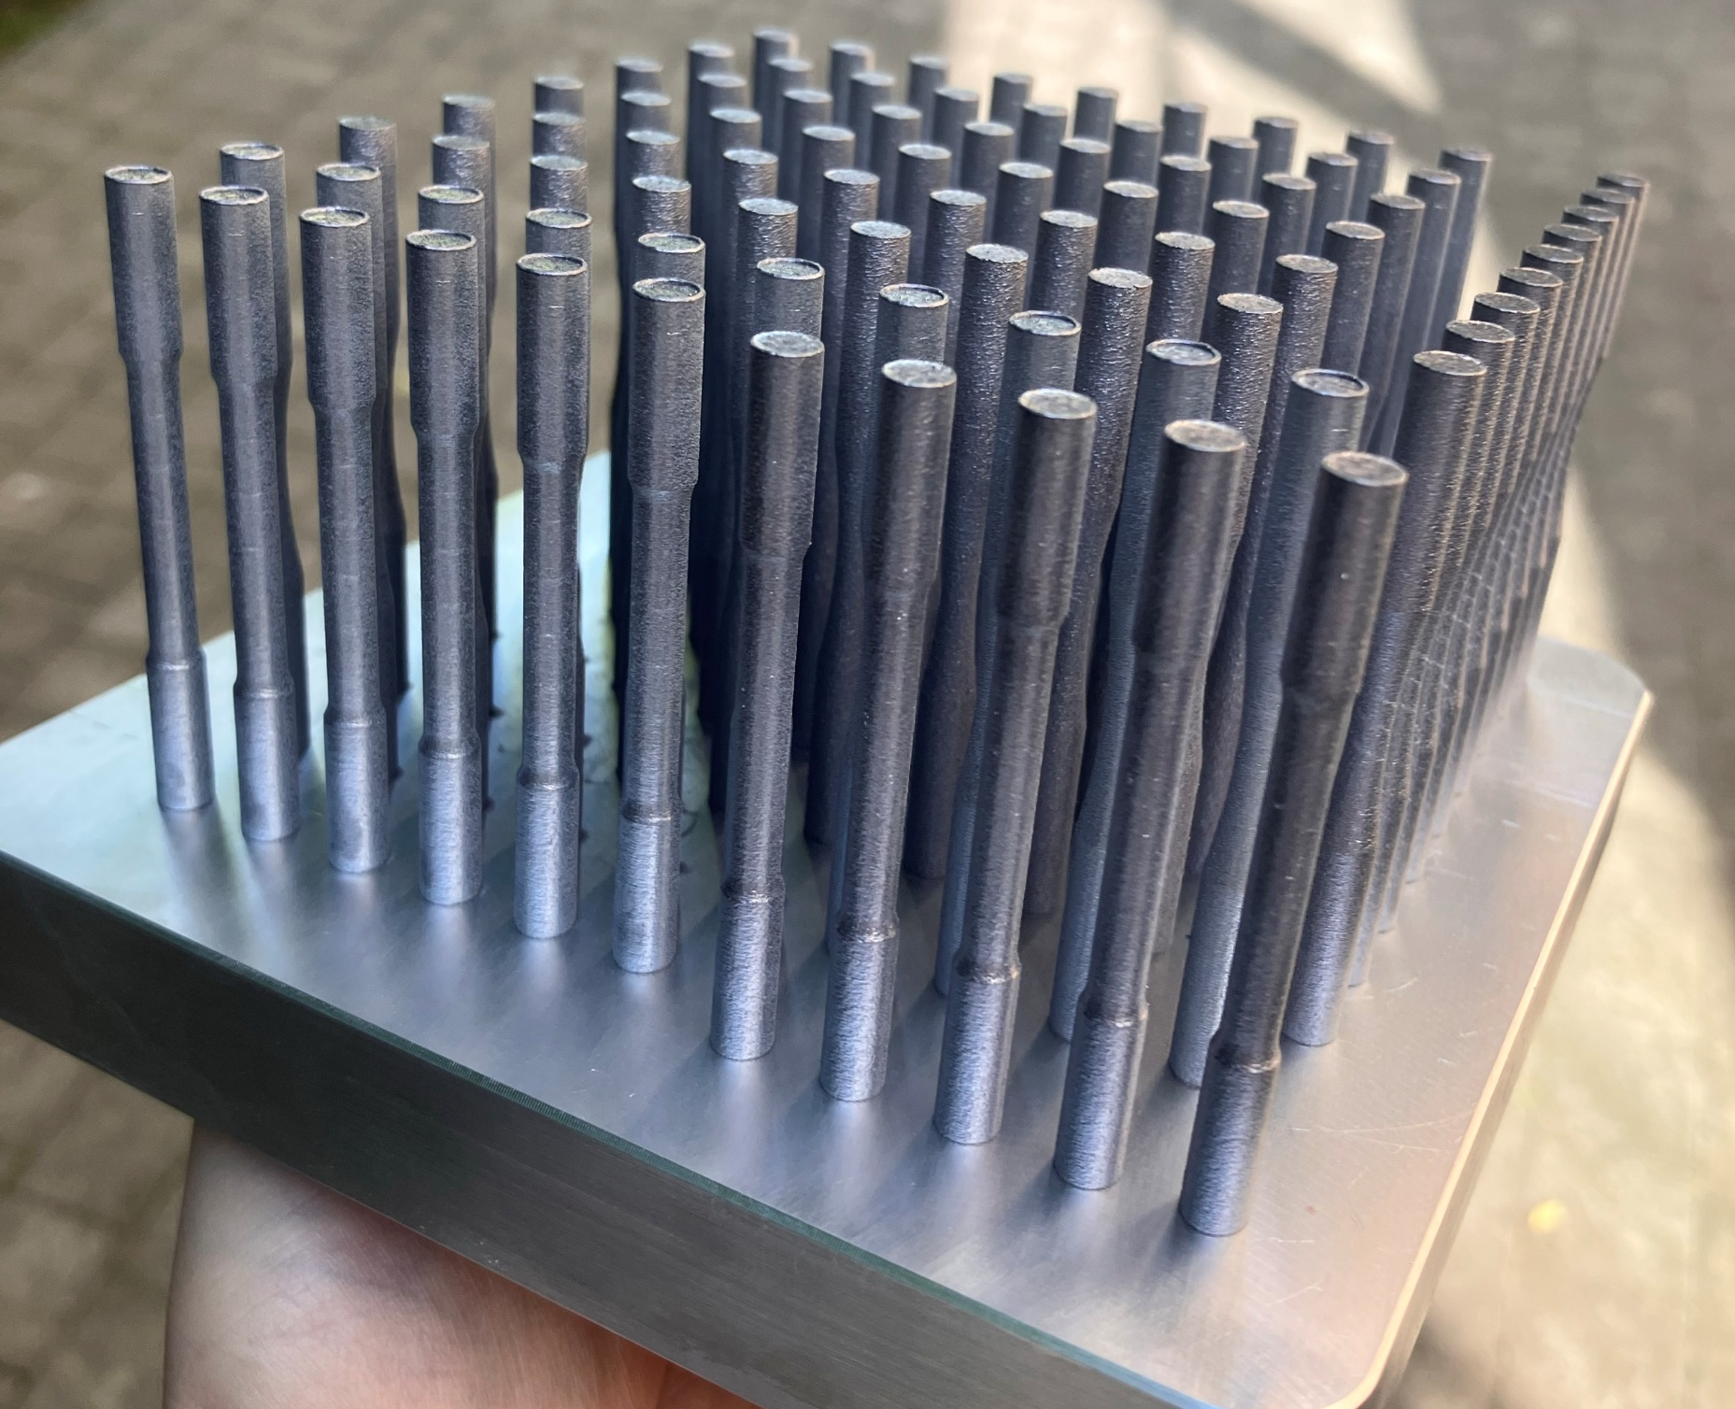
3 sets of parameters involved
Powder : 70% recycled AlSi10Mg + 30% new
ASTM E8/E8M-15a and ASTM E466-15
Stress release heat treatment (SRHT): 2h at 250°C
60 mm
X200 from 3D-systems
Parameters – 30 µm layer – 100 µm hatch
Name | Contours First | Bulk
Rough | 230 W at 1200 mm/s | 230 W at 1200 mm/s
Smooth | 270 W at 600 mm/s | 230 W at 1200 mm/s
Smooth+KHP | 270 W at 300 mm/s | 230 W at 1200 mm/s
5/14
Context and aims
Materials and methods
Results and discussion
4
Conclusion

Slide 6
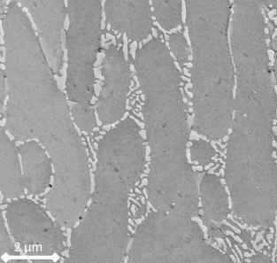
Targetted « defects »
Rough
Smooth
Smooth + KHP
Inhomogeneous
microstructure
Inhomogeneous
microstructure
High Roughness
Medium Roughness
Low
Roughness
Sub-surface porosity
Poncelet et. al, 2021
Critical assessment of the impact of process parameters on vertical roughness and hardness of thin walls of AlSi10Mg processed by laser powder bed fusion
Additive Manufacturing
6/14
Context and aims
Materials and methods
Results and discussion
4
Conclusion

Slide 7
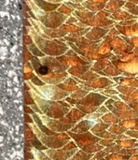
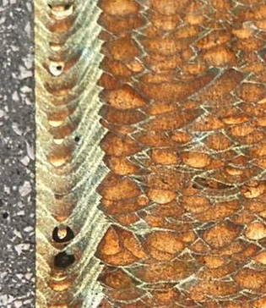
Post-treatment
As-built
Rough
Smooth
Smooth+KHP
Polishing: from SiC 320 to 1/4 μm, removing +-100 µm of the diameter
Sandblasting (SB): made of 98% of Al₂O₃, with d50 = 445 µm for adding compressive stress
7/14
Context and aims
Materials and methods
Results and discussion
4
Conclusion

Slide 8
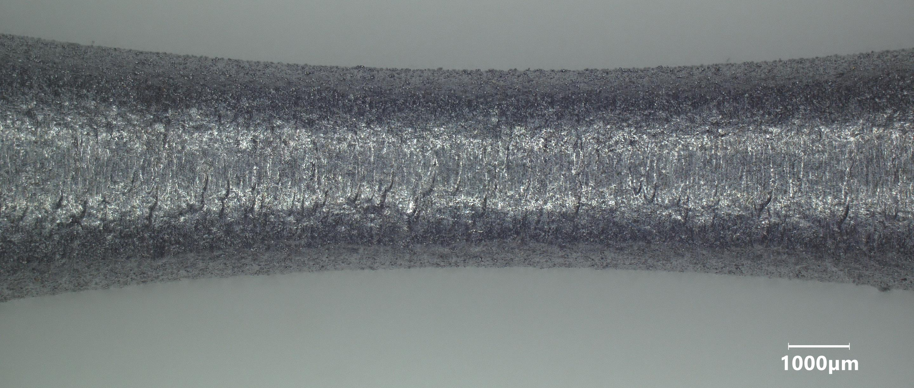
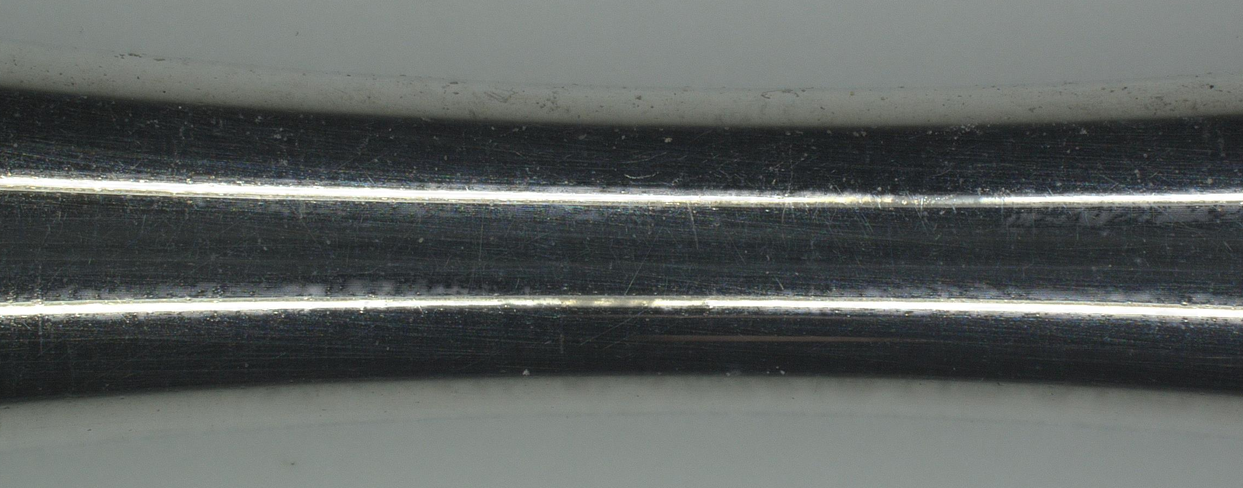
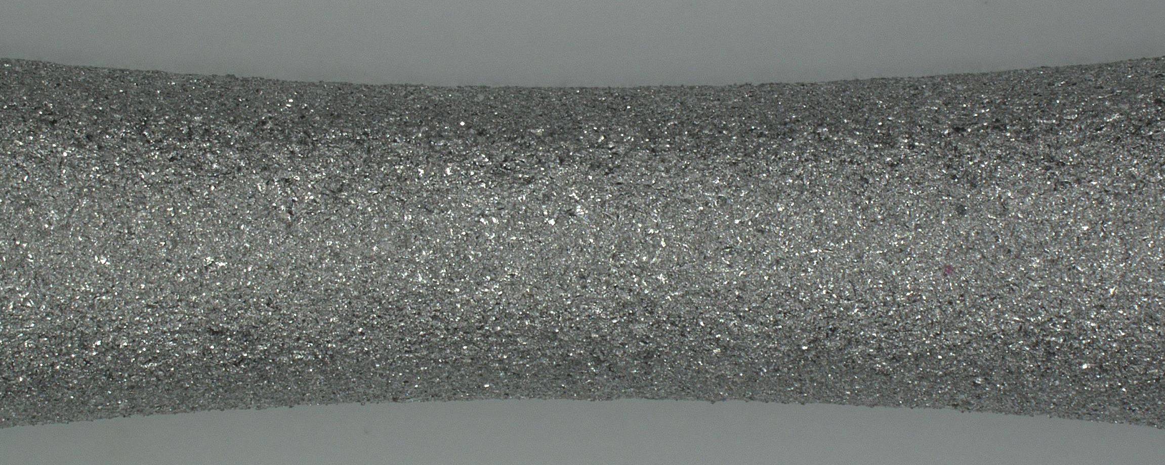
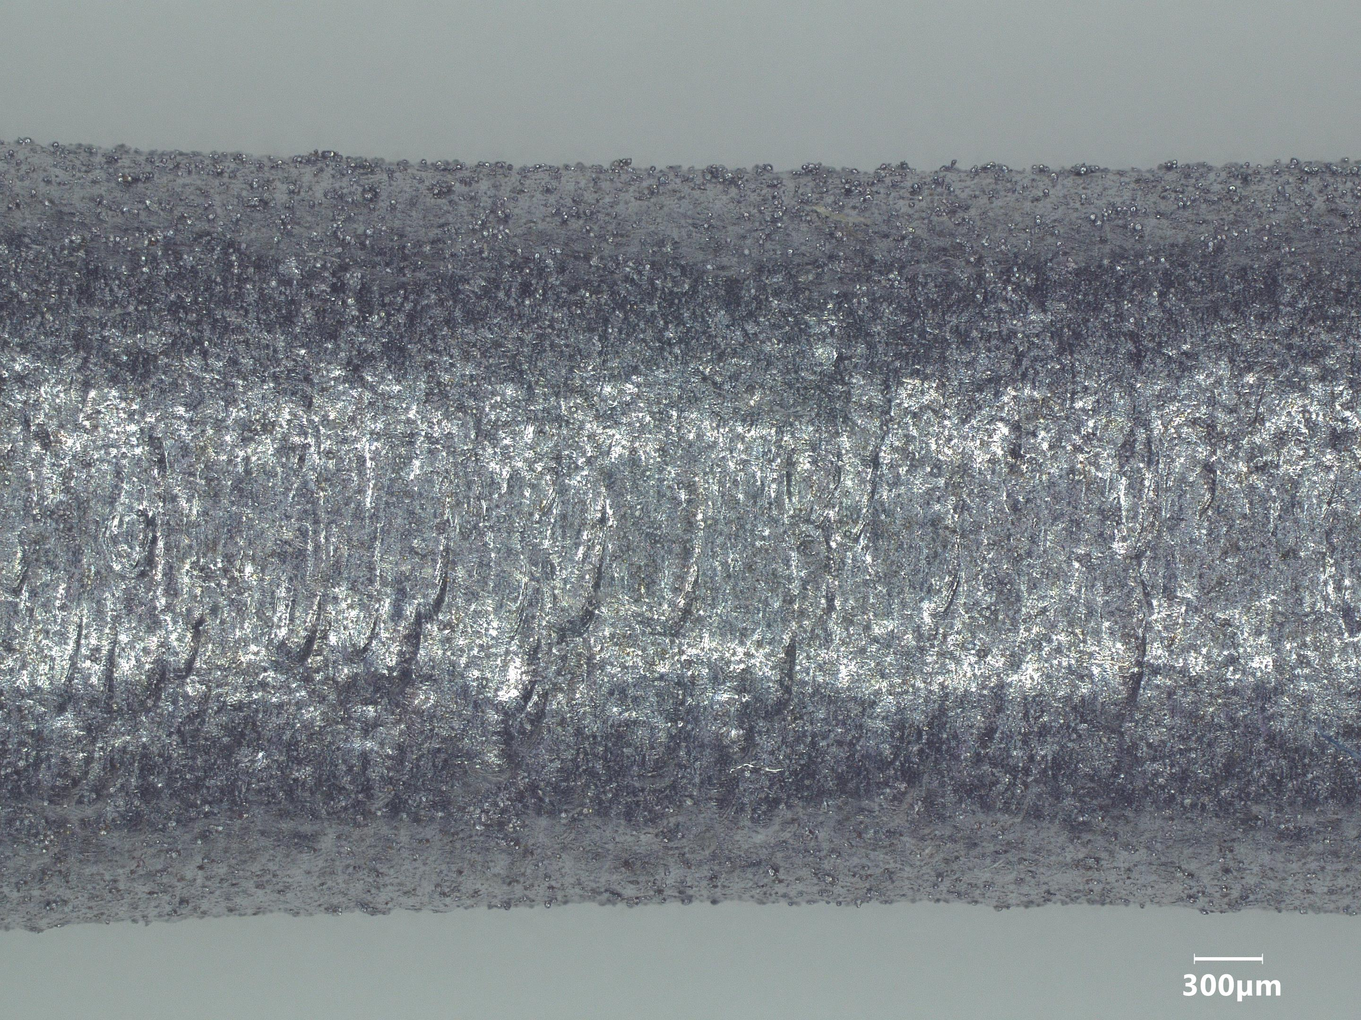
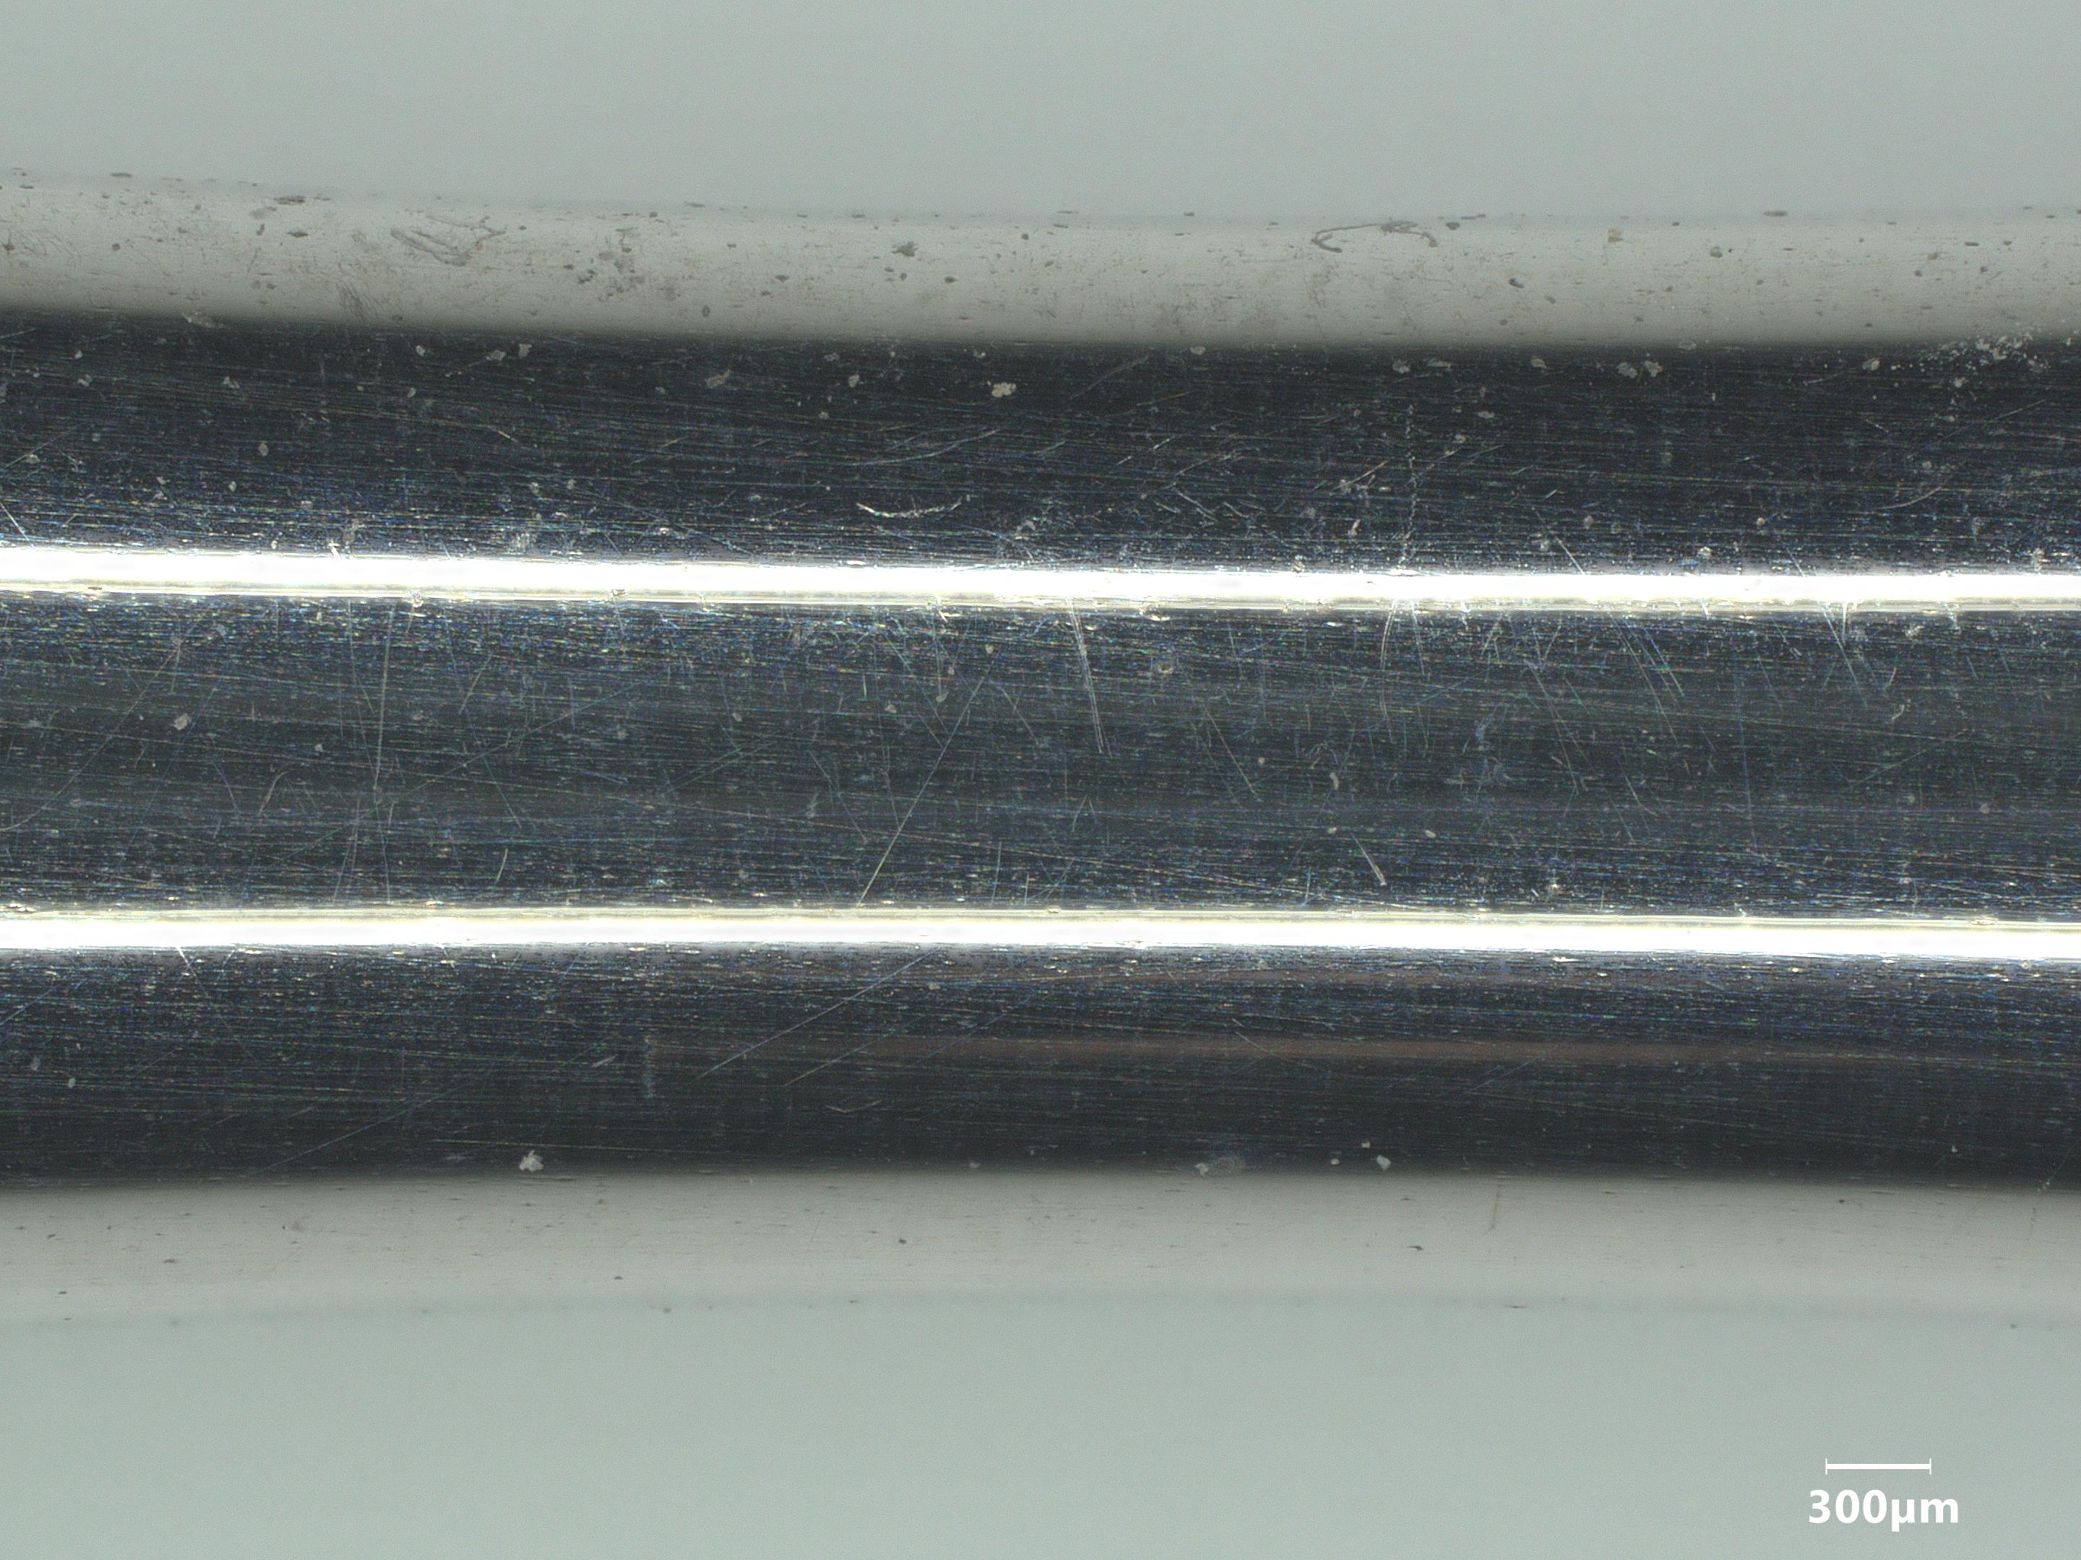
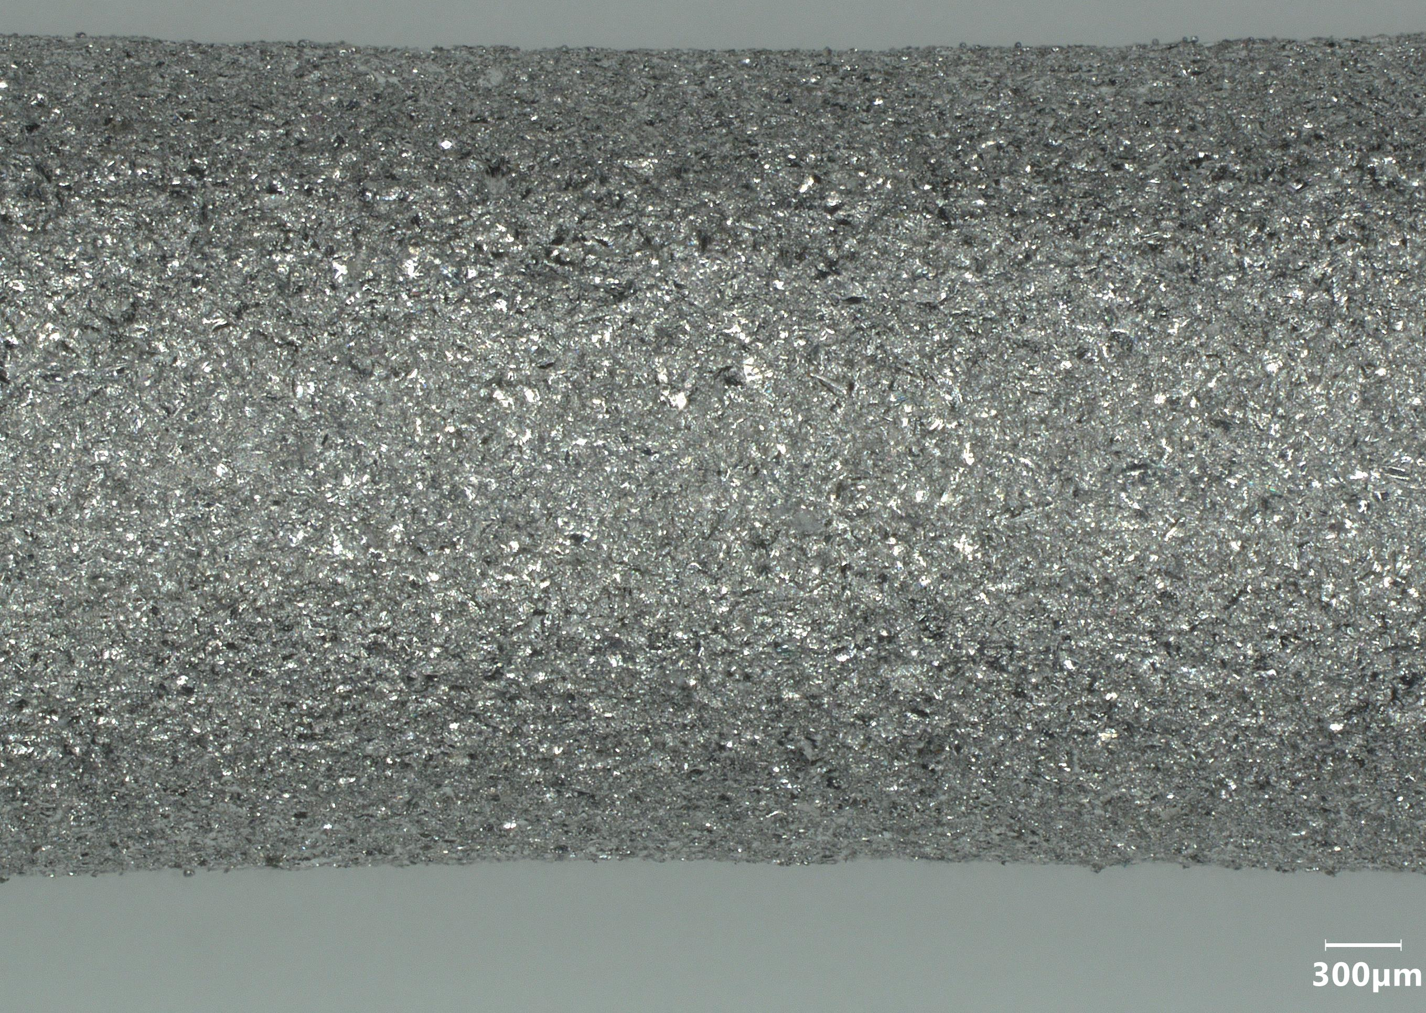
Post-treatment
3 surface states - On a Smooth sample here
As-built
Polished
Sand blasted
8/14
Context and aims
Materials and methods
Results and discussion
4
Conclusion

Slide 9
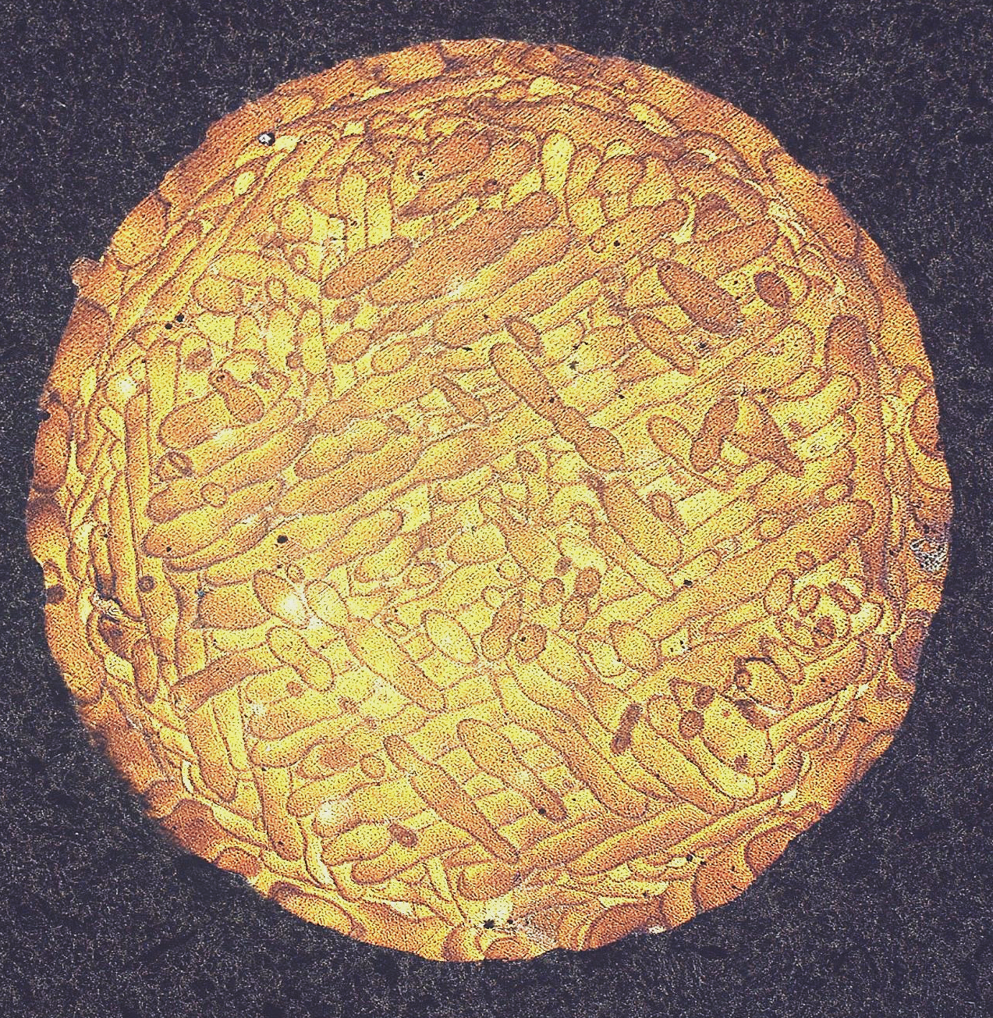
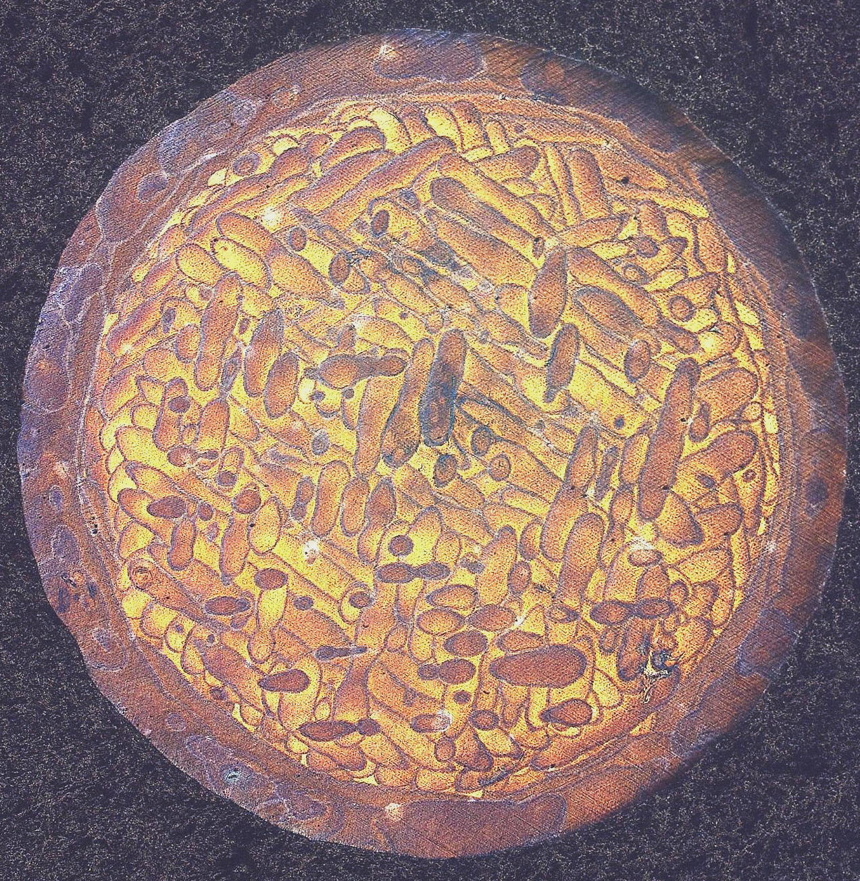
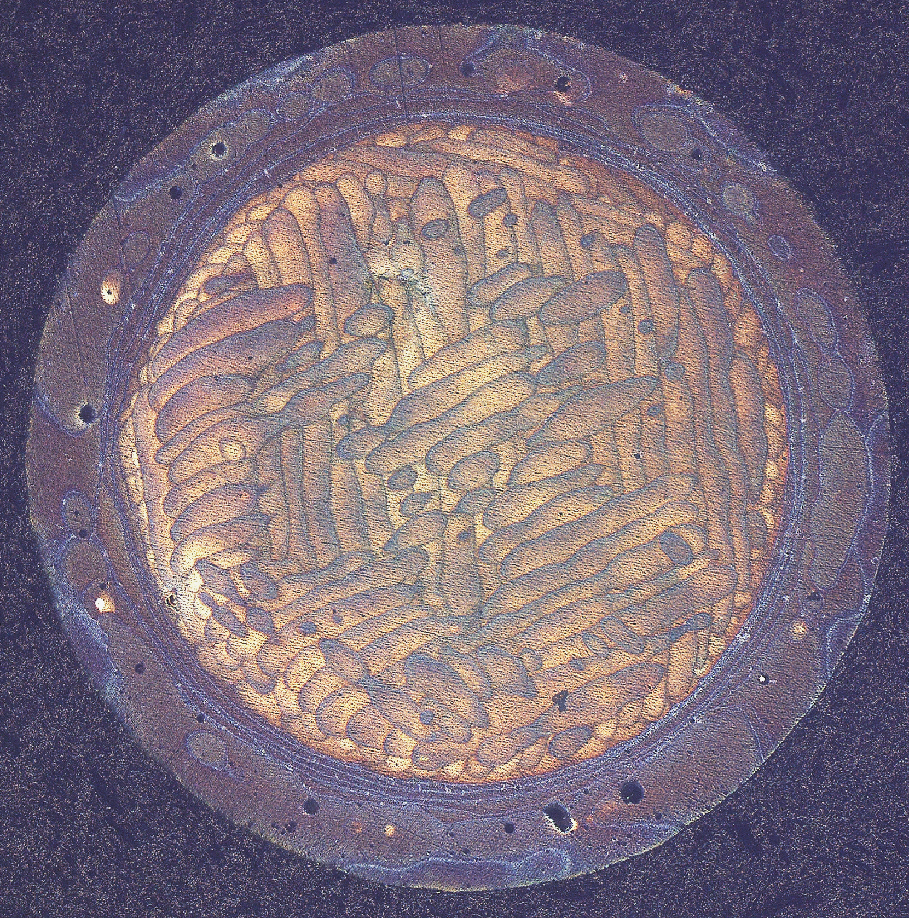
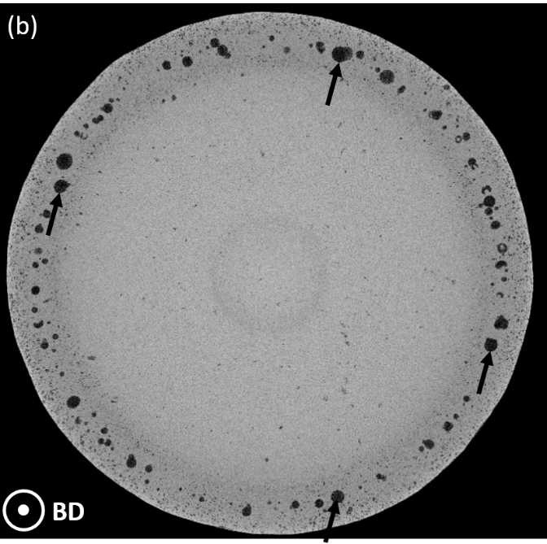
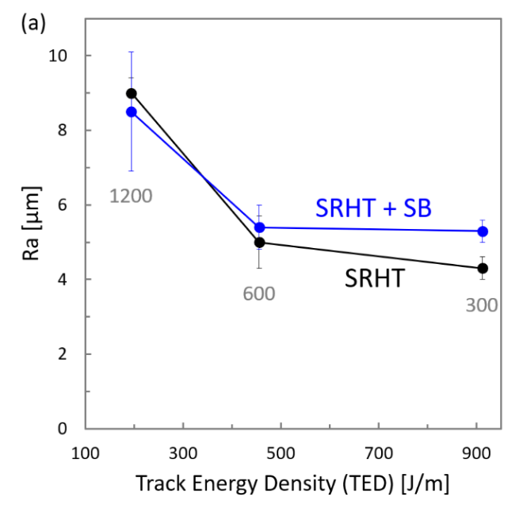
We obtained the expected defects
Rough
Smooth
Smooth + KHP
µCT
Roughness (EN ISO 4288 )
9/14
Context and aims
Materials and methods
Results and discussion
Conclusion

Slide 10
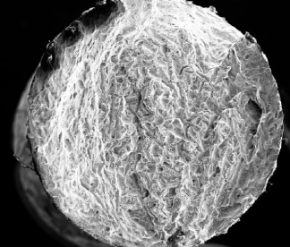
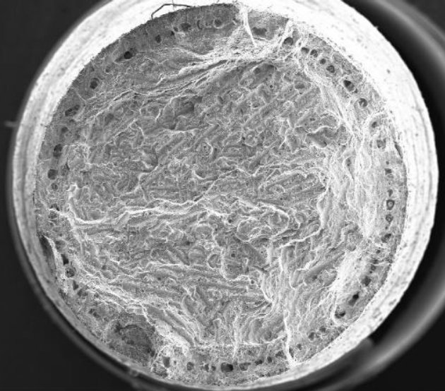
Static properties
L₀ = 20 mm – Crosshead speed= 1mm/min
 | Yield Strength, 0.2% [MPa] | Ultimate Tensile Strength [MPa] | Elongation at break [/]
Rough | 239 | 404 | 0.04
Smooth | 244 | 413 | 0.04
Smooth with KHP | 239 | 392 | 0.03
10/14
Context and aims
Materials and methods
Results and discussion
Conclusion

Slide 11
Fatigue properties
30 Hz – R = 0.1
Initiation: Surface (roughness), Lack-of-fusion, Keyhole, porosity, undefined bulk defects
11/14
Context and aims
Materials and methods
Results and discussion
Conclusion

Slide 12
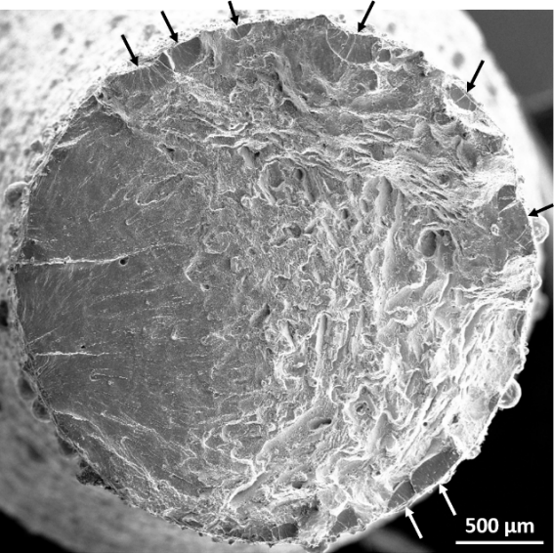
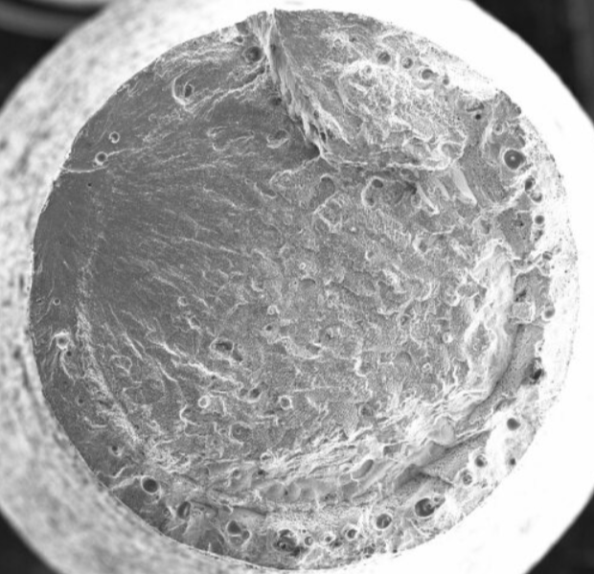
Initiation crack sites
Rough
Low = 140 and 160 Mpa Medium= 180 MPa High = 200 and 220 MPa
Rough: multiple sites
Smooth: single site
Smooth+KHP: single site
Smooth+KHP
12/14
Context and aims
Materials and methods
Results and discussion
Conclusion

Slide 13
Initiation crack sites
Low = 140 and 160 Mpa Medium= 180 MPa High = 200 and 220 MPa
13/14
Context and aims
Materials and methods
Results and discussion
Conclusion

Slide 14
Conclusion
Roughness is more detrimental in fatigue than sub-surface porosity
Higher roughness leads to multiple initiation sites and thus early break
Keyholes in contours are still better than roughness
Polishing brings sub-surface porosity to the surface
Sand blasting is the best post-treatment here
Non-optimized (rough) samples are the worst in any cases
4
Context and aims
Materials and methods
Results and discussion
Conclusion

