Slide 1

From the transmigrants to the homeless
Migrants between official discourses, media coverage, legal meanings, and solidarity experiences.
ERQ Conference
Trento, 9th June 2023
Diletta Tatti

Slide 2
Contents
2015
The « transmigrants » and the hosts
Spring 2022
Ukranian refugees and general mobilisation
2022 – 2023
The « hosting crisis »

Slide 3
Fieldwork
Analysis of officials’ communications
Press review (FR)
Interviews
Analysis of judicial procedures

Slide 4
2015
The « transmigrants » and the hosts

Slide 5

Hosts making up for Government shortcomings
The Belgian system overwhelmed
The citizen’s Platform at the Maximilien park

Slide 6
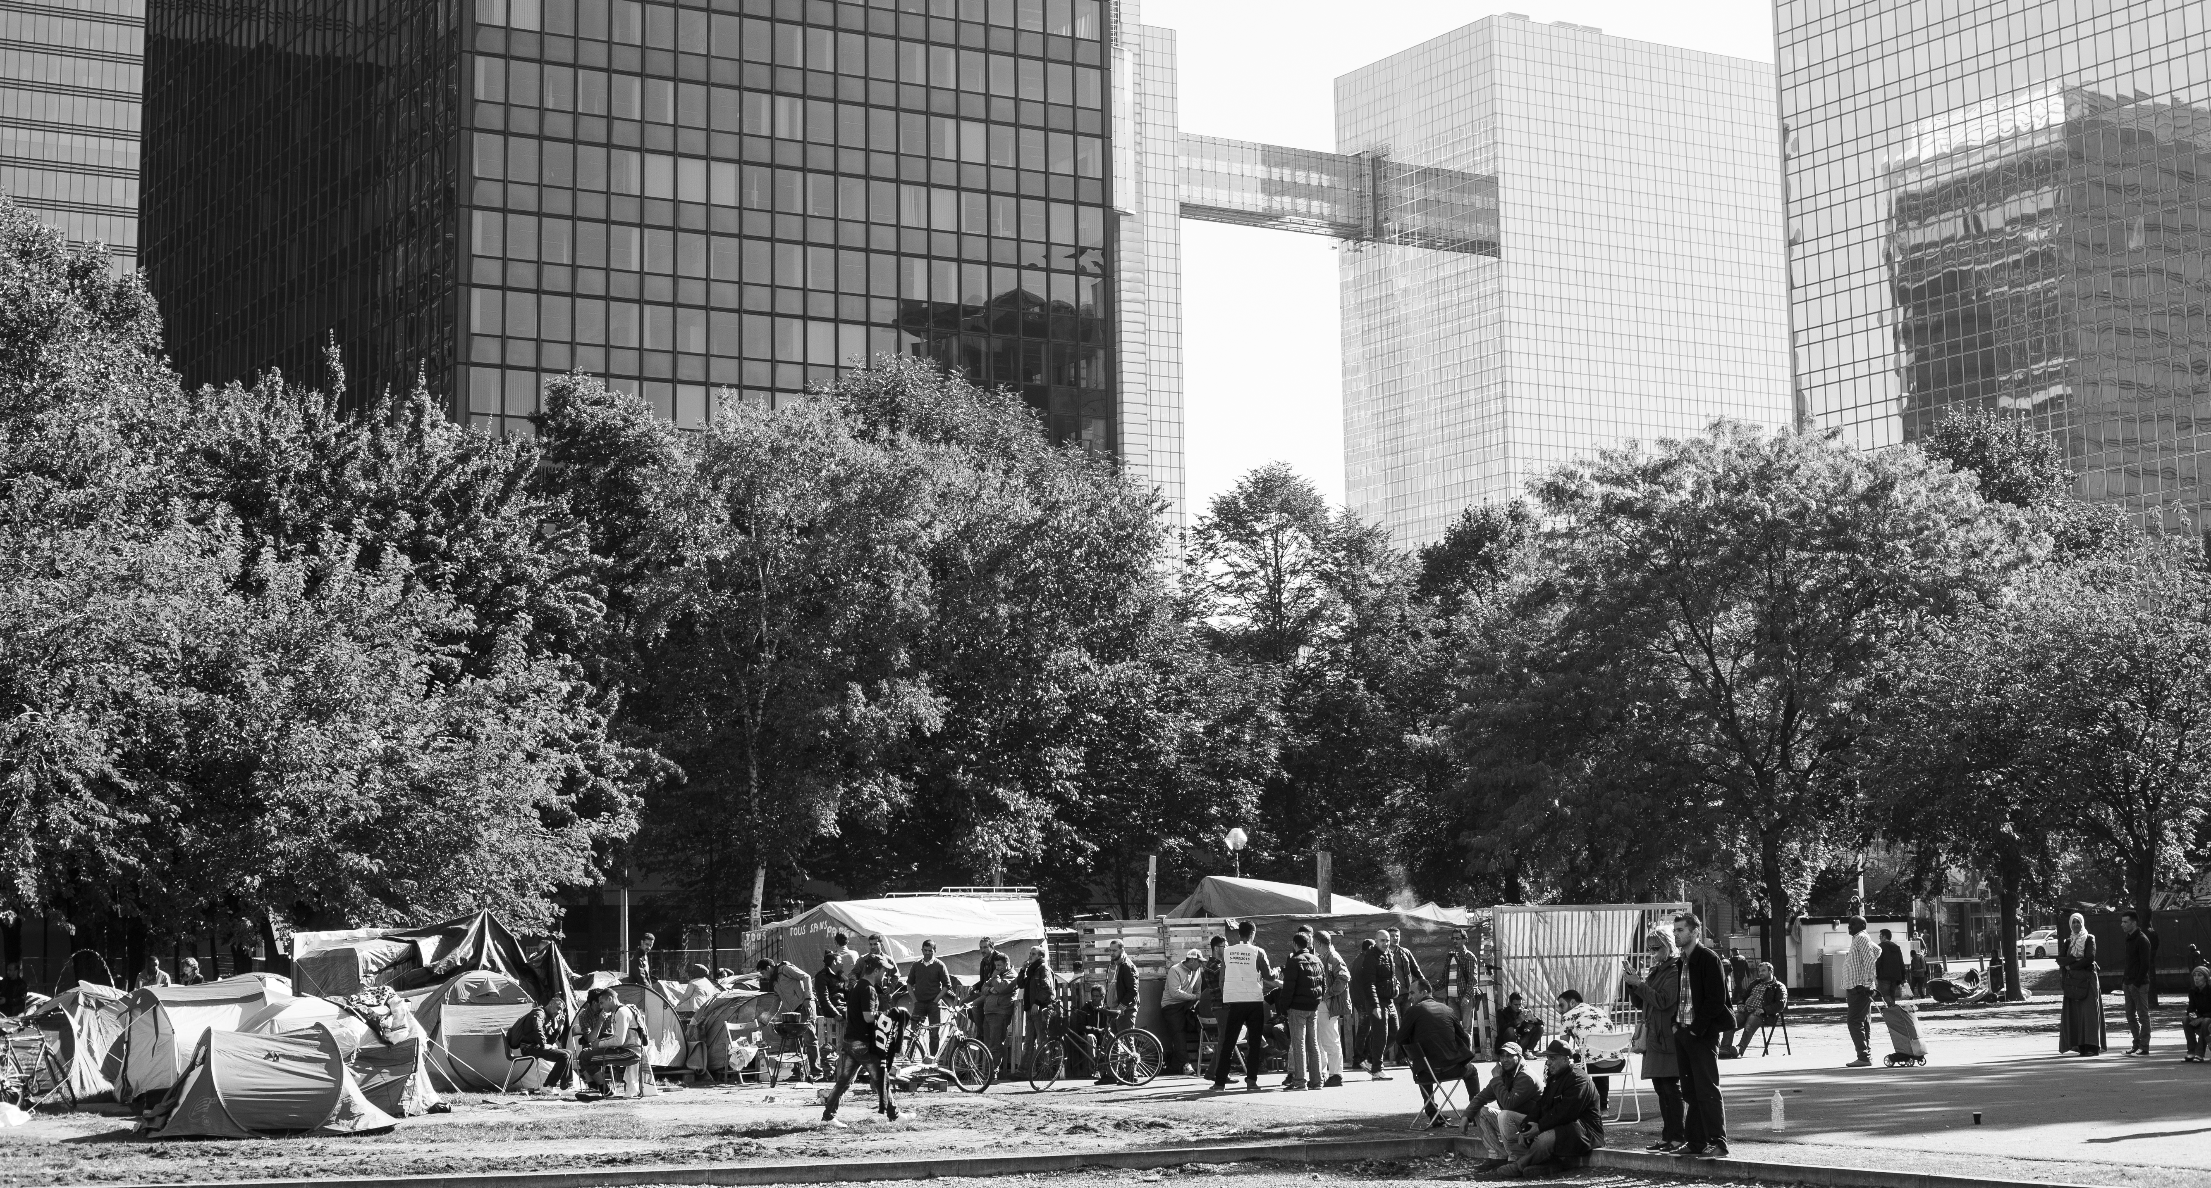
The camp at Maximilien Park

Slide 7
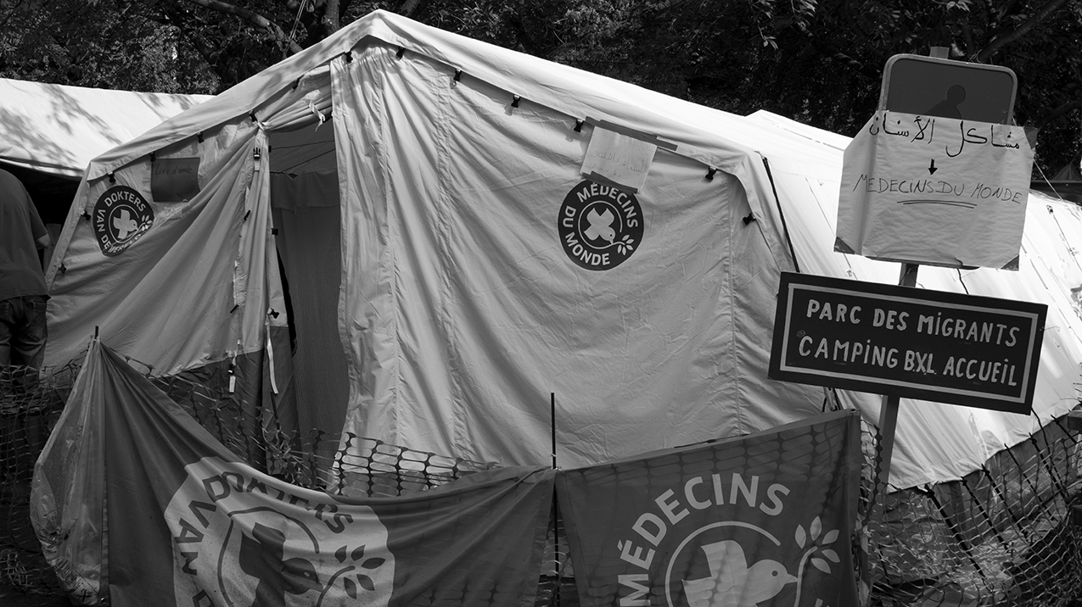

Slide 8
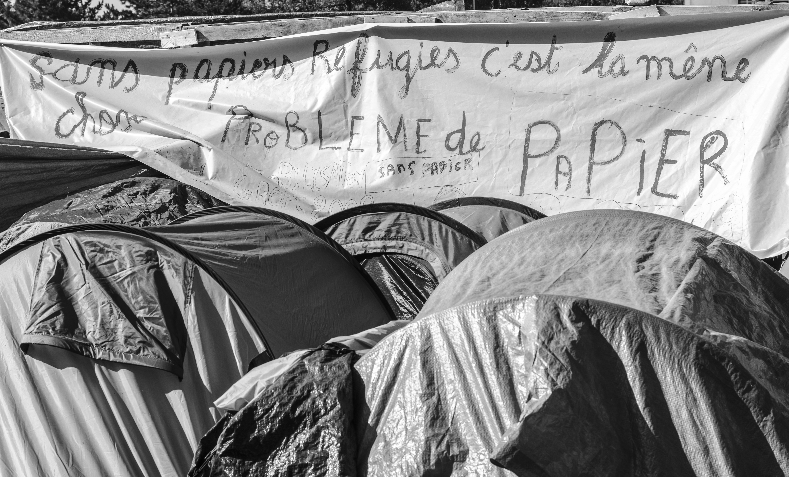
“Undocumented, refugees, it’s the same : a problem of paper(s)”

Slide 9
The « transmigrants »
An over-codifying government narrative
The media : reclaiming the narrative then raising awareness

Slide 10
Judicial (criminal) field
The political use of criminal procedings : the solidarity trial
The migrants : victims or felons?

Slide 11
Executive and judicial narratives
« I was obsessed by this unhealthy way of taking advantage of this public, while insulting them on the other side ! On the one hand they try to convince me that they’re scum, that we shouldn’t help them, that they don’t have the same profile as us, that they’re dangerous people, that they come from far away, that they’ll do anything to succeed, that they can crush us and take advantage of our misery. And on the other hand, once they’ve got a foot in a truck, they become my victims, because that’s really the term that’s been used ! »
Welcome, Sept personnes inculpées pour « trafic d’êtres humains » témoignent, Bruxelles, Antidote, 2021, p. 145.

Slide 12
Spring 2022
Ukranian refugees and general mobilisation

Slide 13
Converging narratives
Institutionnal mobilisation
Citizens’ mobilisation
Judicial narrative put on hold

Slide 14
The limits of a storytelling
Hosting obligations
A double-standard politics

Slide 15
2022 – 2023
The « hosting crisis »

Slide 16
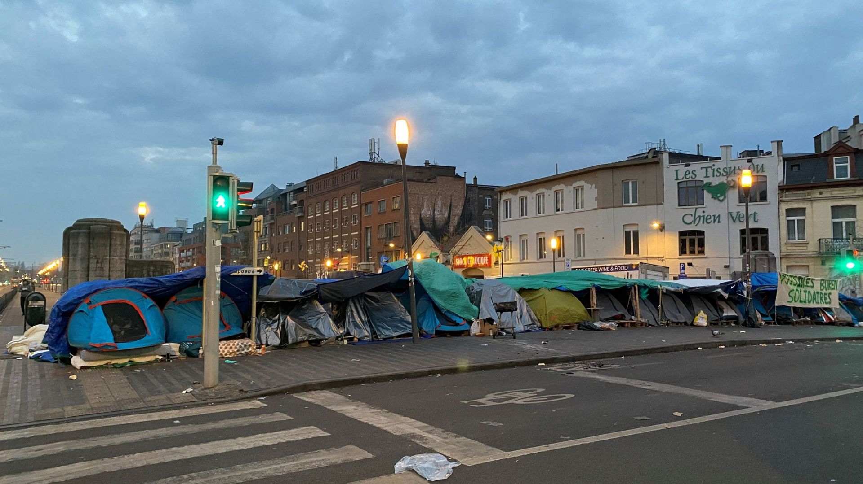
Street camp

Slide 17
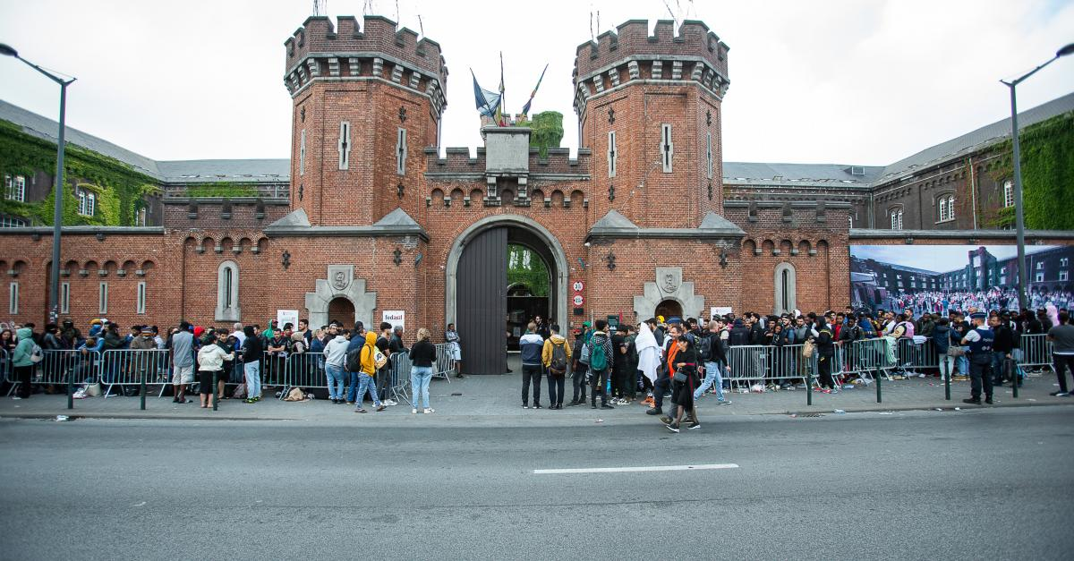

Slide 18
Is a rooted crisis still a crisis ?
The legacy of past governments
Women and children first
Work on the influx and the procedures
Behind the scene : no political will

Slide 19
Judiciary actors set the tone
Lawyers in action
An unequivocal jurisdiction : 8 000 convictions

Slide 20

The supports take action for « the guys »
The ADES network
The humanitarian hub
The embarrassed silence of the Citizens’ platform and the creation of « Stop hosting crisis »

Slide 21
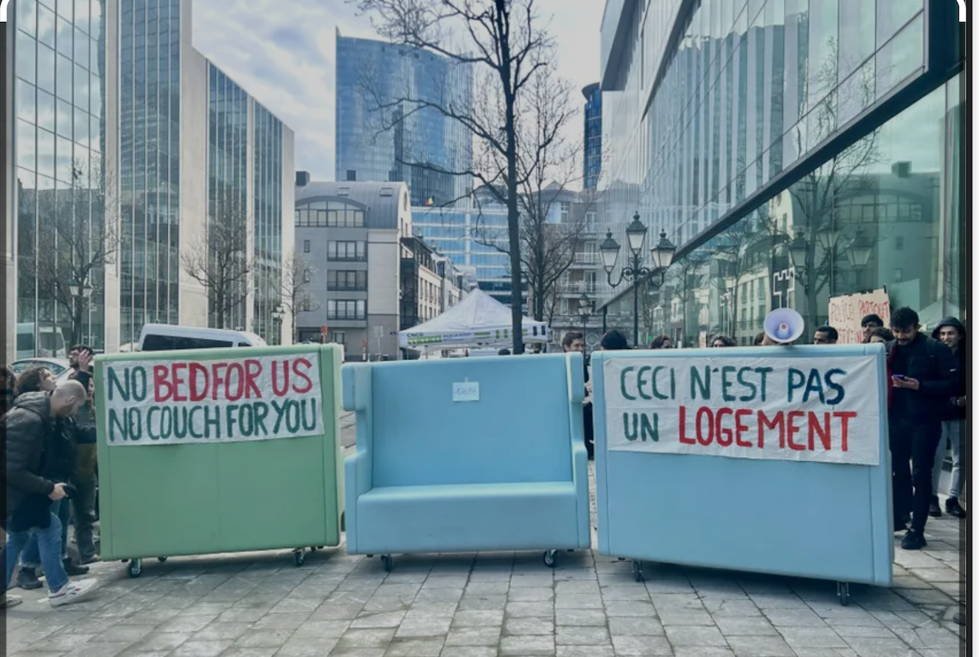
“This is not a home” seizure made at fedasil (government agency responsible for reception)
(end February 2023)

Slide 22
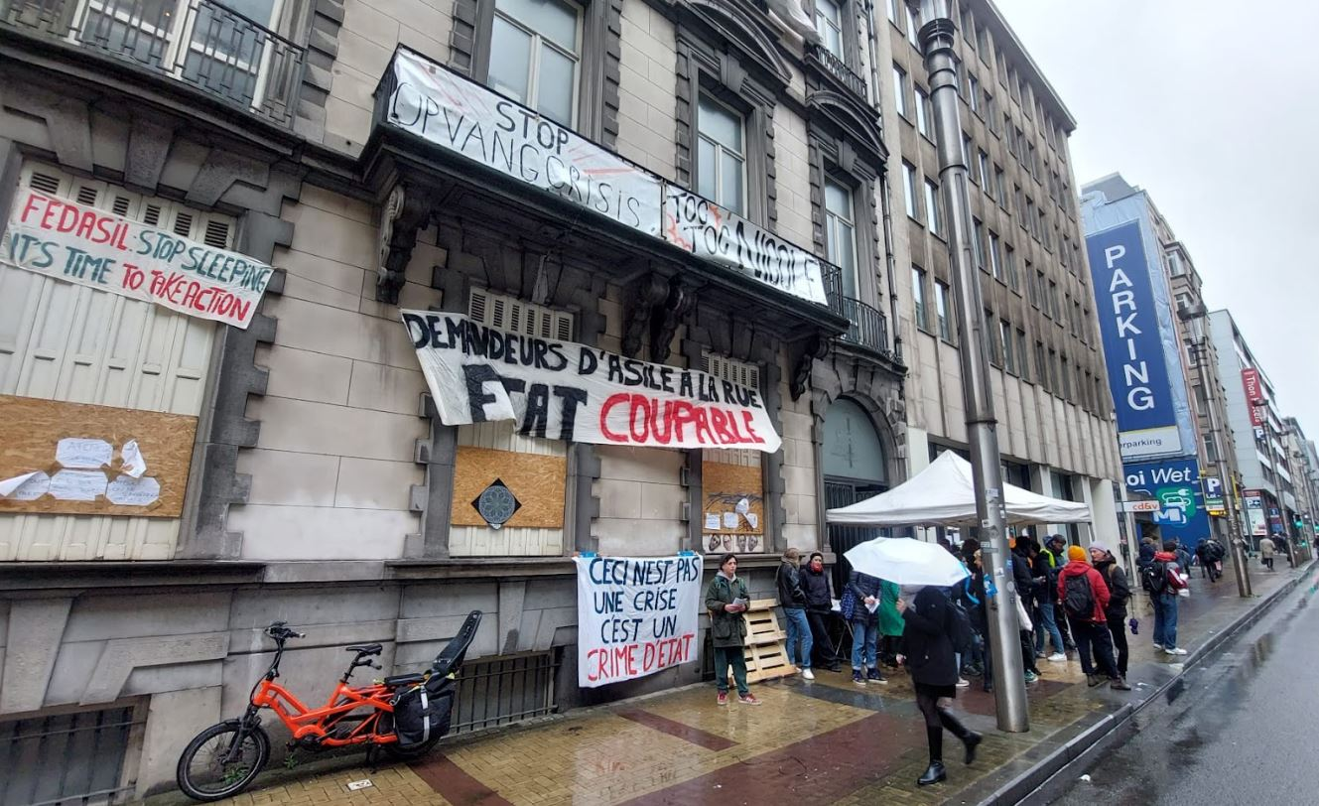
“Toc toc Nicole”
April 2023

Slide 23
Concluding thoughts

