Slide 1


GW in high throughput
M.J. van Setten, M. Giantomassi,
G. Hautier, G.-M. Rignanese

Slide 2
GW in High Throughput
‘additional’ difficulties
  4 step calculation
  N⁴ scaling
  No ‘safe’ parameter set (converged results for all)
  No ‘safe’ computational settings (ncpu, mem, ..)
  Pseudo potentials ?
Notes:
Pseudo potentials well tested for ground state, for gw this is not so clear ..

Slide 3

GW in High Throughput
‘additional’ difficulties
  4 step calculation
  N⁴ scaling
  No ‘safe’ parameter set (converged results for all)
  No ‘safe’ computational settings (ncpu, mem, ..)
  Pseudo potentials ?
GW babysitting problem
Notes:
Pseudo potentials well tested for ground state, for gw this is not so clear ..

Slide 4












GW in High Throughput
‘additional’ difficulties
  4 step calculation
  N⁴ scaling
  No ‘safe’ parameter set (converged results for all)
  No ‘safe’ computational settings (ncpu, mem, ..)
  Pseudo potentials ?
GW babysitting problem
Notes:
Pseudo potentials well tested for ground state, for gw this is not so clear ..

Slide 5

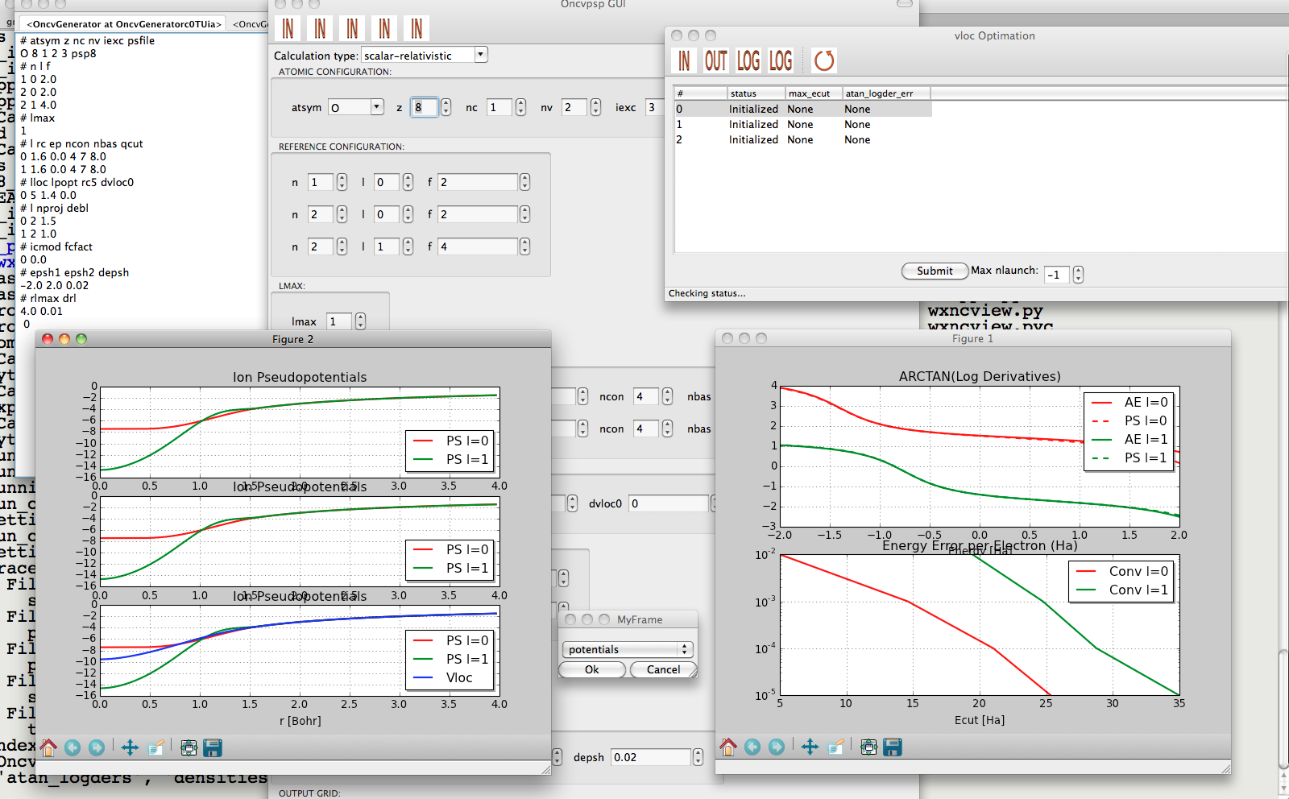
ONCVPSP
Optimized Norm Conserving Vanderbild Pseudo Potentials
  multiple projectors
  multiple gradient constraints
Don Hamann (PRB 88, 085117 (2013))
Package to facilitate PSP
generation
Graphical interface
Automatized testing
Log derivatives made to agree up to 8 Ha
http://www.pseudo-dojo.org/dojo.html
Notes:
Multiple projectors > more degrees of freedom to fix the scattering in the empty space
Log derivatives can be made to match the all electrons ones well beyond 8 H

Slide 6

GW wrapper
Python package that wraps around the ab-initio code
Options
    Vasp / Abinit
    What kind of GW
    Convergence tolerance
Some list of structures > ‘fully’ converged GW results

Slide 7
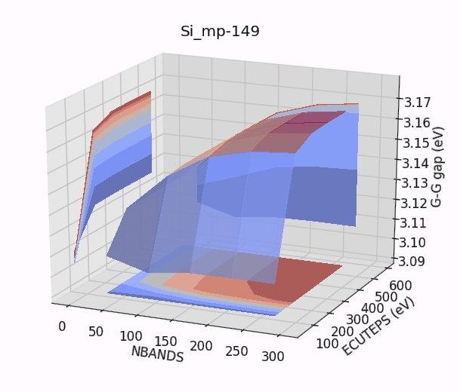

Slide 8
Convergence study
On a low k-point density (2x2x2):
  Set of single parameter ground state convergence studies
  Grid of nbands X encuteps
  For each nbands find converged encuteps
  For the converged encuteps find the converged nbands
  if not found > extend grid and retest
On the final k-point density (500):
  Test derivatives.
  (in most cases the high density derivatives turn out smaller)
  Post process
  (create scissor, apply scissor, …)
(ecut, …)

Slide 9
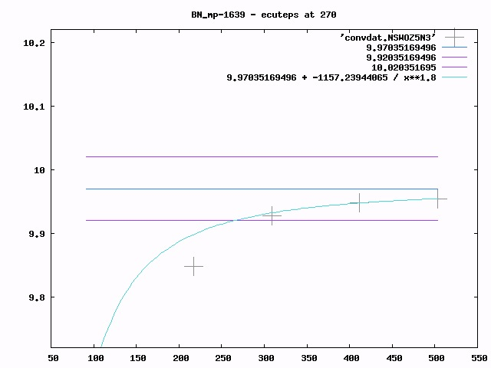
G-G
gap
(eV)

Slide 10
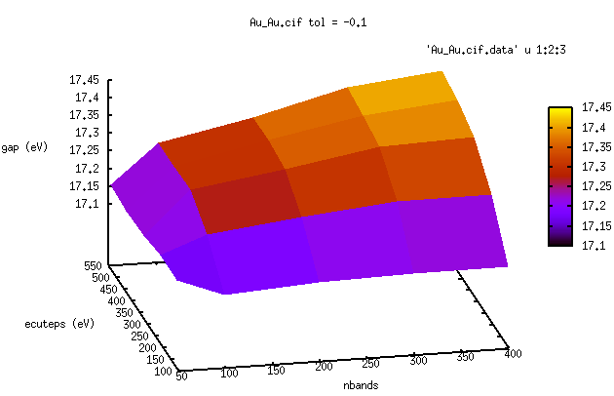
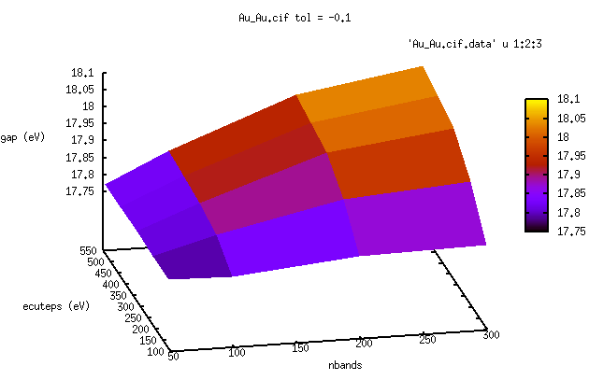
Gold
2x2x2 kpoint mesh
14x14x14 kpoint mesh
Notes:
It actually works: the shape of the surface calculated at 222 is the same as the on calculated

Slide 11
Convergence study
On a low k-point density (2x2x2):
  Set of single parameter ground state convergence studies
  Grid of nbands X encuteps
  For each nbands find converged encuteps
  For the converged encuteps find the converged nbands
  if not found > extend grid and retest
On the final k-point density (500):
  Test derivatives.
  (in most cases the high density derivatives turn out smaller)
  Post process
  (create scissor, apply scissor, …)
(ecut, …)

Slide 12
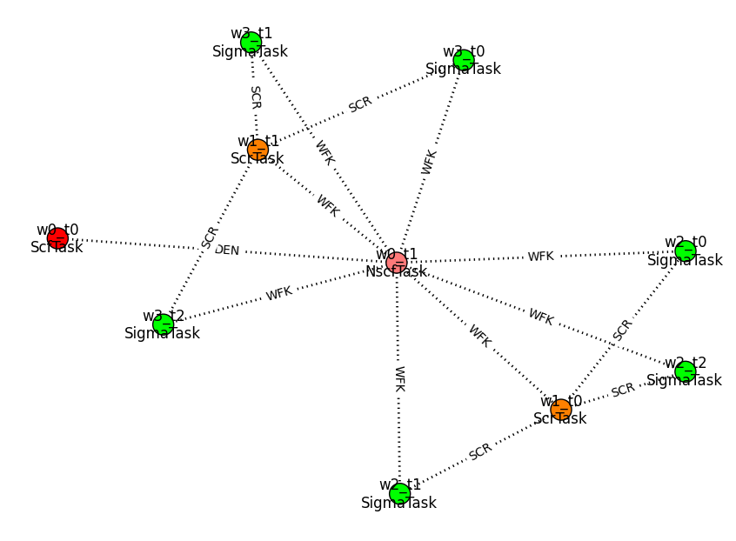
Flow generation

Slide 13
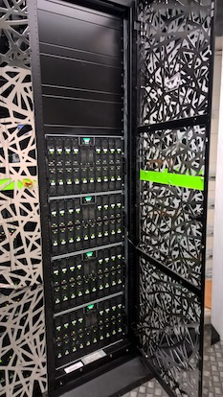
Scheduling the flow on the cluster
Error handling
Convergence testing

Slide 14


Interactive analysis
and presentation of
results
Storing results

Slide 15
Storing jobs in a database

Slide 16
First application: GW160
~ 160 solids, including the not so usual suspects
Wrapper settings:
  Godby – Needs PP
  500 / #atoms kpoints final mesh
  Tolerance 0.1 eV
~ 100 done at this point

Slide 17
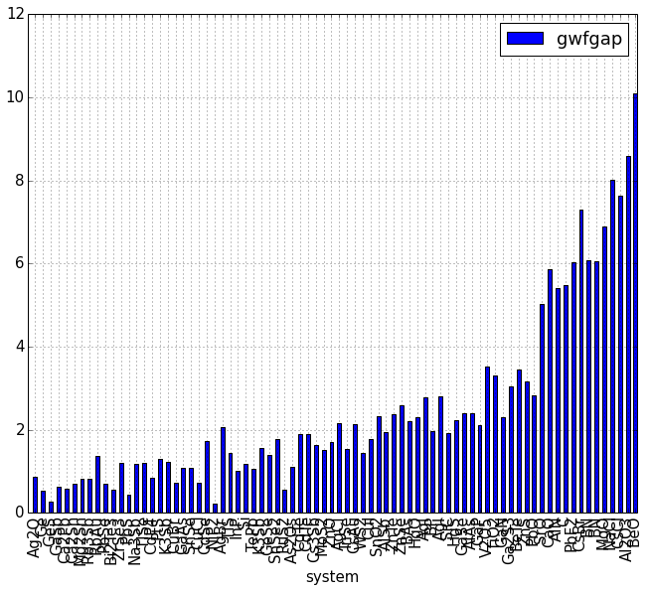

Slide 18
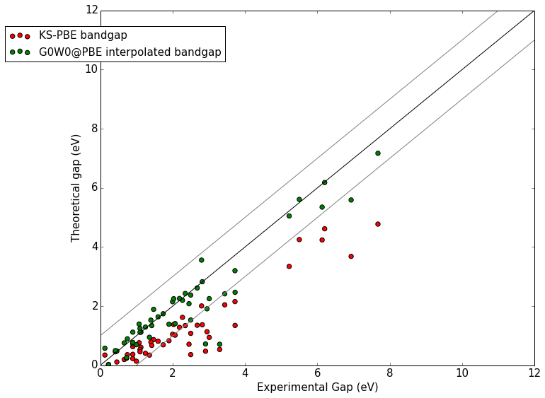

Slide 19
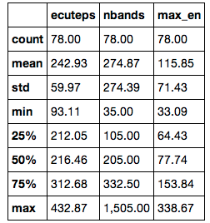
Statistics on the convergence parameters

Slide 20
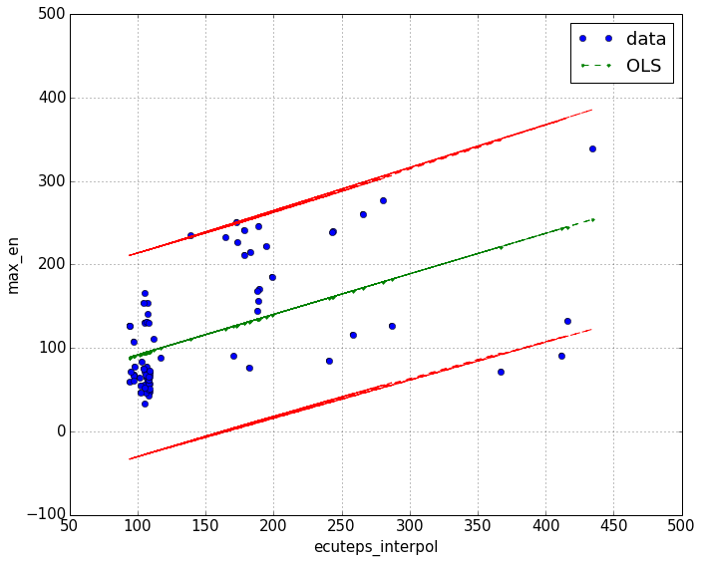
Empty states v.s. ecuteps

Slide 21
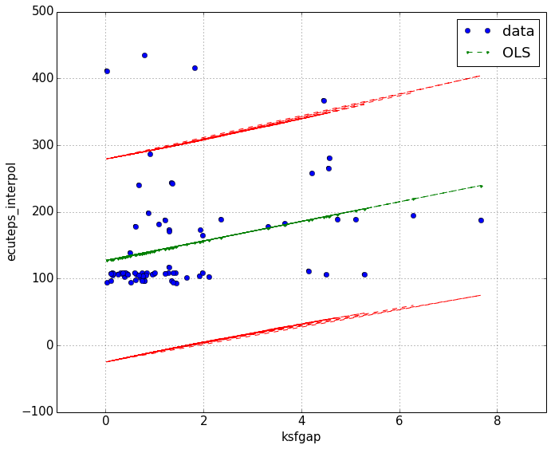
Ecuteps ?

Slide 22
Problems
Paral_KGB
  Wavefunction file explosion beyond a certain system size
  Some times problem in orthonormalization of the
  trial wavefunctions
  NaN ‘s but abinit continues
  Improvements needed for really high-throughput
Memory
  GW screening is not distributed
  Segmentation faults because of earlier allocation failures
  Unsolvable system size limit (GWMEM is no solution)
Restarting / continuing
  Inability to continue from the density on a changed fft mesh
  To make efficient use of large cluster restarting is crucial

Slide 23
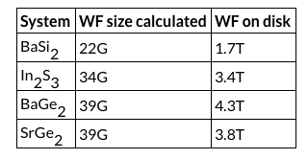
Exploding wavefunction files
Reproducible over different clusters / compilations

Slide 24
Problems
Paral_KGB
  Wavefunction file explosion beyond a certain system size
  Sometimes problem in orthonormalization of the
  trial wavefunctions
  NaN ‘s but abinit continues
  Improvements needed for really high-throughput
Memory
  GW screening is not distributed
  Segmentation faults because of earlier allocation failures
  Unsolvable system size limit (GWMEM is no solution)
Restarting / continuing
  Inability to continue from the density on a changed fft mesh
  To make efficient use of large cluster restarting is crucial

Slide 25
Solutions
Parallelism
  MPI FFT
  Improve the stability of KGB
Memory
  Test scalability of new code
  ‘Fix’ scalability of old code
  Memory allocation should be checked
Code standards
  Should be enforced before merging

Slide 26
Prevention
Abinit development lectures
  Fortran
  Abinit structure
  Python
  Abipy / Pymatgen structure
  How to uses our clusters

Slide 27
--- !ERROR
message: |
A zero was found in coatofin. Check that the fine FFT mesh is finer in each dimension than the coarse FFT mesh.
src_file: m_pawfgr.F90
src_line: 512
...
--- !ERROR
message: |
abi_xpotrf, info=10
src_file: abi_xorthonormalize.f90
src_line: 106
...

Slide 28
Cluster policy
Zenobe like structure on all Ceci
  Group home space
  Python with dependencies
    Users add their own abipy / pymatgen in virtual envs
  Stable Abinit module
    Users should make their own development modules

Slide 29
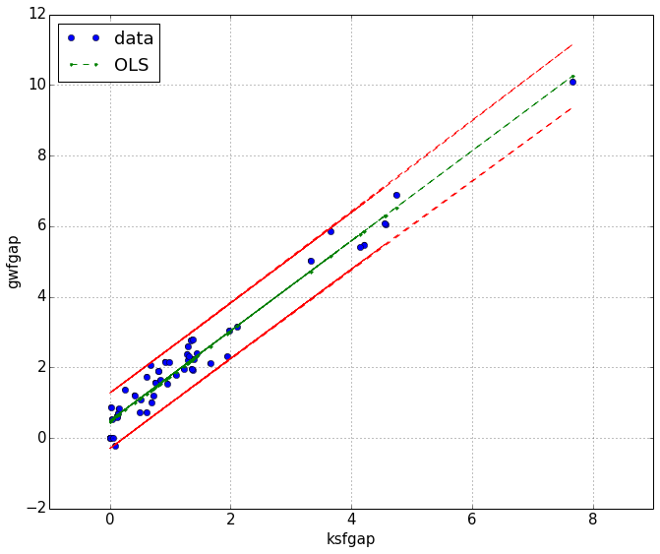

Slide 30
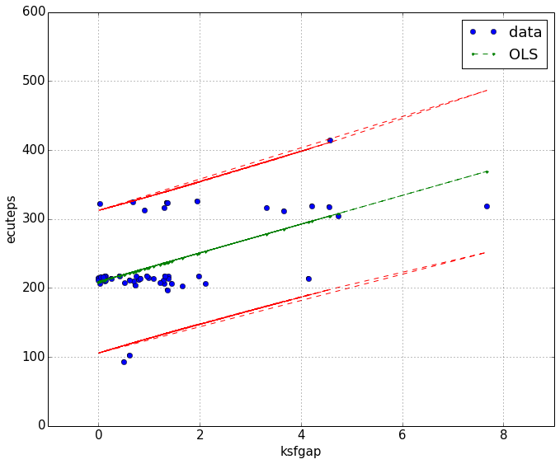

Slide 31
