Slide 1



Low-frequency Noise in Polysilicon Source-Gated Transistors
Qi Chen¹, Valeriya Kilchytska¹, Léopold Van Brandt¹, Eva Bestelink², Radu A. Sporea², Denis Flandre¹
¹ ICTEAM, UCLouvain, Louvain-la-Neuve 1348, Belgium
²ATI, University of Surrey, Guildford, United Kingdom
Athens, May 17, 2024
10th Joint EuroSOI Workshop and International Conference on Ultimate Integration on Silicon 2024

Slide 2
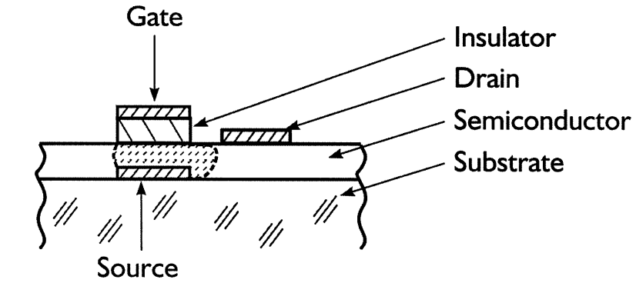
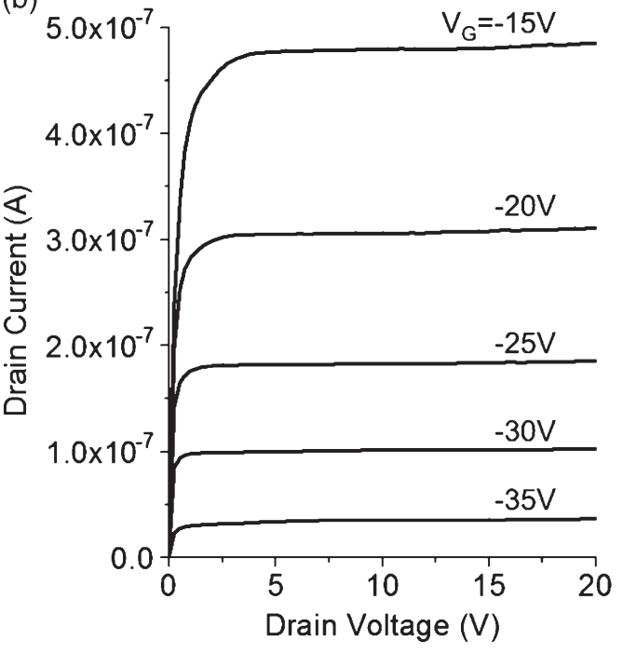

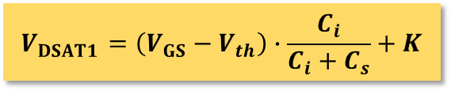

Polysilicon Source-gated Transistors (SGT)
Advantages
Low saturation voltage
High intrinsic gain
Reduced short-channel effects
Applications
Amplifiers
Drive circuit for displays
J. M. Shannon et al., IEEE Electron Device Lett., 2003.
Trade-off
Lower current output for the same gate bias and device dimensions due to the Schottky barrier
$$V_{DSAT1}=\left(V_{GS}−V_{th}\right)∙\frac{C_{i}}{C_{i}+C_{s}}+K$$
$$V_{DSAT2}=V_{GS}−V_{th}$$
Why polysilicon?
Balanced cost and electrical characteristics for thin-film large-area circuit applications
Radu A. Sporea et al., IEEE Trans. Electron Devices, 2010
Low-frequency Noise in Polysilicon Source-Gated Thin-Film Transistor
2

Slide 3
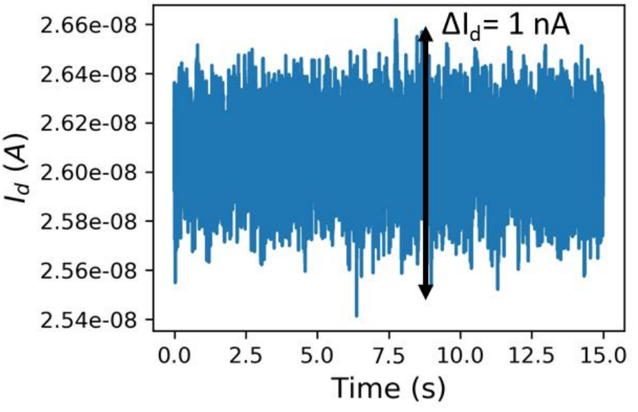
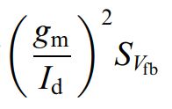
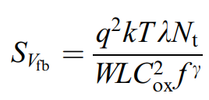

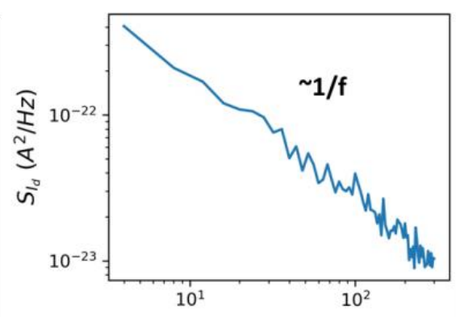
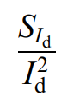
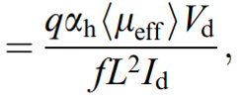

Low-frequency Noise (LFN) in transistors
Low-frequency noise models
McWhorter model (Carrier Number Fluctuation (CNF) model)
Trap density
with
Hooge model (Carrier Mobility Fluctuation (CMF) model)
Hooge parameter
G. Ghibaudo et al., Microelectron. Reliab., 2002
Angeliki Tataridou, PhD Dissertation, 2022.
Low-frequency Noise in Polysilicon Source-Gated Thin-Film Transistor
3
Notes:
The downsizing of the geometrical dimensions, which enhance the performance and speed of transistors, Low Frequency Noise has become a major concern for nanoscale transistors as its impact on both device and circuit level is more important than ever

Slide 4
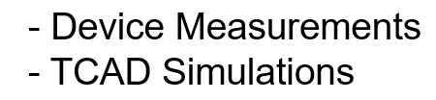
Objective and Outline
Understanding the source of low-frequency noise in polysilicon SGT
DC Characteristics of Polysilicon SGT
LFN Characteristics of Polysilicon SGT
Conclusion and prospects
Low-frequency Noise in Polysilicon Source-Gated Thin-Film Transistor
4

Slide 5
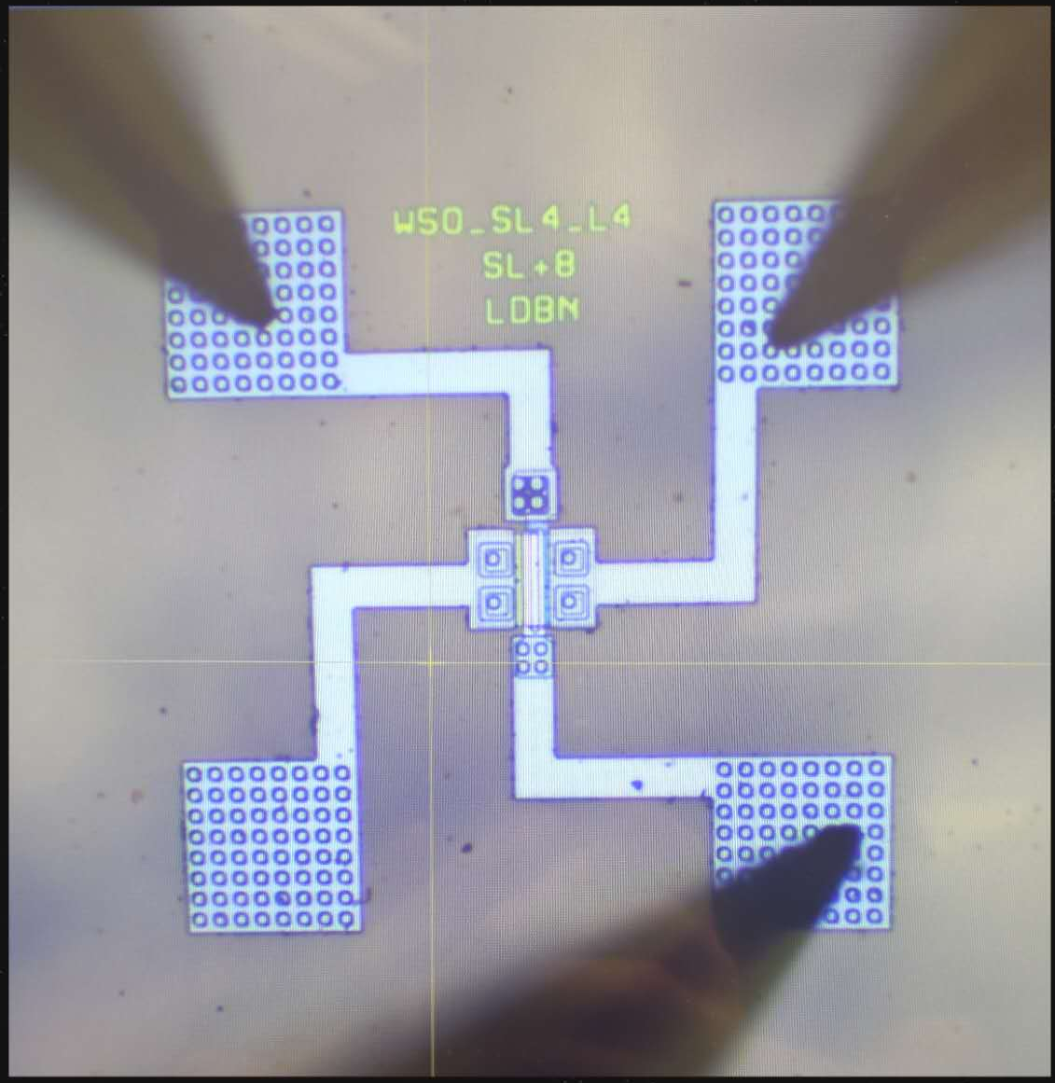
1.1. Device structure
Schematic of the measured device and measurement configurations
TFT configuration
Drain
SGT configuration
Source
field plate
Source
Drain
SiO₂
Schottky
Contact
120 nm
Ohmic
Contact
4 μm
4 μm
Ohmic
Contact
40 nm
Polysilicon
SiO₂
300 nm
Gate
Bulk doping dose: 0.5 ×10¹² cm⁻² & 1.5 ×10¹² cm⁻²
Low-frequency Noise in Polysilicon Source-Gated Thin-Film Transistor
5

Slide 6
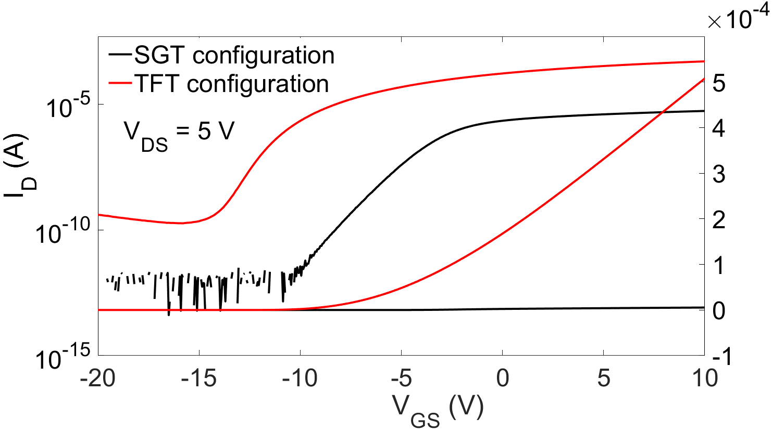
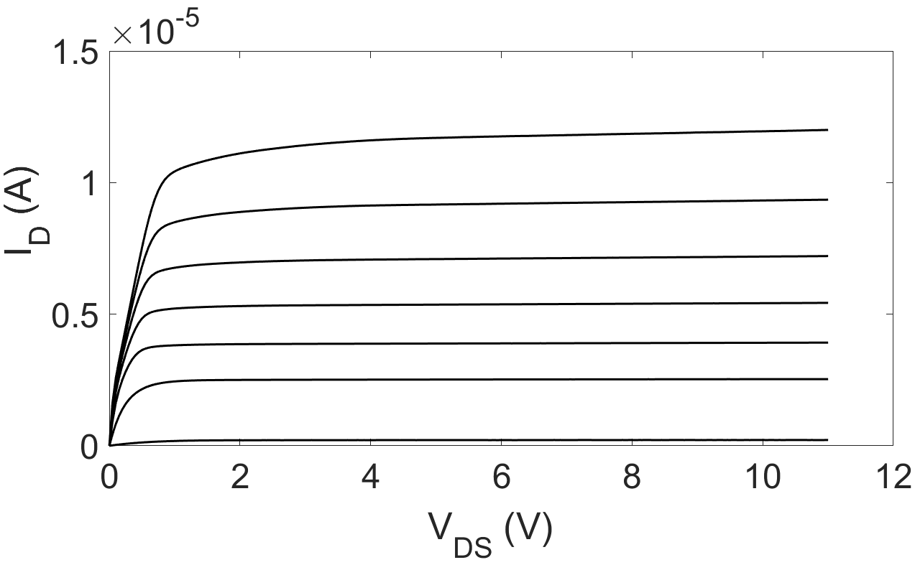
1.2. IV measurements
Transfer curves of SGT and TFT configuration
Output curves of SGT
Linear region
Saturation region
Doping Dose = 0.5 ×10¹² cm⁻²
Bias points @ V_{D} = 5 V
Doping Dose = 0.5 ×10¹² cm⁻²
V_{GS} ranges from 20 to -4 V, -4V per step
On-state current increases by two orders of magnitude in TFT configuration
Typical SGT output curves with low saturation voltages and low output conductance
Low-frequency Noise in Polysilicon Source-Gated Thin-Film Transistor
6
Notes:
Extracted mobility μ = 53 cm·V⁻¹s⁻¹ SGT SS = 0.8 V/dec TFT SS = 1.1 V/dec
The bahvaior off-state and subthreshold region is dominated by the channel like in the FET. The negative bias stress normally yields a negative threshold voltage shift of the thin film transistors due to the additional positive charges trapped in the gate dielectrics or at channel/gate insulator interface.

Slide 7
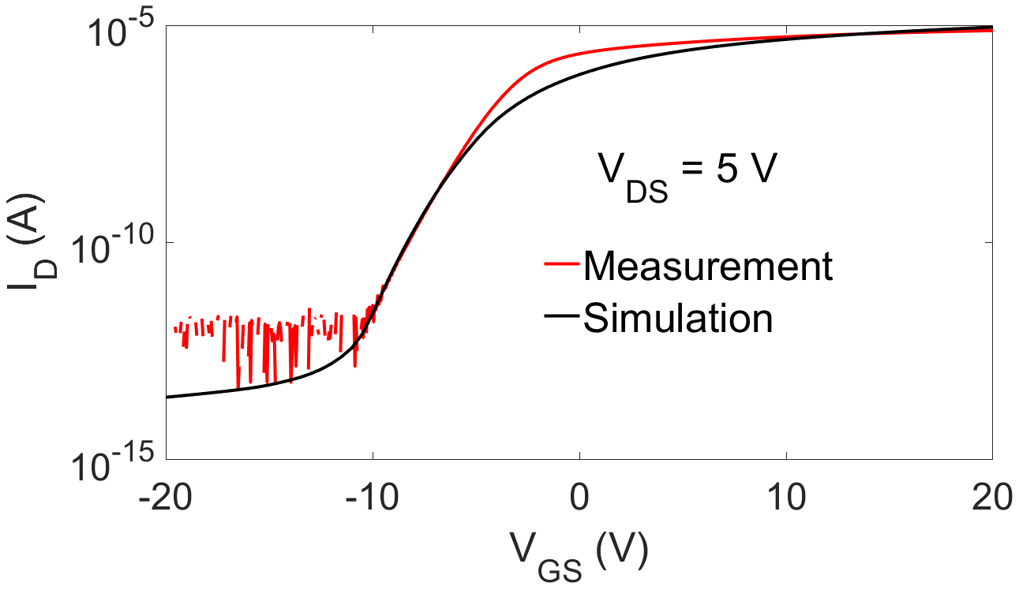
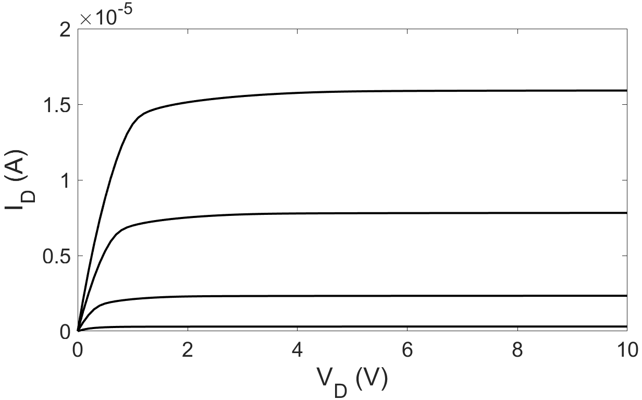
1.3. TCAD Simulations
Schematic simulated device structure
Simulated IV characteristics
Schottky Source with field plate
SiO2
Drain
Polysilicon
I_{ch}
Drain
I_{barrier}
I_{ch}
SiO2
Doping Dose = 0.5 ×10¹² cm⁻²
Gate
Key parameters used in simulations
Parameter | Value
Schottky barrier height | 0.35 eV
Mobility | 20 cm·V⁻¹s⁻¹
Permittivity | 11.7
Fixed charge density Q_{f} | 4×10¹¹ cm⁻²
Acceptor defect density D_{it} | 1×10¹² cm⁻³
Doping Dose = 0.5 ×10¹² cm⁻²
V_{GS} ranges from 0 to 20 V, 5V per step
Low-frequency Noise in Polysilicon Source-Gated Thin-Film Transistor
7

Slide 8
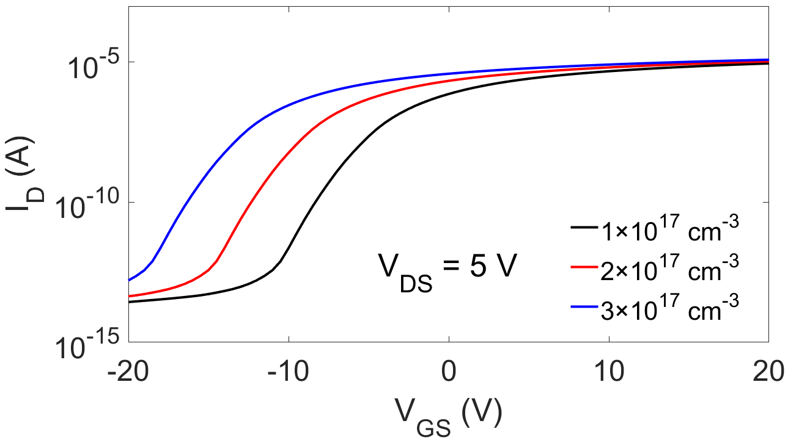
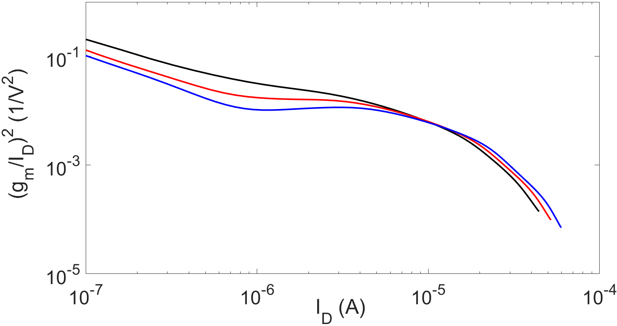
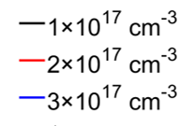

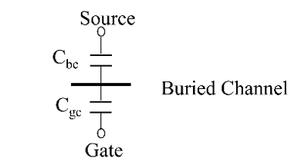
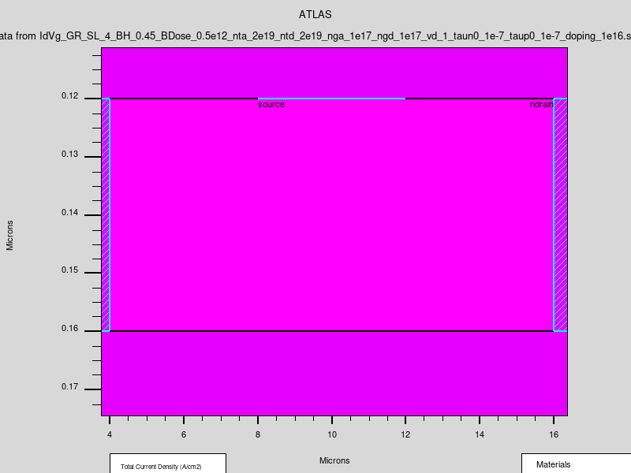
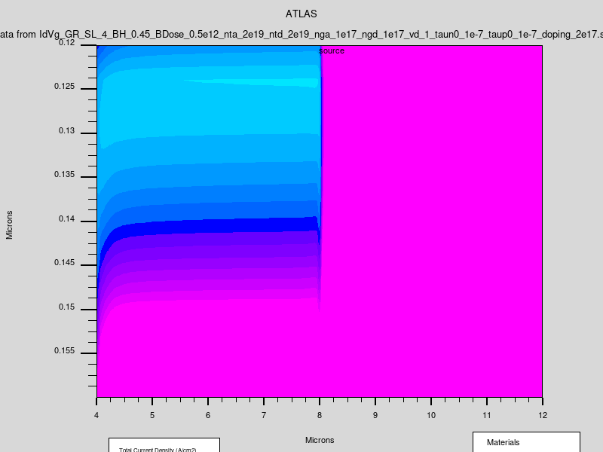
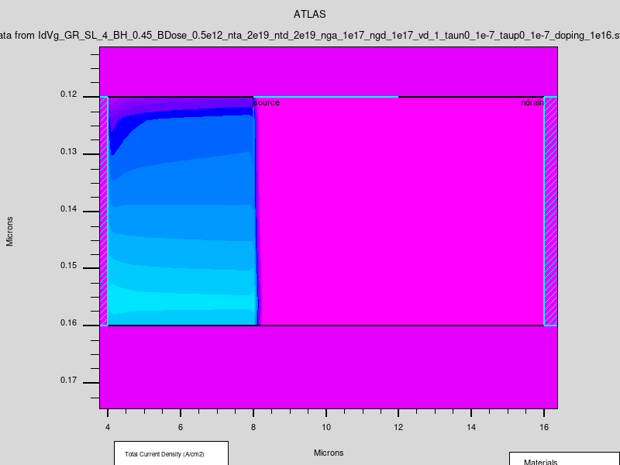
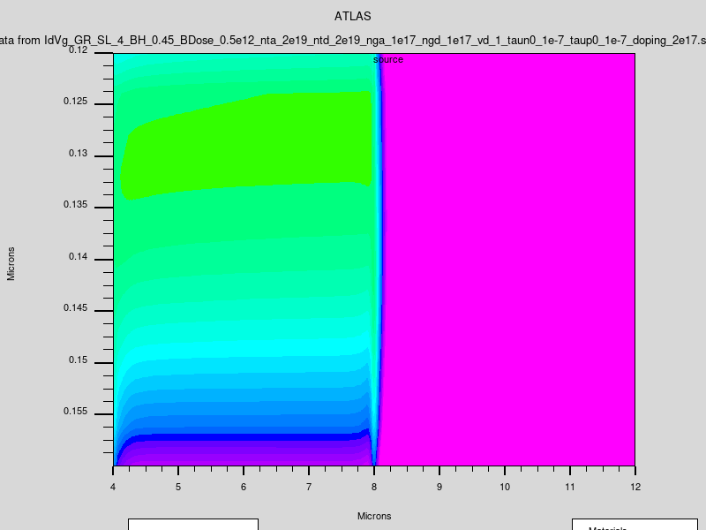
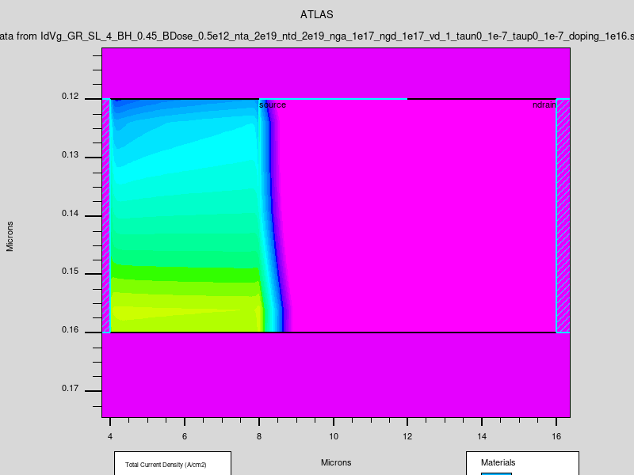
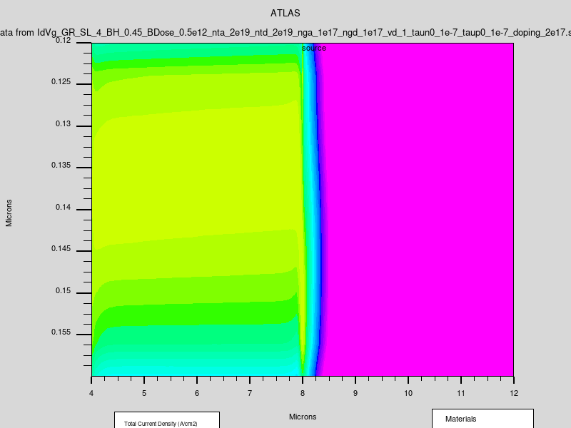
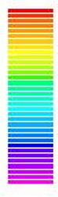
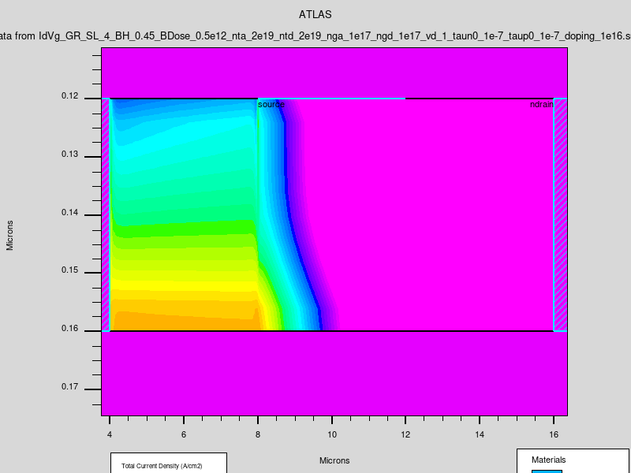
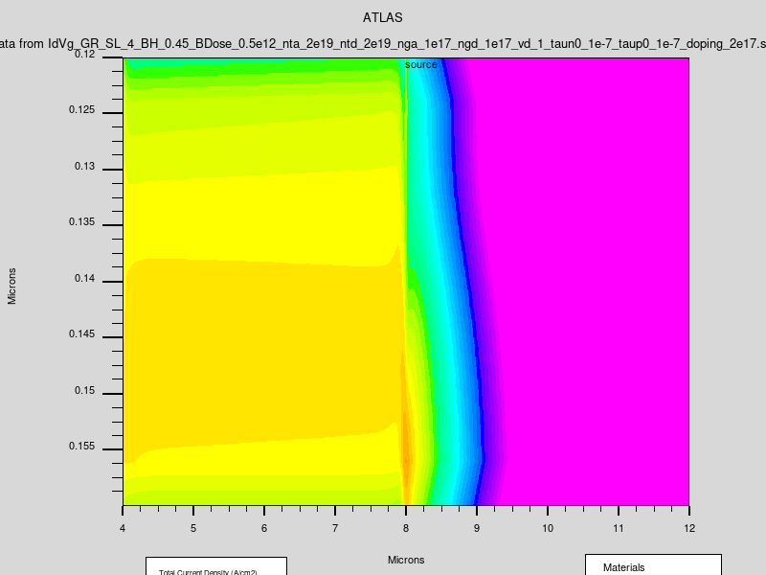
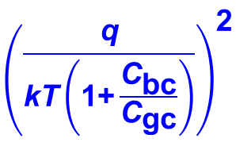
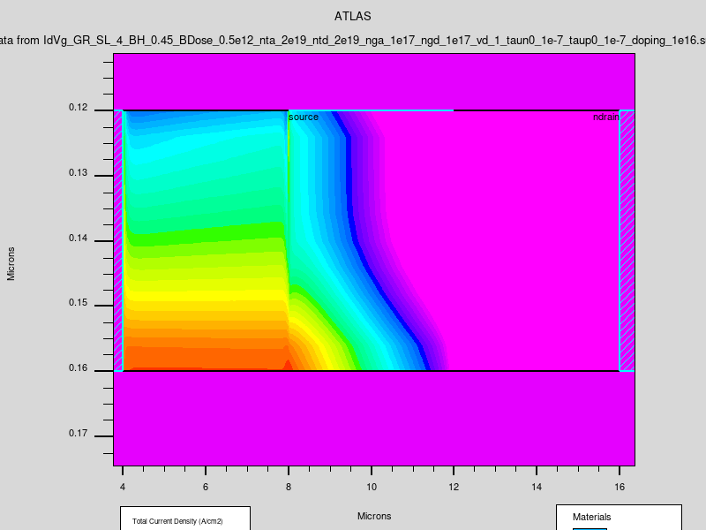
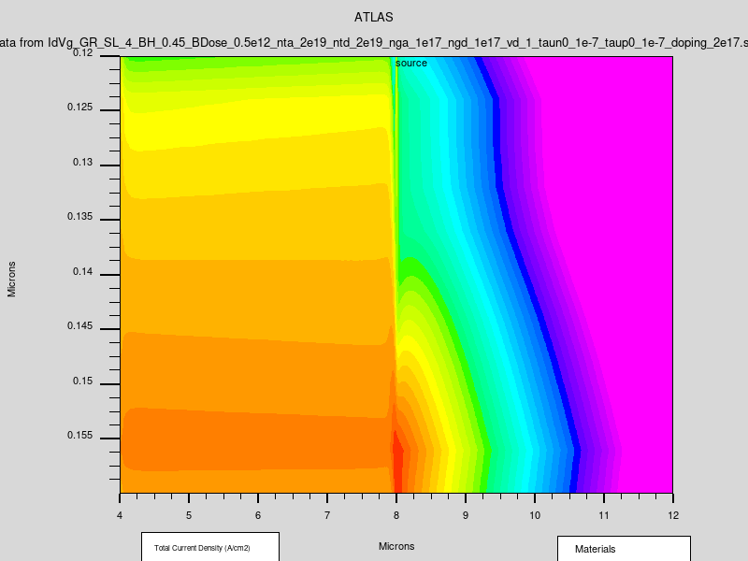
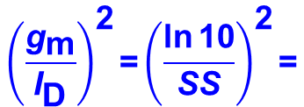
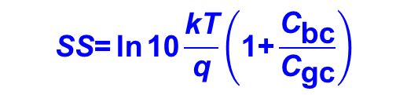
1.3. TCAD Simulations
Transfer and (g_{m}/I_{D})² curves at different doping concentrations
Decreased doping concentration
Decreased doping concentration
Variation of current densities
SS model for accumulation-mode
device
Source Region
Channel
Source Region
Channel
V_{GS} –V_{T} = -6 V
1e17 cm⁻³
2e17 cm⁻³
V_{GS} –V_{T} = -4 V
Log (Current Density) (A/cm²)
4
$$\text{SS}\text{=}\text{ln}{\text{10}\frac{\text{kT}}{\text{q}}\left(\text{1+}\frac{{\text{C}}_{\text{bc}}}{{\text{C}}_{\text{gc}}}\right)}$$
V_{GS} –V_{T} = -2 V
3
V_{GS} –V_{T} = 0 V
2
$${\left(\frac{{\text{g}}_{\text{m}}}{{\text{I}}_{\text{D}}}\right)}^{\text{2}}\text{=}{\left(\frac{\text{ln}{\text{10}}}{\text{SS}}\right)}^{\text{2}}\text{=}$$
V_{GS} –V_{T} = 2 V
1
0
Low-frequency Noise in Polysilicon Source-Gated Thin-Film Transistor
8

Slide 9

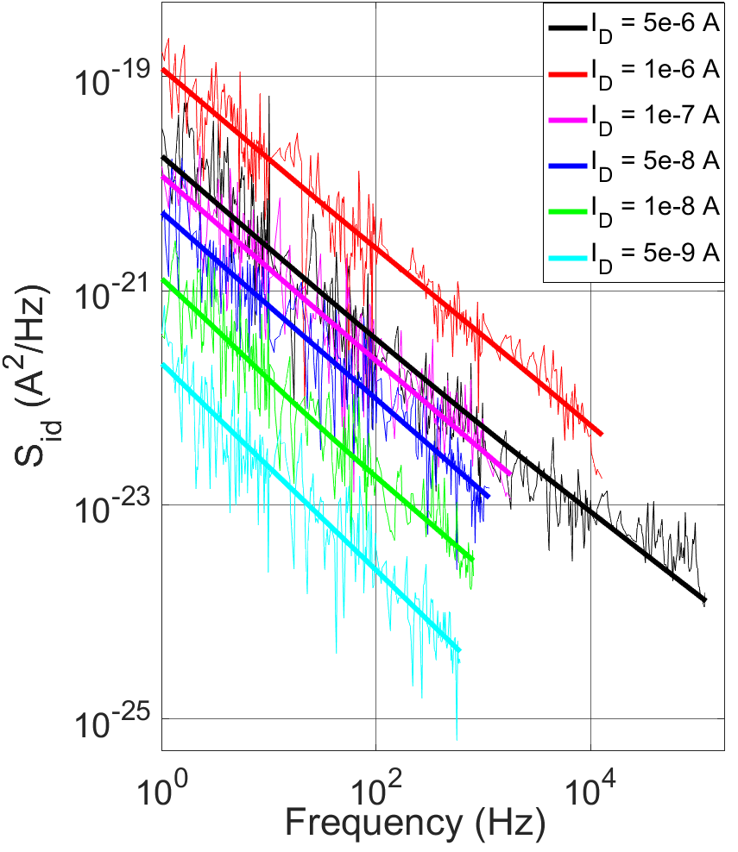
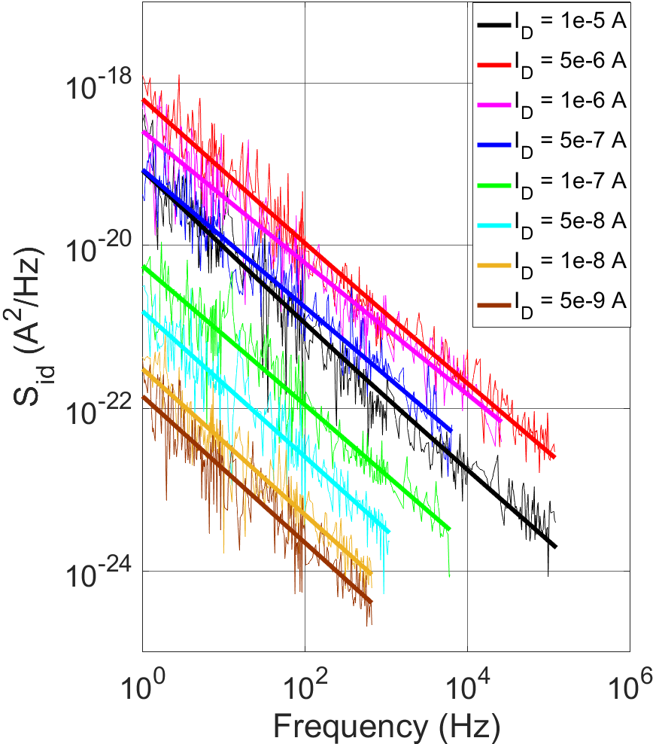
2.1. LFN measurement
Power spectral density (PSD) S_{Id} under different doping and fixed current in Schottky configuration
Doping Dose = 0.5 ×10¹² cm⁻²
Doping Dose = 1.5 ×10¹² cm⁻²
S_{Id} ~ f ^{λ}
with λ = - 0.7 ~ -1.3
f ⁻¹
f ^{-0.81}
f ^{-0.86}
f ⁻¹
The LFN noise behavior are confirmed with the PSD approximately proportional to 1/f
PSD increases with gate voltage in
subthreshold region
f ^{-0.85}
f ^{-0.9}
f ^{-0.83}
f ^{-0.87}
f ^{-0.82}
f ^{-0.87}
f ^{-0.9}
f ^{-0.86}
f ^{-0.91}
V_{D} = 5 V
f ^{-0.96}
f ^{-0.9}
V_{D} = 5 V
f ^{-0.9}
Low-frequency Noise in Polysilicon Source-Gated Thin-Film Transistor
9

Slide 10
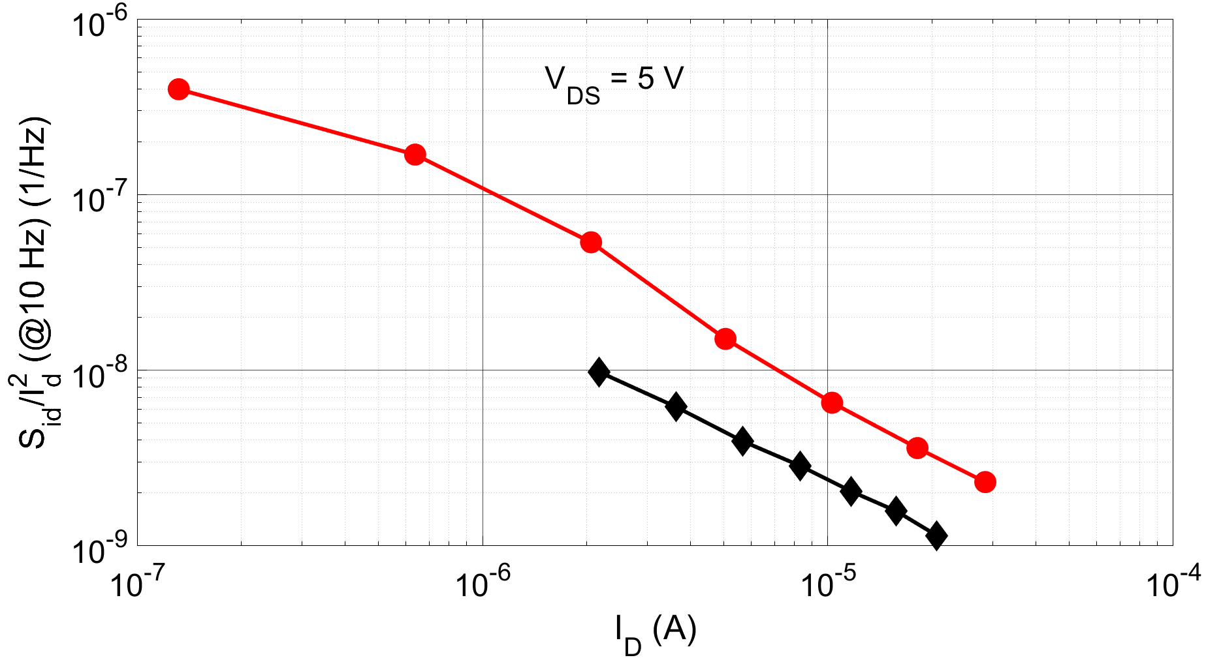

2.2. Analysis of LFN in Ohmic configuration
Normalized S_{id} versus I_{D} of Ohmic configuration
Carrier Mobility Fluctuation (CMF) model
I_{D}⁻¹
G. Ghibaudo et al., Microelectron. Reliab., 2002
I_{D}⁻¹
α_{h} ~ 2.5 ×10 ⁻³
PSD varies as the reciprocal of I_{D} indicating that the noise in subthreshold region originates from
carrier mobility fluctuation, as in previous reported polysilicon transistor.
A. Mercha, et al., Journal of Applied Physics, 2001
Low-frequency Noise in Polysilicon Source-Gated Thin-Film Transistor
10

Slide 11
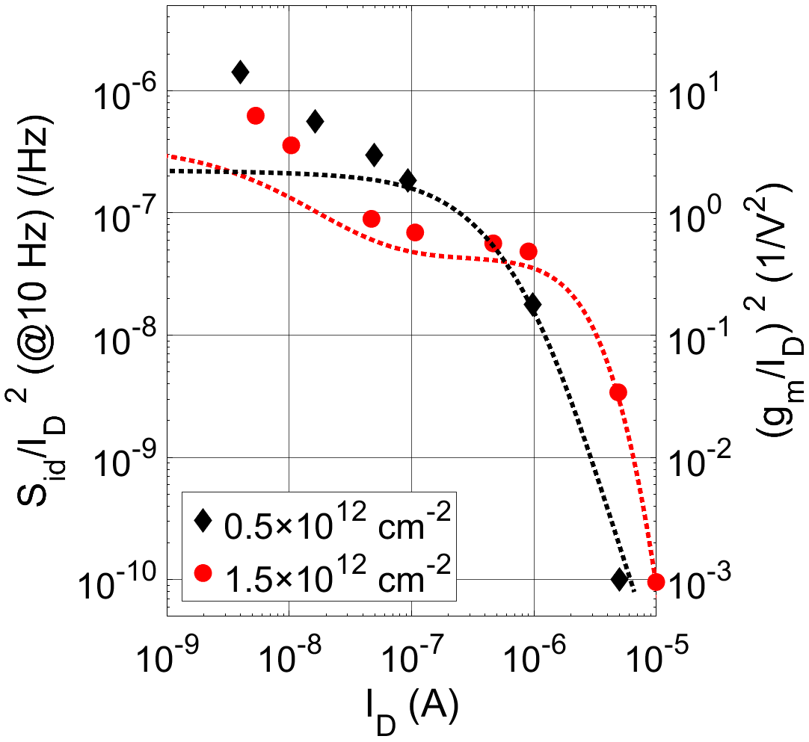
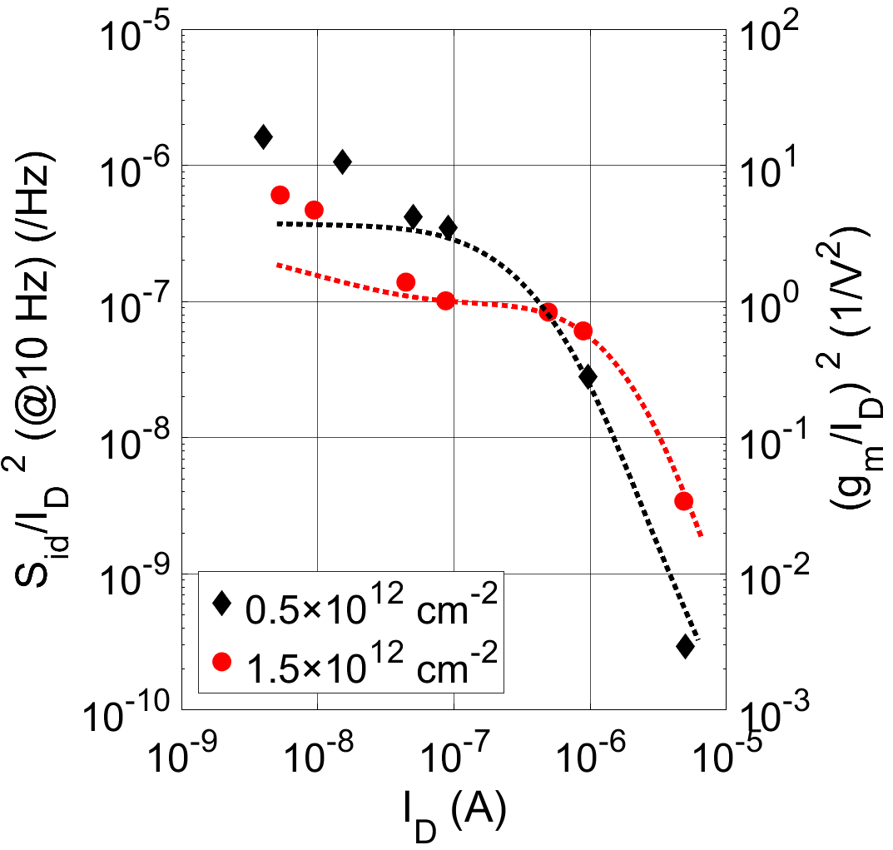

2.3. Analysis of LFN in Schottky configuration
Normalized S_{id} and (g_{m}/I_{D})² versus I_{D} of Schottky configuration
Carrier Number Fluctuation (CNF) model
I_{D}⁻¹
I_{D}⁻¹
with
V_{D} = 0.5 V
V_{D} = 5 V
~ 7 × 10⁻⁸ V²/Hz
The normalized PSD at high I_{D} are proportional to (g_{m}/I_{D})², indicating the domination of CNF model
The normalized PSD at low I_{D} are proportional to I_{D}⁻¹, indicating the domination of CMF model
The plateau can be explained by the variation of buried channel position in subthreshold region
Low-frequency Noise in Polysilicon Source-Gated Thin-Film Transistor
11
Notes:
N_{t} ~ 2.46 × 10¹⁹ eV/cm³

Slide 12
3. Conclusion and prospects
The variation of buried channel position with gate voltages in high doping case causes a second plateau in the (g_{m}/I_{D})²
Configuration | LFN Model
Ohmic | CMF
Schottky | CMF at low I_{D}
 | CNF at high I_{D}
Is CNF due to the barrier current control in SGT in high I_{D}/V_{G} regime? To be probed further by studying the impact of
Source length
Schottky barrier height
Low-frequency Noise in Polysilicon Source-Gated Thin-Film Transistor
12

Slide 13

Thank you !
10th Joint EuroSOI Workshop and International Conference on Ultimate Integration on Silicon 2024
13

