Slide 1



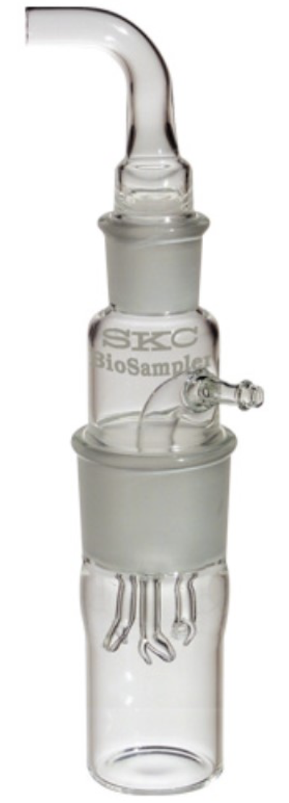
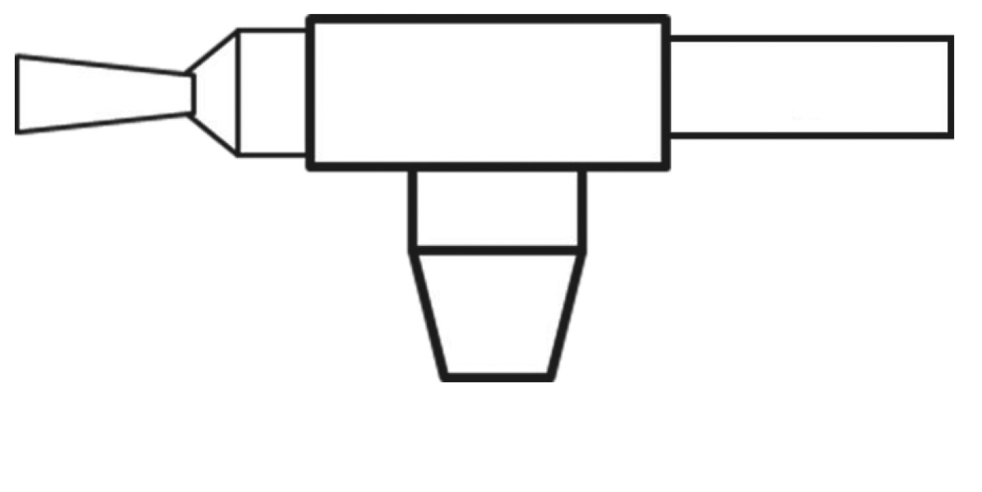





There is a risk of spread during a nebulization session in a patient with COVID-19
Christophe Thibon^{1,2,3}, Laurent Vecellio^{4,5}, Leila Belkhir⁶, Jean-Christophe Dubus^{5,7,8}, Annie Robert⁹, Benoit Kabamba^{2,10}, Gregory Reychler^{1,2,3,5}
1. Secteur de Kinésithérapie et Ergothérapie, Cliniques universitaires Saint-Luc, Brussels, Belgium 2. Institut de Recherche Expérimentale et Clinique (IREC), Université Catholique de Louvain, Brussels, Belgium 3. Service de Pneumologie, Cliniques universitaires Saint-Luc, Brussels, Belgium 4. PST A, Université de Tours, Tours, France. 5. Group Aerosoltherapy GAT of the French Language Respiratory Society-Société de Pneumologie de Langue Française SPLF, France 6. Department of Internal Medicine, Cliniques Universitaires Saint-Luc, Université Catholique de Louvain, Brussels, Belgium 7. Unité de Pneumologie Pédiatrique, Centre Hospitalo-Universitaire (CHU) Timone-Enfants, Marseille, France 8. Aix Marseille Université, IRD, AP-HM, MEPHI, IHU-Méditerranée Infection, Marseille, France 9. Pole épidémiologie et biostatistique, Institut de recherche Expérimentale et Clinique (IREC), Université catholique de Louvain, 1200 Brussels, Belgium 10. Department of Microbiology, Cliniques universitaires Saint-Luc, Brussels, Belgium.
Aim
Methodology
In a previous study we were interested in the risk of nebulizer contamination during a nebulization session in patients infected with SARS-CoV-2
Ten severe COVID-19 patients were recruited at the admission in the hospital and treated with nebulization
Immediately after the first nebulization the residual dose in the nebulizer was sampled and SARS-CoV-2 viral load was quantified by RT-PCR
This study conclude that the nebulizer was not contaminated by SARS-CoV-2 during a single utilisation.
However the fugitive aerosol released in the environment is composed by the medical aerosol and by the bioaerosol exhaled by the patient, wich can be contaminated.
Patients
Ten severe COVID-19 patients were recruited at the admission in the hospital.
They were treated by nebulization of isotonic saline solution, ipratropium bromide, or ipratropium and fenoterol with a standard single-use jet nebulizer (Opti-Mist Plus®, ConvaTec, Bridgewater, NJ) operating at 8 L/min with a T piece connected to a mouthpiece.
Experimentation
During the nebulization the emitted aerosol was continuously collected by a BioSampler® (SKC 20-mL) loaded with 20 mL phosphate-buffered saline (PBS) and 0·5% bovine serum albumin.
The residual and emitted dose were sampled.
The SARS-CoV-2 viral load was quantified in all samples by RT-PCR (negative threshold <100 copies/mL).
In this study,
The airborne transmission of SARS-CoV-2 has been quickly suggested based on the stability of SARS-CoV-2 in aerosol for 3 hours.
Nebulization, by a possible microorganisms contamination and/or by the aerosolization of contaminated particles, may theoretically expose mucosae and eyes of the health care workers.
Various guidelines on nebulization emerged during the SARS-CoV-2 pandemic, in order to ensure a maximal protection.
AIM OF THE STUDY: The aim of this study was to determine the risk of SARS-CoV-2 contamination of the fugitive aerosol emitted in the environment during one nebulization session.
?
Results and conclusion
Practical implication
Results
The median viral load of the patients was 6·5x10⁶ copies/mL (range 5·5x10³ to 6·9x10⁷).
No SARS-CoV-2 RNA was found in the residual doses samples
SARS-CoV-2 RNA was found in 2 out of 10 fugitive aerosol samples
Fugitive aerosol contamination were not correlated with the patient’s viral load
Conclusion
This study confirm that the nebulizer was not contaminated after being used by patient with Covid-19.
The exhaled bioaerosol can contaminate the fugitive aerosol released in the environment
New studies should be carried out in order to issue new reccomendations
However, in the light of this informations we recommend to use a nebulizer with filter and a mouth piece to reduce the environmental particles dispersion.
In add we reccomend to use personal protective equipment including FFP2 mask, gloves and shield.

