Slide 1


The social costs of pesticide use in France
Alliot Christophe, Mc Adams-Marin Delphine, Borniotto Diana, and Baret Philippe

Slide 2
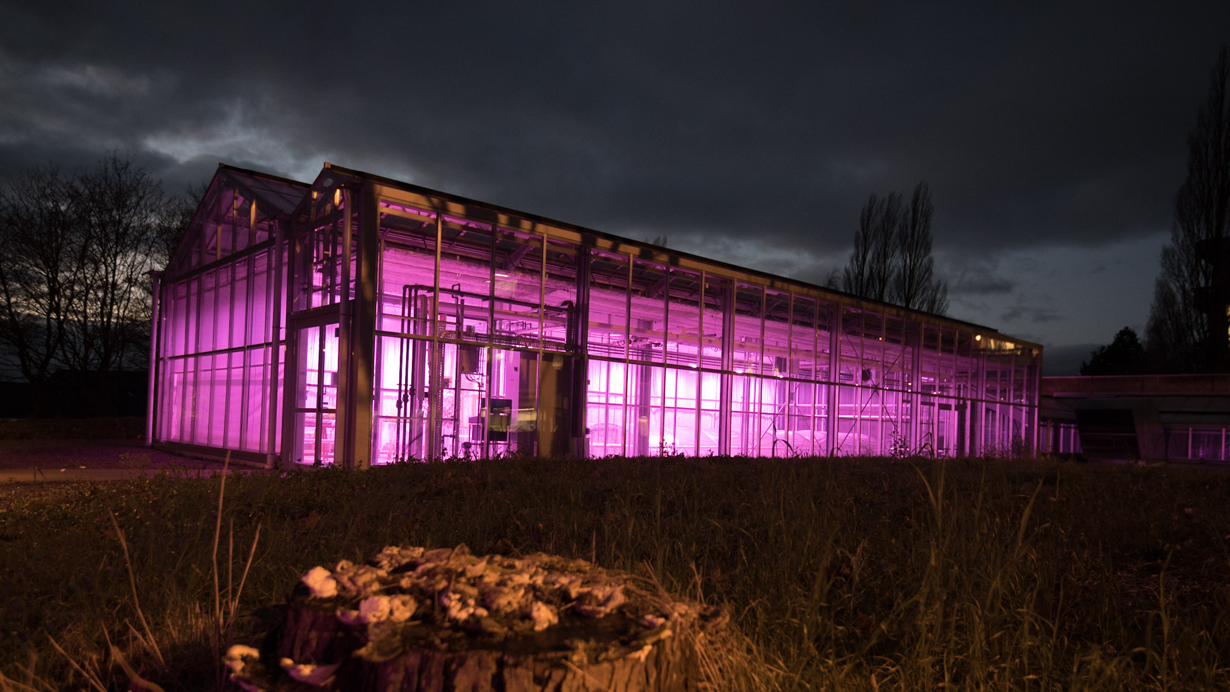

Slide 3
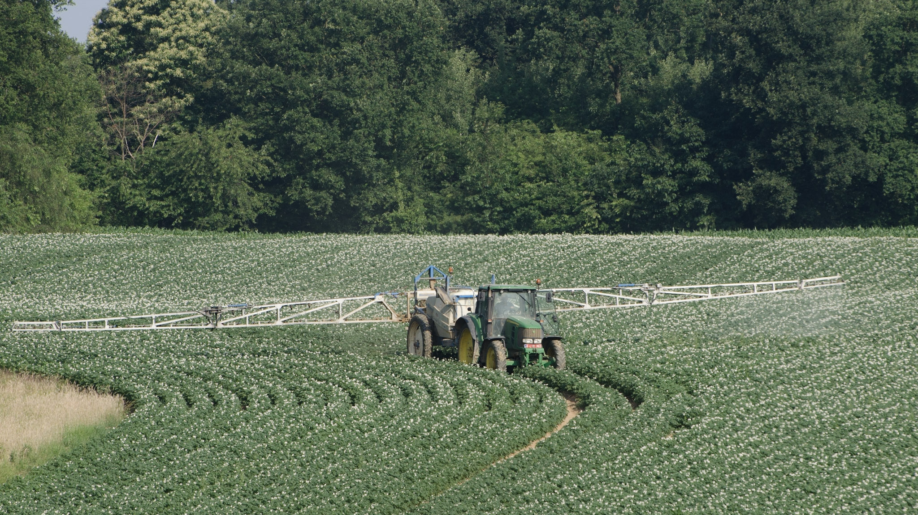

Slide 4
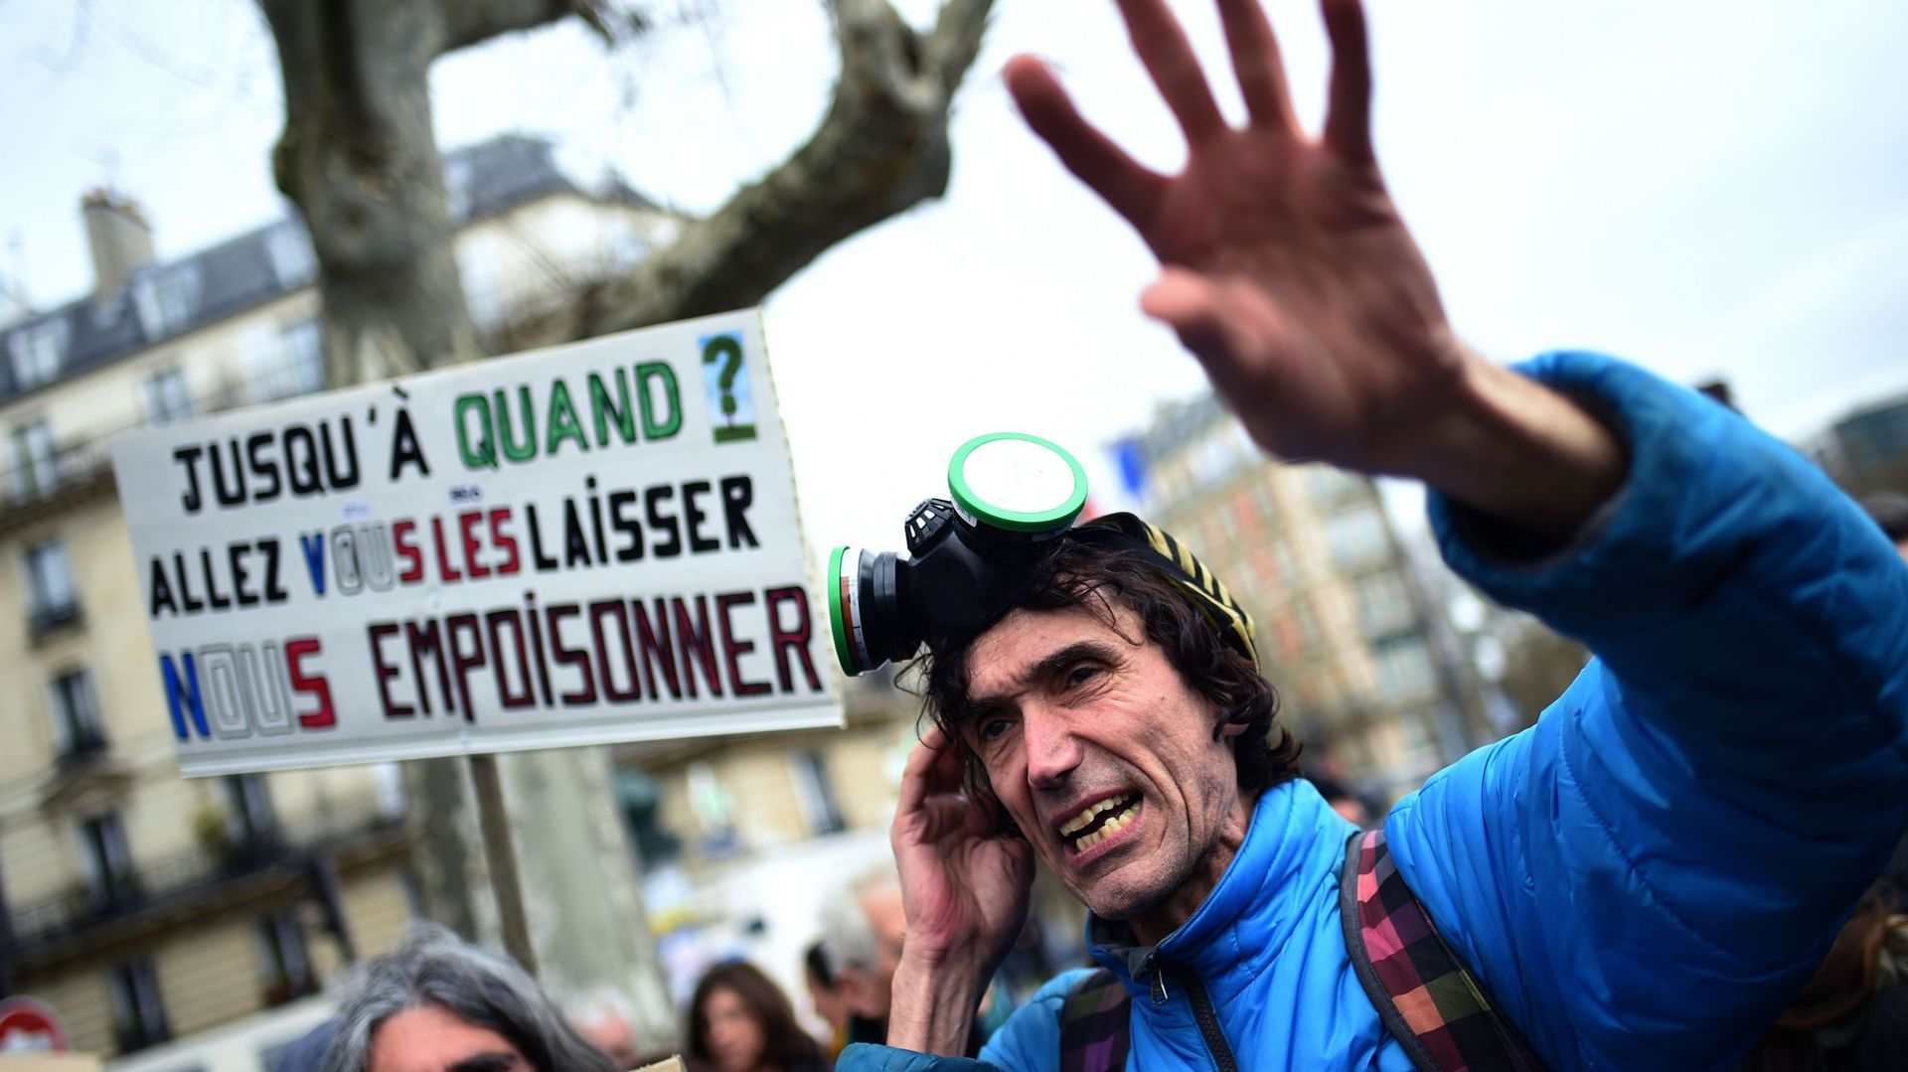
Notes:
https://fr.wikipedia.org/wiki/Voltuan

Slide 5

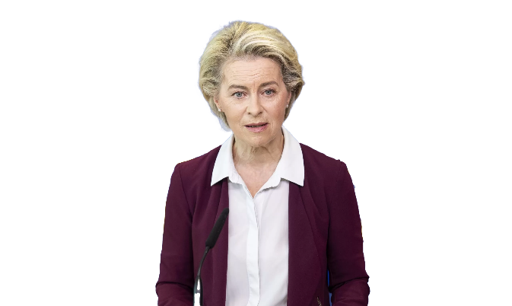

Slide 6


Slide 7
European legal framework on pesticides
Regulation - Placing Plant Protection Products on the Market
Directive - Establishing a Framework for Community Action to Achieve Sustainable Use of Pesticides
Regulation - Machinery for Pesticide Application
Regulation - Statistics on Pesticides
Regulation –
Maximum Residue Limits of Pesticides in or on Foodstuffs
Regulation - Registration, Evaluation, Authorization, and Restriction of Chemicals (REACH)
2005
2006
2009

Slide 8

Externalities
Price
Social cost
Individual cost
Social optimum
Negative externality
Market equilibrium
Quantity
Mr. Pigou

Slide 9

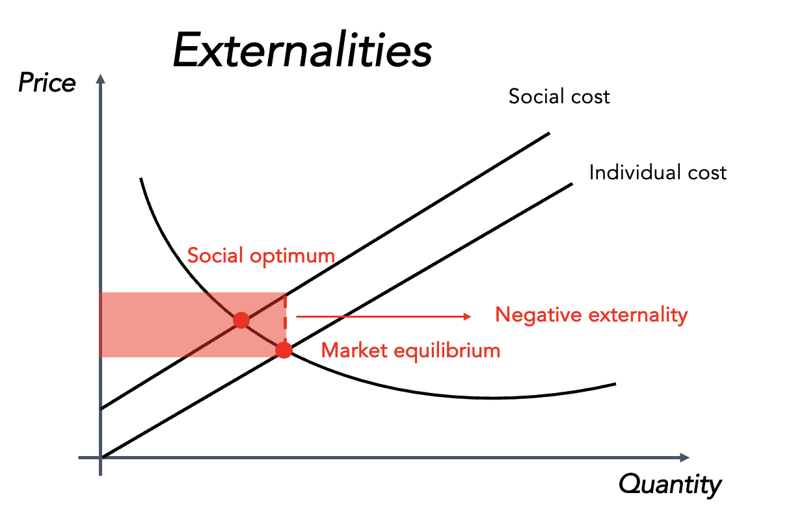

Slide 10
?
?
?
?
?
?
?
?
Social costs?
?
?
?
?
?
?
?
?

Slide 11
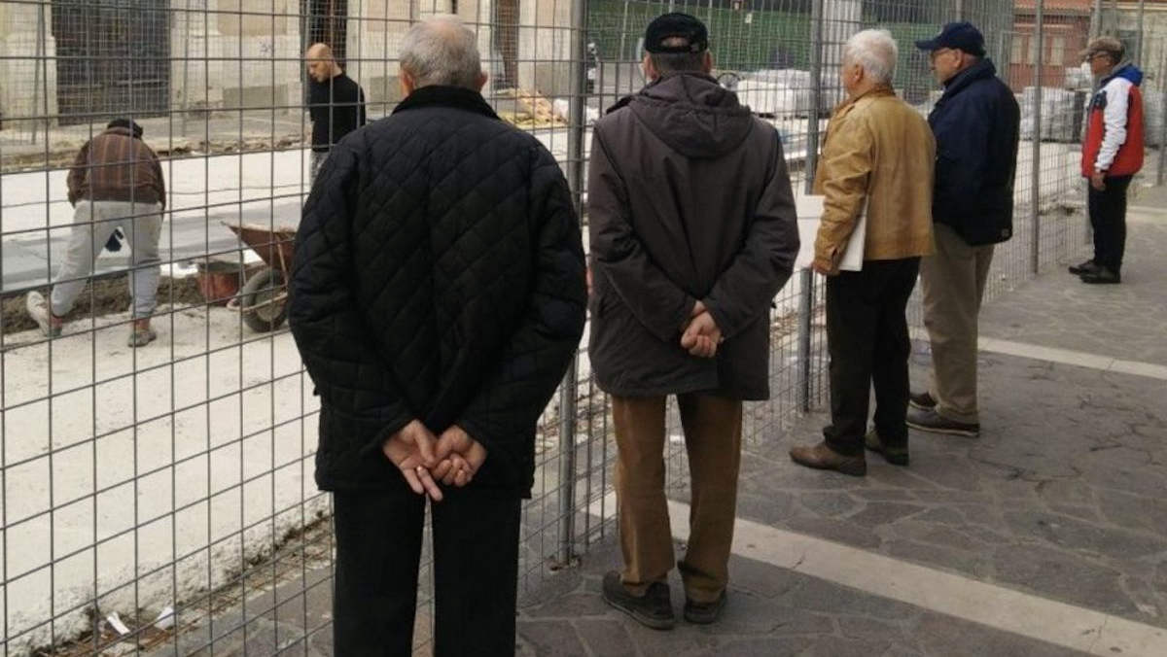
Policies
Pesticides usage
Sociologists
Agronomists
Economists

Slide 12

Strategy:
Develop an indicator to assess the causal link between human action and the environment and monetise it.
Example :
The effect of pesticides usage on biodiversity loss
Ecosystem restoration costs

Slide 13

  A robust and coherent methodological framework

Slide 14

  A robust and coherent methodological framework
  Who is responsible for what?

Slide 15
  A robust and coherent methodological framework
  Who is responsible for what?
  Who already is paying what?

Slide 16
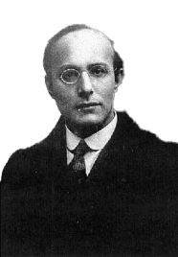
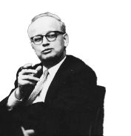
Strategy:
Identify social norms associated with pesticide use and report on public budget expenditures.
Example :
The effect of pesticides usage on biodiversity loss
Costs of developing and implementing biodiversity action plans for biodiversity
Mr. Polanyi
Mr. Kapp

Slide 17
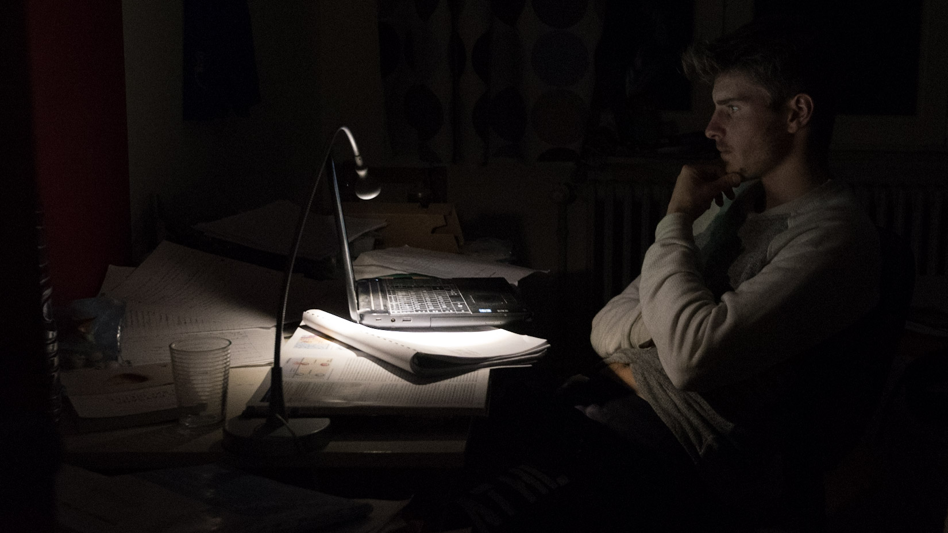

Slide 18
Regulation costs
Environmental costs
Public health costs
Public financial support to the sector

Slide 19
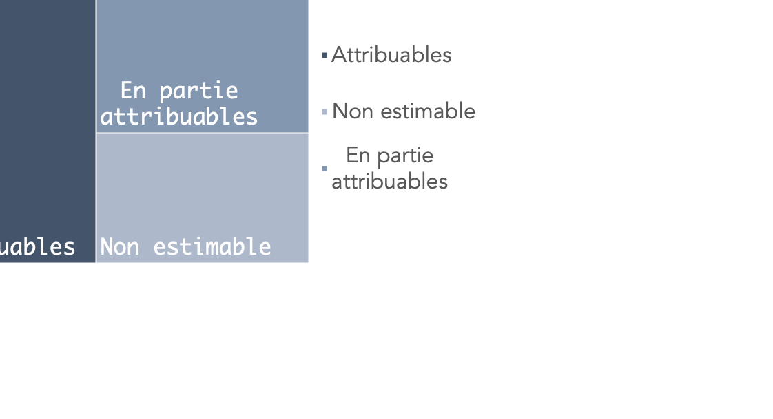
46%
31%
Partly attributable
23%
Not assessable
Attributable

Slide 20
46%
31%
Partly attributable
372 Millions EUR
23%
Not assessable
Attributable

Slide 21
8,205 Millions EUR
46%
31%
Partly attributable
372 Millions EUR
23%
Not assessable
Attributable

Slide 22
8,205 Millions EUR
46%
31%
Partly attributable
?
372 Millions EUR
23%
Not assessable
Attributable

Slide 23

8,205 Millions EUR
46%
31%
Partly attributable
?
372 Millions EUR
23%
Not assessable
Attributable

Slide 24
Regulation costs
Environmental costs
Public health costs
Public financial support to the sector

Slide 25
Public budget of regulatory authorities in proportion to French activity | 1,9m
Budget for national action plans on pesticides | 30m
Budget for public research on the health and environmental risks of pesticides | Not assessable

Slide 26
Environmental costs
Regulation costs
Public health costs
Public financial support to the sector

Slide 27
Public expenditure on water treatment due to pesticides | 260m
Public expenditure on other remedial water treatment measures | Not attributable
Public expenditure on biodiversity protection | Not attributable
Public expenditure on greenhouse gas emissions from the manufacture of pesticides used in France | 31,5m
Public expenditure on incineration of pesticide waste | Not assessable
Coûts de la réglementation
Coûts de la
santé publique
Soutien financier public au secteur

Slide 28
Regulation costs
Environmental costs
Public health costs
Public financial support to the sector

Slide 29
Public expenditure on the treatment of occupational diseases caused by pesticides | 48,5m
Public expenditure on the treatment of consumer diseases caused by pesticides | Not attributable
Excess costs generated because of farmers’ intoxications | Not assessable

Slide 30
Regulation costs
Environmental costs
Public health costs
Public financial support to the sector

Slide 31
Public subsidies to pesticide manufacturers | 0,4m
Public subsidies to farmers who use pesticides | Not attributable

Slide 32
Regulation costs
Environmental costs
Public health costs
Public financial support to the sector

Slide 33
Social costs of pesticide use
Annual budget of the French Ministry of Agriculture and Food

Slide 34
Next steps – Research
Estimating societal costs - Increasing data availability and inventory of pesticide-related social costs
Attribution of social costs - Developing new attribution factors

Slide 35
Next steps – Public policies
Valuable information for (re)designing public budget expenditure
Indicator for monitoring the implementation of public policies
Assessing the social costs of the main pillars of modern agricultural production systems
    Other regional context
    Other farming inputs

Slide 36


Thank you for your attention

