Slide 2
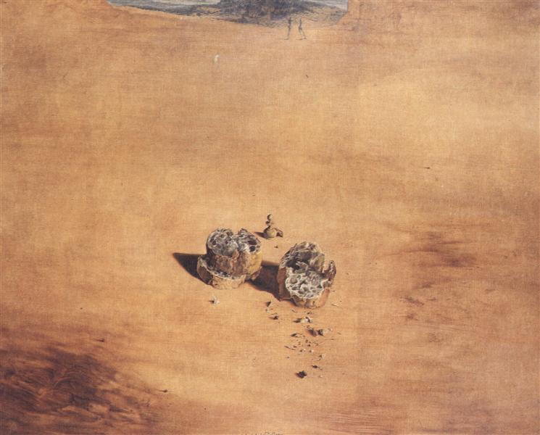
God Eating Bread or God Receiving Gifts:
LXX-Leviticus and the Anthropomorphism of God's Food
Ellen De Doncker SBL Denver 19 November 2022

Slide 3
Overview
Introduction: A One-Sided Perspective
God’s Bread: Occurrences and Variants
  Omission?
  Substitution?
Implications of LXX’s translation: Sacrifice as Gift?
Conclusion

Slide 4
Introduction

Slide 5
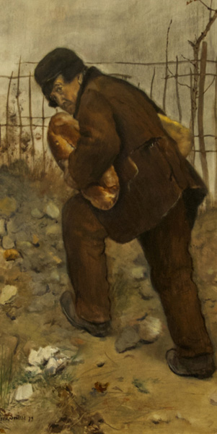
Introduction: A One-Sided Perspective
Anti-Anthropomorphism of the Septuagint: Fritsch (1943) –> part of LXX-theology? (cf. Rösel)
LXX-Leviticus:לחם in reference to God is translated not with ἄρτος but with δῶρον (Lev 21:6.8.17.21.22;22:25), or completely missing (Lev 3:11.16)
  Sign of anti-anthropomorphism? MAJORITY!
  Daniel (1966): Nous nous trouvons devant une modification consciente de la structure de la phrase hébraïque de la part des traducteurs, pour satisfaire à leur désir d’éliminer radicalement de לחם, dans cette conjoncture, tout ce qui pourrait, de près ou de loin, rappeler le sens primitif de ce mot
  Wevers (1997): the translator avoids any notion of God’s bread […] In an Egyptian environment during the Ptolemaic period such notion might well be pagan
  Vahrenhorst (2011), Rösel (1998): Das Wort « Brot » wird in Opferzusammenhängen oft weggelassen. So vermeidet der übersetzer den indruck, dass Gott sich von den Opfern ernähre.
  Büchner (2017): distinguishing between God’s food and the food for humans, stressing that God does not eat like humans, but accepts sacrifices through smoke
  Other reason?
  Voitila (2015): Caution should be exercised regarding the extent of the translator’s exegesis […] a less intentional reason on the part of the translator is possible
Jean-François Raffaëlli, L'homme aux deux pains, 1879

Slide 6
God’s Bread: Occurrences and Variants

Slide 7
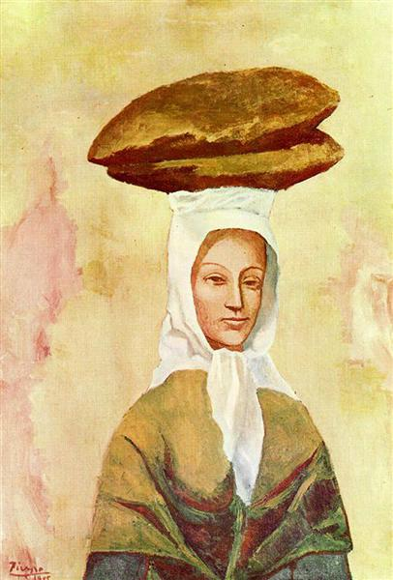
Pablo Picasso, La porteuse de pains, 1905
God’s Bread
Sacrifices as food for God?
  Num 28:2 (MT), God says: “Make sure that you present to me at the appointed time my offerings and my bread/food (לחם ) as an aroma pleasing/appeasing me.”
  God does not eat sacrifices: Psalm 50:7–15
  Eating sacrifice belongs to foreign gods: Deut 32:37-38: “And he will say, Where are their gods, the rock in which they took refuge; Which did eat the fat of their sacrifices, and drank the wine of their drink-offering?”
ἄρτος : standard equivalent ofלחם in LXX-Pentateuch
  64 times
  Also for larger sense as ‘food’
  Conscious break with stereotypical rendering?
Anti-anthropomorphism?
  Omission
  Substitution

Slide 8

God’s Bread
Omission?
Lev 3:11.16
Lev 3:11 | ‏וְהִקְטִיר֥וֹ הַכֹּהֵ֖ן הַמִּזְבֵּ֑חָה לֶ֥חֶם אִשֶּׁ֖ה לַיהוָֽה And the priest shall make it smoke upon the altar; it is the food of the offering made by fire unto the LORD | ἀνοίσει ὁ ἱερεὺς ἐπὶ τὸ θυσιαστήριον· ὀσμὴν εὐωδίας, κάρπωμα κυρίῳ. The priest shall offer on the altar: a sacrifice of sweet savour, a burnt-offering to the Lord
Lev 3:16 | ‏וְהִקְטִירָ֥ם הַכֹּהֵ֖ן הַמִּזְבֵּ֑חָה לֶ֤חֶם אִשֶּׁה֙ לְרֵ֣יחַ נִיחֹ֔חַ כָּל־חֵ֖לֶב לַיהוָֽה׃ And the priest shall make them smoke upon the altar; it is the food of the offering made by fire, for a sweet savour; all the fat [is] the LORD'S | καὶ ἀνοίσει ὁ ἱερεὺς ἐπὶ τὸ θυσιαστήριον· κάρπωμα, ὀσμὴ εὐωδίας τῷ κυρίῳ. πᾶν τὸ στέαρ τῷ κυρίῳ· And the priest shall offer upon the altar: a burnt-offering, a smell of sweet savour to the Lord. All the fat to the Lord.
Pieter Claesz, Still Life with Römer, Silver Tazza and Bread Roll, 1637

Slide 9
God’s Bread
Omission?
Lev 3:11.16
  לחם in broad sense as ‘food’
  LXX: minus of לחם
    Voluntary omission?
Variants:

Slide 10
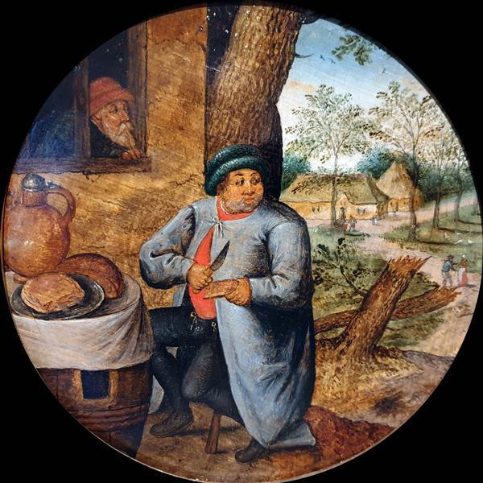
God’s Bread
Omission?
Three main variants
  Anti-anthropomorphist camp: 3 times avoidance!
  emphasizing that YHWH receives something other than the fat
  Suffix
  Lamed v. 16
  minus of לחם
Do these minusses really stem from intentional avoidance?
Possibility of different Vorlage?
Pieter Brueghel de Jongere, De Broodeter, 1616

Slide 11
God’s Bread
Omission?
Possibility Vorlage: textual witnesses:
  1) Suffix:
  SamP v. 11
  In Pentateuch, the verb קטר used 5x with a suffix (Ex 30:7.8; Lev 3:11.16; 4:10) -> suffix: never translated as direct object!
  2) Lamed v. 16
  Idem MT Lev 3:5
  Lamed of datival goal not rendered in LXX-Lev 3:6
  clause אשׁה ריח ניחח (i.e., without lamed) occurs multiple times in Leviticus (Lev 1:9.13.17; 2:2.9; 3:5; 23:18)
  3) minus of לחם
  v. 11: Vorlage?
  v. 16 harmonisation with v. 11?
    Result: parallel v. 5 – 11 – 16
Verse | MT | LXX | SamP | DSS |  | Hexapla/De Rossi
Lev 3:11 | ‏ וְהִקְטִיר֥וֹ הַכֹּהֵ֖ן הַמִּזְבֵּ֑חָה לֶ֥חֶם אִשֶּׁ֖ה לַיהוָֽה | ἀνοίσει ὁ ἱερεὺς ἐπὶ τὸ θυσιαστήριον· ὀσμὴν εὐωδίας, κάρπωμα κυρίῳ. | והקטיר הכהן המזבחה לחם אשה ליהוה | (Pap4QLXXLev^{b} f7) ανοι]σε[ι ο ιερευς επι το θυ][σιαστηριον οσμ]ην[ευωδιας καρπωμα] [τωι Ιαω] | (4Q24 f8) והק֯[ט]יר הכהן המזבחה ל[חם אשה ליהוה. ⟦ ⟧] | Ο ': ὀσμὴ εὐωδίας κάρπωμα. Ἄλλος· ἀρτὸν πυρόν De Rossi: codex 476: אשה ריח ניחח; cod. Kenn. 5: ‌לריח ניחח
Lev 3:16 | ‏ וְהִקְטִירָ֥ם הַכֹּהֵ֖ן הַמִּזְבֵּ֑חָה לֶ֤חֶם אִשֶּׁה֙ לְרֵ֣יחַ נִיחֹ֔חַ --- כָּל־חֵ֖לֶב לַיהוָֽה׃ | καὶ ἀνοίσει ὁ ἱερεὺς ἐπὶ τὸ θυσιαστήριον· --- κάρπωμα, --- ὀσμὴν εὐωδίας τῷ κυρίῳ πᾶν τὸ στέαρ τῷ κυρίῳ· | והקטירם הכהן המזבחה לחם אשה לריח ניחח ליהוה כל חלב ליהוה |  | (4Q25 f2) וה]קטירם הכהן המזב[חה לחם ]אׄשה [לריח ניחח --- כל חלב לי]ה֯[וה ]. | Οʹ· ἄρτον κάρπωμα. Ἄλλος· ἄρτον πυρόν. Ἄλλος· ἄρτον προσφοῥαν
Verse | Vorlage? | LXX
3:5 | אִשֵּׁה רֵיחַ נִיחֹחַ לַיהוָה | κάρπωμα ὀσμὴ εὐωδίας κυρίῳ
3:11 | לריח ניחח אשׁה ליהוה | ὀσμὴν εὐωδίας κάρπωμα κυρίῳ
3:16 | לֶחֶם אִשֶּׁה לְרֵיחַ נִיחֹחַ | κάρπωμα ὀσμὴν εὐωδίας τῷ κυρίῳ

Slide 12
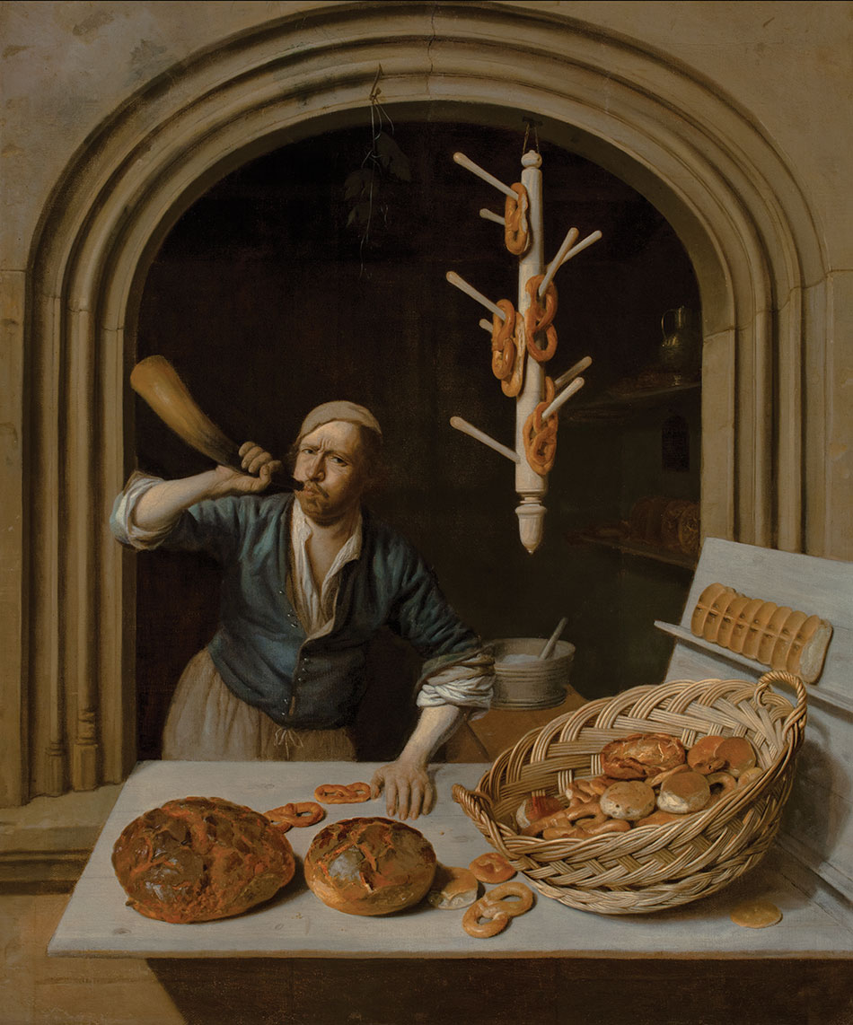
God’s Bread
Omission?
Vorlage
Harmonisation
“Pleasing odour to God” is preserved
  Attention not to confound
  materiality/anthropomorphism
  immateriality/anti-anthropomorphism
Job Adriaensz, De Bakker, 1681

Slide 13
God’s Bread
Substitution?
Lev 21—22
  לחם consistently rendered by δῶρα τοῦ θεοῦ
  LXX probably did have a Vorlage that contained לחם :
    all witnesses read לחם
    Only Targumim: קָרְבָּן but perhaps already interpretative tradition
  Unusual rendering for לחם!
Lev 21:6 | ‏קְדֹשִׁ֤ים יִהְיוּ֙ לֵאלֹ֣הֵיהֶ֔ם וְלֹ֣א יְחַלְּל֔וּ שֵׁ֖ם אֱלֹהֵיהֶ֑ם כִּי֩ אֶת־אִשֵּׁ֨י יְהוָ֜ה לֶ֧חֶם אֱלֹהֵיהֶ֛ם הֵ֥ם מַקְרִיבִ֖ם וְהָ֥יוּ קֹֽדֶשׁ׃ | ἅγιοι ἔσονται τῷ θεῷ αὐτῶν καὶ οὐ βεβηλώσουσιν τὸ ὄνομα τοῦ θεοῦ αὐτῶν· τὰς γὰρ θυσίας κυρίου δῶρα τοῦ θεοῦ αὐτῶν αὐτοὶ προσφέρουσιν καὶ ἔσονται ἅγιοι.
Lev 21:8 | ‏ וְקִדַּשְׁתּ֔וֹ כִּֽי־אֶת־לֶ֥חֶם אֱלֹהֶ֖יךָ ה֣וּא מַקְרִ֑יב קָדֹשׁ֙ יִֽהְיֶה־לָּ֔ךְ כִּ֣י קָד֔וֹשׁ אֲנִ֥י יְהוָ֖ה מְקַדִּשְׁכֶֽם׃ | καὶ ἁγιάσει αὐτόν, τὰ δῶρα κυρίου τοῦ θεοῦ ὑμῶν οὗτος προσφέρει· ἅγιος ἔσται, ὅτι ἅγιος ἐγὼ κύριος ὁ ἁγιάζων αὐτούς.
Lev 21:17 | ‏דַּבֵּ֥ר אֶֽל־אַהֲרֹ֖ן לֵאמֹ֑ר אִ֣ישׁ מִֽזַּרְעֲךָ֞ לְדֹרֹתָ֗ם אֲשֶׁ֨ר יִהְיֶ֥ה בוֹ֙ מ֔וּם לֹ֣א יִקְרַ֔ב לְהַקְרִ֖יב לֶ֥חֶם אֱלֹהָֽיו׃ | Εἰπὸν Ααρων Ἄνθρωπος ἐκ τοῦ γένους σου εἰς τὰς γενεὰς ὑμῶν, τίνι ἐὰν ᾖ ἐν αὐτῷ μῶμος, οὐ προσελεύσεται προσφέρειν τὰ δῶρα τοῦ θεοῦ αὐτοῦ.
Lev 21:21 | ‏כָּל־אִ֞ישׁ אֲשֶׁר־בּ֣וֹ מ֗וּם מִזֶּ֙רַע֙ אַהֲרֹ֣ן הַכֹּהֵ֔ן לֹ֣א יִגַּ֔שׁ לְהַקְרִ֖יב אֶת־אִשֵּׁ֣י יְהוָ֑ה מ֣וּם בּ֔וֹ אֵ֚ת לֶ֣חֶם אֱלֹהָ֔יו לֹ֥א יִגַּ֖שׁ לְהַקְרִֽיב׃ | πᾶς, ᾧ ἐστιν ἐν αὐτῷ μῶμος, ἐκ τοῦ σπέρματος Ααρων τοῦ ἱερέως, οὐκ ἐγγιεῖ τοῦ προσενεγκεῖν τὰς θυσίας τῷ θεῷ σου· ὅτι μῶμος ἐν αὐτῷ, τὰ δῶρα τοῦ θεοῦ οὐ προσελεύσεται προσενεγκεῖν.
Lev 21:22 | ‏ לֶ֣חֶם אֱלֹהָ֔יו מִקָּדְשֵׁ֖י הַקֳּדָשִׁ֑ים וּמִן־הַקֳּדָשִׁ֖ים יֹאכֵֽל׃ | τὰ δῶρα τοῦ θεοῦ τὰ ἅγια τῶν ἁγίων καὶ ἀπὸ τῶν ἁγίων φάγεται·
Lev 22:25 | ‏וּמִיַּ֣ד בֶּן־נֵכָ֗ר לֹ֥א תַקְרִ֛יבוּ אֶת־לֶ֥חֶם אֱלֹהֵיכֶ֖ם מִכָּל־אֵ֑לֶּה כִּ֣י מָשְׁחָתָ֤ם בָּהֶם֙ מ֣וּם בָּ֔ם לֹ֥א יֵרָצ֖וּ לָכֶֽם׃ | καὶ ἐκ χειρὸς ἀλλογενοῦς οὐ προσοίσετε τὰ δῶρα τοῦ θεοῦ ὑμῶν ἀπὸ πάντων τούτων, ὅτι φθάρματά ἐστιν ἐν αὐτοῖς, μῶμος ἐν αὐτοῖς, οὐ δεχθήσεται ταῦτα ὑμῖν.

Slide 14
God’s Bread
Substitution?
Break with stereotypical rendering -> why?
  Solely for anti-anthropomorphic purposes?
  Daniel: ἄρτος [fonctionne] en tant qu’homologue de לחם pour les traducteurs du Pentateuque. S’ils y renoncent, c’est parce qu’ils s’écartent délibérément du strict mot à mot en faveur d’une traduction plus souple, pour satisfaire certaines exigences de forme ou de clarté, concernant d’ailleurs moins לחם que le contexte où il se place.
  Positive movement! What is expressed in LXX? This accounts better for consistency than ‘negative movement’
δῶρον in LXX-Leviticus:
  Lev 2:4, סֹלֶת חַלּוֹת (cakes of fine flour) is rendered by δῶρον κυρίῳ ἐκ σεμιδάλεως
  Semantic link bread – gift?
δῶρον in Greek literature: offering to a deity
LXX: δῶρον | MT | Verse
singular | קָרְבָּן | 1:3.10.14(x2); 2:1(x2).4.5.7.12; 3:1.2.6.7.8.12; 4:23.32; 5:11; 6:13; 7:16.29; 9:15; 17:4
 | סֹלֶת חַלּוֹת | 2:4
plural | קָרְבָּן | 1:2 (2x); 7:13.14; 9:7; 22:18.27; 23:14; 27:9.11
 | קָרְבָּן (pl) | 7:38
 | לֶ֧חֶם | 21:6.8.17.21.22; 22:25

Slide 15
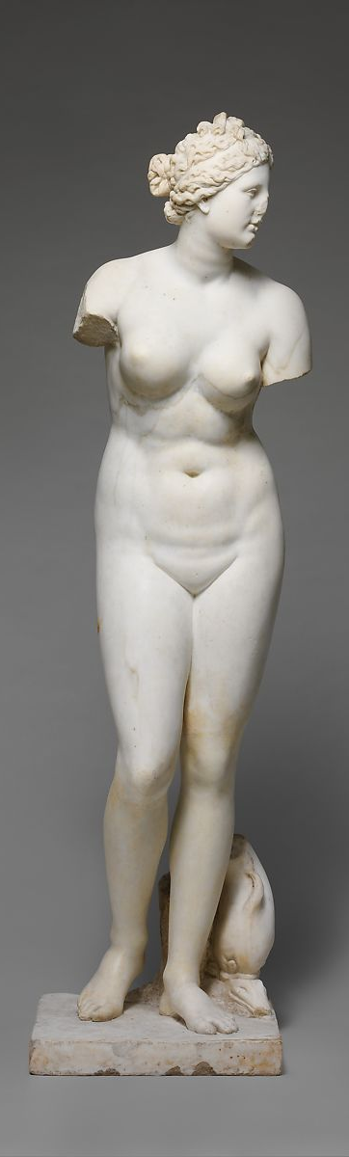
God’s Bread
Substitution?
δῶρον in Greek literature:
  Genitive: the one by whom the gift is given:
  Homeros, Ilias, 3, 54: δῶρ’ Ἀφροδίτης
  Diogenes Laertius, Vitae philosophorum 5, 19: αὐτὸν δὲ θεοῦ δῶρον εἰπεῖν εὐμορφίαν
  Dative: the one to whom the gift is given
  Homeros, Ilias, 6.293:φέρε δῶρον Ἀθήνῃ
  Aristophanes, Plutus 849: Χαρίεντά γ’ ἤκεις δῶρα τῷ θεῷ φέρων
δῶρον in inscriptions:
  Σεράπις δῶρα on amphorae in Pompeii
  LXX-Leviticus: δῶρα τοῦ θεοῦ = gifts by or of/to God?
  LXX-Lev 21 and 22: δῶρα τοῦ θεοῦ with genitive vs. LXX-Pentateuch: δῶρον + God in the dative
  קָרְבָּן לַיהוָה -> lamed transl. by dative BUT also without lamed: LXX: dative! (MT-Lev 23:14: אֶת-קָרְבַּן אֱלֹהֵיכֶם // LXX-Lev 23:14: δῶρον τῷ κυρίῳ)
  Sous-entendre sacrifice also as involvement Holy one -> priests! Context: participation in holiness through sacrifice ! (e.g. Lev 21:8: “it is he that offers the gifts of the Lord your God; he shall be holy, for I the Lord, who sanctifies them, am holy”)
  Literal translation with implications!

Slide 16
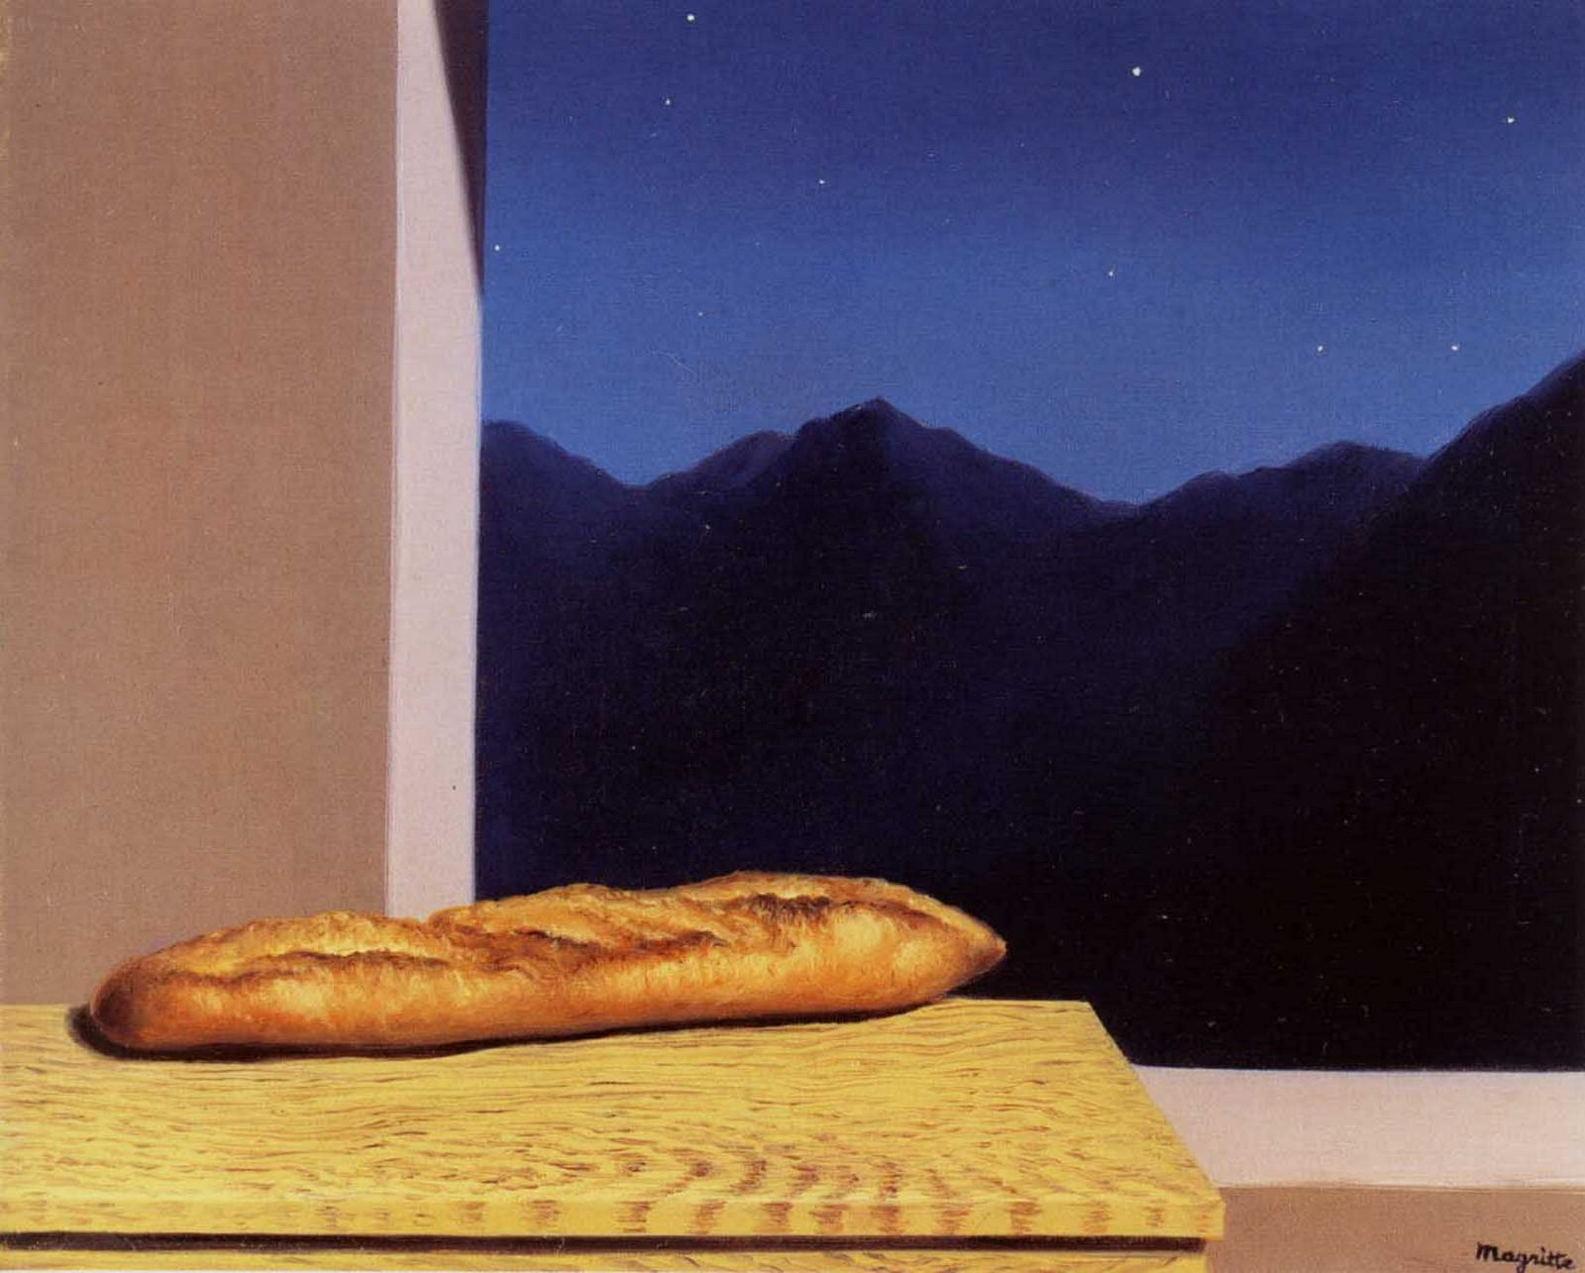
God’s Bread
Substitution?
Choice for δῶρον creates wordpair:
  In LXX-Lev 21:6: θυσία for אִשֶּׁה (most often rendered by κάρπωμα in Leviticus), and δῶρα for לֶחֶם
  Result: two common terms for sacrifice are now used parallelly (τὰς γὰρ θυσίας κυρίου δῶρα τοῦ θεοῦ αὐτῶν αὐτοὶ προσφέρουσιν)
  Ribbens (2016): “a general appeal to all types and kinds of sacrifices”
    both terms are used in LXX-Pentateuch to refer both to bloody and bloodless sacrifices
    Cf. Letter Aristeas 234: οὐ δώροις οὐδὲ θυσίαις: wordpair used for all kinds of sacrifices
  Hieke (2014) MT implies “all sacrifices” in Lev 21: “Speise ihres Gottes“ entschließt diese und alle weiteren Opfer (über die Feueropfer hinaus)
René Magritte, L’avenir, 1936

Slide 17
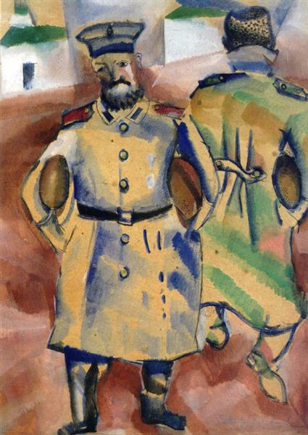
God’s Bread
Substitution?
Choice for δῶρον as purely negative movement ‘away from anthropomorphism’?
  Positive movement seems present: content-fitted translation
    Mutual movement Holy one – holy priests / participation in holiness through sacrifice
    Wordpair -> all sacrifices!
  Carefulness with attribution to anti-anthropomorphism: other, positive elements present as well!
    Cf. M. Dhondt (2021):
  In using the term “exegesis” in reference mainly to deviations between the Hebrew and the Greek, the Septuagint interpretation is measured against a modern, scholarly interpretation of the Hebrew, which is presumably the “correct” reading. Where the ancient and the modern interpretations of the Hebrew overlap, the Greek is seen as “proper translation”; where they differ, for reasons that can be ascribed to the translator, it has been regarded as “exegesis” [...] what constitutes a deviation between the Hebrew and the Greek for modern scholarship may, for the Septuagint translator, have been an expression of what the source text was thought to mean, rather than an attempt to change its content.
Marc Chagall, Soldiers with Bread, 1915

Slide 18
Implications of LXX’s translation:
Sacrifice as Gift?

Slide 19
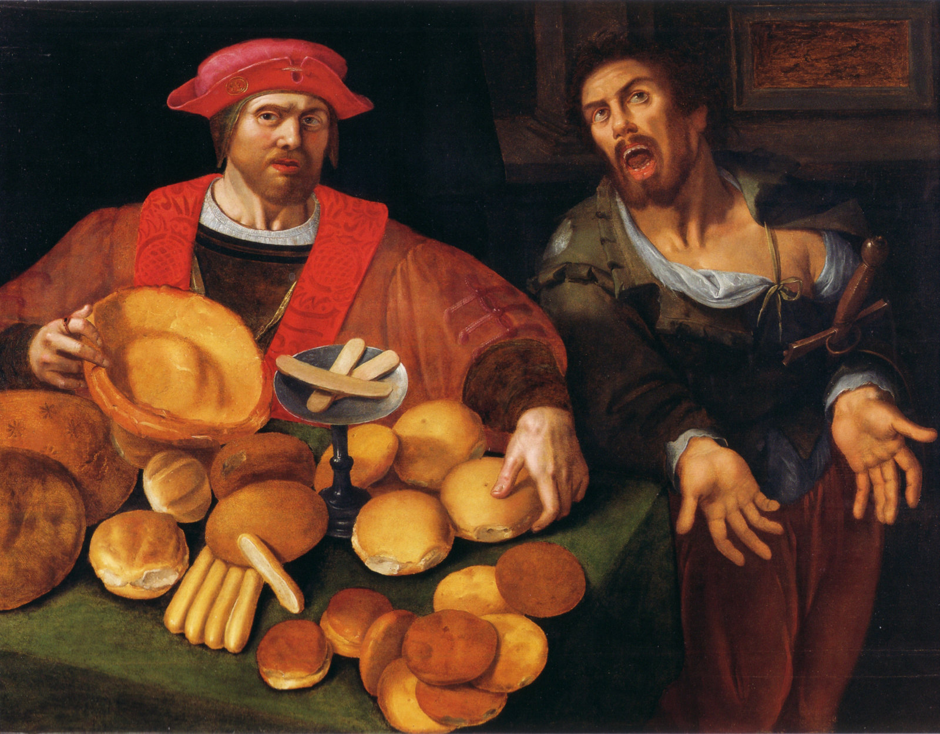
Implications: Sacrifice As Gift?
Through LXX’s translation, sacrifice is presented as a gift, rather than food
Classical binary:
1) sacrifice = gift
      Tylor (1871), Gray (1925), Schenker (1983)
      Plato, Euthrypho 14c: “τὸ θύειν δωρεῖσθαί ἐστι τοῖς θεοῖς”
      LXX
    Sacrifice = meal
      Smith (1889), Eissfeldt
      MT
      Num 28:2 (MT): “Make sure that you present to me at the appointed time my offerings and my bread/food (לחם), as an aroma pleasing/appeasing me.”
The two ideas intertwine in MT and LXX!
  MT: the verb קרב is related to ‘gift’
    Ps 72,10; Mal 1:8, Num 7:10
    inscriptions of Mount Gerizim
  LXX: קרב in the verses regarding ‘God’s food’ in Lev 21—22 rendered by προσφέρω -> related to food
    Ex.: Xenophon, Memorabilia 3.11.13 : ὁρᾷς γὰρ ὅτι καὶ τῶν βρωμάτων τὰ ἥδιστα, ἐὰν μέν τις προσφέρῃ πρὶν ἐπιθυμεῖν, ἀηδῆ φαίνεται Plato, Phaedrus, 270b: φάρμακα καὶ τροφὴν προσφέρων(to prescribe medicine and diet)
Unknown, Rich and Poor, 17th century

Slide 20
Conclusion

Slide 21
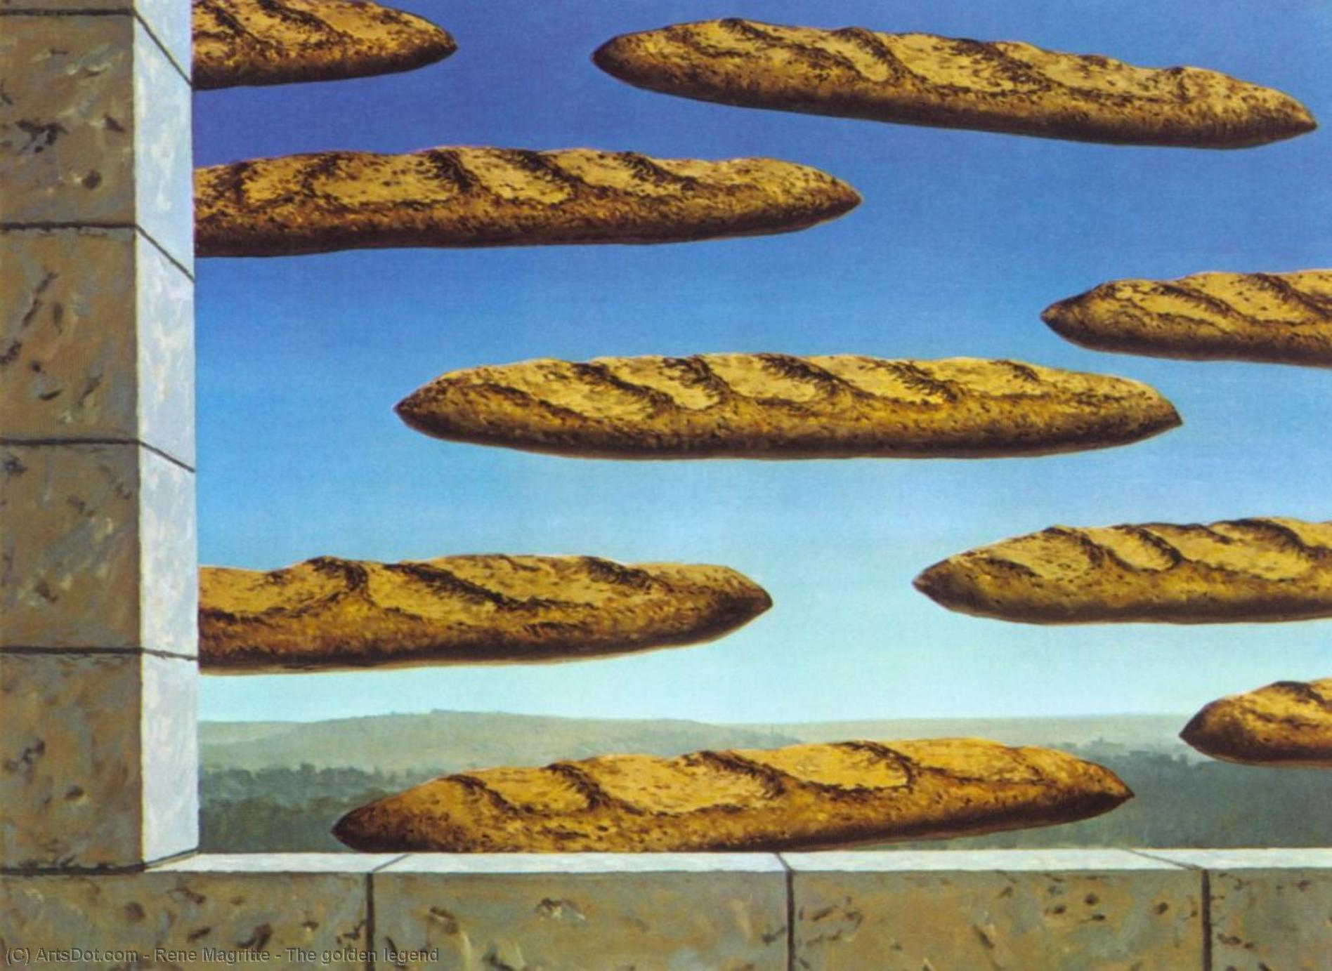
Conclusion
God’s bread in LXX: more than just avoidance
  Vorlage, harmonisation
  Positive movement: syntax and semantics !
    Escaping binary literal/free
    Recent studies on multicausality (Aitken 2015, Dhondt 2021)
Translation technique LXX-Leviticus:
  Translator influenced by pagan vocabulary (Buchner, 2017)
  Love of variety?
  Translation choices to fit both content of verses, and sociocultural context
Question of anthropomorphisms
  More nuanced!
  Importance of focus on positive movement LXX
  Necessity of multi-facetted approach
Rene Magritte, Le doré légende, 1958

Slide 22
Thank you!

