Slide 1

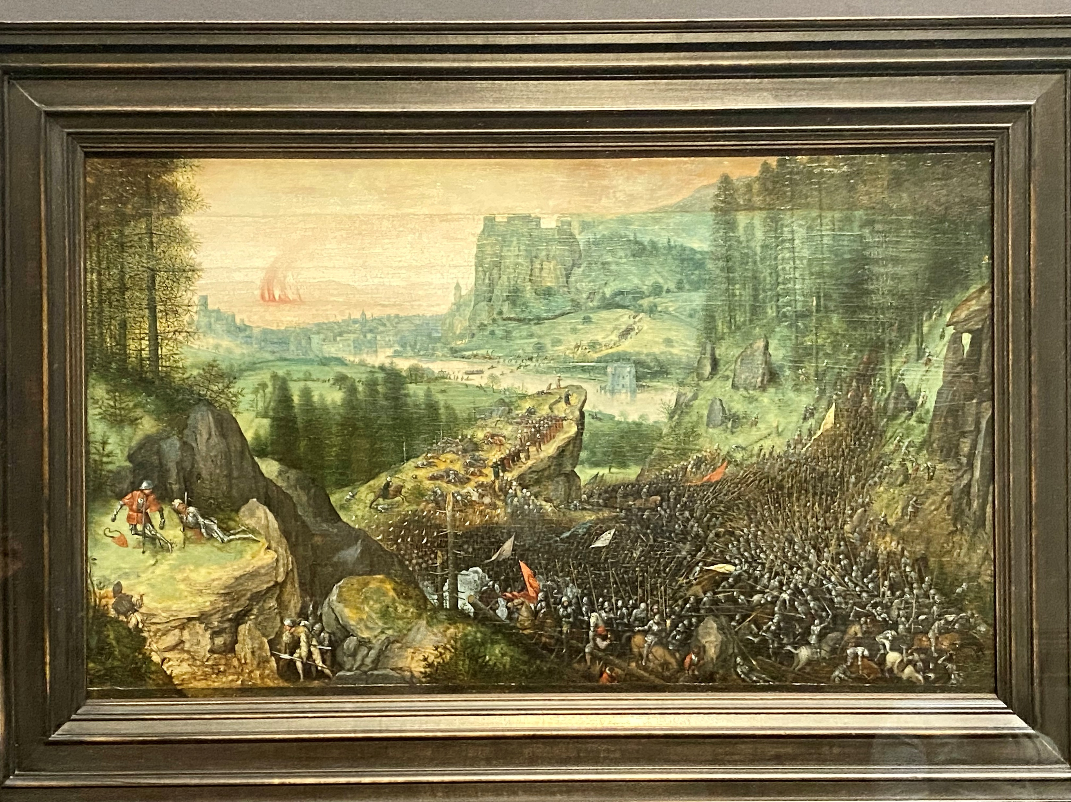


How do root and soil hydraulic properties and soil-root contact impact water uptake at the column scale?
Axelle Koch¹, Mutez Ahmed², Andrea Carminati³, Jan Vanderborght⁴, Mathieu Javaux^{1,4}
ELI, UCLouvain, Belgium
School of Life Sciences, Technical University of Munich, Germany
D-USYS, ETH-Zurich, Switzerland
Agrosphere, Forschungszentrum Juelich GmbH, Germany
P. Bruegel, 1562
@KHM, Vienna

Slide 4
Challenges
Rhizophere and soil-root interface: keys for water uptake but…
  Difficult to observe
  Continuously evolving
  Very heterogeneous
  Hotspot for microbial activity
  Function of soil and root traits
  Does it have an impact at plant/ecosystem scale?

Slide 5

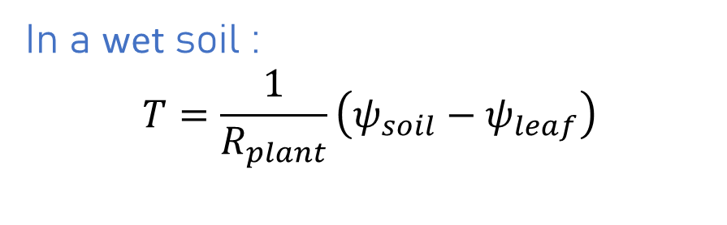
Transpiration vs. leaf water potential
$−ψ_{leaf}$ (cm)
In a wet soil :
$$T=\frac{1}{R_{plant}}\left(ψ_{soil}−ψ_{leaf}\right)$$
R_{plant}=1/K_{plant}
T (cm³ d⁻¹)

Slide 6
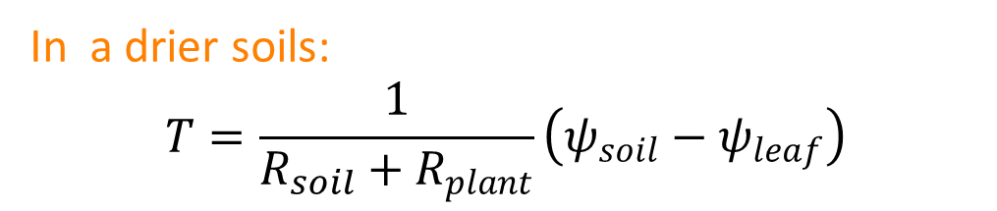
Transpiration vs. leaf water potential
$−ψ_{leaf}$ (cm)
In a wet soil :
$$T=\frac{1}{R_{plant}}\left(ψ_{soil}−ψ_{leaf}\right)$$
R_{plant}+ R_{soil}
R_{plant}
In a drier soils:
$$T=\frac{1}{R_{soil}+R_{plant}}\left(ψ_{soil}−ψ_{leaf}\right)$$
T (cm³ d⁻¹)

Slide 7
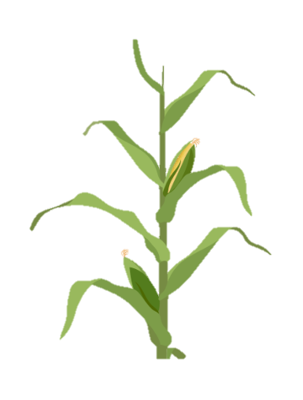

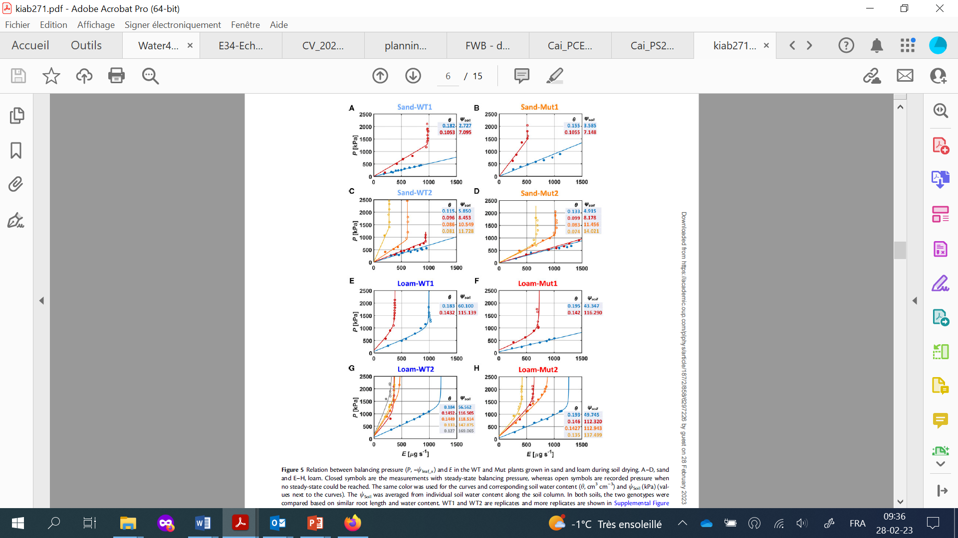

Pressure ecotron
Decrease in water content
Pressure ecotron
TDR
$−ψ_{leaf}$ (cm)
22 cm
P
T (cm³ d⁻¹)
7 cm
Cai et al., 2021

Slide 8
Hydraulic resistances
Plant hydraulic resistance R_{plant} :
  Function of root system hydraulic architecture (RSHA):
    Root system architecture: RS connectivity, topology
    Distribution of root hydraulic properties:
      radial (cortex) conductance k_{r}
      Axial (xylem) conductivity K_{x}
      f(age, order, cavitation, suberization, AQP activities, etc.)
  R_{plant} can be measured
  R_{plant} can be calculated from RSHA (Couvreur et al., 2012; Meunier et al., 2017)
Couvreur et al., 2018

Slide 9
Hydraulic resistances
Soil hydraulic resistance R_{soil} :
  Function of :
    Soil/rhizosphere hydraulic properties
    Root density
    Soil water status
    Soil-root surface
    Uptake rate
  R_{soil} can be measured
  R_{soil} can be estimated (Gardner et al.; De Jong van Liere et al.; Schroeder et al.)
  (local soil resistance can hardly be measured)
Duddek et al., in prep

Slide 10
How do soil type and root hairs impact R_{soil}?
Coarser soils → lower K_{unsat} → larger R_{soil}
Root hairs → increase root soil contact → decrease R_{soil}
Impact of root hairs in wet soil → null
Impact of root hairs in dry soil → visible
Impact of root hairs in coarse soil > in fine soils

Slide 11
How do soil types and root hairs impact R_{soil}?
Coarser soils → decrease K_{unsat} → increase R_{soil}
Root hairs → increase root soil contact → decrease R_{soil}
Impact of root hairs in wet soil → null
Impact of root hairs in dry soil → visible
Impact of root hairs in coarse soil > in fine soils
But….
  Can we represent them at the plant scale?
  Can we identify the causes of the R_{soil}?
  What about root plasticity? (diameter/length/hydraulic properties?)

Slide 12

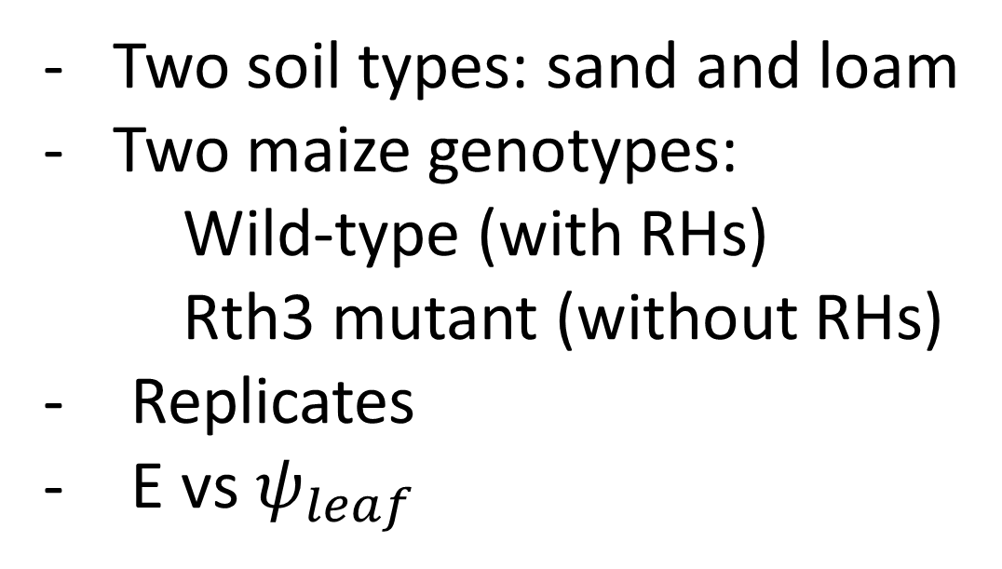
Experiments (Cai et al., 2021)
Two soil types: sand and loam
Two maize genotypes:
    Wild-type (with RHs)
    Rth3 mutant (without RHs)
Replicates
E vs $ψ_{leaf}$
TDR
22 cm
P
7 cm

Slide 13
Results from Cai et al., 2021
SAND, RH SAND HAIRLESS LOAM, RH LOAM, HAIRLESS
Rep. 2 Rep. 1
SAND, RH SAND HAIRLESS LOAM, RH LOAM, HAIRLESS
T [µg s⁻¹]
T [µg s⁻¹]
T [µg s⁻¹]
T [µg s⁻¹]

Slide 14
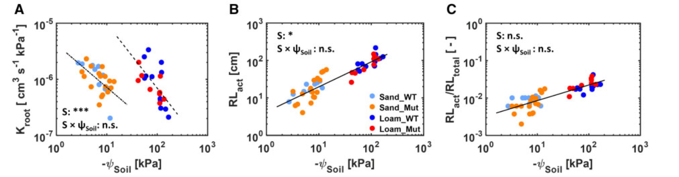
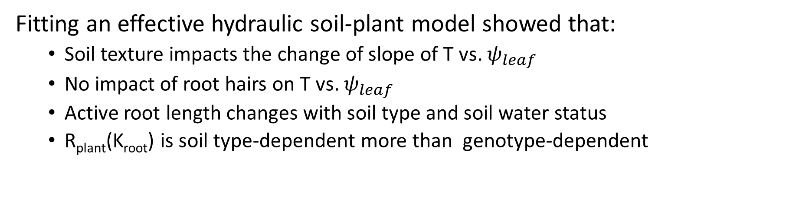
Cai et al., 2021
SAND, RH
SAND HAIRLESS
LOAM, RH
LOAM, HAIRLESS
Fitting an effective hydraulic soil-plant model showed that:
  Soil texture impacts the change of slope of T vs. $ψ_{leaf}$
  No impact of root hairs on T vs. $ψ_{leaf}$
  Active root length changes with soil type and soil water status
  R_{plant}(K_{root}) is soil type-dependent more than genotype-dependent

Slide 15

Modeling
Root Hydraulic model (Doussan 3D)
(~5mm)
Bulk soil water flow model (Richards 3D)
(~1 cm)
Axisym. rhizosphere module (Schroeder et al., 2008 ) (<mm)
Vermeer, 1666/67 @Khm

Slide 16
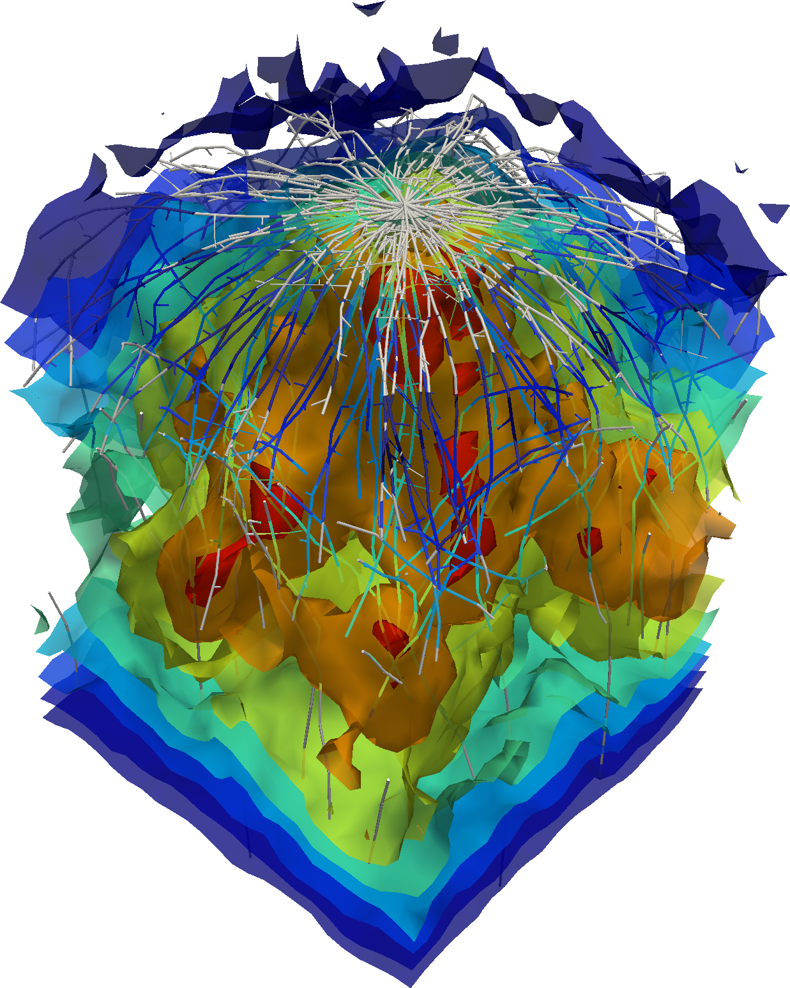
Modeling
Root Hydraulic model (Doussan 3D)
(~5mm)
Simulated root architecture to fit the total root length and diameter + optimisation of kr/kx
Bulk soil water flow model (Richards 3D)
(~1 cm)
Homogeneous measured soil hydraulic properties
Observed initial θ profiles
Axisym. hizosphere module (Schroeder et al., ) (<mm)
Same than bulk soil properties
No difference between genotypes (+ optim. reduction factor)

Slide 17
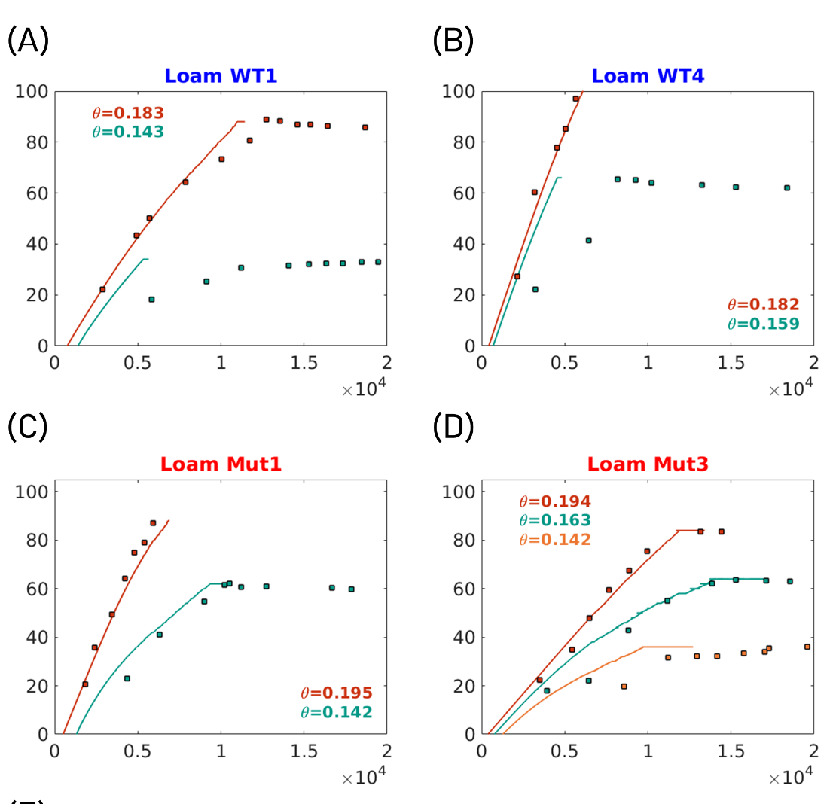




Results- representing experimental results
LOAM, RH SAND HAIRLESS
Transpiration (cm³ d⁻¹)
LOAM, HAIRLESS SAND, RH
Leaf water potential (cm)

Slide 18
Results- representing experimental results
LOAM, RH SAND HAIRLESS
Transpiration (cm³ d⁻¹)
LOAM, HAIRLESS SAND, RH
Leaf water potential (cm)

Slide 19
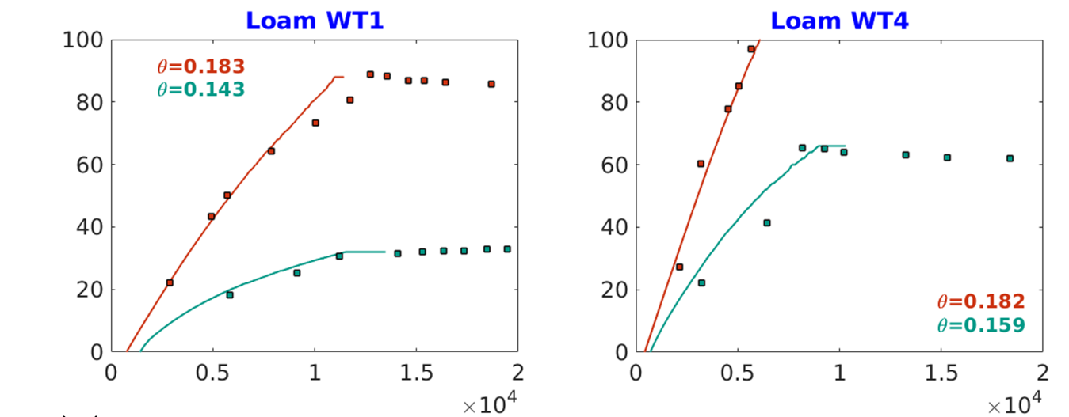

Results – f*K_{rhizo}
Transpiration (cm³ d⁻¹)
Factor f
7% - 8% for Loam with RH
2.2‰- 1‰ for Sand with RH
1.8‰ - 2‰ for Sand hairless
Leaf water potential (cm)

Slide 20
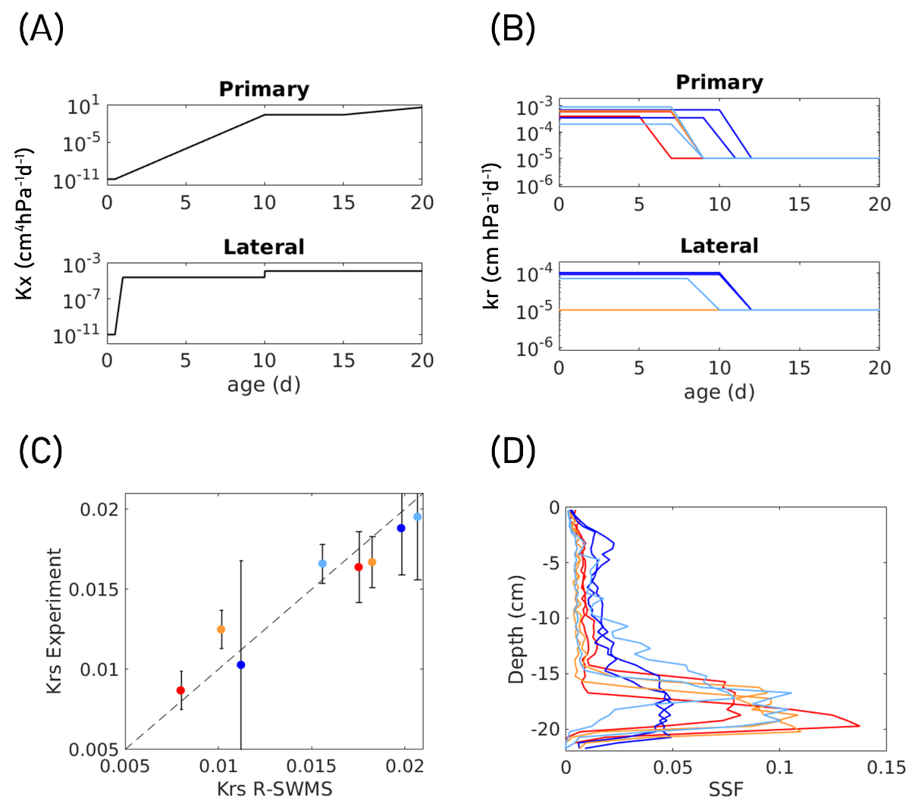
Are root properties genotype/soil dependent?
Root conductance (R_{plant}) is well simulated: No texture/genotype impact on R_{plant}
No specific genotype/soil impact on radial conductivity
Root age matters and generates very heterogeneous root hydraulic properties and uptake patterns in columns
Notes:
Wild type: blue
Mutant: red

Slide 21
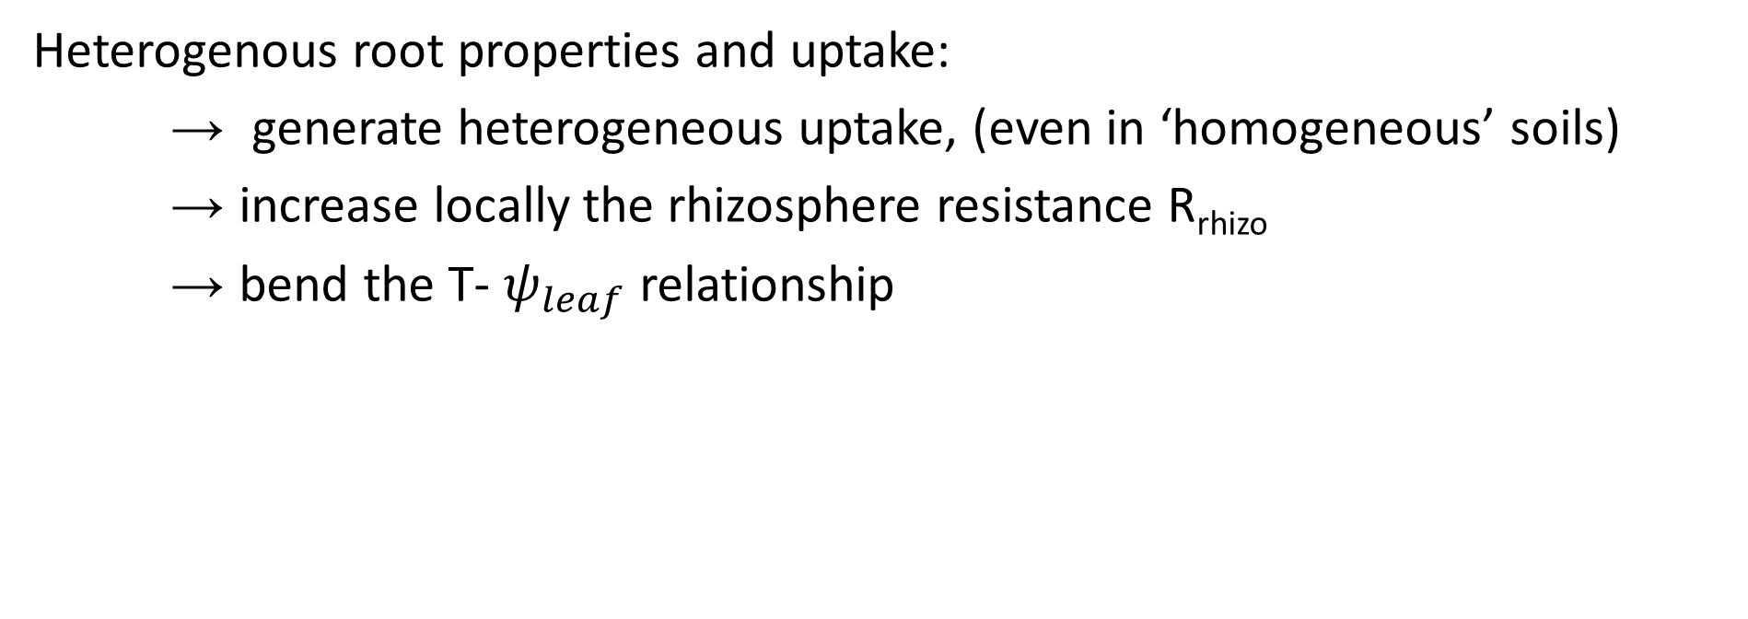
Soil and root resistances are coupled
Heterogenous root properties and uptake:
→ generate heterogeneous uptake, (even in ‘homogeneous’ soils)
→ increase locally the rhizosphere resistance R_{rhizo}
→ bend the T- $ψ_{leaf}$ relationship

Slide 22
Why is R_{soil} underestimated in sand?
Initial soil water distribution not at equilbrium with the root system: Would longer transient simulations increase R_{soil}?
Constant root hydraulic properties? Could root radial conductivity become less conductive in wetter zones?
Bulk soil hydraulic properties = rhizosphere properties:
  Soil-root interface problems?
  Poor measurement of soil conductivity?
  Different rhizosphere conductivity?
  Root shrinkage?

Slide 23
Conclusions
  Can we represent the impact of R_{soil} at the plant scale? A rhizosphere module is needed to reproduced experiments (small scale matters!)
  What causes the rhizosphere effect?
    Heterogeneous root properties
    In loam: Kdrop
    In sand: other processes
  What about root plasticity?
    Root radial conductivity independent to diameter
    Root radial conductivity independent to genotype
    Root radial conductivity independent to soil type

Slide 24
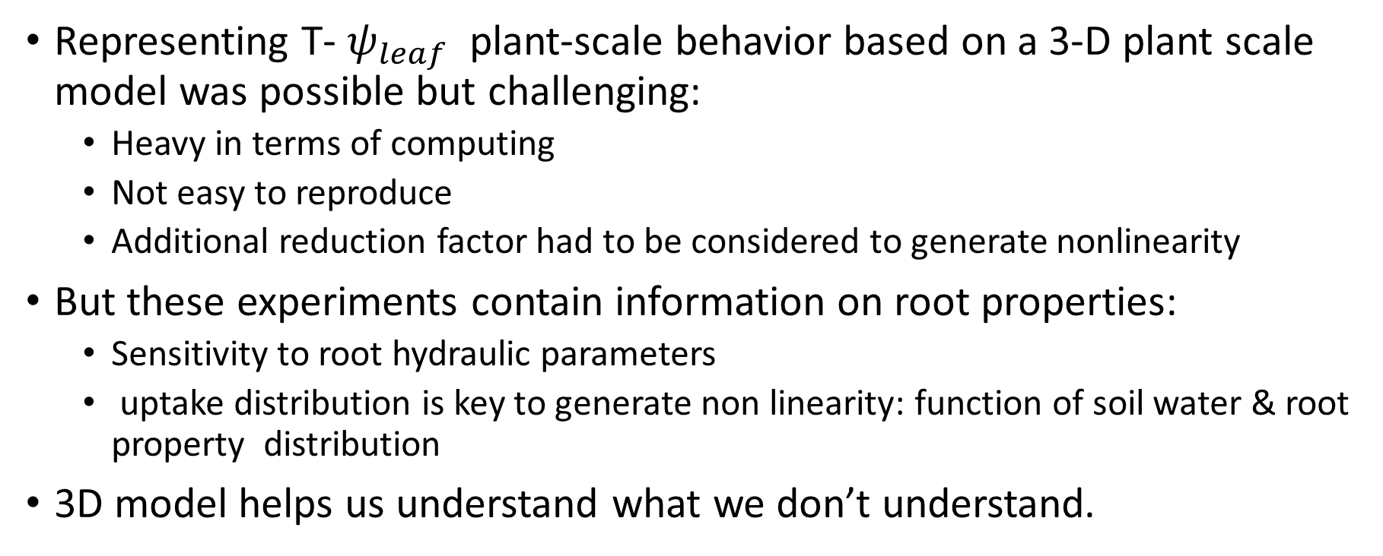
Conclusions
Representing T- $ψ_{leaf}$ plant-scale behavior based on a 3-D plant scale model was possible but challenging:
  Heavy in terms of computing
  Not easy to reproduce
  Additional reduction factor had to be considered to generate nonlinearity
But these experiments contain information on root properties:
  Sensitivity to root hydraulic parameters
  uptake distribution is key to generate non linearity: function of soil water & root property distribution
3D model helps us understand what we don’t understand.

Slide 25
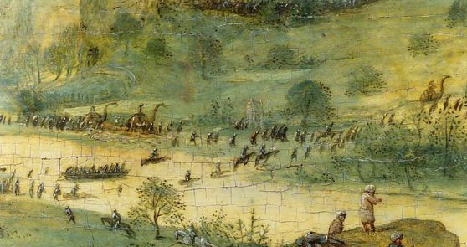

Conclusions
3D model helps us understand what we don’t understand.
Representing T- $ψ_{leaf}$ plant-scale behavior based on a 3-D plant scale model was possible but challenging:
  Heavy in terms of computing
  Not easy to reproduce
  Additional reduction factor had to be considered to generate nonlinearity
But these experiments contain information on root properties:
  Sensitivity to root hydraulic parameters
  uptake distribution is key to generate non linearity: function of soil water & root property distribution

Slide 26
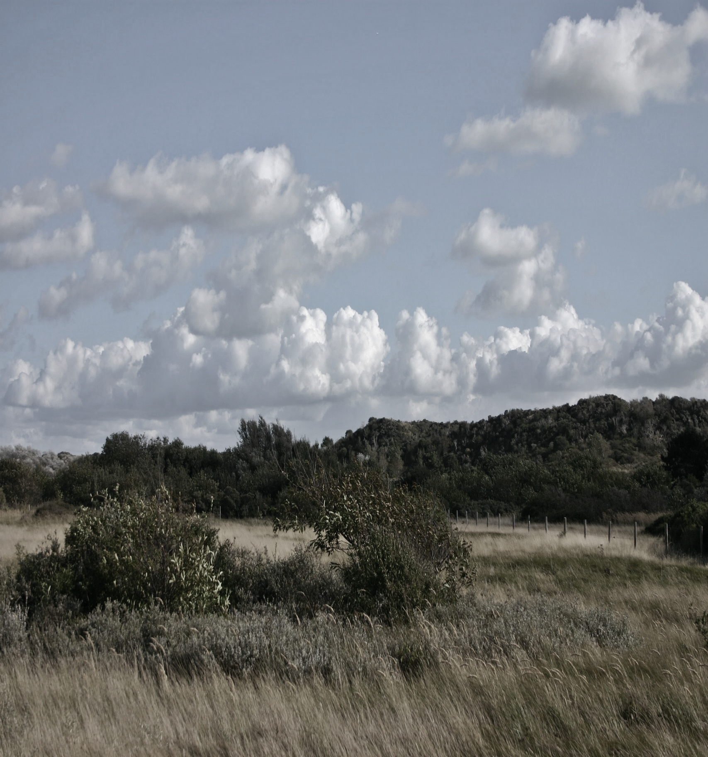

PhD position available
PhD position in soil-plant interactions
Modeling root plasticity
EU-projet RootEd
Doctoral Training Network
Funded for 4 years
Starting Sept 1st, 2023

