Slide 1

Moving Beyond an Academic-Centred Perspective to Understand Impactful Research:
Insights from 15 Years of Practice within a Collaborative University Chair
Laurent Taskin, Lucile Bonnieux, Louise Patesson, Camilla Scola
from UCLouvain (H lab, LouRIM), Belgium

Slide 2
HRM and the need for transdisciplinary research
Despite its applied orientation, HRM remains subject to the research–practice divide.
HRM research is often criticised for being:
  Too abstract and theoretical;
  Difficult to translate into organisational practice and replicate across contexts (Paauwe & Van de Voorde, 2025).
To bridge this gap, Paauwe and Van de Voorde (2025) advocate the co-creation of knowledge between academics and practitioners.
This perspective is consistent with transdisciplinary research, which integrates scientific and practical expertise to address complex organisational and sustainability challenges in real-world settings (Polk, 2015).
Notes:
Literature highlights a persistent isolation between scholars and practitioners (Bansal & Sharma, 2021; Wickert et al., 2020). Consequences include:
Limited practical relevance of research findings (Bansal & Sharma, 2021).
Insufficient contribution of research to addressing major societal and organisational challenges (Mair & Seelos, 2021).
Transdisciplinary Research as a Solution
Academic and organisational actors pursue different objectives:
Scientific publication and theoretical advancement.
Operational effectiveness and business impact.

Slide 3
H lab, a trandisciplinary vector
Humane Management as a shared purpose
A collaborative initiative that brings together academics and practitioners to develop more human-centred forms of management, grounded in recognition, reflexivity, community, and real work (Taskin & Dietrich, 2024).
2. Co-Researching
Research questions emerge from organizational challenges and are jointly explored by practitioners and researchers, ensuring both scientific rigor and practical relevance (Polk, 2015; Paauwe & Van de Voorde, 2025).
3. A learning ecosystem : impact in practice
Over time, H Lab has created a virtuous ecosystem linking research, teaching, and practice, generating knowledge, learning, and concrete HRM innovations for all partners (Mair & Seelos, 2021).
Notes:
HM : In short, Humane Management advocates for an orientation grounded in reflexivity, recognition, attention to real work, and the cultivation of community.
Co-researching : The Chair's partners are consulted in order to submit proposals for topics of interest based on field requirements. The selected themes are translated into research briefs outlining the studies to be conducted. The outcome of this translation work is then discussed again collectively.
A Learning ecosystem : As a university Chair, H Lab constitutes an ecosystem centered not only on research but also on teaching and service to society.

Slide 4
1. A learning ecosystem : Impact in practice
Redefining managers' roles and responsibilities
Research outputs
Investigated the evolving role of managers (2017)
Developed a managerial competencies framework
Learning and impact
HR policy directly informed by the Chair's framework.
Implementation documented jointly by researchers and practitioners (Taskin, 2019)
Translation into HR policy
Redefined what constitutes a good manager
Designed managerial development pathways
Built an assessment framework

Slide 5
2. A learning ecosystem : impact in practice
Training management leaders to Humane Management
Research
Humane Management principles
Research findings and conceptual frameworks
Academic expertise
Learning and impact : Executive Programme
5 co-taught modules
Academic–practitioner pairs
150 trained managers
Alumni community (since 2024)
Practice
Companies' needs
Managers' experience
Organisational challenges
Notes:
we developed an executive training program based on the Chair’s principles: five modules co-led by academic-professional pairs specializing in Humane Management. The programme creates a continuous learning loop where research informs practice, and practitioners' experiences enrich and refine Humane Management.

Slide 6
3. A learning ecosystem : impact in practice
Assessing Humane Management
Research
Humane Management principles and theoretical framework
Conceptualisation of “humane” organisational practices
Translation of principles into evaluative dimensions
Learning and impact:
Humane Management Assessment Tools
Self-assessment tool (co-created)
HM Maturity Index (survey-based)
4 experiential dimensions of HM
Shared and actionable language for partners
Practice
Partner companies’ need for objectification and comparability
Desire for actionable and shared language
Organisational realities and managerial experience
Notes:
This work generates substantial collective learning, and in some cases directly informs HR practices by translating research frameworks into operational tools that make Humane Management observable and actionable.

Slide 7
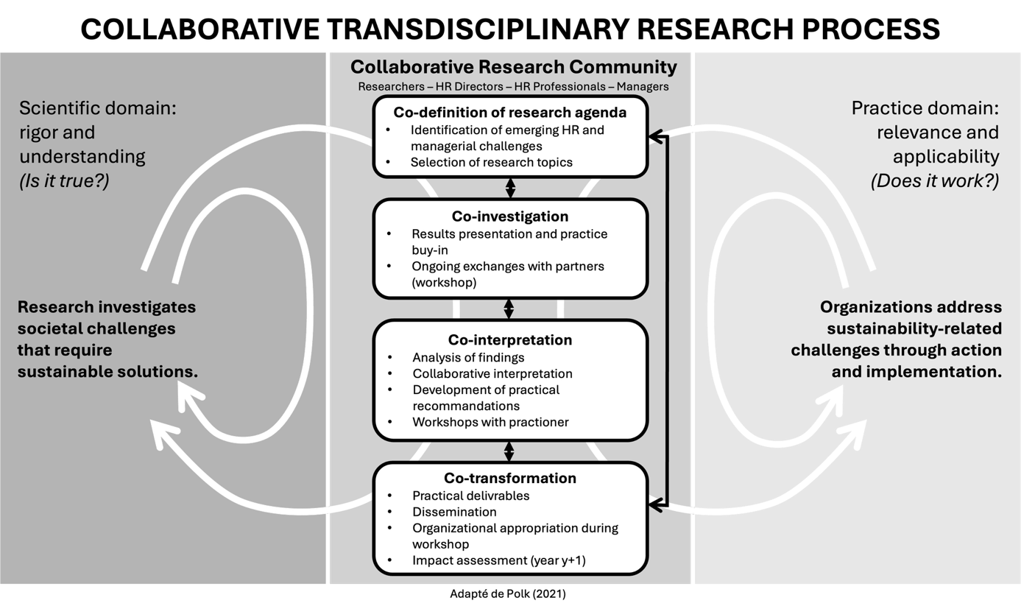
How do we do transdisciplinary research at H lab?
« the term “co-production” was chosen to emphasize the joint responsibility of involved actors as relevant sources of situated and scientific knowledge, “in situ”, context-based, problem solving »
(Polk, 2015 : 111)
Notes:
This approach is also in line with the recommendations of Wickert et al. (2020), who emphasise the importance of researchers adopting a listening posture towards practitioners: this facilitates understanding of the issues and increases the impact of the research results (Bartunek and Rynes, 2014). Once the data has been collected—with access to the field often facilitated by partner organisations (Wickert et al., 2020)—workshops are organised to present the preliminary research findings and, more importantly, to help the research team develop recommendations and practical implications (Wickert et al., 2020). Through workshops and working groups, the research team works with practitioners to co-create concrete, practical and easily applicable solutions (Reineck et al., 2022). The practical knowledge and expertise of practitioners also enable the development of tools that are tailored to the day-to-day operations of organisations (Jarzabkowski et al., 2024). In other words, “co-creating means involving practitioners in the research process to jointly produce knowledge that can solve practical problems” (Bansal and Sharma, 2022, quoted by Williams et al., 2024, p. 14). In terms of deliverables, Paauwe and Van de Voorde (2025) suggest that knowledge transfer must be adapted to the target audience, and the authors suggest using appropriate channels of dissemination (professional publications, training, etc.). In this sense, the H lab offers different ways of communicating results: in addition to research reports, other formats are also available: practical guides, auto-evaluation grids and videos help to popularise the results and recommendations of our research (Wickert et al., 2020). These deliverables often offer practical results that can be quickly implemented by stakeholders (Jarzabkowski et al., 2024)

Slide 8
Being a trandisciplinary researcher
Questions the traditional divide between academic knowledge and practitioners’ expertise by valuing multiple forms of knowing (Alvesson & Sköldberg, 2018).
Builds knowledge through sustained engagement, dialogue, and collective inquiry with practitioners.
Creates spaces of mutual learning (e.g., workshops) where researchers and practitioners jointly explore organizational realities.
Produces hybrid knowledge that combines scientific rigor with practical relevance.
Translates research into accessible formats such as practical guides, videos, and collaborative publications.
Fosters reciprocal learning, where practitioners contribute to the development of scientific understanding.
Redefines the researcher as a reflective partner and boundary spanner, learning with and from practitioners to co-create actionable and theoretically grounded knowledge.
Notes:
Importantly, this approach highlights a reciprocal learning dynamic. It is not only the researcher who brings frameworks to enlighten practice; practitioners actively shape the researcher’s understanding of organizational realities, thereby contributing to the evolution of scientific knowledge itself. Acknowledging this mutual influence invites a redefinition of the researcher’s role in such a transdisciplinary process: not as an expert standing above the field, but as a reflective actor learning ‘with’ and ‘from’ practitioners in the co-construction of actionable and theoretically grounded knowledge.

Slide 9
Conditions for successful transdisciplinary collaboration
Shared purpose and common language : A shared vision and accessible communication align academic and professional actors.
Leadership involvement : Strong support and legitimacy from decision-makers sustain engagement and collaboration.
Organizational learning : Collective learning promotes systemic change beyond individual development.
Long-term horizon : Sustained partnerships enable trust-building, knowledge maturation, and lasting impact.
Genuine relationships : Trust and informal exchanges create social bonds necessary for sincere knowledge sharing.
Notes:
The engaged leaders (and the organizations they commit) seek to take part in this movement of renewal. Humane Management acts as a unifying element—the common purpose—but also as a source of attraction and a way of working, insofar as partners find it intellectually and practically stimulating to participate in a research lab that refines and develops this proposition while contributing to the development of internal reflexions or practices

Slide 10
Bibliography
Alvesson, M., & Skoldberg, K. (2018). Reflexive methodology: New vistas for qualitative research (3rd ed.). London: Sage
Bartunek, J.M., & Rynes, S.L. (2014). Academics and Practitioners Are Alike and Unlike: The Paradoxes of Academic–Practitioner Relationships. Journal of Management, 40 (5), 1181–1201.
Bansal, P., & Sharma, G. (2022). Three Different Approaches to Impact: Translating, Cocreating, and Performing. Business and Society, 61 (4), 827–832.
Jarzabkowski, P., Bednarek, R., Chalkias, K., Cacciatori, E., Kavas, M., Krull, E., & Gallagher Rodgers, R. (2024). Translating, co-creating, and performing: Reflections on a 15-year journey for impact into the grand challenge of disaster insurance. Strategic Organization, 23 (1), 79–97.
Legge, K. (2005). Human Resource Management, Rhetorics and Realities. London: Palgrave.
Mair, J., & Seelos, C. (2021): Organizations, Social Problems, and System Change: Invigorating the Third Mandate of Organizational Research. Organization Theory, 2 (4), https://doi.org/10.1177/26317877211054858.
Paauwe, J., & Van De Voorde, K. (2025). Bridging the research-practice gap in modern human resource management. Human Resource Management Review, 35(2), 101076.
Taskin, L. & Dietrich, A. (2024). Management Humain, Une perspective renouvelée de la GRH et du comportement organisationnel. Brussels: De Boeck supérieur

