Slide 1
Simulation of soil-plant processes: from single roots over 3D root architectures to crops and vegetation types.
Jan vanderborght¹, Andrea Schnepf¹, Guillaume Lobet ¹, Mathieu Javaux ¹, Valentin Couvreur² , Felicien Meunier³, Xiaorang Zhou¹, and Harry Vereecken¹
¹Agrosphere Institute, IBG-3, Forschungszentrum Jülich GmbH, Germany
²Earth and Life Institute, UC Louvain, Belgium
³ Computational and Applied Vegetation Ecology lab, Ghent University, Belgium

Slide 2
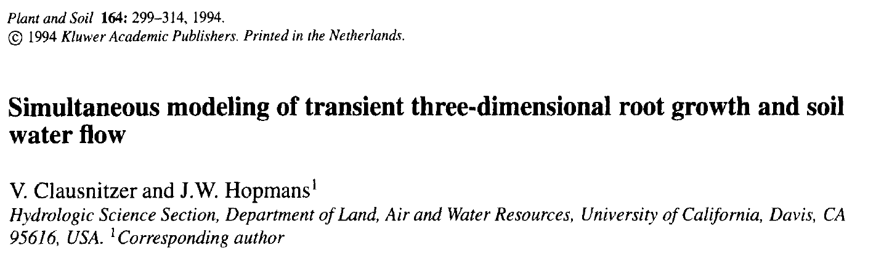
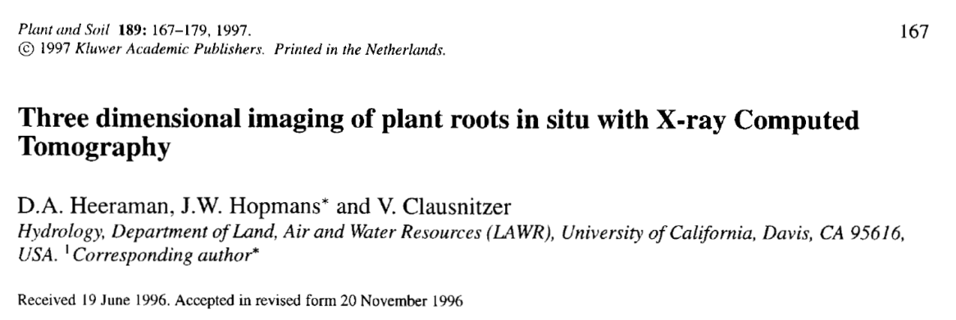
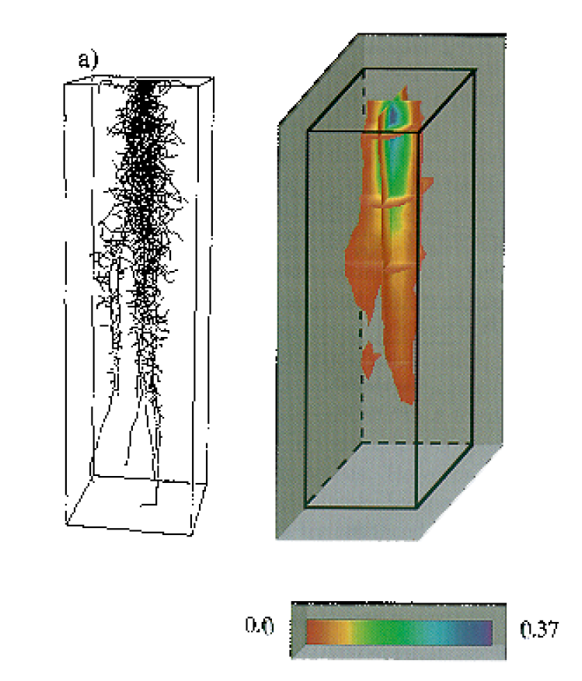
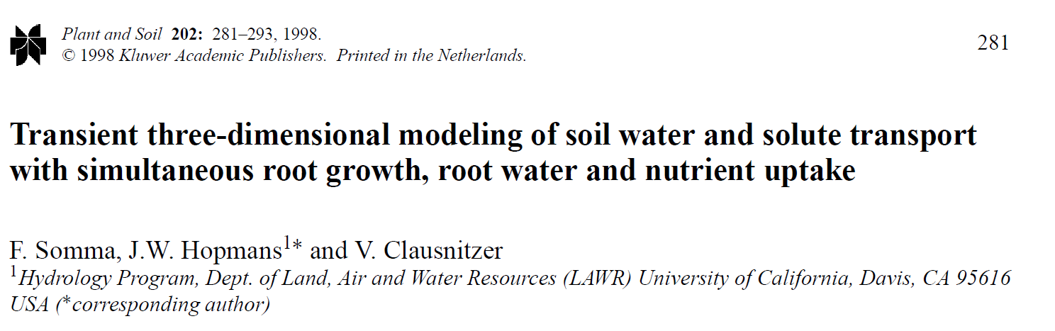
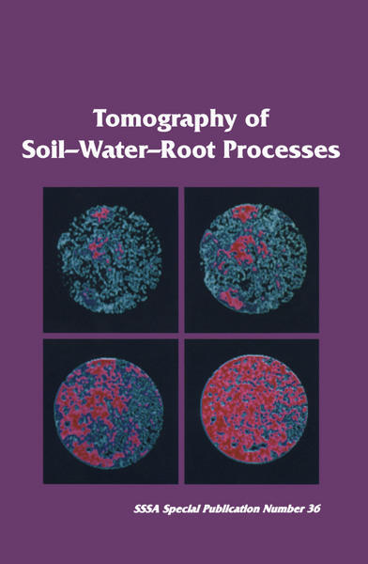
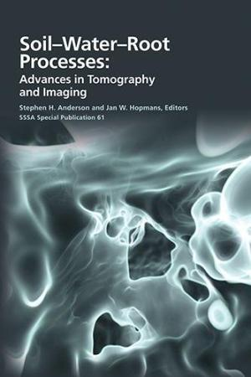
Inspired by Jan Hopmans

Slide 3
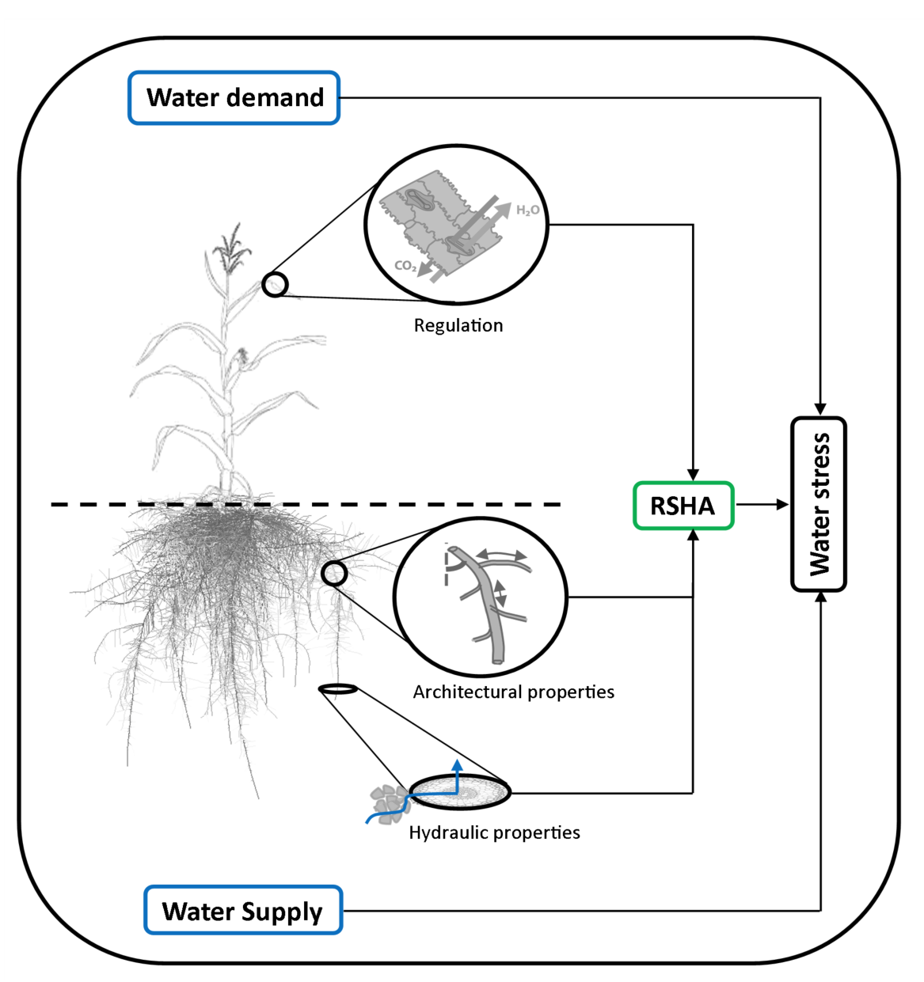
Introduction
Root functioning (water uptake and nutrient uptake) depends on the multiscale structure of the plant root system.
Cell tissues determine hydraulic properties of root segments, which may change over time due to aging.
At the larger scale of organisation, the amount of root segments and how they are connected define the root system architecture (RSA).

Slide 4
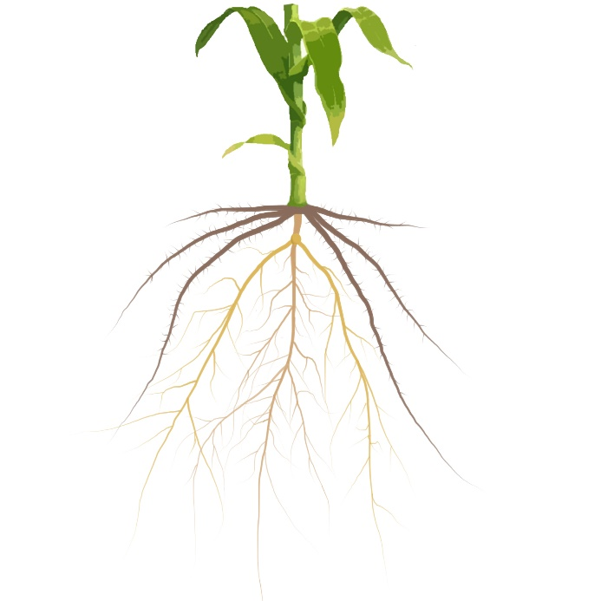
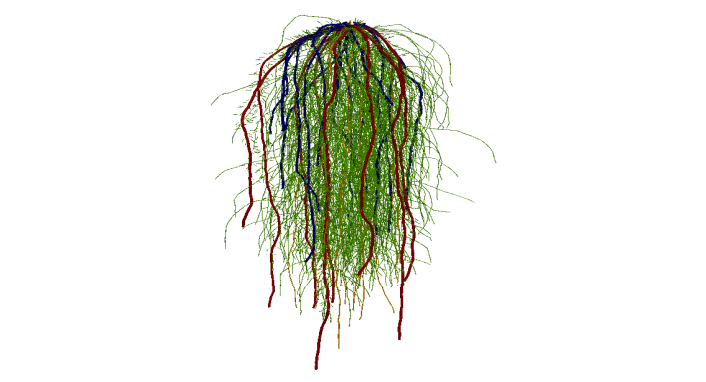
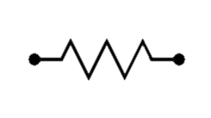
Overall framework
From root traits to effective representations in soil-plant-atmosphere models
Evaporative demand
Root traits
Plant effective representation
+ Spatial extent (SUF)
Water dynamics
Water fluxes
Transpiration
Plant/soil water potentials
Krs
Soil/rhizosphere

Slide 5
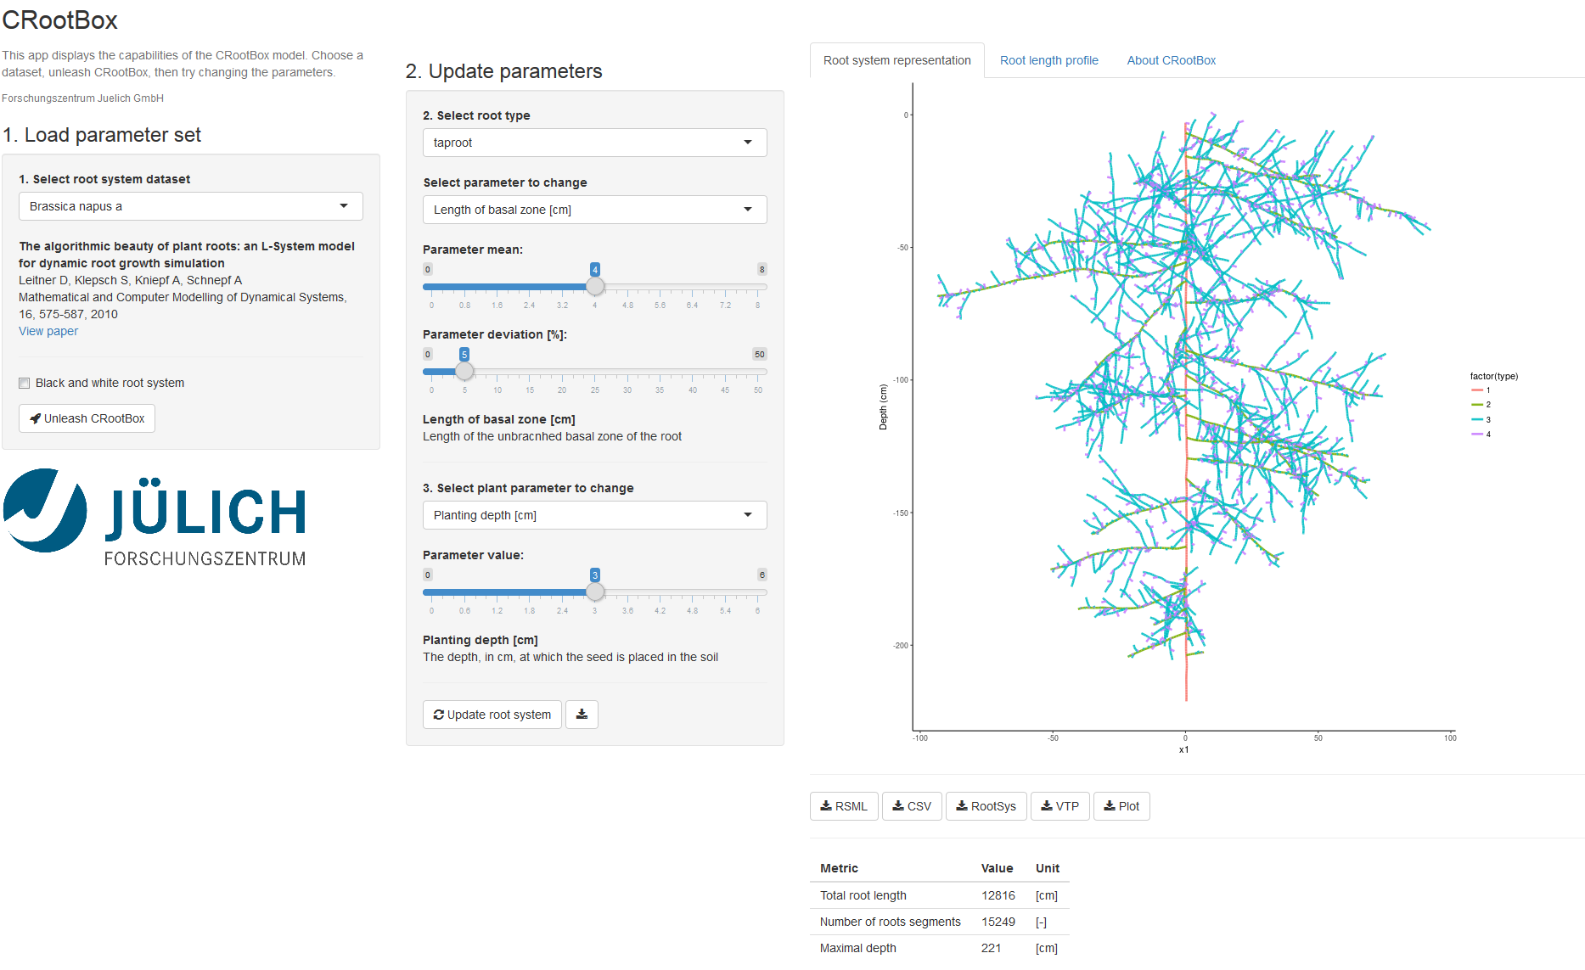
Crootbox: Root system structure/Architecture
https://plantmodelling.shinyapps.io/shinyRootBox/

Slide 6
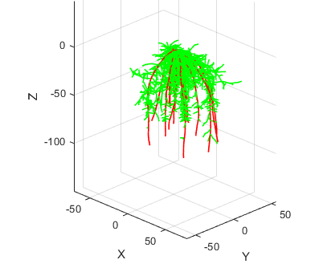
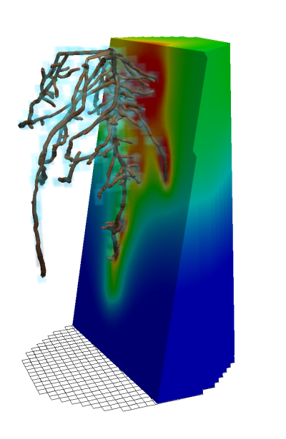
Crootbox+RSWMS/DUMUX
Functional Structural Root Model
CRootbox
Root architecture
RSWMS/DUMUX
Water fluxes in the soil-root system
Schnepf et al., Ann Bot, 2018
Javaux et al., VZJ, 2008
Koch et al., 2018

Slide 7
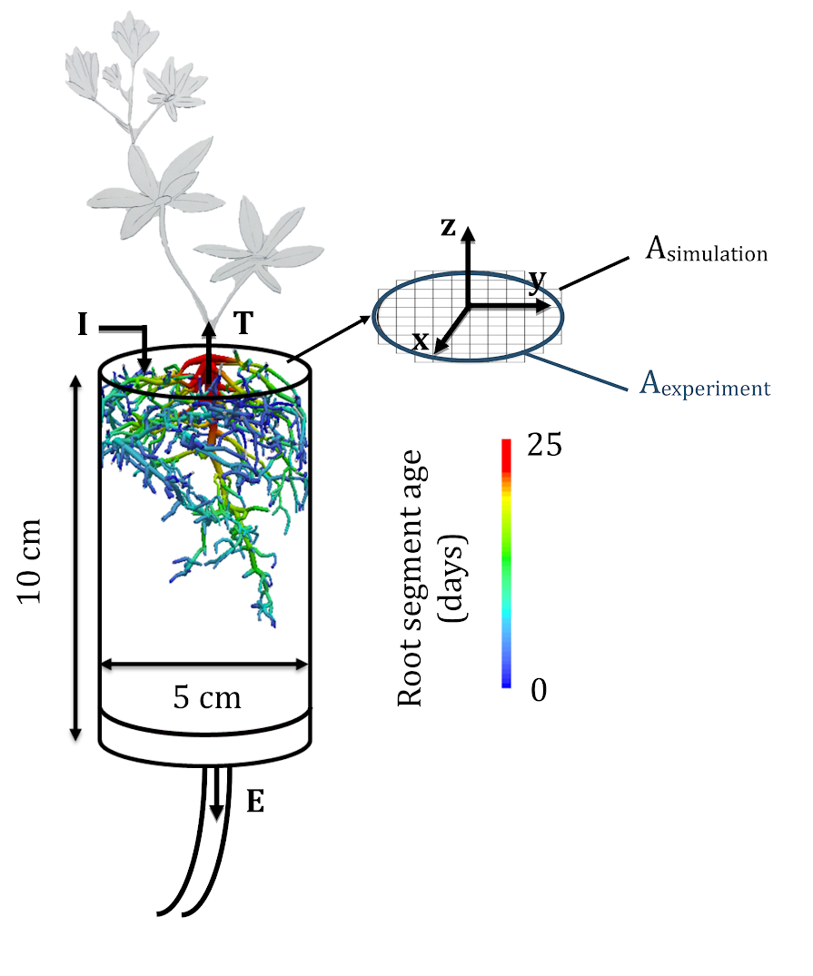
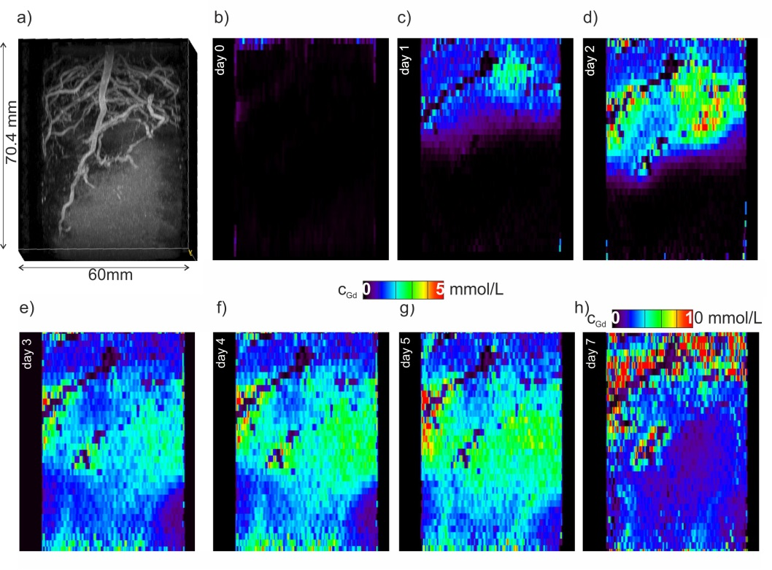
Functional Structural root Imaging using MRI
Interpretation of experimental data and derive root hydraulic properties
Haber Pohlmeier et al., WRR, 2018

Slide 8
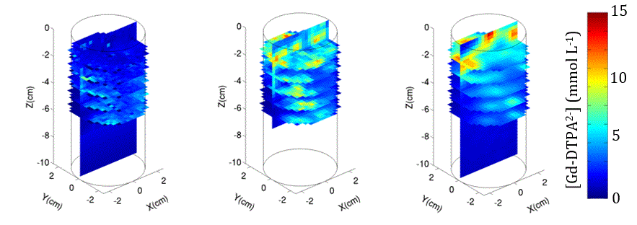
Validation and Parameterization
Small scale experiments (column scale) to validate model concept
Gd concentration distribution at day 5
(initial condition for simulation)
MRI imaged Gd concentration at day 7
Simulated Gd concentration at day 7
Koch et al., J Exp Bot, 2019

Slide 9
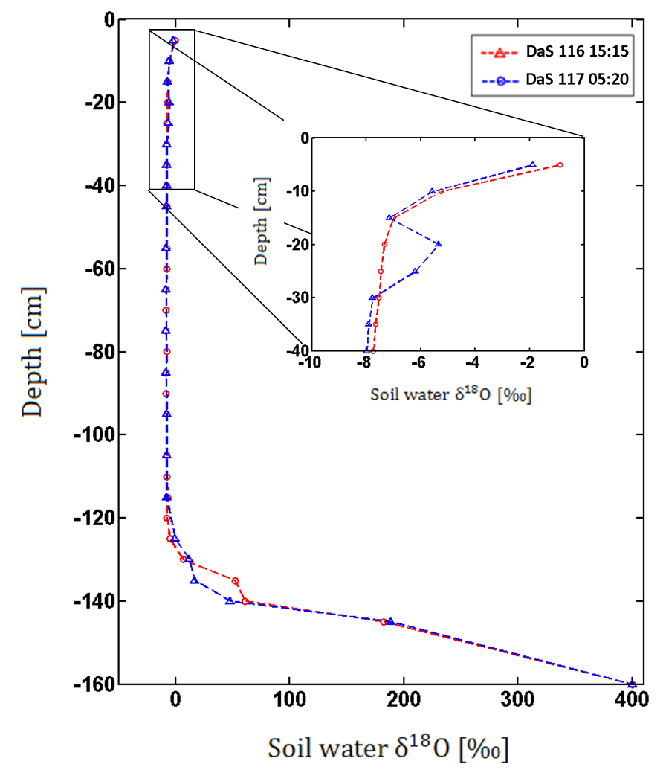
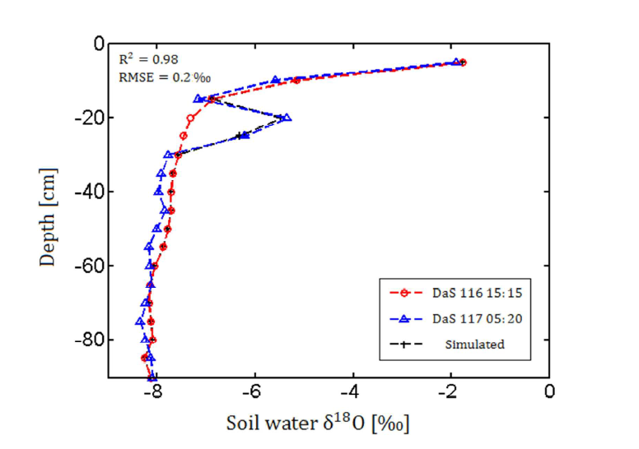
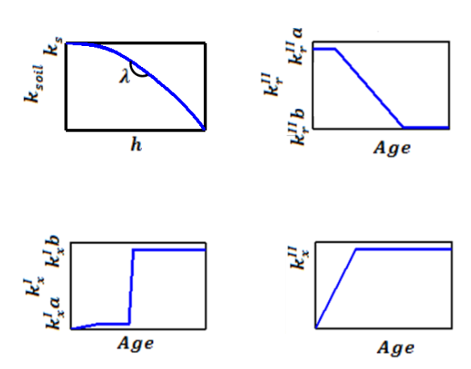
Validation and Parameterization
Meunier et al., VZJ, 2018

Slide 10
General Root Model
Uptake for uniform water potential
Sum of all elements in this vector=Tact
Compensatory uptake
Sum of all elements in this vector=0.

Slide 11
Scaling Up
Identify regions (for instance soil layers) in which the soil water potential is quasi uniform.
Group all root segments in layers and sum up terms in the SUF vector and C₆ matrix
Σ
Σ
Σ
Σ
Σ
Σ
Σ
Σ
Σ
Σ
Σ
Σ
Σ
Σ
Σ

Slide 12
Comparison of different RWU models
General
Parallel root
Big root
Total uptake
Plug and play functions for land surface models (CLM), crop models (Lintul, AgroC), soil hydrological models (Hydrus)

Slide 13
Comparison of different RWU models
Root architecture of different plants generated with CRootbox
Maize
Sunflower
Grass

Slide 14
Comparison of different RWU models
Root segment hydraulic properties and soil water potential distribution
0
Radial
Axial conductance
ψ_{s}
ψ (cm)
-3000
-4000
ψ_{col}
Lr
0
Depth

Slide 15
Comparison of different RWU models
SUF and sink term distributions
Maize
Sunflower
Grass

Slide 16
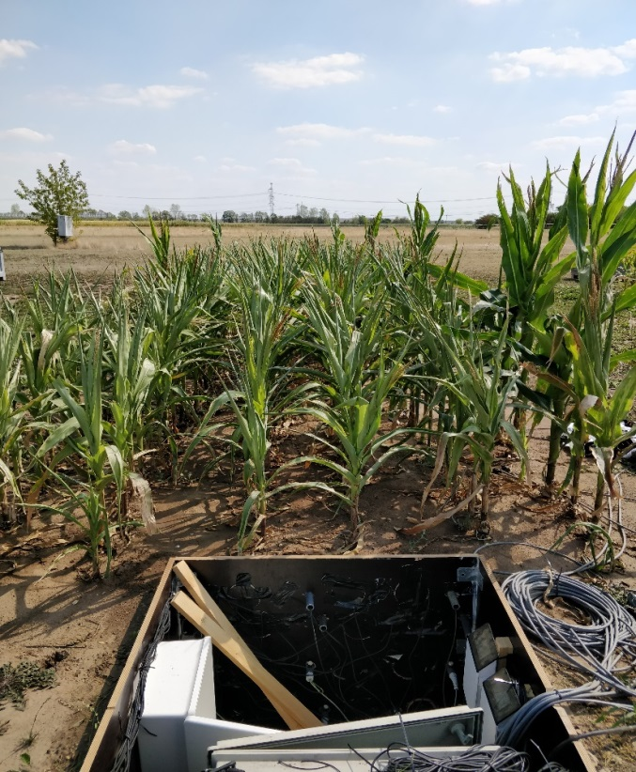
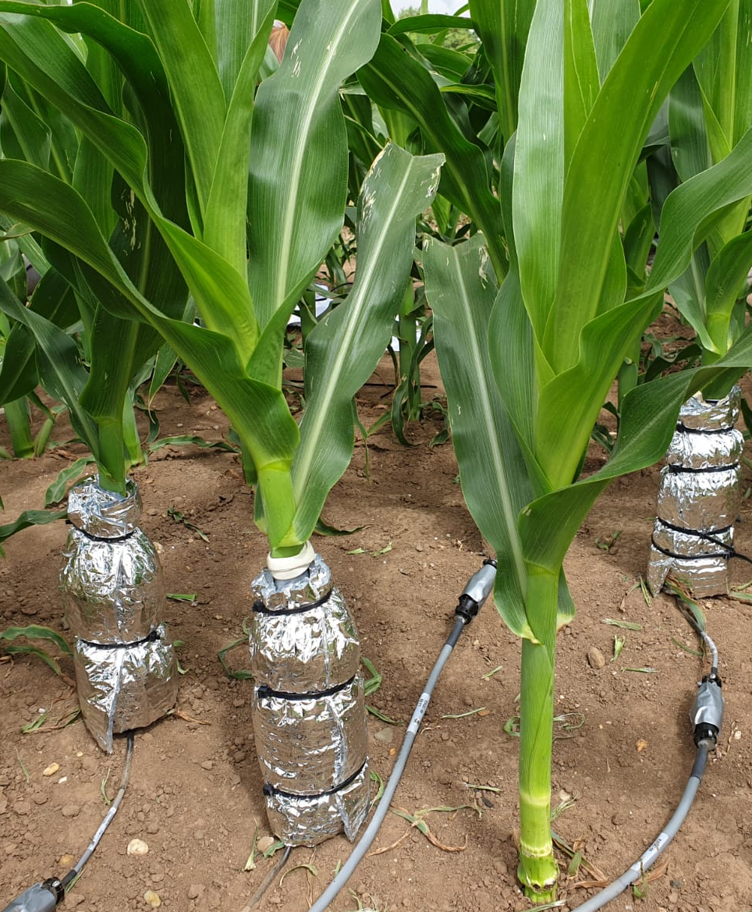
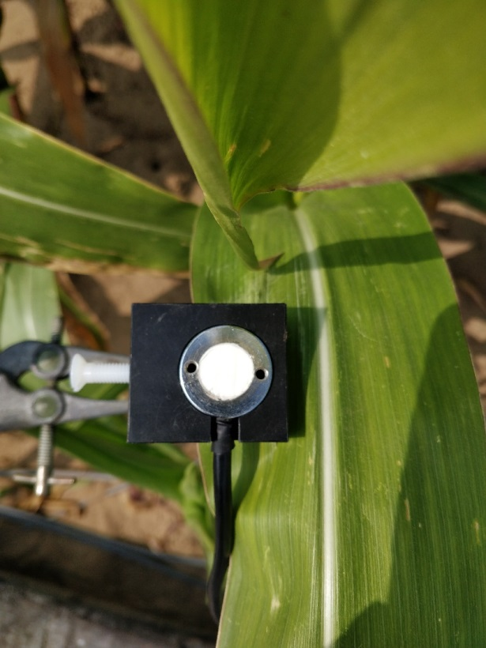
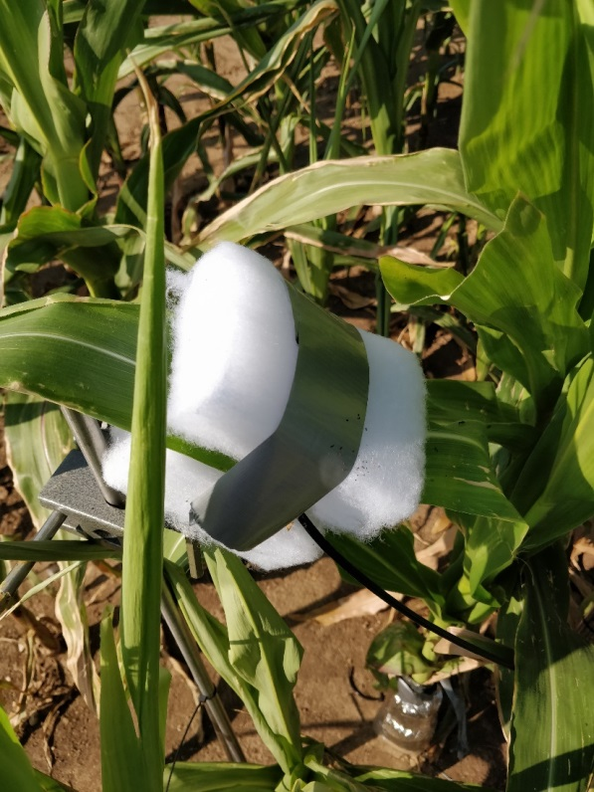
Measuring Leaf Water potential and Sap Flow

Slide 17
Coupling with crop growth models
Root system develops over time and depends on soil hydrological conditions → also Krs.
Crop model to predict root development → Krs +SUF → upscaled FSPM→ plant stress
Thuy Huu Nguyen et al. submitted

Slide 18
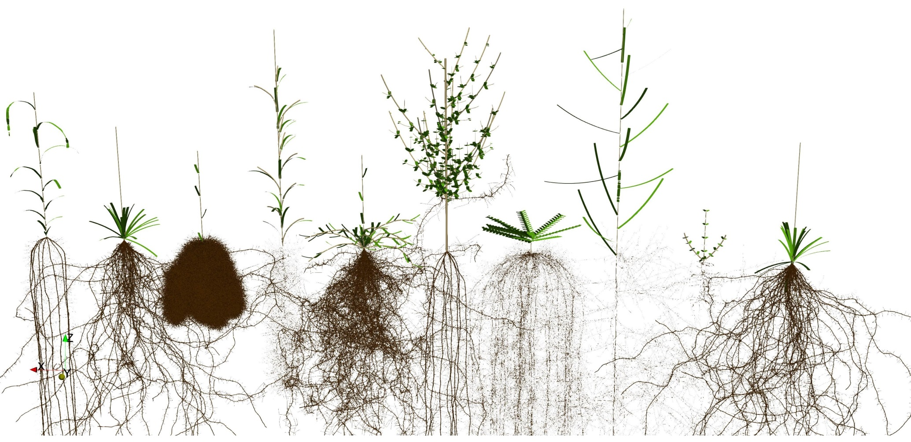
Outlook: Cplantbox
Functional structural modeling of coupled water and carbon transport in plants

Slide 19
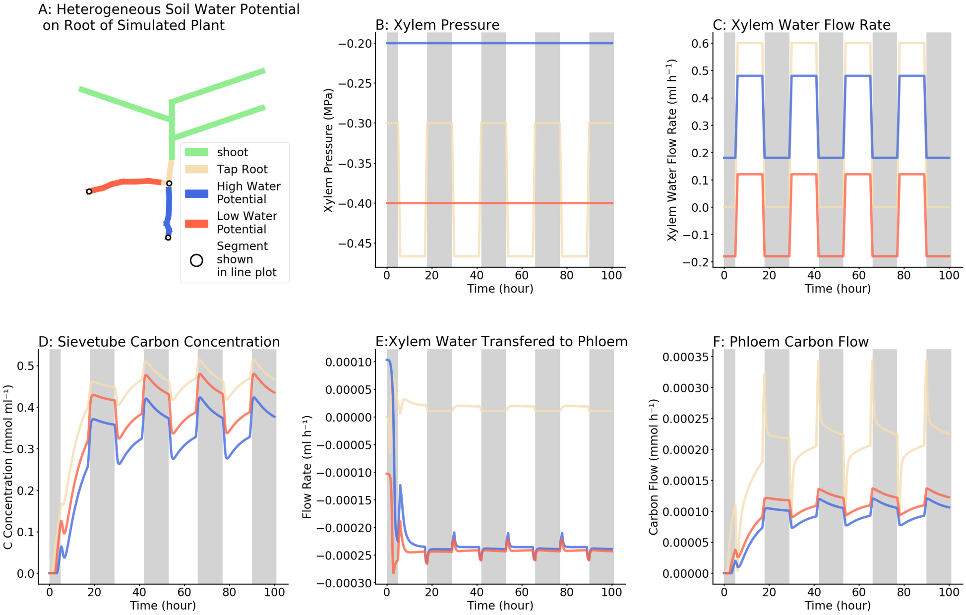
Outlook: Cplantbox
Functional structural modeling of coupled water and carbon transport in plants

Slide 20
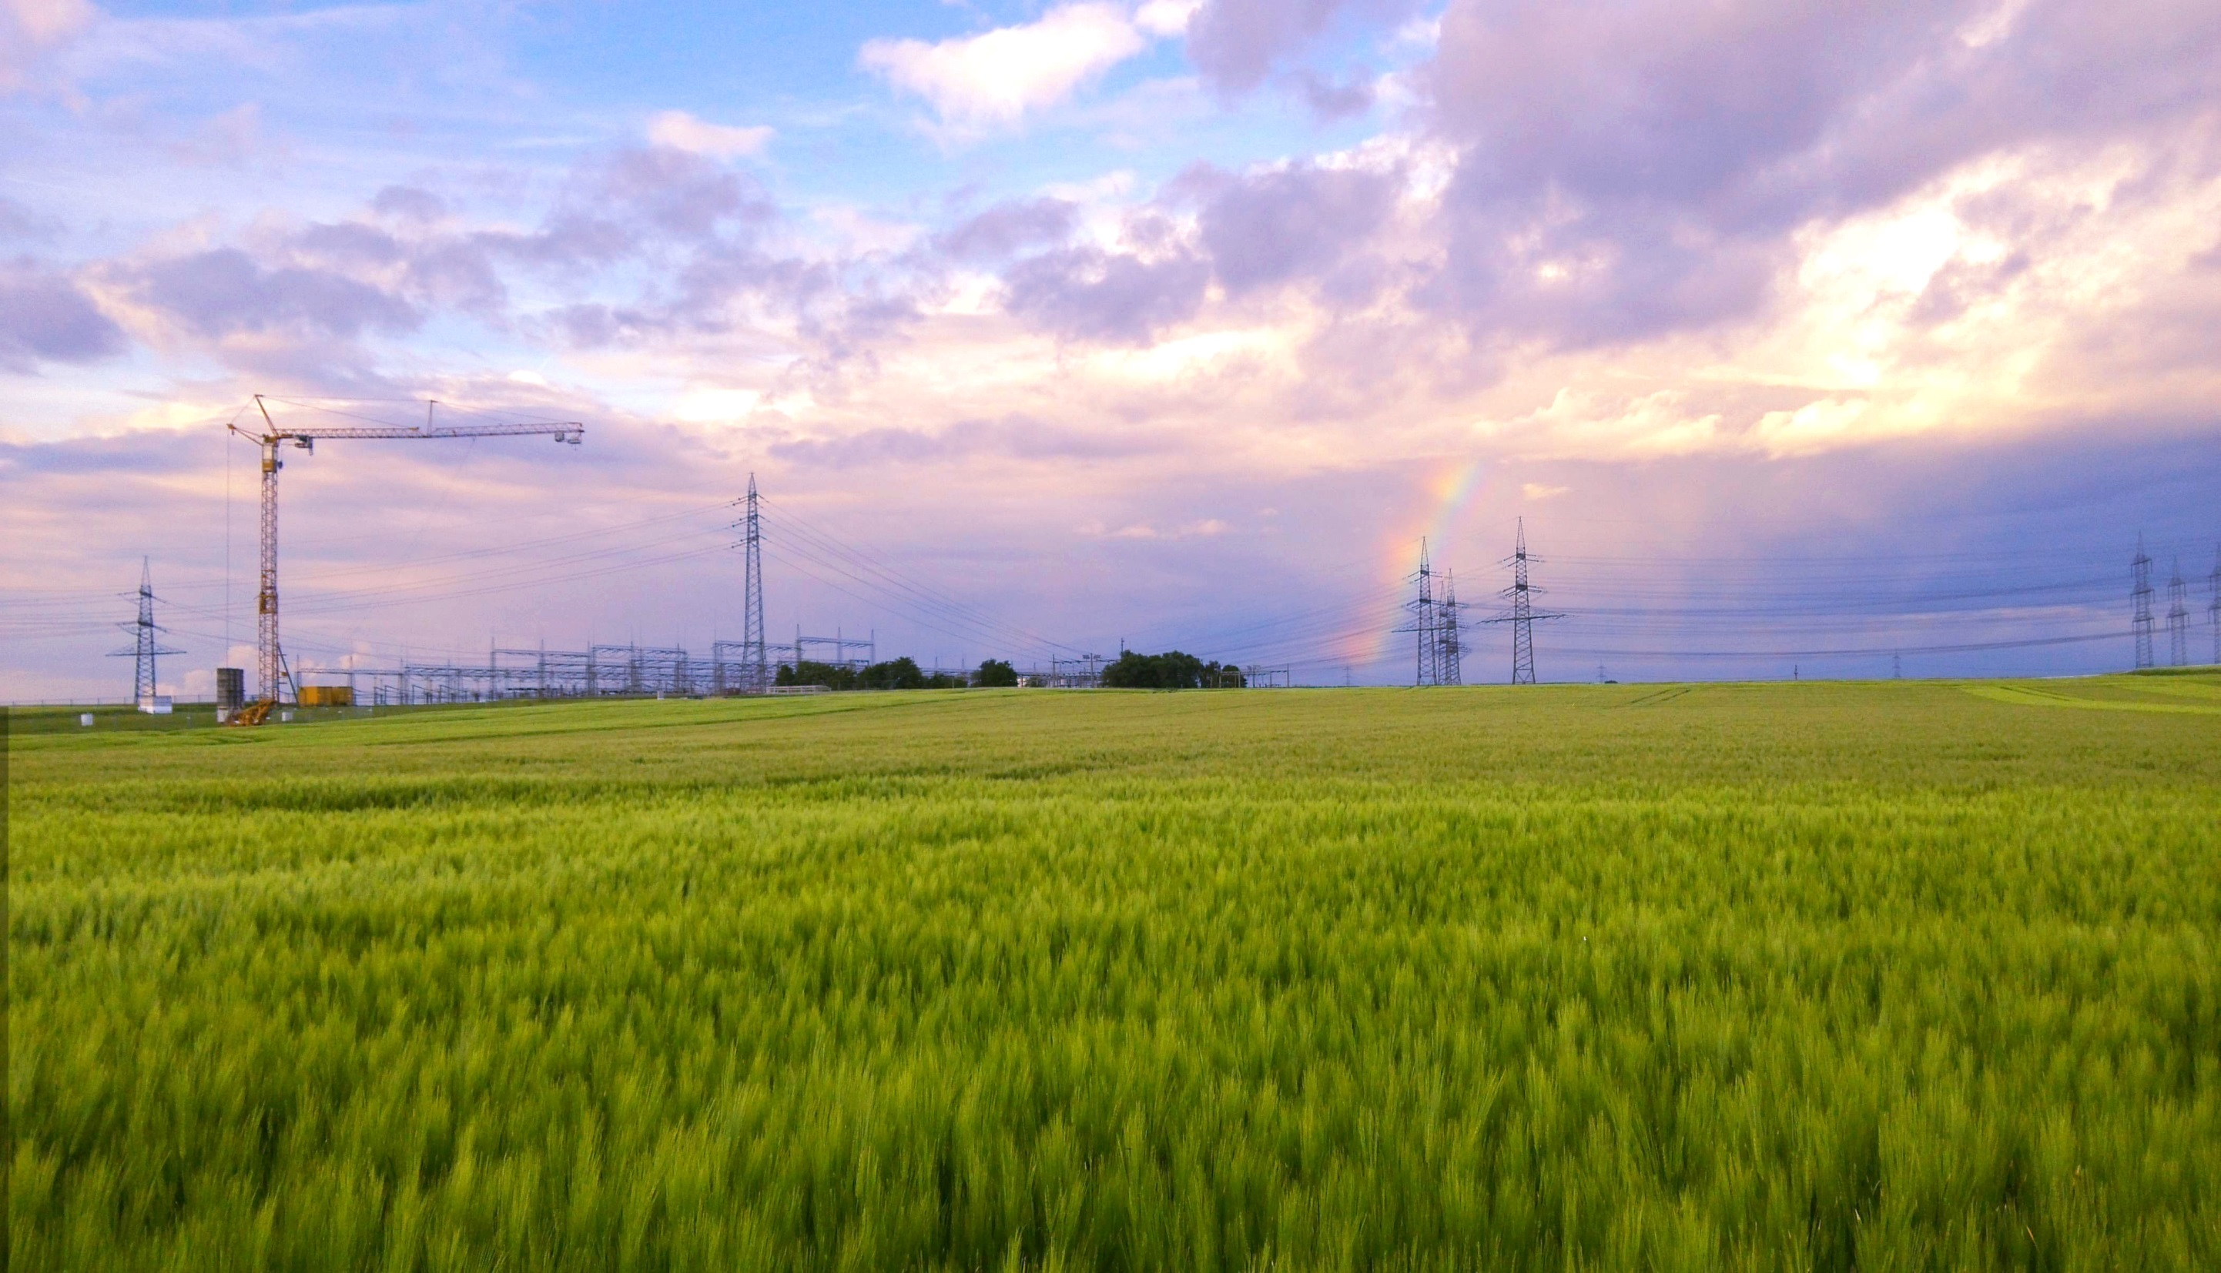
Thank You !

Slide 21



Thank You
Acknowledgements:
Project B4 of DFG funded SFB TR32:
Project P3 of DFG Priority Program “ Rhizosphere Spatiotemporal Organisation – a Key to Rhizosphere Functions” (SPP 2089)
FNRS - grant FC 84104

