Slide 1



The different colours
of water
in Belgium
APNU lecture
12/10/23
M. Vanclooster, UCLouvain – Earth and Life Institute
Notes:
I’ll addres the issue of water quality in agricultural systems in my presentation.

Slide 2
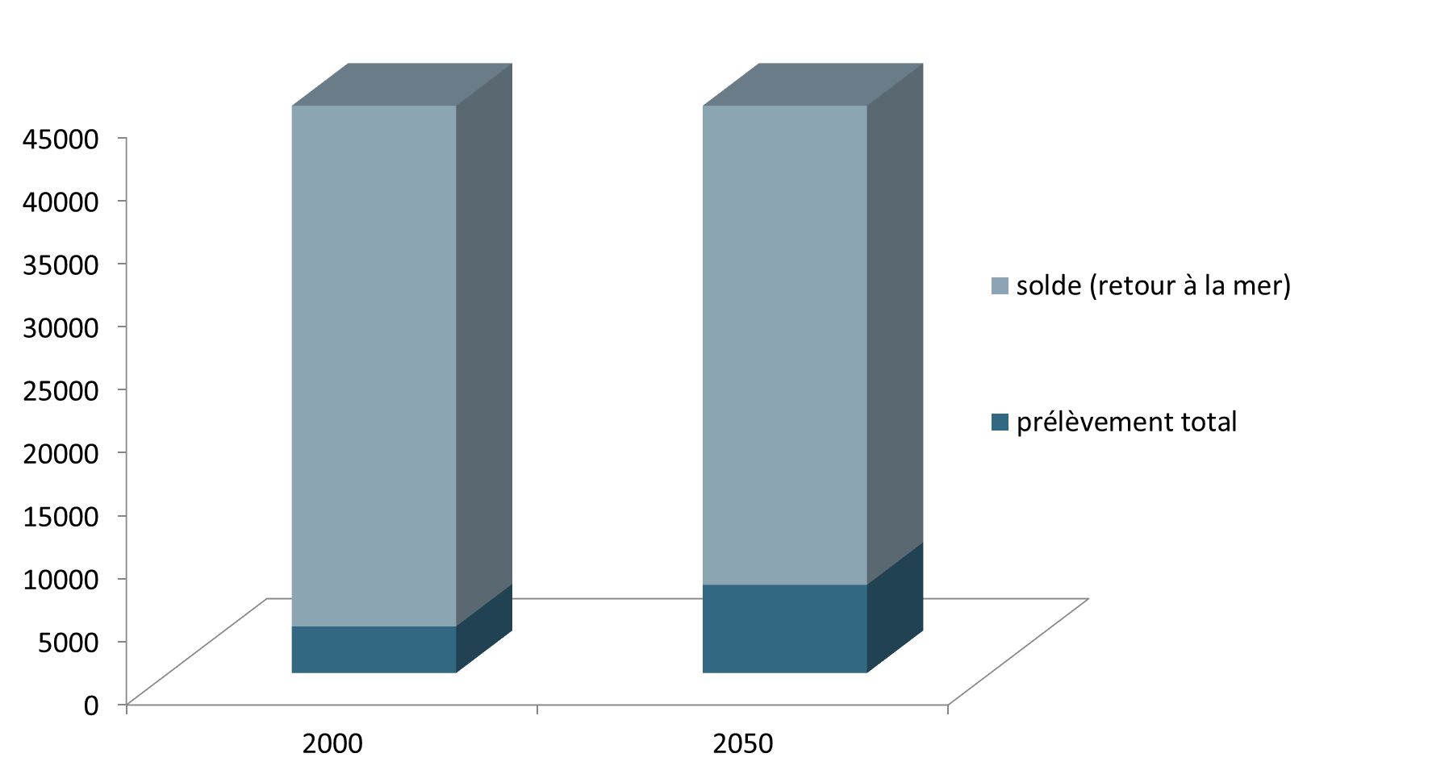
Global water use
km³/year

Slide 3
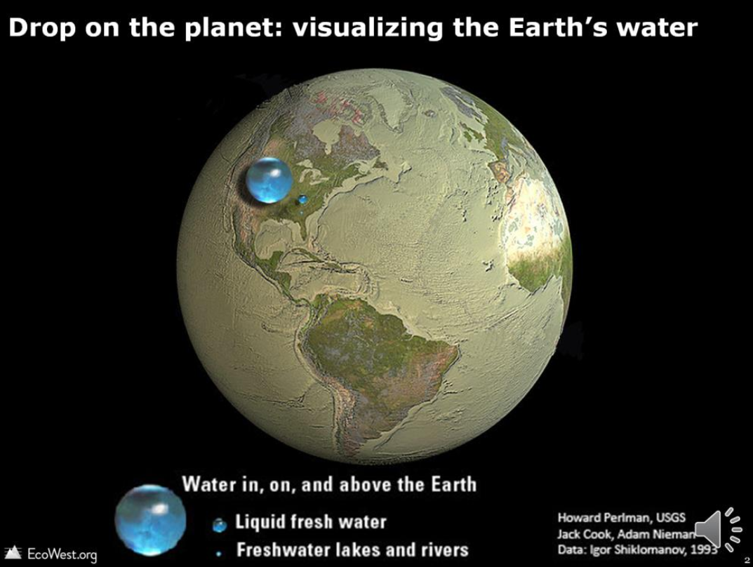
Global water availability

Slide 4
The multi-dimensional aspects of water in Belgium
Water is a multifunctional natural resource
Water is blue, green, grey, salt, fresh, virtual
Water is strongly impacted by Climate Change
Water is essential for economy and jobs
Water is at risk
Water is cross-cutting theme in the development agenda

Slide 5
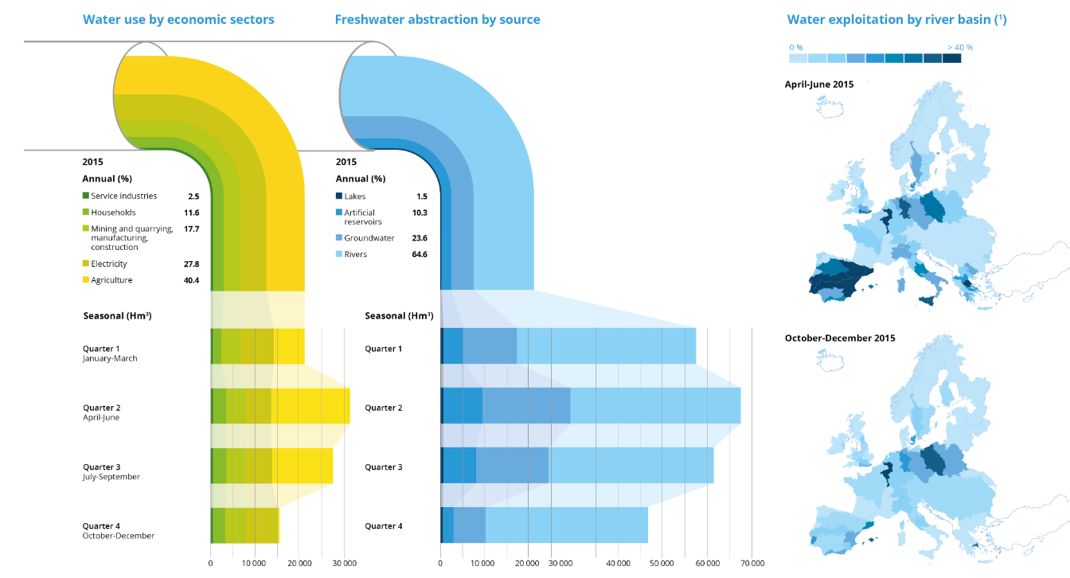
Water use in Europe
Source:Water use in Europe — Quantity and quality face big challenges, EEA, 2018 (update 2023)

Slide 6
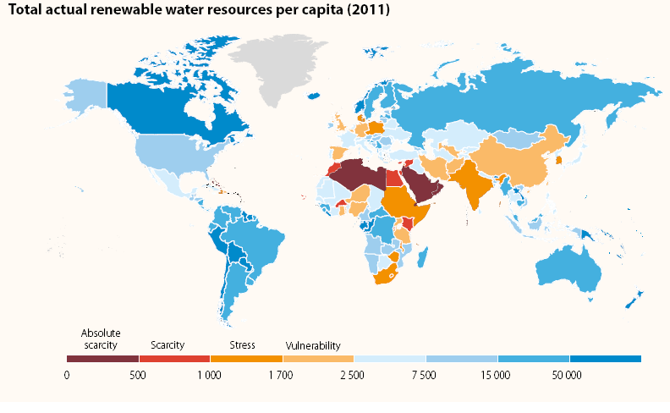
Belgium has water stress
Source: Renewable water per country, WWDR, 2014

Slide 7
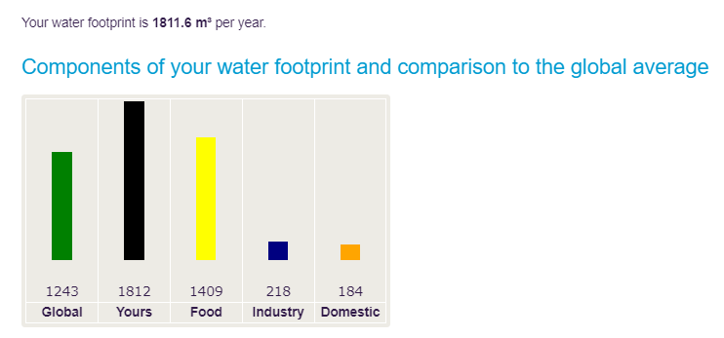
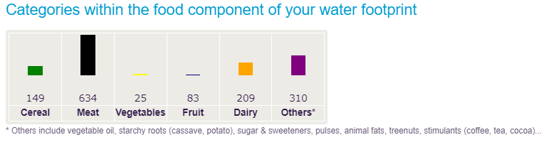
Belgian water foot print
Source: https://www.waterfootprint.org/resources/interactive-tools/personal-water-footprint-calculator/

Slide 8
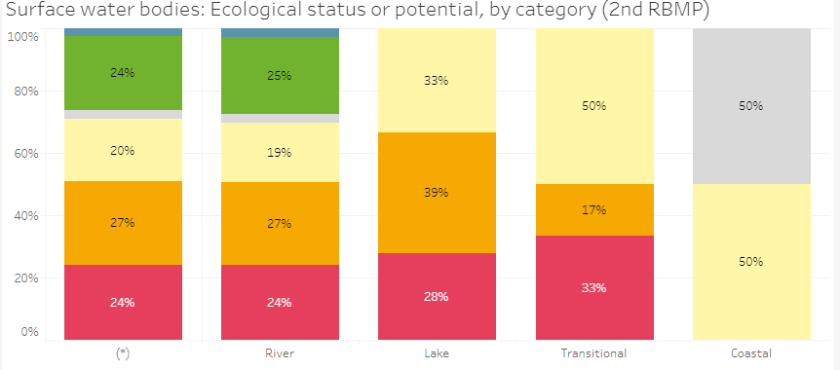
Belgian water quality
Source: https://water.europa.eu/data-maps-and-tools/

Slide 9
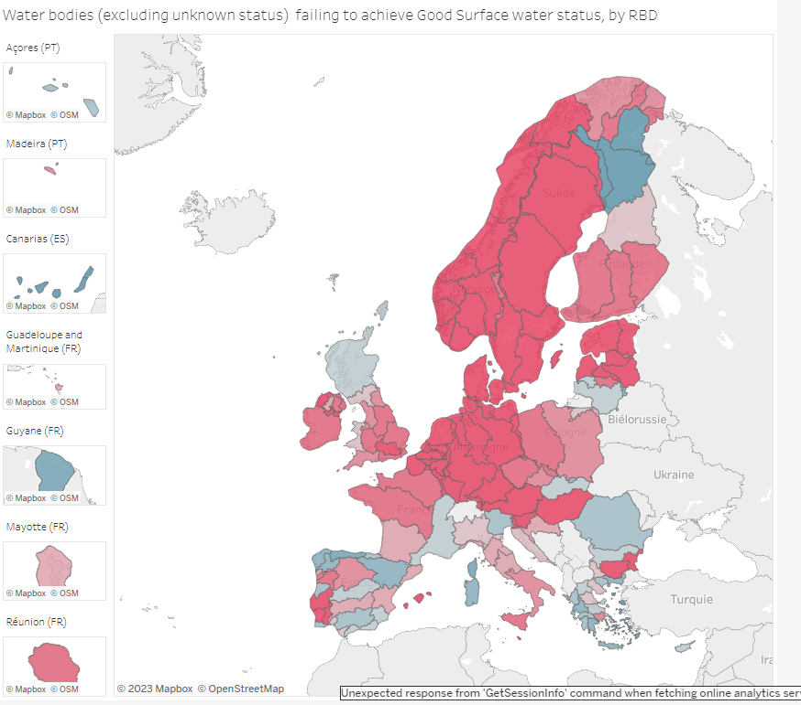
European water quality
Source: https://water.europa.eu/data-maps-and-tools/

Slide 10
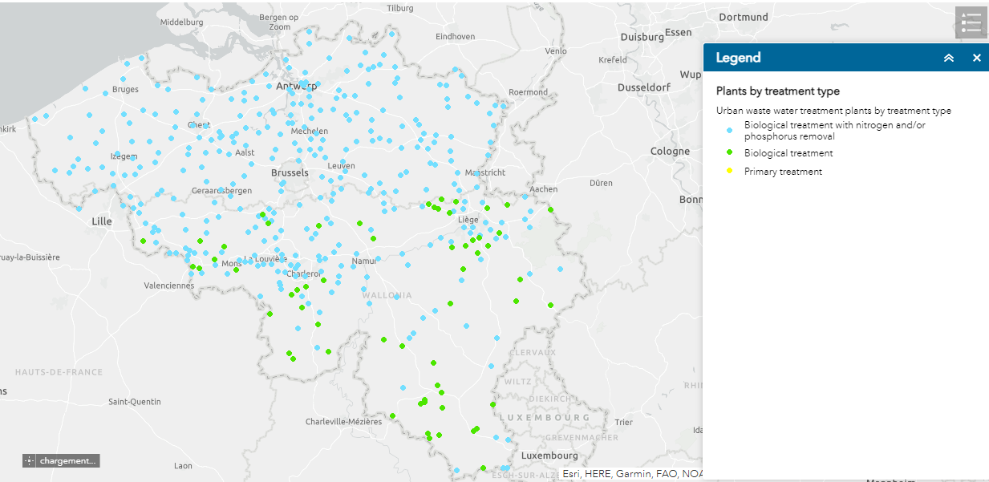
Belgian grey water
Source:https://water.europa.eu/freshwater/countries/uwwt/belgium

Slide 11
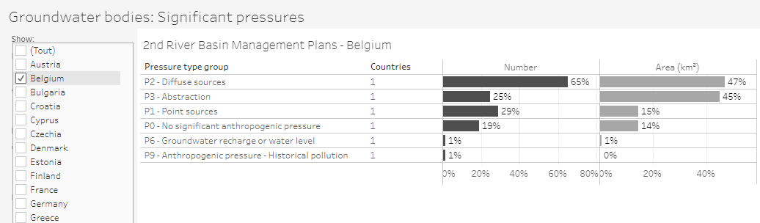
Belgian groundwater pressures
Source: https://water.europa.eu/data-maps-and-tools/

Slide 12
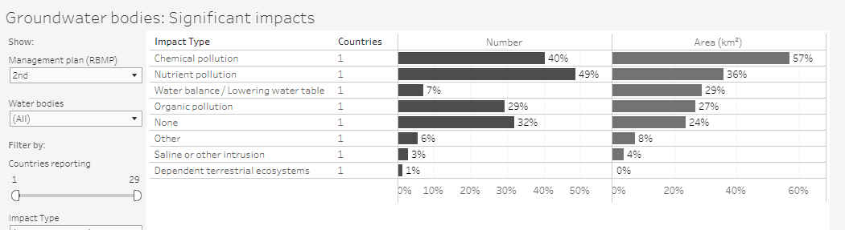
Belgian groundwater: impacts
Source: https://water.europa.eu/data-maps-and-tools/

Slide 13
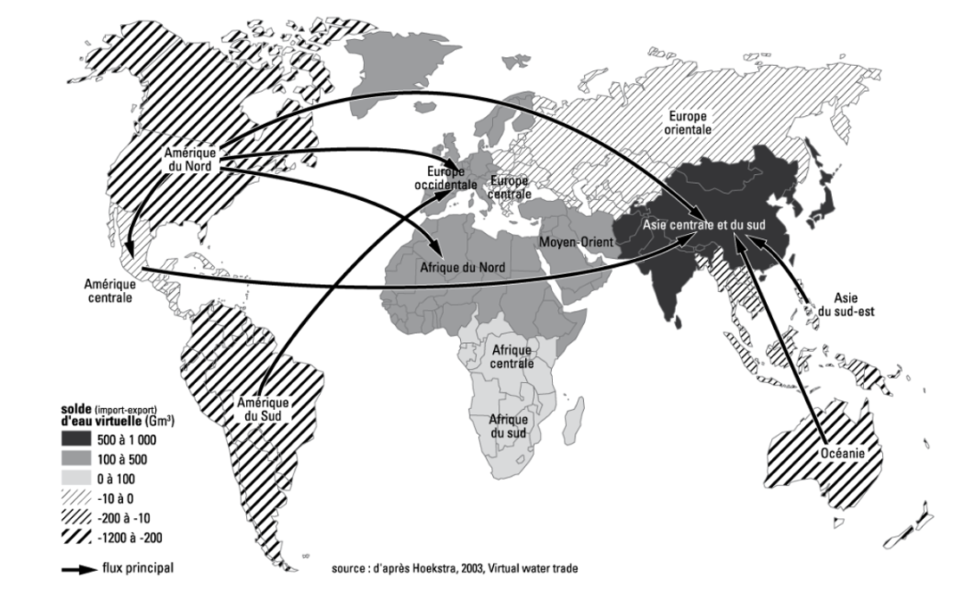
Virtual water trade to Europe (and Belgium)
Source: Hoekstra, 2003

Slide 14
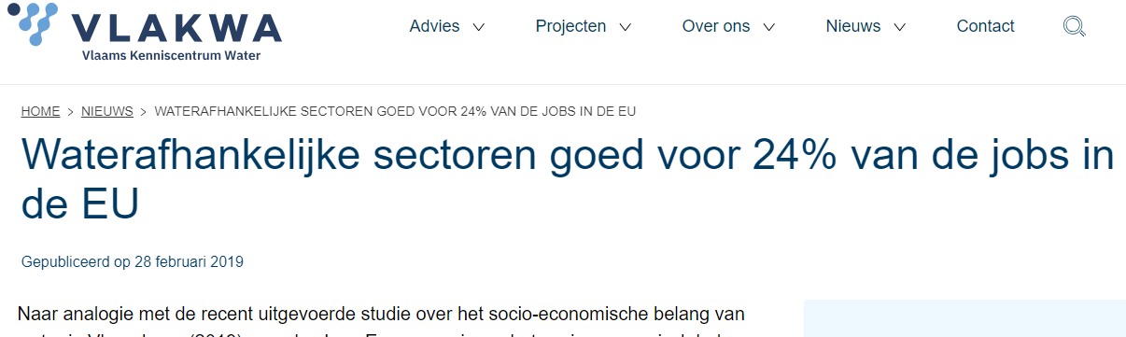
Economic value of water in Europe
Source: https://vlakwa.be/nl/nieuws/waterafhankelijke-sectoren-goed-voor-24-van-de-jobs-de-eu

Slide 15
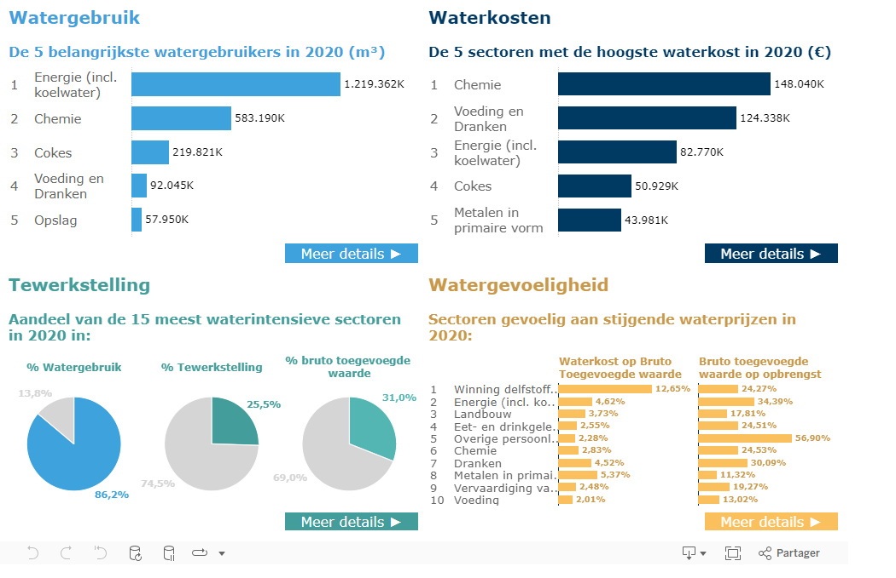
Economic value of water in Flanders
Source: https://vlakwa.be/nl/nieuws/waterafhankelijke-sectoren-goed-voor-24-van-de-jobs-de-eu

Slide 16
Unesco – International Hydrological Program (IHP): IX Phase (2022-2029)
Scientific Research and Innovation
Water Education for the Fourth Industrial Revolution including Sustainability
Bridging the data and knowledge gaps
Integrated and Inclusive Water Resources Management under conditions of global change
Water Governance based on science for mitigation, adaptation and resilience

Slide 17
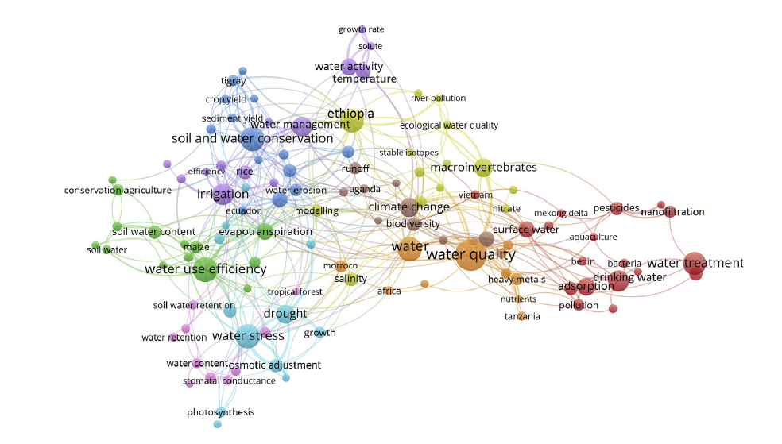
Priority 1: Scientific research on water in Belgium
Source: Long et al., 2002. Journal of cleaner production

Slide 18
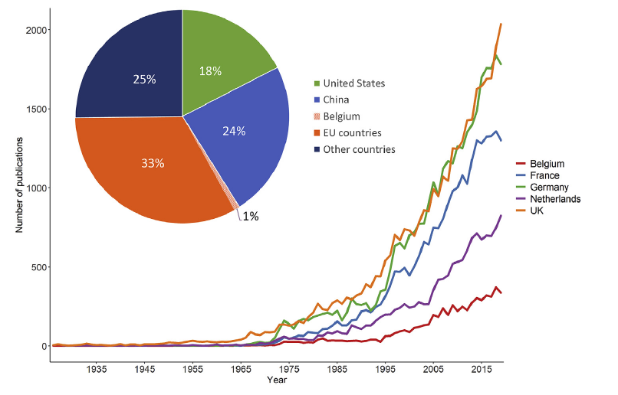
Scientific research on water in Belgium
Source: Long et al., 2002. Journal of cleaner production

Slide 19
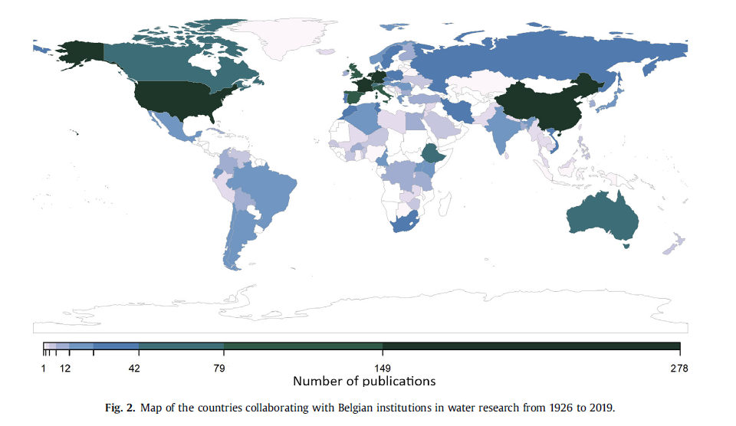
Scientific research on water of Belgian researchers
Scientific research on water of Belgian researchers
Source: Long et al., 2002. Journal of cleaner production

Slide 20
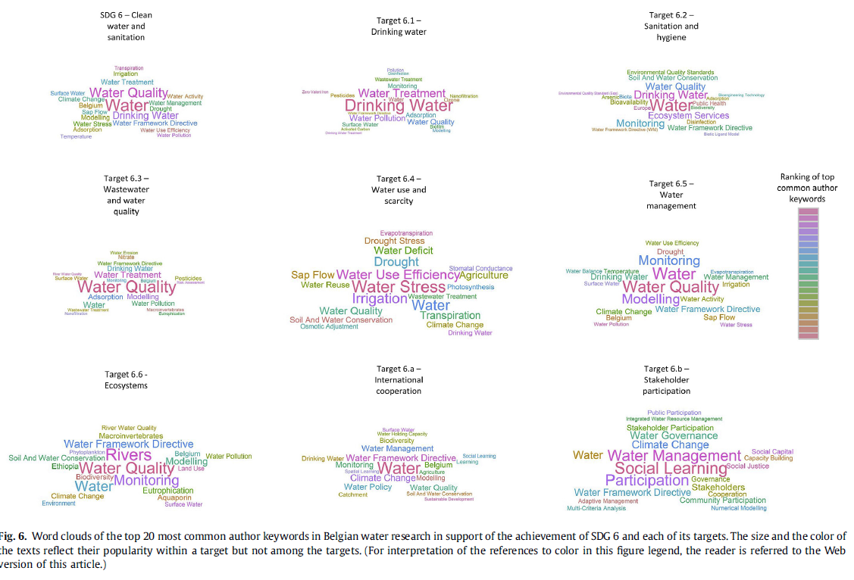
Belgian water research in support of reaching the Sustainable Development Goal-6
Source: Long et al., 2002. Journal of cleaner production

Slide 21
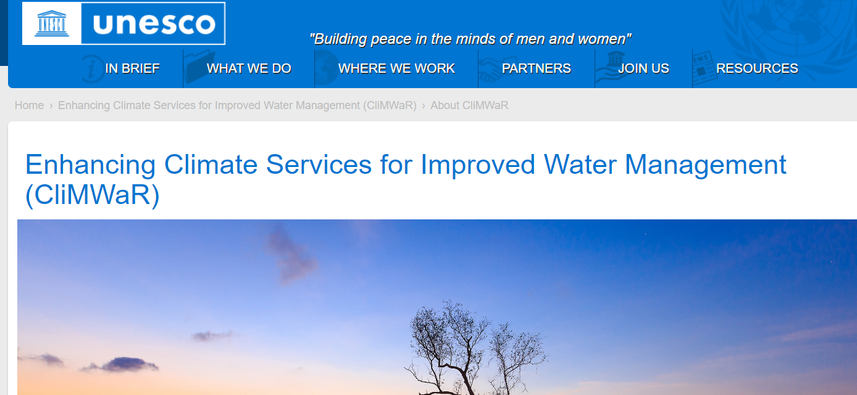
Unesco Flanders – FUST - IHP

Slide 22
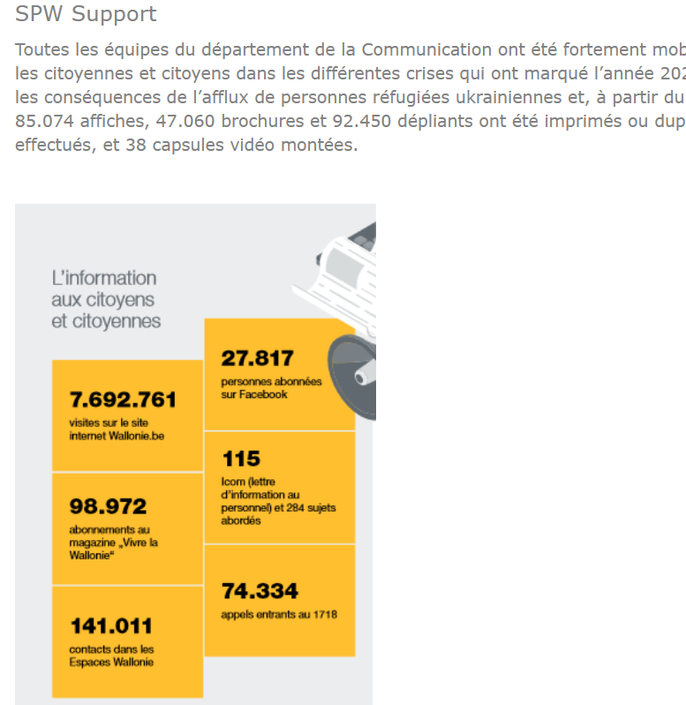
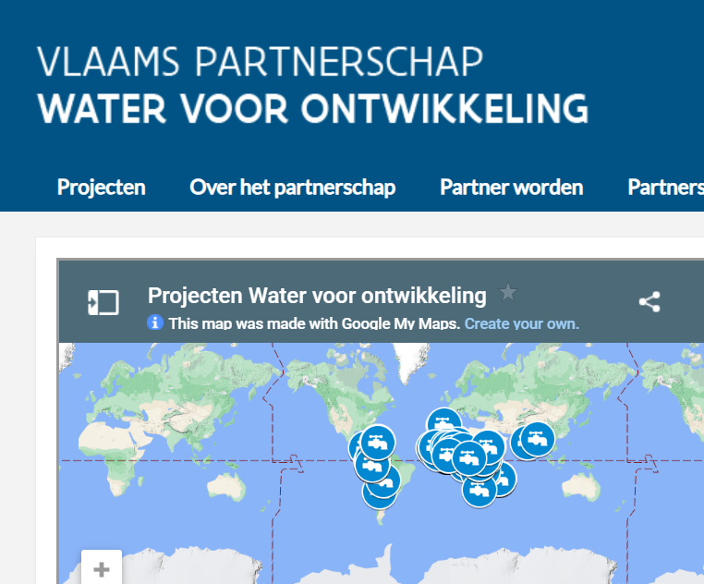
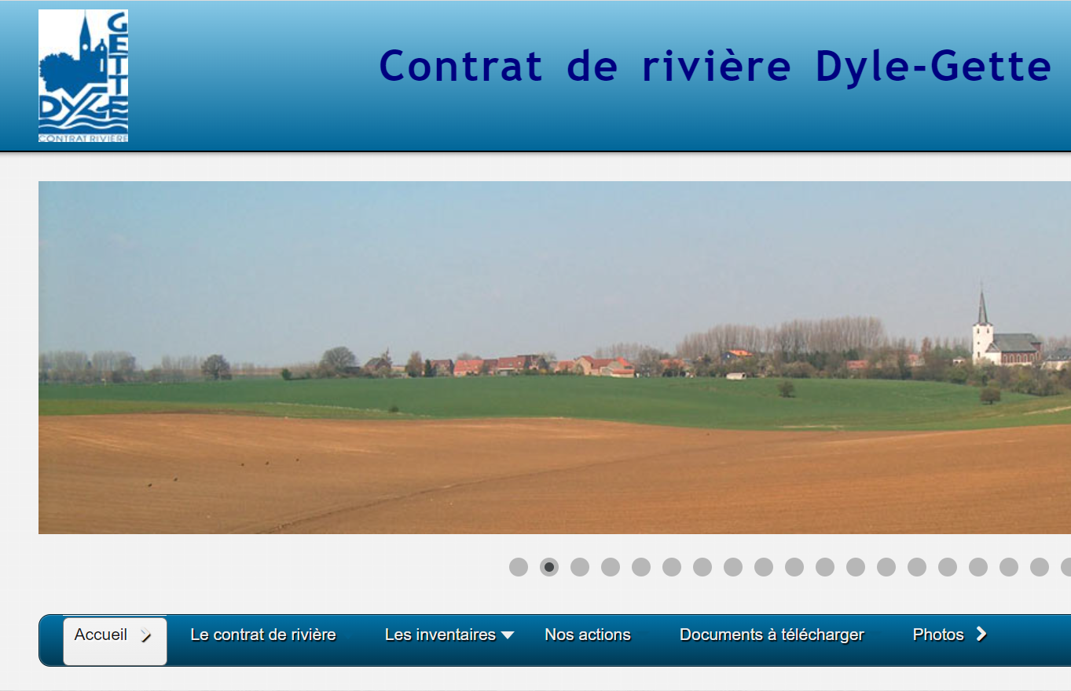
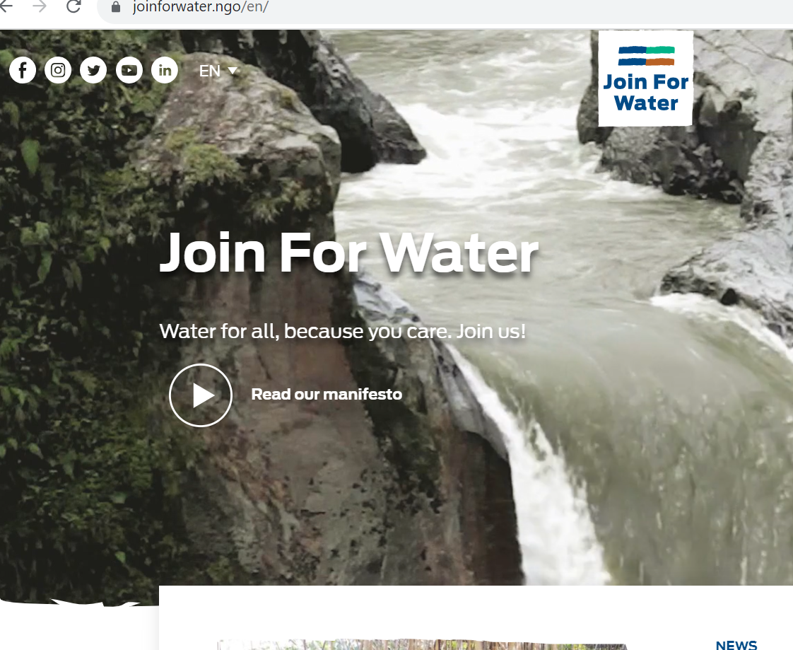
Priority 2: Water education and training

Slide 23
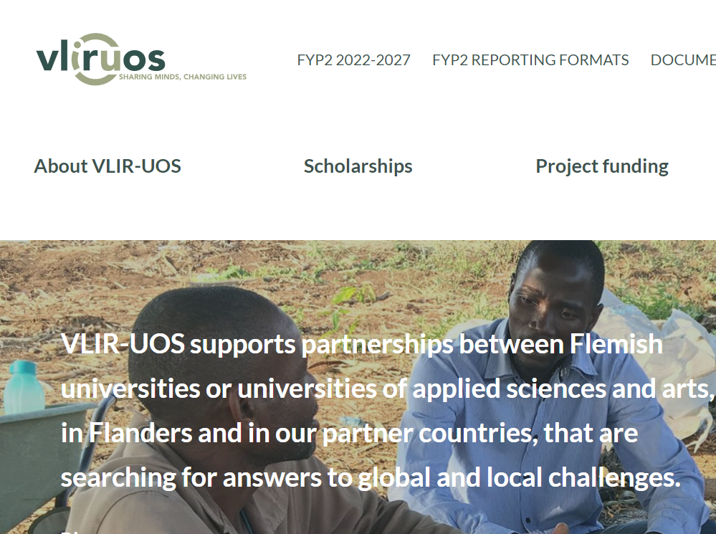
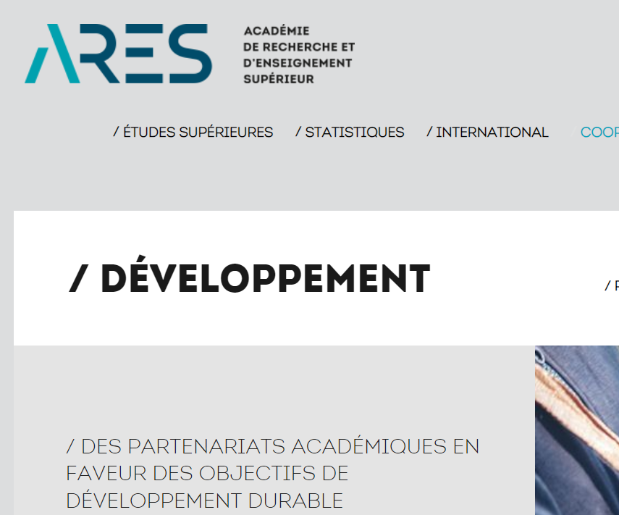
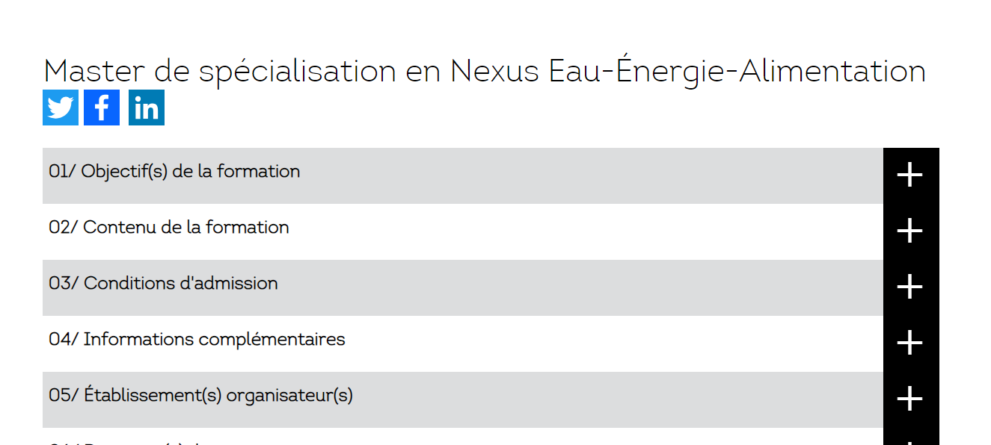
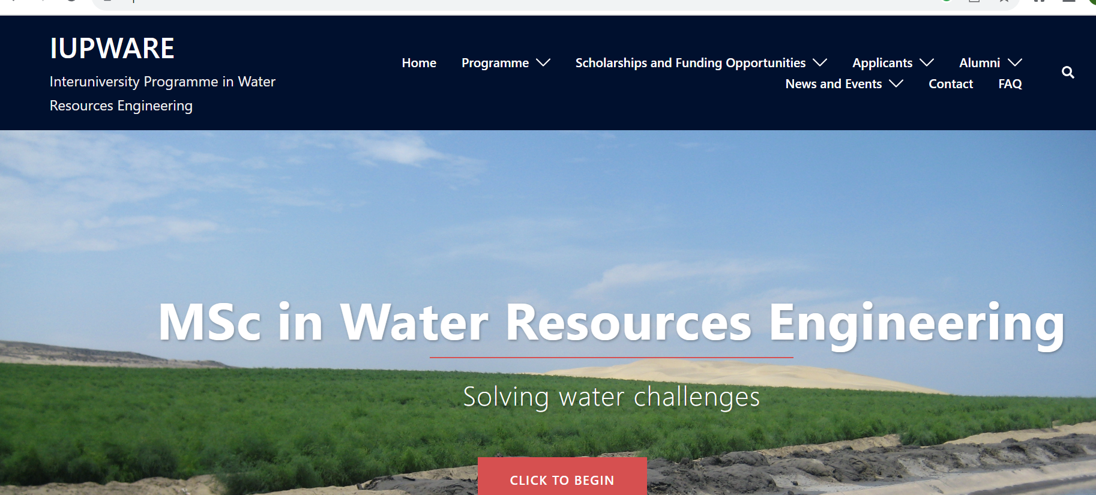
Water education and training

Slide 24
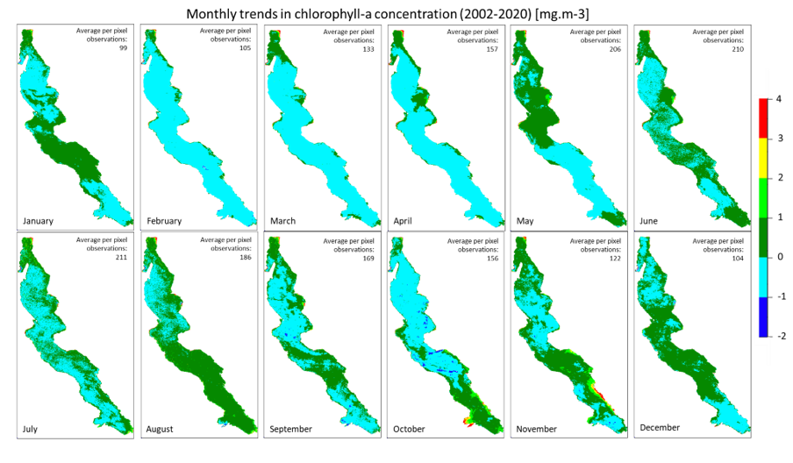
Priority 3: Bridging data gaps:
Remote Sensing
Source: Toussaint et al., 2023. In preparation

Slide 25

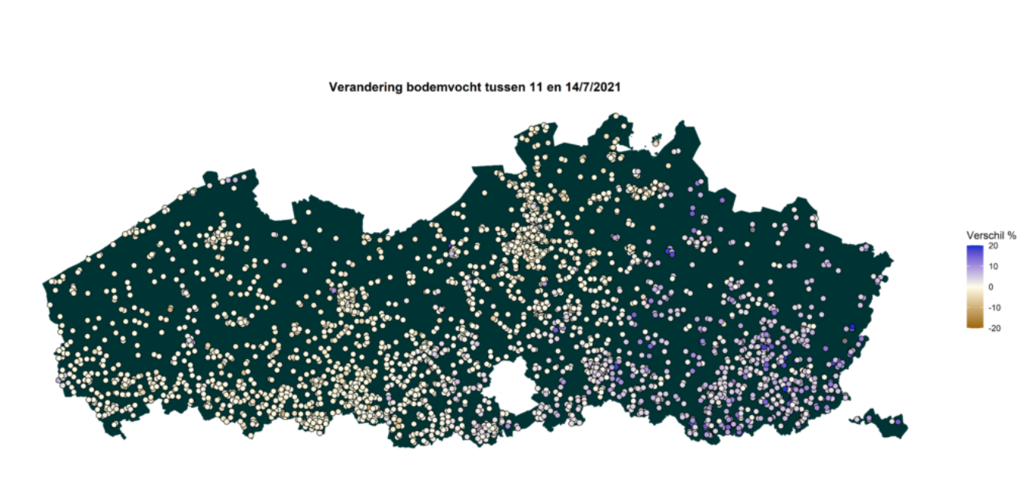
Priority 3: Bridging data gaps: Citizen Science

Slide 26
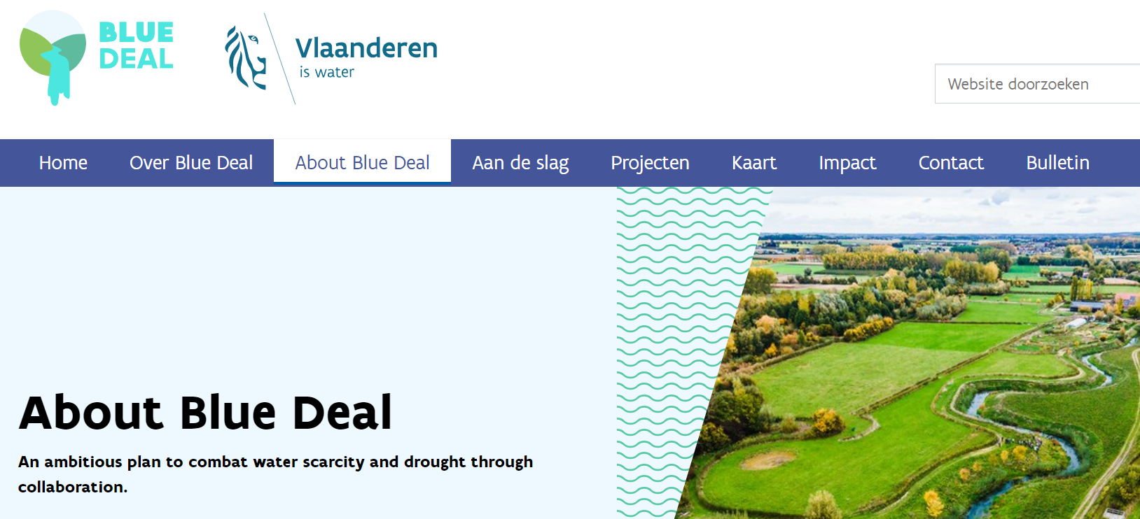
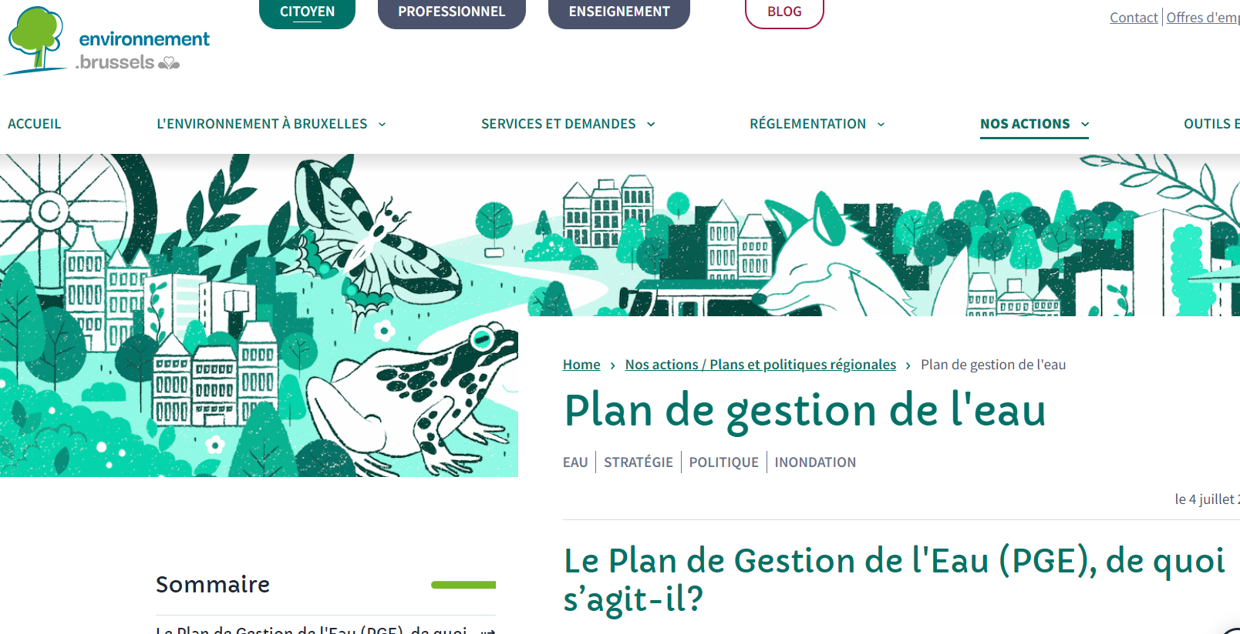
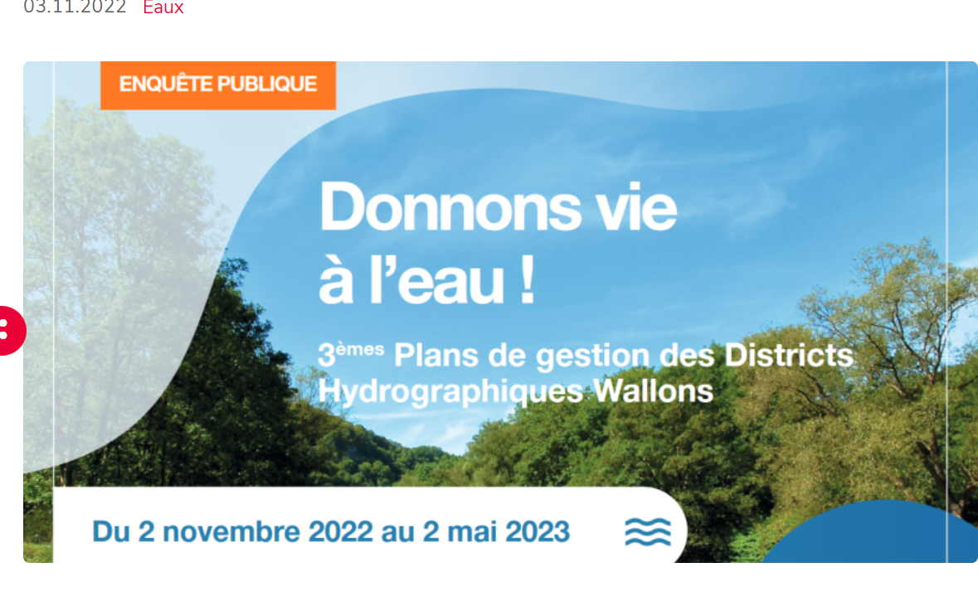
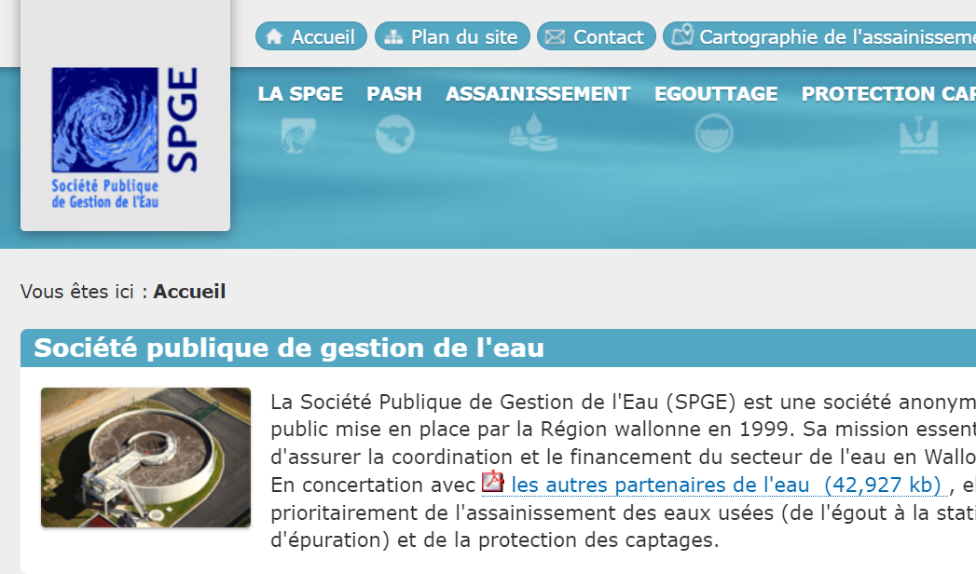
Priority 4: Integrated and inclusive water resources management

Slide 27
Take home message
The different dimensions and multifunctionality of water should be considered when talking about water in Belgium.
Water is a critical resource for maintaining Belgian prosperity and economy, but the belgian water resources are subjected to considerable constraints and pressures.
The 9th phase of UNESCO’s International Hydrological Program (2022-2029) focuses on 5 priority areas. In each of these priority areas, different projects and activities are developed by different belgian citizens, actors of civil society, public authorities and belgian researchers.

