Slide 1


Regenerative medicine as new tool for wound dressing
Maxime Foguenne, Matthieu Cabri, Jean-Christophe Marot, Vincent Scavée, Luis-Carlos Silva-Corten, Fabienne Verheye, Martine Vincent, Jean-Paul Haxhe
Clinique Saint-Pierre Ottignies
1o/09/2021 - Belgian surgical week – miscellaneous session

Slide 2
Introduction ¹
Leg ulcer = heterogenous group
  Venous ulcer
  Diabetic foot ulcer
  Pressure ulcer
  Arterial ulcer
  Neutrophilic ulcer (pyoderma gangrenosum-like)
  ….
Classical treatment :
  Detersion
  Revascularisation surgery
  Infection's treatment
  Discharge
  Pressotherapy
  …
Epidemiology:
  6.000.000 American people/year
  Failure of treatment > 50%
Entanglement of different biological phenomenons :
Healing trouble
Inflammation
Vascularization's defect
Tissular necrosis
Infection
Development of new "advanced" therapies
« time-consuming »
Financial cost +++
1. Greer N. et al., Advanced wound care therapies for nonhealing diabetic, venous, and arterial ulcers. Ann Intern Med. 2013 ; 159 (8) : 532 – 542.

Slide 3
L-PRF : definition ²
Leucocyte plasma-rich fibrin = Choukroun's PRF (2001)
Platelet concentrate for topic use
"Regenerative medicine"
Autologous biomaterial obtained after centrifugation : gel, "stitchable"
 | Friable fibrin | Solid fibrin
Leucocytes | P-PRP (Vivostat, …) | P-PRF (Fibrinet, …)
Leucocytes | L-PRP (Curasan, Regen, Plateltex, Magellan, …) | L-PRF
2. Dohan et al., Classification of platelet concentrates : from pure platelet-rich plasma (P-PRP) to leucocyte- and platelet-rich fibrin (L-PRF). . Trends Biotechnol 2009 ; 27 (3) : 158-167.

Slide 4
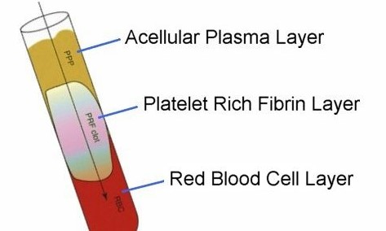
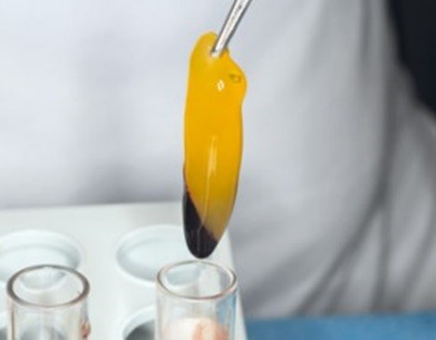
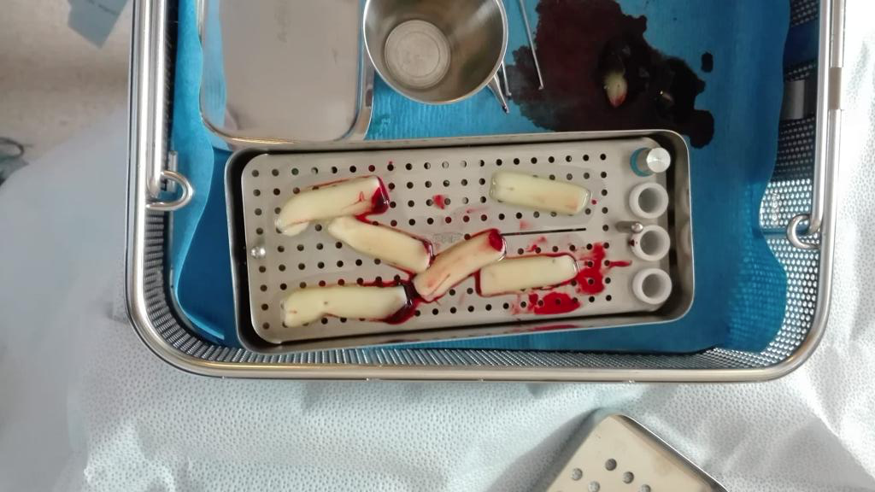
L-PRF : process (1) ³
Production :
Peripheral blood (9-10 ml)
Instantaneous centrifugation (12 min – 2700 rpm – 400G), anticoagulant
L-PRF sample and compression
(15 min - 1mm thickness)
Wound dressing
Wound irrigation PS
Detersion :
  Devitalised tissues
  Fibrin
L-PRF application + irrigation by supernatant
3: Pinto N. et al. Leucocyte- and platelet-rich fibrin (L-PRF) as a regenerative medicine strategy for the treatment of refractory leg ulcers : a prospective cohort study. Platelets 2018 ; 29 (5) : 468-475.

Slide 5
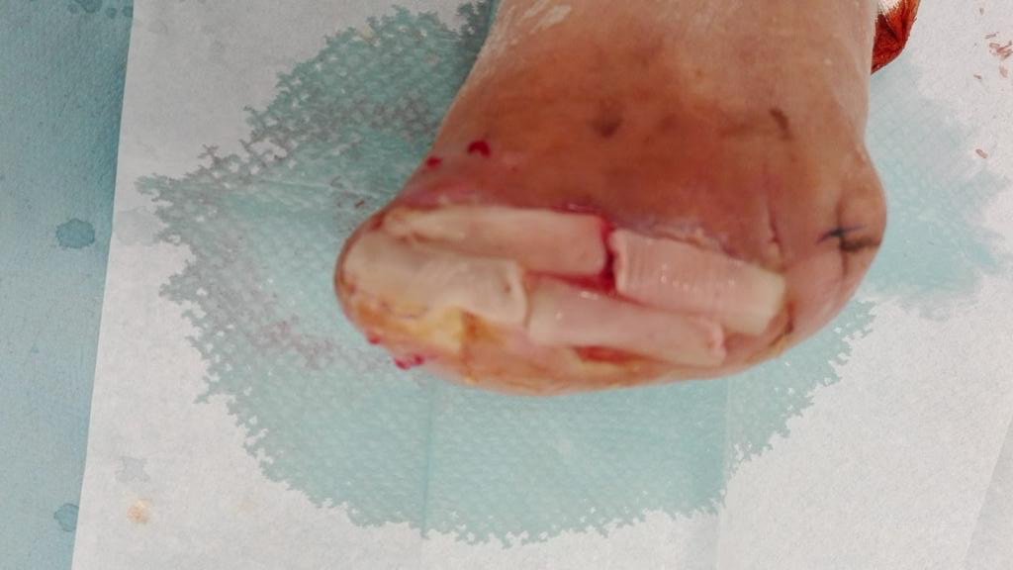
Apply l-PRF all over the wound

Slide 6
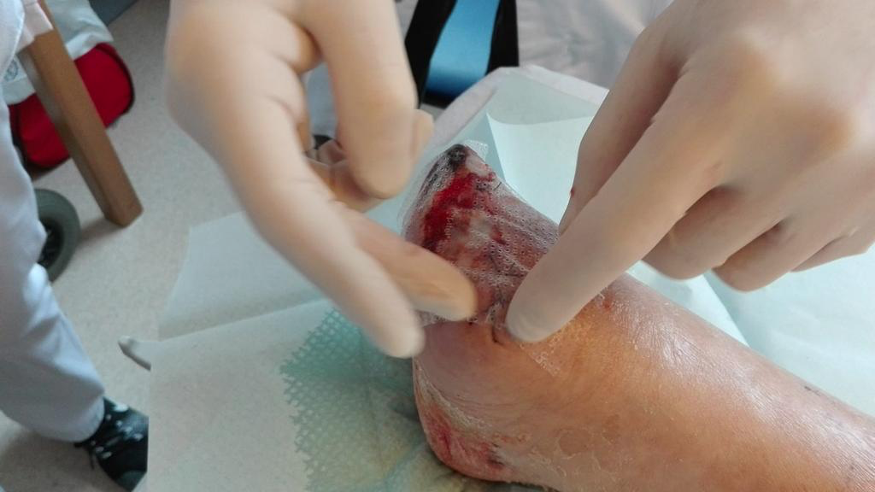
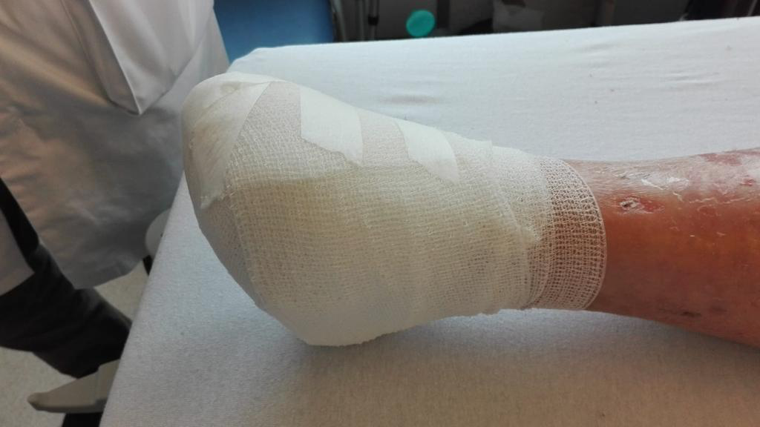
L-PRF : process (2)
Wound dressing
Mépitel
Non-adhesive biatin
Velpeau tape
Follow-up
Wound dressing for 1 week
+ 1w : l-PRF withdrawal and repeat the procedure if necessary

Slide 7
L-PRF : theorical concept ²⁻⁴
Fibrin-rich, platelets (95 %), leucocytes (50%)
GF release :
  Cellular proliferation
  Neoangiogenesis
  Cellular migration
Antimicrobial effect
Proteic matrix
Sustainable process …
1. Promotes tissue regeneration
2. Insulator
4. Berthet A., Les concentrés plaquettaires autologues dans la gestion de l’alvéole post extractionnelle. Défense de Thèse, Université Claude Bernard Lyon, Juin 2018.

Slide 8
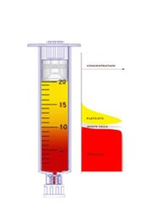
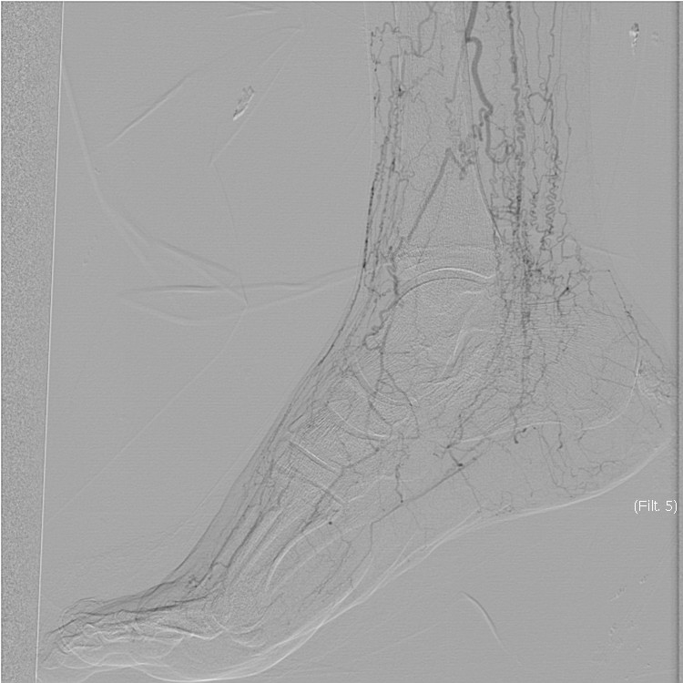
Our institution experience ⁵
10 patients : blood sample + consent form
PAD with non-healing wound despite (9 patients) :
L-PRF
revascularisation surgery
appropriate nurse care
Buerger disease (1 patient) : l-PRF + … PRP⁶
PRP injection → fast (<72H) and sustainable (> 14 days) pain relief (VAS 2/10)
Morphinic use cessation
1st case in Belgium ?
5. Sharma D.et al. Autologous platelet-rich plasma for treatment of ischemic ulcers in buerger’s disease : a pilot study with short-term results. Indian J Vasc Endovasc Surg 2018 ; 5 : 14-20
6. Bioulac B. Freudenstadt

Slide 9
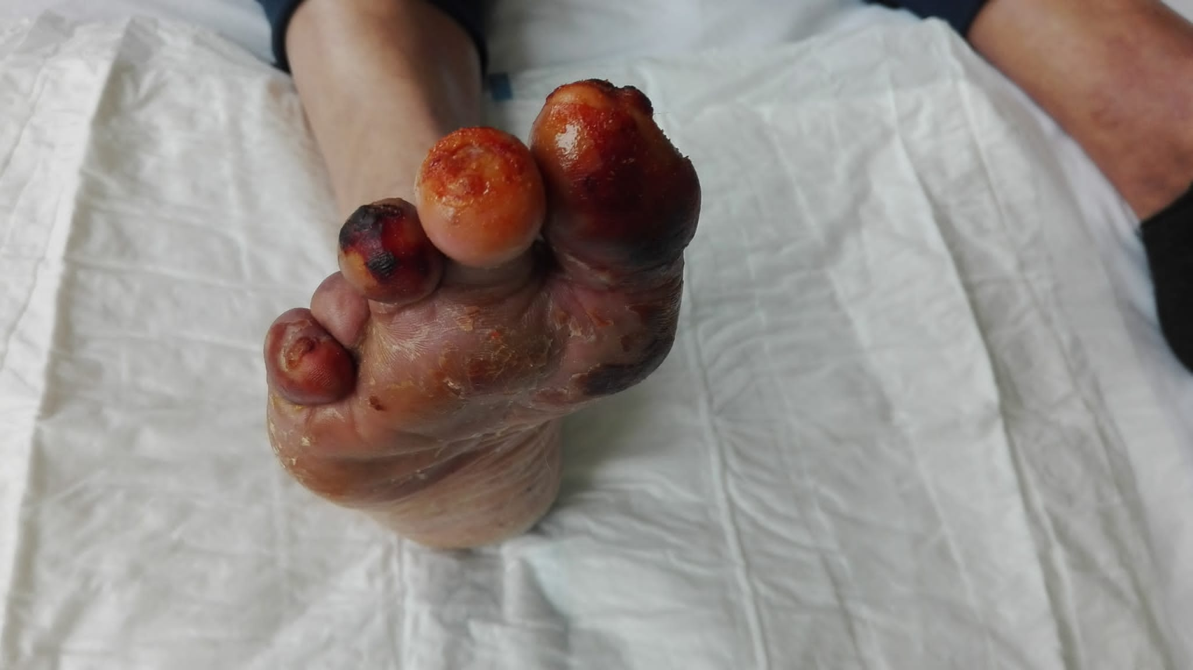
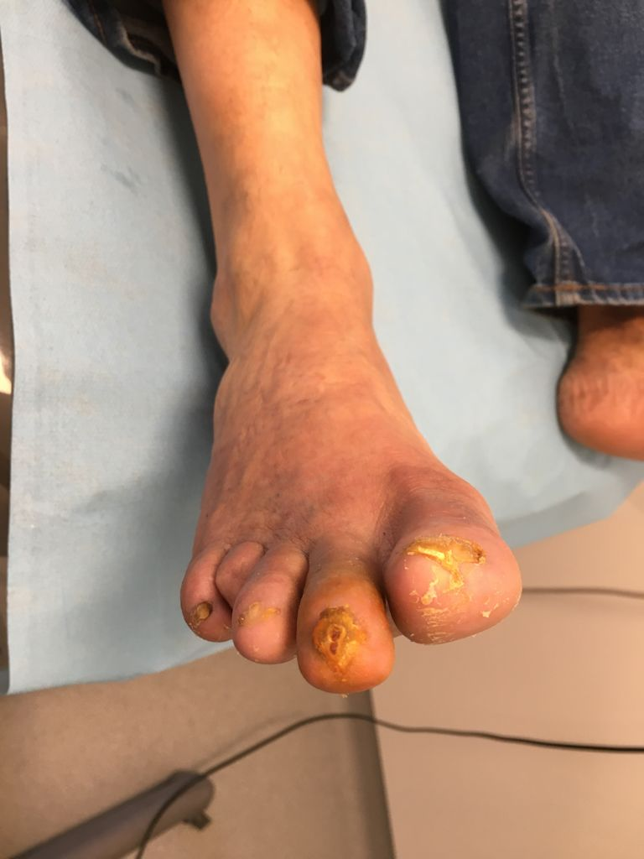
Some pictures …
40y ; Buerger disease
Before
After

Slide 10
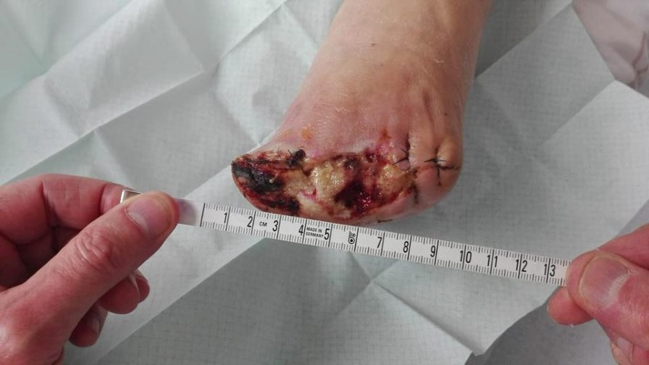
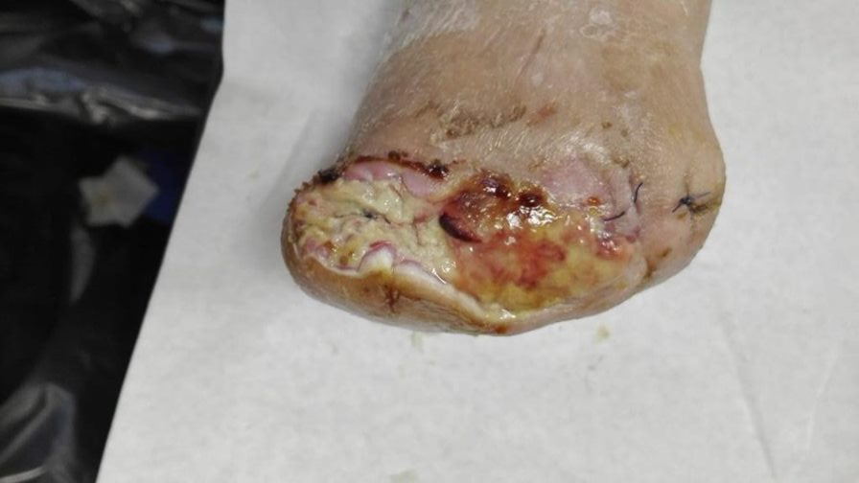
Some pictures …
55y ; decompensated DM ; HBP ; PAD with cicatrisation delay after revascularisation therapy ; burn 4w ealier without any cicatrisation
T0
1W

Slide 11
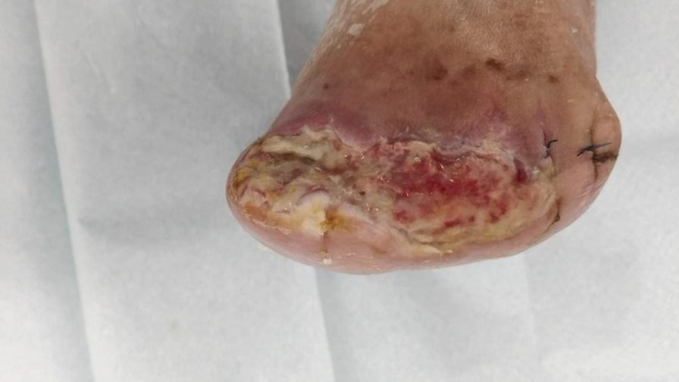
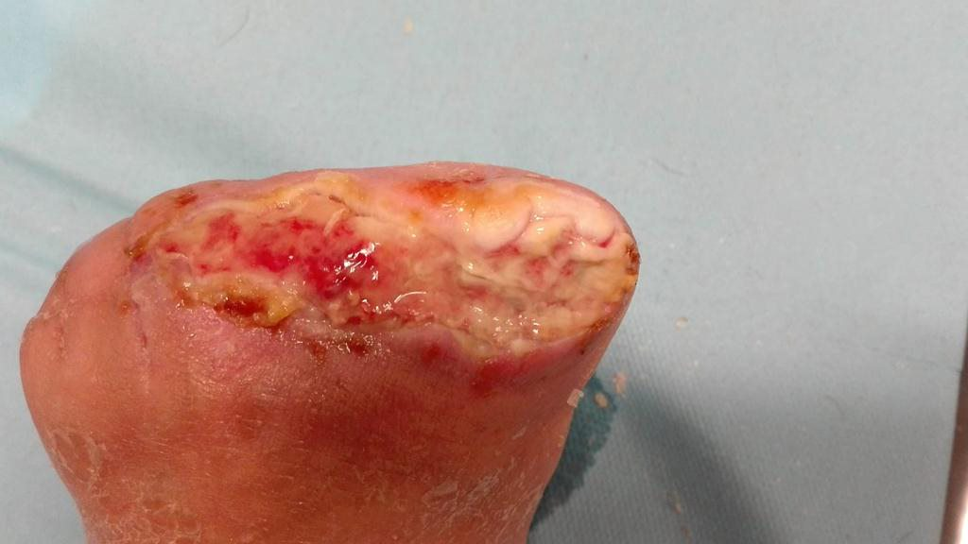
Some pictures …
55y ; decompensated DM ; HBP ; PAD with cicatrisation delay after revascularisation therapy ; burn 4w ealier without any cicatrisation
3W
5W

Slide 12
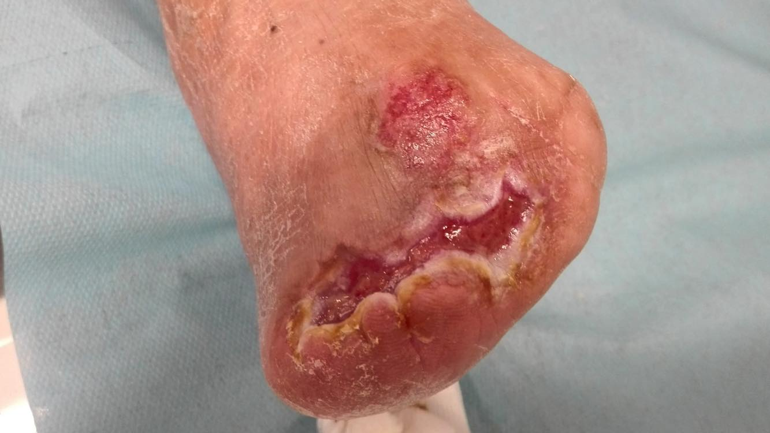
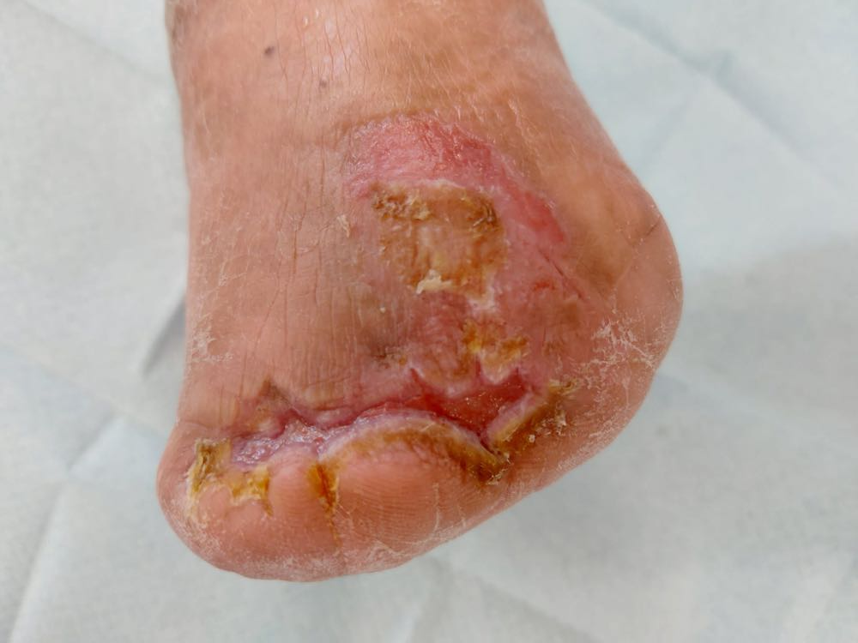
Some pictures …
55y ; decompensated DM ; HBP ; PAD with cicatrisation delay after revascularisation therapy ; burn 4w ealier without any cicatrisation
4M
5M
+ : PAIN RELIEF !
VAS 9/10 --> VAS 3/10 (no M+, no neuropathic painkillers) … within 48 hours

Slide 13
Conclusion
  Autologous compound
  Cheap (financially and humanly)
  Easy to produce
  Efficient, adverse effect
  New tool for the general surgeon as wound dressing …
if effective after first use
BOOSTER

Slide 14
Thank you for your attention !

