Slide 1
Implementation, scale-up and monitoring of new diagnostic tools for diagnosis of TB and DR-TB in Belgium
Dr Emmanuel ANDRE
MDR-TB working group
22/5/2014

Slide 2

Outline
Global context and global issues
Objectives for a Genexpert MTB/Rif surveillance system
Implementing a surveillance system
Emmanuel ANDRE, 25/5/2014

Slide 3
  Global context and global issues
Emmanuel ANDRE, 25/5/2014

Slide 4
Global context
17$
10$
December 2010 : WHO endorsed the Xpert MTB/Rif assay
Operational issues : Increase of DR-TB detection, invalid tests, different algorithms, …
Emmanuel ANDRE, 25/5/2014

Slide 5
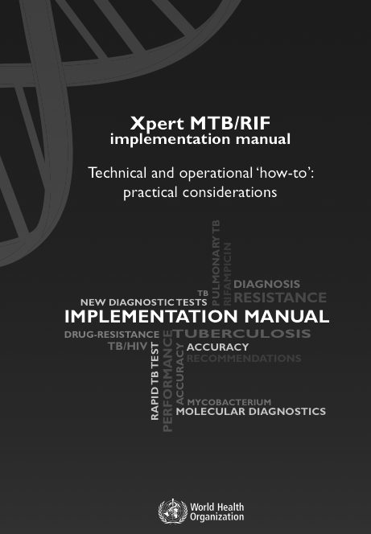
Global context : Diagnosis of pulmonary TB
Emmanuel ANDRE, 25/5/2014

Slide 6

Global context : diagnosis of extra-pulmonary TB
Emmanuel ANDRE, 25/5/2014
Notes:
author-defined composite reference
standard (CRS): culture +/- NAAT, histology,
smear, biochemical testing, clinical signs,
response to TB treatment

Slide 7
Global context : diagnosis of extra-pulmonary TB
Emmanuel ANDRE, 25/5/2014

Slide 8
Global issues : operational implementation and surveillance
Basic surveillance is needed:
1) How are the laboratories dealing with this technology?
2) Are we respecting the algorithms? (what are the algorithms?)
Do we find the expected results?
Emmanuel ANDRE, 25/5/2014

Slide 9
1) How are the laboratories dealing with this new technology?
Early module failure was 42%. Same kind of figures in all settings India, Nigeria, …
Emmanuel ANDRE, 25/5/2014

Slide 10
2) Algorithms
What are the indications and actual conditions of reimbursement for MTB/Rif tests in Belgium?
Suspicion of DR-TB (WHO : strongly recommended)
  Smear positive patient with history of TB treatment (reimbursed)
  TB suspect contact of confirmed DR-TB patient (not reimbursed)
  TB suspect with history of TB treatment (not reimbursed)
  TB suspect orignitaing from country with high prevalence of DR-TB (not reimbursed)
Suspicion of TB (WHO : strongly recommended)
  Suspicion of TB/HIV coinfection (not reimbursed)
Suspicion of TB (WHO : accepted)
  Any suspect of TB, in replacement of microscopy and culture (not reimbursed)
Suspicion of TB (WHO not recommended but may be justified in Belgium)
  Smear positive TB suspect (reimbursed)
Emmanuel ANDRE, 25/5/2014

Slide 11
  Objectives for a GeneXpert MTB/Rif surveillance system
Emmanuel ANDRE, 25/5/2014

Slide 12
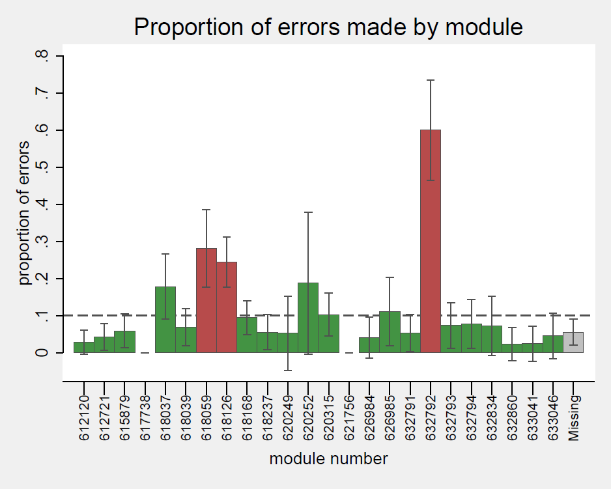
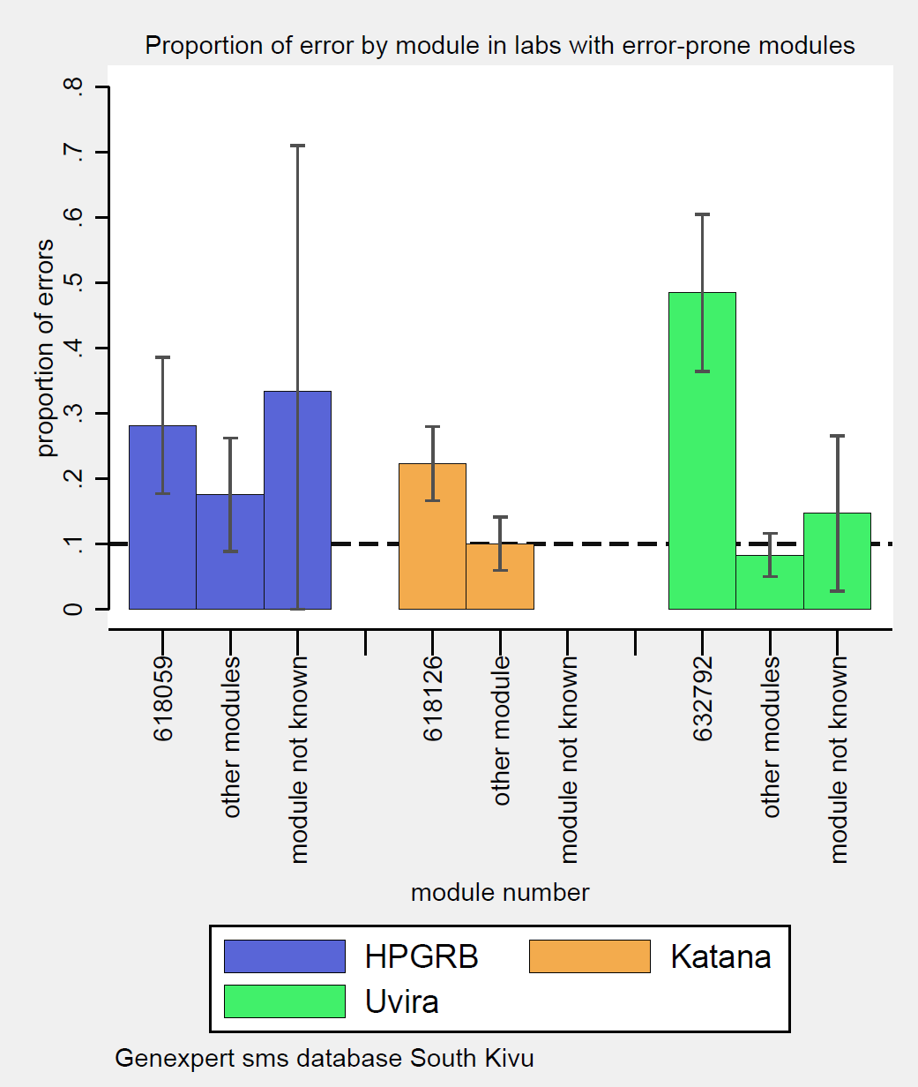
1) Monitoring of error rates
High error rates may be due to:
Lack of training (proven)
Low quality of cartridges (proven)
Bad quality of modules/automates (proven)
Importance of inter-laboratory data sharing to rapidly identify the cause of errors
Preventing high error rates may decrease costs by 10% and prevent invalid results for critical samples (CSF, BAL, …)
Emmanuel ANDRE, 25/5/2014

Slide 13
2) Monitoring of algorithms
What is the indication of the test?
Which patients are being tested?
  Age, Sex
  Clinical history (past TB treatment, DR-TB contact, HIV status, ..)
  Geographical information
Which samples are being processed?
  Pulmonary
  Extra-pulmonary (…)
Have additional tests been performed (microscopy, culture)?
Are our observations comparable with similar countries?
Based on shared experience, should we revise indications for this test?
Emmanuel ANDRE, 25/5/2014

Slide 14
  Implementing a surveillance system
Emmanuel ANDRE, 25/5/2014

Slide 15
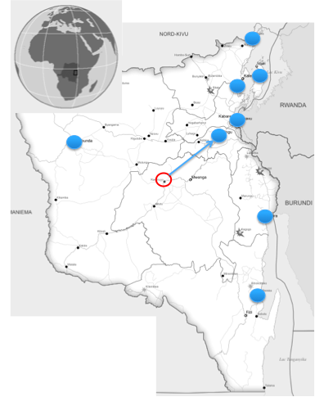
Experience from South-Kivu, DRC (GeneXchange © )
10 GeneXpert sites
Direct introduction of additional data on the GeneXpert laptop
Direct transmission of results to HF
Anonymized data sent by SMS to central server
Centralized monitoring of critical information (error rates, Rif resistance, reason for test, …)
Emmanuel ANDRE, 25/5/2014

Slide 16
Experience from Nigeria and other countries (GxAlert © )
Emmanuel ANDRE, 25/5/2014

Slide 17
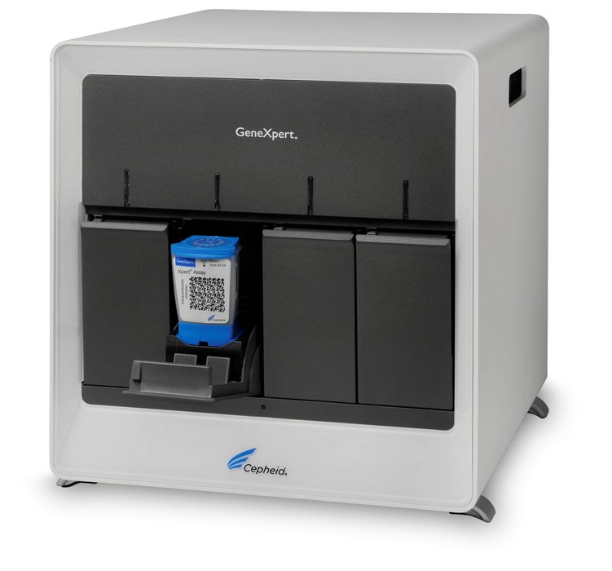
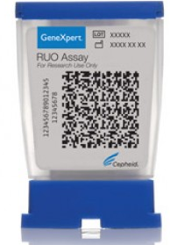
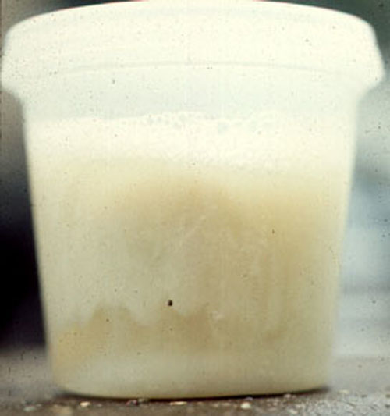

Current GeneXpert network in Belgium
Option 1 & 2:
Lab does not have access to Genexpert
or Lab has a Genexpert but no MTB/Rif tests
-> Sample can be sent to NRL
-> PCR is not performed
Option 3 :
Lab has a Genexpert and MTB/Rif tests
-> PCR is reimbursed if Smear positive
-> PCR is not reimbursed in other-approved indications
-> Sharing of results with NRL is sub-optimal
Conclusion :
We miss the opportunity of rapid diagnosis of (DR)TB
We miss the opportunity of standardization
We miss the opportunity to diminish global cost
We miss the opportunity to rapidly generate a global picture
The system is not prepared for an efficient surveillance linked to an extension of labs and indications
NRL
Lab 1
Lab 2
Lab 3
Emmanuel ANDRE, 25/5/2014

Slide 18
Prerequisits for an optimized surveillance system
We should work as a network and agree to share data
  Incentive 1 : Negotiated price of tests at national level?
  Incentive 2 : Surveillance system should be user-friendly, rapid and paperless
  Incentive 3 : Surveillance system should facilitate Quality Controls and method validation
  Incentive 4 : Surveillance system should permit to produce useful scientific information
We should agree on which data should be shared
  Age, Sex, Geographical information
  Nature of specimen
  Other tests performed (microscopy, culture, …)
  (?) TB history, DR-contact, HIV status, decision of TB treatment
We should agree on which monitoring system should be used
We should agree to use the data we collect
Emmanuel ANDRE, 25/5/2014

Slide 19

Proposition for an improved GeneXpert network
MTB/Rif cartridges to be sent from NRL to laboratories
Improved rapidity and quality of diagnosis
    Optimal clinical impact
    Cost-savings
      Treatment and compl. tests
      Isolation of patients
Biohazard risks
    Decreased number of samples travelling
    Only if Gx is not available
    Only if Rif resistance is detected
ISO15189
    Gx maintenance on site
    NRL/BELTA to coordinate
      Negotieted price
      Lot validation and ditribution
      Data transfer & Surveillance
✓
NRL
Lab 1
Lab 2
Lab 3
Emmanuel ANDRE, 25/5/2014

Slide 20
Thank you!
Special thanks to :
BELTA TB Net
Dr Guido Groenen
NRL
Dr Vanessa Matys
WHO
Wayne Van Gemert (GLI), Suvanand Sahu and Jacob Creswell
NTP - DRC
Benjamin Nyange (IT developper GenXchange), Dr Bakaswa, Dr Kalumuna, Jean-paul Chirambiza, …
UCLouvain & Cliniques Universitaires Saint-Luc
Prof. Michel Delmée and Prof. Patrick Goubau
Abt associates
Jeff Tackle

