Slide 1




High-throughput GW
M.J. van Setten
Institute of Condensed Matter and Nanosciences,
Université catholique de Louvain, Belgium
Notes:
Lausanne AAS 25 mins

Slide 2
High-throughput GW
from a structure
without any human intervention
to converged GW results
Automatic calculations
Screening for new compounds
Database building
Uniform results
No human bias

Slide 3
GW in High Throughput
‘additional’ difficulties as compared to DFT
  Pseudo potentials
  4 step calculation
  N⁴ scaling
  No ‘safe’ parameter set (converged results for all)
  No ‘safe’ computational settings (# cpu’s, memory, time, ...)
Notes:
Pseudo potentials well tested for ground state, for gw this is not so clear ..

Slide 4
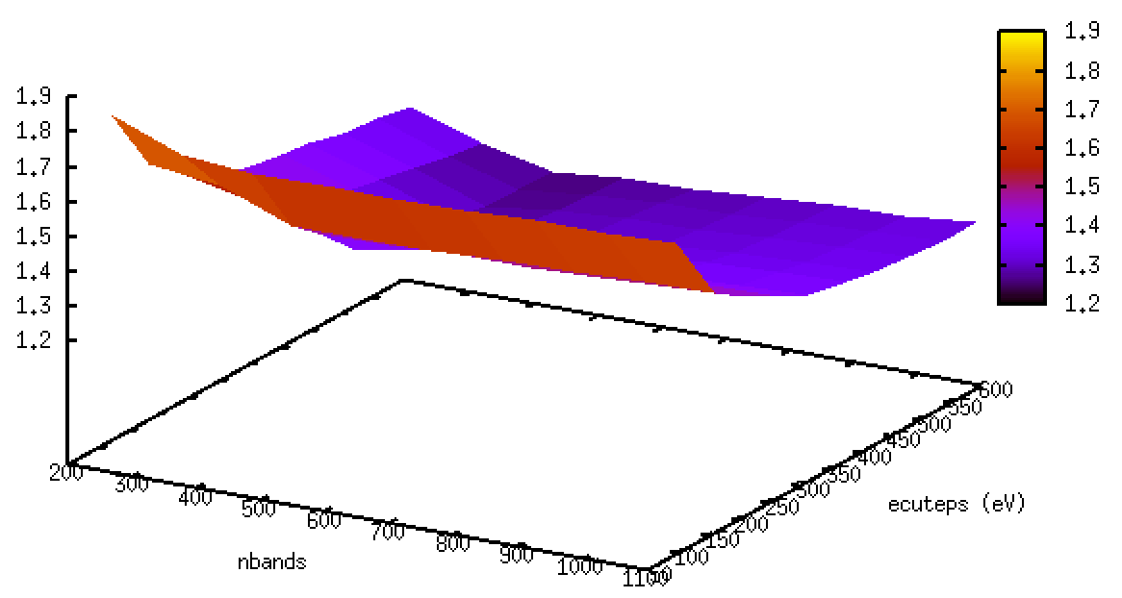
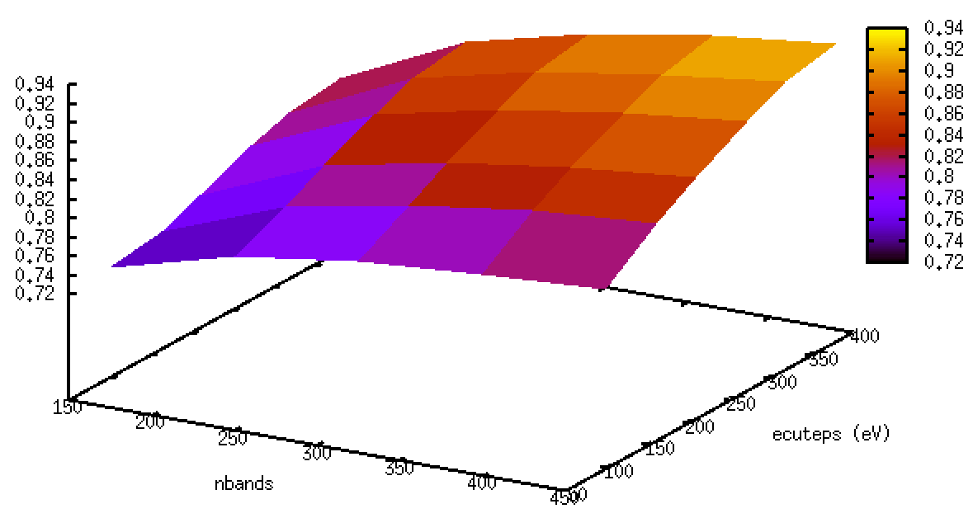
4f unfrozen Au potential
AuCl
Normal 19 electron Au potential

Slide 5
Baby sitting
Determine optimal parallelization settings
Create input
Automatically submit jobs (to the right queue)
Monitor job status
Detect and fix errors
Restart

Slide 6
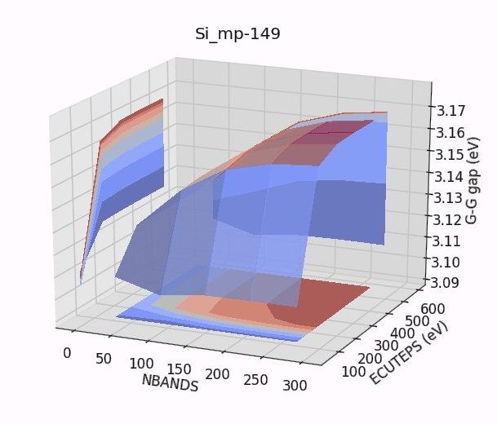
Convergence studies
Energy cutoffs
Kpoints
Smearing
Bands
Pseudo’s

Slide 7
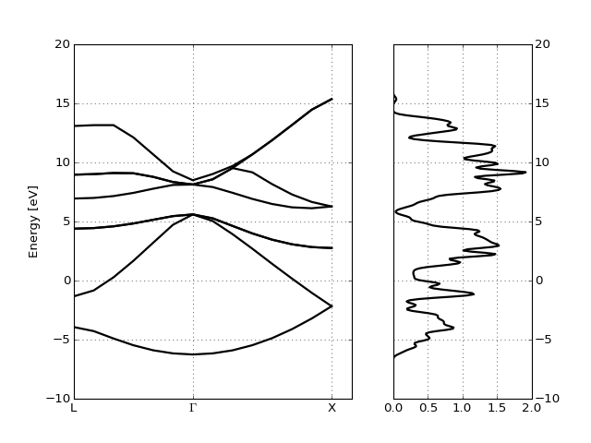
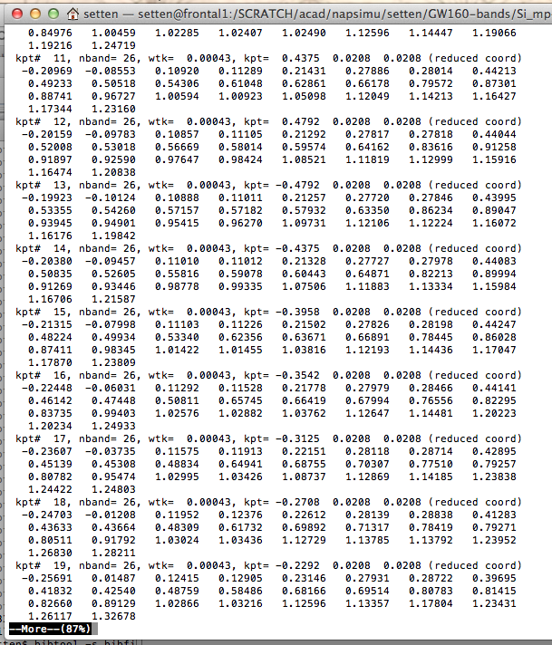
Post processing
nscf_ebands = abiopen("si_nscf_GSR.nc").ebands
gs_ebands = abiopen("si_scf_GSR.nc").ebands
nscf_ebands.plot_with_edos(gs_ebands.get_edos())

Slide 8
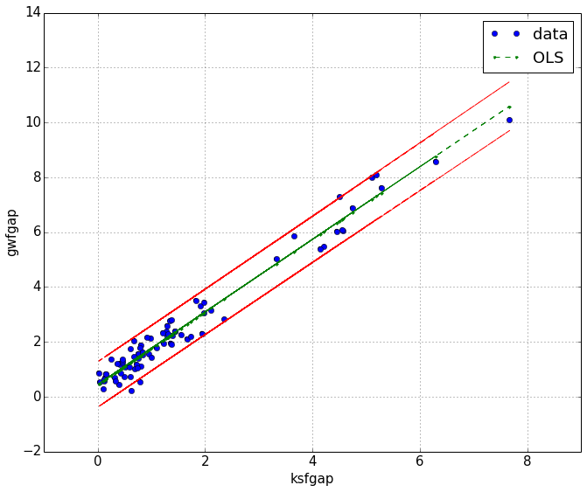
Automatically for many structures
for structure in database:
ebands_input(structure, pseudos=ONCVPSP_GGA)
for structure in database:
ebands_input(structure, pseudos=ONCVPSP_GGA)
for structure in database:
ebands_input(structure, pseudos=ONCVPSP_GGA)

Slide 9

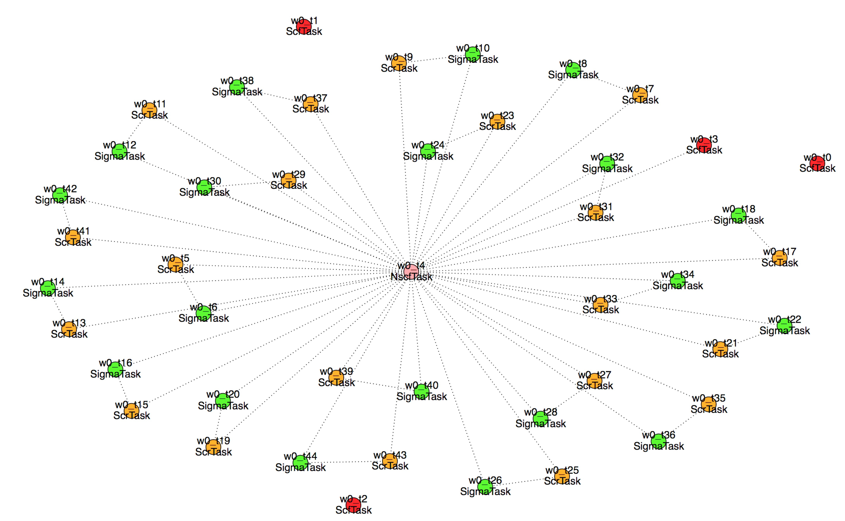
based Python package
Workflow management
ABINIT I/O
Post processing
Flow generation:
GUI or scripted

Slide 11
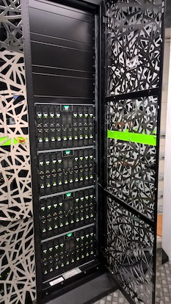
SLURM
PBSPro
Torque
SGE
…
Scheduling the flow on the cluster
Error handling (‘custodian like’)
Convergence testing

Slide 12


Interactive analysis
and presentation of
results
Storing results:
query-able entries
+ netcdf data files
(via gridfs)

Slide 13
Automatic GW flow
On a low k-point density (2x2x2):
  Set of single parameter ground state convergence studies
  Grid of nbands X encuteps
  For each nbands find converged encuteps
  For the converged encuteps find the converged nbands
  if not found > extend grid and retest
On the final high k-point density:
  Test derivatives.
  (in most cases the high density derivatives turn out smaller)
  Post process
  (create scissor, apply scissor, plots, statistical analysis…)
(pw cutoff, …)

Slide 14
Convergence study
On a low k-point density (2x2x2):
  Set of single parameter ground state convergence studies
  Grid of nbands X encuteps
  For each nbands find converged encuteps
  For the converged encuteps find the converged nbands
  if not found > extend grid and retest
On the final high k-point density:
  Test derivatives.
  (in most cases the high density derivatives turn out smaller)
  Post process
  (create scissor, apply scissor, plots, statistical analysis…)
(pw cutoff, …)

Slide 15
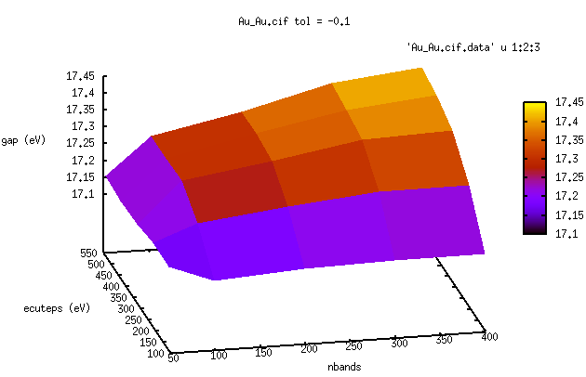
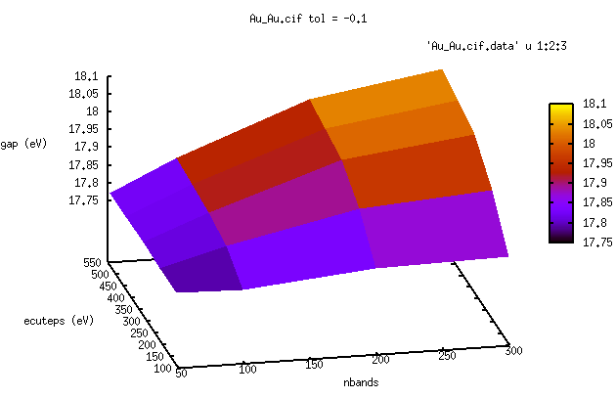
Gold
2x2x2 kpoint mesh
14x14x14 kpoint mesh
Notes:
It actually works: the shape of the surface calculated at 222 is the same as the on calculated

Slide 16
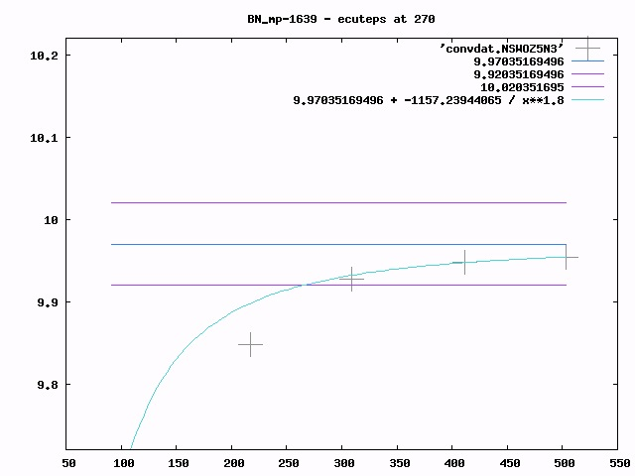
G-G
gap
(eV)

Slide 17
Automatic GW flow
On a low k-point density (2x2x2):
  Set of single parameter ground state convergence studies
  Grid of nbands X encuteps
  For each nbands find converged encuteps
  For the converged encuteps find the converged nbands
  if not found > extend grid and retest
On the final high k-point density:
  Test derivatives.
  (in most cases the high density derivatives turn out smaller)
  Post process
  (create scissor, apply scissor, plots, statistical analysis…)
(pw cutoff, …)

Slide 18
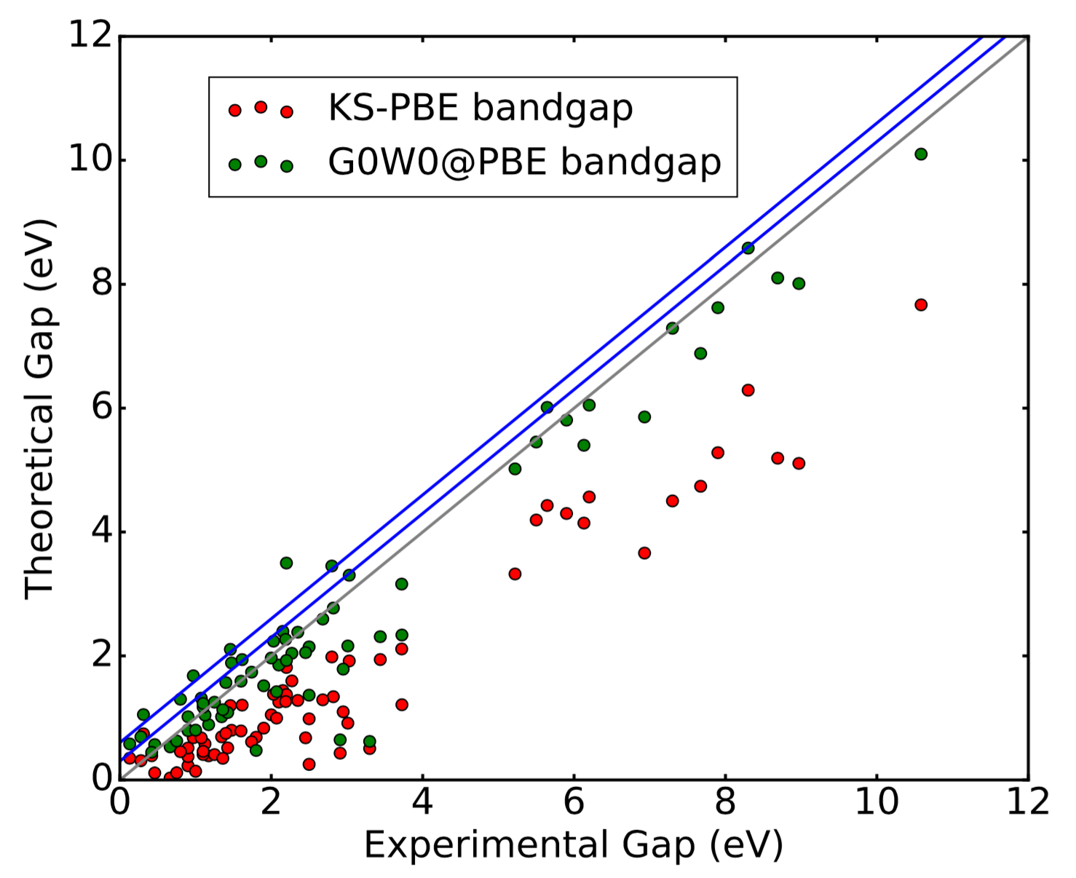
First application
~ 100 solids, including the not so usual suspects
Settings:
  Godby – Needs PP
  Tolerance 0.1 eV

Slide 19
correlation: 0.983
R-squared: 0.966
coefficients
const: 0.4507 (0.063)
ksfgap: 1.3227 (0.028)

Slide 21
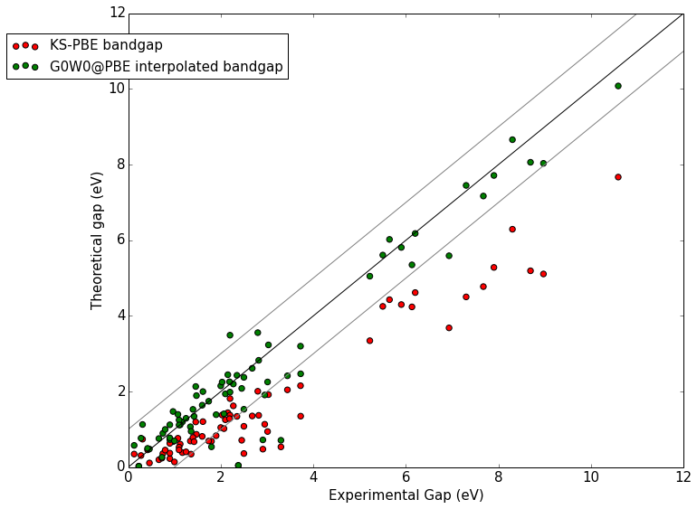

Slide 22
d-states Cu, Cd

Slide 23
Heavy elements Te, Pd
d-states Cu, Cd

Slide 24
Experimental gaps are room temperature
Heavy elements Te, Pd
d-states Cu, Cd

Slide 25
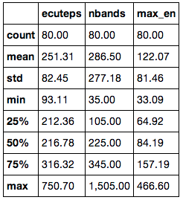
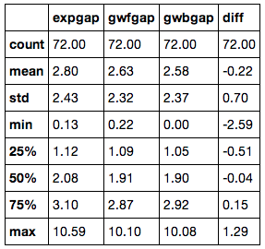
Some Statistics
Parameters for convergence [eV]
G₀W₀@PBE performance (T_{room} exp) [eV]

Slide 26
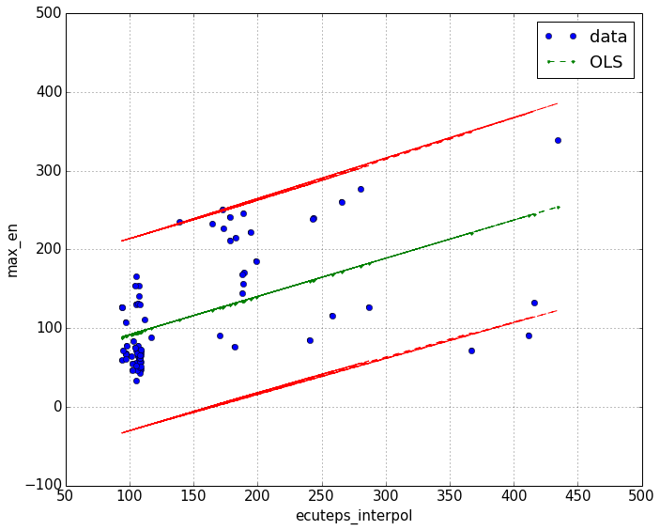
Empty states v.s. Sigma cutoff

Slide 27
Collaborators
Matteo Giantomassi
Geoffroy Hautier
Gian-Marco Rignanese
Don Hamann
Xavier Gonze
Jonathan Laflamme Janssen

Slide 28
Benchmark set for molecules: GW100
Collaboration KIT Karlsruhe, FHI Berlin and
Berkeley Lab US DoE
  TURBOMOLE:
  Gaussian basis sets, spectral representation via Casida
  FHI-Aims:
  numerical local orbitals, analytic continuation
  BerkeleyGW:
  plane waves, plasmon pole and real frequency integration
  5 different ways to evaluate the self-energy
Strictly converged all-electron reference values for IP and EA
Test PP results against all electron references for molecular systems
Sternheimer GW in Abinit

Slide 29
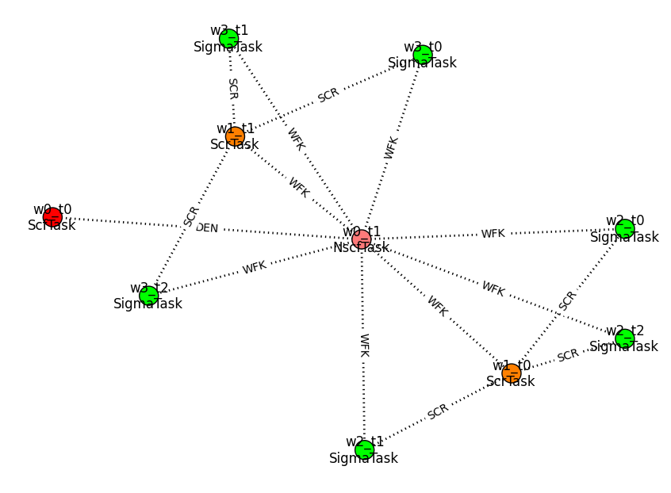
Storing flows in a database

Slide 30
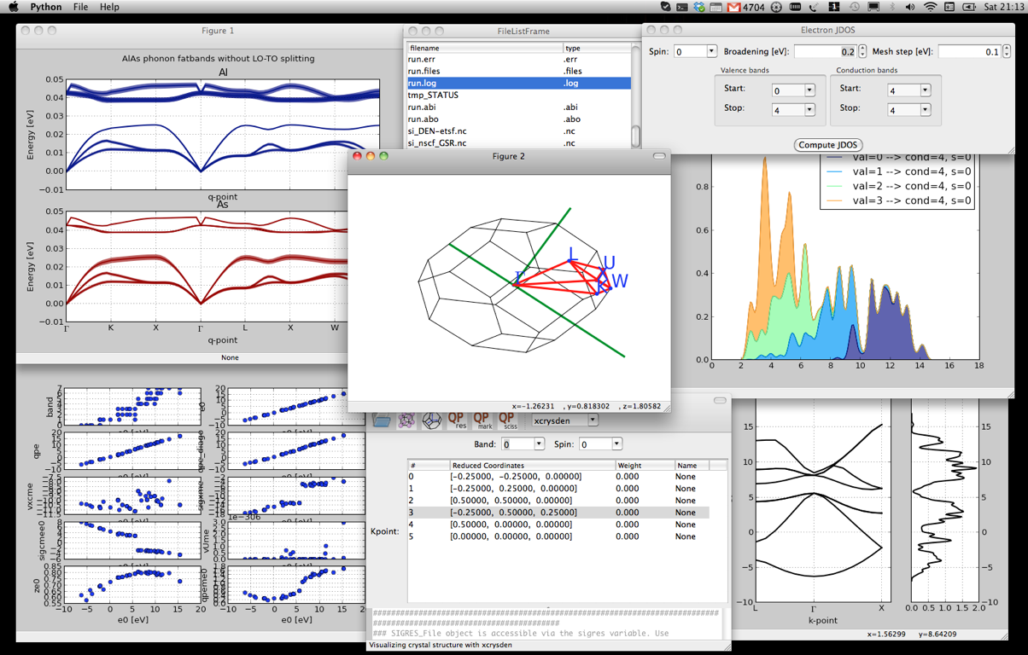
Graphical interfaces

Slide 31

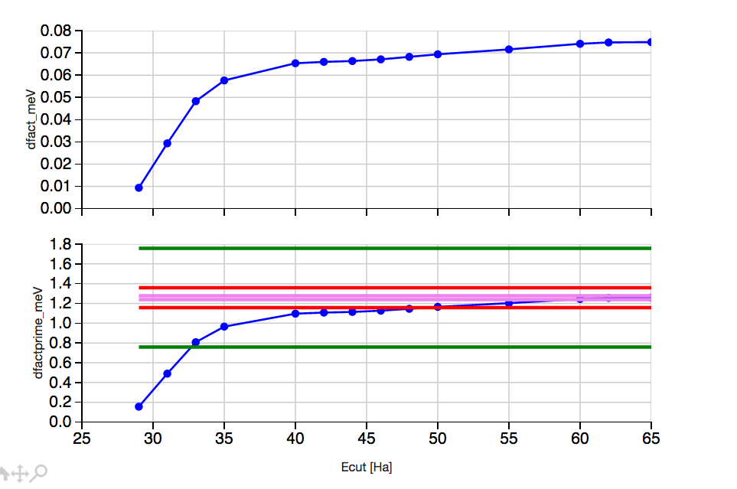
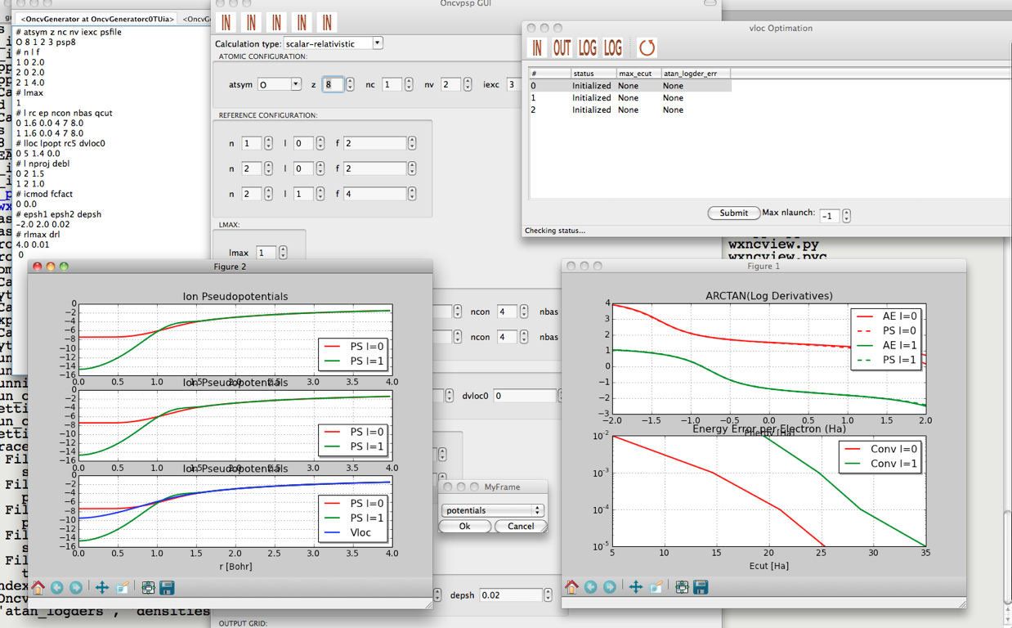
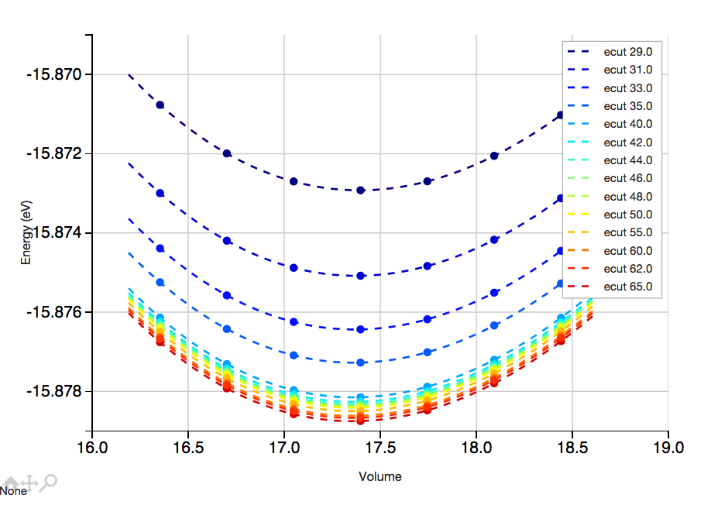
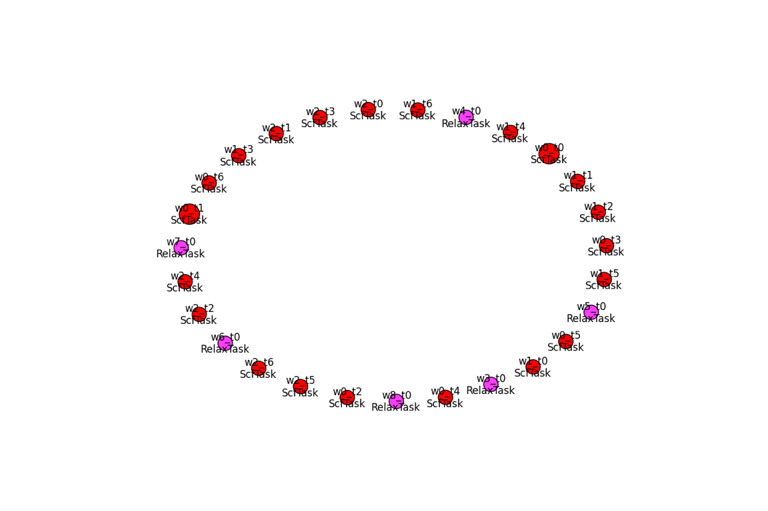
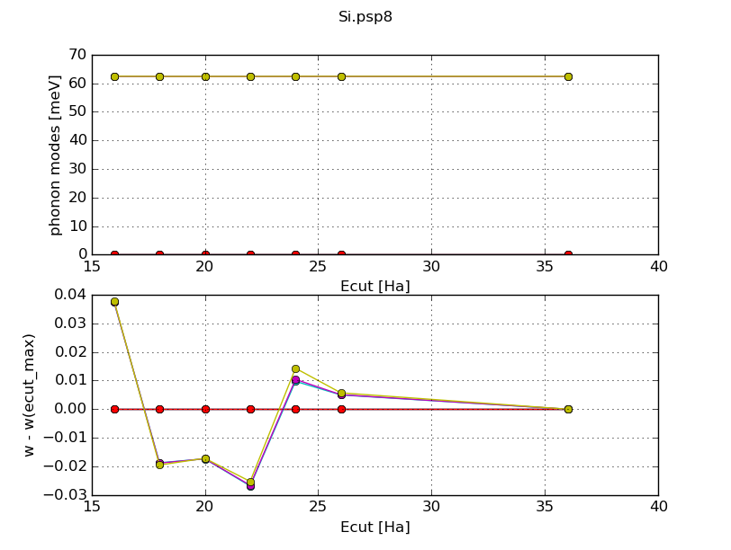
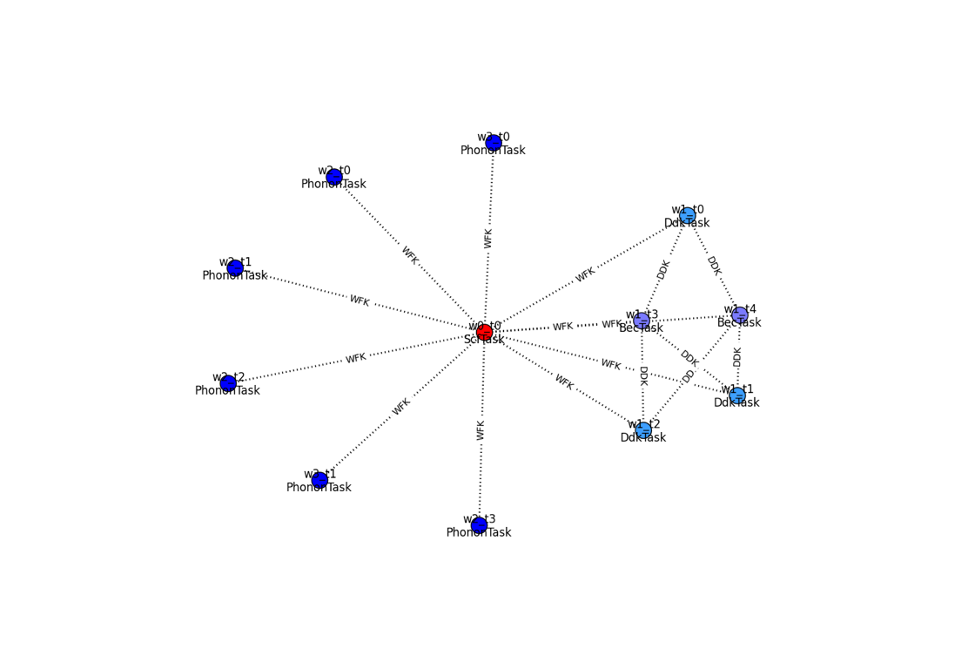
EOS
Flows
Ipython notebook with full info: H-high.ipynb

Slide 32
KS v.s. Quasi-Particle equation
Electron density parameterized by KS single particle states
Greens function in spectral representation, expressed in terms of quasi-particle states leads to the quasi particle equation:
The quasi-particle energies are the electron removal and addition energies
Local exchange-correlation potential
Non-local energy dependent
non-hermitian self-energy
HEDIN Phys Rev 139, A796, HYBERTSEN and LOUIE PRB 34, 5390
Notes:
At this point all is exact, now we need a way to calculate Sigma

Slide 33
GW wrapper
Python package that wraps around the ab-initio code
Options
    What kind of GW
    Convergence tolerance
Some list of structures > ‘fully’ converged GW results

Slide 34
2D convergence problem

Slide 35

Python package for:
post-processing Abinit results
generating input files automatically
creating and executing workflows (relaxations, phonons, benchmarking, convergence studies, PP testing, GW ...)
(I)Python(notebook) based tutorials
High throughput flows and high performance flows
Why python?
relatively easy to use and to learn
interactive environment (IPython, notebooks, GUIs)
excellent support for scientific applications (scipy, pandas, matplotlib...)
ecosystem
tons of other libraries

Slide 36
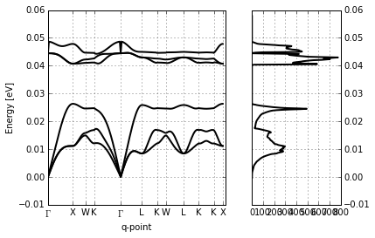
DFPT

Slide 37
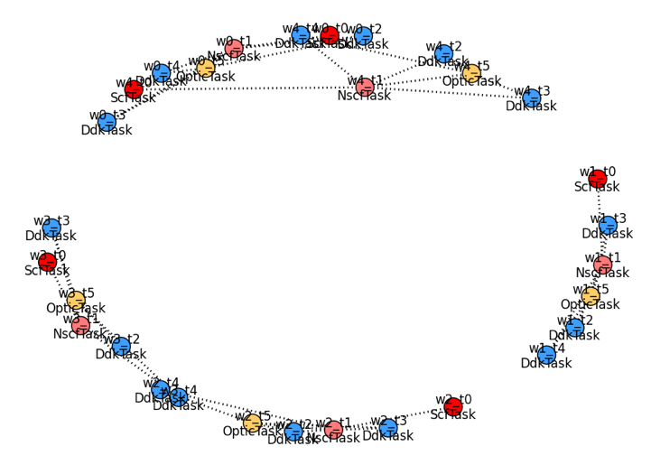
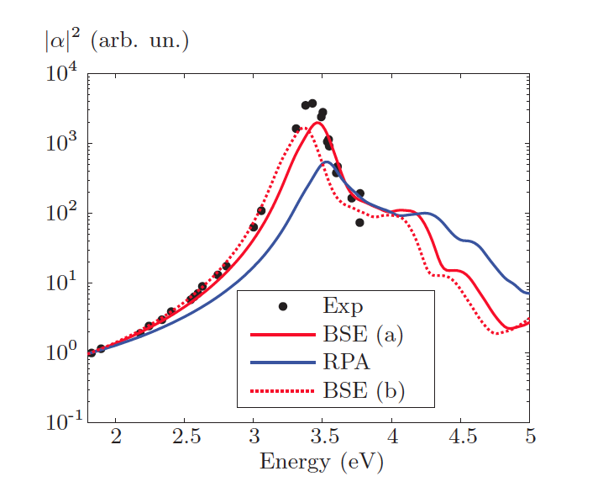
Raman with frozen phonon

Slide 38
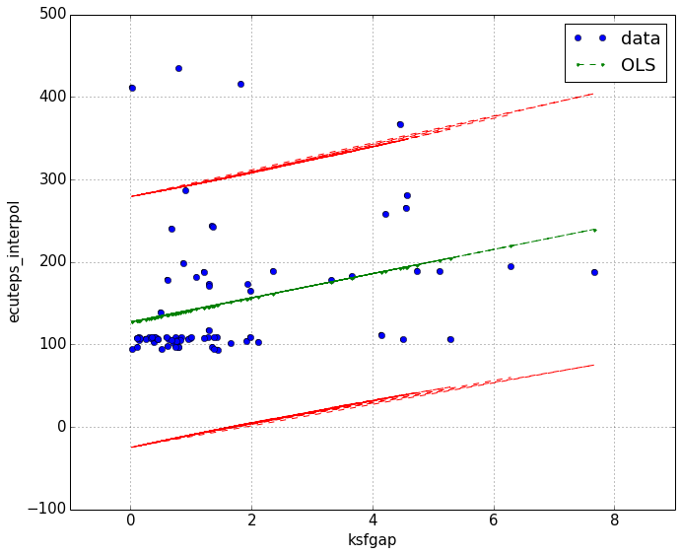
Ecuteps ?

Slide 39


GW in High Throughput
‘additional’ difficulties
  Pseudo potentials
  4 step calculation
  N⁴ scaling
  No ‘safe’ parameter set (converged results for all)
  No ‘safe’ computational settings (# cpu’s, memory, time, ...)
DFT babysitting problem
Notes:
Pseudo potentials well tested for ground state, for gw this is not so clear ..

Slide 40
GW in High Throughput
‘additional’ difficulties
  Pseudo potentials
  4 step calculation
  N⁴ scaling
  No ‘safe’ parameter set (converged results for all)
  No ‘safe’ computational settings (# cpu’s, memory, time, ...)
GW babysitting problem
Notes:
Pseudo potentials well tested for ground state, for gw this is not so clear ..

Slide 41












GW in High Throughput
‘additional’ difficulties
  4 step calculation
  N⁴ scaling
  No ‘safe’ parameter set (converged results for all)
  No ‘safe’ computational settings (# cpu’s, memory, time, ...)
  Pseudo potentials ?
GW babysitting problem
Notes:
Pseudo potentials well tested for ground state, for gw this is not so clear ..

Slide 42

Pseudo Dojo
Optimized Norm Conserving Vanderbild Pseudo Potentials
  multiple projectors
  multiple gradient constraints
Don Hamann (PRB 88, 085117 (2013))
Package to facilitate PSP
generation
Graphical interface
Automatized testing (6)
Log derivatives made to agree up to 8 Ha
http://www.pseudo-dojo.org/dojo.html
Notes:
Multiple projectors > more degrees of freedom to fix the scattering in the empty space
Log derivatives can be made to match the all electrons ones well beyond 8 H

Slide 43
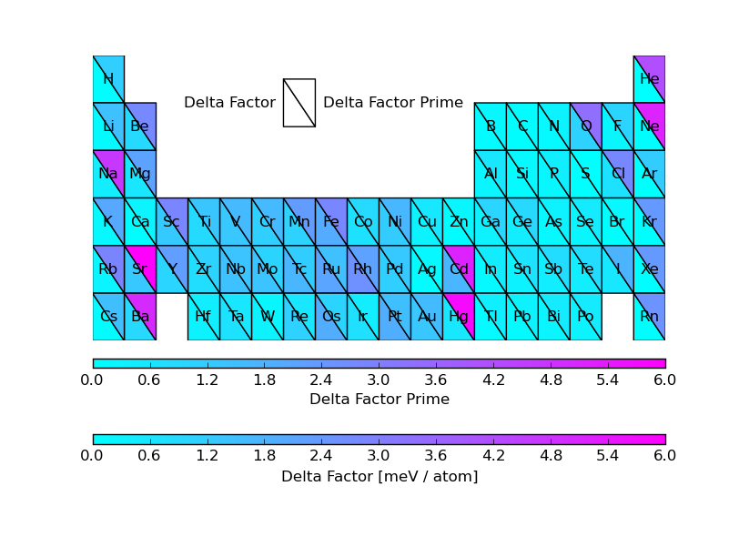
ONCVPSP PDv0.2
(Comparing EOS against AE reference)
[meV]
Mean low cutoff 27 Ha (std 12 Ha), normal cutoff 33 Ha (std 13 Ha)

Slide 44
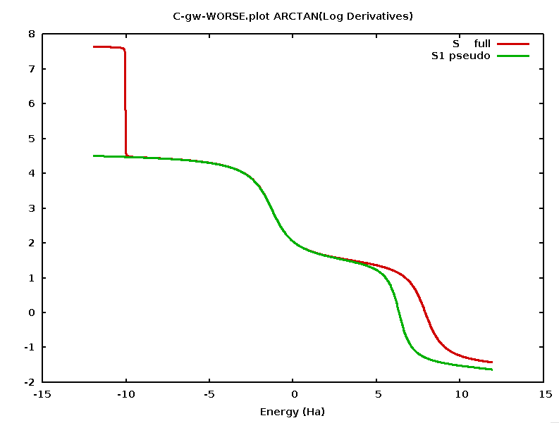
Carbon
log derivatives
Ghost state
Single projector PP

Slide 45
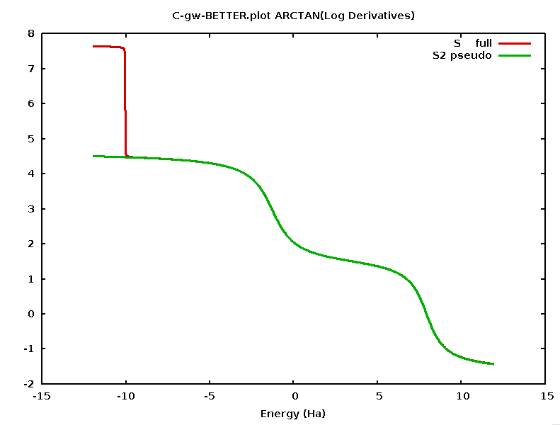
Carbon
log derivatives
2 projector PP
Ghost state
Single projector PP

Slide 46
Abipy for teaching
Different users

Slide 47
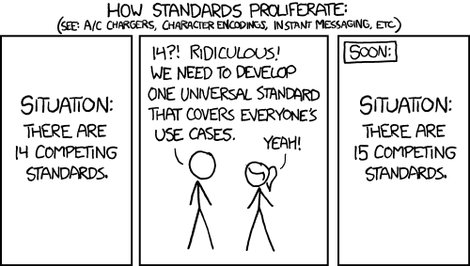

Slide 48
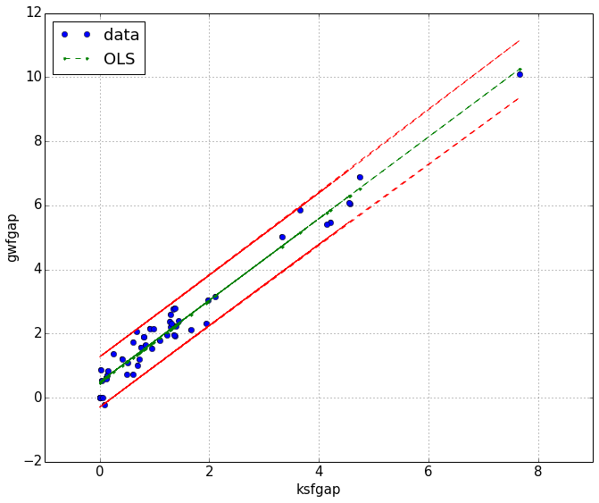

Slide 49
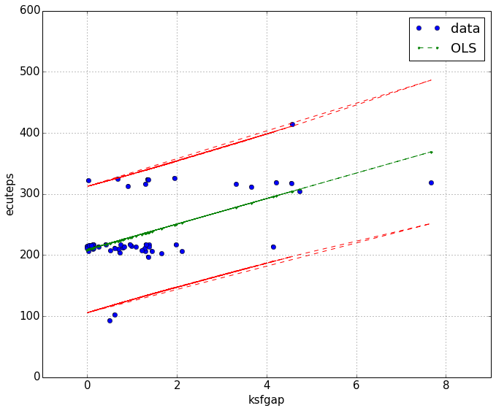

Slide 50
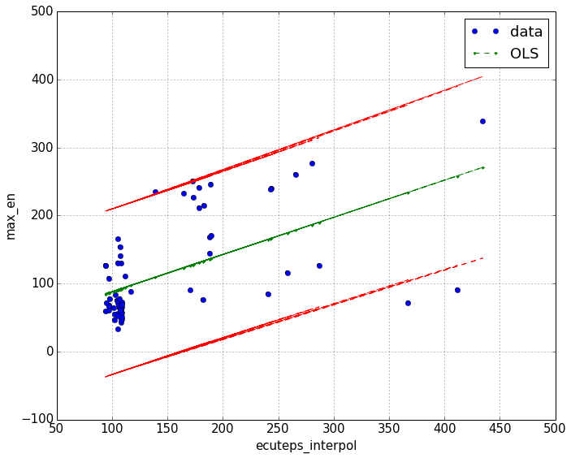

Slide 51
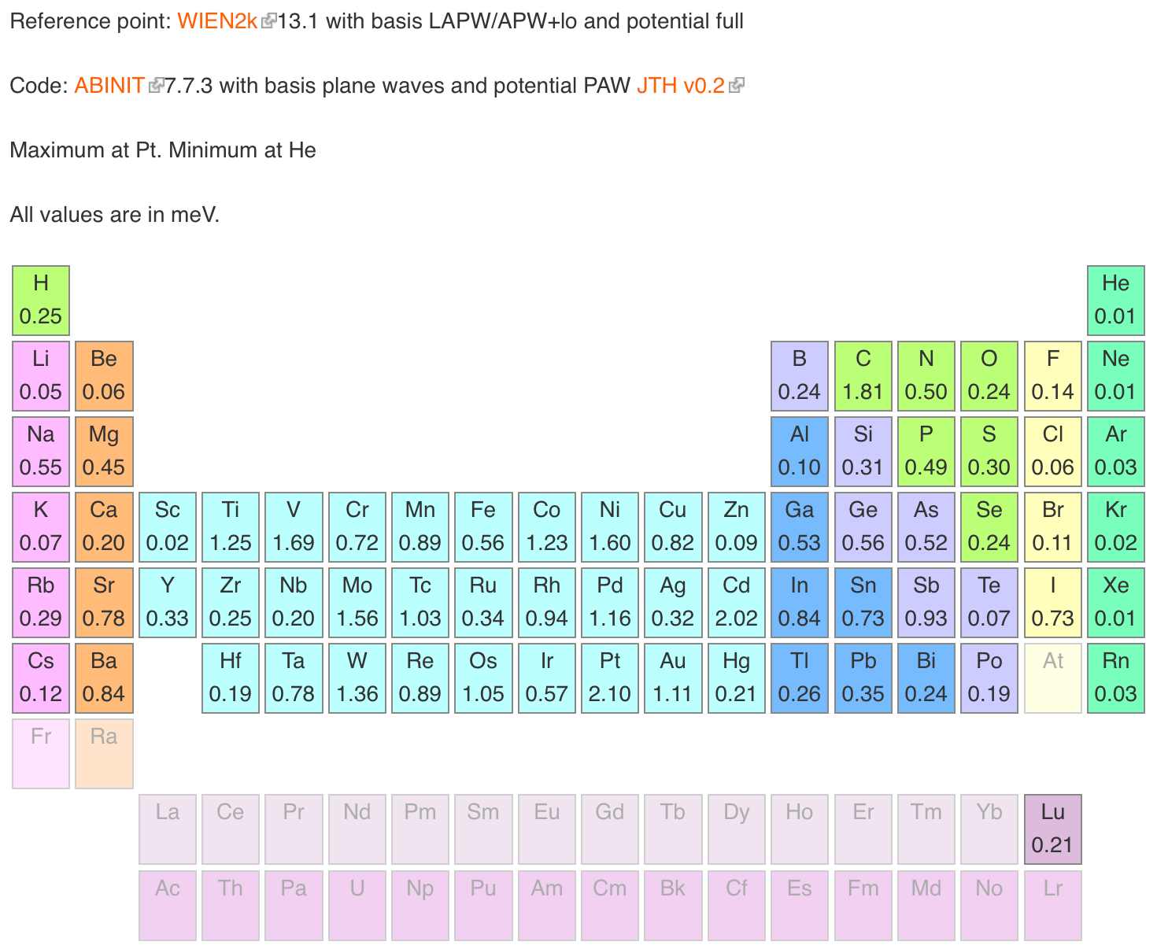

+
9.2
ONCVPSP potentials from the Pseudo-Dojo
Mn. Minimum at Ar
0.07
0.02
0.14
0.91
1.04
0.47
0.29
0.99
0.29
0.05
0.44
0.36
0.44
1.02
1.04
0.05
0.72
0.01
0.18
0.10
1.23
0.90
1.25
3.53
11.7
5.31
2.10
1.18
0.85
0.10
0.33
0.24
0.11
0.17
0.04
0.03
0.28
1.33
1.02
0.79
1.43
1.42
1.68
1.78
2.01
1.22
0.52
1.86
0.07
0.47
0.54
0.41
0.68
0.04
0.95
0.37
0.73
2.71
0.68
0.88
1.39
2.45
0.58
0.38
0.21
0.17
0.21
0.28
0.05
http://www.pseudo-dojo.org

Slide 52
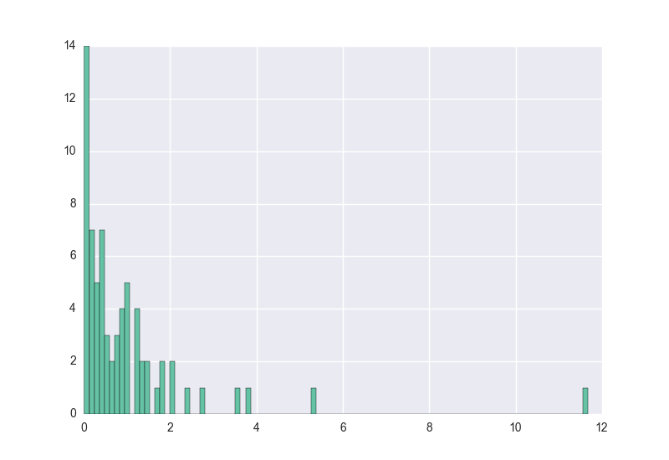
Table of ONCVPSPs
NC with/without semi-core states
Good log derivative up to 3-5 Ha
Validated with DF, GBRV tests, Phonons
Deltafactor:
1.0 meV
(best pseudo for each element, including Mn!)
1.6 meV
(all pseudos)
Mn

