Slide 1

From lexical meaning to functional role:
The case of complex noun-verb phrases in German and Dutch
Sabine de knop & Manon hermann
université saint-louis Bruxelles

Slide 2
(1) Object of analysis

Slide 3
Object of analysis
A contrastive study of prepositional phrases with posture and placement verbs in German and Dutch.
(1) posture and placement verbs
(2) German vs. Dutch
(3) prepositional phrases
Notes:
The title of our presentation can actually be split in three distinct elements

Slide 4
Object of analysis
(1) posture and placement verbs
(2) German vs. Dutch
(3) prepositional phrases

Slide 5

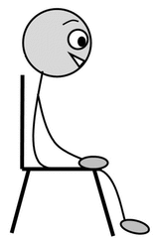
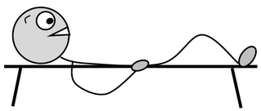
(1) Posture / placement verbs (POSV / PLV)
GERMAN / DUTCH
(Ge) STEHEN
(Du) STAAN
(Ge) SITZEN
(Du) ZITTEN
(Ge) LIEGEN
(Du) LIGGEN
→ satellite-framed languages
(cf. Talmy 2000)
→ MANNER-dimension
very frequent
Not only posture but also
locational + metaphorical
uses
(Ge) STELLEN
(Du) STELLEN
(Ge) SETZEN
(Du) ZETTEN
(Ge) LEGEN
(Du) LEGGEN
Notes:
Three posture verbs (idem English STAND-SIT-LIE)
Three placement verbs
Not only posture but also locational and metaphorical uses: In both German and Dutch, if you want to localize a person or an object in space, you will use a very specific posture verb dnd also if you want to express putting something somewhere, you will use a very specific placement verb
The difficulty is that in German and Dutch use these verbs in a lot of cases which are very abstract and challenging for non native speakers.

Slide 6
Object
(1) posture and placement verbs
(2) German (Ge) vs. Dutch (Du)
(3) prepositional phrases

Slide 7


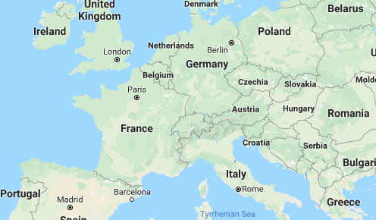

Slide 8
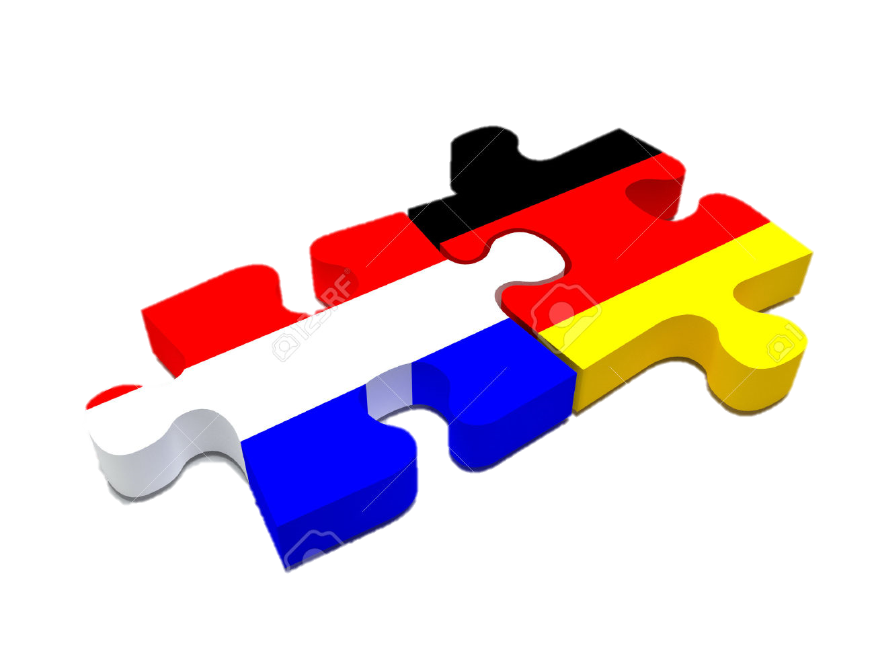
(2) GERMAN vs. DUTCH
Close languages BUT differences!
Coding selection (Lemmens 2005)
(Ge) setzen ≠ (Du) zetten:
(Ge) sich etwas zum Ziel setzen → (Du) zich iets ten doel stellen
(‘to set oneself sth as goal’ = ‘to make sth one's aim’)
(Ge) stellen ≠ (Du) stellen:
(Ge) auf die Beine stellen → (Du) op poten zetten
(‘to put sth on the legs’ = ’to set up sth’)
Notes:
Both languages have posture and placement verbs which are very similar.
But this doesn't mean that they use them in the same contexts and with the same frequency.
There are actually a lot of differences.
Differences can occur in the coding selection: you can have one PV in German but another PV in Dutch.

Slide 9
(2) GERMAN vs. DUTCH
Close languages BUT differences!
Coding obligation (Lemmens 2005)
- Dutch uses POSV and PLV obligatorily for the location of entities in all sentence types >< German: also uses copula in questions
(Du) Waar heb je gezeten? → (Ge) Wo warst du denn? (‘Where have you been?’)
- Dutch has developed a progressive use of POSV + te (‘to’) + infinitive
((Du) zitten te wachten = ‘to sit and wait’)
Notes:
Differences can also occur in the coding obligation

Slide 10
Object of analysis
(1) posture and placement verbs
(2) German vs. Dutch
(3) prepositional phrases

Slide 11
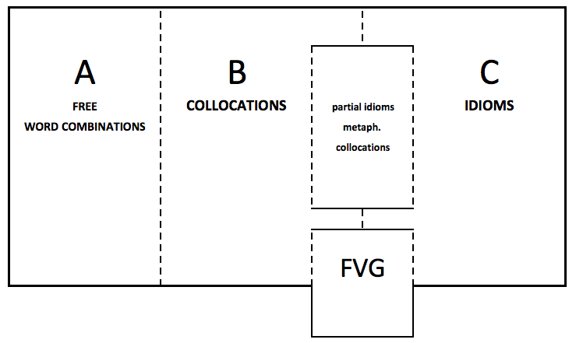
(3) Prepositional phrases
PREPOSITION
+
NOUN
+
POSV/PLV

Slide 12
(3) “Funktionsverbgefüge” (FVG)
(± Complex verbal phrases)
(von Polenz 1963, Herrlitz 1973, Helbig/Buscha 2001, Eisenberg 2013, Kamber 2006, Heine 2006)
CONSENSUS = Combination of a nominal element (with or without preposition) and a Funktionsverb (= lost of lexical meaning, but functional role).
(Ge) in Bewegung setzen – (Du) in beweging zetten
(lit.‘to set into motion’ = ‘to start an activity/process’)
Noun = abstract noun derived from a verb
Verb: often POSV & PLV

Slide 13

(3) Complex verbal phrases (FVG)
POSV & PLV → “FUNKTIONSVERBEN” (± light verbs)
= no lexical meaning → no localization in space
GRAMMATICALIZATION?
- YES: some uses are purely aspectual and have no link with original meaning of localization ((Ge) in Bewegung setzen ‘to start an activity/process’→ inchoative
- NO: in most FVG, the semantics of light verb is still motivated by the original semantics of the POSV/PLV ((Ge) unter Strafe stellen (‘to put under punishment’)(Fabricius-Hansen 2006)
→ CONTINUUM

Slide 14

CONTINUUM
POSTURAL
concrete
(Ge) auf dem Stuhl sitzen
‘to sit on the chair’
LOCATIONAL
concrete
(Ge) in der Schule sitzen
‘to sit in the school’
LOCATIONAL
abstract
(Ge) im Mittelpunkt stehen
’to stand in the centre’
ASPECTUAL
(Ge) in Bewegung setzen
‘to set in motion’
ABSTRACTION

Slide 15
(2) Analysis

Slide 16
Analysis
PLV
(Ge) setzen/ (Du) zetten, (Ge) stellen/ (Du) stellen
→ semantic motivation?
→ conceptualizations and image schemas?
corpora : DeReKo (IDS) and Corpus Hedendaags Nederlands
synchronic (2000-2017), press articles
Notes:
We anaysed 1000 examples from two comparable corpora : the DeReKo from IDS for German and the Corpus Hedendaags Nederlands for Dutch.
It’s a synchronic analysis and I focus on press articles.

Slide 17
Dominant conceptualizations
Notes:
And about conceptualizations:
We realized that there are actually to possibilities
1) the verb is determined by the conceptualisation of the unit (PREP+NOUN) like in
2) the verb is determined by the conceptualisation of the figure like in
One of these two conceptualizations is always dominant.

Slide 18
Dominant conceptualizations
DOMINANCE OF FIGURE
(Du) Zijn naam staat op de lijst. (‘His name stands on the list’) → WRITTEN TEXT
(Du) Het voorstel ligt op tafel. (‘The proposal lies on table’) → HORIZONTALITY
Notes:
And about conceptualizations:
We realized that there are actually to possibilities
1) the verb is determined by the conceptualisation of the unit (PREP+NOUN) like in
2) the verb is determined by the conceptualisation of the figure like in
One of these two conceptualizations is always dominant.

Slide 19
Dominant conceptualizations
DOMINANCE OF [PREPOSITION + NOUN]
(Ge) Der Mann liegt im Koma. (‘The man lies in the coma’) → LYING POSITION/PASSIVITY
(Ge) Der Mann steht auf der Bühne. (‘The man stands on the stage’) → TO BE ON ONE’S BASE
Notes:
And about conceptualizations:
We realized that there are actually to possibilities
1) the verb is determined by the conceptualisation of the unit (PREP+NOUN) like in
2) the verb is determined by the conceptualisation of the figure like in
One of these two conceptualizations is always dominant.

Slide 20
GERMAN SETZEN
IMAGE SCHEMA OF CONTAINER
  ENCLOSURE (Ge) in die Welt setzen (‘to set in the world’)
  IMAGE SCHEMA OF ENABLEMENT → only in FVG –> aspectual use (INCHOATIVITY)
  START OF CONCRETE PROCESS (Ge) in Bewegung setzen (FVG) (‘to set in motion’)
  START OF NEW STATE (Ge) in Kenntnis setzen (FVG) (‘to set in knowledge’)
IMAGE SCHEMA OF VERTICALITY
  SCALE (Ge) auf Platz… setzen (‘to set on place … ’)
  WRITTEN TEXT (Ge) auf die Agenda setzen (‘to set on the agenda’)

Slide 21
GERMAN STELLEN
IMAGE SCHEMA OF VERTICALITY
  TO BE ON ONE’S BASE > FOUNDATION (Ge) auf die Beine stellen (‘to put upright on the legs’)
  CONTROL & POWER FVG: (Ge) an die Spitze (einer Firma) stellen, (Ge) unter Strafe stellen (FVG)
                (‘to set at the top (of a company)’, ‘to set under punishment’)
IMAGE SCHEMA OF CENTRE/PERIPHERY
  EXPOSURE (Ge) in den Mittelpunkt stellen, (Ge) zur Diskussion stellen (FVG)
  (‘to put upright in the center’, ‘to put upright to the discussion’)

Slide 22
DUTCH ZETTEN
IDEM (Ge) SETZEN
  START OF CONCRETE PROCESS : (Du) in gang zetten (‘to set in motion’)
  SCALE: (Du) op de … plaats zetten (‘to set on the … place’)
  WRITTEN TEXT: (Du) op papier zetten (‘to set on paper’)
  BUT // (Ge) STELLEN
  FOUNDATION: (Du) op poten zetten (‘to set on paws’)
  EXPOSURE: (Du) in het zonnetje zetten (‘to set in the little sun’)
→ Lemmens 2006 : « default causative verb »

Slide 23
DUTCH STELLEN
IDEM (Ge) STELLEN
CONTROL & POWER : (Du) onder toezicht stellen (FVG) (‘to put upright under supervision‘)
EXPOSURE: (Du) ter beschikking stellen (FVG) (‘to put put upright at disposal’)
  BUT // (Ge) SETZEN
  START OF NEW STATE: (Du) in staat stellen (FVG) (‘to put upright in state’)
  Lemmens 2006 : “in some relics” → mostly in FVG → aspectual uses

Slide 24
(Ge) SETZEN-STELLEN & (Du) ZETTEN-STELLEN
CONCEPTUALISATION | (Ge) SETZEN | (Ge) STELLEN | (Du) ZETTEN | (Du) STELLEN
ENCLOSURE | X |  | X
START OF CONCRETE PROCESS | X |  | X
START OF NEW STATE | X |  |  | X
SCALE | X |  | X
WRITTEN TEXT | X |  | X
TO BE ON ONE’S BASE > FOUNDATION |  | X | X
CONTROL & POWER |  | X |  | X
EXPOSURE |  | X | X | X
Notes:
Complementary distribution in German
In both languages SETZEN/ZETTEN as more uses

Slide 25
(Ge) SETZEN vs. (Du) ZETTEN
CONCEPTUALISATION | (Ge) SETZEN | (Du) ZETTEN
ENCLOSURE | X | X
START OF CONCRETE PROCESS | X | X
START OF NEW STATE | X
SCALE | X | X
WRITTEN TEXT | X | X
TO BE ON ONE’S BASE > FOUNDATION |  | X
CONTROL & POWER
EXPOSURE |  | X
Notes:
4 uses in common
1 use specific for SETZEN
2 uses specific for ZETTEN
ZETTEN has more uses than SETZEN

Slide 26
(Ge) STELLEN vs. (Du) STELLEN
CONCEPTUALISATION | (Ge) STELLEN | (Du) STELLEN
ENCLOSURE
START OF CONCRETE PROCESS
START OF NEW STATE |  | X
SCALE
WRITTEN TEXT
TO BE ON ONE’S BASE > FOUNDATION | X
CONTROL & POWER | X | X
EXPOSURE | X | X
Notes:
Two uses in common
One use ist just with (Du) Stellen
Another use is just with (Ge) Stellen

Slide 27
Grammaticalization?
in some FVG : YES
→ no localization meaning at all, meaning is purely aspectual
Ex: (Ge) in Bewegung setzen → START OF CONCRETE PROCESS (inchoativity)
(Ge) in Kenntnis setzen → START OF NEW STATE (inchoativity)
Notes:
We come back to the issue of grammaticalization

Slide 28
Grammaticalization?
BUT in most FVG : NO
→ the semantics of the functional verb is related to the semantics of POSV/PLV
Ex: (Ge) unter Strafe stellen (‘to put upright under punishment’) → CONTROL
(Ge) zur Verfügung stellen (‘to put upright at the disposal’) → EXPOSURE
→ also in collocations
(Ge) an die Spitze stellen (’to put upright at the top’) → CONTROL
(Ge) in den Mittelpunkt stellen (‘to put upright in the focus’) → EXPOSURE

Slide 29
(3) Conclusions

Slide 30
(3) Conclusions
TYPOLOGY
SAME TYPOLOGICAL CLASS BUT DIFFERENCES!
- GERMAN: clear distinction between (Ge) setzen and (Ge) stellen (different conceptualizations)
+ balanced distribution
- DUTCH: no clear distinction between (Du) zetten and (Du) stellen
→ (Du) zetten as single causative verb
GRAMMATICALIZATION
- POSV and PLV are still motivated in most FVG → NO GRAMMATICALIZATION!
Notes:
2 aspects

Slide 31


